Slide 1
Wrap-up + exam-prep
Jukka Rintamäki

Slide 2
Agenda
A few quick extras
Concluding thoughts and summarizing
Course feedback (10am)
Exam-prep

Slide 3
A few new trends we haven’t explored
Science-based targets + Regenerative business

Slide 4
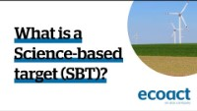
What is a science-based target?

Slide 5
Current trends: Science-based targets + Net-zero
45% global CO2 emission reductions* by 2030 and net-zero by 2050 necessary for stabilizing the climate
This is applied on an individual corporate level
*As compared to 2010, i.e. Paris Agreement
Five-step process
Commit, develop a target, submit, communicate, disclose
Nearly 5,000 businesses have adopted SBTs (1/3 of global market cap - $38 trillion - represented)
Almost 1,100 approved targets
Seems to work to an extent: in 2020, Covid caused global CO2 emissions to decrease 5% -> 12% for companies with science-based targets
Notes:
For more, see e.g. Sciencebasedtargets.org, SDG Compass (sdgcompass.org),

Slide 6
Regenerative business
From exploitation to…
Restoration
Compensation of negative impacts
Preservation
Avoid impact / net-zero impact
Enhancement
Net positive impact
Issue specific (CSV?) or systems-wide
For more detail, see: https://www.weforum.org/agenda/2023/03/regenerative-business-sustainability/
Sources: Hahn & Tampe, 2021; Slawinski et al., 2021
Notes:
Regenerative business is in particular a response to biodiversity loss, which has traditionally been poorly covered by sustainability management trends/systems.

Slide 7
References
Hahn, T., & Tampe, M. 2021. Strategies for regenerative business. Strategic Organization, 19(3): 456–477.
Slawinski, N., Winsor, B., Mazutis, D., Schouten, J. W., & Smith, W. K. 2021. Managing the Paradoxes of Place to Foster Regeneration. Organization and Environment, 34(4): 595–618.

Slide 8
Summarizing

Slide 9
What’s sustainability?
Economy
Environment
Society
Economy
Environment
Society
Weak
sustainability
Strong sustainability
Notes:
Two problems with weak sustainability:
Economy tends to take over, due to its prevalence and its comparatively immediate time frame
These three are not actually equal

Slide 10
We’ve discussed
Weak vs. Strong sustainability
The need to consider planetary boundaries
Integrated corporate sustainability
Sufficient scale, insufficient ambition
Innovative corporate sustainability
Insufficient scale, sufficient ambition
Collective approaches to corporate sustainability
(sort of) sufficient scale, insufficient ambition (for now?)

Slide 11
Integrated corporate sustainability
Innovative corporate sustainability
Organizing sustainability
Reducing unsustainability
Individual firm sustainability?
Sustainable economies/industries?
Business-case motivation
Shared-benefit aims
Broad sustainability outcomes

Slide 12
Systemic approaches
What are grand challenges?
Sustainability crisis
What is robust action, and how does it relate to the sustainability crisis?
Key components
Participatory architecture
Multivocal inscription
Distributive experimentation
How do these three work together?

Slide 13
Institutions
Key terms
Institutional pressures
Coercive, mimetic, normative
Legitimacy
Decoupling

Slide 14
Supply chains
What are some major trends in supply chain sustainability?
What are the main problems in supply chain sustainability?
Where do the problems in supply chains stem from?
What is the role of decoupling? Legitimacy perhaps?

Slide 15
Governance and communication
All the different kinds of standards
Soft regulation
How do these work? Why do voluntary standards exist? Why do they spread?
Key here are institutional pressures and legitimacy
The relationship between communication and action
Communication also brings about actions
Doesn’t only lead to decoupling
The importance of legislative developments

Slide 16
Developments in corporate sustainability
Creating shared value
Biomimicry
Net-zero commitments
Science-based targets
Regenerative business
Biodiversity
Carbon offset, capture, sequestration
Binding international laws concerning sustainability
Circular economy

Slide 17
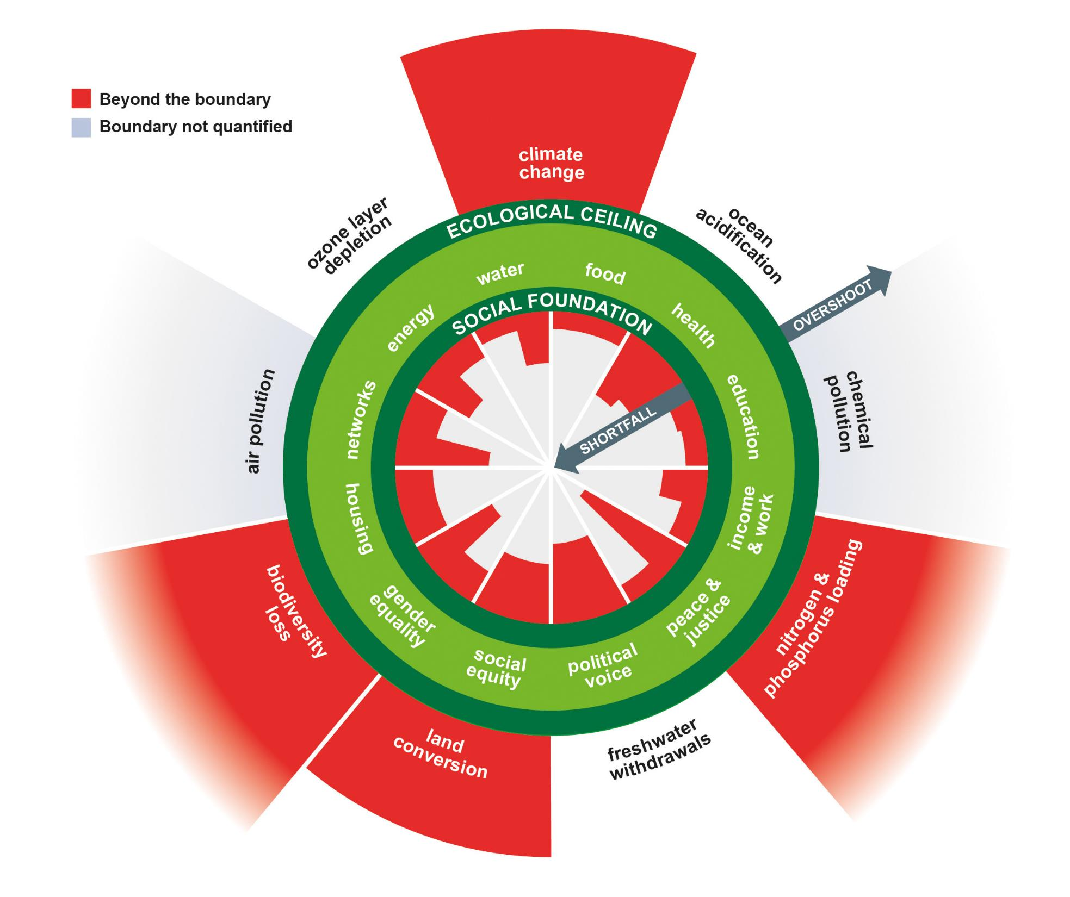
Where we need to get
Planetary boundaries
Social foundations
The most important thing to watch when considering sustainability developments:
(Global) material flows

Slide 18
Exam-prep

Slide 19
Exam basics
You have 3 hours
Friday 8 March 9am
Demonstrate understanding of course topics
I don’t expect you to remember specific references though
(Memorizing article titles, journal names etc. is pointless)

Slide 20
Exam
Broad questions; essay answers
Linking different topics across the module
Focus on
Critical thinking
Your own analysis
Broad understanding of course topics

Slide 21
Model exam question
What is innovative corporate sustainability? Can innovative corporate sustainability play a significant role in building a sustainable future? Provide a critical evaluation.
Define and describe the primary concepts
What is their relationship?
Develop a position
Draw on lecture materials, your lecture notes, and course literature (compulsory readings)
Provide your own analysis
Work individually or in pairs / small groups (20 minutes)

Slide 22
State your position
”I (do not?) believe innovative corporate sustainability can play a reasonably significant part in building a sustainable future, provided a few conditions will be met.”
Remember to state your position early
However, you can also start with a very short introduction to the topic; why talking about innovative sustainability is meaningful or important

Slide 23
Define/describe sustainable future
What is sustainability?
E.g. Taking care of the needs of people’s current needs without sacrificing the ability of future generations to take care of theirs.
Three primary components: economic, ecological, social
Strong sustainability required for future sustainability
Sustainable future: SDGs and the Paris Agreement goals
Briefly describe the SDGs and what the Paris Agreement goals are
Decoupling and circularity, and leave-no-one-behind as main principles

Slide 24
Introduce innovative corporate sustainability
Is generally thought to comprise a broad set of activities
E.g. ”An approach to corporate sustainability that entails seeing sustainability as a source of business innovations, new sources of income, and potential new business models.”
Perhaps add a well-known example, or just something from the lectures/materials (e.g. talk about base-of-the-pyramid, and/or a specific case example)
You may want to do this in a way that lets you distinguish what innovative corporate sustainability is not
When defining concepts, it’s important to aim for specificity – you want to communicate what you are talking about, and what you’re not talking about

Slide 25
Develop a position
Innovative corporate sustainability has potential to play a role in the transition towards a sustainable future
Strong sustainability at its heart
Though only on an individual level
Ambition is there, but currently scope perhaps not so much
Can serve as inspiration for both businesses and regulators

Slide 26
Develop a position
What are the limits here?
Difficult to achieve large-scale economic feasibility
Conflicting logics in the current political economy (profit vs. sustainability)
Can we think of ways of connecting to broader module topics?
Localized small-scale solutions that others can replicate? Distributed experimentation?
Perhaps think of ways of changing the rules of the game
New broadly spread hybrid funding systems for certain types of enterprises for instance?
Forcing externalities into prices?

Slide 27
Conclude
Under certain types of conditions such as favourable regulation, innovative corporate sustainability can play a part in bringing about a sustainable future
But can we expect such conditions?
My take is it would be more useful to [propose something else instead]

