Slide 1
MA1 Seminar
Spring 2024
Department of Film
Aalto University School of Arts, Design and Architecture

Slide 2
Course Objective & Info
The Master’s Thesis Seminar 1 is course that supports students to begin making connections between their artistic practice and the process of writing.
The course is organised in contact teaching sessions, combined with assignments and peer work.
You are invited to share feedback in between the sessions.
Preferred channels of communication: Aalto email & MyCourses
Tämä kurssi tukee opiskelijoita luomaan yhteyksiä taiteellisen praktiikan ja kirjoittamisen prosessin välillä.
Kurssi koostuu lähiopetuksesta, tehtävistä ja vertaistyöskentelystä
Otamme mielellämme palautetta vastaan lähiopetuskerroilla ja niiden välillä
Suositellut yhteydenpitokanavat: Aalto email & MyCourses

Slide 3
Important Contact
Learning Services (LES)/ Student Services
studentservices@aalto.fi
https://www.aalto.fi/en/services/learning-services
Oppimispalvelut (LES)/ Student Services
opiskelijapalvelut@aalto.fi
https://www.aalto.fi/fi/palvelut/oppimispalvelut

Slide 4
Course Schedule Aikataulu
11.3.2024 – F101 Ryhmäopetus - F101 – Väre
25.3.2024 Combined session with MA2
Q202 Ryhmäopetus - Q202 – Väre
29.4.2024 – Q101 Ryhmäopetus - Q101 – Väre
*The space is subject to change. Time: 15:00-17:00

Slide 5
Schedule of the day / Aikataulu
15:00-16:00 Introducing the exercise Missing Movie Report / Harjoitteen esittely
16:00-16:10 Break / Tauko
16:10-17:00 Presenting the results / Tulosten esittely

Slide 6
Exercise: Missing Movie Report
"In downtown Portland, Oregon, in the summer of 1996, Miranda July juggled a tape recorder and a camera, approaching women and girls on the street with a simple question: “If you could make a movie, what would it be about?” July typed up the answers and compiled twenty-four of them in a large black-and-white poster, four feet long, two feet wide. Above the responses she pasted mug shots of the interviewees, grainy or oversaturated images that do and do not identify their subjects."
Beeston, A. and Solomon, S. eds., 2023. Incomplete: The feminist possibilities of the unfinished film (Vol. 5). Univ of California Press.pp.4

Slide 7
Exercise: Missing Movie Report
You were invited to come to the class with a movie idea articulated briefly in 2-3 sentences. This can be an idea you would like to share and test-develop during the session, whether it's yours or from someone outside the film industry.
You can see this exercise is an encouragement to approach new challenges with curiosity, openness, and empathy: engaging with something new, finding inspiration and learning, being analytical, and helping others with their ideas.

Slide 8
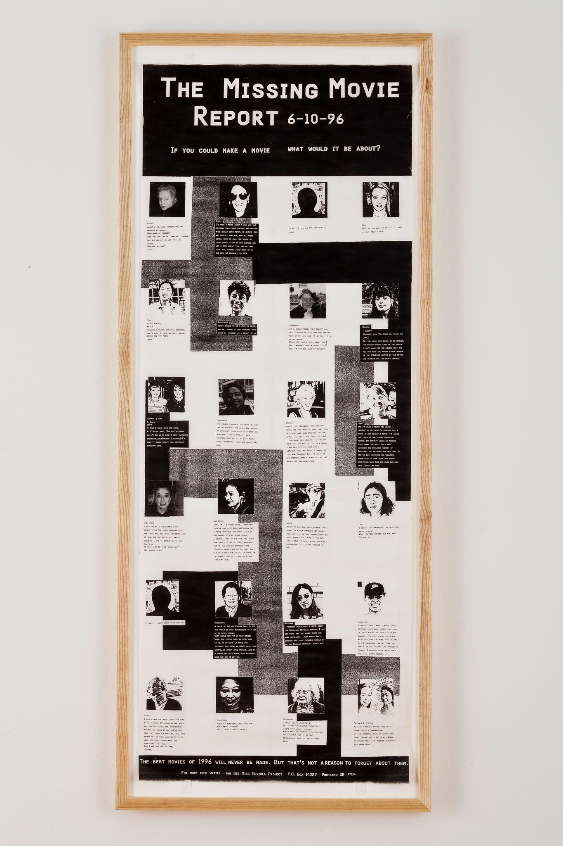

Slide 9
Exercise: Missing Movie Report
Introducing the exercise / Harjoitteen esittely
Forming the groups / jakaantuminen ryhmiin
Share your movie idea to others in group / kerro elokuvaideasi muille ryhmäläisille
Develop the film ideas further together / kehitelkää elokuvaideoita pitemmälle yhdessä

Slide 10
Exercise: Questions and themes
How was it to engage with something new? – Minkälaiselta tuntui tarttua itselle uuteen elokuvaideaan?
How did you react and feel to forced engagement? – Miten reagoit annettuun tehtävään?
How to get inspired? Did you learn something new? – Mistä inspiraatio löytyy? Opitko jotakin omasta tavastasi inspiroitua?
How to be analytical? – Miten olla analyyttinen?
How to help others with their ideas? – Miten voit auttaa muita kehittämään heidän ajatuksiaan eteenpäin?

Slide 11
Tips for developing a project idea research and/or film
Collective brainstorming → ideation flow
Outlining a possible list of references - movies, articles, books, literature..
We suggest that each group develops a one-pager, discussing the concept, a short synopsis, key-characters or milestones, working plan that you can then present in the class.
Be analytical with your “film project, think of the reader/ target audience, similar films works and the historical or cultural context if applicable.

Slide 12
Exercise: Missing Movie Report
16:00-16:10 Break / Tauko
16:10-17:00 Presenting the results and discussion / Tulosten ja ryhmissä tapahtuneen keskustelun esittely

