Slide 1
SUOMI 1 intensiivi
22.4.2024
Markku Haakana

Slide 2
Hei kaikki!
Tervetuloa suomen kielen kurssille!
Minä olen Markku ja olen teidän suomen kielen opettaja.
Hauska tavata!
Kuka sinä olet?
GREETING + minä olen + NAME

Slide 3
Tänään / today
Some basic things about the course
Finnish alphabet & sounds, pronounciation
Luetaan! Let’s practice reading Finnish => text on page 6 Tervetuloa!
Numbers
Some phrases
Countries, nationalities & languages

Slide 4
LC-7210 – Finnish 1 (intensive course), 22.4.-31.5.2024
Mondays (10.15-11.45) and Fridays (14.15-15.45). Room Y309b (on 27.5. in U405)
Markku Haakana (markku.haakana@helsinki.fi)
Course book: Oma suomi 1 (2nd, renewed edition) => you will need the book during the course! Pdf of the first chapter can be found on MyCourses page
Ohjelma (alustava) / Course programme (preliminary) =>

Slide 5
Week 1 (22.4. & 26.4.)
Chapter 1: alphabet & sounds, greetings & presenting yourself, countries & languages, numbers, basics of verb conjugation
Week 2 (29.4. & 3.5.)
Chapter 2: talking about one’s family, questions, genitive
Week 3 (6.5. & 10.5.)
Chapter 3: talking about one’s day, week days & telling the time, more about verb conjugation
Week 4 (13.5. & 17.5.)
Chapter 4: talking about food, shopping, partitive
Week 5 (20.5. & 24.5.)
Chapter 5: talking about one’s home, colours, places in the city, email, minulla on -rakenne, basics of consonant gradation (k-, p-, t- changes)
Week 6 (27.5. & 31.5)
Some revision, text assignment in class (30 mins for writing a text; instructions will be given later!)
Final exam (grammar and vocabulary): 31.5.

Slide 6
There will be a lot of independent work between the classes.
Be active in the lessons!
Two absences during the course are allowed.
Any questions about practical issues?

Slide 7
Instructions in Finnish
Kuuntele! Listen!
Toista! Repeat !
Kuuntele ja toista! Listen and repeat!
Avaa kirja sivu 2! Open your book page….!
Kirjoita! Write!
Parityö Pairwork
Tiimityö Teamwork
Sano suomeksi! Say in Finnish!
Sano englanniksi! Say in English!

Slide 8
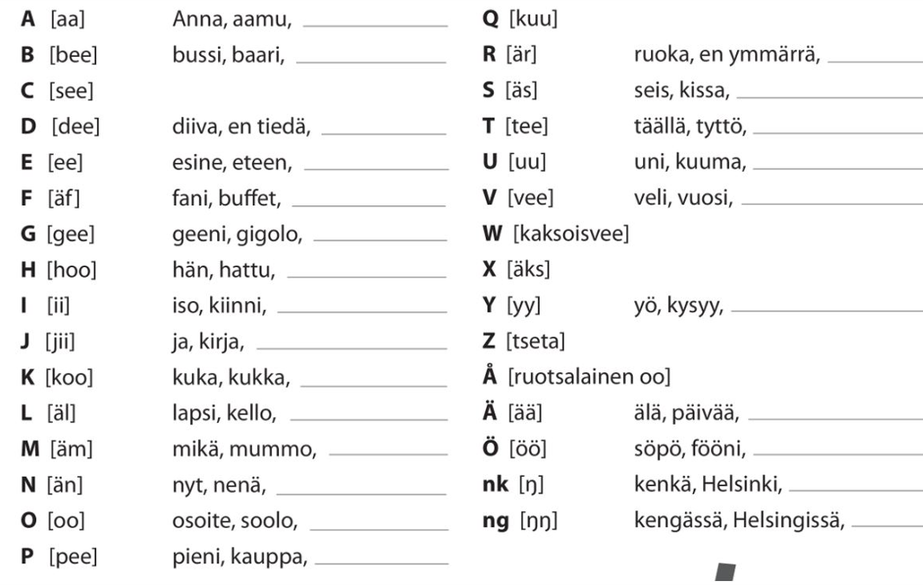

Slide 9
About Finnish sounds:
The length of the sound (short vs. long) is important, as it can change the meaning of the word
For instance:
tuli (‘fire’) / tuuli (‘wind’)
tuli (‘fire’) / tulli (‘customs’)
Hän tapaa ystävänsä (‘s/he meets her/his friend)
Hän tappaa ystävänsä (‘s/he kills her/his friend)
Basic rule: Finnish is pronounced as it is written
Mitä sinä teet? Vs. Eng. What are you doing?

Slide 10
Luetaan! Let’s practice reading Finnish!
=> text Tervetuloa on page 6
=> Try to do exercise 3 (page 7); do the exercise in pairs -- you can ask each other the questions!

Slide 11
More basic things
Numbers (page 8)
Some greetings and phrases (page 9)
Countries, nationalities, languages

Slide 12
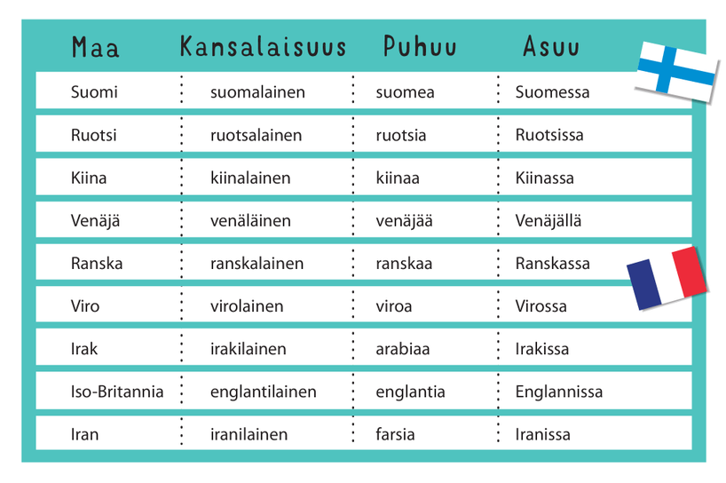
Maat

Slide 13
Kansallisuus (nationality), kansalaisuus(citizenship)

Slide 14
Nationality= country + lainen/läinen
Kotimaa Olen
Englanti englantilainen
Turkki turkkilainen
Japani japanilainen
Kiina kiinalainen
Espanja espanjalainen
Saksa saksalainen
Irlanti irlantilainen
Unkari unkarilainen
Korea korealainen
Thaimaa thaimaalainen
Venäjä !!! venäläinen !!!
Vietnam vietnamilainen
Pakistan pakistanilainen

Slide 15
Minkä maalainen sinä olet?
Maa minkä maalainen
Saksa saksalainen
Sveitsi sveitsiläinen
POIKKEUS!!!!!!
! Suomi suomalainen
Ruotsi ruotsalainen
Venäjä venäläinen
What is your nationality?

Slide 16
At home
Revise the things we went through today (pages 6 to 11)
Do exercises 5 and 8 in the book. We will go through some of them and you can ask about possibly problematic issues!

Slide 17
Homeland, mother tongue
Puhun…
language+ a/ä
Kotimaa äidinkieli
Englanti englanti
Turkki turkki
Japani japani
Kiina kiina
Espanja espanja
Saksa saksa
Ranska ranska
Unkari unkari
Latvia latvia
Korea korea
Kanada englanti,ranska
Venäjä venäjä

Slide 18
SUOMI I intensiivi
26.4.2024
Markku Haakana

Slide 19
Tänään / today
Introducing yourself
Some basic features of Finnish language
Vowel harmony
Conjugation of verbs: first look

Slide 20
First: How do you ask in Finnish “How are you?” / “How is it going?” And how do you typically answer these questions?
-- Mitä kuuluu?
-- (ihan) hyvää // ei mitään erikoista // mitäs tässä
-- Miten menee?
-- (ihan) hyvin // ihan ookoo (ok)

Slide 21
Esittele itsesi seuraavan mallin mukaan // Introduce yourself in the following way
Tervehdys / Greeting (choose your favorite one :)
Minä olen (mä oon) + NAME
Olen kotoisin + COUNTRY-sta
Olen NATIONALITY
Äidinkieleni on LANGUAGE
Lisäksi puhun LANGUAGE-a + LANGUAGE-a …. => EXAMPLE

Slide 22
Esittele itsesi seuraavan mallin mukaan // Introduce yourself in the following way
Tervehdys / Greeting (choose your favorite). Hei!
Minä olen (mä oon) + NAME. Markku (Haakana)
Olen kotoisin + COUNTRY-sta. Suomesta
Olen NATIONALITY. suomalainen
Äidinkieleni on LANGUAGE. suomi
Lisäksi puhun LANGUAGE-a + LANGUAGE-a …. ruotsia, englantia ja vähän ranskaa ja saksaa
=> TRY WITH YOUR FELLOW STUDENT FIRST!

Slide 23
Homework
Käydään läpi harjoitukset 5 ja 8! / Let’s go through exercises 5
and 8!

Slide 24
Finnish language: some features
Think about the following questions in groups.
Round I:
True or false: Finnish is a germanic language.
Name one language that is a relative of Finnish.
Is äita a possible word in Finnish?
True or false: Finnish is pronounced as it is written.

Slide 25
Round II
T/F: Finnish has articles (like English for instance).
T/F: Finnish has no grammatical gender.
T/F: Finnish has no future.
Round III
True or false: Finnish has 8 cases.
Can you name 2 cases that Finnish has? How can one recognize these cases?
What does derivation mean in language? Can you give an example from Finnish?

Slide 26
Vokaalisointu = vowel harmony: a quick look. (see page 13)
Finnish has 8 vowels: a, e, i, o, u, y, ä, ö
They form 2 groups:
Back vowels (takavokaalit): a, o, u
Front vowels (etuvokaalit): ä, ö, y + i, e
=> vowel harmony: a single basic word can have only vowels from one group: either a, o, u OR ä, ö, y => i and e are neutral in the sense that they can combine with either group
auto, outo, aito. NO: ayto, öutö etc.
äly, yö, äiti
(almost) only exception to the rule: some loan words => analyysi, olympialaiset,dynamiitti etc,

Slide 27
Vokaalisointu = vowel harmony: a quick look
If you have a compound word (yhdyssana), vowel harmony does not work over the different parts of the word
äiti+hahmo => äitihahmo ‘mother figure’
yö+vuoro => yövuoro. ‘night shift’
Vowel harmony is present also in some suffixes (e.g. case endings) => they have two variants => the word they are attached to dictates the variant
For instance: -
* -ssa/-ssä talo+ssa möki+ssä INESSIIVI
* -a/ä // -ta/tä talo+a mökki+ä PARTITIVE

Slide 28
Verbien taivutus / Conjugation of verbs: a first look
* Verb has a basic form (perusmuoto): olla (‘to be’), asua (‘to live’), puhua (‘to talk’)
The basic form is used in dictionaries, and in language use it appears in addition with another verb: Minä haluan puhua (‘I want to talk’), Minun täytyy lähteä (‘I have to leave’)
BUT: when you want to use the verb in different persons, you need to add the person suffix to the STEM (vartalo) of the verb:
ole-n asu-t puhu-mme

Slide 29
Verbien taivutus / Conjugation of verbs: a first look
* Finnish has several types of verbs (verbityypit) which have different kinds of stems
* you learn these little by little!
* now we have a first look at verbs olla, asua and puhua
=> what are the person endings?
=> differences between standard and spoken language?
=> how is negation formed? (in Finnish negation is a verb!)
=> examples on page 13 in the text book

Slide 30
First example: verb asua
Stem: asu-
Minä asu+n
Sinä asu+t
Hän asu+u (most often: final vowel duplicated)
Me asu+mme
Te asu+tte
He asu+vat
=> In spoken, colloquial language the system is partly different. Do you know how?

Slide 31
Second example: verb olla
Stem: ole-
Minä ole+n
Sinä ole+t
Hän on Exception to general rules
Me ole+mme
Te ole+tte
He o-vat Exception to general rules
=> How are the negative forms constructed?

Slide 32
Verbien taivutus / Conjugation of verbs: a first look
Negative forms:
Negation verb shows the person (e-n, e-t, e-mme) + the stem of the main verb (asu-, ole-)
Minä en puhu
Sinä et puhu
Hän ei puhu fixed, exceptional form
Me emme puhu
Te ette puhu
He eivät puhu

Slide 33
Harjoitellaan! Let’s practice!
Do exercises 9 and 10 together with your pair! Continue to 11 if you have time!
Home work
Finish the exercises 9-11 on page 14.
Read and translate the first text of chapter 2: Susanin naapurit p.24-25 => talking about one’s family

