Slide 1
English Slides Session 1 Audience, Purpose, Form. Part 2
June Worlshop

Slide 2
What will I be able to do by the end of this course?
Recognize the organisational and language features specific to the major divisions of a master’s thesis in engineering disciplines.
Apply a problem-solution pattern to your thesis introduction to demonstrate a clear need/problem that motivates and justifies the aims defined in the thesis.
Apply a general-specific pattern to your thesis Literature Review
Employ metatextual strategies to produce clear, reader-friendly text.
Apply advanced features of cohesion, grammar and punctuation common to academic writing in a master’s thesis.
Assess common weaknesses in academic texts and revise to improve readability

Slide 3
Types of academic texts?
What are the differences between these academic texts?
Bachelor’s thesis
Master’s thesis
Conference paper
Research article
Review / Survey article
Short communication / Letter
PhD dissertation

Slide 4
(translation: “Diploma work”)
Diplomityö
Master’s Thesis
Thesis
, plural Theses
From Greek, literally ‘placing a proposition’
An opinion or theory that is put forward as a premise to be defended or proved (Adapted from Oxford Dictionary).
A claim (väite)

Slide 5
What is the difference?
MASTER'S
THESIS
RESEARCH ARTICLE
VS.

Slide 6
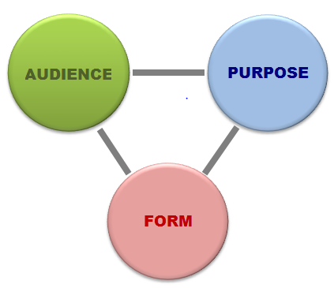
Successful Communication
Need to ask three questions:
Who is my audience?
Why am I writing this?
What should it look like?

Slide 7
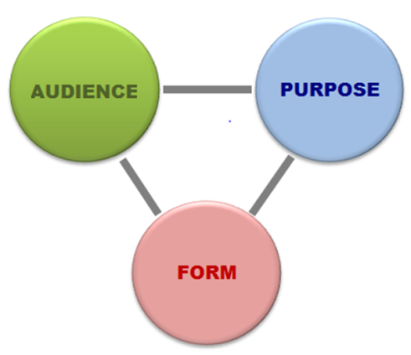
Who is my reader?
ROLE?
Evaluator (grades your work)
Client (needs a solution / information leading to a solution)
MASTER'S
THESIS
A professor
An external company
Your peers (same community)
Journal reviewers
RESEARCH ARTICLE
Challenge/Question
Gatekeeper

Slide 8
Who is my reader?
MASTER'S
THESIS
Knowledge?
More than you
Less than you
A professor
An external company
Your peers (same community)
Journal reviewers
JOURNAL ARTICLE
Less / More?
More

Slide 9
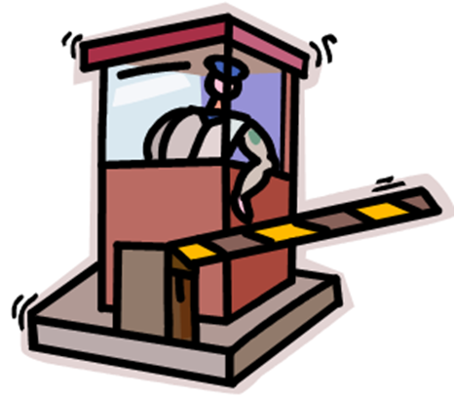
What are the expectations of your gatekeeper?
…that you will pay for entry?
But with what?
You need to prove that you are good enough and that you deserve the title of a GRADUATE ENGINEER…

Slide 10
What are the expectations of your gatekeeper?
You must prove what?
Wide knowledge in your field
Expertise in using common methods and methodologies in order to solve non-trivial problems in your field.
Ability to work independently (= original work)

Slide 11
What should be your purpose?
Three types of purposes:
To inform / teach?
To entertain?
To persuade?
Which?

Slide 12
What should be your purpose?
Audience and purpose typically interconnected:
If audience knows less than the writer (= Client)
Purpose = update knowledge
If audience knows more than the writer (evaluator/supervisor)
Purpose = display knowledge

Slide 13
The aim of a JOURNAL PAPER should be …
to PERSUADE peers that the work …
is original
offers a novel (major) contribution to the field
deserves to be published in a highly ranked journal and to receive a high citation index
→ Cite a lot!

Slide 14
Your purpose should be…
to DISPLAY (= give evidence) to evaluators that you…
have read extensively and understand the literature on your topic.
understand and can successfully apply the methods in your field to solve a non-trivial problem.
can do this independently.
→ Cite many different sources!
→ Describe and justify the process!
→ Avoid taking up too much time from you supervisor!

Slide 15
Journal paper vs. thesis
JOURNAL PAPER
Short (12-18 pp.)
Divided only into sections (3) and subsections (3.1)
Assumes earlier reader knowledge, focusing on narrow segment of most recent research.
Describes the novelty of the output
Many citations to previous papers
Several authors [we], [our]
THESIS
Long (~60 pp)
Divided into chapters (3) and sections (3.1)
Displays knowledge via wide coverage of basic concepts, back-ground knowledge and theory.
Describes and justifies the process.
Fewer citations and low-quality
One author (passive, [I] or [this thesis])
justifies

Slide 16
What is the structure of a thesis?
The structure depends on the field of science and methodology

Slide 17
Categories of science:
Three categories of scientific disciplines (van Aken 2004):
The formal sciences (e.g., philosophy and mathematics)
The explanatory sciences (e.g., the natural sciences and social sciences)
The design sciences (e.g., the engineering sciences, medical science and language teaching).
Van Aken, J. E. ‘Research Based on the Paradigm of the Design Sciences: The Quest for Field-Tested and Grounded Technological Rules.’ Journal of Management Studies 41:2 March 2004, pp. 219-245.

Slide 18
Which category of science?
Three categories of scientific disciplines (van Aken 2004):
The formal sciences (e.g., philosophy and mathematics)
The explanatory sciences (e.g., the natural sciences and social sciences)
The design sciences (e.g., the engineering sciences, medical science and language teaching).
Presents claims whose main test is their internal logical consistency of the argument.
Describe, explain and possibly predict observable phenomena.
Develop solutions for the design and realization of ‘products’, processes or for improving the performance of existing solutions.
Van Aken, J. E. ‘Research Based on the Paradigm of the Design Sciences: The Quest for Field-Tested and Grounded Technological Rules.’ Journal of Management Studies 41:2 March 2004, pp. 219-245.

Slide 19
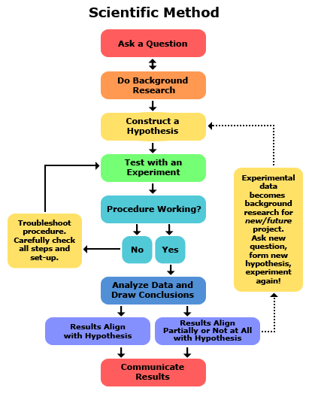
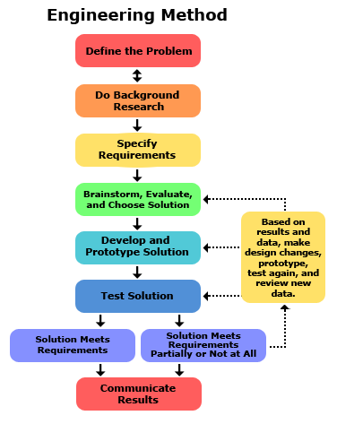
Explanatory sciences
Design sciences
Copyright © 2002-2017 Science Buddies.

Slide 20
Explanatory sciences
Thesis structure
Topic Importance
Motivation
Aims
Introduction
Literature Review
Earlier research
Materials & Methods
Results
Discussion
Achievements
Comparison to earlier work
Limitations
Future work
Copyright © 2002-2017 Science Buddies.

Slide 21
Design sciences
Thesis structure
Topic relevance
Previous solutions
Issues/ inadequacies
Your solution (Aims)
Structure of thesis
Situation
Introduction
Problem
Solution
Theory
Solution Development
Modelling
Simulations
Results
Verification Methods
Validation results
Simulation results
Conclusions
Achievements
Limitations
Future work
Copyright © 2002-2017 Science Buddies.

Slide 22
Design sciences
Thesis structure
Situation
Topic relevance
Previous solutions
Issues/inadequacies
Your solution (Aims)
Structure of thesis
Introduction
Problem
Solution
Theory
Solution Development
Modelling
Simulations
Results
Verification Methods
Validation results
Simulation results
Evaluation
Conclusions
Achievements
Limitations
Future work
Copyright © 2002-2017 Science Buddies.

Slide 23
Types of engineering theses?
Phillip's two-category definition (1999):
The Engineering Thesis (" oriented towards engineering practice")
The Engineering Science Thesis ("advances scientific knowledge in support of future solutions to engineering problems")
Phillips, Greg. 1999. What is an engineering thesis, anyway? Retrieved March 13, 2013. http://last3.in/ggg/thesis.html

Slide 24
Types of engineering theses?
Phillip's two-category definition (1999):
The Engineering Thesis should answer four questions:
What engineering problem requires a solution?
What's wrong with previous solutions that have attempted to solve this problem?
What is your solution?
How does your solution compare with earlier solutions? What are the weaknesses and strengths of your solution?
Phillips, Greg. 1999. What is an engineering thesis, anyway? Retrieved March 13, 2013. http://last3.in/ggg/thesis.html

Slide 25
Types of engineering theses?
Phillip's two-category definition (1999):
The Engineering Science Thesis should answer four questions:
What question about the world needs to be answered?
What's wrong with previous answers to this question?
What is your answer to this question?
How does your answer compare to earlier answers?
Phillips, Greg. 1999. What is an engineering thesis, anyway? Retrieved March 13, 2013. http://last3.in/ggg/thesis.html

Slide 26
Types of engineering theses?
Phillip's two-category definition (1999):
The Engineering Science Thesis
2.1 Exploratory Thesis “What are the properties of system S?”
2.2 Experimental thesis “Is prediction P made by theory T accurate?”
2.3 Theoretical thesis “what theory adequately explains observations O?”
Phillips, Greg. 1999. What is an engineering thesis, anyway? Retrieved March 13, 2013. http://last3.in/ggg/thesis.html

Slide 27
Types of engineering theses?
MIT's four-category definition:
Design of a system followed by construction, testing, and evaluation;
Formulation of an analytical or computational model of a system or process, simulation of the model, and comparison with actual data;
Development of a computer program that might:
simulate a real system (e.g. Artificial Intelligence);
aid in a diagnostic procedure;
provide sophisticated, real-time analysis of measured data;
develop and analyze a theory or theorem which is an abstraction or idealization of an actual process or system;
apply standard methods to aid in understanding a process or system.
Experimental study of physical phenomena.
M.Eng. Thesis Guide: parts 1-2-3. What is the M.Eng. Thesis? Electrical Engineering & Computer Science, Massachusetts Institute of technology. Retrieved March 13, 2013. http://www.eecs.mit.edu/academics-admissions/undergraduate-programs/6-p-meng-program/thesis-guide/1-2-3

Slide 28
Types of engineering theses?
Ken's (outsider’s) view:
Weak claim
State-of-the-Art (What are available solutions?)
Feasibility Study (Can this technology be successfully applied?)
Recommendation (Which technology offers the best solution?)
Design Problem (Does this design meet the requirements for an adequate solution)
Strong claim

Slide 29
How to structure your thesis?
Experimental
Introduction
(Theory/Literature review)
Materials and Methods
Results
Discussion
Engineering¹
Introduction
Literature review
Own contribution
Conclusions
Engineering²
Problem
Methodology
Solution
Verification
¹Timo Laakso's structural model
²Prof. Raimo Kantola's four-part model mentioned in Laakso's guidebook referenced below.
Laakso, Timo. 1999. How to write the diploma thesis. Helsinki University of Technology. Retrieved March 13, 2013. https://into.aalto.fi/download/attachments/1021746/how_to_write_diploma_thesis.pdf

Slide 30
Thesis Structure (Computer Science)
Chapter 1.
Introduction
Chapter 6.
Conclusions and
Future Work
Chapter 2.
Literature Review
Chapter 5.
Evaluation
Chapter 3.
Design
Chapter 4.
Development
Gordon, Damian. Literature Survey, Comprehension & Review, Lecture slides, School of Computing, Dublin Institute of Technology, Dublin, Ireland. Retrieved March 13, 2013 www.comp.dit.ie/dgordon/courses/researchmethods/Lectures/RM0003.ppt

Slide 31
Thesis Structure (Computer Science)
Chapter 1.
Introduction
Chapter 6.
Conclusions and
Future Work
Chapter 2.
Literature Review
Chapter 5.
Evaluation
Chapter 3.
Design
Chapter 4.
Development
Gordon, Damian. Literature Survey, Comprehension & Review, Lecture slides, School of Computing, Dublin Institute of Technology, Dublin, Ireland. Retrieved March 13, 2013 www.comp.dit.ie/dgordon/courses/researchmethods/Lectures/RM0003.ppt

Slide 32
How to structure your thesis?
Chinneck (1999) emphasizes:
"Don't make the readers work too hard! This is fundamentally important. You know what few questions the examiners need answers for. Choose section titles and wordings to clearly give them this information. The harder they have to work to ferret out your problem, your defence of the problem, your answer to the problem, your conclusions and contributions, the worse mood they will be in, and the more likely that your thesis will need major revisions".
Chinneck, John W. How to Organize your Thesis. Dept. of Systems and Computer Engineering, Carleton University, Ottawa, Canada. 1999. Retrieved March 13, 2013. http://www.sce.carleton.ca/faculty/chinneck/thesis.html

Slide 33
How to keep you supervisor happy?
Make your text reader-friendly!
Use metalanguage (i.e., language that talks about your text) to make your structure explicit
Table of Contents
Headings and subheadings
Chapter and section previews
Topic sentences
Linking words

Slide 34
Metalanguage: Chapter and section previews
Previews contents
of chapter

Slide 35
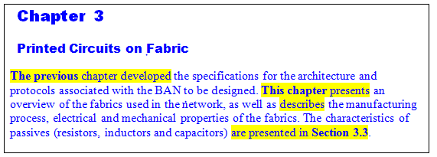
Metalanguage: Chapter and section previews
Restate-forecast

Slide 36
Metalanguage: Chapter and section previews
Previews contents
of a section

Slide 37
Analysis Task 0: What sort of thesis are you doing?
How would you classify your own thesis in terms of Phillip’s, MIT’s and your teacher’s categories?
Create a preliminary description of your thesis that includes
Thesis title
Type of thesis
Thesis aim(s) (e.g.,The aim of this thesis is to...)
Outline of chapters
Chapter previews that explain the purpose and scope of each chapter as well as the sections within these chapters (No preview for Chapter 1!!)

Slide 38
What important info must be repeated in these parts of the thesis?
Abstract
Introduction
The aim of the thesis
Theory
solution
Results
Conclusions

Slide 39
Thesis aims

Slide 40
Thesis aims

Slide 41
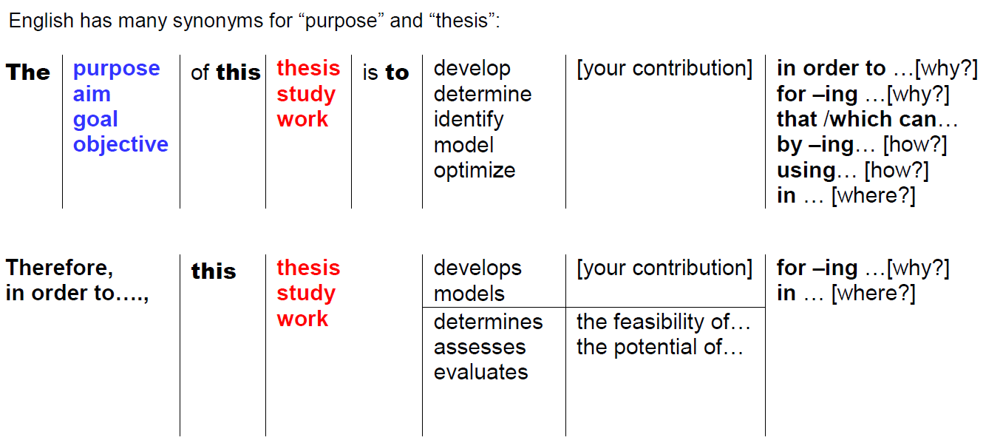
Thesis aims

Slide 42
Thesis aims
What is your contribution?
Will you offer your readers a new theory, framework or model to describe a phenomenon or system, which you will then test and validate using pre-defined criteria or requirements?
Are you going to create a new tool, such as a device, method, protocol, or process to carry out specific tasks or functions?
Will you improve a current solution by adapting or applying a new technology, followed by evaluation and comparison to the existing solution?
Will you evaluate and test a new technology to determine the feasibility (i.e., possibility) of implementing the technology in a specific context?
Or will your contribution be a recommendation based on identifying relevant options and then evaluating and comparing these options in order to find the best alternative for a particular context?

Slide 43
Step 1: Research questions
Step 2: Indirect questions
Is it possible to use a rapid prototyping process to assemble biocompatible films?
The aim of this thesis is to find out is it possible to use a rapid prototyping process to assemble biocompatible films.
The aim of this thesis is to determine whether it is possible to use a rapid prototyping process to assemble biocompatible films.
The aim of this thesis is to study how interpolating scaling functions can be used to solve optimal control problems.
How can interpolating scaling functions be used to solve optimal control problems?
Is geothermal production sustainable?
What sustainability indicators could be used to evaluate the sustainability of a geothermal system?
The aim of this thesis is to investigate whether geothermal production is sustainable.
What sustainability indicators could be used to evaluate the sustainability of a geothermal system?
The aim of this thesis is to investigate whether geothermal production is sustainable.
The aim of this thesis is to find out what sustainability indicators could be used to evaluate the sustainability of a geothermal system.

Slide 44
Step 3: Purpose statement
Step 2: Indirect questions
The aim of this thesis is to determine whether it is possible to use a rapid prototyping process to assemble biocompatible films.
The aim of this thesis is to determine the feasibility of using/applying a rapid prototyping process to assemble biocompatible films.
The aim of this thesis is to develop computational algorithms for solving the optimal control problems using interpolating scaling functions.
The aim of this thesis is to study how interpolating scaling functions can be used to solve optimal control problems.
The aim of this thesis is to investigate whether geothermal production is sustainable.
The aim of this thesis is to find out what sustainability indicators could be used to evaluate the sustainability of a geothermal system.
The aim of this thesis is to investigate whether geothermal production is sustainable.
The aim of this thesis is to develop sustainability indicators that could be used to evaluate the sustainability of a geothermal system.
The aim of this thesis is to develop sustainability indicators and to test their effectiveness by applying the indicators in a geothermal production system.

Slide 45
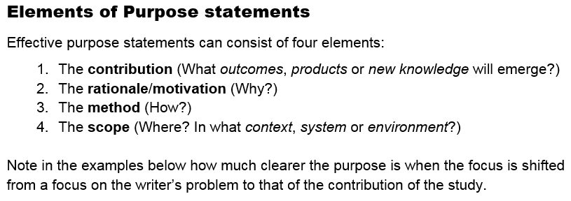
Move 3-1: Thesis aims

Slide 46
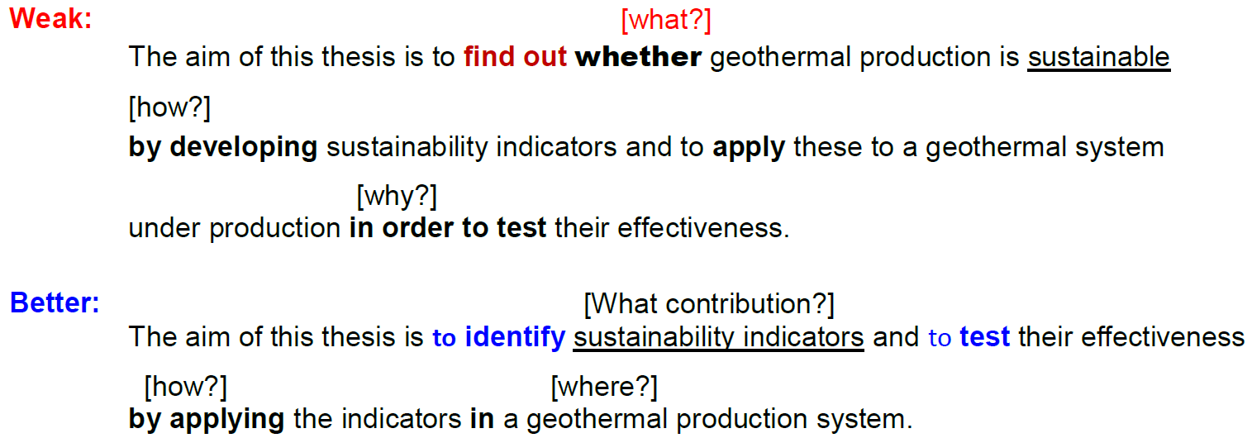
Thesis aims

Slide 47
Help is available!!
Academic Writing for Engineers
http://sana.aalto.fi/awe
Turnitin (plagiarism check) https://wiki.aalto.fi/display/turnitin/Turnitin+for+Students
Aalto University Writing Clinic https://mycourses.aalto.fi/course/view.php?id=405

