Slide 1
Technological Innovation in Service
Technological Innovation in Service
Class 1

Slide 2
WELCOME!

Slide 3
The Instructor: Anastasia Nanni
anastasia.nanni@aalto.fi

Slide 4
What about you?

Slide 5
Some more questions…
Do you know Stranger Things?
Have you seen the last season?
Notes:
Before we start with the course material, I have a few questions for you. I know this may sound a bit strange, but bear with me. First, how many of you are familiar with the Netflix series 'Stranger Things'? Please raise your hand if you are. If you are not, don't worry! It's not a prerequisite for the course !! Great, thank you.
Second, how many of you have seen the latest season of the show? Please raise your hand if you have. The reason I ask is that I want to avoid any spoilers during our conversations
Set in the 1980s, 'Stranger Things' is a popular TV series that follows a group of friends in a small Indiana town as they face supernatural threats and government conspiracies..
Let's take a moment to watch a clip from 'Stranger Things' last season. In this clip the main characters had to rescue their friend Max from a dangerous monster by playing her favorite song, 'Running Up That Hill' by Kate Bush with the limited resources that were available at the time. As you watch this clip, I want you to think about how you would respond in a similar situation now. If you had to save a friend by playing their favorite song, how long would it take you to find it and play it?
So here's what we're going to do: I'm going to ask you all to take out your smartphones or other digital devices and see how quickly you can find and play the song 'Running Up That Hill' by Kate Bush. I'll time you, and we'll see who can do it the fastest. Are you ready to give it a try?"
Today, thanks to the digital revolution, we have access to a wide range of resources and tools that can help us achieve our goals. For example, we can use streaming music platforms like Spotify or Apple Music to access millions of songs, without having to rely on limited resources like the radio or the audiocassette.

Slide 6
Artist: Kate Bush
Song: Running Up That Hill

Slide 7
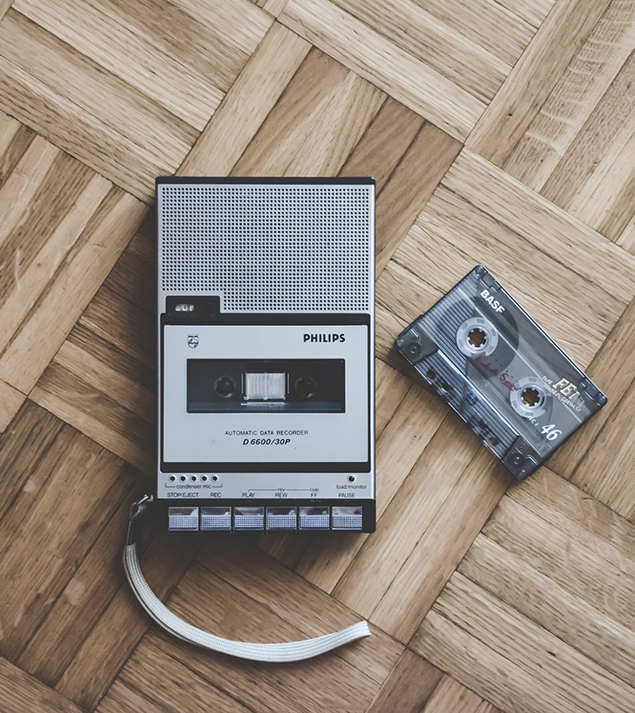
Notes:
As we saw in the 'Stranger Things' clip, the characters used audio cassettes to play their friend's favorite song. For those of you who may not be familiar with audio cassettes, they were a popular way to record and play music before digital music became widespread.
Audio cassettes are tapes made of magnetic material that store music. These tapes are wound around two reels inside a plastic case. To play the music on an audio cassette, you need a cassette player. The cassette player reads the magnetic impulses on the tape and converts them into sound using magnetic heads.
One unique feature of audio cassettes is the need to rewind or fast-forward the tape to find a specific song or section of music. This was often done by manually turning the reels with your fingers or using a pencil or pen to spin the reels. This ritual of rewinding the tape with a pencil or pen became a popular pastime and a cultural reference point for a generation of music lovers.
While audio cassettes are not as popular as they once were, they remain an interesting relic of a bygone era in music and technology.

Slide 9
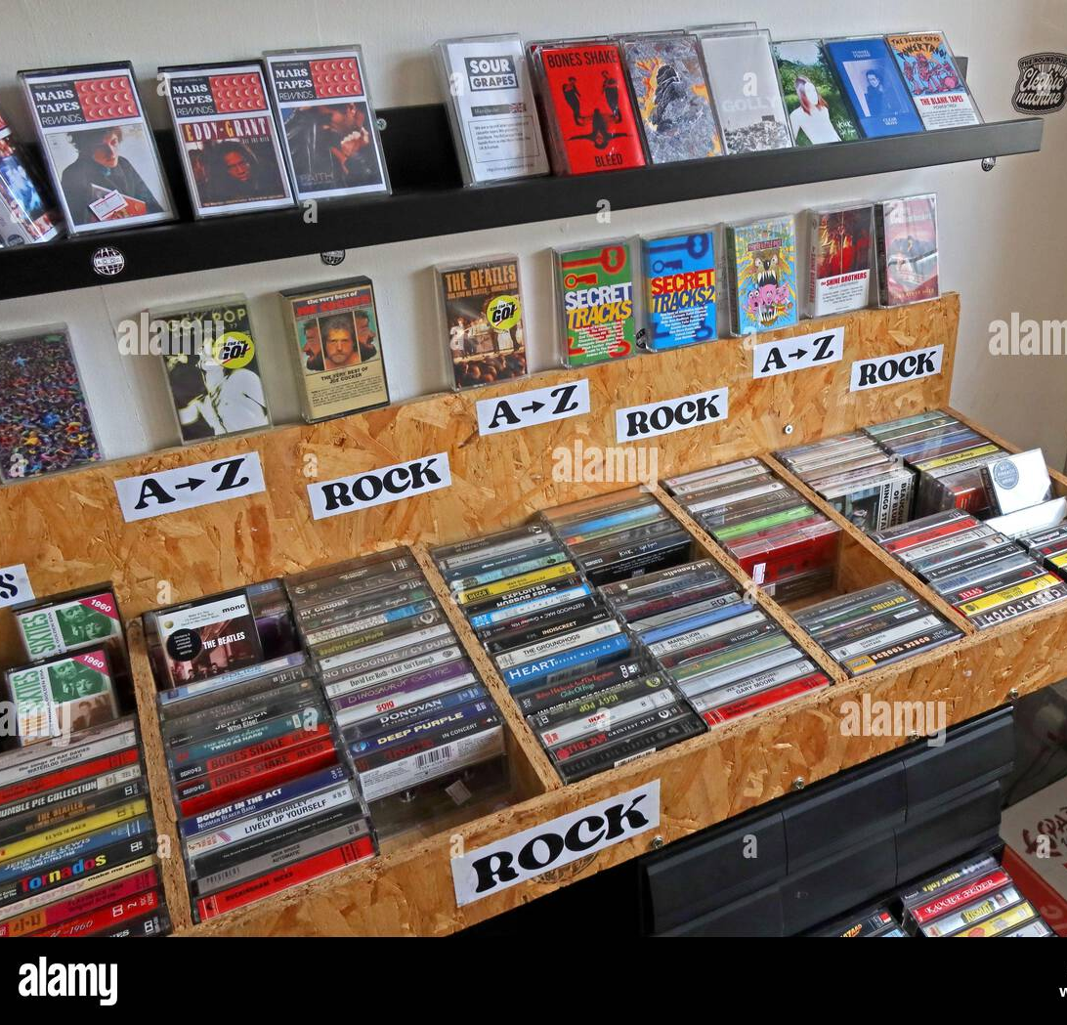
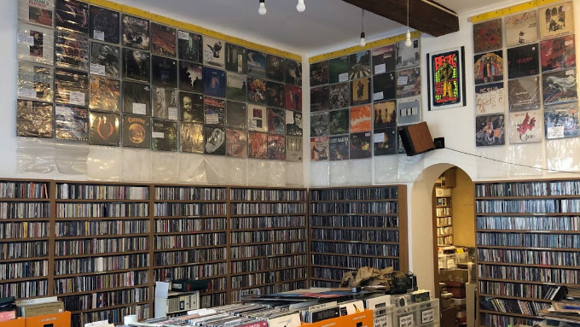
Notes:
Where did customers buy the audiocassette? Audio cassettes are an example of a physical media format that has declined in popularity as digital media has become more widespread. In a similar way, music stores and other physical outlets for music consumption have also been disappearing.

Slide 10
The switch from physical to digital (digitization) makes
Digital Marketing extremely important!
Notes:
This shift from physical to digital media is called digitization, and it has transformed the way we consume and interact with media.
For businesses, this shift has created new opportunities and challenges. Digital marketing has become increasingly important as more and more consumers turn to online platforms to discover, consume, and share media.
In the past, businesses could rely on traditional media channels like TV, radio, and print to reach their target audience. Today, however, digital marketing channels like social media, email, and search engines have become crucial for reaching and engaging with consumers.
By the end of this course,I hope, you'll have a better understanding of how digital marketing has changed different industries.

Slide 11
What was the first technology ever?

Slide 12
Handaxe, lower paleolithic, about 1.8 million years old, hard green volcanic lava (phonolite), 23.8 x 10 cm, found at Olduvai Gorge, Tanzania, Africa
(British Museum)
Notes:
Made nearly two million years ago, stone tools such as this are the first known technological invention.
This chopping tool and others like it are the oldest objects in the British Museum. It comes from an early human campsite in the bottom layer of deposits in Olduvai Gorge, Tanzania. Potassium-argon dating indicates that this bed is between 1.6 and 2.2 million years old from top to bottom. This and other tools are dated to about 1.8 million years.
Using another hard stone as a hammer, the maker has knocked flakes off both sides of a basalt (volcanic lava) pebble so that they intersect to form a sharp edge. This could be used to chop branches from trees, cut meat from large animals or smash bones for marrow fat—an essential part of the early human diet. The flakes could also have been used as small knives for light duty tasks.

Slide 13
Technology is a body of knowledge devoted to creating tools, processing actions and extracting of materials. The term Technology is wide and everyone has their own way of understanding the meaning of technology.
https://litacademy.net/en/services/international-trips/

Slide 14
We use technology to accomplish various tasks in our daily lives, in brief; we can describe technology as products, processes or organizations.
We use technology to extend our abilities, and that makes people as the most important part of any technological system.
Harvard Business Review: https://hbr.org/1985/11/implementing-new-technology
Notes:
Harvard Business Review: https://hbr.org/1985/11/implementing-new-technology

Slide 15
Technology, the application of scientific knowledge to the practical aims of human life or, as it is sometimes phrased, to the change and manipulation of the human environment.
Britannica «https://www.britannica.com/technology/technology»
Notes:
Britannica «https://www.britannica.com/technology/technology»

Slide 16
Technology is human knowledge which involves tools, materials and systems.
The application of technology results in artifacts or products. If technology is well applied, it can benefit humans, but if it is wrongly applied, it can cause harm to human beings.
What is Technology, Karehka Ramey in Techucation, December 12, 2013, http://www.useoftechnology.com/what-is-technology/
Notes:
What is Technology, Karehka Ramey in Techucation, December 12, 2013, http://www.useoftechnology.com/what-is-technology/

Slide 17
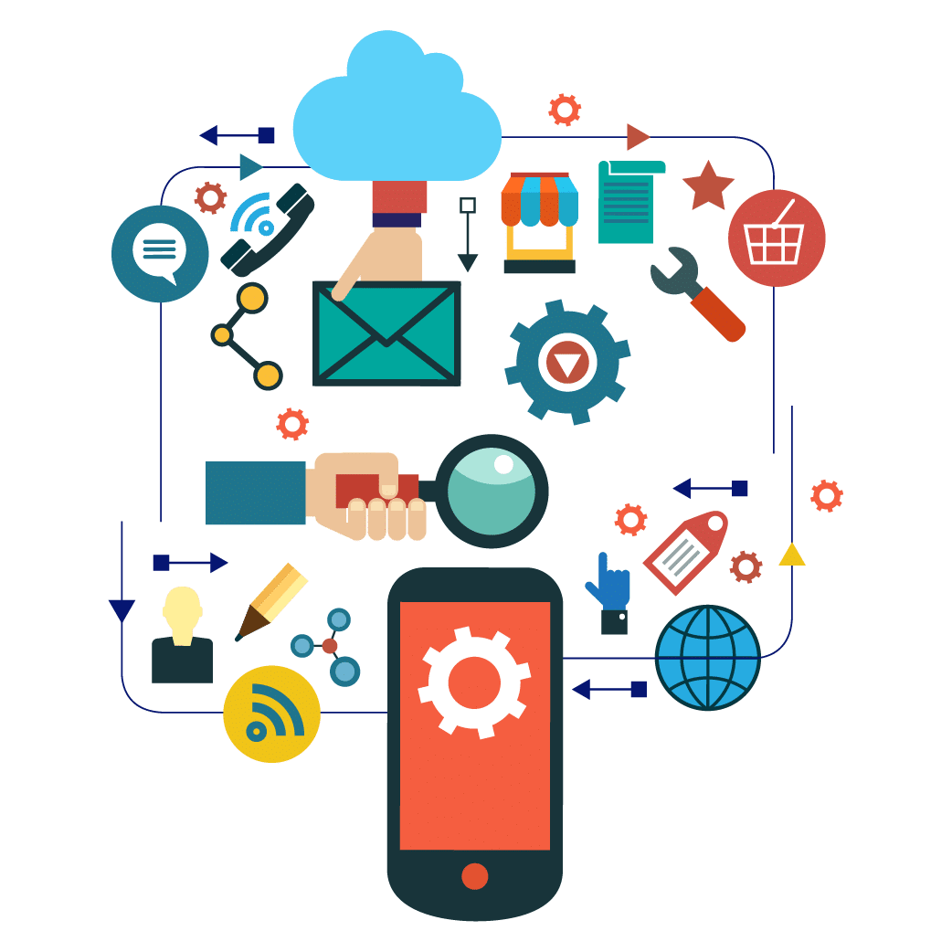
Digital Technologies
are electronic tools, systems, devices and resources that generate, store or process data.
These includes social media, online games and applications, multimedia, productivity applications, cloud computing, systems and mobile devices.

Slide 18
Digital Technologies
260 million views

Slide 19
Digital Technologies
260 million views

Slide 20
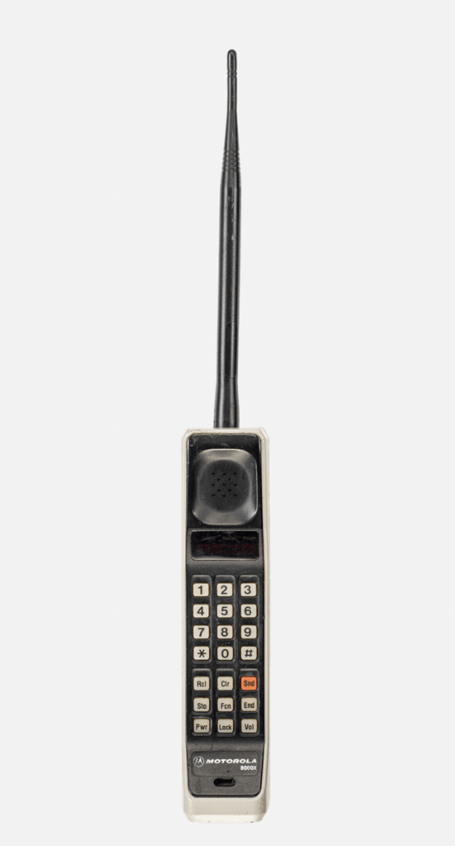
MOTOROLA DynaTAC 8000X
The DynaTAC (Dynamic Adaptive Total Area Coverage) family of devices are acknowledged as the first widely available mobile phones and are true icons of the 1980s. They were the brainchild of Motorola’s Dr Martin Cooper and Rudy Krolopp (both of whom worked for John Mitchell).
The 8000X was the culmination of 15 years work by these engineers and others, becoming the first truly hand-portable mobile phone on the market.

Slide 21
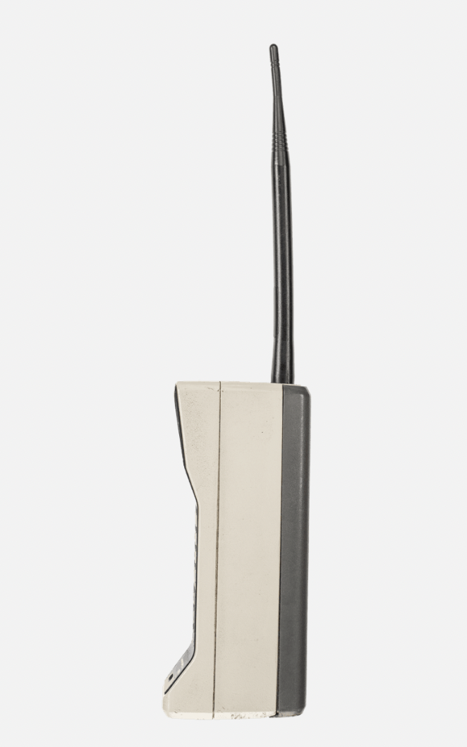
MOTOROLA DynaTAC 8000X
The DynaTAC (Dynamic Adaptive Total Area Coverage) family of devices are acknowledged as the first widely available mobile phones and are true icons of the 1980s. They were the brainchild of Motorola’s Dr Martin Cooper and Rudy Krolopp (both of whom worked for John Mitchell).
In 1984 it came onto the market with a hefty price tag of $3,995 (equivalent to $10,000 in 2020). It offered 30 minutes of talk-time on a single charge (which would take 10 hours!) and weighed 790 grams.

Slide 23
Digital Technologies
260 million views

Slide 24
The IBM Simon is widely regarded as one of the first devices that could be termed as a “smartphone” – however it is important to note that when it was launched, it was characterized as a PDA (personal digital assistant) with communication capabilities via a cellular connection. It was the result of IBM's desire to design a "computer that could fit in your shirt pocket".
The original plan was to put the device on sale in May 1994, however technical issues around “the integration of Simon’s cellular faxing capability” delayed the launch until August 1994 when it was offered across 15 states in the US on BellSouth’s AMPS network for $895 (with a two year contract) or $1099 without a contract – the equivalent to approximately $2000 in 2020.

Slide 25
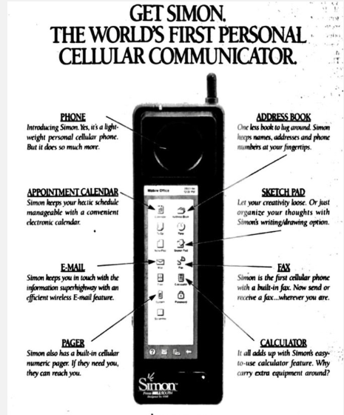
«Simon is the new, small, electronic cellular wonder that goes with you wherever your job happens to take you. It’s the perfect solution for the person on the go whose office isn’t exactly an office»

Slide 26
Digital Technologies
260 million views

Slide 27
APPLE IPHONE
The iPhone has become one of the most admired consumer electronics devices on the planet and its DNA can still be traced back to this original device which Steve Jobs pulled out of his pocket on stage in San Francisco in January 2007.
Weight 135 grams.
The iPhone started shipping exclusively with US carrier AT&T on 29 June 2007. It supported 2.5G GPRS / EDGE network capabilities and cost $499 for the 4GB model and $599 for the 8GB model. Apple then dropped the price by $200, eventually placating early iPhone buyers with a $100 store credit.
Final price 299 $ (373 $ in 2020)

Slide 29
What is the trend that emerges from the evolution of mobile phone shown so far?

Slide 30
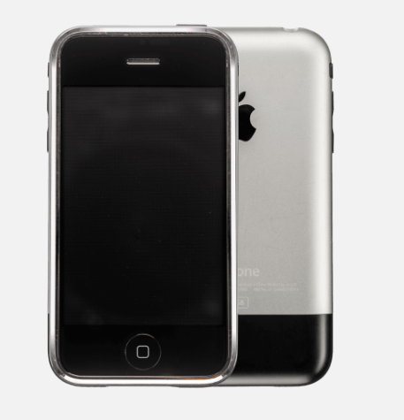
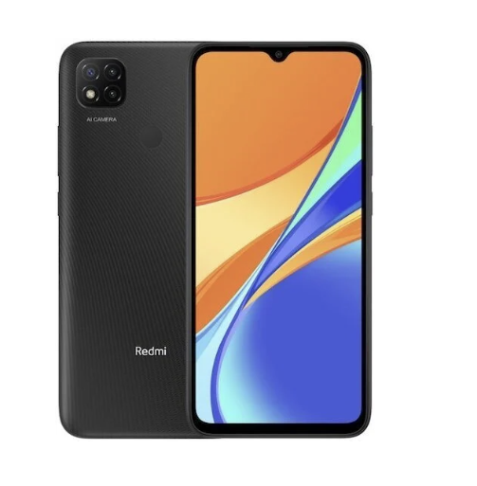
1984
1994
2007
2023
$ 10 000
$ 2000
$ 373
$ 50-100

Slide 31
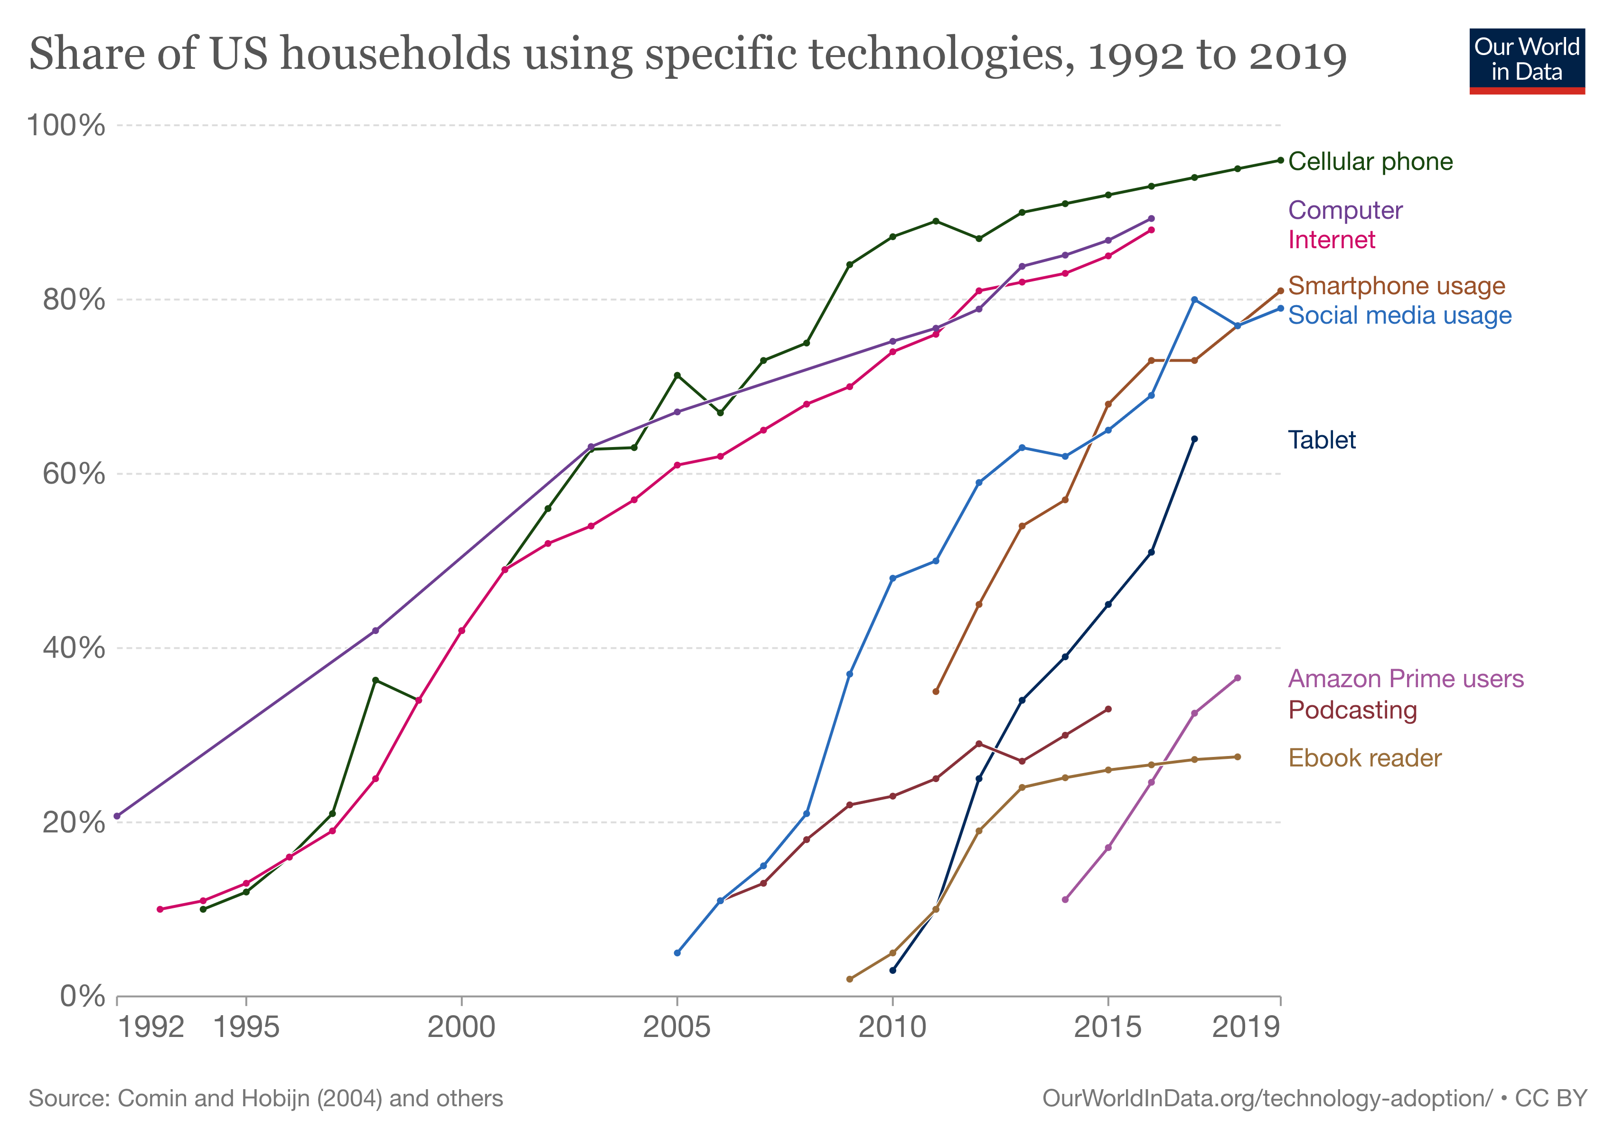
Households using specific technologies

Slide 32
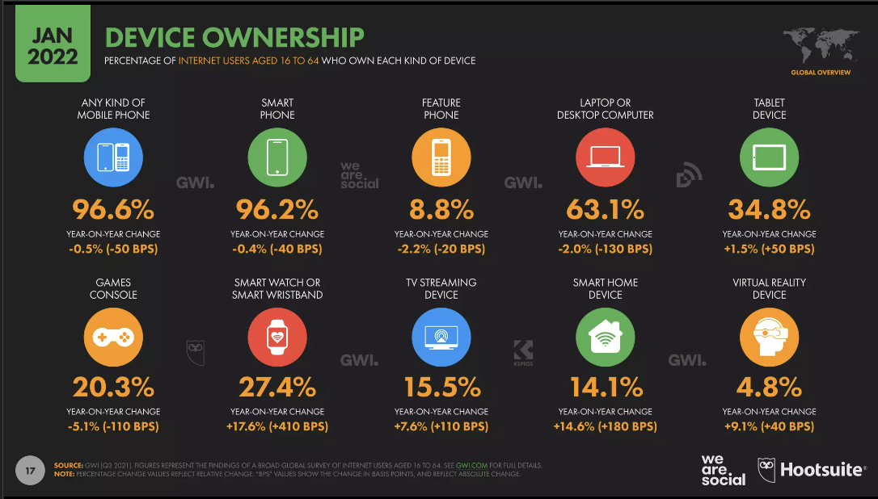
It may come as no surprise to find out which digital devices we used most!
Smartphones have become our personal assistants with 96.2% of people using one!
The Smartphone is everything from a way to connect, to do your online banking, trading stocks, playing games, watching movies, getting information fast!

Slide 33
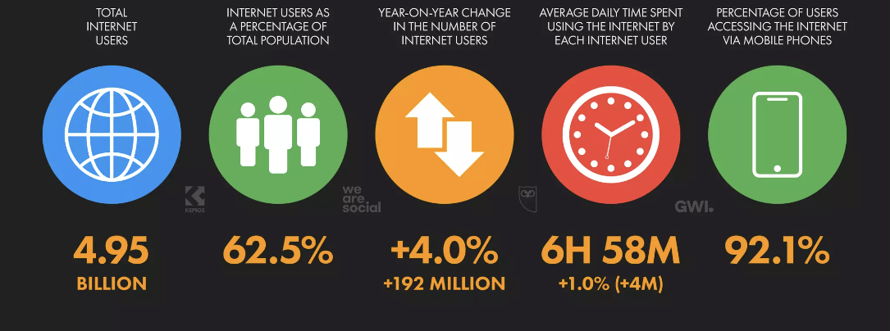
If you need to know something, it's as simple as reaching into your pocket, and entering your questions into your Smartphone.

Slide 34
The course

Slide 35
General Purpose
In this course we will not focus on how to create or manage digital content.
This course will teach you how to detect the consequences of digitalization process and new trends.
The goal is to think about digital marketing critically and strategically.
Focus on the BIGGER PICTURE!
Examples of fails and successes.
(Consider also taking MARK-E0047 MARK-E0047 - Digital Marketing Communications)
Notes:
I want to start saying that in this course, we will not focus on the technical aspects of creating or managing digital content. Rather, our goal is to develop a critical and strategic understanding of digital marketing and its impact on businesses and consumers.
The ultimate goal of this course is to equip you with the skills and knowledge needed to think about digital marketing critically and strategically, and to understand the consequences of the digitization process in the marketing industry.
It's also worth noting that if you are interested in learning more about communication aspects of digital marketing, I would highly recommend taking the course MARK-E0047 - Digital Marketing Communications. This course focuses on the creation and management of digital content, and is an excellent complement to this course."

Slide 36
Why?
Technologies evolve rapidly with new platform and new features!!
Consumers of the future will be more accustomed and more savvy about technologies than you are!
Notes:
As we all know, technology is evolving at a rapid pace, with new platforms and features emerging all the time. This means that businesses and marketers must stay on top of the latest trends and techniques in digital marketing to remain competitive and reach their target audience.
But it's not just about keeping up with the latest tools and platforms - it's also about developing a strategic mindset that allows you to think critically about how to use these tools to achieve your marketing goals.
That's why in this course, we will focus on developing strategic thinking skills in the context of digital marketing. By understanding the bigger picture and thinking critically about the impact of digital technologies on businesses and consumers, you'll be able to create effective marketing campaigns that reach and engage your target audience.
It's also important to note that consumers of the future will be more accustomed and savvy about technologies than we are today. As digital natives, they will expect more from the brands they interact with and will be more discerning in their choices. By developing strategic thinking skills in digital marketing, you'll be better equipped to meet the needs and expectations of these consumers, and create successful marketing campaigns in the fast-paced digital world.»
I want to show you a video that proves that even toddlers are becoming more tech-savvy than we are! In this video, you'll see my one-year-old daughter trying to communicate with Google Home, and let me tell you, she's not exactly a marketing expert (yet).

Slide 37
Consumers of the future
Notes:
But in all seriousness, this video highlights the fact that the next generation of consumers will be more comfortable with technology than we are today. This shows just how quickly children are becoming familiar with technology and how comfortable they are with using it to interact with the world around them.
It's important to recognize that as these children grow up, they will become the consumers of the future, and they will expect a high level of digital sophistication from the brands they interact with.
By developing our strategic and critical skills in digital marketing, we can prepare ourselves for the rapidly evolving technology and changing consumer expectations that we will encounter in the future. As we've seen, the next generation of consumers will be more tech-savvy and demanding than ever before.

Slide 38
Learning goals
Understand the consequences of technological and digital innovation in marketing.
Understand and be able to develop effective marketing strategies to exploit at best technological innovations.
Learn the concept of Artificial Intelligence and its implementation in marketing
Use critical thinking to understand the possible downsides of technological innovation

Slide 39
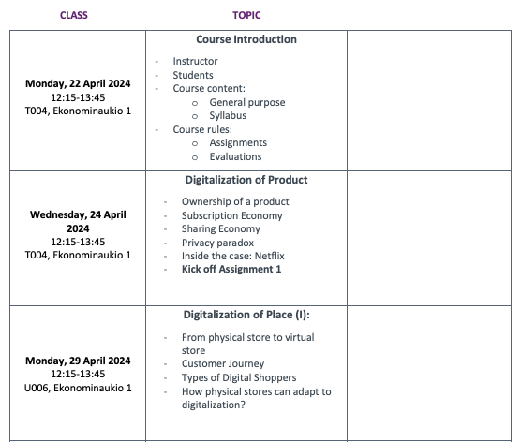
The structure of the course

Slide 40
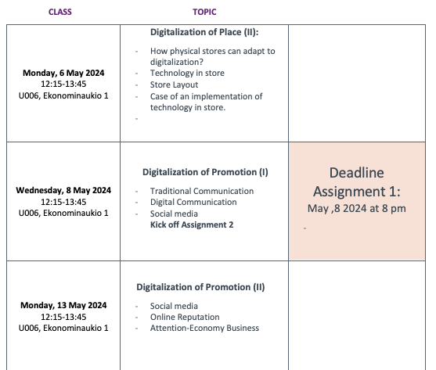
The structure of the course

Slide 41
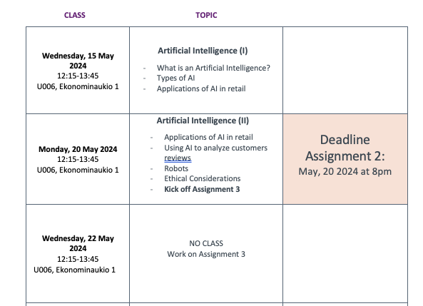
The structure of the course

Slide 42
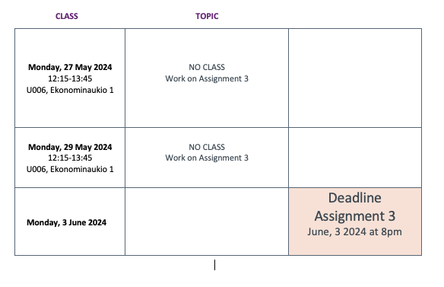
The structure of the course

Slide 43
With the digitalization, what is the future of physical stores?
ASSIGNMENTS’ GOAL

Slide 44
You are the store manager
As store managers, your boss has tasked you with transforming your physical stores to better cater to consumers who are shifting towards e-commerce.
Notes:
As part of this assignment, we want you to put yourselves in the shoes of store managers and consider how they can adapt to the challenges of digitalization. You'll need to think about ways to attract and retain customers in an increasingly digital world.
As store managers, your boss has tasked you with transforming your physical stores to better cater to consumers who are shifting towards e-commerce.
The retail industry is undergoing a significant shift, and your role as store managers has never been more critical. The future success of your stores depends on your ability to adapt and stay ahead of the game.
In today's fast-paced world, the success of your stores depends on your ability to adapt quickly and stay ahead of the curve. Let's work together to create a plan that will allow your stores to stay relevant in the digital age. It's time to roll up your sleeves and get to work!

Slide 45
You are the store manager
The retail industry is undergoing a significant shift, and your role as store managers has never been more critical. The future success of your stores depends on your ability to adapt and stay ahead of the game.
Let's work to create a plan that will allow your stores to stay relevant in the digital age.
Notes:
As part of this assignment, we want you to put yourselves in the shoes of store managers and consider how they can adapt to the challenges of digitalization. You'll need to think about ways to attract and retain customers in an increasingly digital world.
As store managers, your boss has tasked you with transforming your physical stores to better cater to consumers who are shifting towards e-commerce.
The retail industry is undergoing a significant shift, and your role as store managers has never been more critical. The future success of your stores depends on your ability to adapt and stay ahead of the game.
In today's fast-paced world, the success of your stores depends on your ability to adapt quickly and stay ahead of the curve. Let's work together to create a plan that will allow your stores to stay relevant in the digital age. It's time to roll up your sleeves and get to work!

Slide 46
Three Assignments
LIDL
LUSH
Choose one brand among:
ALKO
LINDEX
Notes:
For this assignment, you'll need to choose one of the following industries: fashion, grocery, cosmetics, or banking.
I want to make sure that each of you has an equal opportunity to work on the industry of your choice, But I want to ensure that we have a good balance of industries represented in the class, I've set a limit of 11 spots available for each industry. We will talk about that in few minutes.

Slide 47
Assignment 1: Customers’ insights
Individual Assignment
Goal
Gather insights from the customers
Tasks
Desk research: Collect data from web (trends, forum, reviews).
Conduct five short interviews (no survey) to customers.
Output
PowerPoint
(max 10 slides)

Slide 48
Assignment 2: Develop a strategy
Individual Assignment
Goal
Develop a strategy
Tasks
Design a new store that includes technological elements.
Design a digital communication strategy to promote your new store.
Output
PowerPoint
(max 15 slides)

Slide 49
Assignment 3: Integrate the results
Group assignment
Goal
Develop a integrated strategy for each brand with your colleagues
Tasks
Put together your insights.
Discuss your designs
Output
PowerPoint
(max 30 slides)
Design a new store
Develop a digital communication strategy

Slide 50
Evaluation
Each assignment will be evaluated on a scale from 0 to 100.
The average of the three assessments will be the final grade of the course
NO EXAM!
0 |  | 10 |  | 20 |  | 30 |  | 40 |  | 50 |  | 60 |  | 70 |  | 80 |  | 90 |  | 100
0
(fail)
1
2
3
4
5
You can have 2/100 extra points if you provide course feedback at the end of the course.
Notes:
The course evaluation will be based on a 0 to 100 scale for each assignment. The final grade for the course will be the average of the three assignment scores. There will be no final exam for the course. Additionally, students can earn 2 extra points out of 100 by providing course feedback at the end of the course. Please note that although the workload for the course is not heavy, to receive a good grade, it will require thoughtful consideration and critical thinking for the assignments.

Slide 51
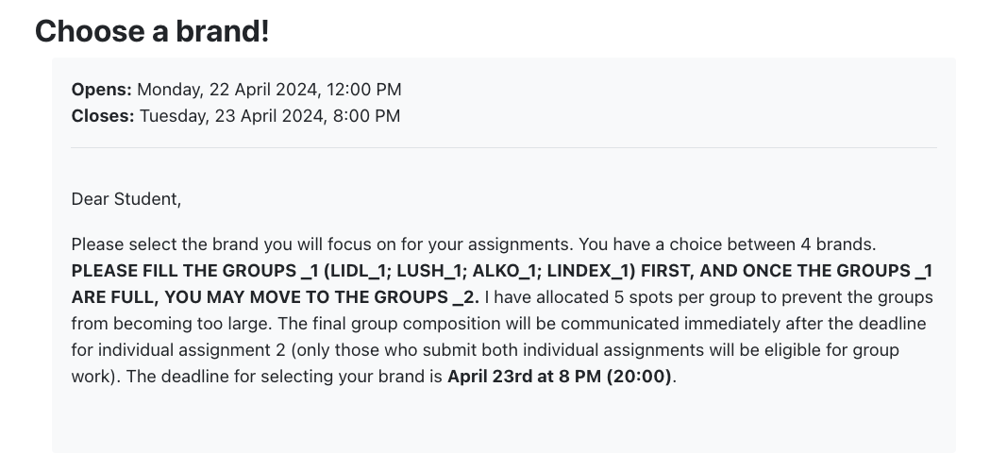
On MyCourse→Assignments
You can choose the industry from Today at noon until Tuesday, 23 April, 8 PM
To distribute the choices more fairly, there are 5 spots available for each group among you students.
Notes:
You can select the industry of your choice from now until Wednesday, March 1, 2023, at 8:00 PM. The selection is available on the MyCourses platform, under the Assignment section. As previously mentioned, to ensure a fair distribution of choices among you 43 students, there are only 11 spots available for each industry.

Slide 52
PLEASE SELECT GROUP 2 ONLY WHEN GROUP 1 IS FULL

Slide 53
Few Rules
You can always interrupt the class (raise your hand) to ask questions (you are encouraged to do so!).
You can always ask me for additional explanations.
You can always reach me out (via mail, after each class).
But…
never miss the assignments’ deadlines. If a student misses the deadline of an assignment, they will fail the course.

Slide 54
Other practicalities
MyCourses is the source for all course-related material and information.
‘Announcements’ forum will include all formal course communication
Everyone is automatically subscribed and will receive an email notification
Check your aalto.fi email regularly

Slide 55
QUESTIONS?

