Slide 1
How to make a good seminar presentation?
Juha Lipponen

Slide 2
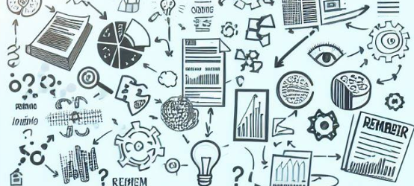
Planning a presentation: Timeline
Deadline
Too many presentations
Exhausting amount of curves, facts and figures.
Because you love your data (for a reason:)
Opening slide
NO time for a Q/A
A good presentation
Motivate the audience: Why is this topic important? Why should you be motivated to listen?
Tell about the set up of your study.
Only the key results that support your upcoming conclusions.
Q/A
Opening slide
Conclusions

Slide 3
Planning a presentation
First: Think what do you want your audience to remember after your presentation?
It may not be a flood of as many facts and figures as possible.
The purpose of your presentation is not to go through all your results!
Try to generate your audience insights.
Image credit: Bing AI

Slide 4
A good presentation is a story!
In a good story, there is a beginning, the middle, and the end.
Scientific presentation parts are according to a framework of a story.
Abstract (entire work in short, not usually in PowerPoint -presentations)
Introduction
Materials and methods
Results
Discussion
Acknowledgements
Image credit: Bing AI

Slide 5
Every Pixar/Disney story:
Describe your area of interest (“Once upon…”)
How is the state of the art and known knowledge in your area (“Every day…”)?
(“One day”) You dediced to find out more, formulate a hypothesis and set up a research arrangement
With (“Because of”) the arrangement of your Materials and Methods, you found….
(”Because of that”), you can conclude, that the results mean…
(“Until finally”), your results can be utilized in…., Continuation work could include….

Slide 6
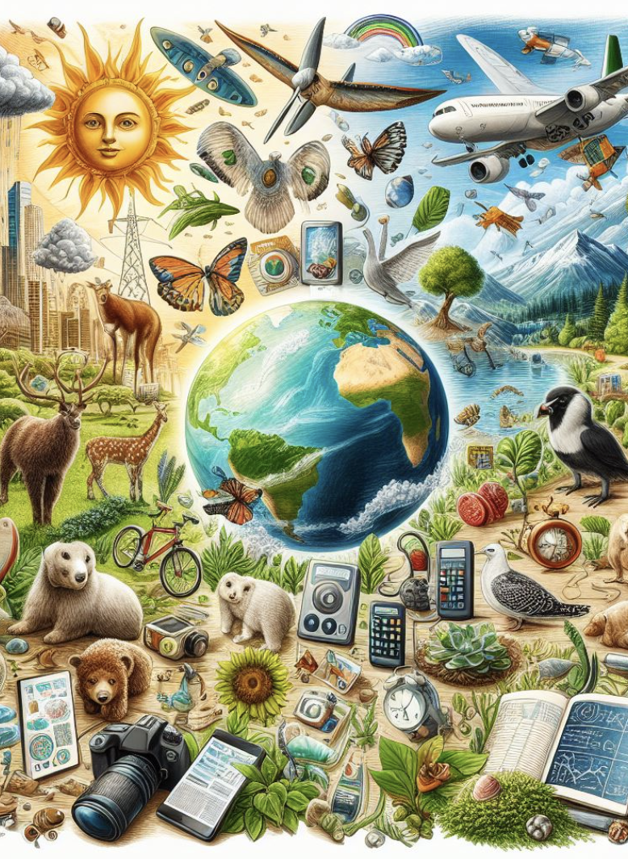
Start walking your audience through your story:
In Introduction, 1–2 slides) tell your audience Why the topic at hand is important
This part motivates your audience of listen: Why they should be interested in coming information?
Take into account the varied starting levels in their expertise. Someone may hear of this topic the first time!
Image credit: Bing AI

Slide 7
Present your Materials and methods, procedures etc.
What exactly did you do?
Which samples did you use?
How and with what were the samples treated?
How and with what were the samples analyzed?
No results yet!
Image credit: Bing AI

Slide 8
What were the results you gathered?
Curves, facts, figures
Avoid presenting “data”, try to present information!
Try to find connections and correlations
It is not necessary to include all the results!
Do not exhaust the audience with too much information!
Choose only the most meaningful results: Those which will be basis of your upcoming conclusions.
In the written report you include the “complete” set of information
Image credit: Bing AI

Slide 9
Conclusions
What do the results mean?
Answer the question “so what??”
How does your results add to the existing knowledge?
Which further questions the results arise?
What would be good to do next?
Image credit: Bing AI

Slide 10
Feature of a good presentation
Reasonable amount of slides:
Max 1 slide/minute
Leave your slides loose
Don’t make your audience read your slides. Also, don’t read out loud them
Use a lot of pictures!
Be in eye conact with your audience. Talk to people, not to the slides!
Practice!
Image credit: Bing AI

Slide 11
Thank you!
Thank all the contributors, funders and coworkers, who helped you in completing your research and your presentation.

