Slide 1




Technological Innovation in Service
Technological Innovation in Service
Class 8

Slide 2

Artificial Intelligence

Slide 3
PERSONA-LIZATION
Brands can use AI to create personalized shopping experiences for their customers. By analyzing customer data, AI can suggest products, provide recommendations, and customize marketing messages.
INVENTORY MANAGE-MENT
AI can help brands optimize inventory management by analyzing data on customer demand, seasonality, and product popularity. This can help brands avoid overstocking or understocking, which can lead to lost sales or excess inventory costs.
CUSTOMER SERVICE
AI-powered chatbots can provide 24/7 customer service, helping customers with product inquiries, order tracking, and returns. AI can also be used to analyze customer feedback to identify areas for improvement and enhance the customer experience.
VISUAL SEARCH
AI can be used to enable visual search, allowing customers to search for products by uploading a photo or taking a picture with their smartphone. This can help customers find products more easily and efficiently.
Retail

Slide 4

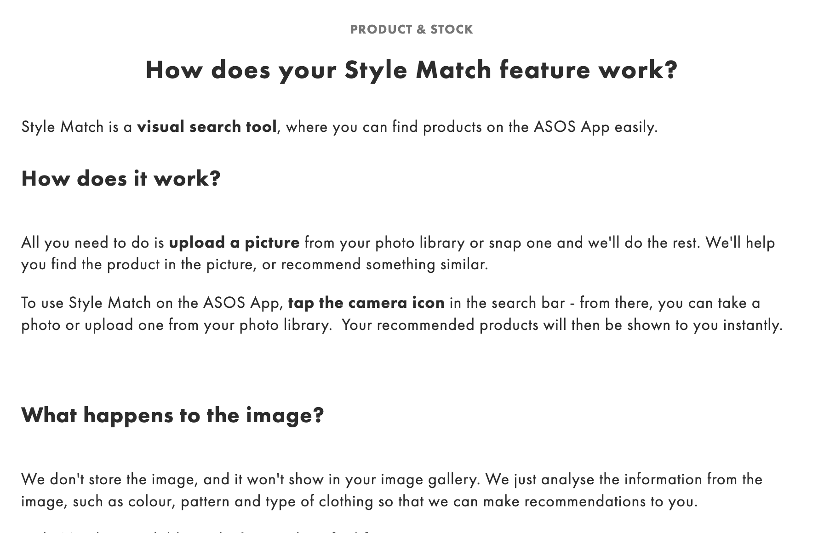
Visual Search: examples
The feature allows users to search the ASOS database of roughly 85,000 products by uploading a reference photo to the app.
So basically if you’re perusing Instagram and find an image of a super expensive coat, you can skirt the outfit and search ASOS for a less expensive version, instead.

Slide 5
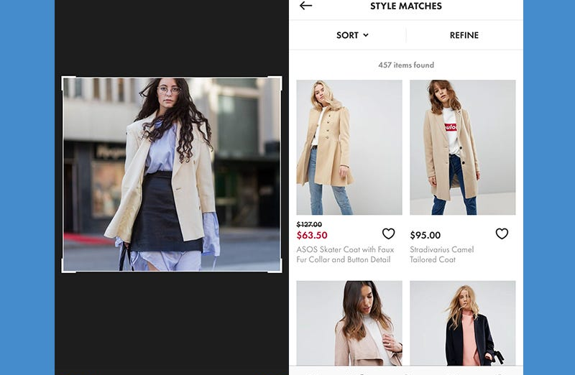
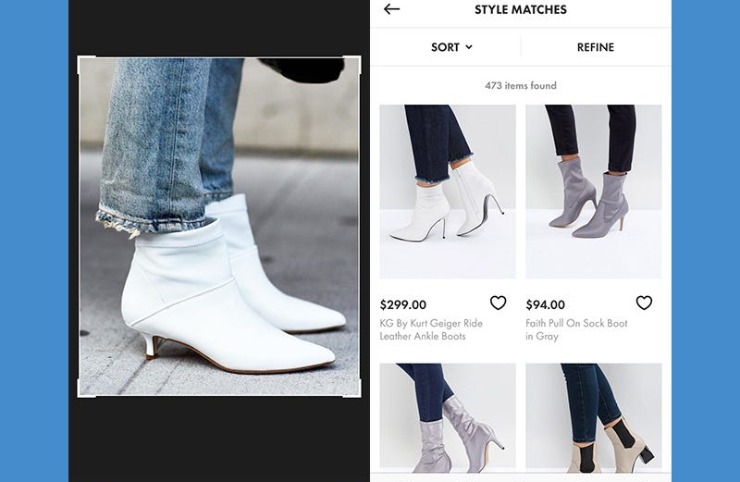
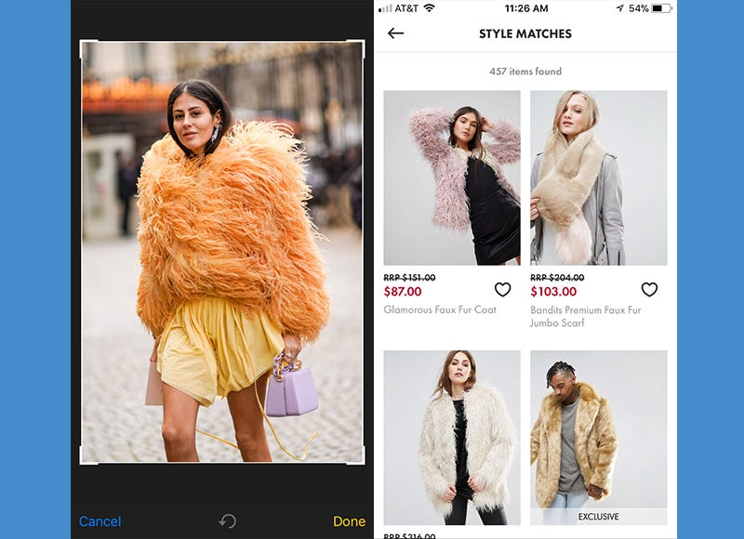
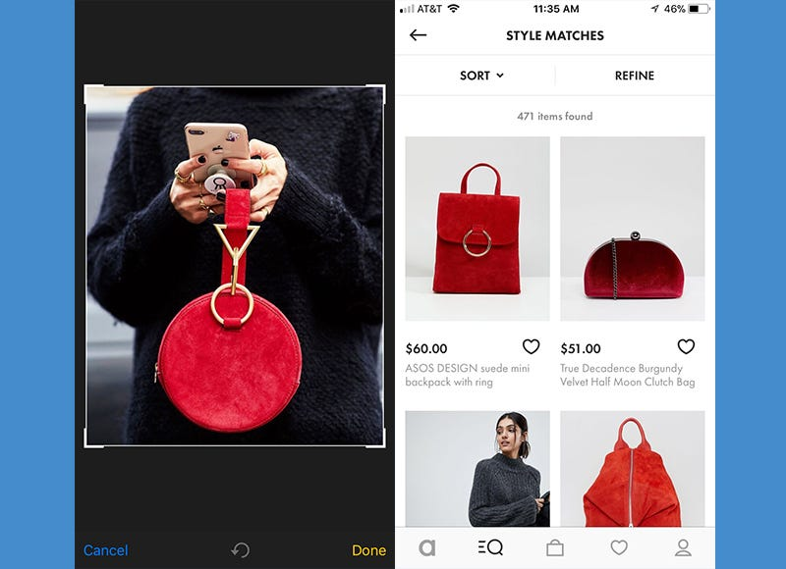
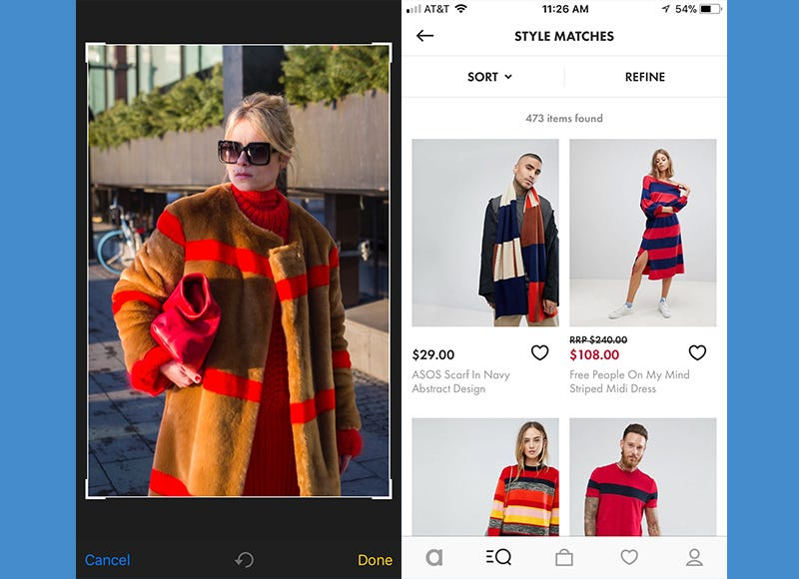

Slide 6

Visual Search: examples

Slide 7
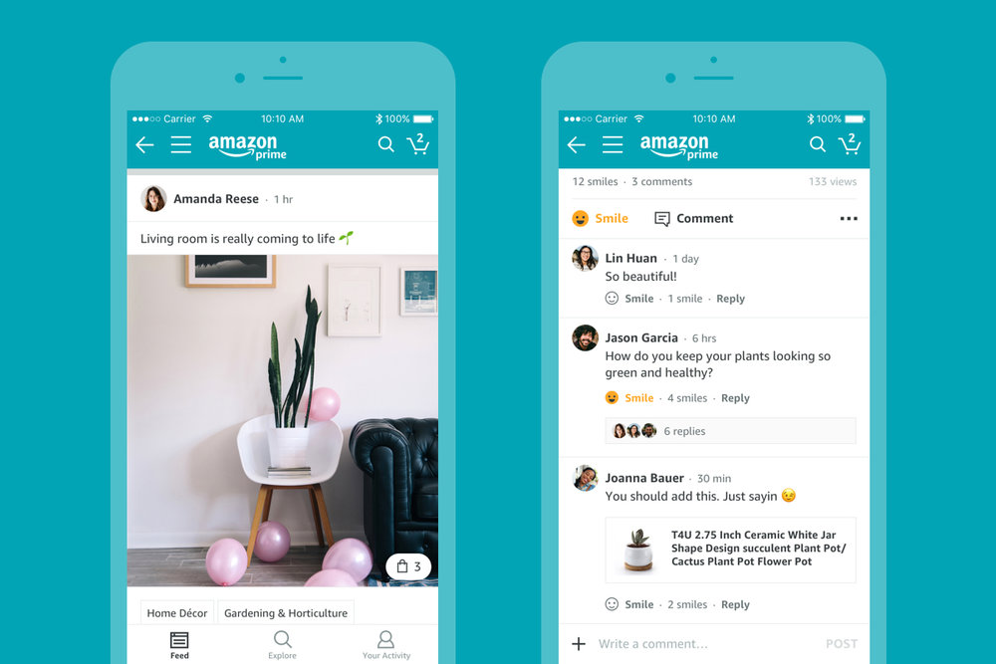
Visual Search: examples
Amazon Spark: the company launched the service for Prime members in 2017.
It prompted customers to pick a selection of interests in the section in the feature, and would then show you a feed of posts from users that related to those interests. The service seemed to be designed to replicate influencers using social networks like Instagram and Pinterest. Users could react to posts with a “smile” or a comment.
The site did not take off.
https://www.failory.com/amazon/spark
https://www.theverge.com/2019/6/15/18680165/amazon-spark-discovery-social-network-shutdown

Slide 8
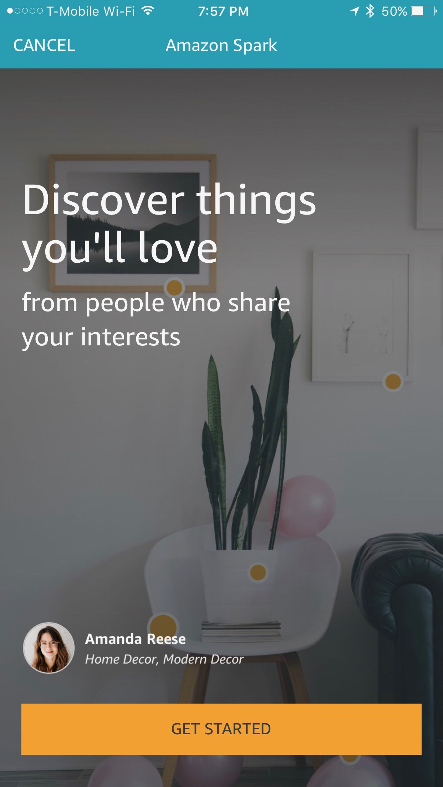
Visual Search: examples
WHY?
Lack of originality (similar to Instagram)
Spark was accessible only to Prime users: this meant that discovering Spark in the first place was a challenge, which is a big problem for a social media platform that relies on virility.
Excluding brands: However, Amazon neglected the brands that sell products on Amazon and did not include them in the strategy. If they had allowed brands to engage with potential customers through the platform, they could have a lot more relevant and interesting content.

Slide 9

Visual Search: examples

Slide 10

Visual Search: examples
Google Photos users can upload new photos, view, edit, save and create new videos, animations, collages, albums and photos books.
The robust search option (visual search) is a major draw for the platform. It lets you search for generic subjects, like "dogs" or "beach" to narrow your options, which is especially useful if you haven't yet sorted your pictures into albums.
In a similar vein, you can also set it to create "live albums," which automatically populate with photos of friends and family members.
Source: https://www.businessinsider.com/guides/tech/how-does-google-photos-work?r=US&IR=T
Notes:
Source: https://www.businessinsider.com/guides/tech/how-does-google-photos-work?r=US&IR=T

Slide 11
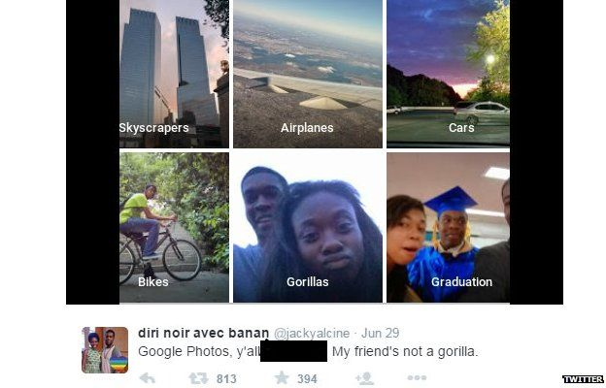
Visual Search: examples
2015: Jacky Alcine via Twitter.

Slide 12
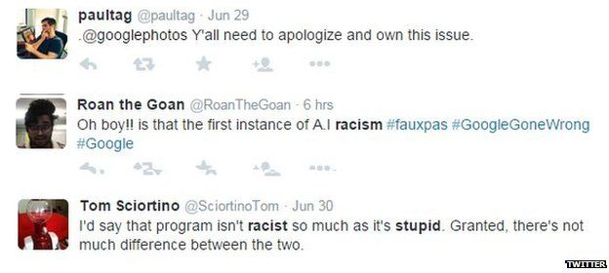
Visual Search: examples

Slide 13
Visual Search: examples
Google has acknowledged the sensitivity of the mistake.
"We're appalled and genuinely sorry that this happened," a spokeswoman told the BBC.
"We are taking immediate action to prevent this type of result from appearing. There is still clearly a lot of work to do with automatic image labelling, and we're looking at how we can prevent these types of mistakes from happening in the future.”
Source: https://www.bbc.com/news/technology-33347866

Slide 14
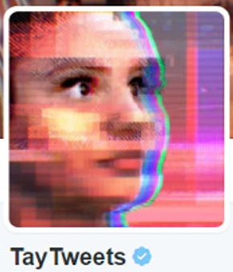

What do the examples of Chatbot Tay and Google Photos suggest?

Slide 15
Training artificial intelligence (AI) systems with the right data is critical for ensuring their accuracy and effectiveness. As demonstrated by examples such as Microsoft's Tay chatbot and Google Photos' labeling of "gorillas" as black people, using biased or inaccurate data can lead to serious errors and negative consequences.
These examples show that AI is only as good as the data it's trained on. To avoid these kinds of mistakes and ensure AI is used ethically and effectively, it's important to carefully curate and vet the data used to train these systems. This involves ensuring the data is representative of diverse perspectives, removing biased or offensive content, and continuously monitoring and refining the algorithms as they learn and evolve. By training AI with the right data, we can help ensure that these systems are accurate, fair, and effective tools for improving our lives and society.

Slide 16
PERSONA-LIZATION
Brands can use AI to create personalized shopping experiences for their customers. By analyzing customer data, AI can suggest products, provide recommendations, and customize marketing messages.
INVENTORY MANAGE-MENT
AI can help brands optimize inventory management by analyzing data on customer demand, seasonality, and product popularity. This can help brands avoid overstocking or understocking, which can lead to lost sales or excess inventory costs.
CUSTOMER SERVICE
AI-powered chatbots can provide 24/7 customer service, helping customers with product inquiries, order tracking, and returns. AI can also be used to analyze customer feedback to identify areas for improvement and enhance the customer experience.
VISUAL SEARCH
AI can be used to enable visual search, allowing customers to search for products by uploading a photo or taking a picture with their smartphone. This can help customers find products more easily and efficiently.
PRICING OPTIMIZA-TION
AI can analyze data on competitor prices, product demand, and market trends to help brands optimize their pricing strategy. This can help brands stay competitive and maximize profitability.
Retail

Slide 17

Price optimization
Price optimization is a mathematical analysis technique used in retail and other industries to determine the ideal price points for products and services based on various factors such as supply and demand, customer behavior, competitor pricing, and market trends. The data used in price optimization can include survey data, operating costs, inventories, and historic prices and sales.
Source: https://www.pricefx.com/learning-center/price-optimization-what-how/
"As data about drivers proliferates, auto insurers look to adjust rates". The New York Times

Slide 18

Price optimization:examples
Amazon also uses artificial intelligence to drive dynamic pricing . The algorithm enables optimal sales and revenue automatically.
Amazon changes product prices 2.5 million times a day!
This means that an average product changes cost every 10 minutes.
Amazon managed to boost revenue by 25% using dynamic pricing and the company continues to use the technique extensively.
Source:https://postindustria.com/using-ai-in-marketing-top-5-cases-machine-learning-examples/

Slide 19
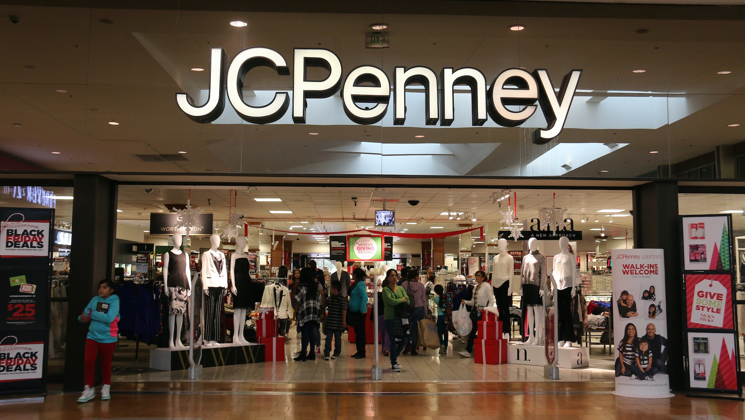
Price optimization:examples
They proposed a new system that used AI-powered algorithms to set "fair and square" prices.
Source: https://sundayspecial.substack.com/p/the-death-of-jcpenney
https://www.priceintelligently.com/blog/j-c-penny-s-pricing-strategy
Notes:
https://sundayspecial.substack.com/p/the-death-of-jcpenney
https://www.priceintelligently.com/blog/j-c-penny-s-pricing-strategy

Slide 20
Instead of using deep discount sales to attract customers, starting this week the chain will simply offer three prices: (1) “Every Day”, (2) “Month Long Value” (theme sales such as back-to-school related products in August), and (3) “Best Prices” (clearance).
Prices will also now end in “0” instead of “99” and price tags will list just one price (instead of including the de rigueur “previously sold at a higher price” convention
Source: https://sundayspecial.substack.com/p/the-death-of-jcpenney
https://www.priceintelligently.com/blog/j-c-penny-s-pricing-strategy
Notes:
https://sundayspecial.substack.com/p/the-death-of-jcpenney
https://www.priceintelligently.com/blog/j-c-penny-s-pricing-strategy

Slide 21

20% Sales Drop
(4 Billions Dollars)

Slide 22

Why?
The system was not well-received by customers, who were confused by the new pricing structure and felt that the prices were too high.
In addition, the AI-powered system was not able to accurately predict customer demand or identify the optimal price points for each product, leading to overpriced items that did not sell and underpriced items that sold out too quickly.
No products differentiation: when selling a relatively undifferentiated product, the only lever to generate higher sales is discounts. Even worse, if competitors drop prices on comparable products.

Slide 23
PERSONA-LIZATION
Brands can use AI to create personalized shopping experiences for their customers. By analyzing customer data, AI can suggest products, provide recommendations, and customize marketing messages.
INVENTORY MANAGE-MENT
AI can help brands optimize inventory management by analyzing data on customer demand, seasonality, and product popularity. This can help brands avoid overstocking or understocking, which can lead to lost sales or excess inventory costs.
CUSTOMER SERVICE
AI-powered chatbots can provide 24/7 customer service, helping customers with product inquiries, order tracking, and returns. AI can also be used to analyze customer feedback to identify areas for improvement and enhance the customer experience.
VISUAL SEARCH
AI can be used to enable visual search, allowing customers to search for products by uploading a photo or taking a picture with their smartphone. This can help customers find products more easily and efficiently.
PRICING OPTIMIZA-TION
AI can analyze data on competitor prices, product demand, and market trends to help brands optimize their pricing strategy. This can help brands stay competitive and maximize profitability.
AI can be used to detect fraudulent activity, such as credit card fraud or identity theft. This can help brands protect their customers and minimize financial losses.
FRAUD DETECTION
Retail

Slide 24

Fraud Detection:example
Amazon's AI-powered fraud detection system is called Amazon Fraud Detector, and it is a cloud-based service that helps businesses identify and prevent fraudulent activities in real time. The system uses a combination of supervised and unsupervised machine learning algorithms to analyze data from various sources, including transaction history, customer behavior, and account information, to identify patterns of fraudulent activity
The system then uses this data to train the fraud detection models and generate fraud risk scores for each event. Businesses can set up rules to automatically block or flag events with high fraud risk scores and investigate them further.
Source:https://aws.amazon.com/it/fraud-detector/

Slide 25
Fraud Detection: possible risk
FALSE POSITIVE
Source: https://www.formica.ai/blog/how-to-reduce-false-positive-with-ai-powered-fraud-detection

Slide 26


Example: Bank
A false accusation or ill-informed denial of a credit card transaction of a legitimate customer can leave the customer with a negative attitude towards your business; these customer insult scenarios cost more to the trades than what fraud can do to them.
Accused customers majorly choose to replace their bank after such transaction denial. Getting such a reputation for undertaking steps in fraud prevention is not a good trade-off. This dissatisfaction caused to customers has many severe consequences on the business. That is why it is more important to reduce the False-Positives than reducing the fraud itself.

Slide 27
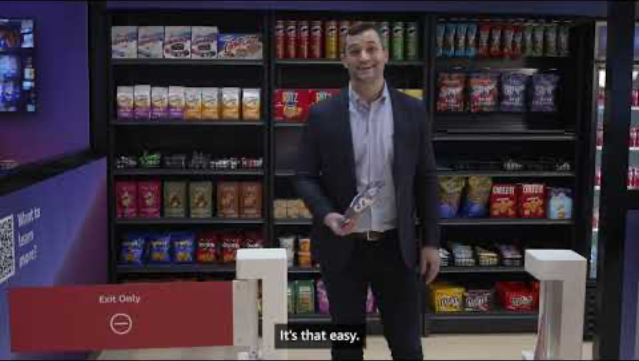
Atomated Self checkout: Just walk out!
2022-2023

Slide 28
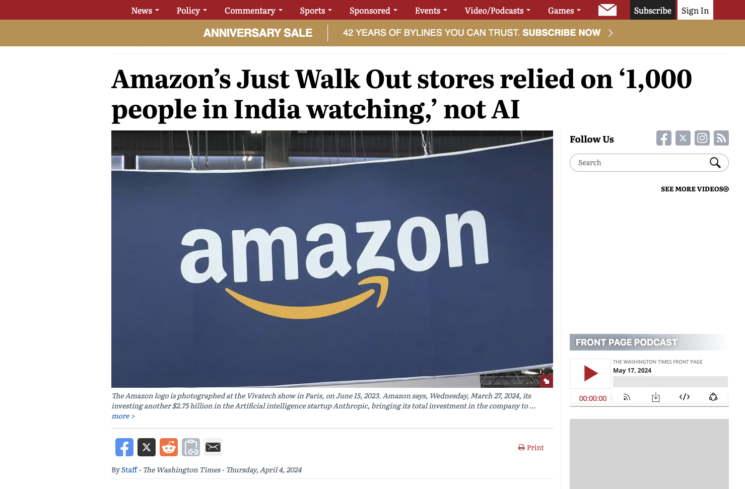
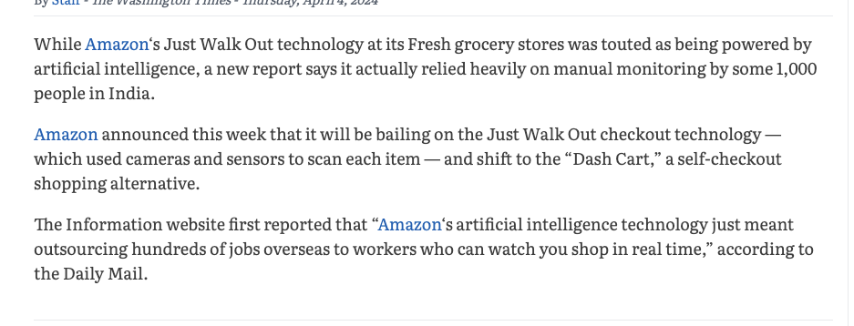
April,4, 2024

Slide 29


Slide 30

ETHICAL CONSIDERATIONS ON ARTIFICIAL INTELLIGENCE

Slide 31

PRIVACY
With the vast amount of data that businesses collect and use to train AI systems, privacy is a major concern.
It is important to consider how customer data is collected, stored, and used, and to ensure that customers have control over their data and how it is used.

Slide 32

BIAS
AI systems are only as good as the data they are trained on. If the data is biased or incomplete, the AI system may produce biased or incomplete results.
It is important to ensure that AI systems are trained on unbiased data and to monitor them for any biases that may arise.

Slide 33

ACCOUNTABILITY AND REGULATION
As AI systems become more autonomous, it can be difficult to assign responsibility for their actions. It is important to ensure that there is clear accountability for AI systems and that businesses take responsibility for any negative impacts that they may have on customers.
there is a need for clear regulations to ensure that businesses are using AI ethically and responsibly

Slide 34
Kick off Assignment 3

Slide 35

You are the store manager
And now you need to collaborate with your colleagues (and their ideas) to create the best version of the store to offer to consumers

Slide 36

First Step: Gather Customers’ Insights
Second Step: Develop a strategy
Third Step: Integrate the results and the ideas

Slide 37

So...Assignment 3
Goal:
Develop a integrated strategy for each industry (fashion, bank, grocery, cosmetics) with your colleagues.
Group Assignment
Tasks:
Put together your insights: Are there commonalities? Are there differences?
Put together your designs: Are there commonalities? Are there differences?
Create an ideal design of the store. Choose together one or more technological element to integrate in the store.
Which is the best way to promote this store (digital communication strategy)?

Slide 38
Output: ppt (max 30 slides)
Integrated results of your desk research
Selection of the results and interpretation of data
Table of informant
ANONYMOUS! (fictional names)
Age, gender, profession and another variable relevant for our goal (e.g., frequency of visit)
Insights from the interviews
Communalities and differences among the insights collected by each student.
Summary of the insights from both desk research and interviews
All the informants interviewed by each group memeber,
Comment and interpret these communalities and differences

Slide 39
Put together your insights
Are there commonalities?
Are there differences?
Interpret communalities and differences and create an comprehensive list of the insights.
Discuss your ideas.
Are there commonalities?
Are there differences?
Discuss your ideas to create a new store.

Slide 40
Output: ppt (max 30 slides)
New store
Carefully report how the new store enhances customers’ experience, is omnichannel,has a curated assortment and technology in store.
Store layout
Design the store layout
Digital communication strategy
Technology in store
Which kind of technology best meet customers’ needs.
How the technology will work?
What are the effect of the technology?
Content of the advertising
Social media in fit with your customers
Expected effects of the communication strategy
Communalities and differences among the different views adopted by each student.

Slide 41
Create an ideal design of the store.
Design a new store based on the comprehensive list of customers’ insights.
Choose together one or more technological element to integrate in the store.
  Which are customers' needs?
  Which technology best fit the customers’ needs?
  How the technology will work?
  What are the effect of the technology on the store system (customers, employee, firm)?
  What are the limitations of the technology? How can these limitations attenuated?
Design the store layout highlighting the areas in which the technology will work.

Slide 42
Which is the best way to promote this store (digital communication strategy)?
What are the strengths of the new store?
Who are the customers of the new store?
Write the content of your adv. Why it is appealing to your customers?
Which Social Media platform is the most suitable to reach your customers?
What do you expect will be the effect of your digital campaign?

Slide 43
What I Expect?

Slide 44
DETAILS!

Slide 45
PRACTICALITIES
Today is the deadline for Assignment 2 !
The grades of Assignment 2 will be published after the deadline of Assignment 3 ( to not influence your work!).
I will post on Mycourse the final composition of the groups after the submission of Assignment 2 (hopefully tonight).
I will upload an example of group work from last year.

Slide 46
Evaluation
Integrated results of your desk research
Table of informant
Insights from the interviews
Summary of the insights from both desk research and interviews
Technology in store
Store layout
Digital communication strategy
New store
10 points
5 points
10 points
5 points
10 points
15 points
5 points
15 points
Clarity of the report
Consinstency between the parts of the report
Fit and consistency between insights and strategy
Creativity
5 points
5 points
5 points
10 points

Slide 47

DEADLINE
June, 3 2024 at 8 pm

Slide 48
Course Feedback
Remember: If you provide feedback for the course, you will receive 2/100 additional points to your final grade.
Check MyCourse: Under the "Feedback" section for the opening and deadline of the feedback survey.
Important Dates: The feedback survey will be open from May 22, 2024, to June 5, 2024.
Note: After the deadline, there will be nothing I can do to allow you to provide feedback.

