Slide 1
Information Systems Security
Dr. Michael Lapke

Slide 2
Historical Context
1000BC and earlier: protect sensitive data
1950s – Phone Phreakers
Early Social Engineering and Dumpster Diving
Technical manipulation – discovering control tones
AT&T started to use 2600 Hz automatic switches
Blind people especially good at this (7 year old Joe Engressia found this by mistake)
Automated “Blue Boxes” eventually built
1980s – PC Revolution + Internet = BBS
Set up Community of like minded individuals that persists today
A tale of 3 early hackers – Woz, Cpn’ Crunch, Mitnick

Slide 3
Defining Contemporary IS Security
Information Systems Security refers to security at an organizational level
When students are first thinking of security, they think of personal security
What types of threats do individual face?
There is some overlap between organizational and personal but there is a significant difference between the two
What might those be?

Slide 4
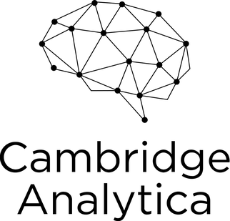
Contemporary Anecdotes
2014 – Present
500 million records
Phone numbers, addresses, passport numbers, credit card #s and exp dates, email addresses
Outside hackers
2015-present
Unauthorized access of user data
Used to influence 2016 US election and Brexit
Technically legal and within company policy
Disbanded and reformed into Data Propria – helping Trump for 2020
2017
150 million consumers
SSN, DOB, address, DL’s, CC info
Web vulnerability via Java code weakness within CSS

Slide 5
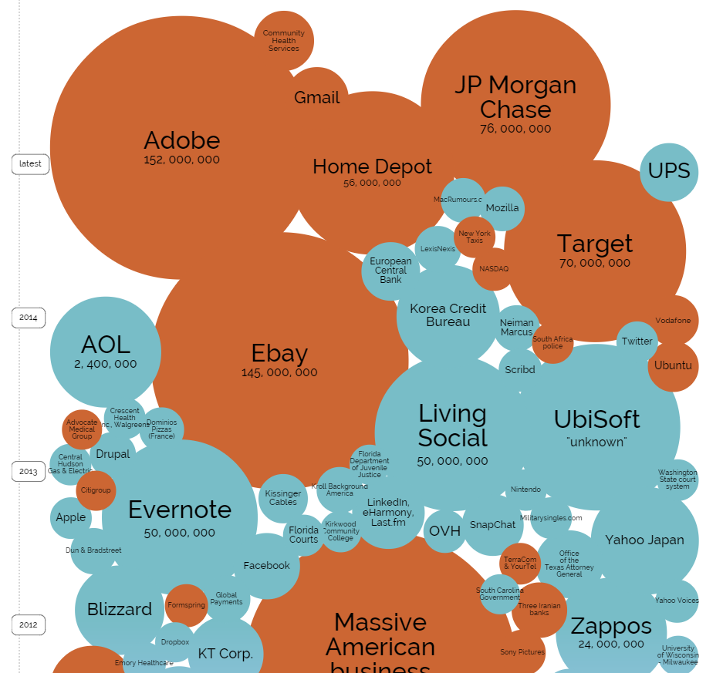
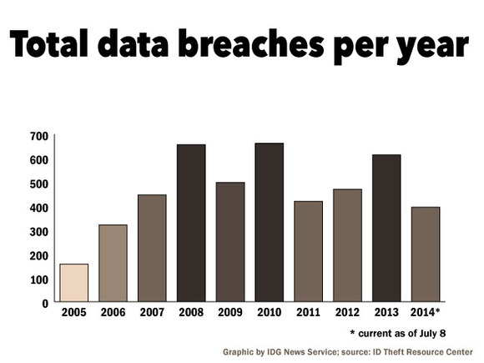
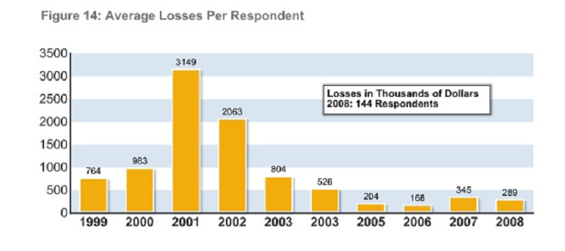

Slide 6
Public Perception
Security equates security to “hacking”
Mainstream perspective of hacking is negative
Truth is more nuanced…
White Hat vs Black Hat vs Grey Hat
Subculture of Hacking has many flavors
Script Kiddies
Tinkerers
Criminals – Financial Theft, CP, intellectual property theft
State based attacks

Slide 7
The Traditional Model
CIA - Confidentiality, Integrity, Availability
Confidentiality: Data hidden/protected from those who should not access it
Integrity: data cannot be modified in an unauthorized or undetected manner
Availability: computer, systems, communication must function correctly at all times
This is all data centered / technocentric
Sole guideline for decades – still viewed by many as the sole standard

Slide 8
Technology is the Core of CIA
Access Control
Encryption
Firewalls
Technical Core
Malware Protection
Secure Development Practices

Slide 9
Technical Attack Vectors
A denial of service attack (DoS attack) disrupts computer access to Networked services – also Distributed DoS (DDoS)
Malicious Software:
Viruses , Trojan Horses, Worms, Spyware
Bad faith mobile apps (particularly on Android platform)
Software Vulnerability
Back door in proprietary software
SQL Injection in Web Interfaces (server side scripting vulnerability)
XSS in Web Interfaces (client side scripting vulnerability)
IP Spoofing
Password Cracking – brute force break of encrypted passwords

Slide 10
Controlling for Technical Attacks
Access Control (Passwords & System permissions)
Firewalls
Malware Protection (Viruses, etc)
Intrusion Detection System
Encryption (stored or over network)
Secure development practices
A priori – before the software is released
Post facto – Strict schedule for patching and updating existing programs

Slide 11
Examples of bypassing controls
Firewalls – brute force attacks & malware directly manipulating ports
Malware protection – ZeroDay Exploits
Access Control – Social Engineering & Insider Threats
IDS – know the algorithm and move slow
Software Dev – throw s*** on the wall and see what sticks

Slide 12
The Managerial Model
To step away from the technocentric perspective of years past, a managerial approach emerged
Driven by Standards Organizations (ISO, NIST, OECD)
Implementation
Risk Analysis (ID assets, threats, vulnerabilities, impact, and controls)
Policy Formulation (Design)
Security Development Lifecycle
Business Continuity
Regulatory Compliance
Implementation – security rollout

Slide 13
People based Attacks
Social Engineering
People are inherently helpful
Phishing or spear phishing
Footprinting – Eavesdropping & Dumpster diving
Insider Attacks
How to protect against disgruntled employee?
Hardware Theft
More mobile devices than ever… how to stop malicious theft or carelessness by employees?

Slide 14
Adding a Layer to the Technical
The “formal” or managerial layer can provide for planning and strategy to more complicated issues than can be controlled for with the technology alone
Formal
Technical

Slide 15
So we are good to go…. Right?
Security Breaches exploded as we hit the height of organizations going online
These were hard hitting breaches that directly cost the average org $3-4 million / year
The technical layer was quickly instituted in most organizations and major breaches declined
After a 4-6 year lull (~2002 to ~2008), breaches surged again in 2009
We responded with the formal layer being broadly implemented across many organizations

Slide 16
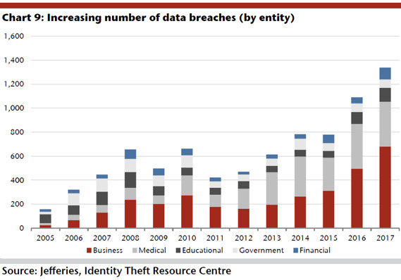
How have breaches trended since?

Slide 17
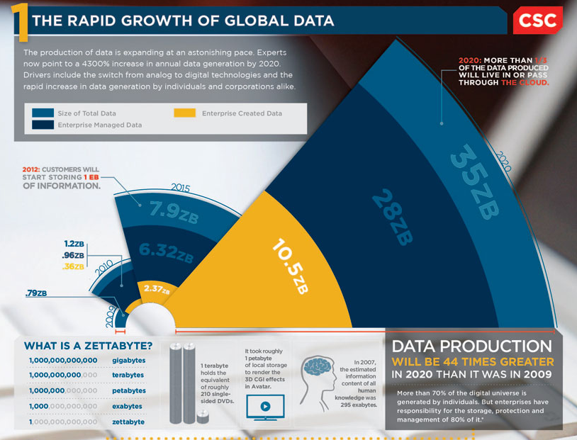
What about the future?

Slide 18
So What Might be the Culprit?
A period of instability inevitably follows the implementation of an IS Security Policy due the absence of institutionalization of said policy.
immediate effect of resistance to the IS Security measures introduced in the policy.
mid term effect of ad hoc modifications to the policy which may ultimately weaken the policy

Slide 19
A Layered Model of Security
Informal
Formal
Technical

