Slide 1
Building Databases with Access
Dr. Michael Lapke

Slide 2
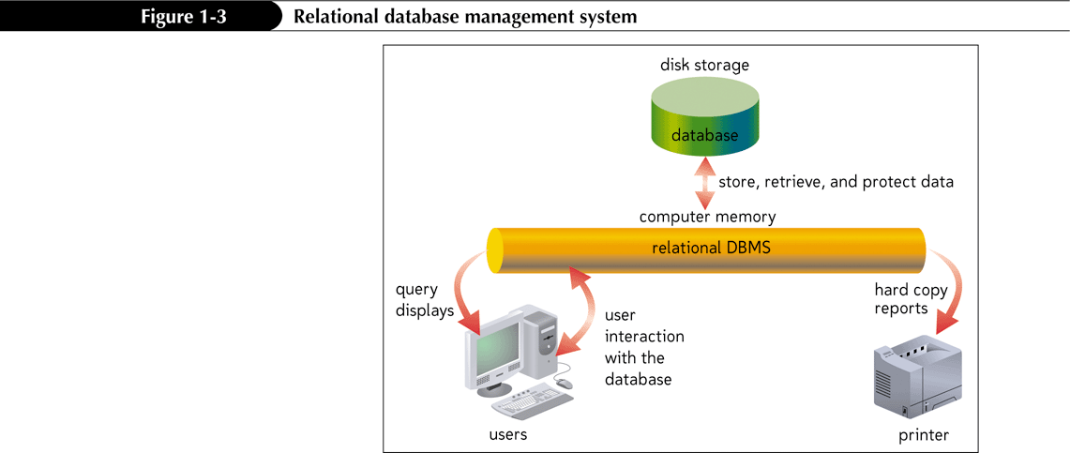
Relational Database Management Systems
A database management system (DBMS) is a software program that lets you create databases and then manipulate data in them
In a relational database management system, data is organized as a collection of tables

Slide 3
The Access Window

Slide 4
2 Main Phases
Phase 1
Build the DB
Create tables by establishing fields and primary keys
Establish relationships
Enter data
Phase 2
Make DB functional
Transform data to information (queries)
Allow for controlled and user friendly input (forms)
Communicate information in a pleasing format (reports)

Slide 5
Phase 1/Step 1: Build Tables
Your first step in organizing data is to build the tables you designed with the ERD
Change view to “Design View”
Create fields (including name & datatype)
Primary Keys are designated here
For composite Primary Keys, select all of the fields you will be using and designate
“Create” new tables, as needed in order to reflect the design

Slide 6
Phase 1/Step 2: Relationships
A collection of related tables is called a database, or a relational database
A primary key is a field(s) whose value(s) uniquely identify each record in a table
When you include the primary key from one table as a field in a second table to form a relationship between the two tables, it is called a foreign key in the second table
You connect the records in the separate tables through common field (PK to FK)

Slide 7
Databases and Relationships

Slide 8
Phase 1/Step 3: Enter Data
In the first row below the field names, enter the value for each field in the first record, pressing the tab or Enter key to move to the next field
After entering the value for the last field in the first record, press the Tab or Enter key to move to the next row, and then enter the values for the next record. Continue this process until you have entered all the records for the table
Be sure to enter data for parent tables before you enter data into child tables!

Slide 9
Entering Records

Slide 10
Phase 1 Complete
At this point, you have completed the build of the core database. To recap…
Build tables (with PKs) based on ERD
FKs are included but implied at this stage… they are not formally declared as FKs
Establish relationships based on ERD
This is where you link the FKs to the PKs
Enter the starting data, starting with the parent tables and ending with the child tables
Time to move to Phase 2

Slide 11
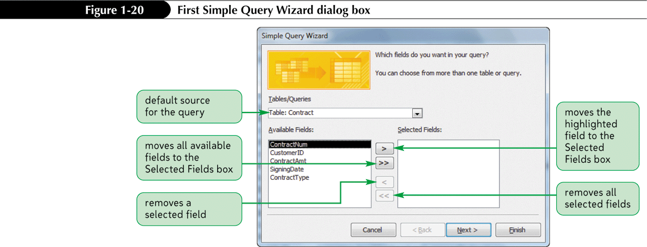
Phase 2/Step 1: Queries
A query is a question you ask about the data stored in a database
The Simple Query Wizard allows you to select records and fields quickly

Slide 12
How are queries designed?
Based on business requirements and need for information
Examples of queries
Pulling a single customer record
Total sales over a certain time period
Different flavors of this such as sales of a given item, within a given region, divided by demographics
Joining tables by their relationships
A student and their grades, a customer and their purchases, etc

Slide 13
Creating a Simple Form
A form is an object you use to enter, edit, and view records in a database
You can design your own forms, use the Form Wizard, or use the Form tool to create a simple form quickly and easily
Primarily works with tables for data entry

Slide 14
Creating a Simple Form

Slide 15
Creating a Simple Report
A report is a formatted printout (or screen display) of the contents of one or more tables in a database
The Report tool places all the fields from a selected table or query
Generally built off of queries as the queries have already transformed the “data” into “information”

