Slide 6
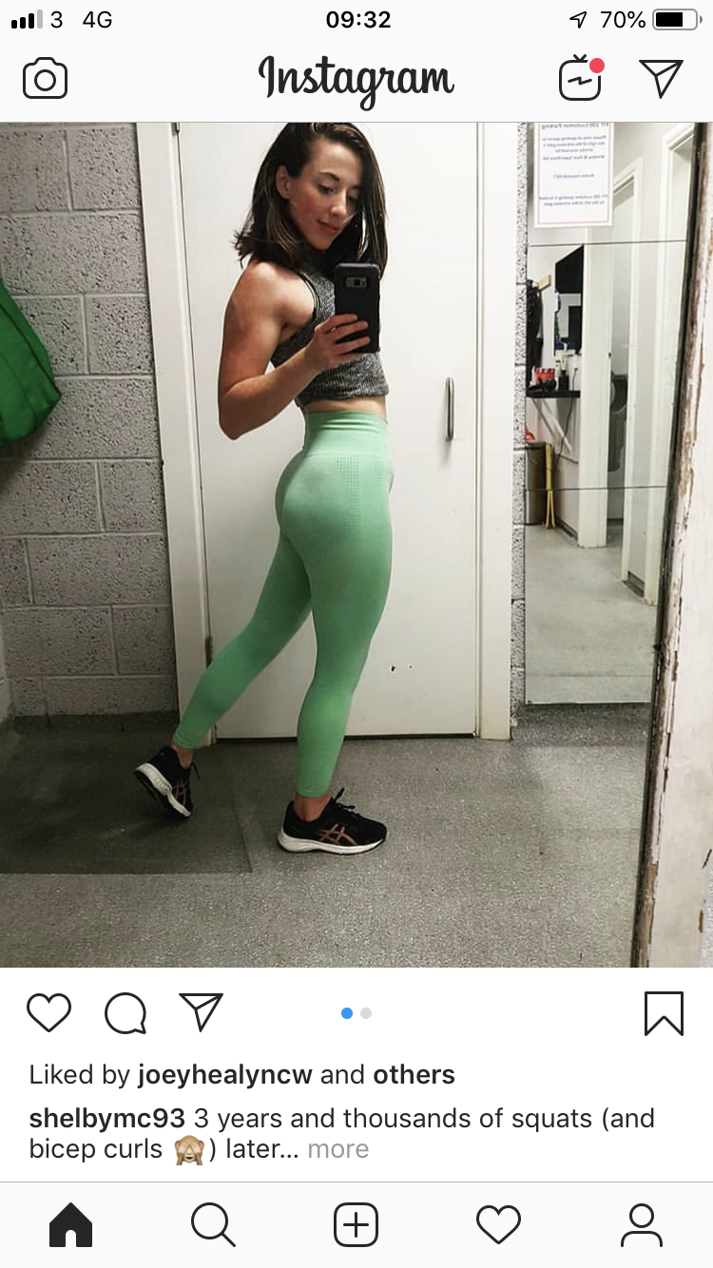

Slide 12
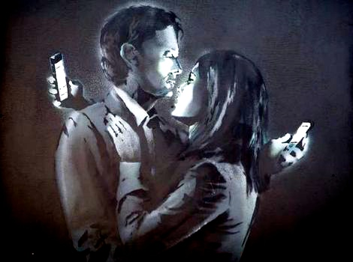
CONSUMER CULTURE IS A CULTURE OF CONSUMPTION

Slide 15
CONSUMER CULTURE IS THE CULTURE OF A MARKET SOCIETY

Slide 19
CONSUMER CULTURE IS UNIVERSAL

Slide 23
CONSUMER CULTURE IS COMPRISED OF PRIVATE CHOICES

Slide 28
CONSUMER CULTURE HAS BECOME THE PRIVILEGED MEDIUM FOR NEGOTIATING IDENTITY

Slide 31
CONSUMER CULTURE EVIDENCES THE LINK BETWEEN AESTHETICISATION & POWER

