Slide 10
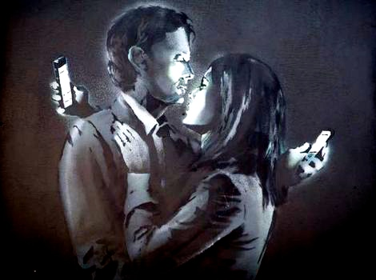
ASCRIBED IDENTITY

Slide 18
ACHIEVED IDENTITY

Slide 34
ENTANGLEMENTS

