Slide 5
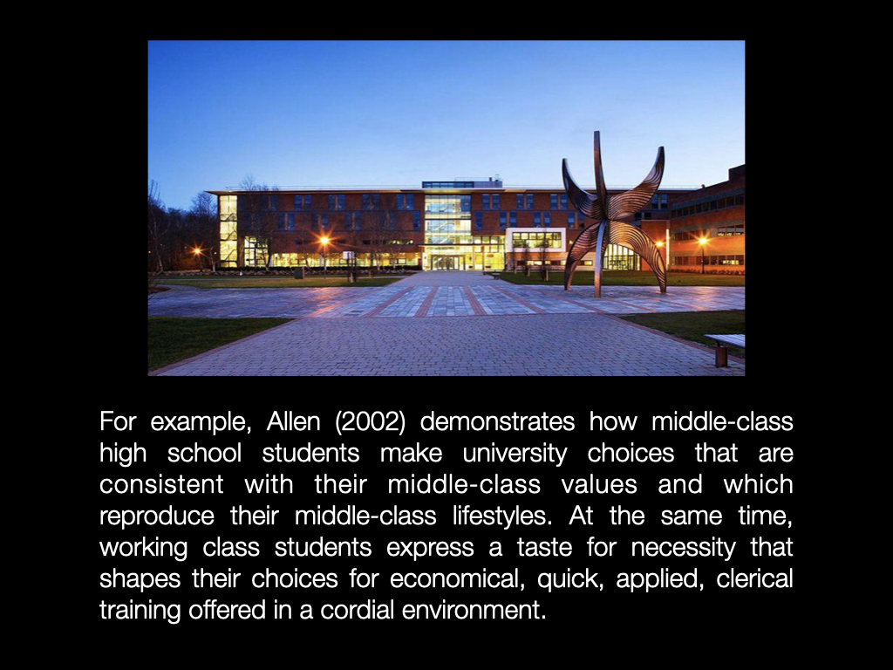

Slide 9
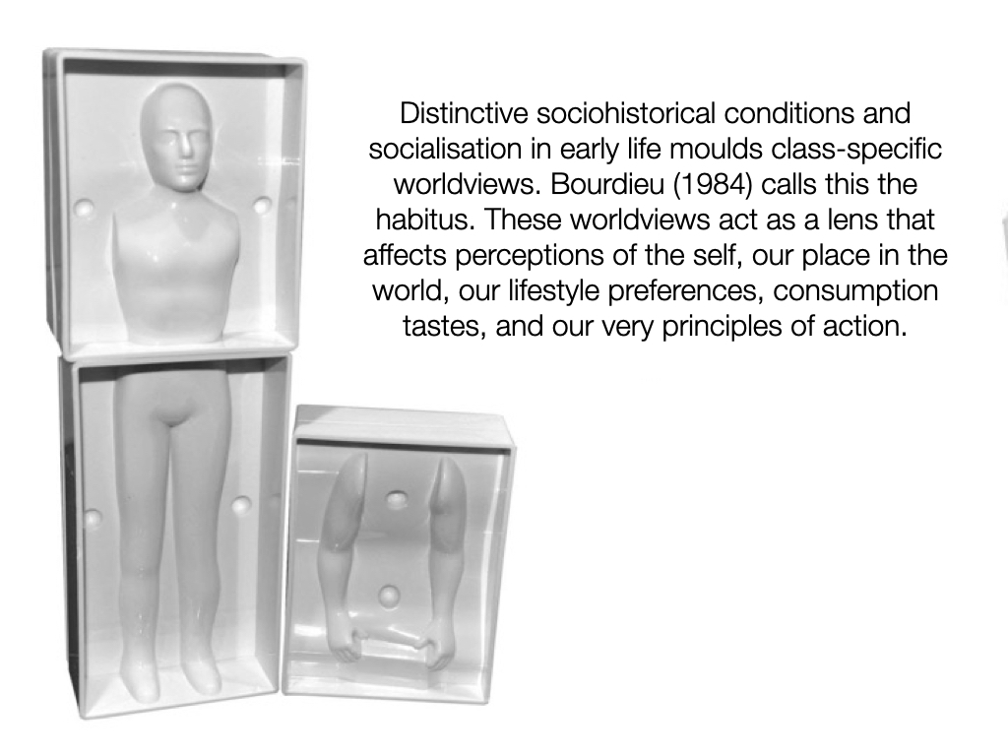

Slide 11
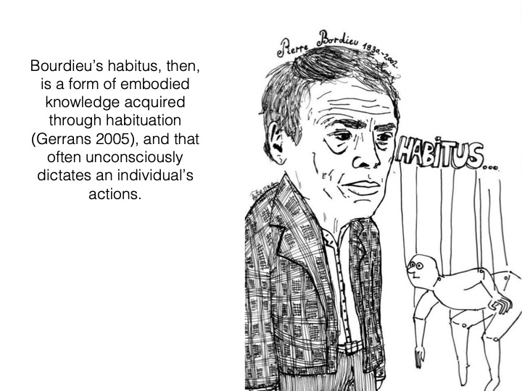

Slide 13
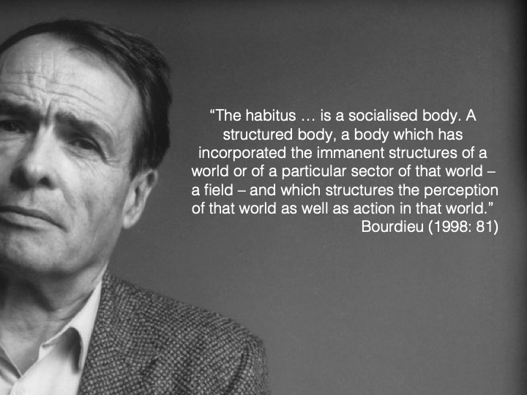

Slide 15
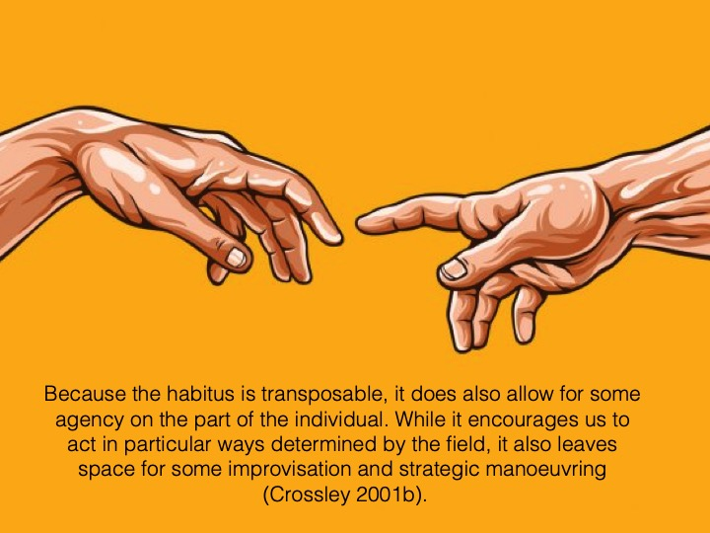
Notes:
In the face of unexpected circumstances a person will strive to apply her or his dispositions in other ways; that is, they are encouraged to transpose those dispositions into another ‘key’. In this way the habitus ‘provides a practical mastery of situations of uncertainty’ and enables people to cope with unforeseen and constantly changing situations’.

Slide 16
As seen through the prism of habitus, we don’t actually keep repeating the same things in the same conditions, over and over. Rather the habitus incorporates a series of more or less creative acts undertaken over time, implying ‘a margin of tolerance for the inconstancies of the environment’.

Slide 24
