Slide 1
Key Environment Issues: An Introduction

Slide 2
Learning Outcomes
After this topic you should be able to
Understand the economic impact of environment issues
Identify & discuss the key environment issues
Understand the drivers of environmental change

Slide 3
The Problem
Unprecedented global economic growth since 1920
Growth is unevenly distributed & incurs significant cost to the environment
World pop: 1970: 3bn, 2022: 8bn, 2050: 9.7bn (est.)
Serious economic, social and environmental consequences are a result
Population DENSITY is a concern
Total Population by Country 2023 (worldpopulationreview.com)
Pop density: Helsinki 3034 p/km², Bangladesh 1329 p/km²

Slide 4
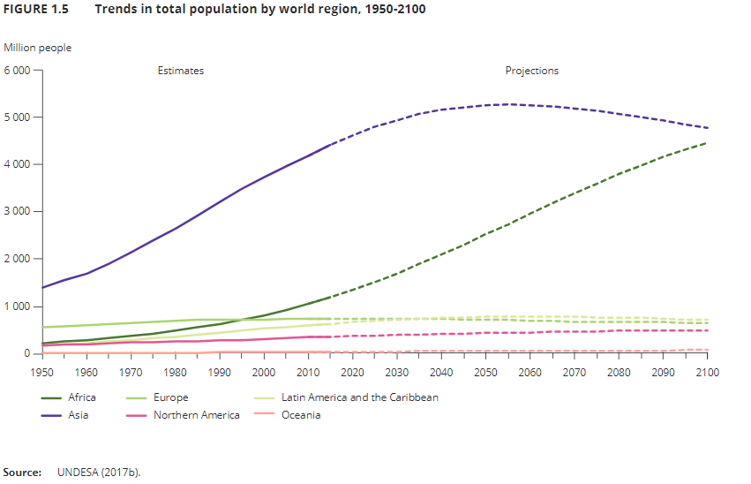

Slide 5
Environment and Economic Growth
Environment problems will be the biggest challenge to economic growth by 2030. Why?
Climate Change
Biodiversity
Water
Air Quality

Slide 6
Climate Change: The Cost of Inaction
How We Almost Stopped Climate Change 30 Years Ago – YouTube
Why is it so difficult?
Who gives up revenue?
Who pats the cost?
Without further policies, by 2030 global emissions of greenhouse gases are projected to grow by a further 37%, and 52% to 2050.
This could result in an increase in global temperature over pre-industrial levels in the range of 1.7-2.4° Celsius by 2050
leading to increased heat waves, droughts, storms and floods, resulting in severe damage to key infrastructure and crops.

Slide 7
Total Greenhouse Gas Emissions (by region) 1970-2050: Policy Inaction

Slide 8
Climate Change Challenges
An OECD simulation shows that actions by all countries are needed to achieve a 39% reduction in global greenhouse gas emissions by 2050 relative to 2000 levels.
Such action would reduce GDP by 0.5% and 2.5% in 2030 and 2050 respectively, equivalent to a reduction in annual GDP growth of about 0.1 percentage points per annum on average.
The more countries and sectors that participate in climate change mitigation action, the cheaper and more effective it will be to curb global greenhouse gas emissions.
However, these costs are not distributed evenly across regions
While OECD countries should take the lead, further co-operation with a wider group of emerging economies, the “BRIICS” countries (Brazil, Russia, India, Indonesia, China and South Africa) in particular, can achieve common environmental goals at lower costs.

Slide 9
Biodiversity
A considerable number of today’s known animal and plant species are likely to be extinct, largely due to expanding infrastructure and agriculture, as well as climate change.
Food and bio fuel production together will require a 10% increase in farmland worldwide with a further loss of wildlife habitat.
Continued loss of biodiversity is likely to limit the Earth’s capacity to provide the valuable ecosystem services that support economic growth and human well-being.
We are even having difficulty with commercial crops. Coffee in Costa Rica, Peaches in Georgia (US).
EEA does not focus on biodiversity, but on food

Slide 10
Sources of losses in mean species abundance to 2030

Slide 11
Water
Water scarcity will worsen due to unsustainable use and management of the resource as well as climate change;
the number of people living in areas affected by severe water stress is expected to increase by another 1 billion to over 3.9 billion

Slide 12
People Living in Areas of water stress, by level of stress

Slide 13
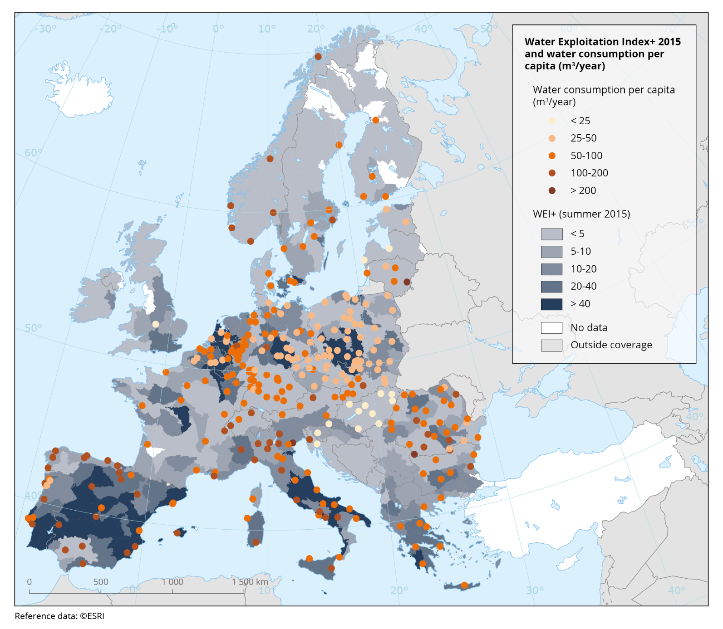
Water Exploitation Index - EU
WEI > 20 = Stress
An INDEX aggregates several independent variables to provide some perspective on an overall topic.
Notice that numerous areas facing water stress already conserve.

Slide 14
Air Quality
https://www.youtube.com/watch?v=qBGvPZlucLA
Health impacts of air pollution will increase worldwide, with the number of premature deaths linked to ground-level ozone quadrupling and those linked to particulate matter more than doubling.
International trade exacerbates these problems.

Slide 15
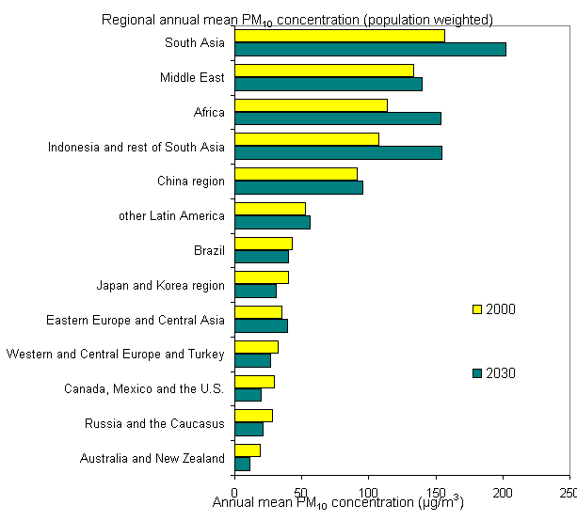
 |  | Fig: Annual mean PM10 concentrations, 2000-2030
 |  | Source: OECD Environmental Outlook Baseline, 2007.

Slide 16
Drivers of Environmental Change
Demographic Developments
Urbanisation
Economic Growth

Slide 17
Population and demographic developments
Population growth is a key driver of local and global environmental change due to
Increased consumption of natural resources and land use
Changes in wealth and age structure

Slide 18
Urbanisation
Worlds population is becoming increasingly urbanised. In 1970 36% of world population lived in urban areas. By 2014 that share had reached 54%
Urbanisation has positive and negative environmental consequences.
On the positive side urbanisation can lead to the concentration of activities and allow for economies of scale and easier access (ie water & energy)
On the negative side, a greater concentration of population can cause higher levels of air pollutions

Slide 19
Economic Growth
Economic Growth and rising per capita income, if based on the increased use of natural resources exacerbate environmental pressures
However other sources of growth, such as technological progress or improvement in education and human skills can decouple environmental pressures from economic growth

Slide 20
Links between economic activity and environmental pressures
Energy use is driven by economic activity and technological developments
As GDP is projected to quadruple so will energy use – around 80% increase over global energy consumption in 2016

Slide 21
Possibility vs Plausibility
Hamburg Climate Futures Outlook
Technology dictates possibility
Political and social barriers dictates feasibility
Socio-economic factors help to define plausibility
HCFO: joint analysis of our potential for dealing with climate change.

Slide 22
Summary
There is global agreement that climate change, loss of biodiversity, access to fresh water and air pollution are serious issues that need to be addressed through international policy action
Global coordination effort is required to find the most effective solutions
The type of policy action matters (awareness campaigns, regulation, punitive legislation, carbon taxes, green technology)

Slide 23
Scope of the course
Given the urgent need to address key environmental issues it is important to explore the different policy options available to tackle the problem
The first section of the course expands on basic economic tools used to address environmental issues.
The second section addresses the effectiveness of a variety of policies employed in reducing environmental issues.
The last section is dedicated to examining specific issues including forestry, fisheries, water policy, climate change, energy sources and policy, and attempts to establish global agreements.

Slide 24
Required Reading
Field & Field Ch.1 (before Session 2)
In class we will use content from EEA State of the Environment Report for 2020. The Executive Summary is on MyCourses. Also these links
https://www.eea.europa.eu/soer/2020/at-a-glance
https://www.eea.europa.eu/highlights/soer2020-europes-environment-state-and-outlook-report
https://www.eea.europa.eu/soer/2020/soer-2020-videos

