Slide 1
Module 2
The Economy and the Environment
Field & Field Chapter 2

Slide 2
Defining Environmental Economics
Environmental economics is the application of the principles of economics to the study of how environmental resources are managed
It focuses primarily on how and why people make decisions that have consequences for the natural environment
Also concerned with how economic institutions and policies can be changed to consider environmental quality
Related fields:
  Mineral Economic Energy Economics
  Water Economics Marine Economics
  Forest Economics Agricultural Economics Land Economics

Slide 3
The Economy and the Environment
The economic functions of production and consumption occur within the natural environment.
Natural resource economics is the study of nature as the provider of raw materials and energy inputs (a)
The impact of economic activity on the quality of the natural environment is called environmental economics (b)
Fig 1: The economy and the environment
Nature
a
Economy
b

Slide 4
The Environment: An Economic and Social Asset
Inputs of natural resources are important in economic production
Environment quality can be thought of as a productive asset for a society
In other words, there is a trade off between conventional economic output and environmental quality
Fig 2 shows a PPF which is a curve showing the different combinations of two things a society can produce at any given time, given its resources and technological capabilities
This is nearly identical to a PPF model of producing capital goods and consumer goods.

Slide 5
The PPF: Trade-off between environmental quality and market goods
Fig 2 (a) PPF today
Fig 2 (b): PPF in 60 years
Market goods
Market
goods
C₂
C₄
C₃
C₁
e₂
e₁
e₄
e₃
Environmental
Quality
Environmental
Quality

Slide 6
The PPF for Market Goods and Environmental Quality
The PPF shows the different combinations of market output and environmental quality that are available to a group of people who have a fixed endowment of resources and technology
In fig 2 (a) If the current level of economic output is C1, and increase to C2 can be obtained only at the cost of a decrease in environmental quality
Where society chooses to locate itself on the PPF is a matter of social choice
In fig 2 (b) shows that degrading the environment too much today will affect future possibilities and PPF will shift inwards. Future generations can have the same level of output as present generation but only at a lower level of environmental quality

Slide 7
The Fundamental Balance of Materials
The Fundamental Balance Phenomenon says that in the long run all materials taken out of the natural system by human beings must eventually end up back in the system.
M = R^{d}_{p} + R^{d}_{c}
  Where M = Raw materials extracted
  R^{d}_{p} = discharged producer residuals
  R^{d}_{c}= discharged consumer residuals
Economy is divided into two broad segments (producers and consumers)
Production and consumption create ‘residuals’ which may be emitted into the air or water or land
The implication is that to reduce the mass of residuals disposed into the environments, it is necessary to reduce the level of raw materials into the system

Slide 8
The Fundamental Balance 2
R^{d}_{p} + R^{d}_{c} = M = G + R_{p} – R^{r}_{p} – R^{r}_{c}
This says that the quantity of raw materials (M) is equal to the output of goods and services (G) plus production residuals (R_{p}) minus the amounts that are recycled from producers (R^{r}_{p}) and consumers (R^{r}_{c})
This leaves us three ways of reducing M
  Reduce G
  Reduce R_{P}
  Increase R^{r}_{p} R^{r}_{c}

Slide 9
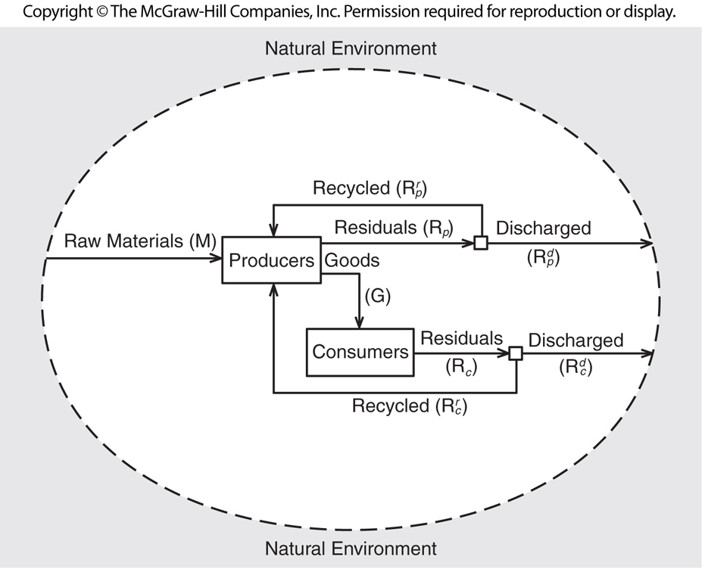
The natural environment cycle gets more complex when we consider and economy with many producers with different
Resource needs
Production processes
Outputs
Abilities to reuse/recycle
Residual streams
Effluent streams

Slide 10
Renewable Resources
Face a maximum rate of regeneration. Optimal allocation across time is a function of
  Sustainability
  Cost of capture
  Productivity of use
Examples
  Solar and Wind power
  Fisheries (ecological cycles, natural resource preservation)
  Forests
  Ozone & GHG absorptive capacity

Slide 11
Non-Renewable Resources
Will eventually be depleted or severely limited in availability. Optimal allocation across time is a function of
  Availability of close substitutes
  Cost of extraction
  Value in the production process
  Works like a finance problem
Examples
  Oil
  Natural Gas
  Minerals

Slide 12
Emissions, ambient quality, & damages, fig2.3
We need to consider the source of our concern.
Are we concerned only about the effect on humans?
Is there also concern for the environment itself?
If we are concerned only about humans, the discussion turns rapidly to elasticities and substitution.
This is both a philosophical and a practical question.
Mechanistic view of society
Organic view of society

Slide 13
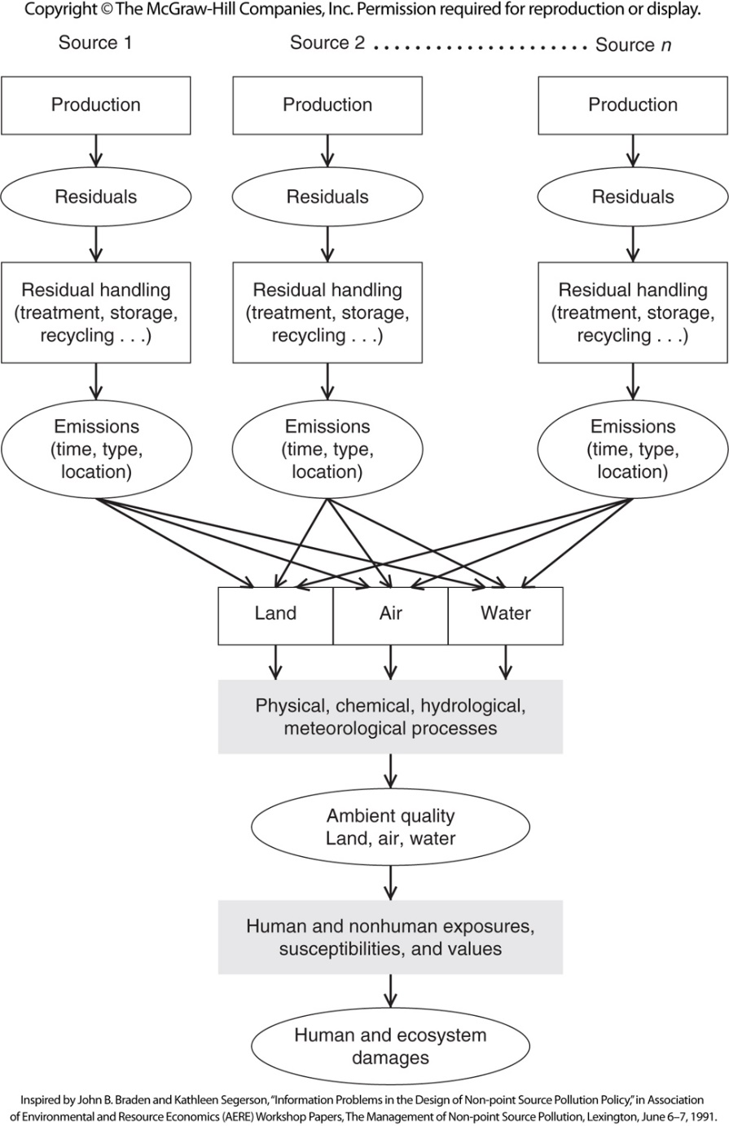

Slide 14
Types of pollutants
Cumulative vs. non-cumulative
Local, regional, global
Point source vs. non-point (mobile) source
Continuous vs episodic (discharge rates)
Non-emission damage: strip mining, habitat destruction, etc.

Slide 15
Summary
The topic explored some basic linkages between the economy and the environment
Discussed the trade-offs between conventional economic goods and environmental quality between current and future generations using the PPF
Introduced the fundamental balance phenomenon and how we might reduce residuals from production and consumption

