Slide 1
Business to Business Marketing
Chapter 10
Managing product offerings

Slide 2
Business product
service elements
physical attributes
advice giving
core benefit
+
adapted/ augmented
offering
-
maximum
value
threshhold
Figure 10.1 Elements of business to business offering

Slide 3
Table 10.1 Sample augmenting elements
for adapted product offer
installation, maintenance, training, warranty operations assistance, trouble-shooting automated ordering, logistics management shared resource planning, information sharing process engineering and redesign cost reduction programmes advice and consulting, joint product development joint market research, co-promotion
(adapted from Anderson and Narus 1991)

Slide 4
Figure 10.2 Product offer and relationship exchange
a. Drinks Industry
pure transactional
exchange
pure collaborative exchange
ingredients & raw materials
(e.g. natural & artificial flavours;
carbon dioxide, fruit, sugar, water)
packaging
controls & equipment
(e.g. automated process controls; machinery for integrated processing, filling & packing)

Slide 5
Figure 10.2 Product offer and relationship exchange
b. Flaring out on relationship spectrum: ingredients suppliers
pure transactional
exchange
pure collaborative exchange
ingredients
(e.g. natural & artificial flavours)
Adapted from Anderson and Narus (1991)

Slide 6
Figure 10.3 Product service system
value
mainly in (physical)
product content
product-service system
value
mainly in
service
content
service content
(physical)
product content
pure (physical)
product
product oriented
use oriented
result oriented
pure service
product advice, installation, maintenance, disposal
product lease, sharing
activity management; functional performance
(Tukker 2004)

Slide 7
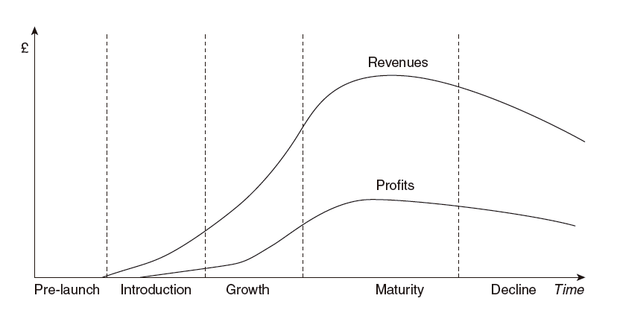
Figure 10.4 Stages in the life cycle of an offering

Slide 8
Product life cycle
Introductory phase: product may still be costing more money than it is bringing in since there is a series of marketing tasks to be carried out
Growth phase: competition is likely to increase, with consequent pressure on prices and this pressure creates greater demand and thus fuels further growth
Maturity: rate of sales growth slows; profits may continue to rise in aftermath of growth phase; to maintain the profit trend requires cost reductions
Decline: profit margins will decline and the business marketer must look for ways to extract further value

Slide 9
Figure 10.5 Boston Consulting Group
market share/market growth matrix
relative market share
high low
star
question mark
market growth rate
low high
cash cow
dog

Slide 10
Figure 10.6 Joint problem solving as value co-creation in knowledge intensive services
Supplier resources
Expert knowledge
Specialist skills & techniques
Project management skills
Customer understanding
Diagnosis skills
Proactive attitude
Reaction ability & willingness
Confidence
Ability to foresee risks
Facilities & professional equipment
Experience
Accumulated knowledge
Ability to see larger patterns
Ability to structure the process
Objectivity & integrity, ethical codes
Relational capital
Relations to actors with complementary skills
Customer resources
Information on needs
Requirements
Goals
Schedule
Budget
Information on context
Operational environment
Previous solutions
Industry expertise
Specialist knowledge of industry
Conventions
Regulations
Production material
Existing solutions & materials
Effort & time
Financial resources
Supplier roles
Value option advisor
Value process organizer
Value amplifier
Value experience support
Customer roles
Co-diagnoser
Co-designer
Co-producer
Co-implementor
Co-marketer
Co-developer
Diagnosing needs
Organizing process and resources
Value-in-use
Designing & producing the solution
Managing value conflicts
Implementing the solution
(reproduced from Aarikka-Stenroos & Jaakkola (2012), Fig. 3, p. 22)

Slide 11
Characteristics required to be innovative firm
commitment to long-term growth rather than short-term profit;
general acceptance within the firm of the value of innovation;
ability to be aware of its threats and opportunities;
willingness to invest in the long-term development of technology;
willingness to include risky opportunities within a balanced portfolio of activities;
mutual respect amongst individuals and a willingness to work together across functions;
ability both to become aware of and take effective advantage of externally developed technology;
ability both to manage the tension between the need for stability within the firm and the need for
creativity, and to provide room for creativity;
readiness to accept change; and
combination of suitable specialization as well as diversity of knowledge and skills
(Trott, 2012)

Slide 12
Figure 10.7 The new offering development process
idea generation
idea screening
business case analysis
concept development
prototype
and marketing elaboration
market trial
commercial launch
(adapted from Trott, 2005)

Slide 13
New product development
Clancy and Krieg (2003) estimate that no more than 10% of all new products or services are trading profitably 3 years after launch
Berggren and Nacher (2001) indicate that the failure rate could be as high as 95%
Schilling and Hill (1998) present a much broader band of between 33% and 60% of products not generating an economic return
Even an optimistic estimate of failure rates for new industrial products puts it as high as 30% (Armstrong and Kotler, 2005)

