Slide 1
Business to Business Marketing
Chapter 5
Researching Business to Business Markets

Slide 2
Learning outcomes
Be able to explain why accuracy, timeliness, relevance and uniqueness are valuable characteristics of marketing information
Understand how the fundamental characteristics of business to business markets affect the market research process
Know how to apply market research sampling techniques in business markets
Know why survey response rates tend to be low in business to business market surveys, and what techniques can be used to improve response rates
Be able to use a standard industrial classification as a basis for sample selection in business markets
Understand how the relationship between a market research agency and a business to business client organization can affect the success of a research project

Slide 3
Value of marketing information
Accuracy
Timeliness
Relevance
Uniqueness

Slide 4
Using market research
There is good evidence that more successful business to business marketing organizations make more use of formal market research than those that are less successful.

Slide 5
B2B market research
Although many aspects of market research are the same in business and consumer markets – such as sampling theory – there are several practical differences that arise from the basic features of business markets.
As well as understanding their direct customers, business marketers need to be aware of developments further downstream in the chain of derived demand, at the level of their customer’s customer and perhaps even beyond that.

Slide 6
Probability sampling | Non-probability sampling
Simple random sampling | Convenience sampling
Stratified random sampling | Snowball sampling
Systematic sampling | Quota sampling
Cluster/multistage sampling | Focus groups
Table 5.1: Sampling methods

Slide 7
 | Company size categories
 |  | 1 to 9 employees | 10 to 99 employees | 100 or more employees | Total
 | Proportion in population | 85% | 10% | 5% | 100%
Primary industries | 5% | 425 | 50 | 25 | 500
Manufacturing industries | 25% | 2125 | 250 | 125 | 2500
Service industries | 70% | 5950 | 700 | 350 | 7000
Total | 100% | 8500 | 1000 | 500 | 10000
Table 5.2: Illustrating stratified random sampling

Slide 8
Electronic methods of survey delivery
www.onlinesurveys.ac.uk
www.surveywriter.net
www.surveymonkey.com
www.surveysystem.com
www.surveycrafter.com

Slide 9
SIC
A standard industrial classification (SIC) is a systematic method of classifying economic activity, originally designed by governments, which is useful for specifying business market research samples from list providers and for defining an industry sector unambiguously.

Slide 10
UK SIC(2007)
Sections of the UK SIC (2007)
A Agriculture, forestry and fishing
B Mining and quarrying
C Manufacturing
D Electricity, gas, steam and air conditioning supply
E Water supply, sewerage, waste management and remediation activities
F Construction
G Wholesale and retail trade; repair of motor vehicles and motorcycles
H Transport and storage
I Accommodation and food service activities
J Information and communication
K Financial and insurance activities
L Real estate activities
M Professional, scientific and technical activities
N Administrative and support service activities
O Public administration and defence; compulsory social security
P Education
Q Human health and social work activities
R Arts, entertainment and recreation
S Other service activities
T Activities of households as employers; undifferentiated goods and services producing activities of households for own use
U Activities of extraterritorial organisations and bodies

Slide 11
UK SIC(2007)
17 Manufacture of paper and paper products
17.1 Manufacture of pulp, paper and paperboard
17.11 Manufacture of pulp
17.12 Manufacture of paper and paperboard
17.2 Manufacture of articles of paper and paperboard
17.21 Manufacture of plastic products
17.21/1 Manufacture of corrugated paper and paperboard; manufacture of sacks and bags of paper
17.21/9 Manufacture of paper and paperboard containers other than sacks and bags
17.22 Manufacture of household and sanitary goods and of toilet requisites
17.23 Manufacture of paper stationery
17.24 Manufacture of wallpaper
17.29 Manufacture of other articles of paper and paperboard
68 Real estate activities
68.1 Buying and selling of own real estate
68.10 Buying and selling of own real estate
68.2 Renting and operating of own or leased real estate
68.20 Renting and operating of own or leased real estate
68.20/1 Renting and operating of Housing Association real estate
68.20/2 Letting and operating of conference and exhibition centres
68.20/9 Letting and operating of own or leased real estate (other than Housing Association real estate and conference and exhibition services) n.e.c.
68.3 Real estate activities on a fee or contract basis
68.31 Real estate agencies
68.32 Management of real estate on a fee or contract basis

Slide 12
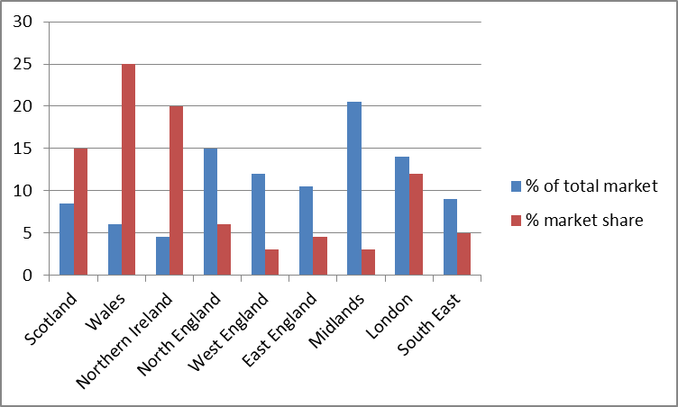
Figure 5.1: Airco Ltd, Market Size & Market Share

