Slide 1
Teaching Methods
Modi ! (Sam, Yong, Rahman, Meng)
09.11.2017

Slide 2
Outlines
  Animated video
  Teaching with games
  Problem Based Learning
  Role playing
  Digital tool - Presemo

Slide 3
Animated video
(benefits)
Communication Skills
  Brilliant and innovative way to communicate stories, ideas and concepts
Technical Skills
  A great gateway for students to learn much more difficult technical skills
Self-expression
  The beauty of animation can be placed into pre-drawn environments, by choosing everything from plot to speech bubbles

Slide 4
Animated video
(benefits)
Presentation Skills
  Provides an exciting and dynamic platform to give interesting and class engaging presentations
  Animation is a great way to encourage students to put greater effort for learning, gives visual explanations of concepts
Building Bridges
  Language barrier can be immediately overcome
Example: process technology, working principle of fuel cell, induction motor etc.
Example tools:
    Domo, Myths and Legends, Kerpoof, Zimmer Twins, Go Animate 4 Schools etc.

Slide 5
Animated video
(need to consider)
Elements that impact engagement
Elements that promote active learning
Recommendations:
  Keep videos brief and targeted on learning goals
  Use signaling to highlight important ideas or concepts
  Use a conversational, enthusiastic style to enhance engagement
  Embed videos in a context of active learning by using guiding questions, interactive elements, or associated homework assignments

Slide 6
Teaching with Games
Engaging students
  Making learning fun motivates students and helps them to pay attention and stay focused on the subject
  Encourage students to learn outside of the class and allow students to focus well enough to learn better
  Writing a lesson with a story context combined with a challenge for the student to overcome (in other words, making it into a game) significantly improves the learning performance

Slide 7
Teaching with Games
Learning from mistakes
  If you lose, start the game and try again
  Games allow students to assess their knowledge for themselves, give them a chance to see where they are having trouble before a test
Recommendations:
  Appropriate guidance to the students during the game and help them analyze the playing afterward
  The games should not be an end in themselves, but instead be a tool for learning

Slide 8

Problem Based Learning
Problem-based learning (PBL) is a student-centered pedagogy in which students learn about a subject through the experience of solving an open-ended problem found in trigger material.

Slide 9
Why and How
Best way to connect learning to real life
Best way to generate motivation
Smart Engagement
Celebrate the result

Slide 10
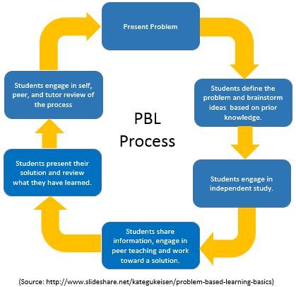

Slide 11
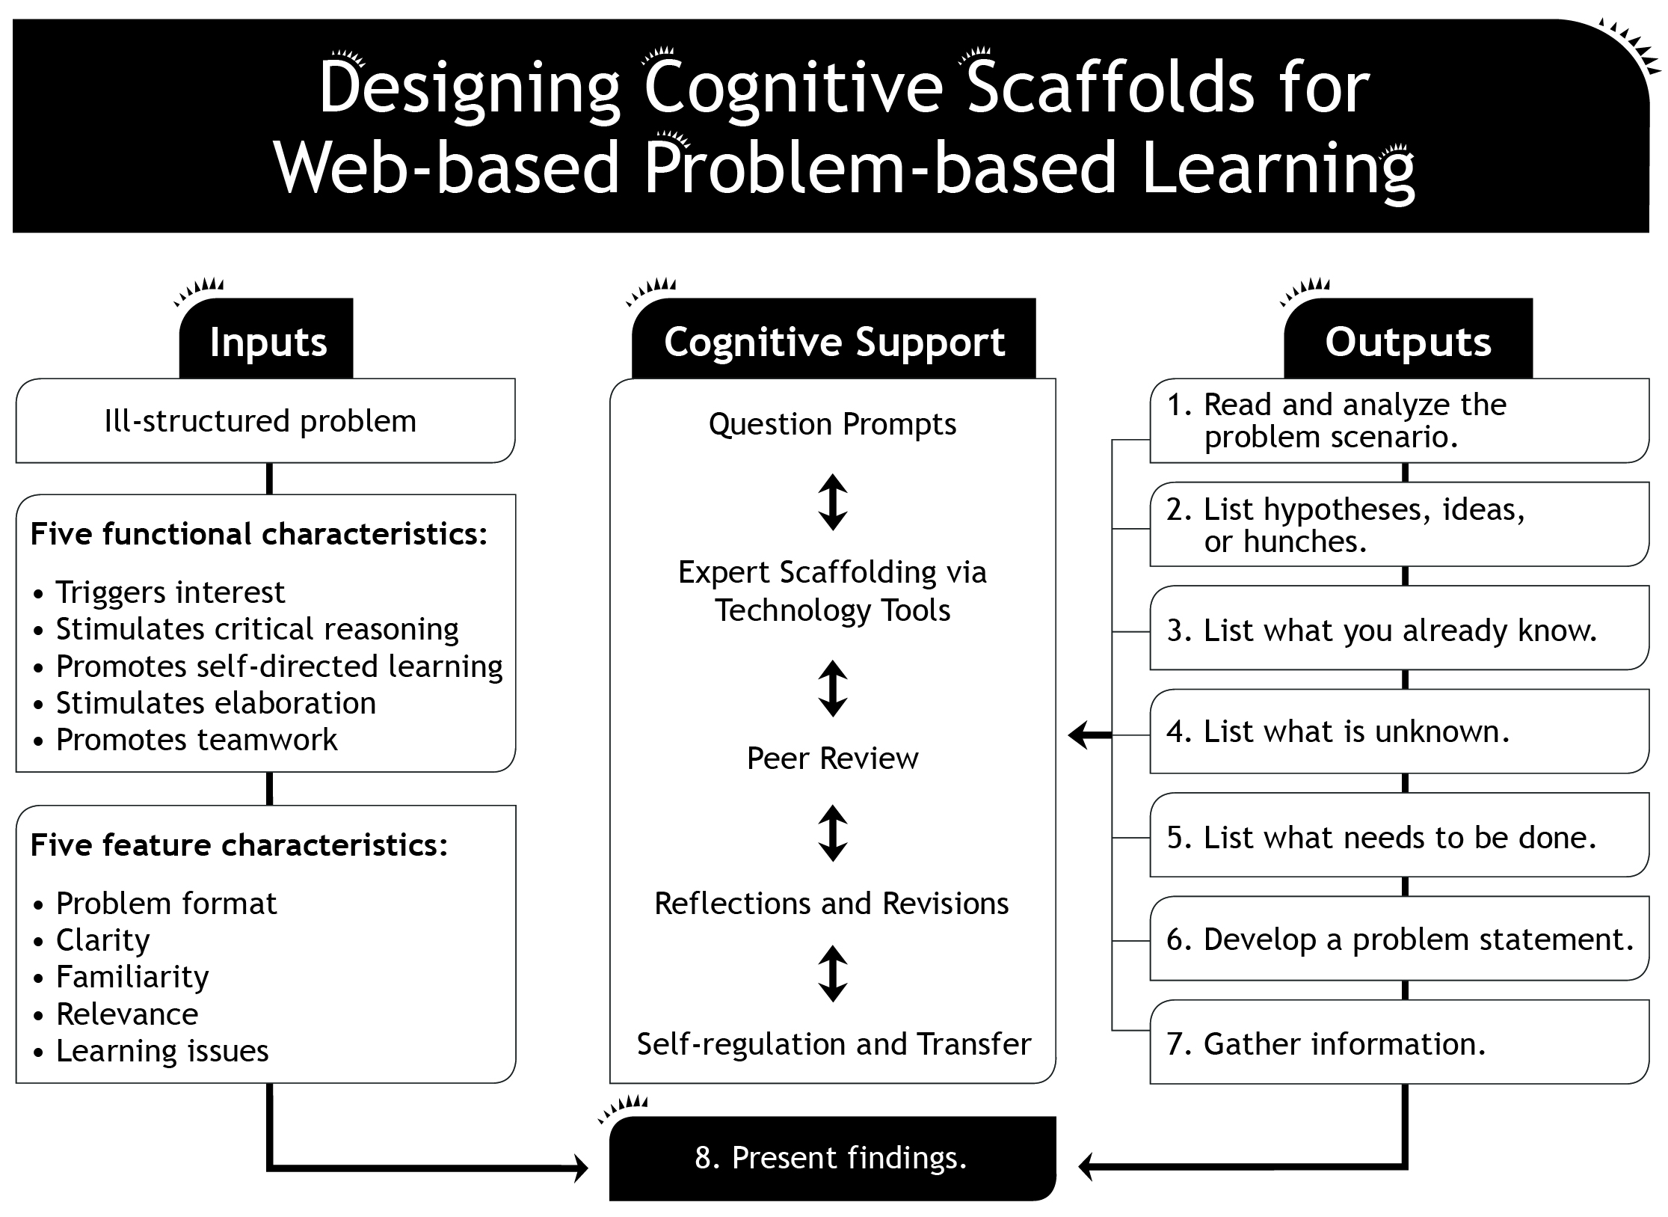
The role of the tutor is to facilitate learning by supporting, guiding, and monitoring the learning process

Slide 12
Role playing
In using Role Play for teaching, students can act out relationships between persons or situations related to professions or organisations.
What do teachers/students need to think about in playing a role:
Attitudes
Values
Problem solving skills
What skills does roleplaying develop:
Social and interaction skills
Negotiation skills
Convincing and marketing skills
I would also argue that Role play can allow a much deeper understanding of real world issues where some form of negotiation was involved in a historical sense and it is a learning objective to better understand this (thus the use of Role-play would be appropriate if one is practicing Constructive alignment based teaching – i.e. where the teaching method fits the learning objective)

Slide 13
Role play design
Aspects for the teacher to consider:
Definition of goals
Selection of theme
Guidance of participants
Naming of observers and their guidance during roleplay (what they should pay attention to)
The acting in the situation
Activation of the group
Use of available space
The discussion
Notes:
I have tried to devise an example for large classes (up to 125 per course) as this is the typical class size for courses I teach

Slide 14
Role Playing: Example
Background:
Renewables targets for EU countries were set in 2009.
The overall objective was for EU-27 to reach a 20% target in 2020, from 8.5% in 2005.
The target had to be shared between different member states, and thus negotiations were needed between states on the ”burden sharing”.
Role-play exercise:
Groups of students form to represent each member state in the negotiation & European Commission as facilitators.
A mock negotiation is carried out with each group arguing its case for a certain ”burden sharing” of the target

Slide 15

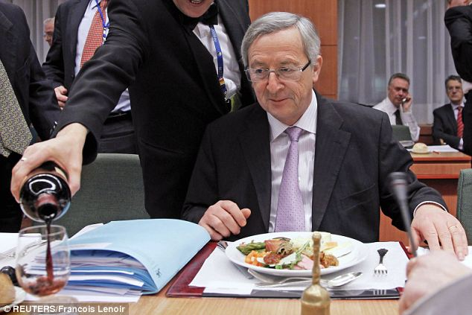
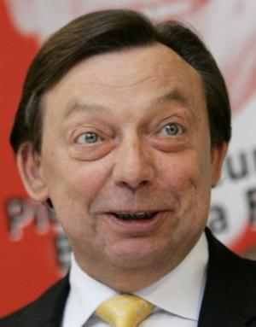
Role Playing: Example
Student groups represent each country & one group as European Commission
Students can ”act” like the country characteristics to introduce drama element
EC plays ”Chair” role

Slide 16
Role play example design
Goal: Reach a negotiated settlement that adds up to the overall 20% target
Theme: Target negotiation as defined
Guidance of participants: Each group to receive basic info on background position of country
Observers: Those acting as the European Commission somewhat form the role of observers here
The acting in the situation: To represent each member state and put cogent arguments for accepting a certain target %
Activation of the group: Provision of background info
Use of available space: Would need careful consideration – 28 different groups
The discussion: Each country present initial case, followed by negotiation chaired by the “European Commission” group

Slide 17
Role play example outcome
Goal: Reach a negotiated settlement that adds up to the overall 20% target
Theme: Target negotiation as defined
Guidance of participants: Each group to receive basic info on background position of country
Observers: Those acting as the European Commission somewhat form the role of observers here
The acting in the situation: To represent each member state and put cogent arguments for accepting a certain target %
Activation of the group: Provision of background info
Use of available space: Would need careful consideration – 28 different groups
The discussion: Each country present initial case, followed by negotiation chaired by the “European Commission” group

Slide 18
Role play example outcome (what really happened!)
2.2%
BE
BG
CZ
DK
DE
EE
IE
EL
ES
FR
IT
CY
LV
LT
LU
HU
MT
NL
AT
PL
PT
RO
SI
SK
FI
SE
UK
13%
RES share in 2005
16%
9.4%
6.1%
13%
17.0%
RES share in 2020
30%
5.8%
18%
25%
18.0%
16%
3.1%
18%
6.9%
20%
8.7%
23%
10.3%
5.2%
17%
13%
2.9%
40%
32.6%
23%
15%
11%
0.9%
13%
4.3%
10%
0%
14%
2.4%
23.3%
34%
15%
7.2%
31%
20.5%
24%
17.8%
25%
16%
14%
6.7%
38%
28.5%
49%
39.8%
1.3%
15%
Average increase 2005-2020: 11.5%

Slide 19
Digital tool - Presemo
An browser-based classroom participation system.
  http://presemo.aalto.fi/new
One can have multiple Presemo rooms .
Highly flexible to different mobile device's (e.g. smartphone, tablet, laptop).

Slide 20
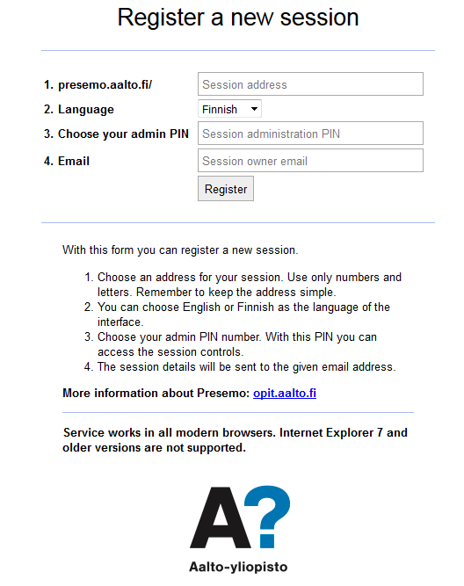
  http://presemo.aalto.fi/new
Choose an address for your session.
Use only numbers and letters. Remember to keep the address simple.
PIN has to be numbers.

Slide 21
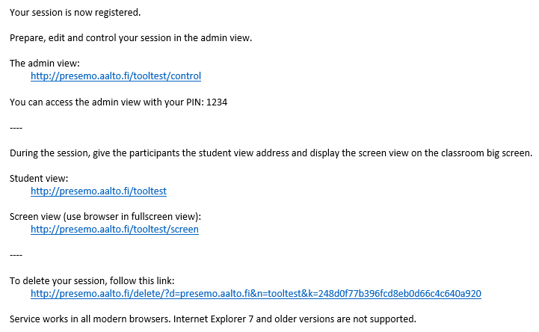
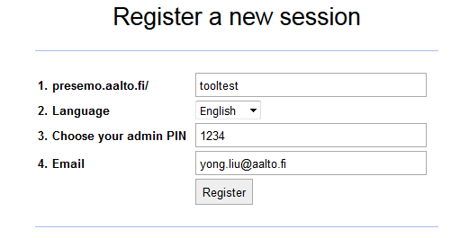
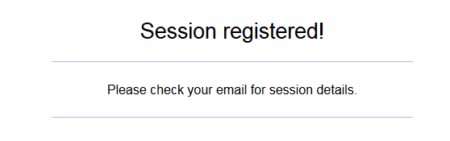
Step 1: Registration at http://presemo.aalto.fi/new
Step 2: Waiting for a system email (a few seconds)
Step 3: Using the functions from the email properly

Slide 22
This is where you control the tool and post questions to students in the class
This is the url that you should provide to students
This url shows the summary of students’ answer, which should be shown on the projector screen.
Using this url to delete the session after the class.

Slide 23
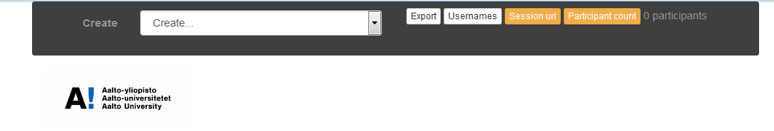
I will show how to use these functions now!

