Slide 1
Illustrator lecture 1: how to combine raster maps and vector features?
WAT-E2090 Water and people

Slide 2
RStudio
Open demo1.Rmd
Run the whole script, so that the figures are saved in the last part of the script

Slide 3
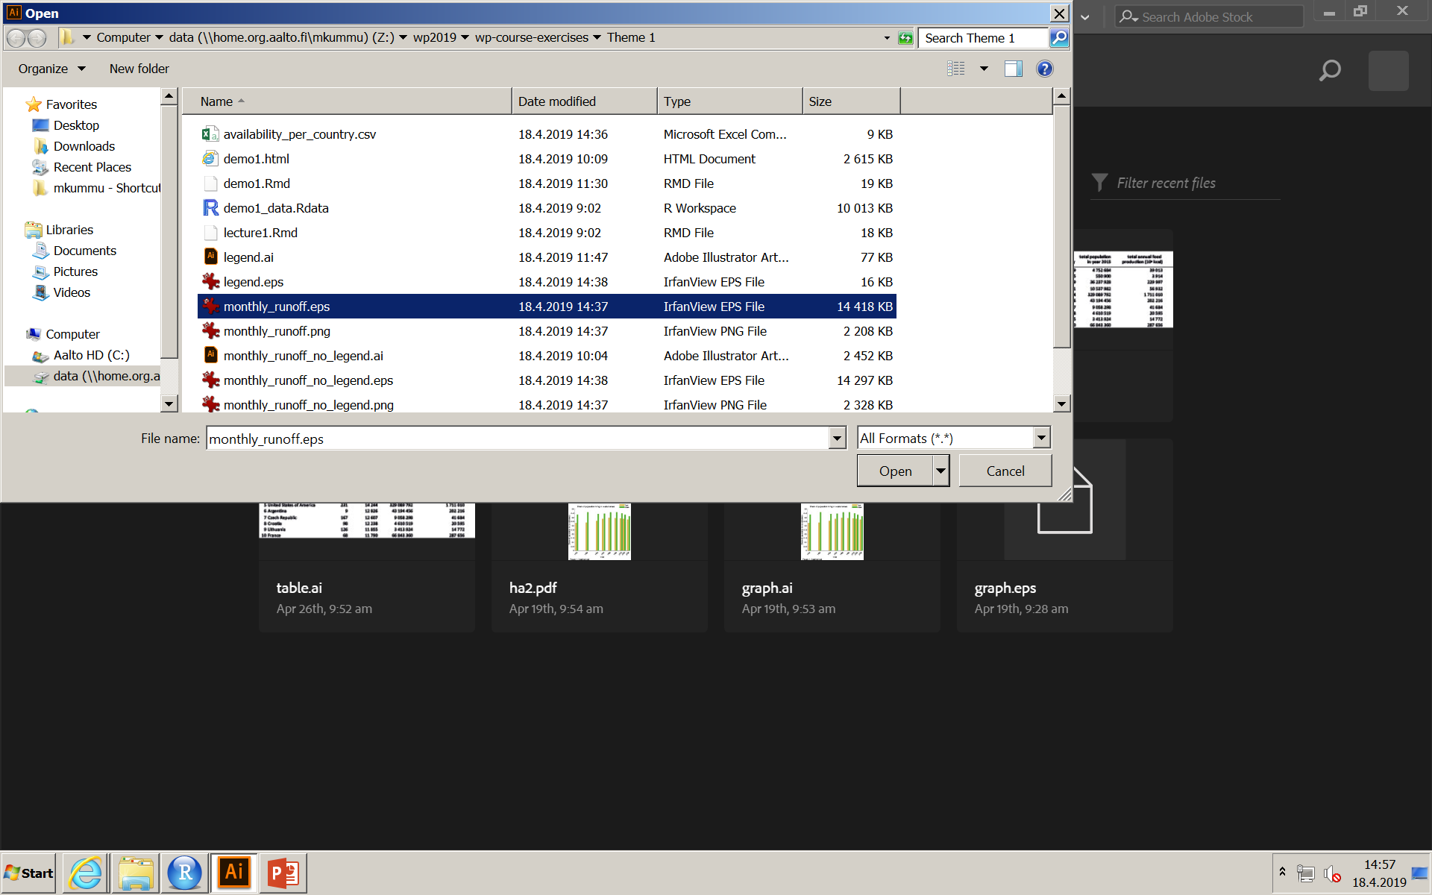
Open Adobe Illustrator
Programme is available in the computer rooms listed in MyCourses
File – open, and browse the legend.eps

Slide 4
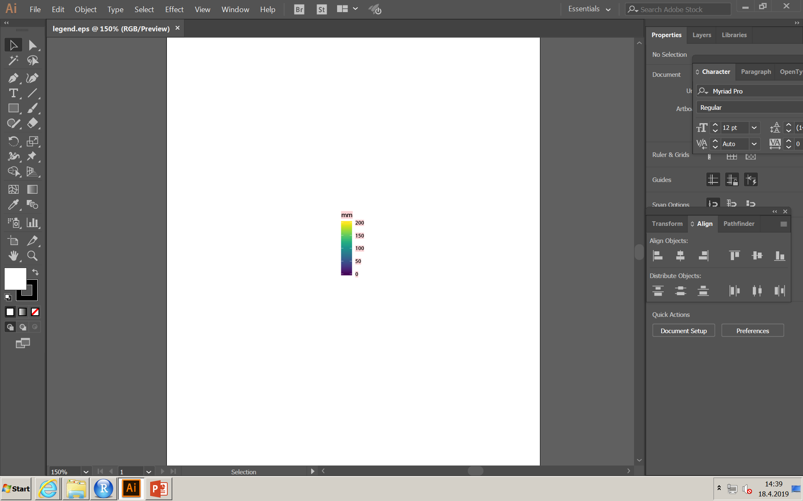
Legend appears as below

Slide 5
Remove clipping mask, grouping,
R, excel and other programmes produce unnecessary masks and grouping to vector files. It is advisable to remove those before starting to work with the figure.
Do following commands from menubar
Select – All (select all the objects)
Object – Ungroup
Object – Clipping mask – release (not always needed)
Object – Compound path – release

Slide 6
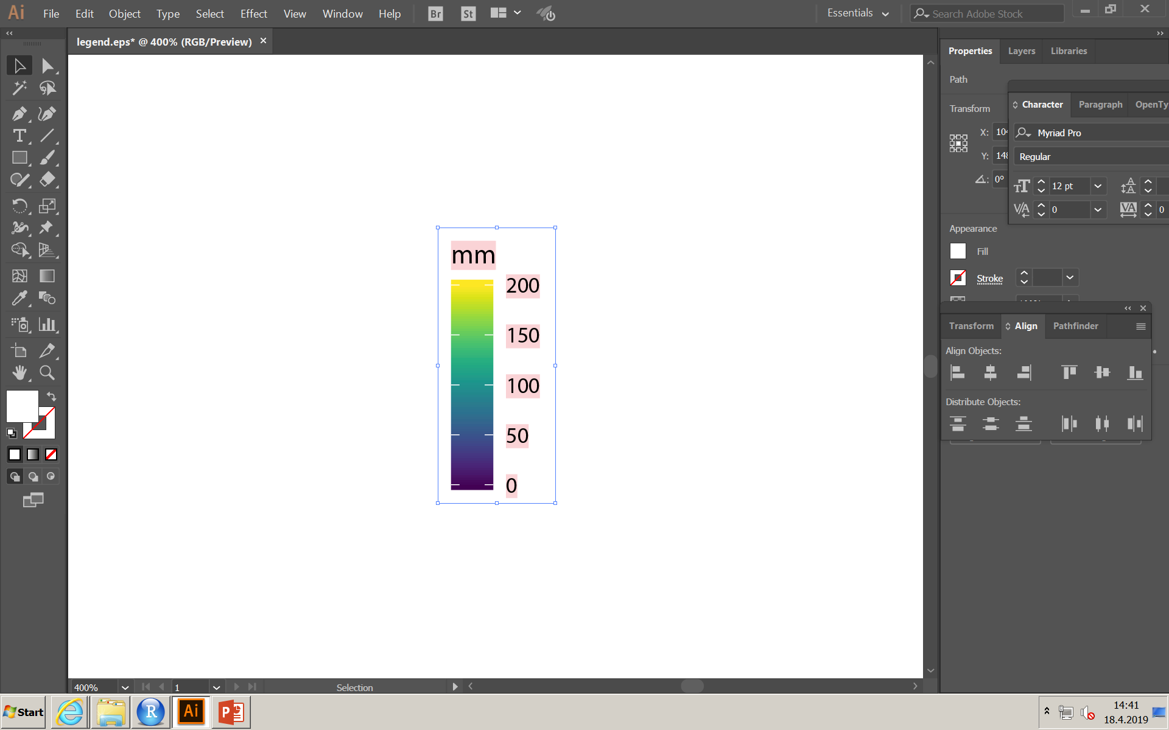
Delete masks
After you have ungrouped and released the masks, you can delete the unnecessary items by selecting them and pressing delete.
In the case of the legend, select the white background and delete it

Slide 7
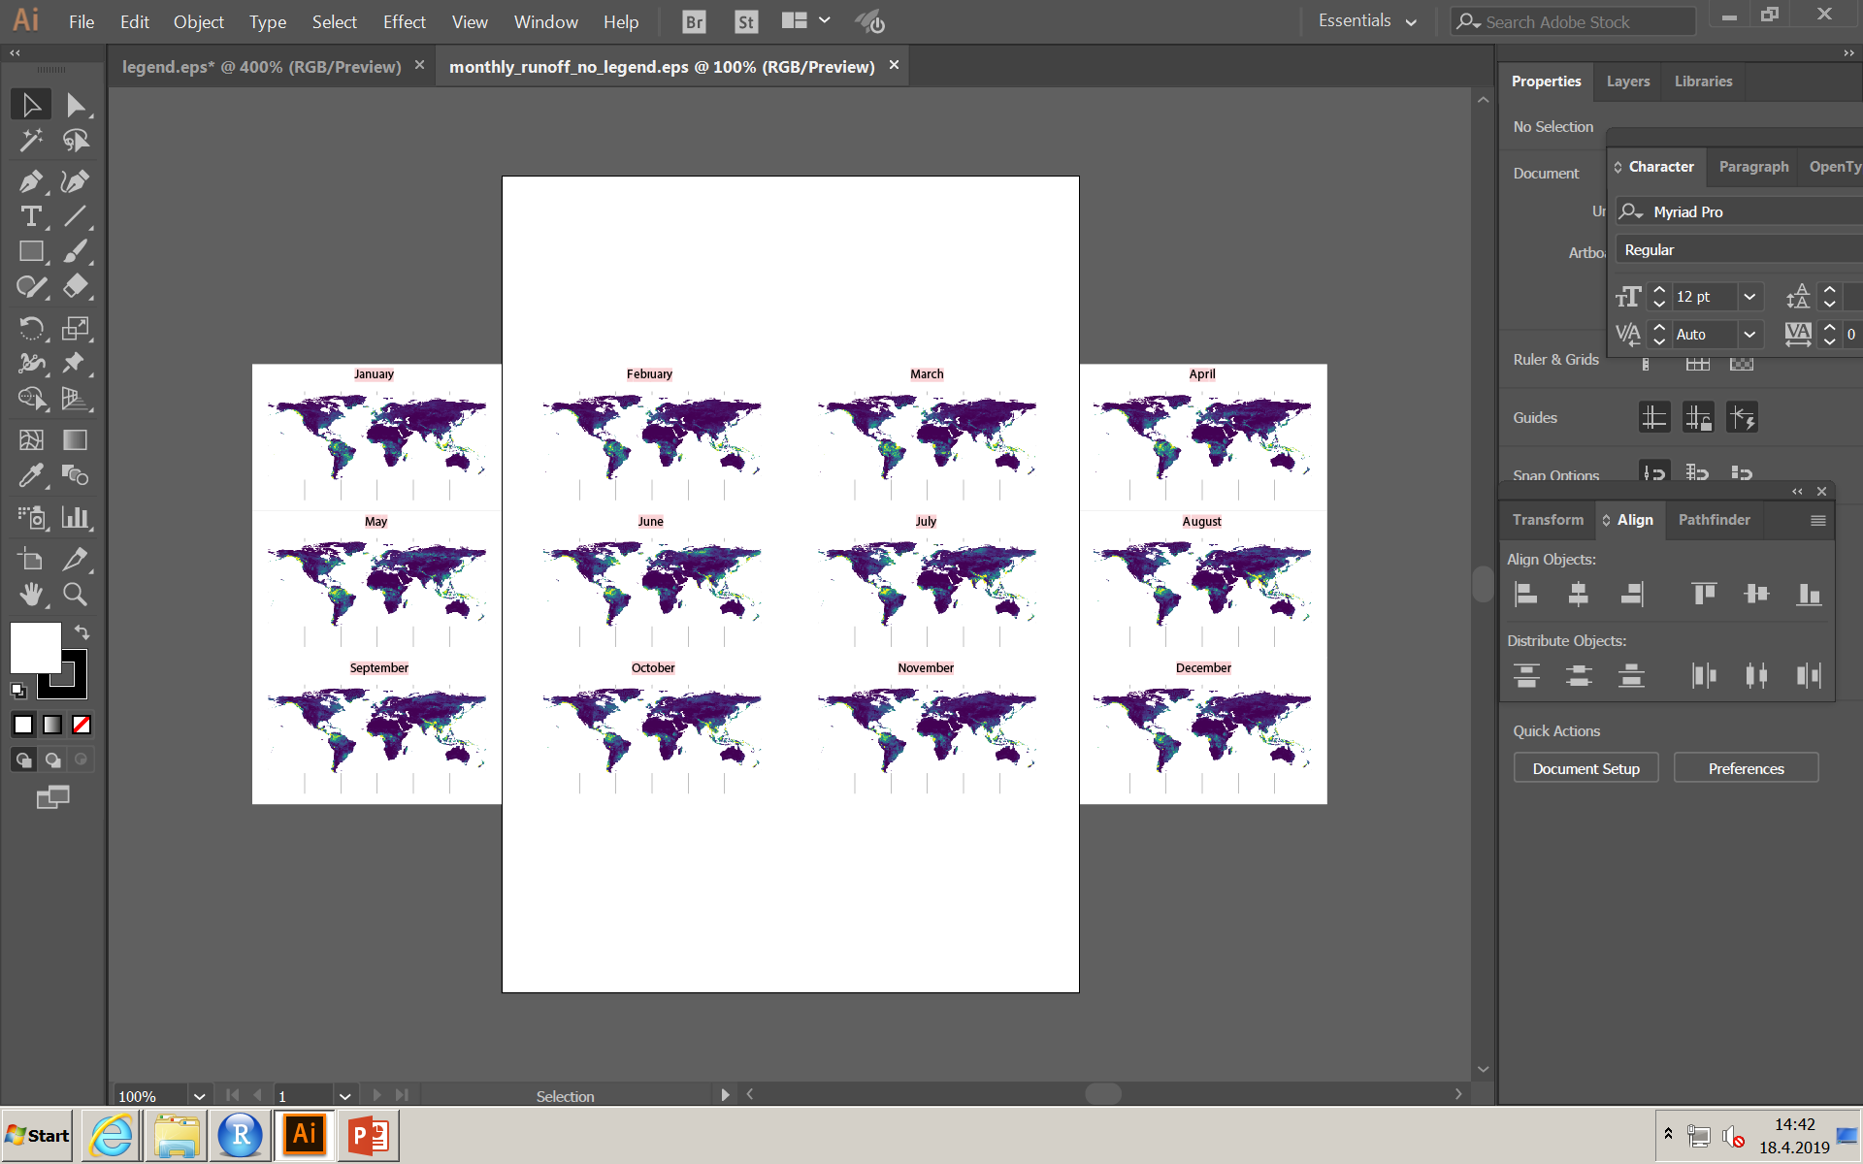
Open maps
Next open the monthly_runoff_no_legend.eps file with Adobe Illustrator
Ungroup, and remove clipping mask as well as compound path

Slide 8
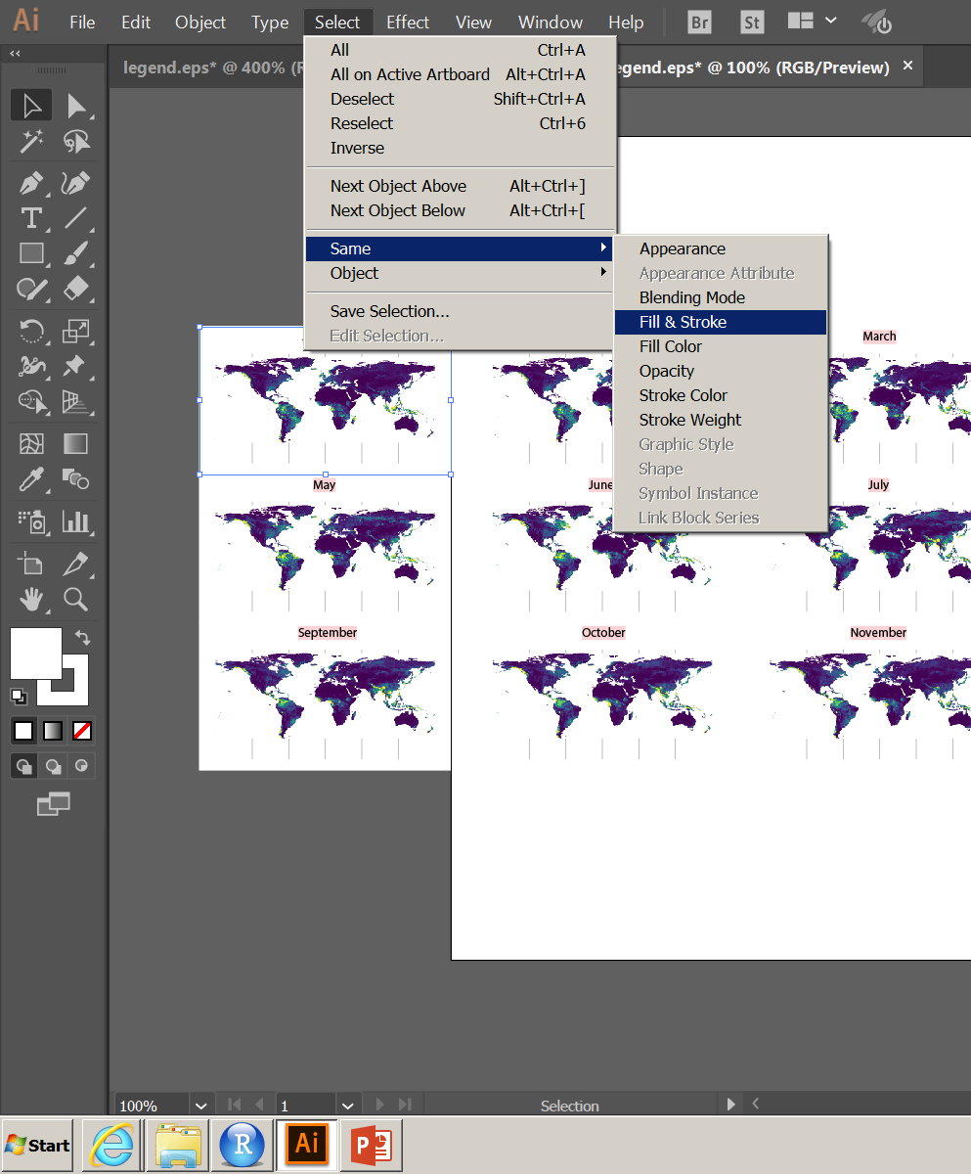
Delete masks
After you have ungrouped and released the masks, you can delete them. But instead of selecting all 12 white backgrounds, select one white background and then click Select – Same – Fill & Stroke. Then delete all at once.

Slide 9
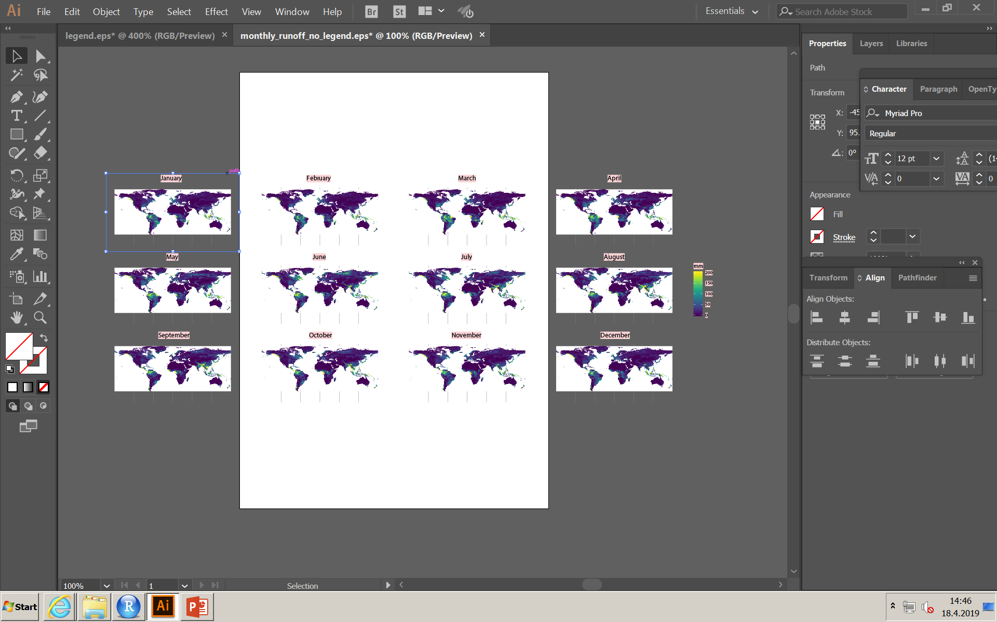
Copy legend to maps pane
In legend tab, select all features and then copy those (ctrl+c). Go back to maps and paste them (ctrl+v)

Slide 10
Create new layer
Click the layers tab on the right or open the layers window (Window – layers)
Create new layer by clicking the ‘menu’ on the right upper corner
Name the layer as text, and click ok

Slide 11
Move text to new layer
Select all the text: Select – Object – All text Objects
Select new layer (called text) from the list of layers
Right mouse click on one of the texts
Select Arrange – Send to current layer…

Slide 12
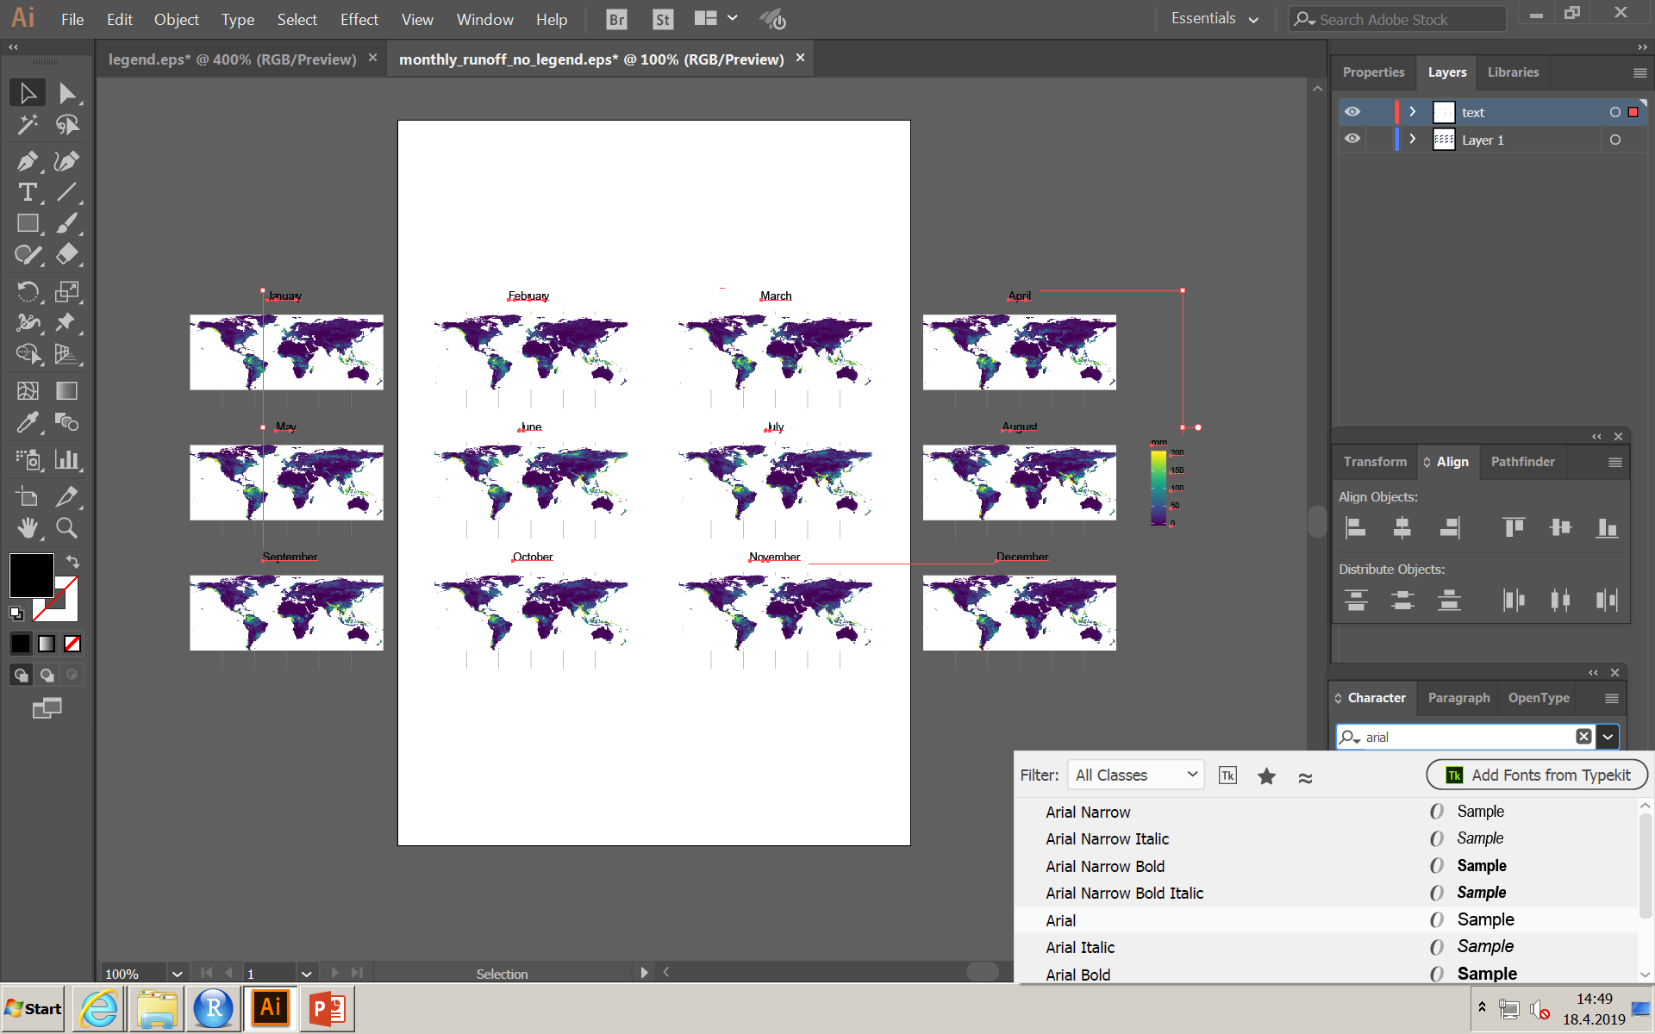
Modify text
Now all the text is in its own layer, and you can lock the layer, hide it or select all features in it easily
Click small circle after text layer (selects all features in it), go to Properties tab (next to layers) or open font window (Window – Type – Character) and select Arial to the font

Slide 13
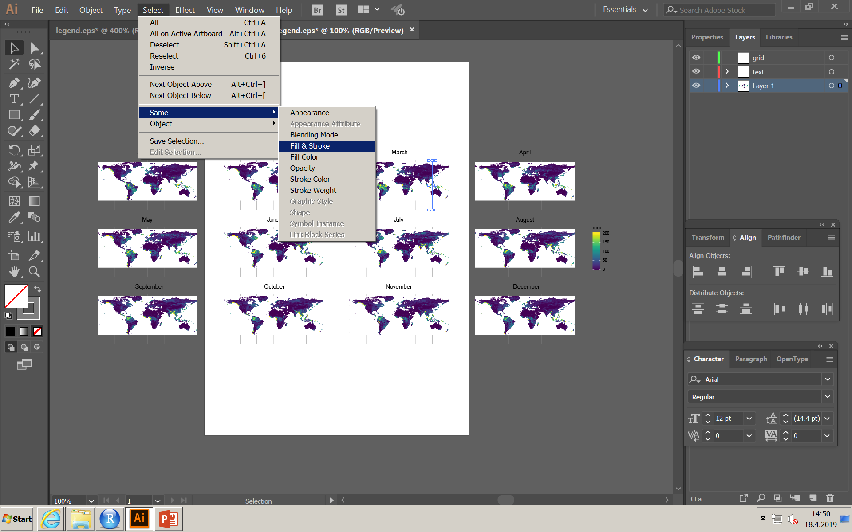
Move grid to own layer
Do same as above, but now for lat and lon grids.
Create new layer (grid)
Select one line of a grid, and then Select – same – fill & stroke
Select the new layer (grid)
Right click one of the grids, Arrange – move to current layer

Slide 14
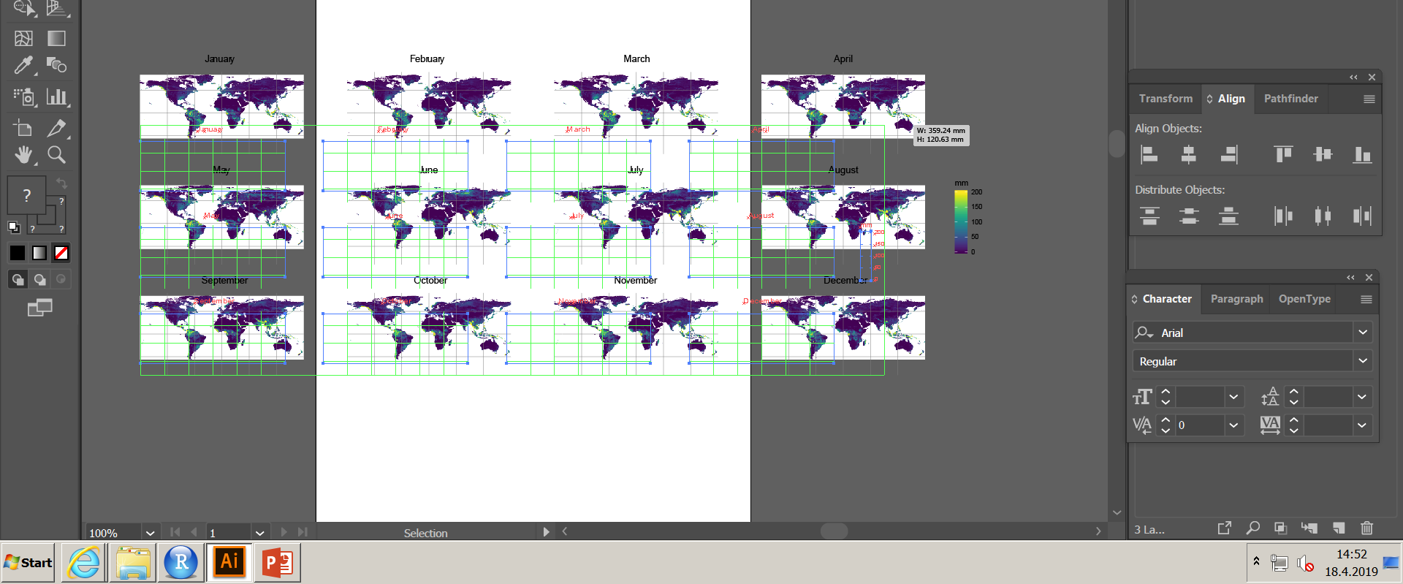
Reshape figures
You can make the maps smaller to fit to art board by dragging from the corner of it. To retain the ratios, keep shift key pressed down
Select all the objects (select – all)
Select corner with mouse and drag to the size you want

Slide 15
Adding titles etc
Add new layer for the text
Select Text tool from the left toolbar
Point it to place in which you want to add text
Add titles etc
You can align text boxes with align tools (when you select multiple objects, they appear at the top toolbar)

Slide 16
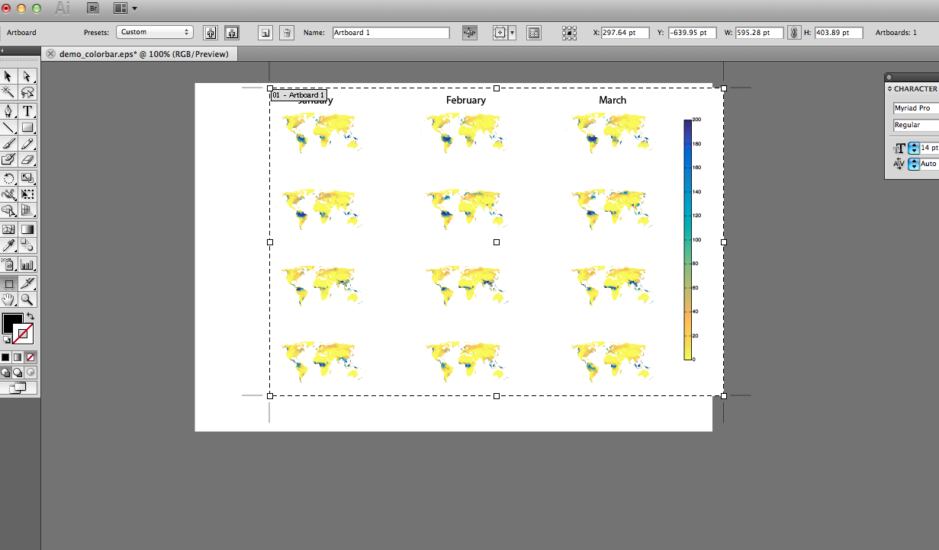
Adjust art board
By clicking art board symbol in left toolbar, you can adjust it to fit into the figure content

Slide 17
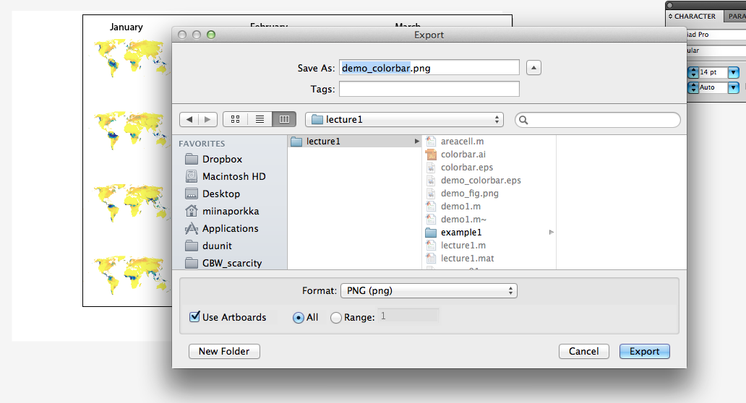
Export figure
Once you are happy on your figure, you can export it as png, for example, to be used in a document
File – Export…
To crop the exported figure to art board, you can tick the Use artboards option

