Slide 1
Illustrator lecture 2: how to use Adobe Illustrator with vector plots?
WAT-E2090 Water and people

Slide 2
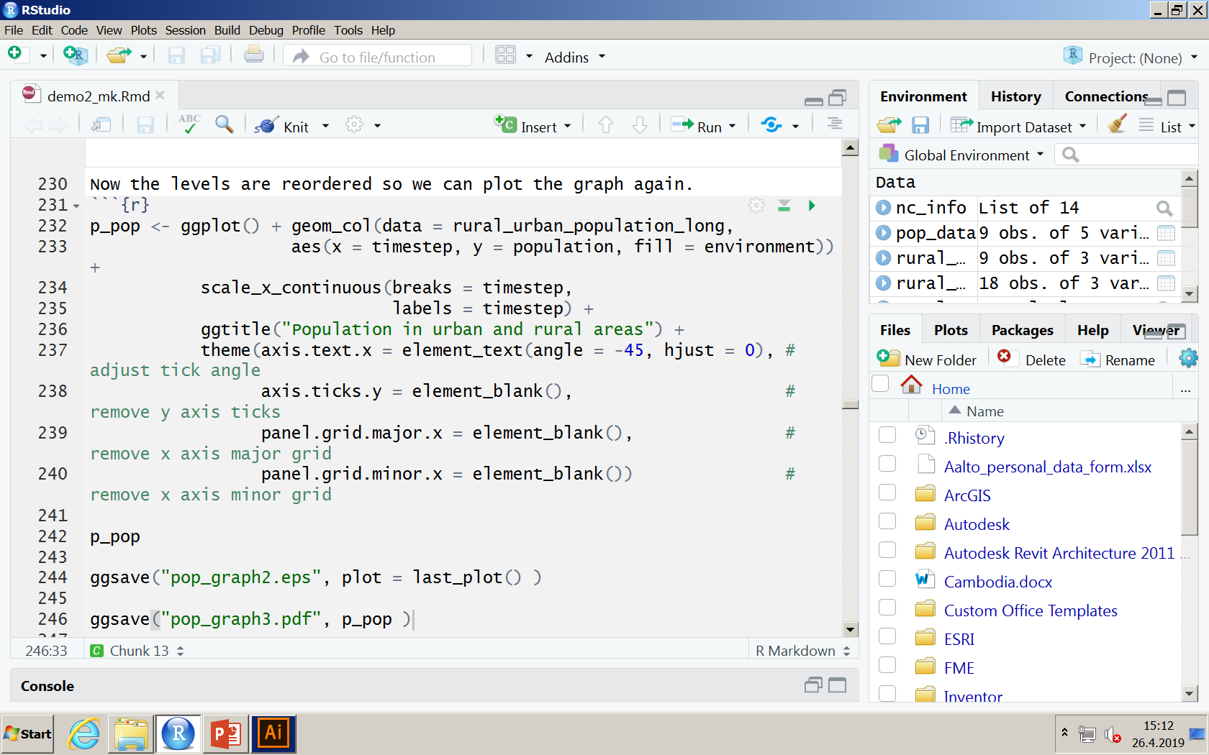
R
Open demo2.rmd (pull from git)
Run until line 230
Name the ggplot as p_pop (p_pop – ggplot() +..
You can plot the p_pop as simply writing p_pop
And save the plot with ggsave function, as in figure below. Or optionally, using plot = last_plot() option

Slide 3
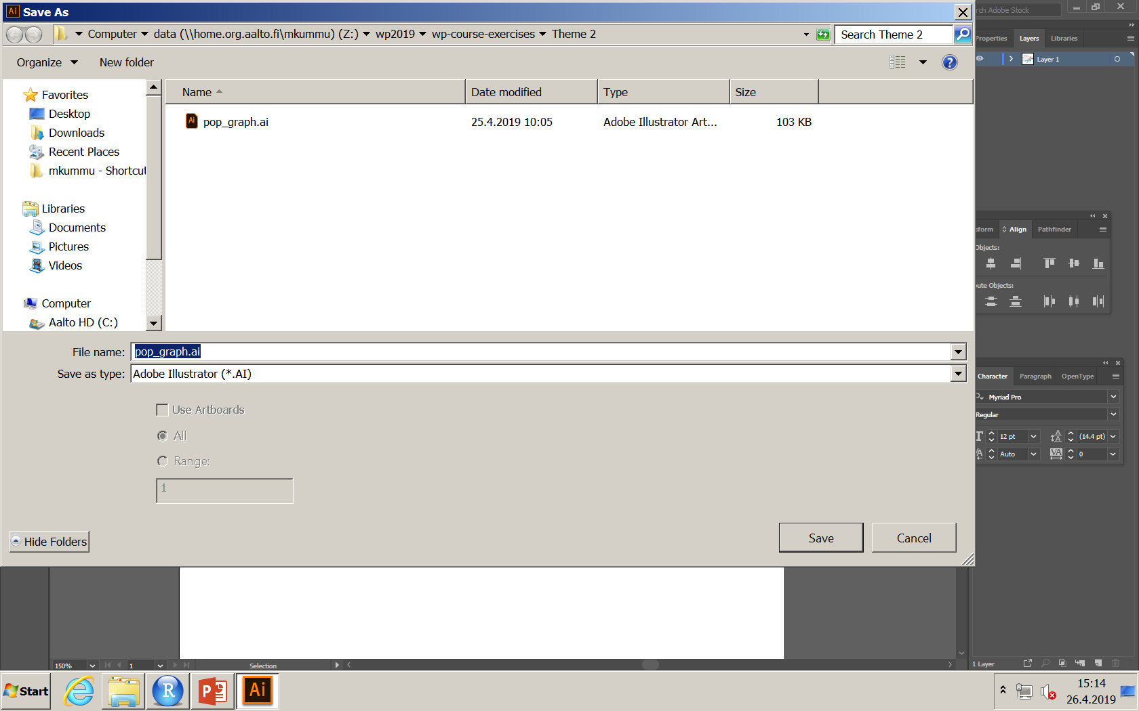
Open adobe illustrator
Programme is available in listed computer rooms (see MyCourses)
Open the file we just saved: File… Open… pop_graph2.eps

Slide 4
Remove clipping mask, grouping,
R, excel and other programmes produce unnecessary masks and grouping to vector files. It is advisable to remove those before starting to work with the figure. Do as follows:
Do following commands from menu bar
Select – All
Object – Ungroup
Object – Clipping mask – release
Object – Compound path – release

Slide 5
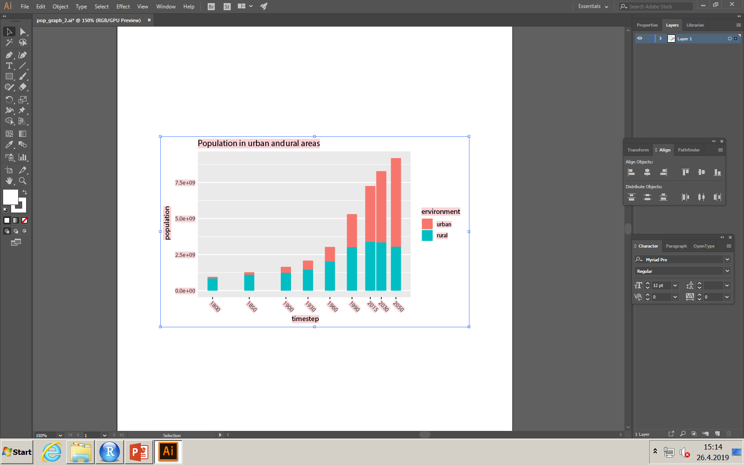
Delete masks
After you have released the masks, you can delete them by selecting the white areas and pressing delete (the A4 page remaining is the art board and you cannot delete that)

Slide 6
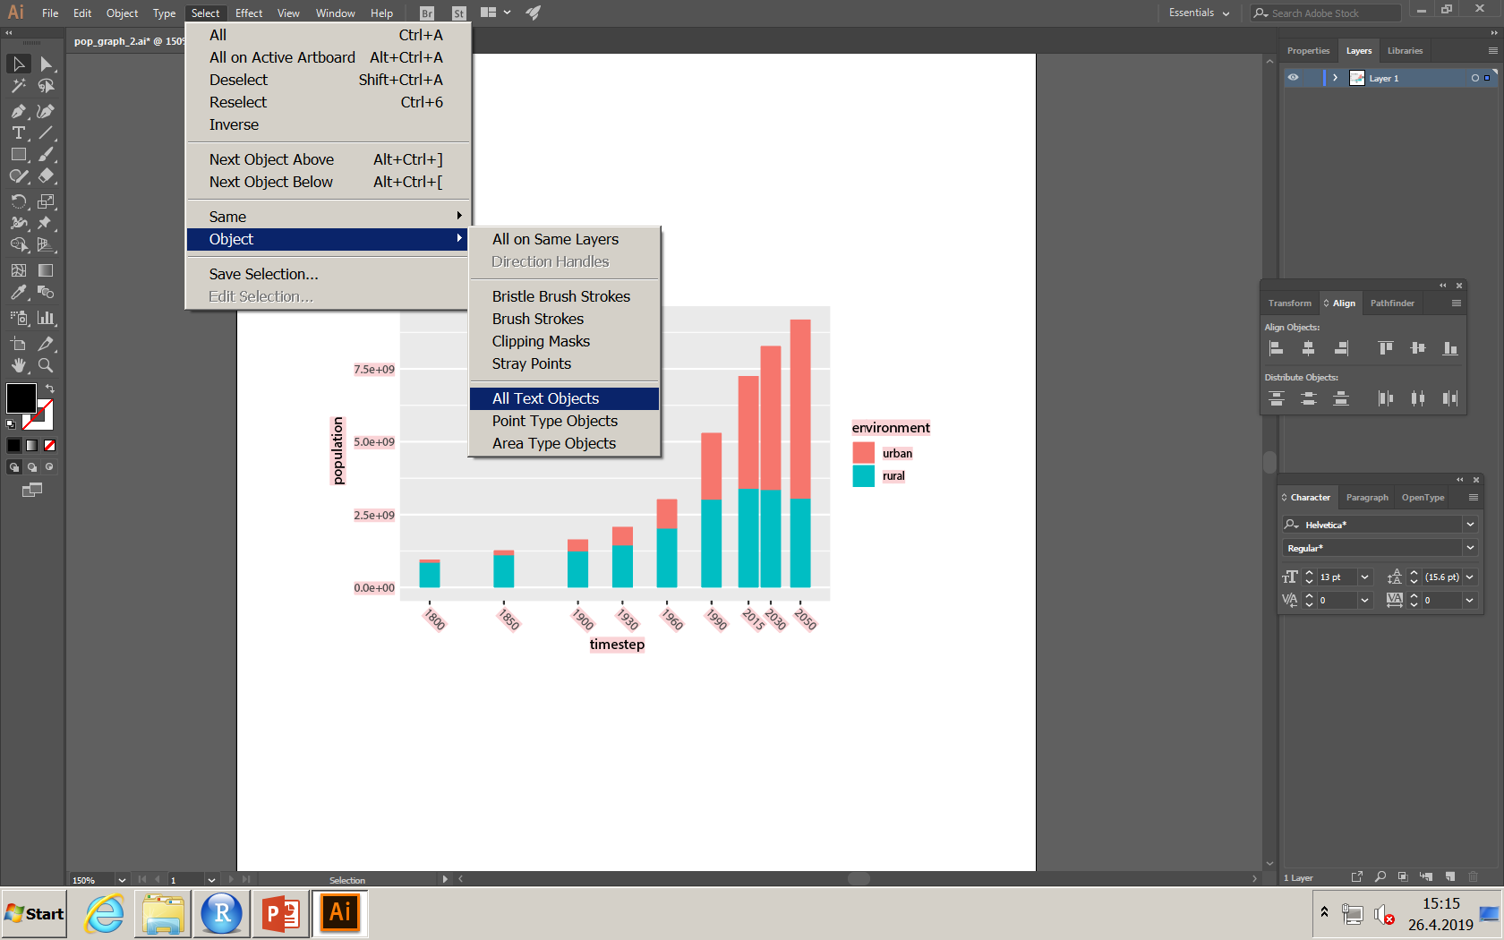
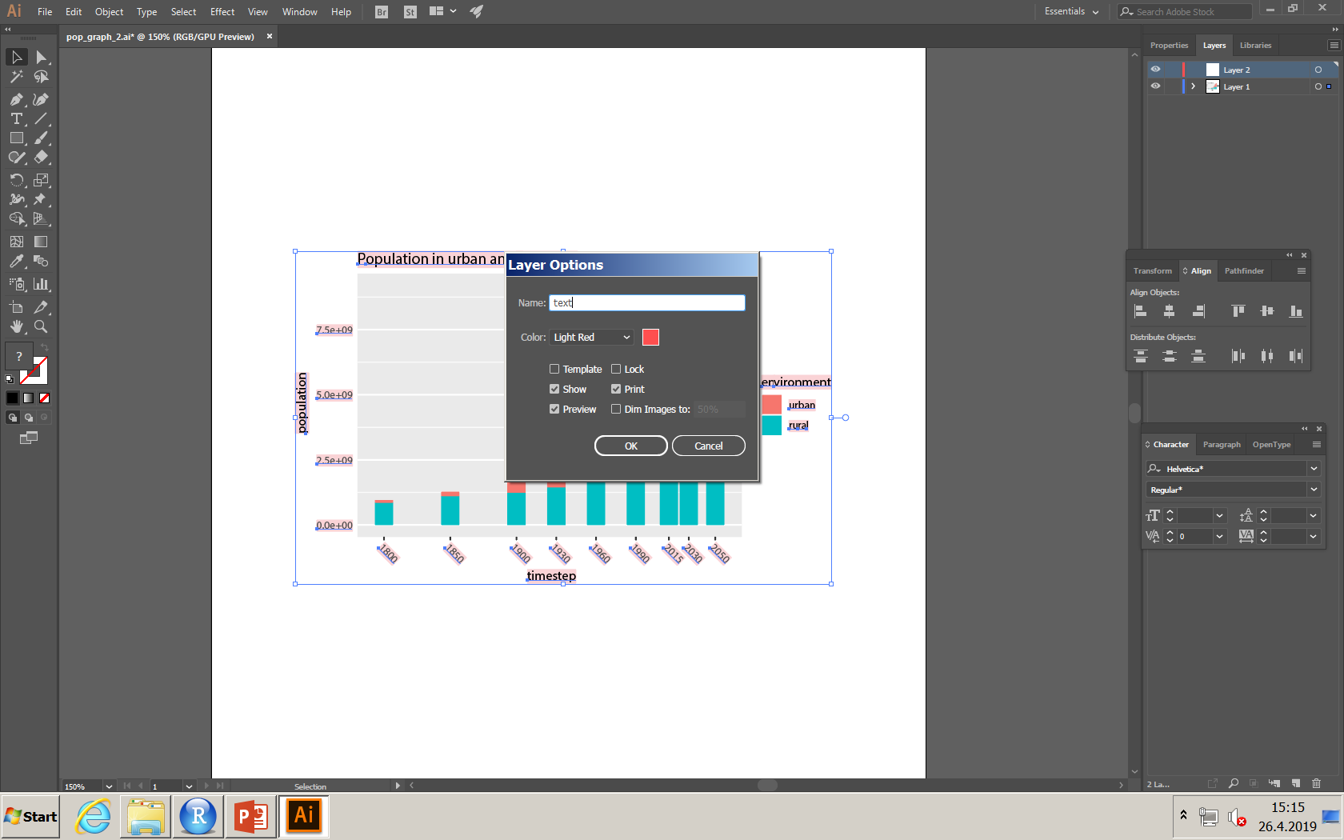
Move text objects to own layer
Select one piece of text
Choose: Select – Object – All text objects
Create a new layer:
choose layer tab on the right
From small menu item, select create a new layer
Name it and click ok
Move selected objects to the new layer:
Right mouse button on one of the selected text objects
Choose: Arrange - Send to current layer

Slide 7
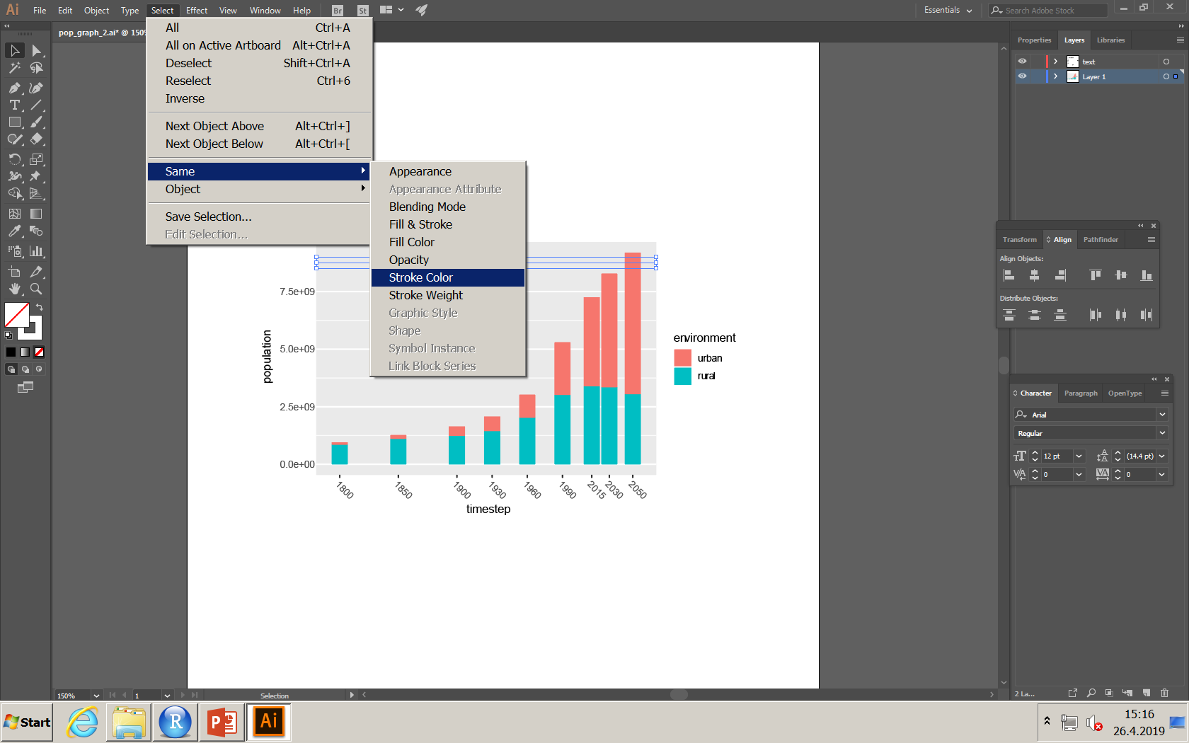
Move white grid lines to own layer
Select all grid lines
Select on of them
Choose: select – same – stroke color
Create new layer (see previous slide)
Move the grid lines to this new layer as done before

Slide 8
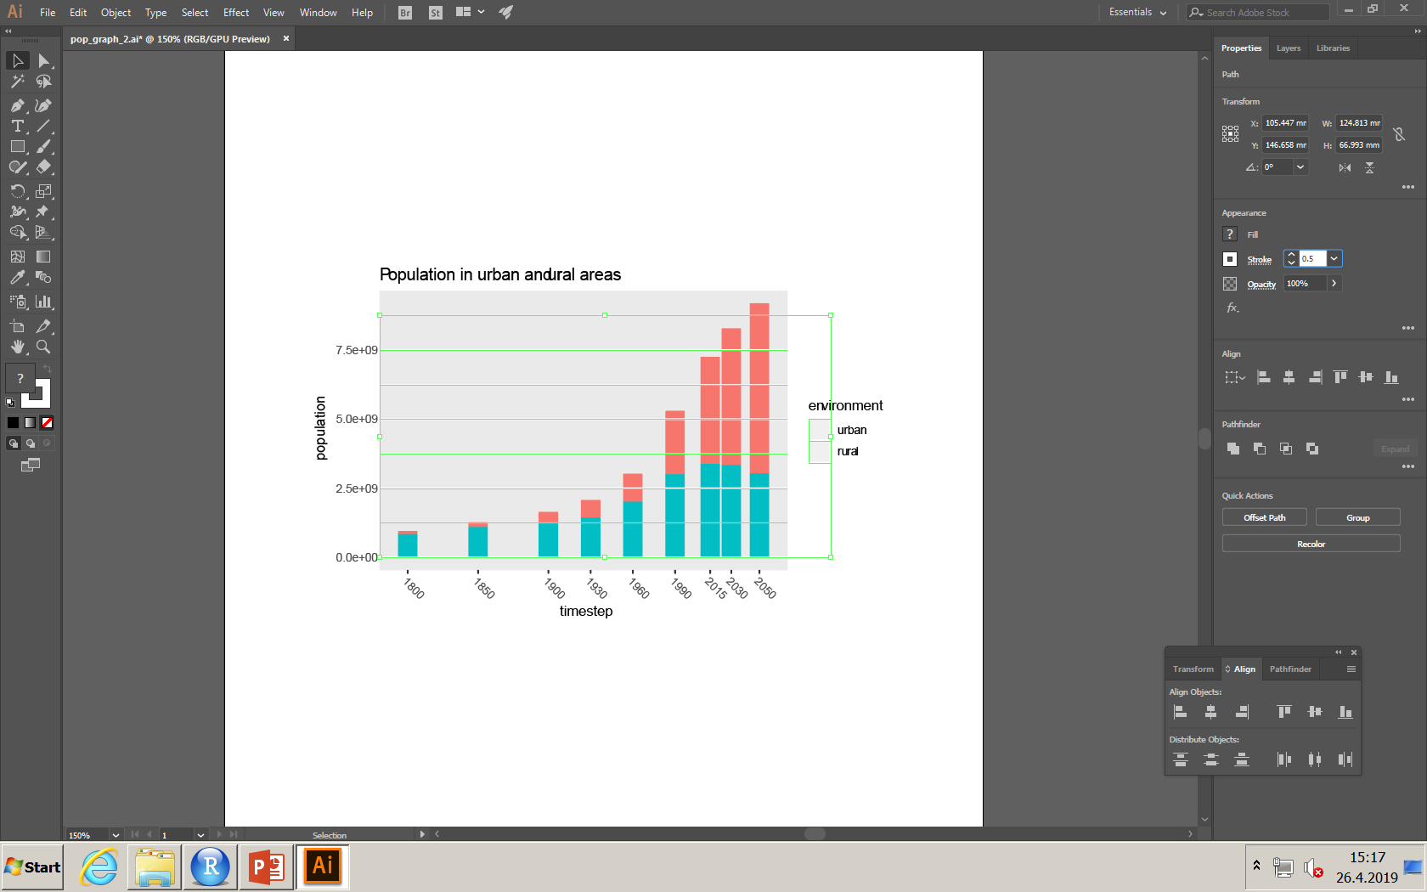
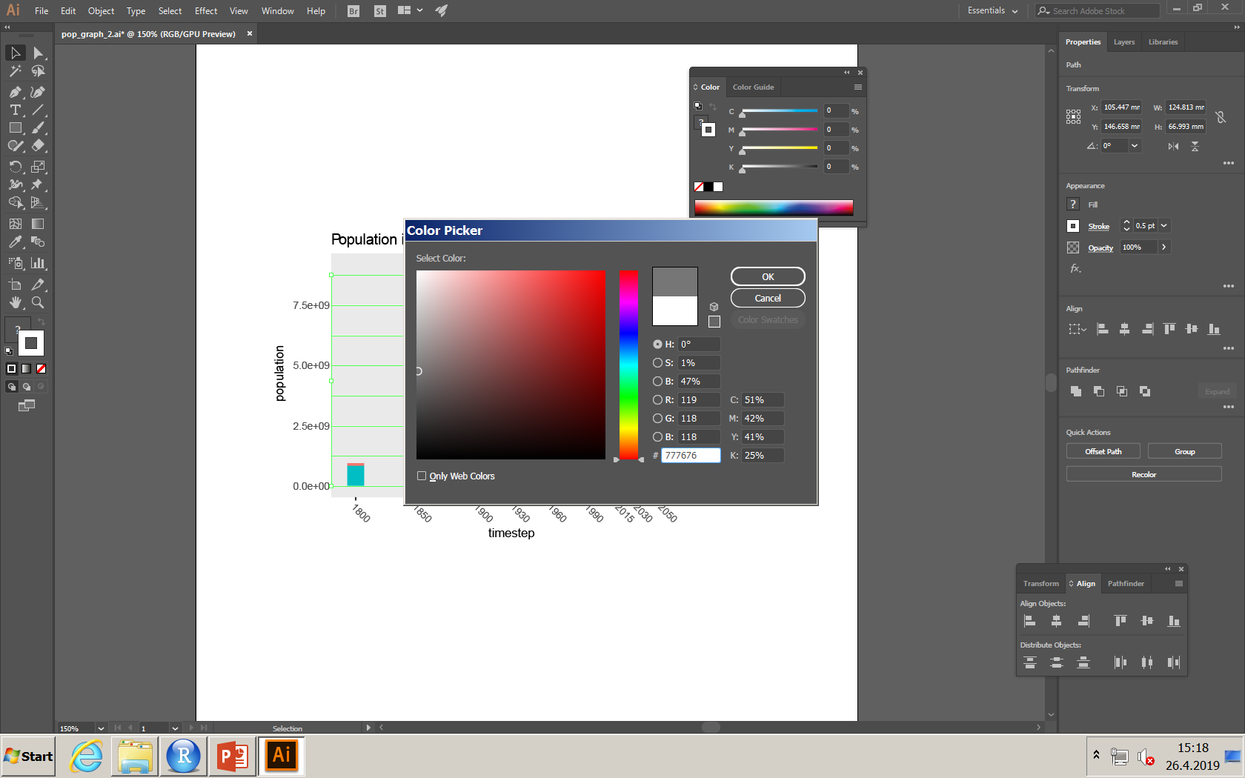
Changing grid line colours
To change colors of the grid lines, select one bar or the color in legend, then:
Select – Same – Stroke color
Double click the color rectangle on left
Select the colour of your liking and click ok

Slide 9
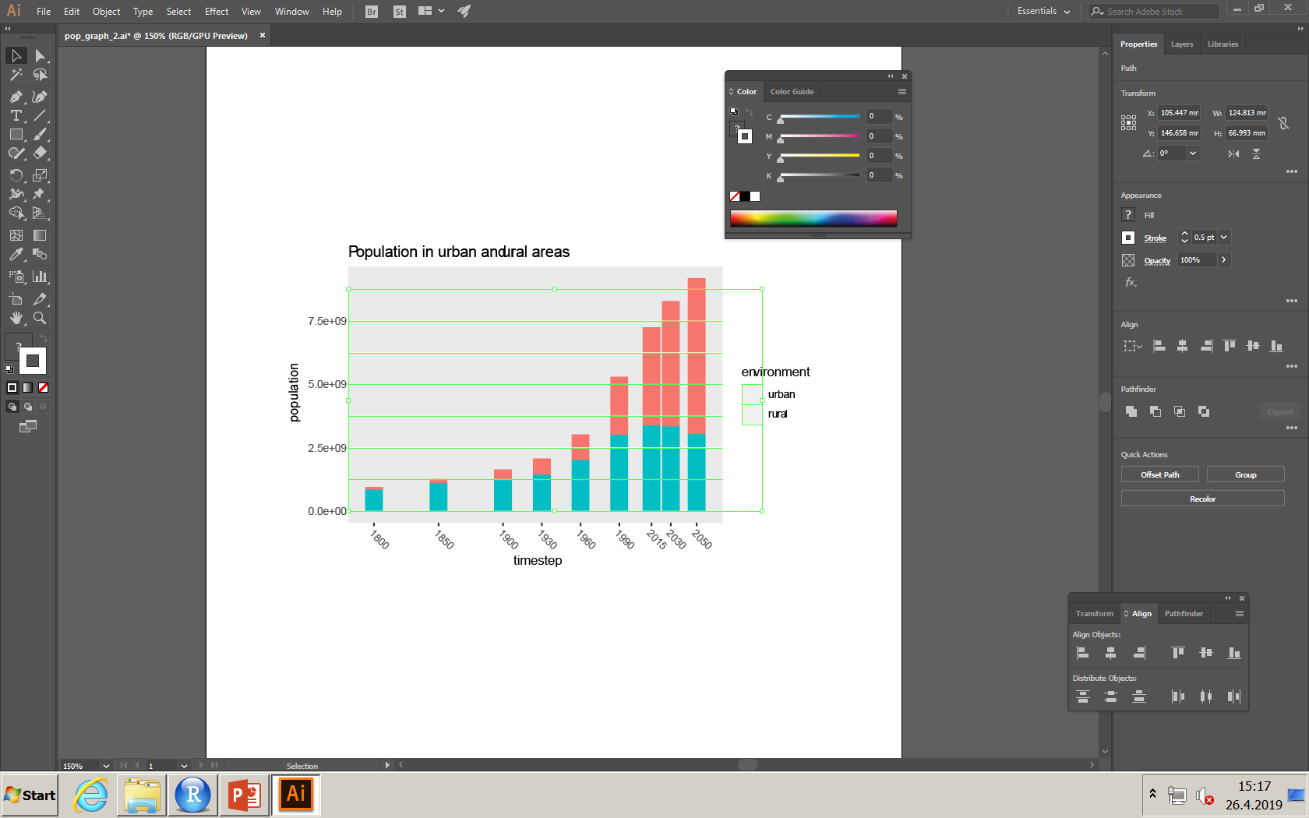
Change stroke width
When all the grid lines are still selected, move to properties tab on the right, and adjust stroke to 0.25

Slide 10
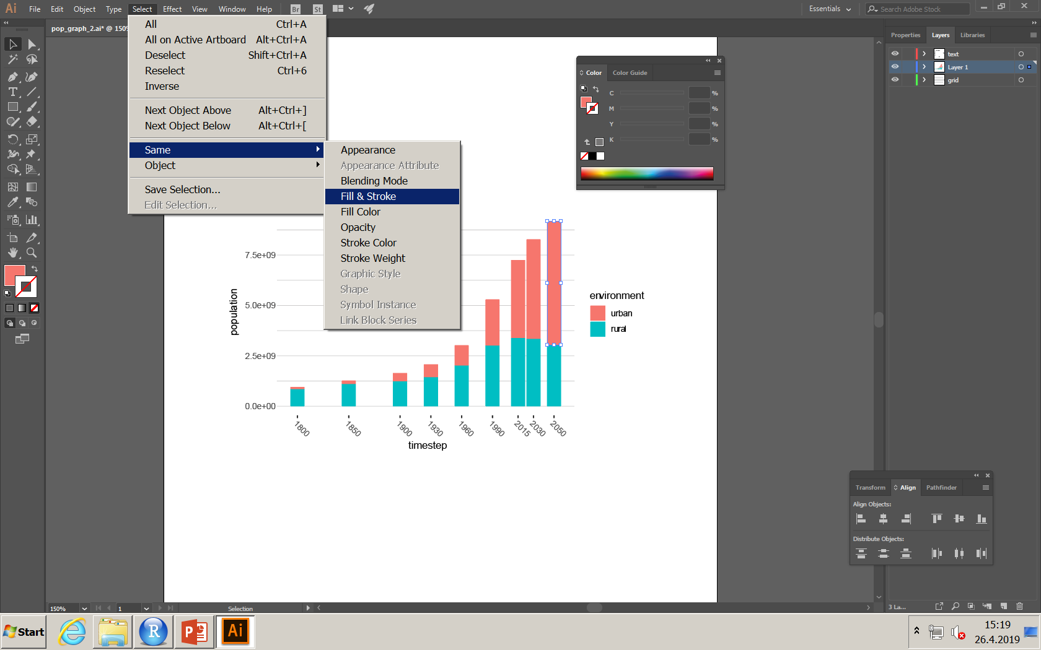
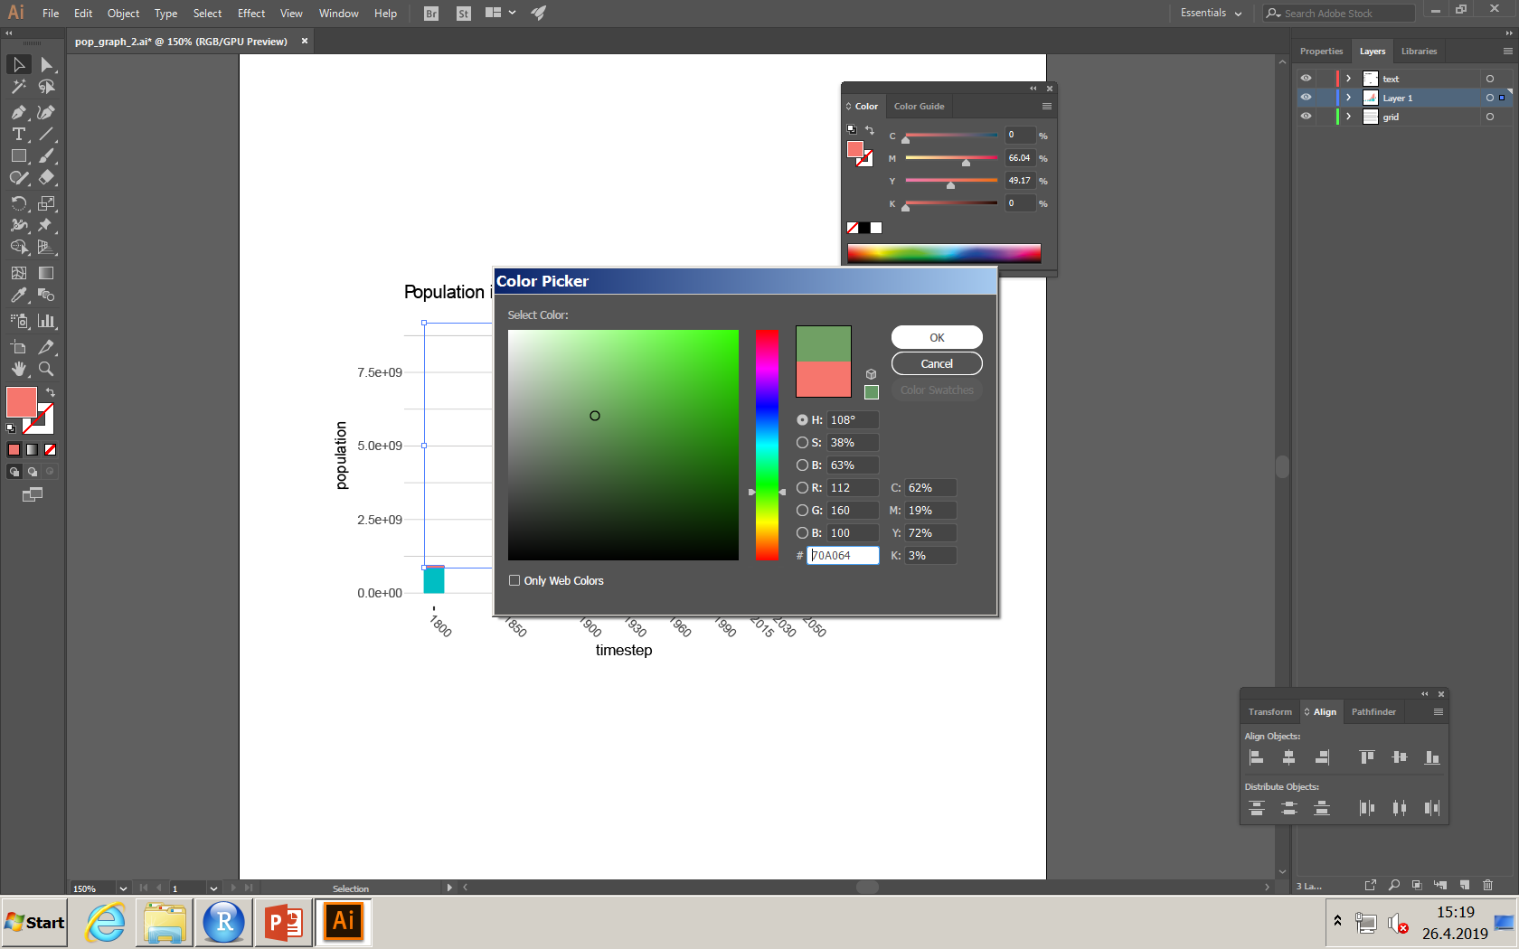
Changing colours of the bars
To change colors of the bars, select one bar or the color in legend, then:
Select – Same – Fill and stroke
Select the colour of your liking and repeat for other bars
If you’re interested, colorbrewer2.org offers a range of nice color schemes to be used particularly in mapping

Slide 11
Modify text
Instead of having these e+09 indicating billions in x-axis tick-labels, you can remove those and modify the axis caption instead

Slide 12
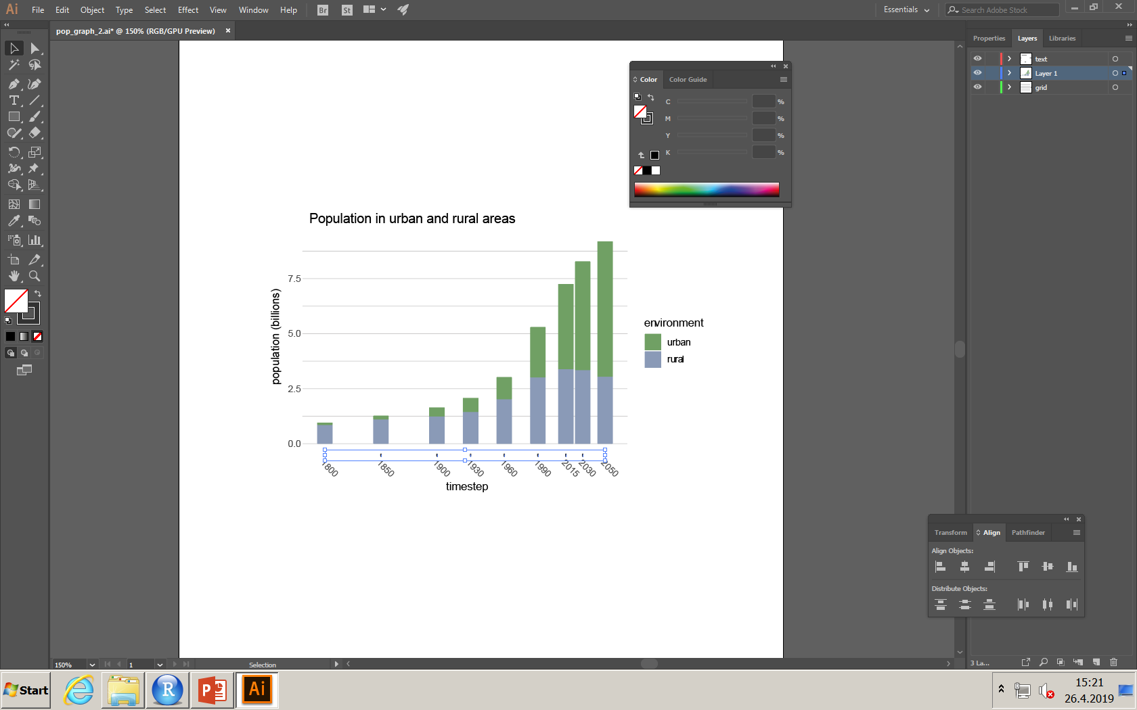
Removing unnecessary objects
There are tick marks for the years
Are they necessary for the figure?
If not, remove by selecting them all and press delete

Slide 13
Transform multiple objects
Select all the years
Choose Object – transform - transform each
Put 45° to angle, with selecting preview, you can see how it changes the figure
Click ok

Slide 14
Align and distribute tools
Sometimes you want to arrange objects differently than in your original Matlab plot
Align and distribute tools are useful for that
You can find them under Window – Align
You can find more information at https://www.qualitylogoproducts.com/blog/how-to-use-align-tool-adobe-illustrator/

Slide 15
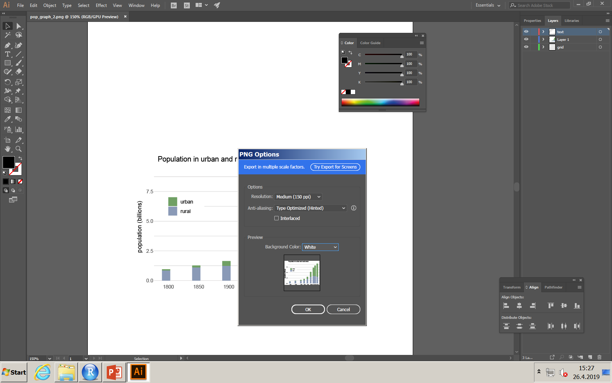
Export figure
Once you are happy on your figure, you can export it as png, for example, to be used in a document
File – Export as…
Select png as the format
Use at least 150 dpi resolution
Select the background color and then click ok

