Slide 1
Assignment 3
WAT-E2110 – Design and Management of Water and Wastewater Networks
Leakage modelling
Suvi Ahopelto, 4.3.2019

Slide 2
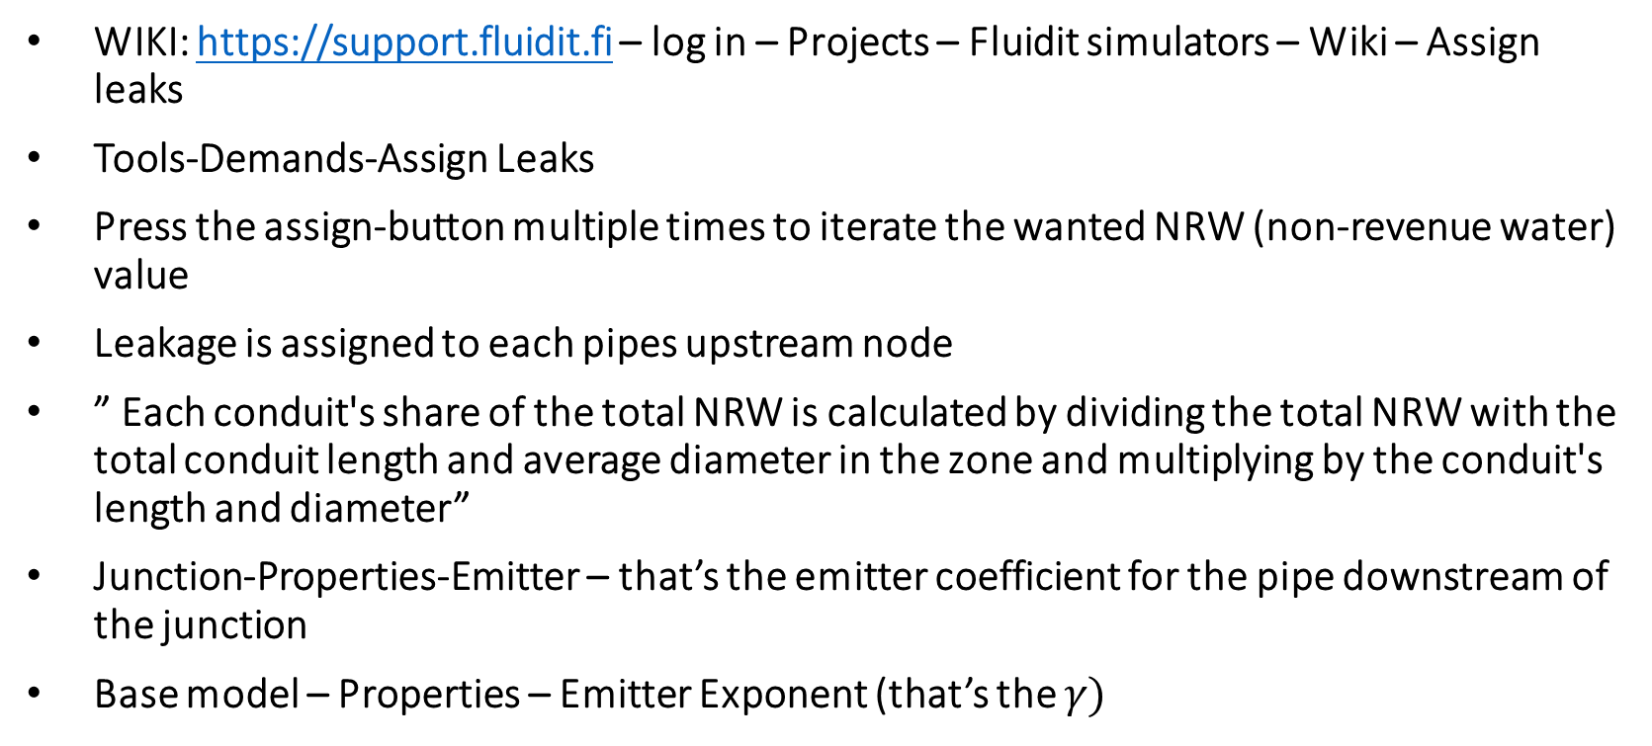
Assign leaks tool in the Fluidit software
WIKI: https://support.fluidit.fi – log in – Projects – Fluidit simulators – Wiki – Assign leaks
Tools-Demands-Assign Leaks
Press the assign-button multiple times to iterate the wanted NRW (non-revenue water) value
Leakage is assigned to each pipes upstream node
” Each conduit's share of the total NRW is calculated by dividing the total NRW with the total conduit length and average diameter in the zone and multiplying by the conduit's length and diameter”
Junction-Properties-Emitter – that’s the emitter coefficient for the pipe downstream of the junction
Base model – Properties – Emitter Exponent (that’s the $γ)$

Slide 3
Hints - general
It’s useful to use ’child scenarios’
  Go to Model Browser – Base Scenario – Right click – Select Create Child Scenario
  Then you can create a child scenario for each part
  Child scenario inherits properties from the base scenario. Changes made to mother scenario will be inherited to it's children.
  Base scenario is not affected by the changes you make in the child scenario
  For example, you could make a seperate child scenario for each part.
  You can compare results between different scenarios in the software
See the wiki: https://support.fluidit.fi – log in – Projects – Fluidit simulators – Wiki
NRW = Leakage (in this case)

Slide 4
Hints – 1
a) Calculating the total input volume:
Leakage = NRW
Total = Revenue + NRW
0.15*Total = NRW
Combine these two formula and get ->
Total = Revenue + 0.15*Total
(1-0.15)*Total = Revenue
Total = Revenue/0.85
a) Total daily volume of leakage:
  Window - Statistics on selected components - Daily Leak [m3/d] /Sum
  Or it should be the same as NRW in the Assign Leakage-window
c) Emitter coefficients are found in Junctions - Emitter

Slide 5
Hints – 2
You can report either at what conditions the system breaks (negative pressures) or pressures drop too low (under 20 m)
You need to change the Total in Assign Leak –tool
  Test different values
Don’t use too much time on finding the right value, the result doesn’t need to be super accurate

Slide 6
Hints – 3
The point is to compare two different ways of adding leakage to the model: emitters and pattern
  Compare results from part 1 (emitters, which are pressure-dependent) and part 3 (leakage as a pattern, which is not pressure-dependent)
Set the emitter coefficients for each junction to zero (because we are not using the emitters anymore)
You can add the leakage to the average demand for each node
  Demands – … (three dots) – Demand – Divide the original value by 0.85

