Slide 1
Design of autonomous off-road robot
Benjamin Nikolov & Elias Ala-Kaila
6.4.2018

Slide 2
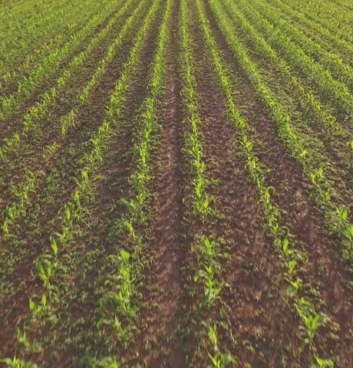
Design principles
Field Robot Event 2018
4-wheel drive and 4-wheel steering
Weatherproofing
Equal force support system
Easy manufacturability

Slide 3
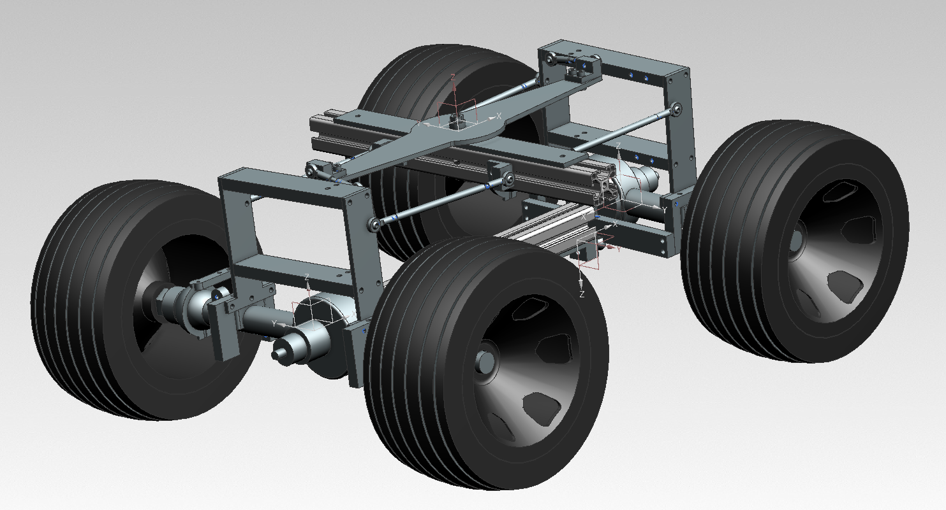

Slide 4
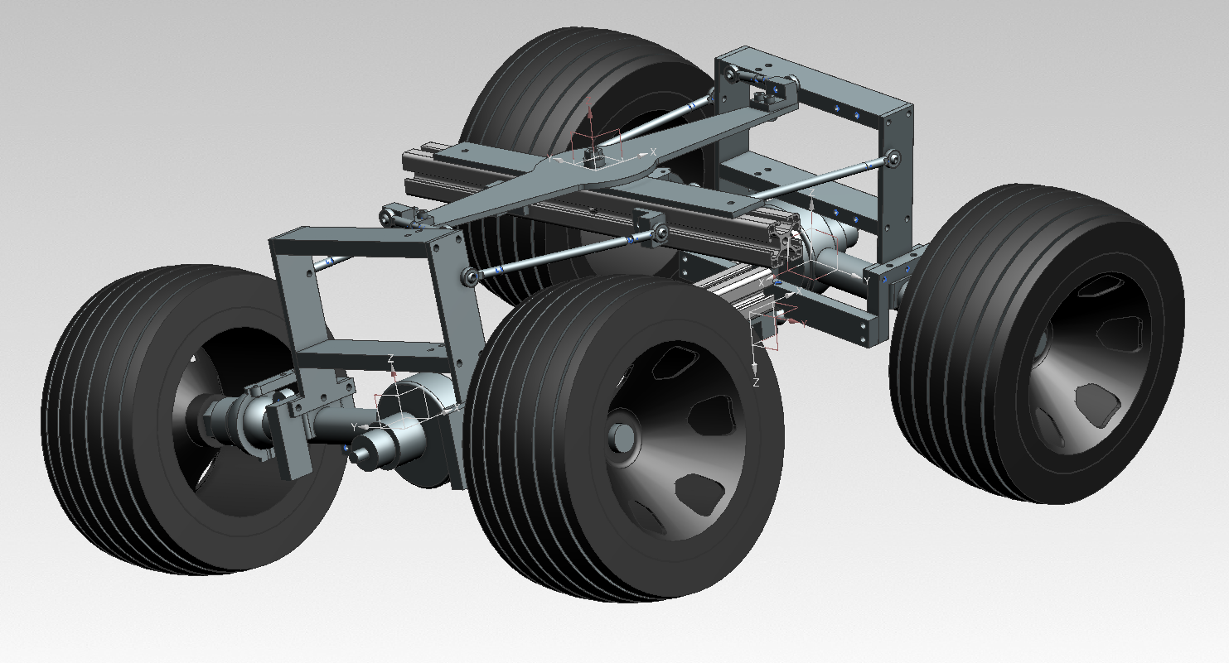

Slide 5
Kinematic equations
Parameters:
Robot heading 𝜃
Angle difference between the front wheels and heading 𝛼_{f}
Angle difference between the rear wheels and heading 𝛼_{r}
velocity of the front wheels 𝑣_{f}
velocity of the front wheels 𝑣_{r}
distance between the axles 𝑙

Slide 6
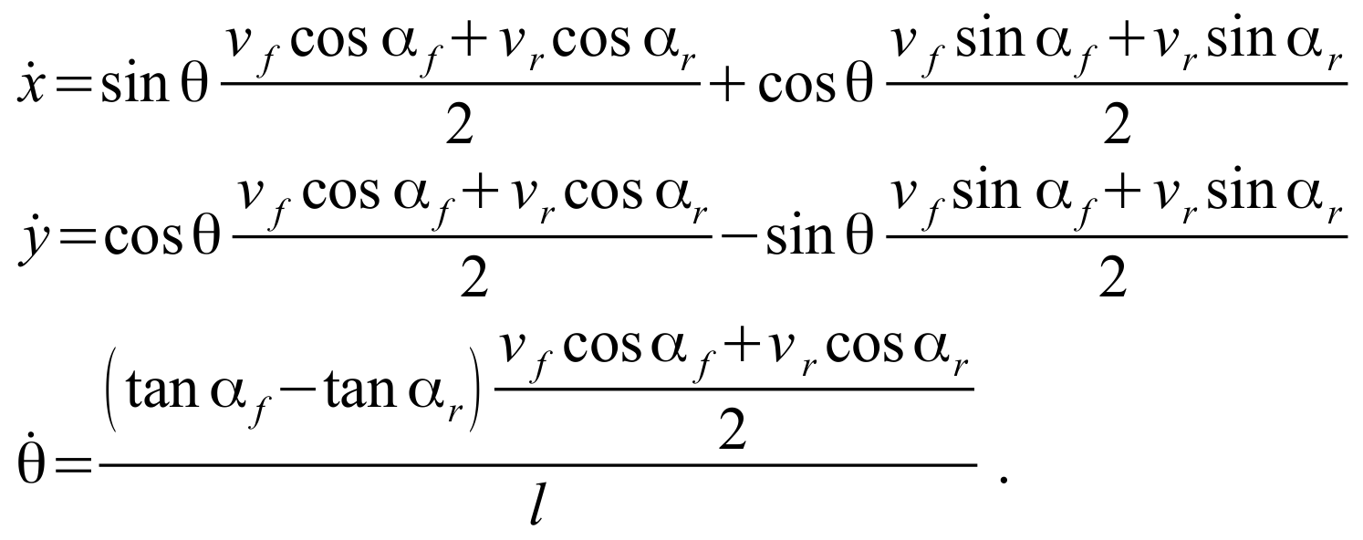
Kinematic equations

Slide 7
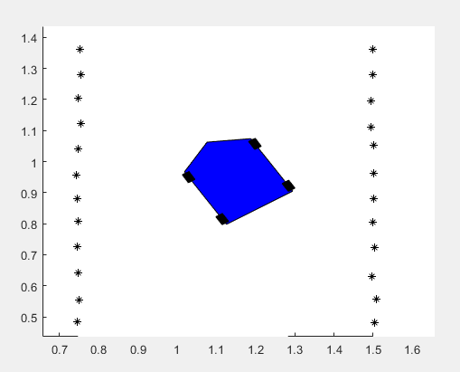
Simulation of navigation
Robot
Maize crop
Simulation with Simulink
Visualization with Matlab plot
Simulation of laser scanner data is used to improve navigation algorithm

Slide 8
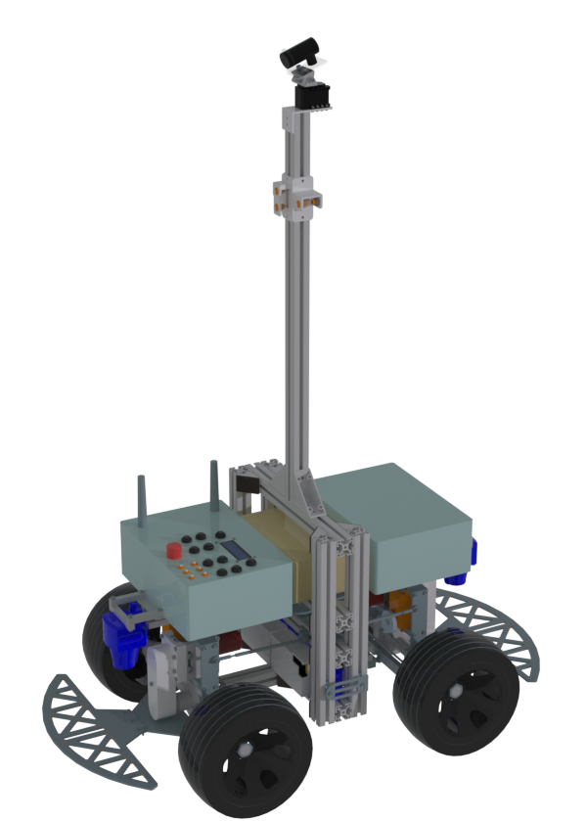
Results
4-wheel drive
4-wheel steering
Length: 880 mm
Width: 488 mm
Clearance: 65 mm
Weight: 20 kg

Slide 9
Thank you

