Slide 1
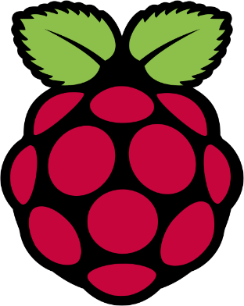
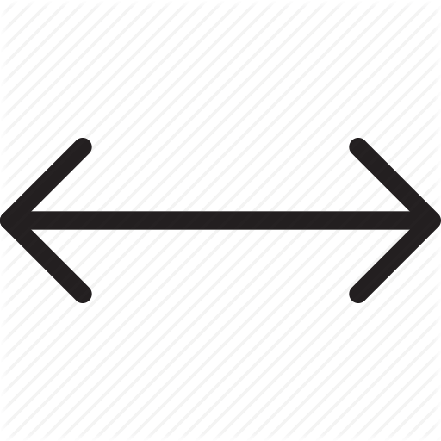
Experiment on control communication from Raspberry Pi over to a CNC machine
Jouni Hannonen Sanchayan Rajeetharan Quoc Huynh

Slide 2
Overview
Introduction Motivation Game
Interconnection between two systems
GPIO ( General-Purpose Input/Output)
OPC UA ( Open Platform Communications Unified Architecture)
Results
Conclusion

Slide 3
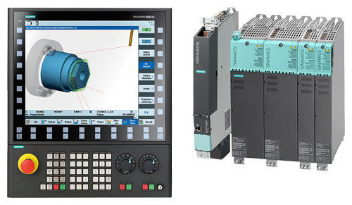
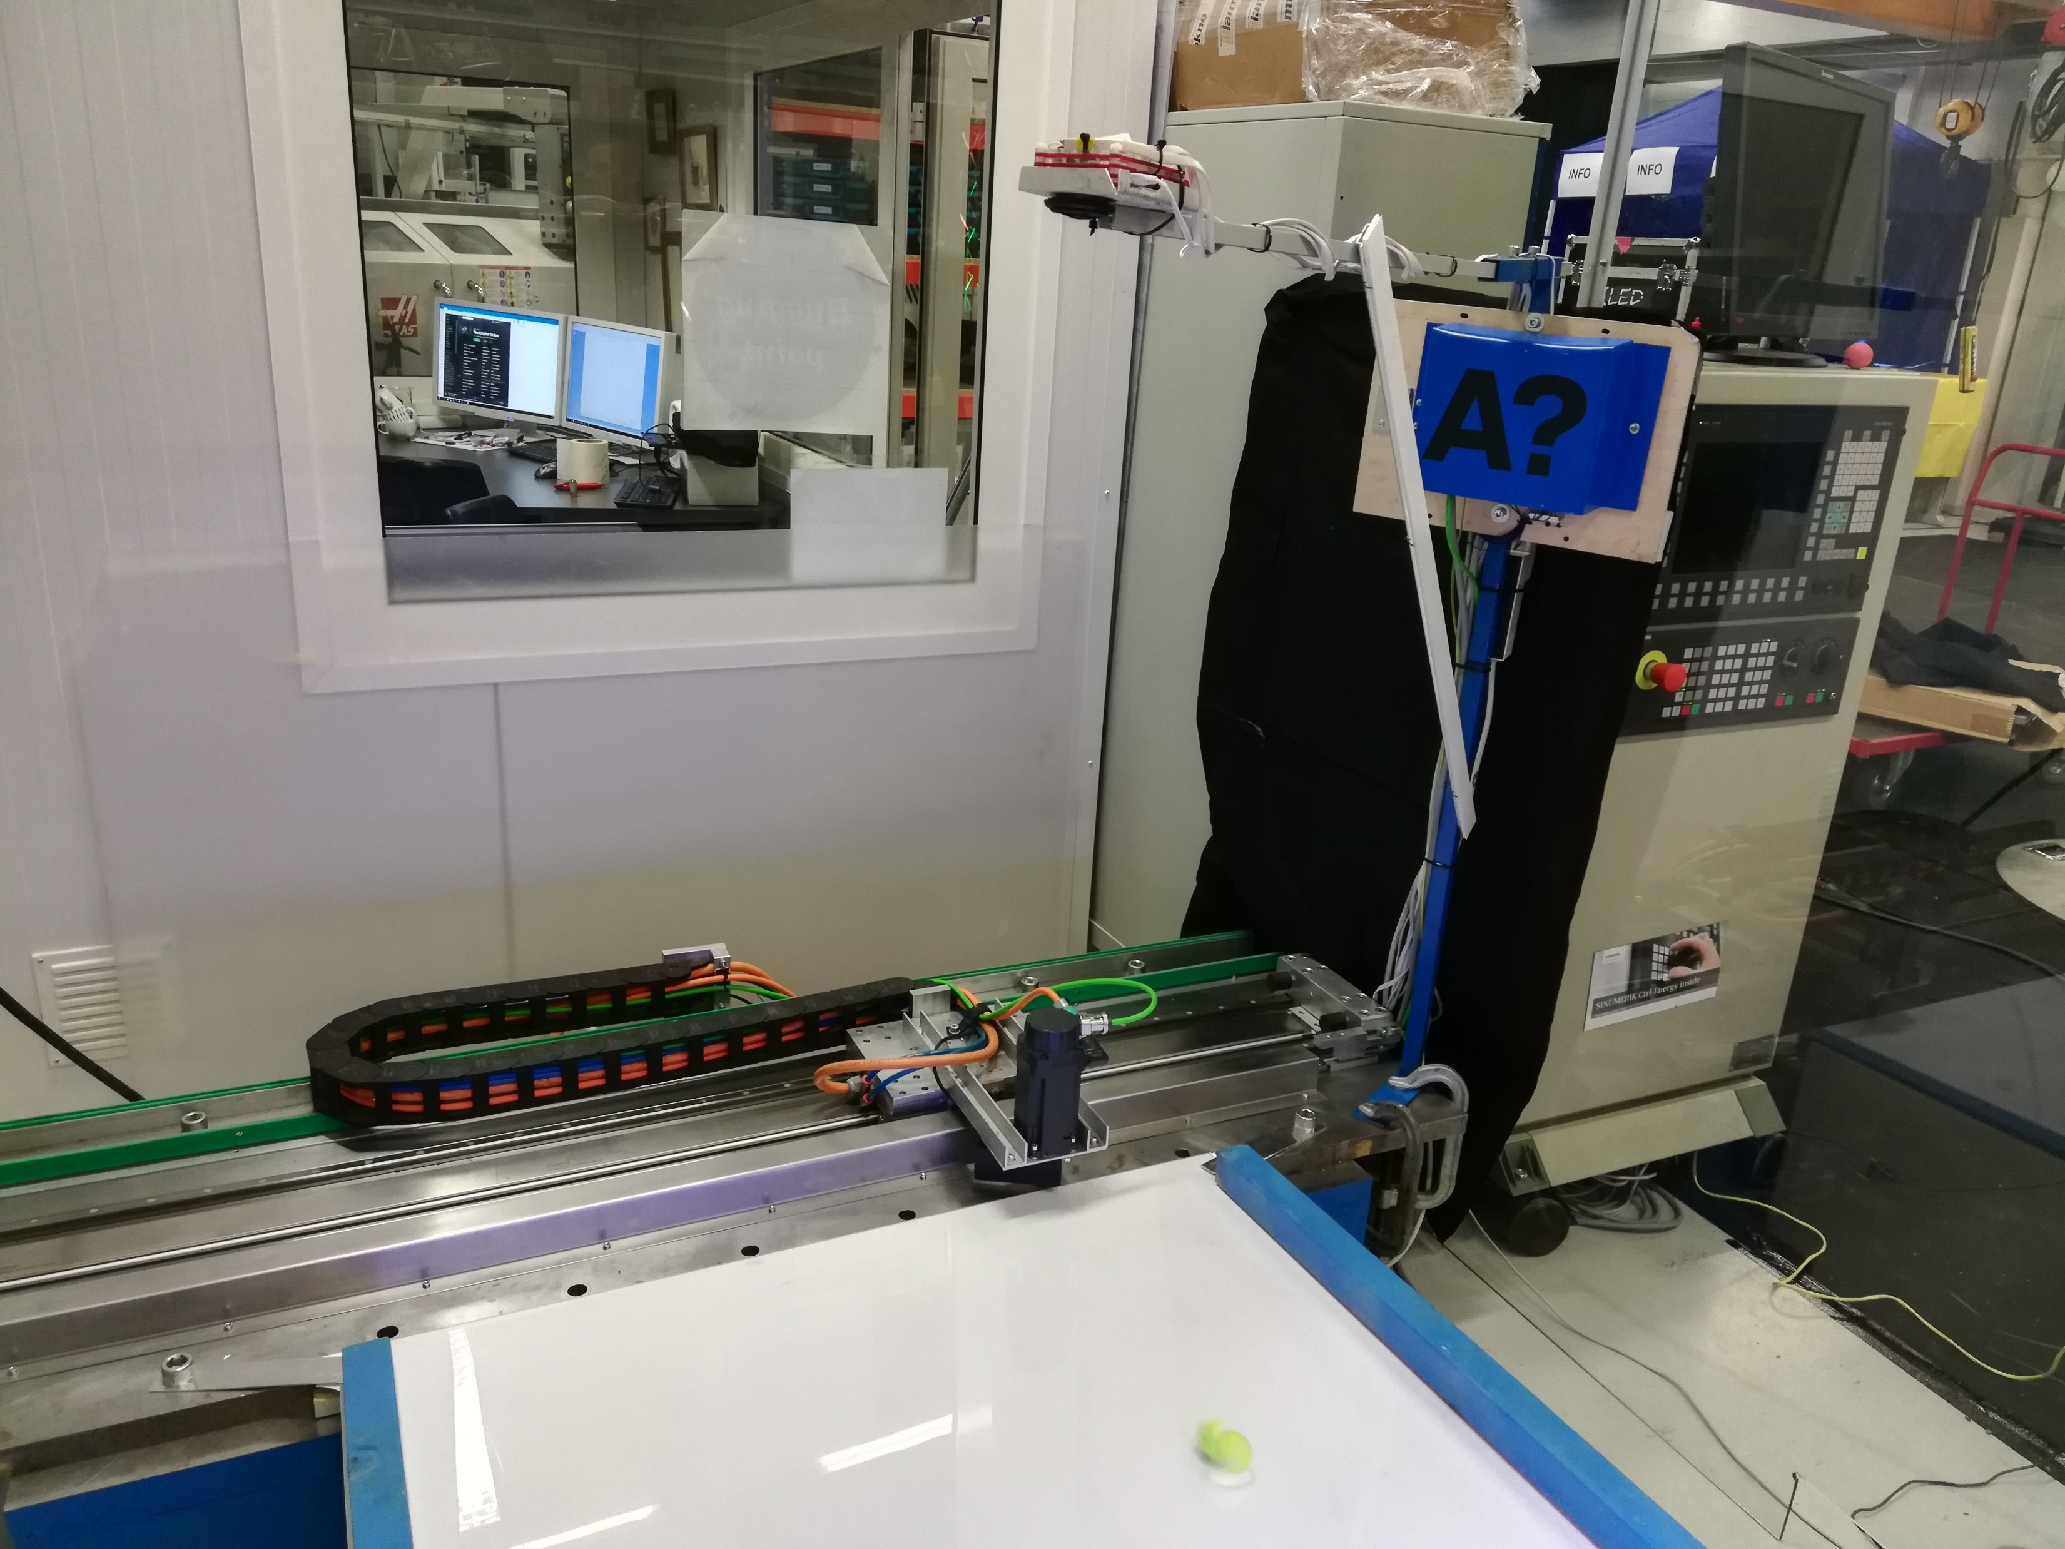
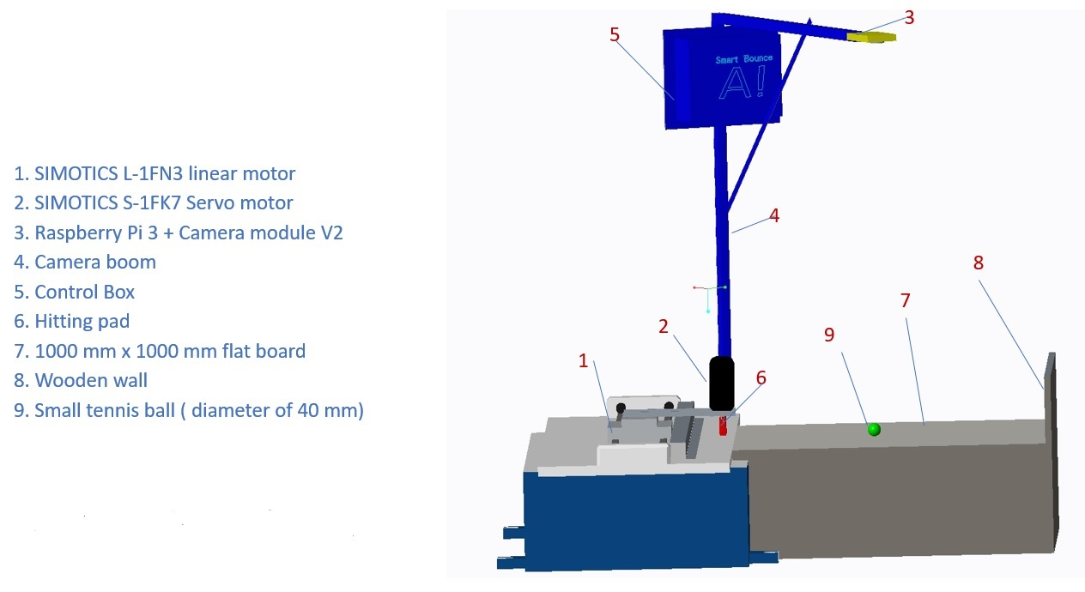
Introduction

Slide 4
Game in action

Slide 5
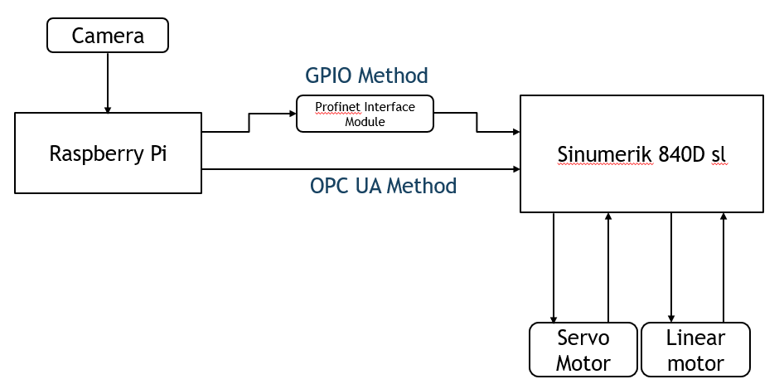
Raspberry pi to CNC interconnection
GPIO Method
OPC UA
Profinet

Slide 6
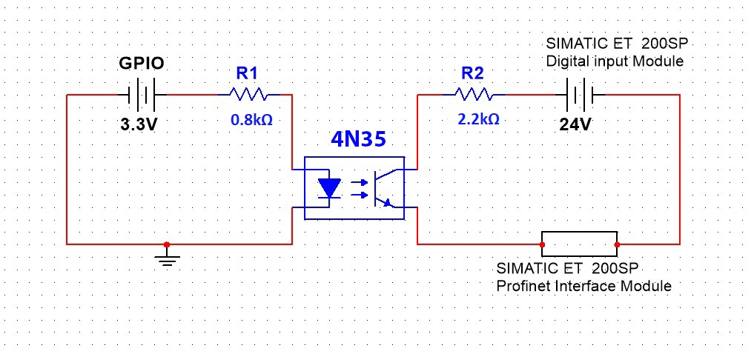
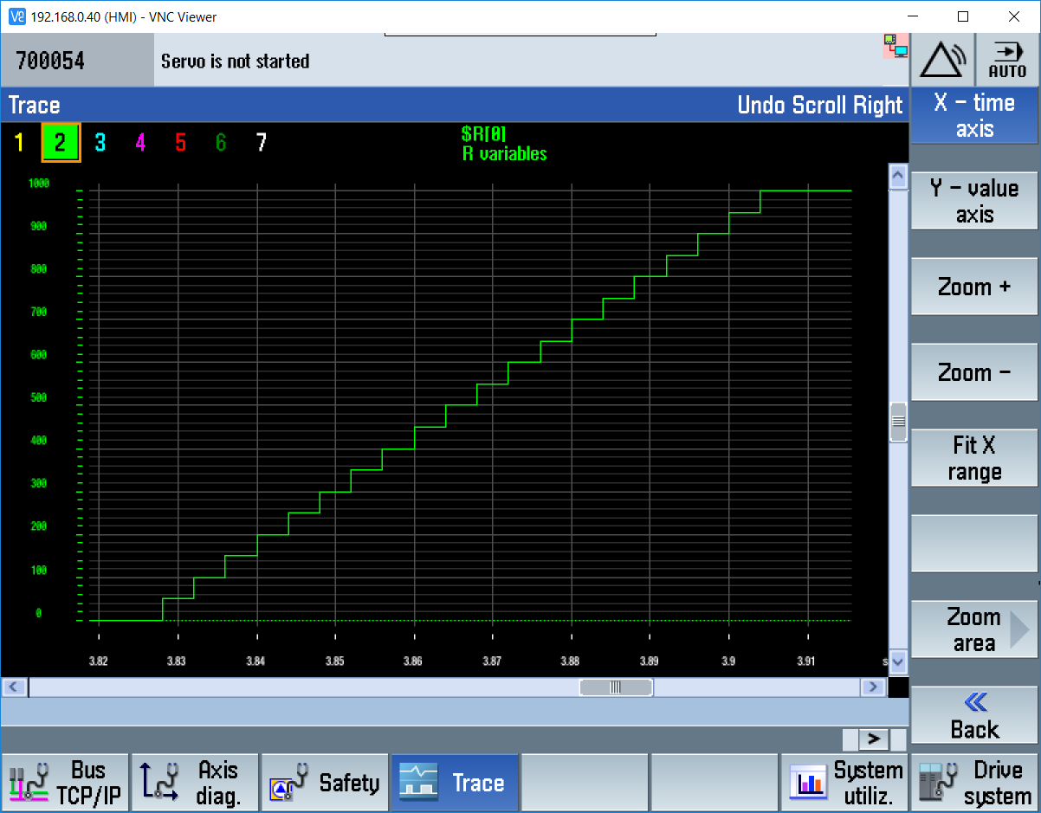
GPIO method
Utilize GPIO Pins - 12 digital signals
Electrical Switching mechanism
Profinet Interface Module + Digital input module
Average 4 ms data update cycle is monitored
X axis – time , Y axis – CNC system variable value

Slide 7
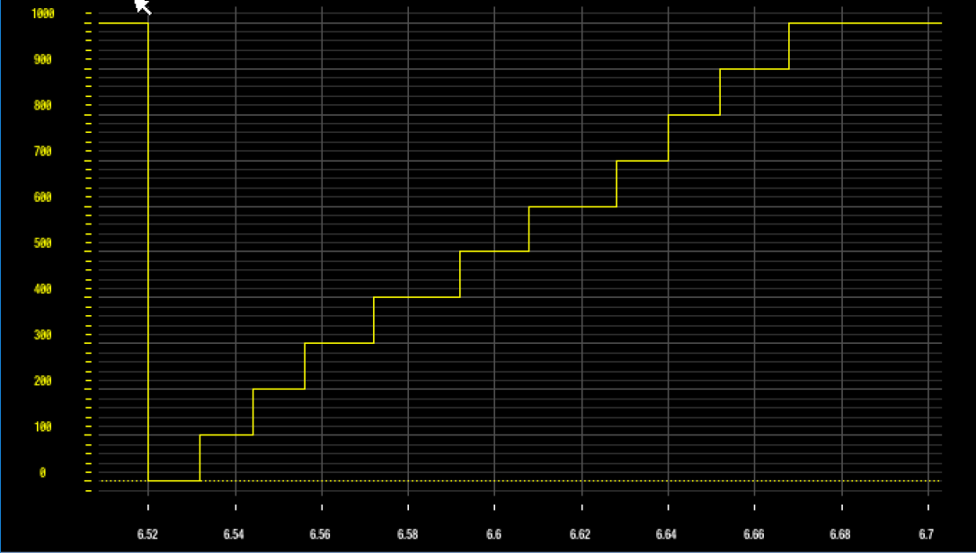
OPC UA method
Communication protocol
Synchronous data exchange based control
No additional hardware required
Modify 3 CNC system variables
Average 14 ms data update cycle monitored
X axis – time , Y axis – CNC system variable value

Slide 8
Results & Conclusion
Average data update cycle in GPIO is 4 ms and OPC UA is 14 ms.
CNC system have less data update cycle in GPIO than OPC UA.
OPC UA is easy to implement
GPIO requires additional hardware
Data Type , through GPIO integer only
GPIO implementation is limited due to number of pins

Slide 9
Questions
?

