Slide 1
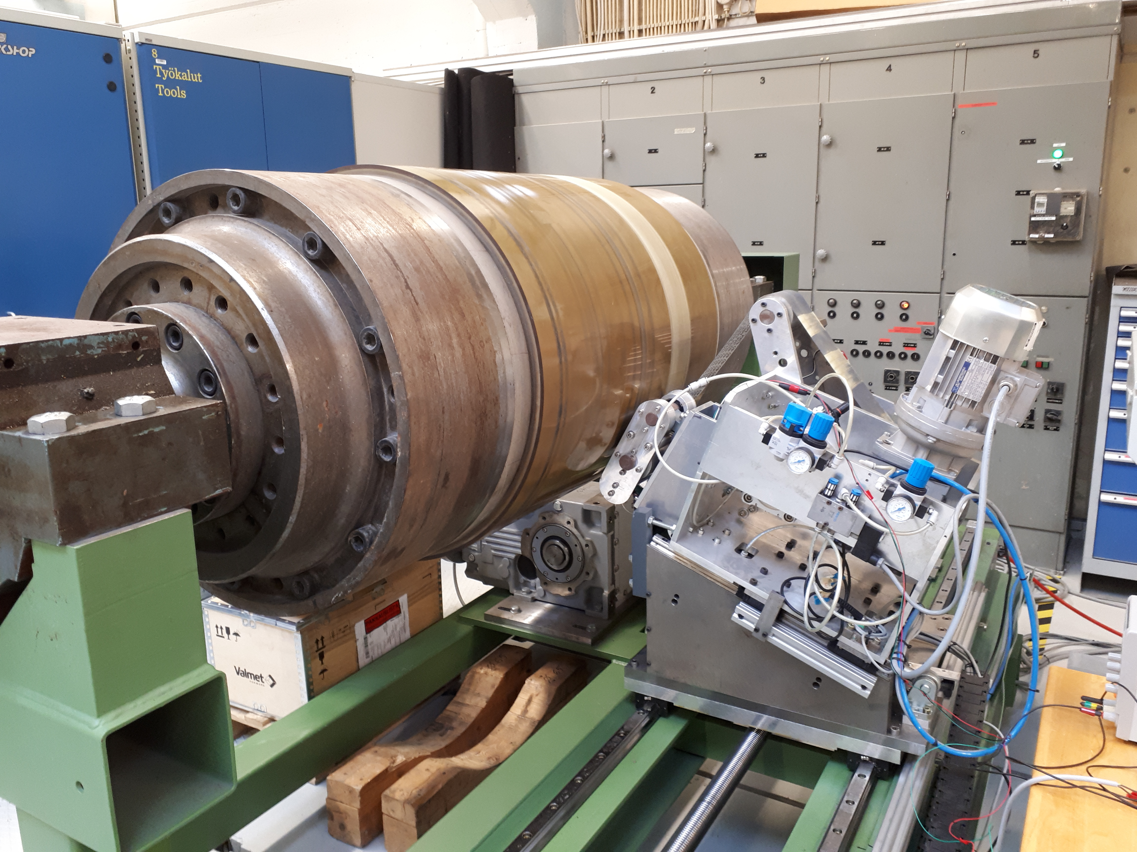
Superfinisher
Team SuperFin Panu Kiviluoma
Antti Kopsa Petri Kuosmanen
Janne Mattila
Jenni Pekkarinen

Slide 2
Content
Introduction
Research goal
Operation principle
Measuring
Results

Slide 3
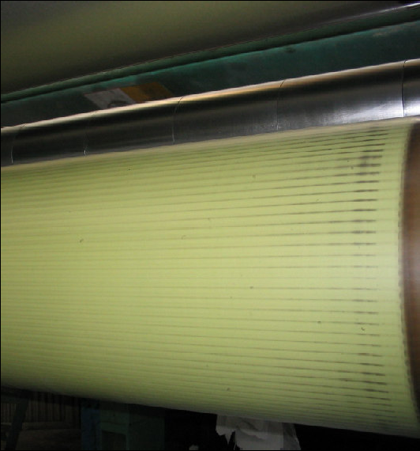
Introduction
Barring
Runout
Causes variation to paper quality
Previous measuring methods
Linear displacement sensors
Laser
Figure: Barring on an Elastic Cover of an S-Roll-Shell. SHW Newsletter No.9, January 2004.

Slide 4
Research goal
Measuring
By accelerometer
Controlling
Voice coil
Based on accelerometer and encoder

Slide 5
Operation principle (1/2)
Measuring
Grinding
Follower roll
Accelero-
meter
Voice coil motor

Slide 6
Operation principle (2/2)
Measuring
Accelerometer
Encoder
Analyzing data
Matlab
Adjusting grinding pressure
With voice coil motor

Slide 7
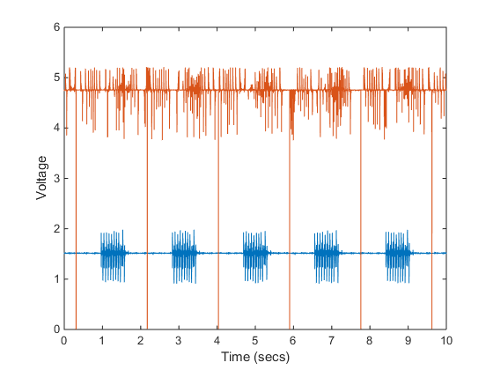
Measuring
Experimental measurement with tapes
Encoder
Accelerometer
Analyzing data
Matlab
Adjusting grinding pressure
Controlling voice coil

Slide 8
Results
Able to recognize barring with accelerometer
Able to control grinding based on measurement

Slide 9
Questions?

