Slide 1
Global Marketing Management Course kick-off
Paula Kilpinen, 8.1.2019

Slide 2
Agenda
Welcome and introduction to the course
Introductions
Objectives and Learning outcomes
Course syllabus and Schedule
Course practicalities
Business project
L’Oréal Brandstorm
Case report and case presentation
Speed dating- Getting to know each other

Slide 3
Introductions
Academic experience
L’Oréal 1990-2003 (HQ/subsidiary)
General Manager for the Luxury Products Division
AaltoEE: Head of Solutions and Impact, part of the management team 2013-2016
HRM Partners, CEO and business coach, 2016-
Working with a number of Finnish Top 100 companies
RESPONSE-project researcher 2006-09 (Nokia, Kone, Wärtsilä, Perlos, Fiskars)
Doctoral dissertation 2005-2013
Post-doc Researcher and Lecturer 2013-
Business experience
Executive education, career and leadership development, coaching

Slide 4
Introductions

Slide 5
Objectives
Apply international business and marketing concepts into real life situations in international companies
Work with a global company and partcipate in L’Oréals Brandstorm competion
Work on a ‘hands‐on’ project in a multicultural team

Slide 6
Learning outcomes
Prepare an international product launch and marketing campaign
Analyse market-and customer-related data
Collaborate in culturally diverse teams
Communicate effectively in an international setting
Make a competitive presentation (written and oral)

Slide 7
Project-based learning
”Project-based learning is a type of instruction, where students work together to solve realworld problems. Successful problem-solving often requires students to draw on lessons from several disciplines and apply them to the problem.”

Slide 8
Traditional vs. project-based learning

Slide 9
Course syllabus and schedule

Slide 10
Business project

Slide 11
Business project: L’Oréal Brandstorm
CASE REPORT
10 pages
Market analysis, opportunities and strategy
CASE PRESENTATION
3 + 7 (Back-up) slides: Focus on the solution and strong strategy, and based on a solid analysis, feedback from teacher and peers
5 min video presentation with 3 slides, panel will consist of L’Oréal managers

Slide 12
Business project

Slide 13
Business project

Slide 14
Business project

Slide 15
Business project

Slide 16
Business project

Slide 17
Case Report (10 pages)
The analysis involves the following steps and questions:
1. Analyze the market, customers and consumers
Which competitors spring to mind?
Where does L’Oréal position itself within this market?
Who are the brand consumers?
What trends can you identify?
What innovations strike you (services, digital,etc)?

Slide 18
Case Report (10 pages)
2. Based on what you have just found out, do a SWOT analysis. This is a key step to defining the opportunities by analyzing:
Business Performance
Product Portfolio
Market Share and Potential Growth
Positioning and Image
Target Demographics
Pricing
Communication Strategy (online and offline)

Slide 19
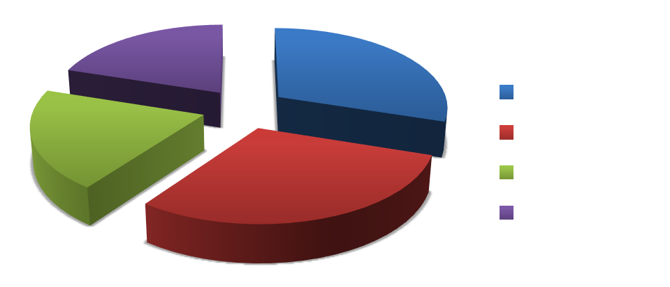
Case presentation
3 + 7 (Back-up) slides: Focus on the solution and strong strategy, and based on a solid analysis
5 min video presentation with 3 slides
Panel will consist of L’Oréal managers and Aalto Faculty

Slide 20
Business project
Form a team (group of 3) and send the information to Xiaoshi via mycourses or e-mail xiaoshi.xu@aalto.fi
Find a name for your team
Register by January 18th

Slide 21
Course practicalities

Slide 22
Course requirements- attendance
75 % participation required
Learning process:
Active participation in class: max 2 points/ class
Learning journal (1/3 page) using the wiki activity module on mycourses learning space, max 2 points/ entry
Key learnings and take-aways from the day’s session
How to apply the session’s content into the business project
Learnings from the project team work
Reflection paper on course readings (1/2 page), max 2 points/paper

Slide 23
Evaluation
Case and its presentation 80%
Case report 10 pages (analysis) 20%
Case resort (10 ppt slides) 30%
Presentation (5 min) 30%
Class activity 20%
Active participation in class
Learning journal
or Reflection papers

Slide 24
Course hours and consultation
Course hours Main Building A-401
Tuesday 9.15‐11:30
Friday 9.15‐11:30
Consultation: Right after class
Course website: https://mycourses.aalto.fi/course/search.php?search=26E00800
E-mail to: paula.kilpinen@aalto.ﬁ or xiaoshi.xu@aalto.fi

Slide 25
Speed dating

Slide 26
Speed dating
Introduce yourself to 5-6 other people
Discuss the following questions:
What motivates you to take the course?
What inspires you in the Brandstorm competition?
What would you contribute to the project work?

Slide 27
For next class
Familiarize yourself with the Brandstorm challenge and be prepared to ask questions
Complete your personal strenghts-based survey Reflect profile (optional) by January 15th
Form a team by January 18th

