Slide 1
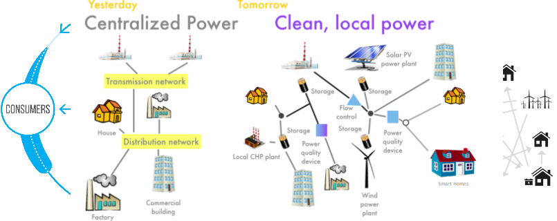
Business idea
Platform for peer to peer local renewable energy
Create a platform to provide local communities with peer to peer renewable energy
Our proposal would have full impact on the SDG #7 – Affordable and clean energy. Therefore, it would impact on the following aspects of the energy supply for local communities:
Better usage of available energy
Empowerment of sustainable and profitable energy utilization
Promotion of green and alternative energies
Development of a local community (peer-2-peer)
Less need of energy transportation, reducing both costs and contamination
More households in small companies are investing in smart meters, energy storages and even solar panels
To tackle climate change we have to integrate renewable energy resources into the power grid
It allows a simple way to enable a peer-to-peer market for producers and consumers of energy → inspired by sharing economy

