Slide 1
A C-123/11 and KHO 2013:155
Group Taxation – Loss relief in cross-border merger into Finland
Sanna Sotkasiira, Veera Taimi and Nelli-Maria Sarasmaa

Slide 2
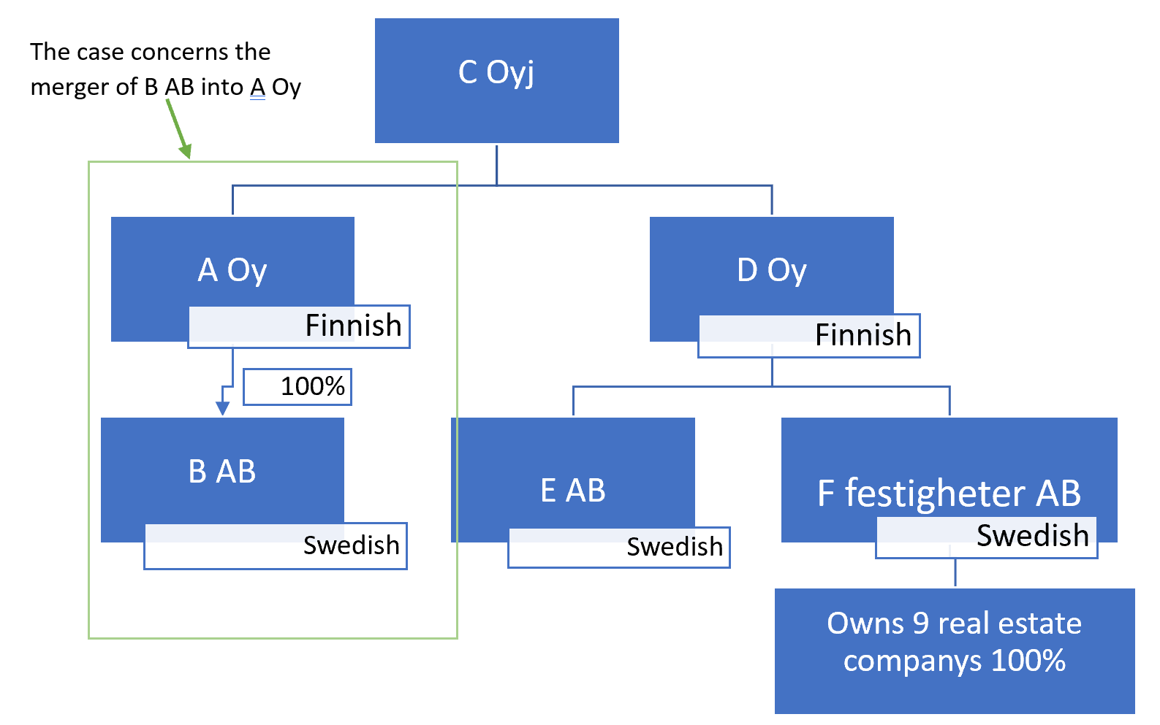
C-Group

Slide 3
Facts of the case
A Oy applied for an advance decision on whether it would be able to deduct B AB´s losses in accordance with Paragraph 123(2) of the Law on income taxes after the B AB had been merged into A Oy.
Following trading losses, B AB closed it's sales outlets with no intention to continue trading in Sweden. However, B AB remained bound by two long-term leases of business premises.
A´s business plan was to carry out the cross-border subsidiary merger. The merger was a commercially reasonable solution because responsibilities, assets and liabilities was transferred to the A. Since B no longer had employees in Sweden, there was no permanent establishment in Sweden.
B has no possibility to deduct losses in Sweden because there is no longer permanent establishment. Therefore the question is about the final losses.
According to Finnish Keskusverolautakunta A Oy could not deduct from tax the subsidiary's losses on the ground that B’s losses had been ascertained pursuant to Swedish tax law.
A appealed against the Keskusverolautakunta´s decision and appealed a judgment from the KHO relying in particular on freedom of establishment.
A also referred to the Council directive (2009/133/EC) which purpose is to permit cross-border mergers and acquisitions in principle under the same conditions as purely domestic arrangemets.

Slide 4
Decision and argumentation of the courts
Korkein hallinto-oikeus (KHO)
KHO wondered the question whether the Finnish legislation containes a restriction of freedom of establishment and if so, could the restriction be justified on the public interest grounds relied on balanced allocation of their power to income taxes and to guard against the risks of the double use of the losses and tax avoidance.
Therefore, the KHO requested for a preliminary ruling concerned the interpretation of Articles 49 TFEU and 54 TFEU. The request included the following to questions:
1) Do the articles in question require that A may deduct the losses of B which was resident in another Member State and which has merged with the A, when those losses arise from the B’s activity there in the years prior to the merger and when the A has no permanent establishment in the State of residence of B and, under national law, the receiving company may deduct losses of the merged company only if the latter is a resident company or the losses arose in the permanent establishment situated in that State?
2) Do the articles have a bearing on whether the loss to be deducted is calculated in accordance with the tax legislation of the receiving comapny's State of residence, or should the losses ascertained pursuant to the law of the State of residence of the company which is to be merged be considered as deductible losses?

Slide 5
Decision and argumentation of the courts
Court of Justice of the European Union (CJEU)
When setting up a subsidiary B in Sweden, A used its right to freedom of establishment, so Articles 49 TFEU and 56 TFEU apply.
Because Finnish law has granted a tax advantage for the parent company by allowing the resident parent company the possiblity of taking a resident subsidiary's losses into account when it merges with the subsidiary, the exlusions of such an advantage would make establishment in another Memeber State less attractive.
For such a different treatment to be compatible with EU law, it must relate to situations which are not objectively comparable or be justified by an overriding reason in the public interest.
In this case the situation are objectively comparable from the point view that tax legislation intends to allow the parent company to benefit from the tax advantage.
Justification: a restrictive measure would go beyond what is necessary to the attain the essential part of the objectives pursued in a situation in which the non-resident subsidiary has exhausted the possibilities available in the State of residence of having the losses taken into account. It is for the parent company to show that is the case.

Slide 6
Decision and argumentation of the courts
CJEU´s answers to KHO's questions:
1) The articles don't preclude national legislation under which a parent company merging with a subsidiary established in another Member State, which has ceased activity, cannot deduct from its taxable income the losses incurred by that subsidiary in respect of the tax years prior to the merger, while that national legislation allows such a possibility when the merger is with a resident subsidiary.
Such national legislation is none the less incompatible with European Union law if it does not allow the parent company the possibility of showing that its non-resident subsidiary has exhausted the possibilities of taking those losses into account and that there is no possibility of their being taken into account in its State of residence in respect of future tax years either by itself or by a third party.
2) The rules for calculating the non-resident subsidiary’s losses for the purpose of their being taken over by the resident parent company must not constitute unequal treatment compared with the rules of calculation which would be applicable if the merger were with a resident subsidiary.

Slide 7
Decision and argumentation of the courts
The judgement of KHO:
The KHO overruled the preliminary ruling and gave a new one:
If B merger into A, A Oy can deduct B AB´s losses according to Finnish legislation and
if A Oy verify that B has used all possibilities to notice the losses and there is no possibility that B or a third part could notice those losses in Sweden for future tax years.
Additionally, the losses should be represented according to The Act on Income from Professional Activities.

Slide 8
Implications
This decision will make it easier for companies to do international business when foreign companies are not treated differently from domestic ones.
The risk is that companies start to misuse the transfer of losses to another country.

Slide 9
Sources
KHO:2013:155. https://www.kho.fi/fi/index/paatoksia/vuosikirjapaatokset/vuosikirjapaatos/1380864264713.html
C123/11. http://curia.europa.eu/juris/celex.jsf?celex=62011CJ0123&lang1=fi&type=TXT&ancre=
Council directive 2009/133/EC.
https://eur-lex.europa.eu/legal-content/EN-FI/TXT/?uri=CELEX:32009L0133&from=EN

