Slide 1
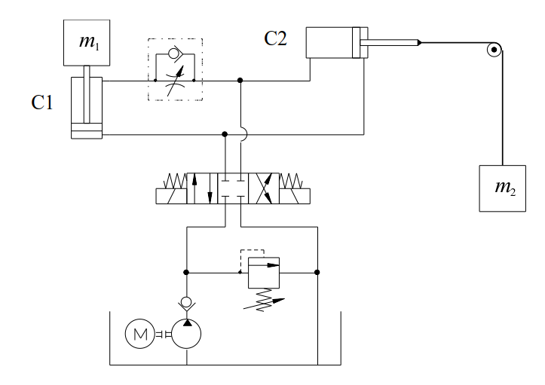
Pressure here = 0
no pressure losses in the directional control valve.
Also during movement.
Exercise 9
Pressure here > 0
- during movement (lifting)
Pressures needed to start the lifting?
Flow rates are zero ⇒ pressures due to flow friction do not exist
”Ideal” directional control valve here, no pressure losses.
Notice rod side area here as the active piston area.

Slide 2
Start pressures
Lower pressure need here ⇒ this will start

Slide 3
During movement
Throttle flow rate
Pressure here > 0 during movement (lifting)
The flow rate is smaller than pump flow rate
Pump flow rate
Pressure loss (if all the pump flow goes to C1)
Start of lift
192,95 bar
Reduced to A side
A side pressure (= pump pressure)
⇒ Cylinder C2 is moving as well (”sooner”)! ⇒ all the pump flow rate does not go to C1

Slide 4
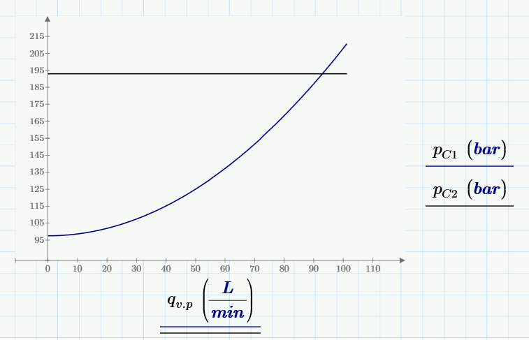
Cylinder pressure as function of flow rate
Cylinder input pressure rises if flow rate increases
(because of throttle flow)
When cylinder pressure C2 is reached ⇒ balance
Increasing cylinder flow rate

Slide 5
Flow rates - analytical
p_{B}= ?
192,95 bar
B
For lifting of load 97,68 bar is needed (calculated earlier)
For the throttle pressure loss
192,95 bar - 97,68 bar = 95,27 bar
is needed at A side (piston side)!
The corresponding pressure at B side is
192,95 bar
A
The corresponding throttle flow
Piston velocity (C1)
Flow rate for A chamber (piston side)

Slide 6
Cylinder C2
Flow rate to cylinder C2 (pump flow rate – cylinder C1 flow rate)
Cylinder C2 piston velocity

Slide 7
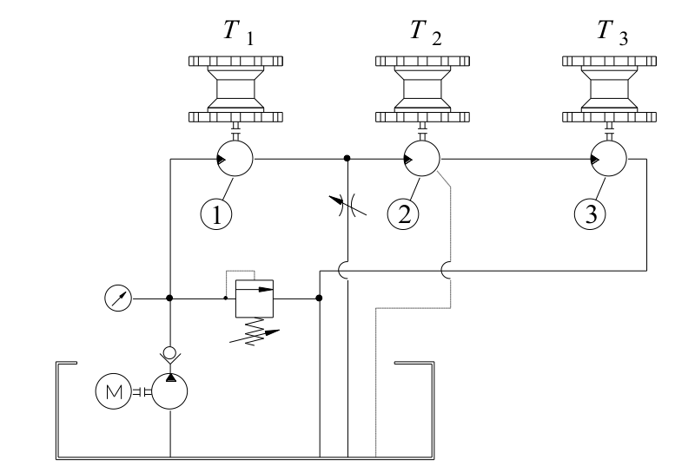
Exercise 10
Calculate the minimum setting pressure of pressure relief valve needed to ensure the operation of the system at the announced loads. In addition, calculate the rotational speed of the motors.
System is used to operate three chain conveyors, each equipped with individual hydraulic drive motor. Load torques of the motors are T₁ = 1500 Nm, T₂ = 700 Nm and T₃ = 300 Nm. Displacements of the motors are V _{g,m1} = 1000 cm³/r, V _{g,m2} = 1000 cm³/r and V_{g,m3} = 500 cm³/r. Efficiencies of all the motors η_{v} = 0.90 ja η_{hm} = 0.85, the leakages of motors 1 and 3 are totally internal and of motor 2 totally external.
System pump produces constant flow of 8 l/min. The controllable throttle is circular in cross-section and has a diameter of d_{t} = 0.5 mm. C_{q} = 0.7 and ρ = 860 kg/m³.

Slide 8
Pressures

Slide 9
Rotational speed of motors
Pump flow – throttle flow
Motor 2 input flow – motor 2 case drain
Pump flow
Internal
Internal
External
Pump flow – throttle flow ⇒ motor 2
$$q_{V,m2}=q_{V,P}−q_{V,t}=6,77 l/min$$
Motor 2 input flow – motor 2 case drain ⇒ motor 3
Pump flow
$$q_{V,m3}=q_{V,m2}∙η_{v,m2}=6,09 l/min$$
$$n_{m3}=\left(\frac{q_{V,m3}}{V_{g,m3}}\right)∙η_{v,m3}=10,96 r/min$$

