Slide 1
Fluid Power Basics - Assignments 2019
Assignment 2
Exercises 5-8
Calculation exercises
Exercises
Input prameters
Tables for results
Version official
1.2

Slide 2
Instructions:
Form the research group (maximum 4 people) via MyCourses.
This file contains instructions for completing calculation exercises.
Assignments explained
Input parameters to be used. Different for each group (A-J).
Prepare 2 files
This template with Results (use the existing tables in the document)
Calculation file (pdf) inluding equations used. Electronic formats (Mathcad, Matlab, Excel, etc.). Also clear hand-written (and scanned) documents possible!
Submit your a) numerical results (this file) and b) calculation file (pdf) to MyCourses calculation assignment mailbox before the deadline!
Deadline 28.2.2019

Slide 3
Group identification (fill in)
Group code (A-J)
Group members

Slide 4
Updates
Page 13, correction (10.2.2019)
0.45 l/min leakage @ 35 bar ⇒ 0.45 l/min leakage @ 50 bar
Pages 8 and 11 (12.2.2019)
New output tables for both loads (m₁ and m₂)

Slide 5
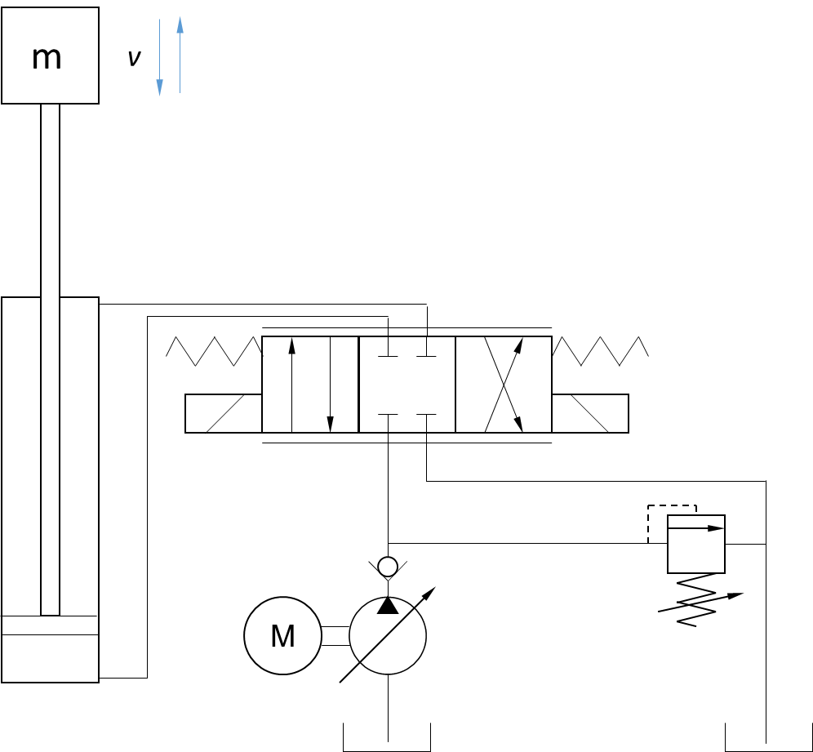
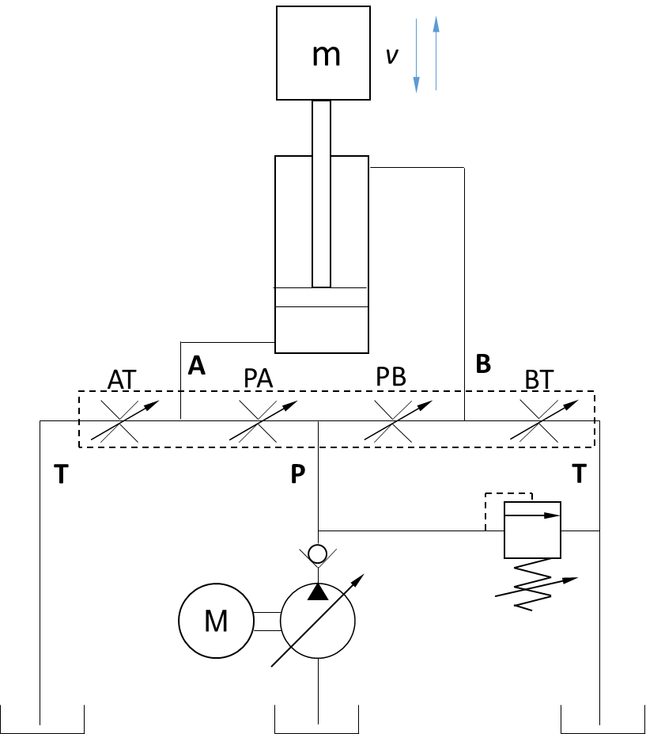
Hydraulic cylinder system performance
U> 0 V PA, BT open
U< 0 V PB, AT open
Cylinder system with 4/3 proportional control valve
Cylinder system with equivalent circuit for 4/3 proportional control valve

Slide 6
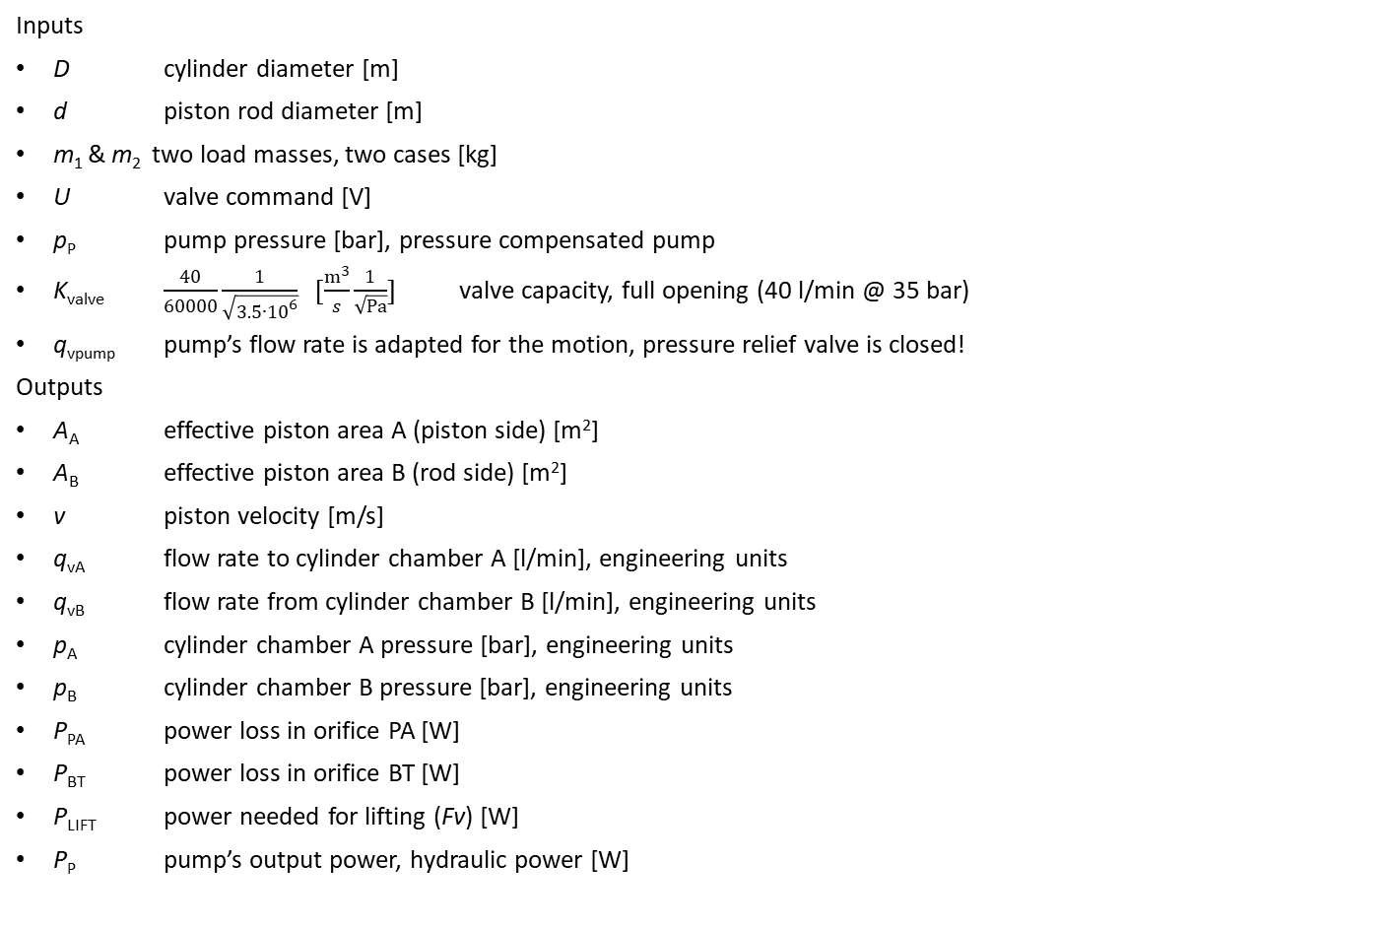

5. Hydraulic cylinder system - lifting
Hint!
Use
Force equation (cylinder)
Continuity equations (cylinder chamber flows and piston velocity)
Turbulent throttle equation(s)
Boundary conditions are pump and tank pressure: describe throttle flows as functions of pressures (pressure differences) to solve for the piston velocity.
Other solution methods also possible!
Inputs
D cylinder diameter [m]
d piston rod diameter [m]
m₁ & m₂ two load masses, two cases [kg]
U valve command [V]
p_{P} pump pressure [bar], pressure compensated pump
K_{valve} $\frac{40}{60000}\frac{1}{\sqrt{3.5∙{10}^{6}}} [\frac{m^{3}}{s}\frac{1}{\sqrt{Pa}}]$ valve capacity, full opening (40 l/min @ 35 bar)
q_{vpump} pump’s flow rate is adapted for the motion, pressure relief valve is closed!
Outputs
A_{A} effective piston area A (piston side) [m²]
A_{B} effective piston area B (rod side) [m²]
v piston velocity [m/s]
q_{vA} flow rate to cylinder chamber A [l/min], engineering units
q_{vB} flow rate from cylinder chamber B [l/min], engineering units
p_{A} cylinder chamber A pressure [bar], engineering units
p_{B} cylinder chamber B pressure [bar], engineering units
P_{PA} power loss in orifice PA [W]
P_{BT} power loss in orifice BT [W]
P_{LIFT} power needed for lifting (Fv) [W]
P_{P} pump’s output power, hydraulic power [W]
The flow rate in each of the control edges (throttles) can be calculated with equation
$$q_{v}=K_{valve}\frac{\left|U\right|}{10}\sqrt{∆p}$$
Pressure relief valve (PRV) is closed
U> 0 V PA, BT open
U< 0 V PB, AT open
For lifting consider control edges
PA and BT partially open, defined by valve voltage U
PB and AT closed (no leakage)
Fluid Power Basics

Slide 7
5. Input parameters
Input parameters for Groups A-J

Slide 8
5. Results
Outputs | Value | Unit | Definition
A_{A} |  | [m²] | effective piston area A (piston side)
A_{B} |  | [m²] | effective piston area B (rod side)
LOAD 1
v₁ |  | [m/s] | piston velocity
q_{v,A.1} |  | [l/min] | flow rate to cylinder chamber A, engineering units
q_{v,B.1} |  | [l/min] | flow rate from cylinder chamber B, engineering units
p_{A.1} |  | [bar] | cylinder chamber A pressure, engineering units
p_{B.1} |  | [bar] | cylinder chamber B pressure, engineering units
P_{PA.1} |  | [W] | power loss in orifice PA
P_{BT.1} |  | [W] | power loss in orifice BT
P_{LIFT.1} |  | [W] | power needed for lifting (Fv)
P_{PUMP.1} |  | [W] | pump’s output power, hydraulic power
LOAD 2
v₂ |  | [m/s] | piston velocity
q_{v,A.2} |  | [l/min] | flow rate to cylinder chamber A, engineering units
q_{v,B.2} |  | [l/min] | flow rate from cylinder chamber B, engineering units
p_{A.2} |  | [bar] | cylinder chamber A pressure, engineering units
p_{B.2} |  | [bar] | cylinder chamber B pressure, engineering units
P_{PA.2} |  | [W] | power loss in orifice PA
P_{BT.2} |  | [W] | power loss in orifice BT
P_{LIFT.2} |  | [W] | power needed for lifting (Fv)
P_{PUMP.2} |  | [W] | pump’s output power, hydraulic power
VALVE
K_{VALVE} |  | [m^3/𝑠 1/√Pa] | valve capacity parameter for each control edge, full opening

Slide 9
6. Hydraulic cylinder system - lowering
The flow rate in each of the control edges (throttles) can be calculated with equation
$$q_{v}=K_{valve}\frac{\left|U\right|}{10}\sqrt{∆p}$$
Inputs
The same as in exercise 5, except
U valve command [V]
Outputs
v piston velocity [m/s]
q_{vA} flow rate from cylinder chamber A [l/min], engineering units
q_{vB} flow rate to cylinder chamber B [l/min], engineering units
p_{A} cylinder chamber A pressure [bar], engineering units
p_{B} cylinder chamber B pressure [bar], engineering units
P_{AT} power loss in orifice AT [W]
P_{PB} power loss in orifice PB [W]
P_{LOWER} power from lowering (⎪Fv ⎪) [W]
P_{P} pump’s output power, hydraulic power [W]
Pressure relief valve (PRV) is closed
U> 0 V PA, BT open
U< 0 V PB, AT open
For lifting consider control edges
PB and AT partially open, defined by valve voltage U
PA and BT closed (no leakage)
Fluid Power Basics

Slide 10
6. Input parameters
Input parameters for Groups A-J

Slide 11
6. Results
Outputs | Value | Unit | Definition
LOAD 1
v₁ |  | [m/s] | piston velocity
q_{v,A.1} |  | [l/min] | flow rate from cylinder chamber A, engineering units
q_{v,B.1} |  | [l/min] | flow rate to cylinder chamber B, engineering units
p_{A.1} |  | [bar] | cylinder chamber A pressure, engineering units
p_{B.1} |  | [bar] | cylinder chamber B pressure, engineering units
P_{PAT.1} |  | [W] | power loss in orifice AT
P_{PB.1} |  | [W] | power loss in orifice PB
P_{LIFT.1} |  | [W] | mechanical power from lowering (⎪Fv⎪)
P_{PUMP.1} |  | [W] | pump’s output power, hydraulic power
LOAD 2
v₂ |  | [m/s] | piston velocity
q_{v,A.2} |  | [l/min] | flow rate from cylinder chamber A, engineering units
q_{v,B.2} |  | [l/min] | flow rate to cylinder chamber B, engineering units
p_{A.2} |  | [bar] | cylinder chamber A pressure, engineering units
p_{B.2} |  | [bar] | cylinder chamber B pressure, engineering units
P_{AT.2} |  | [W] | power loss in orifice AT
P_{PB.2} |  | [W] | power loss in orifice PB
P_{LIFT.2} |  | [W] | mechanical power from lowering (⎪Fv⎪)
P_{PUMP.2} |  | [W] | pump’s output power, hydraulic power

Slide 12

7. Hydraulic cylinder system - leakage
Inputs
The same as in exercise 5, except
U= 0 valve command [V]
K_{LEAK} leakage flow parameter [m³/s/Pa]
v= 0 piston velocity [m/s]
Outputs
q_{vPA} flow rate through orifice PA [l/min], engineering units
q_{vPB} flow rate through orifice PB [l/min], engineering units
q_{vAT} flow rate through orifice AT [l/min], engineering units
q_{vBT} flow rate through orifice BT [l/min], engineering units
q_{vP} pump’s flow rate [l/min], engineering units
p_{A} cylinder chamber A pressure [bar], engineering units
p_{B} cylinder chamber B pressure [bar], engineering units
P_{PA} power loss in orifice PA [W]
P_{PB} power loss in orifice PB [W]
P_{AT} power loss in orifice AT [W]
P_{BT} power loss in orifice BT [W]
P_{P} pump’s output power, hydraulic power [W]
F force needed to stop the cylinder movement [N]
F
v= 0
The leakage flow in each of the control edges (throttles) is laminar and the flow rate can be calculated with equation
$$q_{v}=K_{LEAK}∆p$$
AT
A
PA
PB
B
BT
T
P
T
M
Pressure relief valve (PRV) is closed
Fluid Power Basics

Slide 13

7. Input parameters
*
Calculate parameter K_{LEAK}
$$q_{v}=K_{LEAK}∆p$$
by using parameters
q_{v}= 0.45/60000 m³/s
Δp= 50⋅10⁵ Pa
(0.45 l/min leakage @ 50 bar)
Input parameters for Groups A-J

Slide 14
7. Results
Outputs | Value | Unit | Definition
K_{LEAK} |  | [m3/s/Pa] | leakage flow rate parameter
q_{v,A} |  | [l/min] | flow rate through orifice PA [l/min], engineering units
q_{v,B} |  | [l/min] | flow rate through orifice PB [l/min], engineering units
q_{vAT} |  | [l/min] | flow rate through orifice AT [l/min], engineering units
q_{vBT} |  | [l/min] | flow rate through orifice BT [l/min], engineering units
q_{vP} |  | [l/min] | pump’s flow rate [l/min], engineering units
p_{A} |  | [bar] | cylinder chamber A pressure [bar], engineering units
p_{B} |  | [bar] | cylinder chamber B pressure [bar], engineering units
P_{PA} |  | [W] | power loss in orifice PA
P_{PB} |  | [W] | power loss in orifice PB
P_{AT} |  | [W] | power loss in orifice AT
P_{BT} |  | [W] | power loss in orifice BT
P_{P} |  | [W] | pump’s output power, hydraulic power
F |  | [N] | force needed to stop the cylinder movement

Slide 15

8. Hydraulic cylinder system – leak + movement
Inputs
The same as in exercise 7, except
F= 0 no external piston force [N]
Outputs
q_{vPA} flow rate through orifice PA [l/min], engineering units
q_{vPB} flow rate through orifice PB [l/min], engineering units
q_{vAT} flow rate through orifice AT [l/min], engineering units
q_{vBT} flow rate through orifice BT [l/min], engineering units
q_{vP} pump’s flow rate [l/min], engineering units
p_{A} cylinder chamber A pressure [bar], engineering units
p_{B} cylinder chamber B pressure [bar], engineering units
P_{PA} power loss in orifice PA [W]
P_{PB} power loss in orifice PB [W]
P_{AT} power loss in orifice AT [W]
P_{BT} power loss in orifice BT [W]
P_{P} pump’s output power, hydraulic power [W]
v piston velocity [m/s]
The leakage flow in each of the control edges (throttles) is laminar and the flow rate can be calculated with equation
$$q_{v}=K_{LEAK}∆p$$
v
F= 0
AT
A
PA
PB
B
BT
T
P
T
Hint!
Use
Force equation (cylinder)
Continuity equations (cylinder chamber flows and piston velocity)
Boundary conditions are pump and tank pressure: describe throttle flows as functions of pressure differences to solve for the piston velocity.
Other solution methods also possible!
M
Pressure relief valve (PRV) is closed
Fluid Power Basics

Slide 16
8. Input parameters
*
Calculate parameter K_{LEAK}
$$q_{v}=K_{LEAK}∆p$$
by using parameters
q_{v}= 0.45/60000 m³/s
Δp= 50⋅10⁵ Pa
(0.45 l/min leakage @ 35 bar)
Input parameters for Groups A-J

Slide 17
8. Results

