Slide 1
Imperfect competition
Svetlana ledyaeva
Notes:
Blackout the screen: Review: Ricardian: CA; H-0: factor abundance, what are the crucial common assumptions?

Slide 2
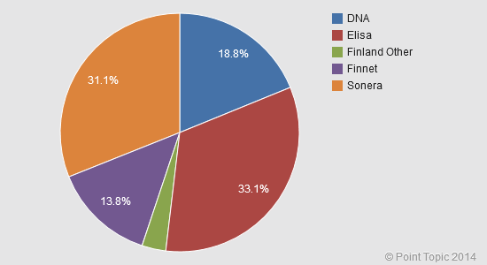
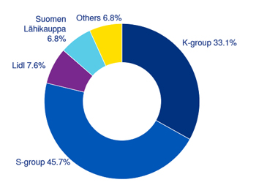
Perfect competition?

Slide 3
Perfect competition?
We have analysed perfect competition, in which agents optimize taking prices in the market as given
Many firms are large in their market; they realize that their production decisions will influence the market price
Firms will take this effect into consideration when maximizing profits; this brings us into the realm of imperfect competition
Another way to gain from trade: international trade can reduce the distortions of imperfect competition by increasing competition (pro-competitive gains from trade)

Slide 4
Outline
Monopoly equilibrium in Autarky
Oligopoly (duopoly) equilibrium in Autarky
Trade equilibrium and pro-competitive gains from trade
Prep for next lecture
Intra-industry trade
Dixit-Stiglitz demand

Slide 5
Monopoly Autarky equilibrium
Price
Monopolist faces market demand
Marginal revenue (MR) has the same intercept with a slope twice as steep
Assume constant MC
Max profit: MR=MC
Positive profit!
demand
p_{mon}
operating
profits
mark-up
MC
C
MR
q_{mon}
Quantity

Slide 6
Monopoly Autarky equilibrium
Assume constant MC=c & demand: p=a-b*q
Monopolist choose q to max profit: MC=MR
R= p*q = (a-b*q)q = aq-bq² ➔ MR = R`= a-2bq = MC = c
Solution: q*= (a-c)/2b, p*=(a+c)/2
General solution: price×(1-1/ε) = MC ,
where ε is price elasticity of demand (see textbook for details, p.180-181)
Mark-up depends on ε
ε=-(dq/dp)(p/q)

Slide 7
Recall: perfect competition eqm
slope = p_{M}/p_{F}
Recall that under perfect competition in all sectors in a country producing two goods (Food and Manufactures) in autarky:
domestic production = domestic consumption
MRT = MC_{M}/MC_{F}= p_{M}/p_{F} = MRS
The economy achieves the optimal equilibrium (given no trade)
Food
U_{au,pc}
MRS = p_{M}/p_{F}
MRT = p_{M}/p_{F}
ppf
Manufactures
Notes:
Delta Qf * MCf=delta Qm * MCm

Slide 8
Monopoly Autarky equilibrium
Consider a country producing two types of good in autarky: Food and Manufactures
Perfect competition in food sector: p_{F} = MC_{F}
Monopoly in the manufacturing sector: p_{M}×(1-1/ε) =MC_{M}
At the autarky equilibrium we know:
  domestic demand = domestic supply
  Utility maximization gives: MRS = p_{M}/p_{F}
  Profit maximization gives: p_{F} = MC_{F} & p_{M}×(1-1/ε) = MC_{M}
Combining this info gives a wedge between MRT and MRS:

Slide 9
Monopoly Autarky equilibrium
Autarky equilibrium: a point like mon
consumption = production
consumption at mon gives price ratio (equal to MRS)
MRT at mon lower than price ratio because of mark-up pricing in monopoly sector (so MRT < MRS = price ratio)
To be consistent we need: MRT / MRS = (1-1/ε)
Food
mon
-slope = MRT < p_{M}/p_{F}
-slope = MRS = p_{M}/p_{F}
U_{au,mon}
ppf
Manufactures

Slide 10
Monopoly Autarky equilibrium
The autarky equilibrium with a monopoly is not optimal; the equilibrium is distorted
a higher welfare level can be reached at point pc (where MRS = MRT = price ratio)
The extent of the distortion depends on the ratio
MRT / MRS = (1-1/ε) and thus on the mark-up of price over marginal cost in the monopoly sector
Food
U_{au,pc}
mon
slope = MRT < p_{M}/p_{F}
pc
slope = MRS = p_{M}/p_{F}
U_{au,mon}
ppf
Manufactures
Notes:
p_{M}×(1-1/ε) =MC_{M}

Slide 11
Duopoly Autarky equilibrium
We established that a monopolist charges a mark-up of price over marginal cost (using MR = MC)
This mark-up leads to operating profits and a sub-optimal outcome for the economy (too low production in monopoly sector)
There can also be a few firms active in a certain sector; this is called an oligopoly – each firm realizes its actions influence the market-clearing price level
We now analyse firm behaviour in a Cournot-setting: firms produce homogenous goods and choose their optimal output level, taking the output level of the other firms as given.
Profit maximization always involves MR = MC; we focus on a duopoly (two firms)

Slide 12
Duopoly Autarky equilibrium
2 firms: A & B
Let p be market price and q=q_{A}+q_{B} be total output; market demand is p=a-bq; total cost=c*q
Firm A chooses q_{A} to max its profit:
π_{A}=(p-c)q_{A}=[(a-c)-b(q_{A}+q_{B})]q_{A}
Solution: q_{A}*=(a-c)/2b-1/2*q_{B,} (A’s reaction curve)
Similarly, for firm B: q_{B}*=(a-c)/2b-1/2*q_{A} (B’s reaction curve)

Slide 13
duopoly Autarky equilibrium
At equilibrium:
q_{A}=q_{B}=(a-c)/3b
p_{duo}=(a+2c)/3
Recall p_{mon}=(a+c)/2
P_{mon}> p_{duo} (because a > c)
note that the duopoly equilibrium results in higher output, lower prices and lower mark-up
firm A reaction curve
output firm B
Cournot
q_{duo,B}
firm B reaction curve
q_{duo,A}
output firm A
Notes:
Difference=(a-c)/6

Slide 14
oligopoly Autarky equilibrium
General solution for more firms (see textbook for details)
A firm active in an oligopoly market realizes its actions affect the market clearing price
firm output ↑ implies market price ↓
The firm only takes into consideration the effect of the price decrease for its own output (and not the effect on the other firms)
Profit maximization (MR = MC) for firm A implies:
More oligopoly firms in the market implies lower market share per firm, and thus lower mark-up
market share of firm A

Slide 15
Pro-competitive gains from trade
A country with a monopoly – sector does not produce at the social optimum
This distortion can be reduced by allowing for free trade
Free trade ➔ more firms ➔ more competition ➔ lower market shares ➔ lower mark-up ➔ lower distortion
These are the pro-competitive gains from trade
They are operative in addition to the earlier analysed gains from technology differences and differences in factor abundance

Slide 16
monopoly autarky wedge
free trade oligopoly wedge
pro-competitive gains from trade
Figure 9.6
see book for details (p.186-187)

Slide 17
summary
Imperfect competition implies a mark-up of price over marginal costs
The size of the mark-up depends on the price elasticity of demand and the degree of competition
Imperfect competition leads to a sub-optimal outcome in general equilibrium (deviation between MRS and MRT)
International trade increases market competition and reduces the distortionary effect of imperfect competition (these are the pro-competitive gains from trade)

Slide 18
Intra-industry trade
Till now, we have discussed several reasons for inter-industry trade
Largest share of trade between the developed countries is intra-industry trade

Slide 19
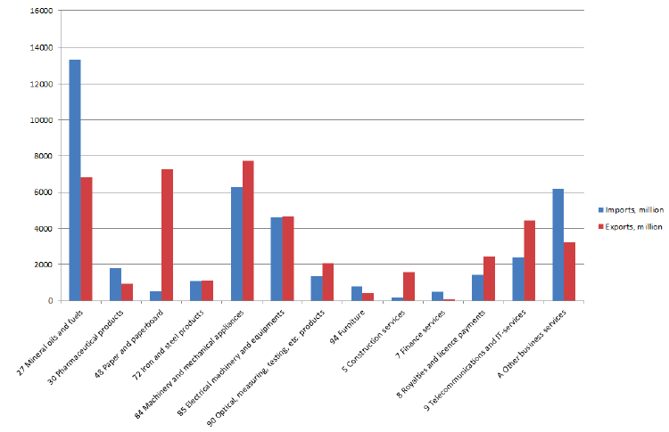
Finland, export and imports of some product categories in 2013

Slide 20
Intra-industry trade
How do we explain intra-industry trade?
To explain intra industry trade flows, Paul Krugman realized that the exported goods are usually similar, but not identical to the imported goods
Example: S. Korea exports LG mobile phones and imports Nokia mobile phones; these goods are produced with similar technology and factor intensity, but are not the same
Arguing that consumers like to demand different varieties, Krugman builds on the Dixit-Stiglitz (DS) monopolistic competition model to explain intra industry trade
Notes:
What is monoplistic competition

Slide 21
Dixit-stiglitz demand
DS demand is based on the following utility function:
where U = utility, i = variety index, c_{i} = consumption of variety i, N = number of varieties, α = parameter
α measures love of variety; if α=1, variety does not matter, goods are perfect substitutes; if α=0, varieties are complements for each other.
One interesting feature: consumers always want more varieties even if they have to reduce the consumption of existing varieties.

Slide 22
Dixit-stiglitz demand
To see this, assume that the consumer consumes all the varieties in equal amounts, ci = c, and p is the same for all varieties. Then given the budget constraint:
N×p×c=I ➔ c=I/(N×p)
This gives: U = (Nc^{α})^{(1/α)} = N^{(1/α)}c = N^{(1/α-1)*)}(Nc)
=n^{(1/α-1)}(I/p)
Since 1/α > 1, utility increases with the number of varieties (given total income)
Love of variety
Claim on resources
Notes:
Alpha measures love of variety

Slide 23


Dixit-stiglitz demand
Consumers maximize their utility:
Subject to the budget constraint:
Solution:
ε is elasticity of demand
Demand of a good variety depends on: income, price of j, ε & general price index P
Utility U=I/P
ε=1(1-a)>1

