Slide 2
Responsibility in Business
Matti Häyry
Aalto University School of Business
51E 00100 Business Ethics
Lecture 1

Slide 3
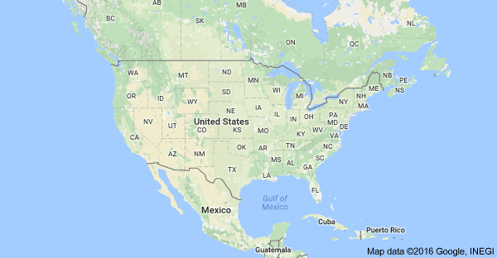
The Dan River Incident

Slide 4
The Dan River Incident

Slide 5

The Dan River Incident

Slide 6
The Dan River Incident
The pipe

Slide 7
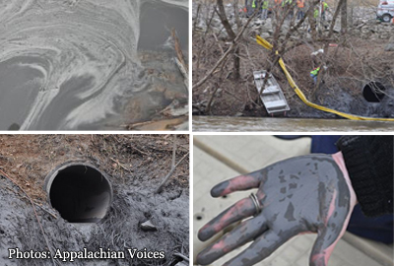
The Dan River Incident

Slide 8
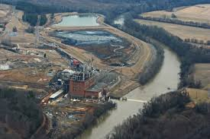
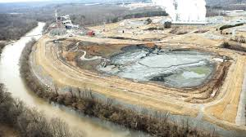
The Dan River Incident
On Sunday 2 February 2014, Duke Energy employees noticed that coal ash waste was spilling from one of the company’s coal ash ponds through a pipe into Dan River in Riverbend, near Eden, North Carolina.
The company delayed reporting this publicly until the next day.
The spillage was stopped in about a week.
Duke estimated that 50.000 to 82.000 tons of coal ash and 27 million gallons of contaminated water had been released into the Dan River.
http://www.catawbariverkeeper.org/issues/coal-ash-1/duke-energy-dan-river-coal-ash-spill-what-do-we-currently-know-what-do-we-need-to-know/?searchterm=None

Slide 9
The Dan River Incident
The Riverbend ash pond was an unlined high hazard coal ash waste pond which had been left untreated since the closure of the Duke Energy coal power plant in April 2013.
According to the operation permit, Duke was required to have the ash pond closed 1 year before closing the plant.
After the spill, Duke representatives said that this would be dealt with “eventually”.
Similarly toxic ash ponds remain in many closed coal power plant sites along rivers.
http://www.catawbariverkeeper.org/issues/coal-ash-1/duke-energy-dan-river-coal-ash-spill-what-do-we-currently-know-what-do-we-need-to-know/?searchterm=None

Slide 10
The Dan River Incident
The coal ash spill affected c. 70 miles of Dan River downstream Eden.
The coal ash settled mostly on the river bottom sediments.
Some of it has been removed, but not all of it can or ever will be.
The US Environmental Protection Agency (EPA) reports that there are no serious health hazards.
The financial damage to society has been estimated at > $ 300 million
https://www.epa.gov/dukeenergy-coalash/frequently-asked-questions-faqs-about-duke-energy-coal-ash-spill-eden-nc

Slide 11
So who is to blame?

Slide 12


Slide 13


Slide 14
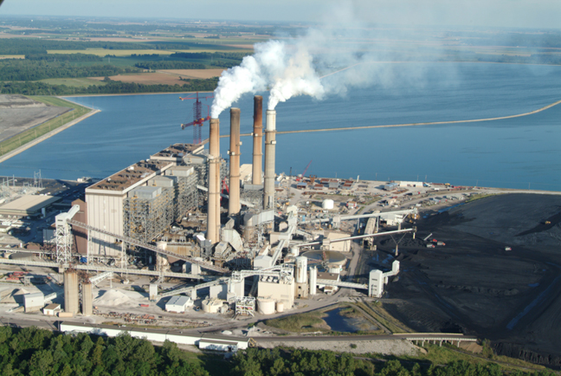

Slide 15
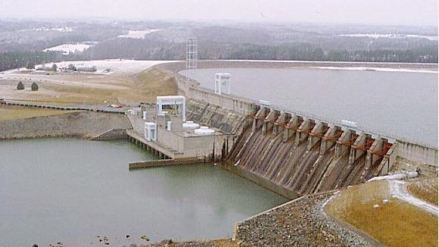

Slide 16
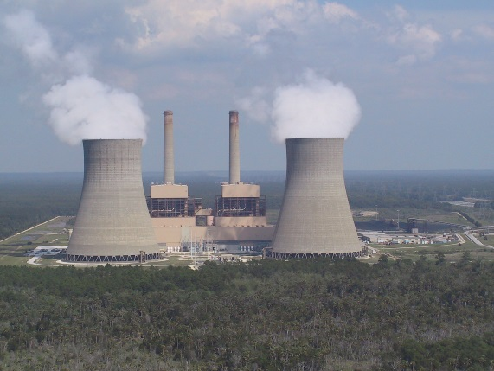

Slide 17
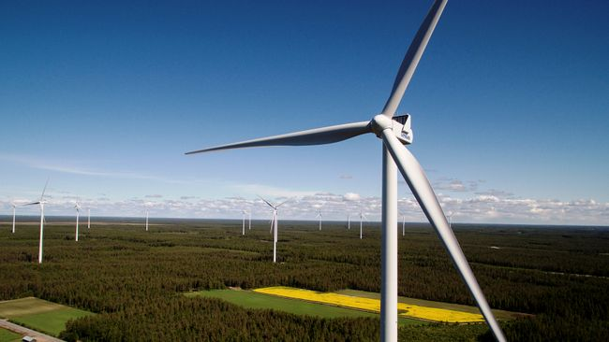

Slide 18
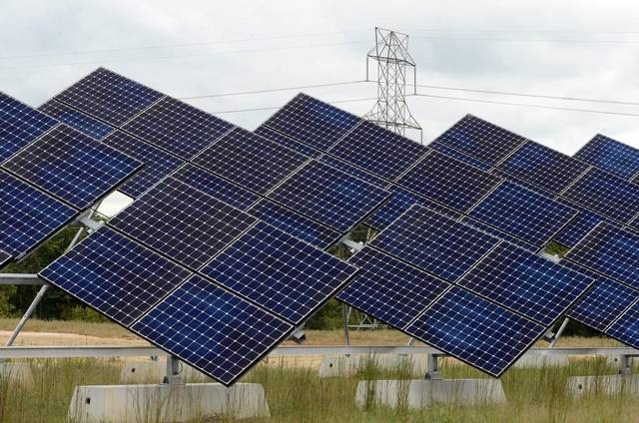

Slide 19
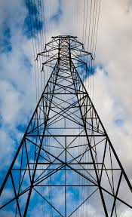

Slide 21
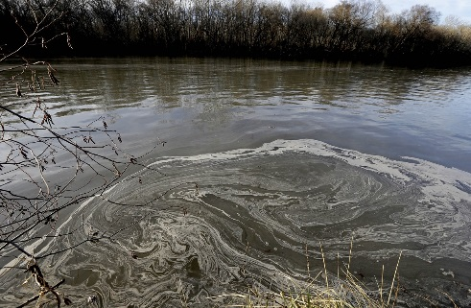
Duke Energy
Is one of the biggest US energy companies.
Has 7.4 million electricity retail customers in the South East and Mid West parts of the US.
Covers a population of about 24 million people.
Has 7 nuclear power plants, 18 coal-fired power stations, over 20 hydroelectric facilities, 24 oil and gas-fired facilities, 4 solar farms, and one wind farm.
Is doing well business-wise.
Is the 50th best US employer – Business Insider.
Wikipedia and official website

Slide 22
Duke Energy
In 1999, the EPA started an enforcement action against Duke Energy.
Wikipedia and its sources

Slide 23
Duke Energy
In 1999, the EPA started an enforcement action against Duke Energy.
They argued that DE had increased emissions by making unlicensed modifications to some of their old and deteriorating coal power plants.
Wikipedia and its sources

Slide 24
Duke Energy
In 1999, the EPA started an enforcement action against Duke Energy.
They argued that DE had increased emissions by making unlicensed modifications to some of their old and deteriorating coal power plants.
Lower courts supported DE’s view, but in 2007, the Supreme Court ruled in favour of the EPA.
Wikipedia and its sources

Slide 25
Duke Energy
In 1999, the EPA started an enforcement action against Duke Energy.
They argued that DE had increased emissions by making unlicensed modifications to some of their old and deteriorating coal power plants.
Lower courts supported DE’s view, but in 2007, the Supreme Court ruled in favour of the EPA.
In 2002, DE was identified as the 46th-largest corporate producer of air pollution in the US.
Wikipedia and its sources

Slide 26
Duke Energy
In 1999, the EPA started an enforcement action against Duke Energy.
They argued that DE had increased emissions by making unlicensed modifications to some of their old and deteriorating coal power plants.
Lower courts supported DE’s view, but in 2007, the Supreme Court ruled in favour of the EPA.
In 2002, DE was identified as the 46th-largest corporate producer of air pollution in the US.
After 2005, The Political Economy Research Institute has ranked DE as US Nr 13 air polluter.
Wikipedia and its sources

Slide 27
Duke Energy
In 2014, the Dan River incident at the DE power plant was the third worst coal ash spill to happen in the US.
Wikipedia and its sources; https://www.justice.gov/opa/pr/duke-energy-subsidiaries-plead-guilty-and-sentenced-pay-102-million-clean-water-act-crimes; http://www.bizjournals.com/charlotte/news/2016/09/07/arge-duke-energy-investor-to-divest-selling-380m.html

Slide 28
Duke Energy
In 2014, the Dan River incident at the DE power plant was the third worst coal ash spill to happen in the US.
North Carolina regulators immediately blamed DE for the violation on the river.
Wikipedia and its sources; https://www.justice.gov/opa/pr/duke-energy-subsidiaries-plead-guilty-and-sentenced-pay-102-million-clean-water-act-crimes; http://www.bizjournals.com/charlotte/news/2016/09/07/arge-duke-energy-investor-to-divest-selling-380m.html

Slide 29
Duke Energy
In 2014, the Dan River incident at the DE power plant was the third worst coal ash spill to happen in the US.
North Carolina regulators immediately blamed DE for the violation on the river.
It was also observed that DE had similar problems elsewhere in the state.
Wikipedia and its sources; https://www.justice.gov/opa/pr/duke-energy-subsidiaries-plead-guilty-and-sentenced-pay-102-million-clean-water-act-crimes; http://www.bizjournals.com/charlotte/news/2016/09/07/arge-duke-energy-investor-to-divest-selling-380m.html

Slide 30
Duke Energy
In 2014, the Dan River incident at the DE power plant was the third worst coal ash spill to happen in the US.
North Carolina regulators immediately blamed DE for the violation on the river.
It was also observed that DE had similar problems elsewhere in the state.
In May 2015, DE was sentenced to pay $ 102 million for Clean Water Act crimes.
Wikipedia and its sources; https://www.justice.gov/opa/pr/duke-energy-subsidiaries-plead-guilty-and-sentenced-pay-102-million-clean-water-act-crimes; http://www.bizjournals.com/charlotte/news/2016/09/07/arge-duke-energy-investor-to-divest-selling-380m.html

Slide 31
Duke Energy
In 2014, the Dan River incident at the DE power plant was the third worst coal ash spill to happen in the US.
North Carolina regulators immediately blamed DE for the violation on the river.
It was also observed that DE had similar problems elsewhere in the state.
In May 2015, DE was sentenced to pay $ 102 million for Clean Water Act crimes.
In September 2016, the Government Pension Fund of Norway excluded DE on ethical grounds.
Wikipedia and its sources; https://www.justice.gov/opa/pr/duke-energy-subsidiaries-plead-guilty-and-sentenced-pay-102-million-clean-water-act-crimes; http://www.bizjournals.com/charlotte/news/2016/09/07/arge-duke-energy-investor-to-divest-selling-380m.html

Slide 32
The Government Pension Fund of Norway excluded Duke Energy?

Slide 33
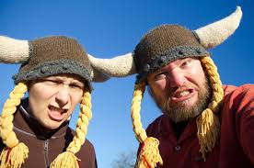
The Government Pension Fund of Norway excluded Duke Energy?

Slide 35
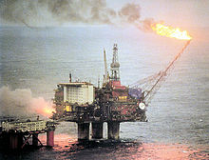
Government Pension Fund of Norway
In the late 1960s, North Sea oil was discovered in Norwegian waters.
Wikipedia and its sources

Slide 36
Government Pension Fund of Norway
In the late 1960s, North Sea oil was discovered in Norwegian waters.
Wikipedia and its sources

Slide 37
Government Pension Fund of Norway
In the late 1960s, North Sea oil was discovered in Norwegian waters.
Since then, export of oil and gas has been an important element in the Norwegian economy.
Wikipedia and its sources

Slide 38
Government Pension Fund of Norway
In the late 1960s, North Sea oil was discovered in Norwegian waters.
Since then, export of oil and gas has been an important element in the Norwegian economy.
In 2011, Norway was the world’s
    Nr 8 crude oil exporter
    Nr 9 refined oil exporter
    Nr 3 natural gas exporter
Wikipedia and its sources

Slide 39
Government Pension Fund of Norway
In the late 1960s, North Sea oil was discovered in Norwegian waters.
Since then, export of oil and gas has been an important element in the Norwegian economy.
In 2011, Norway was the world’s
    Nr 8 crude oil exporter
    Nr 9 refined oil exporter
    Nr 3 natural gas exporter
Norway is the 7th richest country in the world, after Qatar, Luxembourg, Singapore, Kuwait, Brunei, and the United Arab Emirates.
Wikipedia and its sources

Slide 40
Government Pension Fund Global
In anticipation of a decline of the oil and gas sector in the future, Norway established in 1990 a national Petroleum Fund.
Wikipedia and its sources

Slide 41
Government Pension Fund Global
In anticipation of a decline of the oil and gas sector in the future, Norway established in 1990 a national Petroleum Fund.
The point of the Fund is to invest some of the vast surplus generated in order to distribute the gains more evenly between generations.
Wikipedia and its sources

Slide 42
Government Pension Fund Global
In anticipation of a decline of the oil and gas sector in the future, Norway established in 1990 a national Petroleum Fund.
The point of the Fund is to invest some of the vast surplus generated in order to distribute the gains more evenly between generations.
The name of The Petroleum Fund of Norway was in 2006 changed to Government Pension Fund Global.
Wikipedia and its sources

Slide 43
Government Pension Fund Global
In anticipation of a decline of the oil and gas sector in the future, Norway established in 1990 a national Petroleum Fund.
The point of the Fund is to invest some of the vast surplus generated in order to distribute the gains more evenly between generations.
The name of The Petroleum Fund of Norway was in 2006 changed to Government Pension Fund Global.
It is still commonly referred to as the Oil Fund (Oljefondet).
Wikipedia and its sources

Slide 44
Government Pension Fund Global
At $ 873 billion, the GPFD is the largest “pension fund” in Europe and (according to its 2011 evaluation) in the world.
Wikipedia and its sources

Slide 45
Government Pension Fund Global
At $ 873 billion, the GPFD is the largest “pension fund” in Europe and (according to its 2011 evaluation) in the world.
The Fund has since 1998 been allowed to invest in the international stock market, first 40% of its portfolio, then 60% (since 2009), and now 70% (since 2014).
Wikipedia and its sources

Slide 46
Government Pension Fund Global
At $ 873 billion, the GPFD is the largest “pension fund” in Europe and (according to its 2011 evaluation) in the world.
The Fund has since 1998 been allowed to invest in the international stock market, first 40% of its portfolio, then 60% (since 2009), and now 70% (since 2014).
As a result, it currently holds 1.3 % of global equity markets, and with 2.3 % of European stocks, it is said to be the biggest stock owner in Europe.
Wikipedia and its sources

Slide 47
Government Pension Fund Global
Three criticisms have been levelled at the Fund and its operation:
Wikipedia and its sources

Slide 48
Government Pension Fund Global
Three criticisms have been levelled at the Fund and its operation:
    More of the revenues should go to the state budget now, instead of saving for the future.
Wikipedia and its sources

Slide 49
Government Pension Fund Global
Three criticisms have been levelled at the Fund and its operation:
    More of the revenues should go to the state budget now, instead of saving for the future.
    Exposure to the highly volatile international stock market is not financially safe.
Wikipedia and its sources

Slide 50
Government Pension Fund Global
Three criticisms have been levelled at the Fund and its operation:
    More of the revenues should go to the state budget now, instead of saving for the future.
    Exposure to the highly volatile international stock market is not financially safe.
    The investment policy of the Fund can be unethical.
Wikipedia and its sources

Slide 51
Government Pension Fund Global
Three criticisms have been levelled at the Fund and its operation:
    More of the revenues should go to the state budget now, instead of saving for the future.
    Exposure to the highly volatile international stock market is not financially safe.
    The investment policy of the Fund can be unethical.
A Council on Ethics was established in 2004 to help to counter the last argument.
Wikipedia and its sources

Slide 52
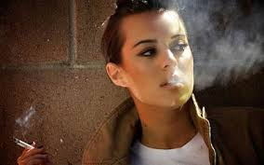
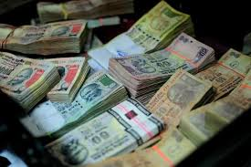
Council on Ethics
For the Norwegian Government Pension Fund Global
http://etikkradet.no/en/

Slide 53
Council on Ethics
For the Norwegian Government Pension Fund Global
The ethical integrity of the Fund’s investments were at the turn of the millennium questioned.
http://etikkradet.no/en/

Slide 54
Council on Ethics
For the Norwegian Government Pension Fund Global
The ethical integrity of the Fund’s investments were at the turn of the millennium questioned.
Investments had been made in controversial companies involved in businesses like
http://etikkradet.no/en/

Slide 55
Council on Ethics
For the Norwegian Government Pension Fund Global
The ethical integrity of the Fund’s investments were at the turn of the millennium questioned.
Investments had been made in controversial companies involved in businesses like
    arms production
http://etikkradet.no/en/

Slide 56
Council on Ethics
For the Norwegian Government Pension Fund Global
The ethical integrity of the Fund’s investments were at the turn of the millennium questioned.
Investments had been made in controversial companies involved in businesses like
    arms production,
    tobacco
http://etikkradet.no/en/

Slide 57
Council on Ethics
For the Norwegian Government Pension Fund Global
The ethical integrity of the Fund’s investments were at the turn of the millennium questioned.
Investments had been made in controversial companies involved in businesses like
    arms production,
    tobacco, and
    fossil fuels.
http://etikkradet.no/en/

Slide 58
Council on Ethics
For the Norwegian Government Pension Fund Global
The ethical integrity of the Fund’s investments were at the turn of the millennium questioned.
Investments had been made in controversial companies involved in businesses like
    arms production,
    tobacco, and
    fossil fuels.
The Fund’s Advisory Council on Ethics was established 19 November 2004 by royal decree to deal with this.
http://etikkradet.no/en/

Slide 59
Council on Ethics
For the Norwegian Government Pension Fund Global
The general task of the Council is to monitor and evaluate the Fund’s investments and identify those of them that are in conflict with the Fund’s Ethical Guidelines.
http://etikkradet.no/en/

Slide 60
Council on Ethics
For the Norwegian Government Pension Fund Global
The general task of the Council is to monitor and evaluate the Fund’s investments and identify those of them that are in conflict with the Fund’s Ethical Guidelines.
In the fact finding the Council rely on external consultants.
http://etikkradet.no/en/

Slide 61
Council on Ethics
For the Norwegian Government Pension Fund Global
The general task of the Council is to monitor and evaluate the Fund’s investments and identify those of them that are in conflict with the Fund’s Ethical Guidelines.
In the fact finding the Council rely on external consultants.
Since 2009, the Council has worked with RepRisk ESG Business Intelligence.
http://etikkradet.no/en/

Slide 62
Council on Ethics
For the Norwegian Government Pension Fund Global
The general task of the Council is to monitor and evaluate the Fund’s investments and identify those of them that are in conflict with the Fund’s Ethical Guidelines.
In the fact finding the Council rely on external consultants.
Since 2009, the Council has worked with RepRisk ESG Business Intelligence.
RepRisk is a global research firm and provider of environmental, social, and governance risk data.
http://etikkradet.no/en/

Slide 63
Council on Ethics
For the Norwegian Government Pension Fund Global
After receiving data from the consultant (RepRisk) and evaluating cases, the Council can make recommendations to Norges Bank (the central bank of Norway).
http://etikkradet.no/en/

Slide 64
Council on Ethics
For the Norwegian Government Pension Fund Global
After receiving data from the consultant (RepRisk) and evaluating cases, the Council can make recommendations to Norges Bank (the central bank of Norway).
The recommendation can be:
http://etikkradet.no/en/

Slide 65
Council on Ethics
For the Norwegian Government Pension Fund Global
After receiving data from the consultant (RepRisk) and evaluating cases, the Council can make recommendations to Norges Bank (the central bank of Norway).
The recommendation can be:
    Exclude – sell the company’s stocks
http://etikkradet.no/en/

Slide 66
Council on Ethics
For the Norwegian Government Pension Fund Global
After receiving data from the consultant (RepRisk) and evaluating cases, the Council can make recommendations to Norges Bank (the central bank of Norway).
The recommendation can be:
    Exclude – sell the company’s stocks
    Reinstate – lift the ban on a company
http://etikkradet.no/en/

Slide 67
Council on Ethics
For the Norwegian Government Pension Fund Global
After receiving data from the consultant (RepRisk) and evaluating cases, the Council can make recommendations to Norges Bank (the central bank of Norway).
The recommendation can be:
    Exclude – sell the company’s stocks
    Reinstate – lift the ban on a company
    Under observation – use pressure to improve
http://etikkradet.no/en/

Slide 68
Council on Ethics
For the Norwegian Government Pension Fund Global
After receiving data from the consultant (RepRisk) and evaluating cases, the Council can make recommendations to Norges Bank (the central bank of Norway).
The recommendation can be:
    Exclude – sell the company’s stocks
    Reinstate – lift the ban on a company
    Under observation – use pressure to improve
Norges Bank and the Ministry of Finance have made the decisions to divest or use influence.
http://etikkradet.no/en/

Slide 69
Council on Ethics
For the Norwegian Government Pension Fund Global
On Council advice, Norges Bank has excluded:
http://etikkradet.no/en/

Slide 70
Council on Ethics
For the Norwegian Government Pension Fund Global
On Council advice, Norges Bank has excluded:
    5 companies / Production of cluster munitions
http://etikkradet.no/en/

Slide 71
Council on Ethics
For the Norwegian Government Pension Fund Global
On Council advice, Norges Bank has excluded:
    5 companies / Production of cluster munitions
    12 companies / Production of nuclear weapons
http://etikkradet.no/en/

Slide 72
Council on Ethics
For the Norwegian Government Pension Fund Global
On Council advice, Norges Bank has excluded:
    5 companies / Production of cluster munitions
    12 companies / Production of nuclear weapons
    21 companies / Production of tobacco
http://etikkradet.no/en/

Slide 73
Council on Ethics
For the Norwegian Government Pension Fund Global
On Council advice, Norges Bank has excluded:
    5 companies / Production of cluster munitions
    12 companies / Production of nuclear weapons
    21 companies / Production of tobacco
    3 companies / Serious violation of human rights
http://etikkradet.no/en/

Slide 74
Council on Ethics
For the Norwegian Government Pension Fund Global
On Council advice, Norges Bank has excluded:
    5 companies / Production of cluster munitions
    12 companies / Production of nuclear weapons
    21 companies / Production of tobacco
    3 companies / Serious violation of human rights
    21 companies / Severe environmental damage
http://etikkradet.no/en/

Slide 75
Council on Ethics
For the Norwegian Government Pension Fund Global
On Council advice, Norges Bank has excluded:
    5 companies / Production of cluster munitions
    12 companies / Production of nuclear weapons
    21 companies / Production of tobacco
    3 companies / Serious violation of human rights
    21 companies / Severe environmental damage
    1 company / Gross corruption
http://etikkradet.no/en/

Slide 76
Council on Ethics
For the Norwegian Government Pension Fund Global
On Council advice, Norges Bank has excluded:
    5 companies / Production of cluster munitions
    12 companies / Production of nuclear weapons
    21 companies / Production of tobacco
    3 companies / Serious violation of human rights
    21 companies / Severe environmental damage
    1 company / Gross corruption
    3 companies / Serious violations of individuals’ rights in situations of war or conflict
http://etikkradet.no/en/

Slide 77
Council on Ethics
For the Norwegian Government Pension Fund Global
On Council advice, Norges Bank has excluded:
    5 companies / Production of cluster munitions
    12 companies / Production of nuclear weapons
    21 companies / Production of tobacco
    3 companies / Serious violation of human rights
    21 companies / Severe environmental damage
    1 company / Gross corruption
    3 companies / Serious violations of individuals’ rights in situations of war or conflict
    5 companies / Other particularly serious violations of fundamental ethical norms
http://etikkradet.no/en/

Slide 78
Council on Ethics
For the Norwegian Government Pension Fund Global
In addition, Norges Bank has excluded, based on its own Investment Management rules:
    51 companies / Production of coal or coal-based energy
http://etikkradet.no/en/

Slide 79
Council on Ethics
For the Norwegian Government Pension Fund Global
In addition, Norges Bank has excluded, based on its own Investment Management rules:
    51 companies / Production of coal or coal-based energy (so why was DE not excluded earlier?)
http://etikkradet.no/en/

Slide 80
Council on Ethics
For the Norwegian Government Pension Fund Global
In addition, Norges Bank has excluded, based on its own Investment Management rules:
    51 companies / Production of coal or coal-based energy (so why was DE not excluded earlier?)
Two companies are currently under observation:
    1 company / Risk of severe corruption
    1 company / Risk of severe environmental damage
http://etikkradet.no/en/

Slide 81
Council on Ethics
For the Norwegian Government Pension Fund Global
In addition, Norges Bank has excluded, based on its own Investment Management rules:
    51 companies / Production of coal or coal-based energy (so why was DE not excluded earlier?)
Two companies are currently under observation:
    1 company / Risk of severe corruption
    1 company / Risk of severe environmental damage
Some companies (8 up till 2013) have been reinstated because they have changed their ways.
http://etikkradet.no/en/

Slide 82
What size of investments are we talking about?

Slide 83
Council on Ethics
For the Norwegian Government Pension Fund Global
Since the Government Pension Fund Global is a big investor, the sums involved are also big.
http://etikkradet.no/en/

Slide 84
Council on Ethics
For the Norwegian Government Pension Fund Global
Since the Government Pension Fund Global is a big investor, the sums involved are also big.
    The leading losers from the policy are tobacco producers – divestment $ 2 billion.
http://etikkradet.no/en/

Slide 85
Council on Ethics
For the Norwegian Government Pension Fund Global
Since the Government Pension Fund Global is a big investor, the sums involved are also big.
    The leading losers from the policy are tobacco producers – divestment $ 2 billion.
    A close second are companies that are seen to cause environmental damage – $ 1.5 billion.
http://etikkradet.no/en/

Slide 86
Council on Ethics
For the Norwegian Government Pension Fund Global
Since the Government Pension Fund Global is a big investor, the sums involved are also big.
    The leading losers from the policy are tobacco producers – divestment $ 2 billion.
    A close second are companies that are seen to cause environmental damage – $ 1.5 billion.
    And the third are perceived human rights violators – $ 650 million.
http://etikkradet.no/en/

Slide 87
Council on Ethics
For the Norwegian Government Pension Fund Global
Since the Government Pension Fund Global is a big investor, the sums involved are also big.
    The leading losers from the policy are tobacco producers – divestment $ 2 billion.
    A close second are companies that are seen to cause environmental damage – $ 1.5 billion.
    And the third are perceived human rights violators – $ 650 million.
    Of the last, $ 372 million divested off Walmart.
http://etikkradet.no/en/

Slide 88
Council on Ethics
For the Norwegian Government Pension Fund Global
Since the Government Pension Fund Global is a big investor, the sums involved are also big.
    The leading losers from the policy are tobacco producers – divestment $ 2 billion.
    A close second are companies that are seen to cause environmental damage – $ 1.5 billion.
    And the third are perceived human rights violators – $ 650 million.
    Of the last, $ 372 million divested off Walmart.
Duke Energy faced an > $ 300 million divestment.
http://etikkradet.no/en/

Slide 89
Council on Ethics
For the Norwegian Government Pension Fund Global
In 2013, the Finance Minister of Norway announced that the Council will be disbanded.
http://etikkradet.no/en/

Slide 90
Council on Ethics
For the Norwegian Government Pension Fund Global
In 2013, the Finance Minister of Norway announced that the Council will be disbanded.
    Its duties would be assumed by Norges Bank, all exclusions would be managed centrally.
    Smooth management was the justification.
http://etikkradet.no/en/

Slide 91
Council on Ethics
For the Norwegian Government Pension Fund Global
In 2013, the Finance Minister of Norway announced that the Council will be disbanded.
    Its duties would be assumed by Norges Bank, all exclusions would be managed centrally.
    Smooth management was the justification.
Objections to this included:
http://etikkradet.no/en/

Slide 92
Council on Ethics
For the Norwegian Government Pension Fund Global
In 2013, the Finance Minister of Norway announced that the Council will be disbanded.
    Its duties would be assumed by Norges Bank, all exclusions would be managed centrally.
    Smooth management was the justification.
Objections to this included:
    The ethics watchdog should be independent.
    Too much power would be concentrated.
    Fewer companies would be excluded.
    Investments would become less ethical.
http://etikkradet.no/en/

Slide 93
Council on Ethics
For the Norwegian Government Pension Fund Global
In 2014, the Norwegian Parliament decided to appoint a new Council, under new guidelines.
http://etikkradet.no/en/

Slide 94
Council on Ethics
For the Norwegian Government Pension Fund Global
In 2014, the Norwegian Parliament decided to appoint a new Council, under new guidelines.
    It would now make its recommendations to Norges Bank, not to the Ministry of Finance.
    Distance from policy was the justification.
http://etikkradet.no/en/

Slide 95
Council on Ethics
For the Norwegian Government Pension Fund Global
In 2014, the Norwegian Parliament decided to appoint a new Council, under new guidelines.
    It would now make its recommendations to Norges Bank, not to the Ministry of Finance.
    Distance from policy was the justification.
Objections and counter-objections continue:
http://etikkradet.no/en/

Slide 96
Council on Ethics
For the Norwegian Government Pension Fund Global
In 2014, the Norwegian Parliament decided to appoint a new Council, under new guidelines.
    It would now make its recommendations to Norges Bank, not to the Ministry of Finance.
    Distance from policy was the justification.
Objections and counter-objections continue:
    “The Fund excludes too many companies.”
http://etikkradet.no/en/

Slide 97
Council on Ethics
For the Norwegian Government Pension Fund Global
In 2014, the Norwegian Parliament decided to appoint a new Council, under new guidelines.
    It would now make its recommendations to Norges Bank, not to the Ministry of Finance.
    Distance from policy was the justification.
Objections and counter-objections continue:
    “The Fund excludes too many companies.”
    “Exclusions do not disturb its performance.”
http://etikkradet.no/en/

Slide 98
Council on Ethics
For the Norwegian Government Pension Fund Global
In 2014, the Norwegian Parliament decided to appoint a new Council, under new guidelines.
    It would now make its recommendations to Norges Bank, not to the Ministry of Finance.
    Distance from policy was the justification.
Objections and counter-objections continue:
    “The Fund excludes too many companies.”
    “Exclusions do not disturb its performance.”
    “The Fund excludes too few companies.”
http://etikkradet.no/en/

Slide 99
Council on Ethics
For the Norwegian Government Pension Fund Global
In 2014, the Norwegian Parliament decided to appoint a new Council, under new guidelines.
    It would now make its recommendations to Norges Bank, not to the Ministry of Finance.
    Distance from policy was the justification.
Objections and counter-objections continue:
    “The Fund excludes too many companies.”
    “Exclusions do not disturb its performance.”
    “The Fund excludes too few companies.”
    “It is supposed to make money, not policy.”
http://etikkradet.no/en/

Slide 100
What do we know so far?

Slide 101
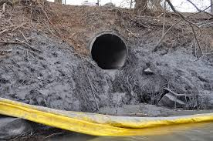
A lot of toxic coal ash was spilled into Dan River in North Carolina in 2014

Slide 102
A lot of toxic coal ash was spilled into Dan River in North Carolina in 2014

Slide 103
A lot of toxic coal ash was spilled into Dan River in North Carolina in 2014
The culprits had to pay $ 102 million + for the estimated $ 300 million damage

Slide 104
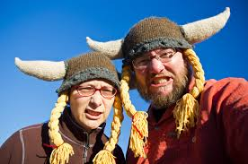
A lot of toxic coal ash was spilled into Dan River in North Carolina in 2014
The culprits had to pay $ 102 million + for the estimated $ 300 million damage
By divesting > $ 300 million, Norwegians told that they do not approve their deed

Slide 105
A lot of toxic coal ash was spilled into Dan River in North Carolina in 2014
The culprits had to pay $ 102 million + for the estimated $ 300 million damage
By divesting > $ 300 million, Norwegians told that they do not approve their deed
Lesson?

Slide 106
A lot of toxic coal ash was spilled into Dan River in North Carolina in 2014
The culprits had to pay $ 102 million + for the estimated $ 300 million damage
By divesting > $ 300 million, Norwegians told that they do not approve their deed
Lesson?
If every investor followed Norway’s example, all unethical companies would be driven out of business?

Slide 108
So what exactly are the grounds on which the Council on Ethics makes its recommendations?

Slide 109
Council on Ethics
For the Norwegian Government Pension Fund Global
Guidelines
http://etikkradet.no/en/guidelines/
http://etikkradet.no/en/

Slide 110
Council on Ethics
For the Norwegian Government Pension Fund Global
Guidelines
Section 2.
Criteria for product-based observation and exclusion of companies

Slide 111
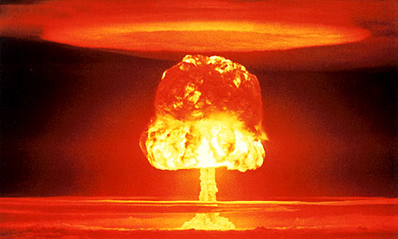
Council on Ethics
For the Norwegian Government Pension Fund Global
Guidelines
Section 2.
Criteria for product-based observation and exclusion of companies
(1) The Fund shall not be invested in companies
which themselves or through entities they control:
      produce weapons that violate fundamental humanitarian principles through their normal use
      produce tobacco
      sell weapons or military material to states that are subject to investment restrictions on government bonds as described in the management mandate for the Fund, section 3-1(2)(c).

Slide 112
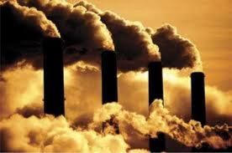
Council on Ethics
For the Norwegian Government Pension Fund Global
Guidelines
Section 2.
Criteria for product-based observation and exclusion of companies
(2) Observation or exclusion may be decided
for mining companies and power producers
which themselves or through entities they
control derive 30 per cent or more of their
income from thermal coal or base 30 per cent
or more of their operations on thermal coal.

Slide 113
Council on Ethics
For the Norwegian Government Pension Fund Global
?
?
Guidelines
Section 2.
Criteria for product-based observation and exclusion of companies
(3) In assessments pursuant to subsection (2)
above, in addition to the company’s current
share of income or activity from thermal coal,
importance shall also be attached to forward-
looking assessments, including any plans the
company may have that will change the share
of its business based on thermal coal and the
share of its business based on renewable
energy sources.

Slide 114


Council on Ethics
For the Norwegian Government Pension Fund Global
Guidelines
Section 2.
Criteria for product-based observation and exclusion of companies
(4) Recommendations and decisions
on exclusion of companies based on
subsections (2) and (3) above shall not
include a company’s green bonds where
such are recognized through inclusion in
specific indices for green bonds or are
verified by a recognized third party.

Slide 115
Council on Ethics
For the Norwegian Government Pension Fund Global
Guidelines
Section 3.
Criteria for conduct-based observation and exclusion of companies

Slide 116
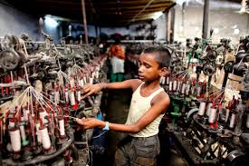
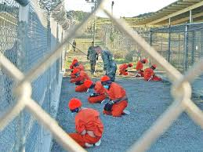
Council on Ethics
For the Norwegian Government Pension Fund Global
Guidelines
Section 3.
Criteria for conduct-based observation and exclusion of companies
Companies may be put under observation or be
excluded if there is an unacceptable risk that the
company contributes to or is responsible for:
1. serious or systematic human rights violations,
such as murder, torture, deprivation of liberty,
forced labour and the worst forms of child labour
2. serious violations of the rights of individuals in
situations of war or conflict

Slide 117
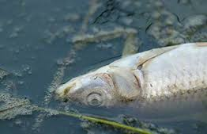
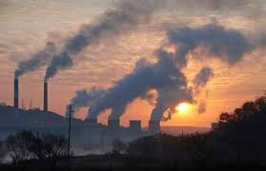
Council on Ethics
For the Norwegian Government Pension Fund Global
Guidelines
Section 3.
Criteria for conduct-based observation and exclusion of companies
Companies may be put under observation or be
excluded if there is an unacceptable risk that the
company contributes to or is responsible for:
3. severe environmental damage
4. acts or omissions that on an aggregate
company level lead to unacceptable
greenhouse gas emissions

Slide 118


Council on Ethics
For the Norwegian Government Pension Fund Global
Guidelines
Section 3.
Criteria for conduct-based observation and exclusion of companies
Companies may be put under observation or be
excluded if there is an unacceptable risk that the
company contributes to or is responsible for:
5. gross corruption
6. other particularly serious violations of fundamental ethical norms.

Slide 120
What are our questions, then?

Slide 121
What are the reasons given by the CE in particular cases?

Slide 122
Find out and report
What are the reasons given by the CE in particular cases?

Slide 123
Find out and report
What are the reasons given by the CE in particular cases?
What other reasons could be given in particular cases?

Slide 124
Find out and report
What are the reasons given by the CE in particular cases?
What other reasons could be given in particular cases?
Environmental ethics

Slide 125
Find out and report
What are the reasons given by the CE in particular cases?
What other reasons could be given in particular cases?
Environmental ethics
Sustainability

Slide 126
Find out and report
What are the reasons given by the CE in particular cases?
What other reasons could be given in particular cases?
Environmental ethics
Sustainability
CSR

Slide 127
Find out and report
What are the reasons given by the CE in particular cases?
What other reasons could be given in particular cases?
Environmental ethics
Sustainability
CSR
Business ethics

Slide 128
Find out and report
What are the reasons given by the CE in particular cases?
What other reasons could be given in particular cases?
Environmental ethics
Sustainability
CSR
Business ethics
Moral theories

Slide 129
Find out and report
What are the reasons given by the CE in particular cases?
What other reasons could be given in particular cases?
Environmental ethics
Sustainability
CSR
Business ethics
Moral theories
Theories of justice

Slide 130
Find out and report
What are the reasons given by the CE in particular cases?
What other reasons could be given in particular cases?
Environmental ethics
Sustainability
CSR
Business ethics
Moral theories
Theories of justice

Slide 131
Find out and report
What are the reasons given by the CE in particular cases?
What other reasons could be given in particular cases?
Environmental ethics
Sustainability
CSR
Business ethics
Moral theories
Theories of justice

Slide 132
Find out and report
What are the reasons given by the CE in particular cases?
What other reasons could be given in particular cases?
Environmental ethics
Sustainability
CSR
Business ethics
Moral theories
Theories of justice
The background in the different approaches and theories will be provided by lectures, guest lectures, and reading material.
Everything is geared towards your investigation and reporting.

Slide 133
Course completion
Attend classes!

Slide 134
Course completion
Attend classes!

Slide 135
Course completion
Attend classes!
We do the main work here (apart from the book exams).

Slide 136
Course completion
Attend classes!
We do the main work here (apart from the book exams).
For completion, you need to attend 10 sessions fully.

Slide 137
Course completion
Attend classes!
We do the main work here (apart from the book exams).
For completion, you need to attend 10 sessions fully.
If you are absent (for compelling reasons) you need to:
    Familiarise yourself with the Lecture content.
    Keep in touch with the exercises (ask your mates).

Slide 138
Course completion
Attend classes!
We do the main work here (apart from the book exams).
For completion, you need to attend 10 sessions fully.
If you are absent (for compelling reasons) you need to:
    Familiarise yourself with the Lecture content.
    Keep in touch with the exercises (ask your mates).
If you have (for extremely compelling reasons) more absences, you will have to make up for those by excursions – attendances at related seminars (check with me what is “related”) and completing Reflective Learning Diaries of those (instructions: MyCourses).

Slide 139
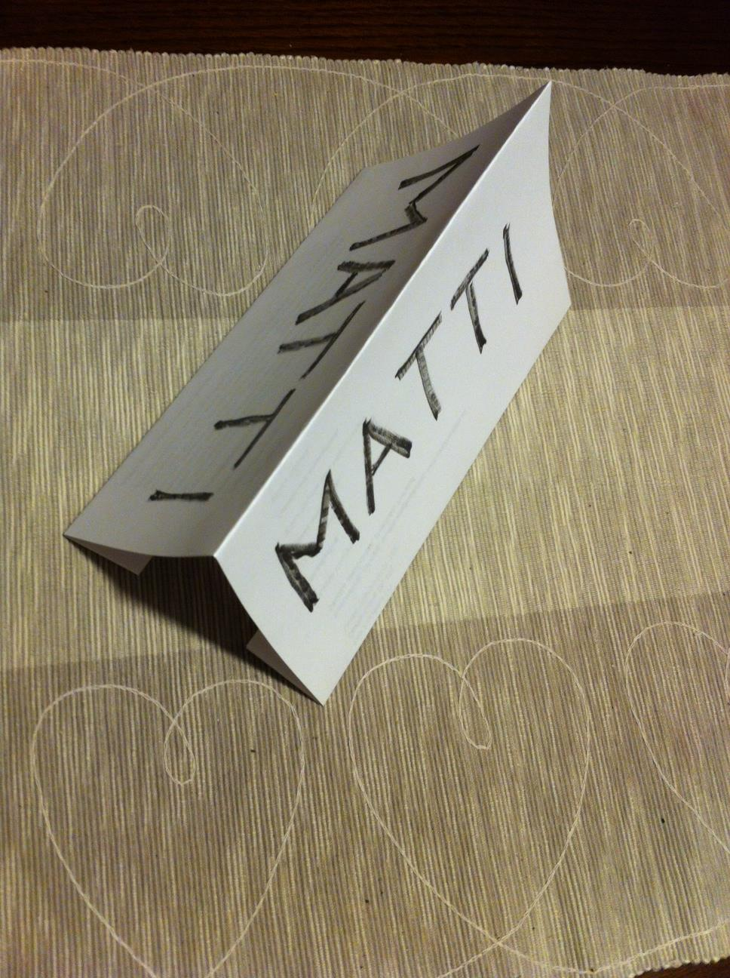
Break
Name cards
Folding instructions
First name on both sides
Always with you in our classes
MyCourses
Click top left corner to see the tabs on the left, with details!

Slide 140
Group Work 1
Twenty-second introductions
Name
From
Studies (and experience)
Why in Aalto
Objects of interest – real work / academic life
Course expectations
Where do you see yourself in five years’ time?

Slide 141
Group Work 1
Groups

Slide 142
Find out and report
What are the reasons given by the CE in particular cases?
What other reasons could be given in particular cases?
Environmental ethics
Sustainability
CSR
Business ethics
Moral theories
Theories of justice
The background in the different approaches and theories will be provided by lectures, guest lectures, and reading material.
Everything is geared towards your investigation and reporting.

Slide 143
Group Work 1
Cases
Wal-Mart
Imperial Tobacco
Lockheed Martin
Jacobs Engineering Group
ZTE Corporation
Kosmos Energy
Find out and report
What does the company do?
What reasons has the Council on Ethics given for its exclusion?
How much was divested?
How did the company react?
Was there a public reaction?
http://etikkradet.no/en/

Slide 144

