Slide 2
Management Approaches from Taylorism to CSR
Matti Häyry
Aalto University School of Business
51E 00100 Business Ethics
Lecture 2

Slide 3
After the intermission, you will all have a question about what you have heard here. Write it down and email it to me matti.hayry@aalto.fi

Slide 4
CLIP 1: World ahoy!
https://www.youtube.com/watch?v=IeD7mYk_Wq0
CLIP 2: Britain leads the way!
https://www.youtube.com/watch?v=xLhNP0qp38Q

Slide 5
Pins and needles

Slide 6
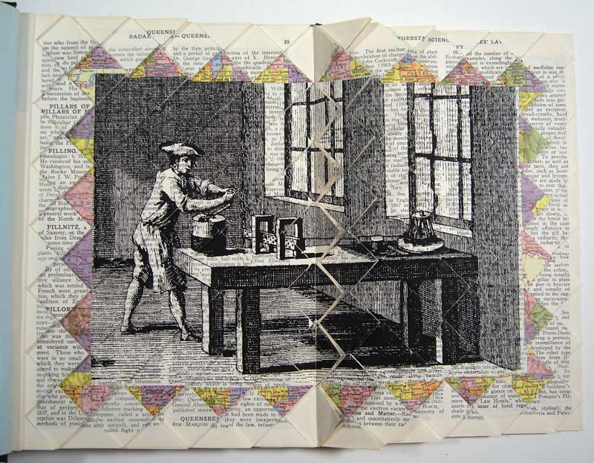
Pin maker = a few pins per person a day

Slide 7
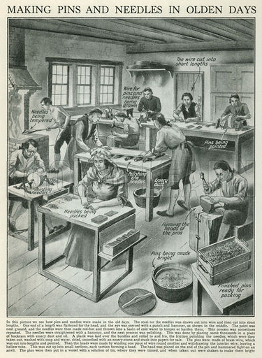
Pin and needle workshop = dozens / person

Slide 8
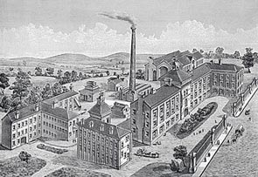
Needle factory

Slide 9
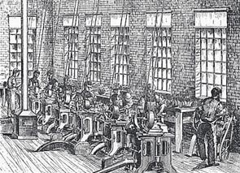
Straightening, cutting, and pointing two ends

Slide 10
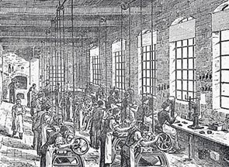
Punching holes for the needle eyes

Slide 11
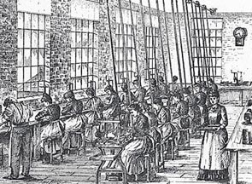
Cutting into two and gathering metal waste

Slide 12
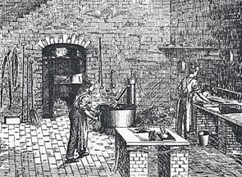
The needles are hardened and tempered

Slide 13
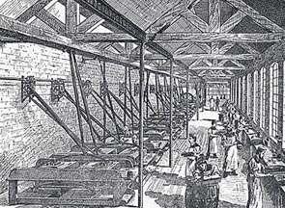
The needles are polished and nickel plated

Slide 14
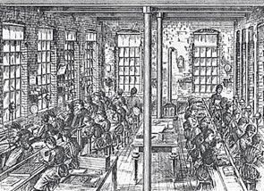
The needles are quality controlled

Slide 15
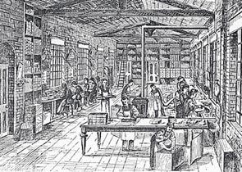
The needles are packaged for distribution

Slide 16
Adam Smith: thousands per person a day

Slide 17
Adam Smith: thousands per person a day
= increased productivity

Slide 18
Adam Smith: thousands per person a day
= increased productivity
= higher salaries

Slide 19
Adam Smith: thousands per person a day
= increased productivity
= higher salaries
= increased wealth of the nation

Slide 20
Adam Smith: thousands per person a day
= increased productivity
= higher salaries
= increased wealth of the nation
Organisation and management
contributed to the industrial
revolution and continue
to contribute to…

Slide 21
Of course, there were other developments…

Slide 22
Of course, there were other developments…
Adam Smith + Thomas Malthus + David Ricardo
Capitalism

Slide 23
Of course, there were other developments…
Adam Smith + Thomas Malthus + David Ricardo
Capitalism
+ Karl Marx
Socialism

Slide 24
Of course, there were other developments…
Adam Smith + Thomas Malthus + David Ricardo
Jeremy Bentham
+
James Mill
+
John Stuart Mill
Capitalism
+ Karl Marx
Socialism

Slide 25
Of course, there were other developments…
Adam Smith + Thomas Malthus + David Ricardo
Jeremy Bentham
+
James Mill
+
John Stuart Mill
Capitalism
+ Karl Marx
Socialism
Positivism + Empiricism
+ Economic rationality

Slide 26
Of course, there were other developments…
Adam Smith + Thomas Malthus + David Ricardo
Jeremy Bentham
+
James Mill
+
John Stuart Mill
Capitalism
Jean-Jacques Rousseau
+
Immanuel Kant
+
G. W. F. Hegel
+ Karl Marx
Socialism
Positivism + Empiricism
+ Economic rationality

Slide 27
Of course, there were other developments…
Adam Smith + Thomas Malthus + David Ricardo
Jeremy Bentham
+
James Mill
+
John Stuart Mill
Capitalism
Jean-Jacques Rousseau
+
Immanuel Kant
+
G. W. F. Hegel
+ Karl Marx
Socialism
Positivism + Empiricism
+ Economic rationality
Idealist + Post-structural
+ Post-modern + Critical

Slide 28
But back to management approaches
This lecture gives a historical background to Corporate Social Responsibility (CSR) as a management approach.
CSR can be viewed from other angles, as well (ethical, political, critical, etc.), but these are not focal here.
This is a narrative of the development of approaches to management from the early “scientific” to CSR.
It is based on the idea that management approaches are aimed at solving the problems faced / created by their predecessors.
Earlier approaches remain, in modified forms.

Slide 29
Included in this story are
Taylorism as the herald of scientific management
Fordism as its like-minded alternative
Industrial relations management
Personnel management
Human resources management
Public relations management
Corporate social responsibility management

Slide 30
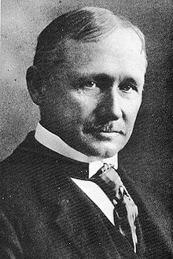
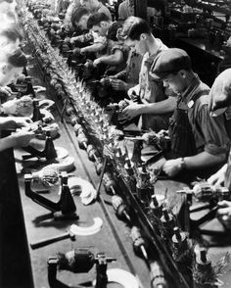
Taylorism
Frederick Taylor 1856–1915, North East US
One of the first attempts at managerial engineering
“Shop management”, “process management”
Scientific management (Louis Brandeis, 1910)
Classical scientific management
Started in the 1880s and the 1890s
Peak popularity (US and Europe) during the 1910s
Still influential as a part of other approaches

Slide 31
Taylorism
Analysis, synthesis, logic, rationality, empiricism
Efficiency and elimination of waste
Standardisation of best practices
Disdain for tradition for its own sake or for status
Transformation of craft into mass production
Knowledge transfer between workers
Knowledge transfer from workers into tools, processes, and documentation

Slide 32
Taylorism
Taylorism increased productivity in industrial work and economic efficiency in enterprise
Optimising productivity required more managerial control over workers
In many cases, efficiency favoured mechanisation and automation
Despite incentives (higher salaries for more skilled workers), jobs became unpleasant
Due to automation and outsourcing they then also became fewer or disappeared altogether

Slide 33
Taylorism
Understandably, many workers were annoyed, especially the unskilled and the unemployed
Or, to put this in fancier words, anomie was spreading among the working classes
Their work lacked the meaning that it once had had (?!?) and they were left without direction
Marx had already drawn attention to alienation from the fruits of one’s labour, others, and self
So in management, it was time to attend to industrial relations and the human dimension

Slide 34
Fordism was a part of the solution,
then became a part of the problem

Slide 35
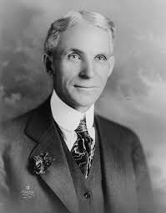
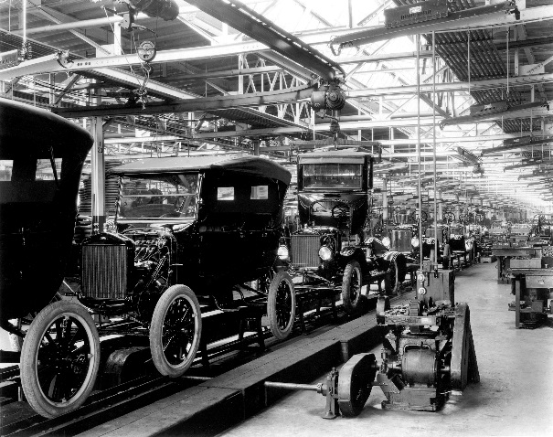
Fordism
Henry Ford 1863–1947, MI
Ford Motor Company launched in 1903
Introduced mass-produced Model T in 1908
Started using a moving assembly line in 1913
Vertical integration: Everything in the supply chain comes from within the corporation
Higher salaries to workers (vs absenteeism), franchising, mass marketing, cheap cars
Ford workers could afford to buy a Ford

Slide 36
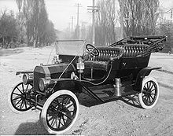
Fordism
By 1914, 250.000 Model Ts had been sold
The total production, by 1927, was 15 million
All newer Ford Ts were black due to assembly line requirements (before that, many colours)
“Any customer can have a car painted any color that he wants so long as it is black.”
Since 1914, Ford paid double the usual salaries
Since 1926, Ford had a 5-day, 40-hour work week

Slide 37
Fordism
European industrialists, impressed, embraced Fordism (and Taylorism) to shed pre-capitalist traditionalism and irrational business methods
In 1927, Ford replaced model T with model A
In an interesting twist to the tale, the government of Soviet Union contracted in 1929 Ford to set up the Gorky Automobile Plant in Russia to produce model As, and then further on model AAs and Bs
This helped the industrialisation of Russia
And the Gorkovsky Avtomobilny Zavod provided GAZs to the Finnish Army for many decades

Slide 38
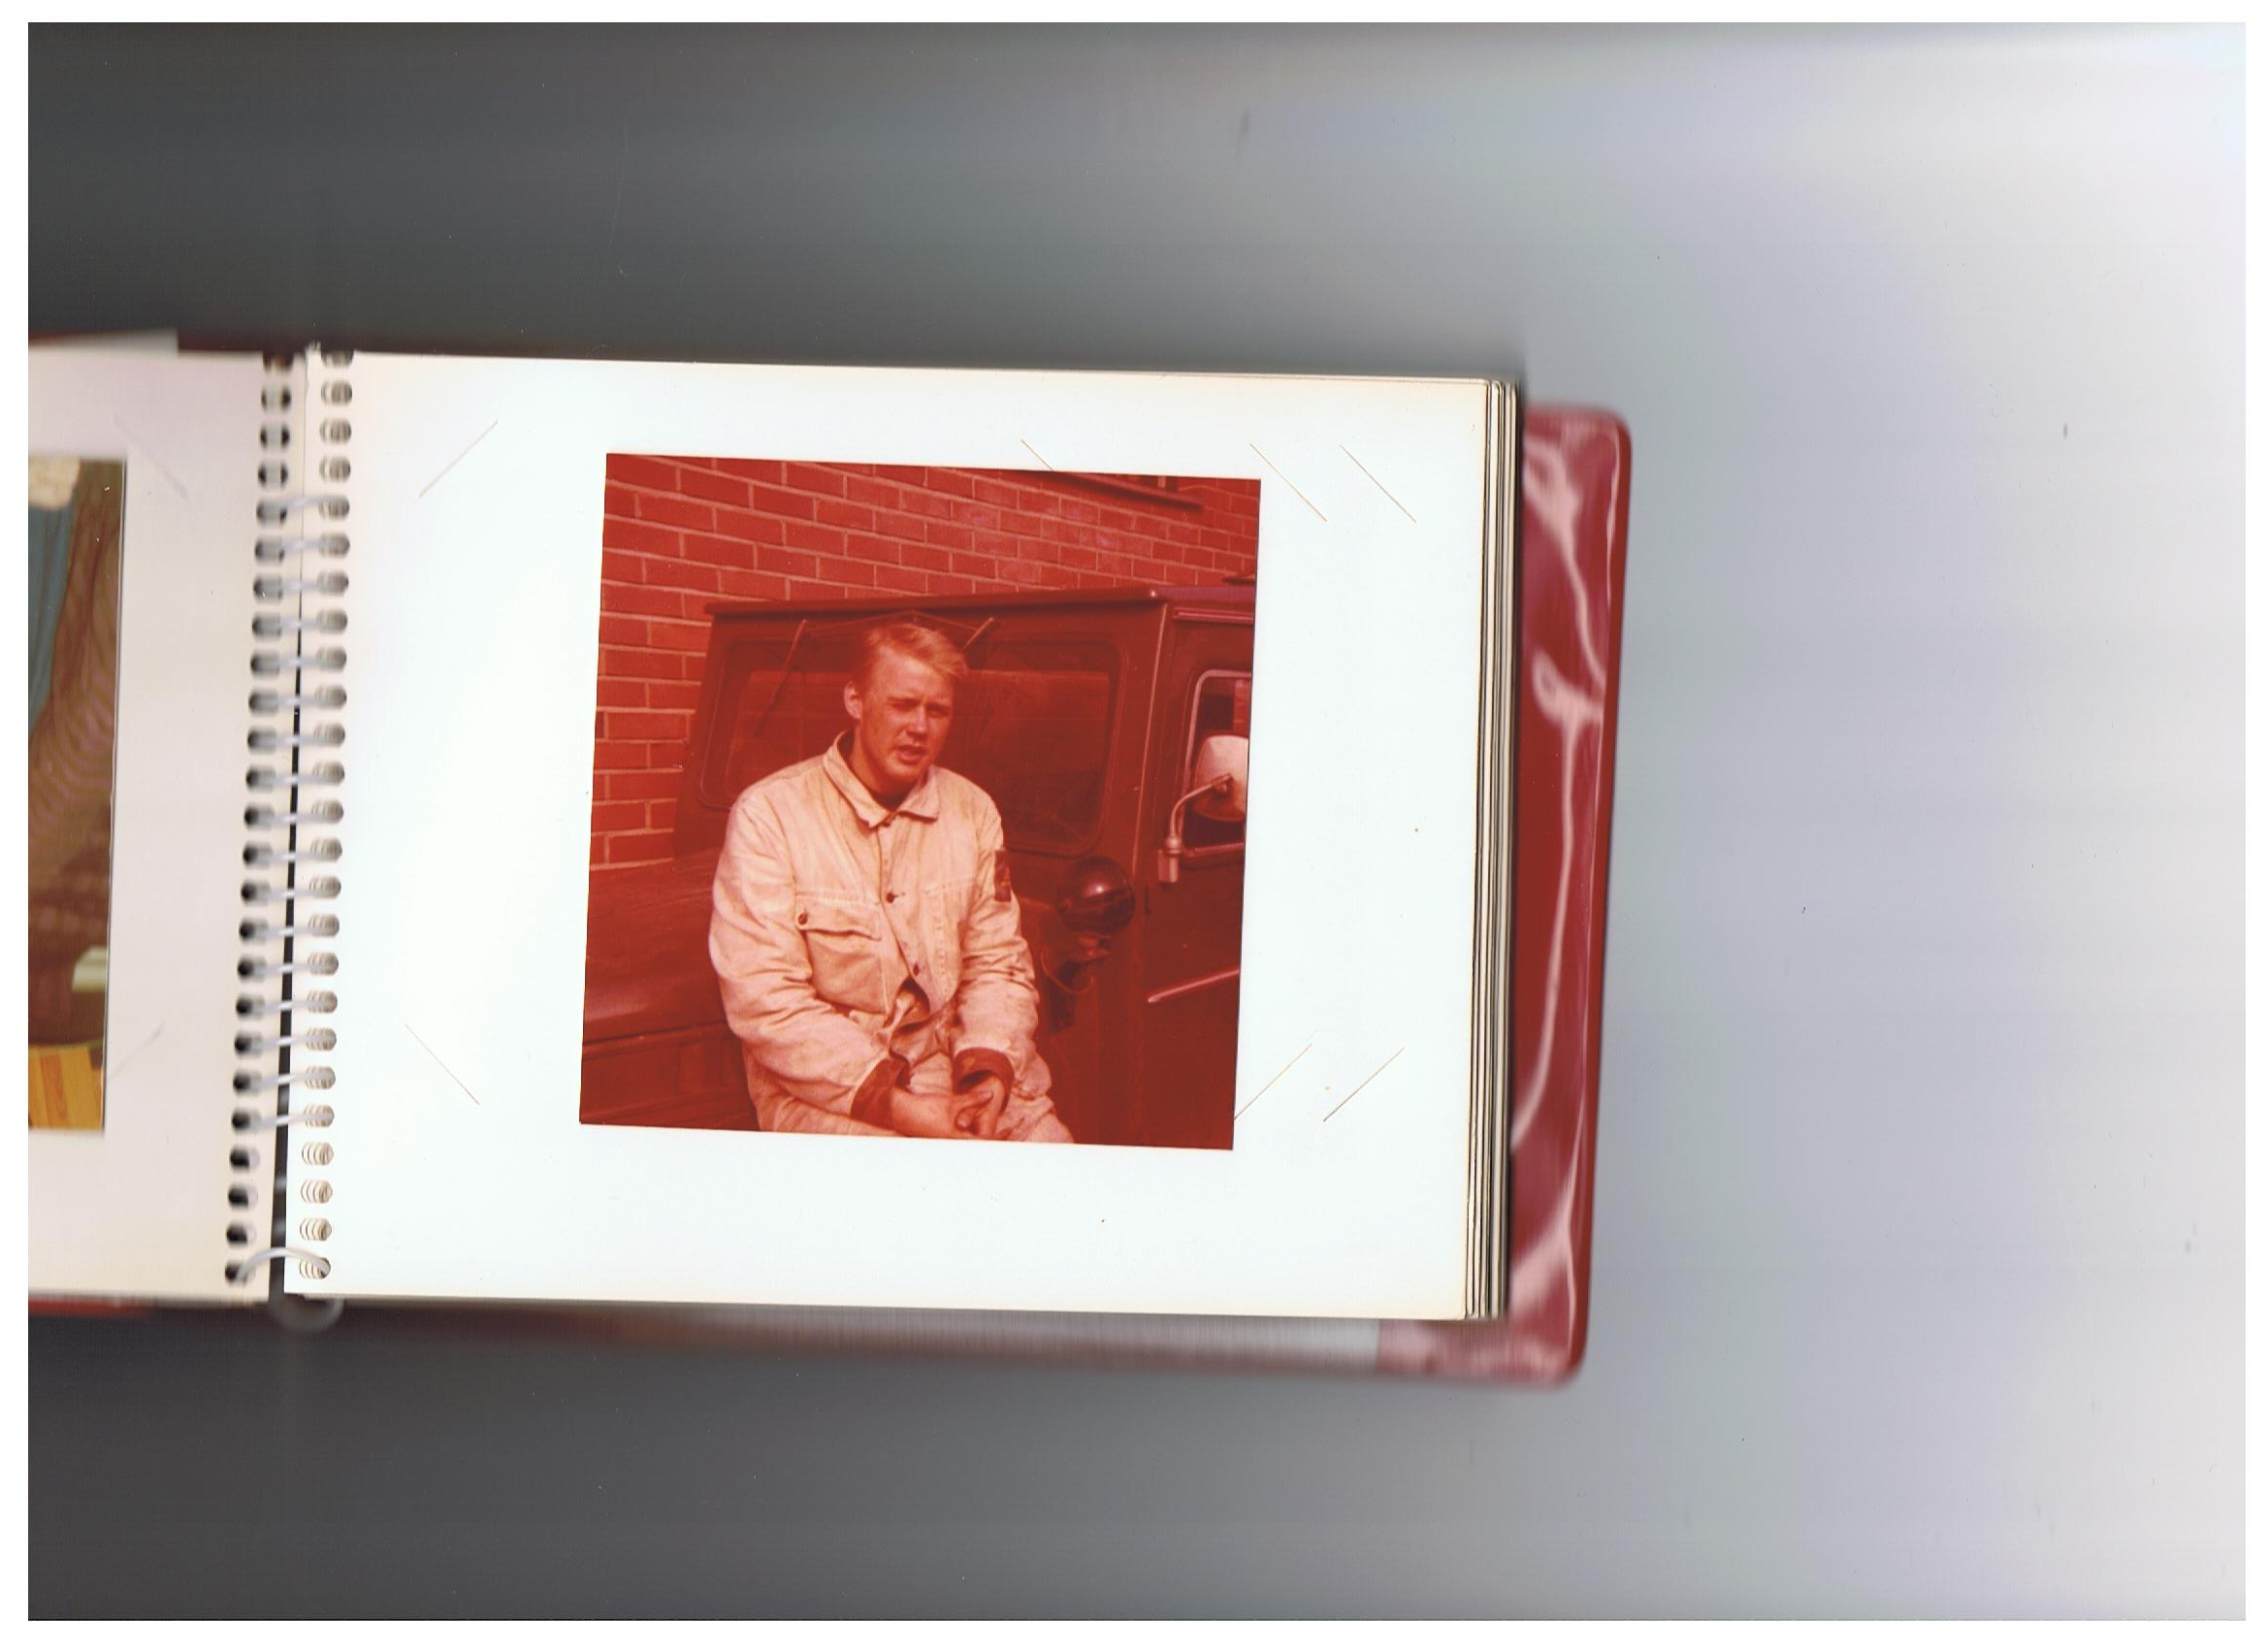

Slide 39
What is your question?
Write it down, clearly,
with your name.
What is your answer?
The rest of the class will,
we hope, have this.

Slide 40
The story so far

Slide 41
The story so far
Craft production

Slide 42
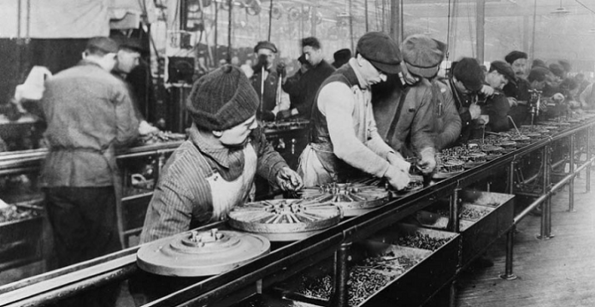
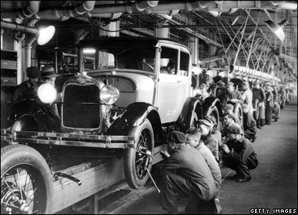
The story so far
Craft production
Division of labour, mass production

Slide 43
The story so far
Craft production
Division of labour, mass production
Huge increase in productivity

Slide 44
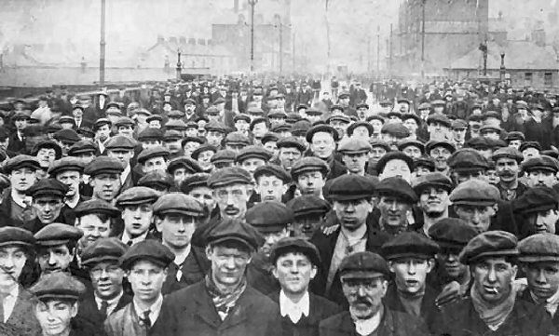
But there was this anomie / alienation issue

Slide 45
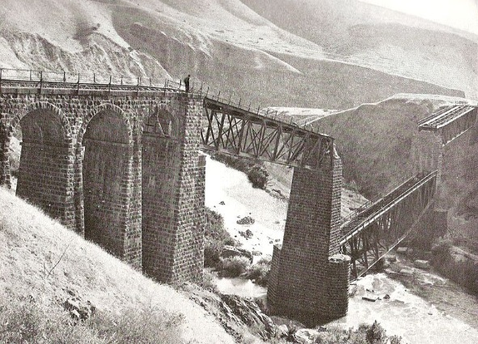
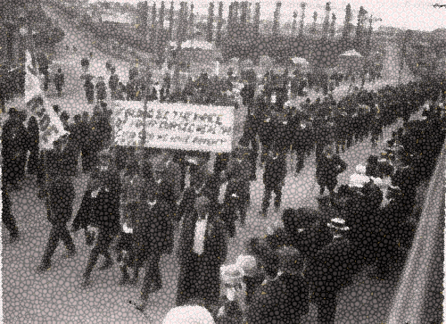
Industrial relations management
Taylorism and Fordism boosted productivity, but they also provoked resistance from the workers.
Taylorism rewarded skill and industriousness, yet aimed at replacing workers by automation.
Fordism opted for non-skilled labour with limited tasks as “cogs” in the assembly line “machine”.
Taylor saw less intelligent workers as stupid animals whose tasks have to be managed.
Ford was strongly opposed to labour unions and thought that they were a hindrance to efficiency.

Slide 46
Industrial relations management
More sensitive approaches tried to make up for the relative disregard of the human dimension.
The main idea was that the worker as an individual has needs that merit attention.
Already in 1912, James Hartness wrote about this in his The Human Factor in Works Management.
The ensuing Human Resources (HR) approach developed this further, with division of labour.
Scientific management principles still dictate(d) the organisation, and HRM adjusts workers to it.

Slide 47
Industrial relations management
The interesting thing, looking at Taylor and Ford and early HRM, is that there are two issues here.
The first is how frictions and resistance at the workplace can be handled administratively.
The second is related to the political conflict that may exist between owners and the workforce.
HRM is a solution to the first issue – conflict may be good or bad, but it is in need of management.
The second issue goes deeper, and evokes different reactions, depending on the angle.

Slide 48
Responses to resistance

Slide 49
Responses to resistance
Value
Resistance is bad
Resistance is good

Slide 50
Responses to resistance
Value
Norm
Resistance is bad
Resistance is good
Resistance should be handled managerially
Resistance should be handled politically

Slide 51
Responses to resistance
Value
Norm
Resistance is bad
Resistance is good
Resistance should be handled managerially
Negotiate or threaten to punish by loss of privilege or job
Resistance should be handled politically

Slide 52
Responses to resistance
Value
Norm
Resistance is bad
Resistance is good
Resistance should be handled managerially
Negotiate or threaten to punish by loss of privilege or job
Listen, embrace, adjust, and make palatable by a human touch
Resistance should be handled politically

Slide 53
Responses to resistance
Value
Norm
Resistance is bad
Resistance is good
Resistance should be handled managerially
Negotiate or threaten to punish by loss of privilege or job
Listen, embrace, adjust, and make palatable by a human touch
Resistance should be handled politically
Suppress social activity to secure a productivity-friendly setting

Slide 54
Responses to resistance
Value
Norm
Resistance is bad
Resistance is good
Resistance should be handled managerially
Negotiate or threaten to punish by loss of privilege or job
Listen, embrace, adjust, and make palatable by a human touch
Resistance should be handled politically
Suppress social activity to secure a productivity-friendly setting
Hail resistance as a way of effecting social and political change

Slide 55
Responses to resistance
Value
Norm
Resistance is bad
Resistance is good
Resistance should be handled managerially
Negotiate or threaten to punish by loss of privilege or job
Listen, embrace, adjust, and make palatable by a human touch
Resistance should be handled politically
Suppress social activity to secure a productivity-friendly setting
Hail resistance as a way of effecting social and political change

Slide 56
Personnel management
Emerged in the early 1900s to create a more content, skilled, and more reliable workforce.
The reliability of the workforce, such as it was, had in the 18th and 19th centuries been secured by the threat of unemployment and starvation.
Training for tasks needing skills had been done on the apprenticeship model – old tutors new.
World War I reduced the workforce and necessitated hiring women to factories.
They had to be trained – and men placated.

Slide 57
Personnel management
Personnel departments took over the job.
Their task was to ensure that workers knew what they were doing and were not prone to strike.
Between the World Wars, personnel departments were mostly kept although men returned to jobs.
During World War II the exercise was repeated.
Since gender equality had made some progress by then, old times did not resume after the war.
HRM developed and boundaries became blurred.

Slide 58
What is the difference between personnel and human resources management?

Slide 60
Basis for comparison | Personnel Management | HRM
Meaning | The aspect of management that is concerned with the work force and their relation-ship with the entity. | The branch of manage-ment that focuses on the most effective use of the manpower of an entity to reach organizational goals
Approach | Traditional | Modern
Treatment of manpower | Machines or tools | Asset
Type of function | Routine function | Strategic function
Basis of pay | Job evaluation | Performance evaluation
Management role | Transactional | Transformational
Communication | Indirect | Direct
Labor management | Collectively bargained contracts | Individual contracts
Initiatives | Piecemeal | Integrated
Management actions | Procedure | Business needs
Decision making | Slow | Fast
Job design | Division of labor | Groups and teams
http://keydifferences.com/difference-between-personnel-management-and-human-resource-management.html#ixzz4Rt3ItbD5

Slide 61
Human resources management
Was an outgrowth of personnel management.
Started to become independent in the 1930s.
An essential insight was that stimuli unrelated to financial compensation and working conditions could generate more productive workers.
By this time, new studies were emerging in industrial and organisational psychology, organisational behaviour and theory.
This shifted the focus from “treat them like people” to “handle them as a resource”.

Slide 62
Human resources management
Is advertised as a more “human touch” than the personnel management that preceded it.
Which is weird, as it emphasises organisational goals over the fair treatment of individuals.
Workers (in general) are a resource, a store of skills and powers, to be used for corporate good.
If they can be optimised, this will be done.
If they cannot, they are replaced.
“New contract: Your new hours are 8am–3pm.”

Slide 63
Be that as it may, what are the effects
of Personnel Management and HRM?

Slide 64
Responses to resistance
Value
Norm
Resistance is bad
Resistance is good
Resistance should be handled managerially
Negotiate or threaten to punish by loss of privilege or job
Listen, embrace, adjust, and make palatable by a human touch
Resistance should be handled politically
Suppress social activity to secure a productivity-friendly setting
Hail resistance as a way of effecting social and political change

Slide 65
Responses to resistance
Value
Norm
Resistance is bad
Resistance is good
Resistance should be handled managerially
Negotiate or threaten to punish by loss of privilege or job
Listen, embrace, adjust, and make palatable by a human touch
Resistance should be handled politically
Suppress social activity to secure a productivity-friendly setting
Hail resistance as a way of effecting social and political change

Slide 66
Value
Norm
Resistance is bad
Resistance is good
Resistance should be handled managerially
Negotiate or threaten to punish
Listen, embrace, and adjust
Resistance should be handled politically
Suppress social activity
Hail resis-tance as political

Slide 67
Value
Norm
Resistance is bad
Resistance is good
Resistance should be handled managerially
Negotiate or threaten to punish
Listen, embrace, and adjust
PM and HRM
Resistance should be handled politically
Suppress social activity
Hail resis-tance as political

Slide 68
Value
Norm
Resistance is bad
Resistance is good
Succeed
Resistance should be handled managerially
Negotiate or threaten to punish
Listen, embrace, and adjust
PM and HRM
Resistance should be handled politically
Suppress social activity
Hail resis-tance as political
Fail

Slide 69
Value
Norm
Resistance is bad
Resistance is good
Succeed
Resistance should be handled managerially
Negotiate or threaten to punish
Listen, embrace, and adjust
PM and HRM
Resistance should be handled politically
Suppress social activity
Hail resis-tance as political
Fail
Political unrest
Political upheaval?
Revolution?

Slide 70
Increased productivity
Value
Norm
Resistance is bad
Resistance is good
Succeed
Resistance should be handled managerially
Negotiate or threaten to punish
Listen, embrace, and adjust
PM and HRM
Resistance should be handled politically
Suppress social activity
Hail resis-tance as political
Fail
Political unrest
Political upheaval?
Revolution?

Slide 71
Environmental and social damage
Increased productivity
Value
Norm
Resistance is bad
Resistance is good
Succeed
Resistance should be handled managerially
Negotiate or threaten to punish
Listen, embrace, and adjust
PM and HRM
Resistance should be handled politically
Suppress social activity
Hail resis-tance as political
Fail
Political unrest
Political upheaval?
Revolution?

Slide 72
PR, CSR, sustainability, environmental ethics, and business ethics
Environmental and social damage
Increased productivity
Value
Norm
Resistance is bad
Resistance is good
Succeed
Resistance should be handled managerially
Negotiate or threaten to punish
Listen, embrace, and adjust
PM and HRM
Resistance should be handled politically
Suppress social activity
Hail resis-tance as political
Fail
Political unrest
Political upheaval?
Revolution?

Slide 73
Succeed
PR, CSR, sustainability, environmental ethics, and business ethics
Environmental and social damage
Fail
Increased productivity
Value
Norm
Resistance is bad
Resistance is good
Succeed
Resistance should be handled managerially
Negotiate or threaten to punish
Listen, embrace, and adjust
PM and HRM
Suppress social activity
Hail resis-tance as political
Resistance should be handled politically
Hail resis-tance as political
Fail
Political unrest
Political upheaval?
Revolution?

Slide 74
Succeed
PR, CSR, sustainability, environmental ethics, and business ethics
Environmental and social damage
Fail
Increased productivity
Value
Norm
Resistance is bad
Resistance is good
Succeed
Resistance should be handled managerially
Negotiate or threaten to punish
Listen, embrace, and adjust
PM and HRM
Resistance should be handled politically
Suppress social activity
Hail resis-tance as political
Fail
Political unrest
Political unrest
Political upheaval?
Revolution?

Slide 75
Bliss?
Succeed
PR, CSR, sustainability, environmental ethics, and business ethics
Environmental and social damage
Fail
Increased productivity
Value
Norm
Resistance is bad
Resistance is good
Succeed
Resistance should be handled managerially
Negotiate or threaten to punish
Listen, embrace, and adjust
PM and HRM
Resistance should be handled politically
Suppress social activity
Hail resis-tance as political
Fail
Political unrest
Political unrest
Political upheaval?
Revolution?

Slide 76
So let’s see how PR and CSR can respond to resistance…

Slide 77
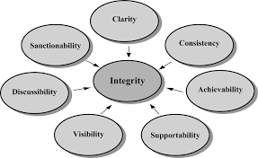
Public relations management
Ideally, public relations management facilitates the company’s good and socially useful efforts by removing misunderstandings and frictions.
This prevents, eliminates, and reduces false fears that may cause resistance in customers, collaborative partners, and the general publics.
It then serves good managerial and political purposes to both private and public benefit.
PR conceived like this disseminates truthful information about the company’s products, practices, impact, and social responsibility.

Slide 78
Public relations management
Realistically, PR manages the company’s public image to the company’s and its shareholders’ benefit by any means deemed necessary.
That the company is seen to act responsibly may then take precedence over how it actually acts.
Resistance is controlled by combining truths, half-truths, spin, persuasion, distraction and rhetoric (incl. “CSR” as window dressing).
When this goes wrong (when it is exposed), spin PR can be seen to join forces with political oppression, and radicalise resistance.

Slide 79
Bliss?
Succeed
PR, CSR, sustainability, environmental ethics, and business ethics
Environmental and social damage
Fail
Increased productivity
Value
Norm
Resistance is bad
Resistance is good
Succeed
Resistance should be handled managerially
Negotiate or threaten to punish
Listen, embrace, and adjust
PM and HRM
Resistance should be handled politically
Suppress social activity
Hail resis-tance as political
Fail
Political unrest
Political unrest
Political upheaval?
Revolution?

Slide 80
Bliss?
Succeed
PR, CSR, sustainability, environmental ethics, and business ethics
Environmental and social damage
Fail
Increased productivity
Value
Norm
Resistance is bad
Resistance is good
Succeed
Resistance should be handled managerially
Negotiate or threaten to punish
Listen, embrace, and adjust
PM and HRM
Resistance should be handled politically
Suppress social activity
Hail resis-tance as political
Fail
Political unrest
PR
CSR
Nicely
Political unrest
Political upheaval?
Revolution?

Slide 81
Bliss?
Succeed
PR, CSR, sustainability, environmental ethics, and business ethics
Environmental and social damage
Fail
Increased productivity
Value
Norm
Resistance is bad
Resistance is good
Succeed
Resistance should be handled managerially
Negotiate or threaten to punish
Listen, embrace, and adjust
PM and HRM
Resistance should be handled politically
Suppress social activity
Hail resis-tance as political
Fail
Political unrest
PR
CSR
Nicely
Nastily
E.g. a police state
Political unrest
Political upheaval?
Revolution?

Slide 82
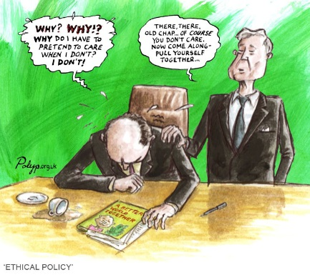
Corporate social responsibility management

Slide 84
Corporate social responsibility management
In CSR management, or the business model of CSR, the “entity” has to care, because / on condition that responsible = profitable business.
This is the starting point of the Norwegian Government Pension Fund Global, and its Council on Ethics issuing recommendations.
“Our task is to reduce ethical risks attached to the investment portfolio.” Johan H. Andersen.
By implication, if the entity wants investments from funds like the GPFG, it has to comply.

Slide 85
Corporate social responsibility management
CSR assumes that business corporations are agents, with duties and responsibilities.
As agents they have
a duty to observe laws (possibly their “spirit” as well as their letter),
a responsibility towards the communities and environments (social and ecological) in which they operate (at least not to harm them), and
possible further duties or near-duties to more positive contributions to ecological, educational, or social programmes.

Slide 86
Corporate social responsibility management
The first duty of corporations as business agents is, however, perceived to be clear:
Companies express their agency or citizenship
by earning adequate returns on the employed resources (to the shareholders)
legally and responsibly (observing the interests of other stakeholders)
and perhaps philanthropically (contributing to voluntary charities and causes)

Slide 87
Corporate social responsibility management
And why should companies and corporations recognise these duties and responsibilities?
Because / On condition that / To the degree that
earning returns to shareholders is their raison d’être – the reason for their existence
illegality and irresponsibility towards other stakeholders risk returns to shareholders
voluntary philanthropy contributes positively to earning returns to shareholders

Slide 88
Corporate social responsibility management
So when are the responsibility (and perhaps philanthropy) conditions met in real life?
In other words, when and to what degree do the following contribute to earning adequate returns to shareholders?
Observing laws (in the main / to the fullest)
Not harming people or social institutions
Not damaging the built / natural environment
Philanthropic contributions to ecological, educational, or social programmes

Slide 89
To be or not to be responsible?
Is it even profitable?

Slide 90
After the intermission, you will all have a question about what you have heard here. Write it down and email it to me matti.hayry@aalto.fi

Slide 91
To be or not to be responsible?
Is it even profitable?

Slide 93
Group Work 2
Groups

Slide 94
Find out and report
What are the reasons given by the CE in particular cases?
What other reasons could be given in particular cases?
Environmental ethics
Sustainability
CSR
Business ethics
Moral theories
Theories of justice
The background in the different approaches and theories will be provided by lectures, guest lectures, and reading material.
Everything is geared towards your investigation and reporting.

Slide 95
Group Work 2
Cases
Wal-Mart
Imperial Tobacco
Lockheed Martin
Jacobs Engineering Group
ZTE Corporation
Kosmos Energy
Find out and report
What CSR reasons did the Council on Ethics give for its exclusion?
Have those reasons jeopardised returns for the shareholders, including the NGPFG?
Do they generally?
What is the evidence?

Slide 96
