Slide 2
Moral Philosophies and Business Ethics
Matti Häyry
Aalto University School of Business
51E 00100 Business Ethics
Lecture 6

Slide 3
After the intermission, you will all have a question Send it to me by email to: matti.hayry@aalto.fi

Slide 5
Find out and report
What are the reasons given by the CE in particular cases?
What other reasons could be given in particular cases?
Environmental ethics
Sustainability
CSR
Business ethics
Moral theories
Theories of justice
The background in the different approaches and theories will be provided by lectures, guest lectures, and reading material.
Everything is geared towards your investigation and reporting.

Slide 6
Find out and report
What are the reasons given by the CE in particular cases?
What other reasons could be given in particular cases?
Environmental ethics
Sustainability
CSR
Business ethics
Moral theories
Theories of justice
The background in the different approaches and theories will be provided by lectures, guest lectures, and reading material.
Everything is geared towards your investigation and reporting.

Slide 7
Find out and report
What are the reasons given by the CE in particular cases?
What other reasons could be given in particular cases?
Environmental ethics
Sustainability
CSR
Business ethics
Moral theories
Theories of justice
The background in the different approaches and theories will be provided by lectures, guest lectures, and reading material.
Everything is geared towards your investigation and reporting.

Slide 8
Find out and report
What are the reasons given by the CE in particular cases?
What other reasons could be given in particular cases?
Environmental ethics
Sustainability
CSR
Business ethics
Moral theories
Theories of justice
The background in the different approaches and theories will be provided by lectures, guest lectures, and reading material.
Everything is geared towards your investigation and reporting.

Slide 9
Find out and report
What are the reasons given by the CE in particular cases?
What other reasons could be given in particular cases?
Environmental ethics
Sustainability
CSR
Business ethics
Moral theories
Theories of justice
The background in the different approaches and theories will be provided by lectures, guest lectures, and reading material.
Everything is geared towards your investigation and reporting.

Slide 11
Individual rights
Communal tradition
Capability promotion
Fair contract
Relations Care
Preference satisfaction
Responsi-bility / Not

Slide 12
Justice and fish
Individual rights
Communal tradition
Capability promotion
Fair contract
Relations Care
Preference satisfaction
Responsi-bility / Not

Slide 13
Justice and fish
Individual rights
Communal tradition
Capability promotion
Fair contract
Relations Care
Preference satisfaction
Responsi-bility / Not
Give fish meals

Slide 14
Justice and fish
Give rods and teach fishing and cooking skills
Individual rights
Communal tradition
Capability promotion
Fair contract
Relations Care
Preference satisfaction
Responsi-bility / Not
Give fish meals

Slide 15
Justice and fish
Give rods and teach fishing and cooking skills
Individual rights
Communal tradition
Capability promotion
Fair contract
Relations Care
Preference satisfaction
Responsi-bility / Not
Give fish meals
to as many as possible

Slide 16
Justice and fish
Give rods and teach fishing and cooking skills
Individual rights
Communal tradition
Capability promotion
Fair contract
Relations Care
Preference satisfaction
Responsi-bility / Not
Give fish meals
to as many as possible
provided that this will not interfere with some getting their cup of rice.

Slide 17
Justice and fish
Give rods and teach fishing and cooking skills so as to enable the preparation of fish meals for the willing.
Individual rights
Communal tradition
Capability promotion
Fair contract
Relations Care
Preference satisfaction
Responsi-bility / Not
Give fish meals
to as many as possible
provided that this will not interfere with some getting their cup of rice.

Slide 18
Justice and fish
Give rods and teach fishing and cooking skills so as to enable the preparation of fish meals for the willing.
Individual rights
Communal tradition
Capability promotion
Fair contract
Relations Care
Preference satisfaction
Responsi-bility / Not
Give fish meals
to as many as possible
provided that this will not interfere with some getting their cup of rice.
Is the inability to get fish meals their own fault? If so, forget. If not, do something.

Slide 19
Justice and fish
Give rods and teach fishing and cooking skills so as to enable the preparation of fish meals for the willing.
Individual rights
Communal tradition
Capability promotion
Fair contract
Relations Care
Preference satisfaction
Responsi-bility / Not
Give fish meals
to as many as possible
provided that this will not interfere with some getting their cup of rice.
Is the inability to get fish meals their own fault? If so, forget. If not, do something.
Or help them to realize that they caught and cooked the fish.

Slide 20
Justice and fish
Give rods and teach fishing and cooking skills so as to enable the preparation of fish meals for the willing.
Individual rights
Communal tradition
Capability promotion
Fair contract
Relations Care
Preference satisfaction
Responsi-bility / Not
Make them and others see that they at least cooked and served the fish and deserve the credit for this work.
Give fish meals
to as many as possible
provided that this will not interfere with some getting their cup of rice.
Is the inability to get fish meals their own fault? If so, forget. If not, do something.
Or help them to realize that they caught and cooked the fish.

Slide 21
Justice and fish
How the fish is caught, cooked, and served and by and to whom depends on custom, tradition, and communal practices.
Give rods and teach fishing and cooking skills so as to enable the preparation of fish meals for the willing.
Individual rights
Communal tradition
Capability promotion
Fair contract
Relations Care
Preference satisfaction
Responsi-bility / Not
Make them and others see that they at least cooked and served the fish and deserve the credit for this work.
Give fish meals
to as many as possible
provided that this will not interfere with some getting their cup of rice.
Is the inability to get fish meals their own fault? If so, forget. If not, do something.
Or help them to realize that they caught and cooked the fish.

Slide 22
Justice and fish
Get your own fish!
How the fish is caught, cooked, and served and by and to whom depends on custom, tradition, and communal practices.
Give rods and teach fishing and cooking skills so as to enable the preparation of fish meals for the willing.
Individual rights
Communal tradition
Capability promotion
Fair contract
Relations Care
Preference satisfaction
Responsi-bility / Not
Make them and others see that they at least cooked and served the fish and deserve the credit for this work.
Give fish meals
to as many as possible
provided that this will not interfere with some getting their cup of rice.
Is the inability to get fish meals their own fault? If so, forget. If not, do something.
Or help them to realize that they caught and cooked the fish.

Slide 23
Justice and fish
Get your own fish!
The authorities will step in if someone tries to poison it or steal it from you.
How the fish is caught, cooked, and served and by and to whom depends on custom, tradition, and communal practices.
Give rods and teach fishing and cooking skills so as to enable the preparation of fish meals for the willing.
Individual rights
Communal tradition
Capability promotion
Fair contract
Relations Care
Preference satisfaction
Responsi-bility / Not
Make them and others see that they at least cooked and served the fish and deserve the credit for this work.
Give fish meals
to as many as possible
provided that this will not interfere with some getting their cup of rice.
Is the inability to get fish meals their own fault? If so, forget. If not, do something.
Or help them to realize that they caught and cooked the fish.

Slide 24
Justice and fish
Get your own fish!
The authorities will step in if someone tries to poison it or steal it from you.
How the fish is caught, cooked, and served and by and to whom depends on custom, tradition, and communal practices.
Give rods and teach fishing and cooking skills so as to enable the preparation of fish meals for the willing.
Individual rights
Communal tradition
Capability promotion
Is fish a
basic good?
Yes
Fair contract
No
Relations Care
Preference satisfaction
Responsi-bility / Not
Make them and others see that they at least cooked and served the fish and deserve the credit for this work.
Give fish meals
to as many as possible
provided that this will not interfere with some getting their cup of rice.
Is the inability to get fish meals their own fault? If so, forget. If not, do something.
Or help them to realize that they caught and cooked the fish.

Slide 25
Justice and fish
Get your own fish!
The authorities will step in if someone tries to poison it or steal it from you.
How the fish is caught, cooked, and served and by and to whom depends on custom, tradition, and communal practices.
Give rods and teach fishing and cooking skills so as to enable the preparation of fish meals for the willing.
Individual rights
Communal tradition
Capability promotion
Is fish a
basic good?
Yes
Fair contract
Provided
No
Relations Care
Preference satisfaction
Not provided
Responsi-bility / Not
Make them and others see that they at least cooked and served the fish and deserve the credit for this work.
Give fish meals
to as many as possible
provided that this will not interfere with some getting their cup of rice.
Is the inability to get fish meals their own fault? If so, forget. If not, do something.
Or help them to realize that they caught and cooked the fish.

Slide 27
Of course, there were other developments…
Adam Smith + Thomas Malthus + David Ricardo
Jeremy Bentham
+
James Mill
+
John Stuart Mill
Capitalism
Jean-Jacques Rousseau
+
Immanuel Kant
+
G. W. F. Hegel
+ Karl Marx
Socialism
Positivism + Empiricism
+ Economic rationality
Idealist + Post-structural
+ Post-modern + Critical

Slide 28
Theoretical and ideological background

Slide 29
Theoretical and ideological background
Political and moral philosophy since Ancient Greece

Slide 30
Theoretical and ideological background
Political and moral philosophy since Ancient Greece
Capitalism
Socialism

Slide 31
Theoretical and ideological background
Political and moral philosophy since Ancient Greece
Capitalism
Utilitarianism
Governments ought to promote the greatest good of the greatest number of people
Socialism

Slide 32
Theoretical and ideological background
Political and moral philosophy since Ancient Greece
Capitalism
Utilitarianism
Governments ought to promote the greatest good of the greatest number of people
Deontology
Governments ought to be based directly on rules and principles dictated by reason
Socialism

Slide 33
Theoretical and ideological background
Political and moral philosophy since Ancient Greece
Capitalism
Utilitarianism
Governments ought to promote the greatest good of the greatest number of people
Deontology
Governments ought to be based directly on rules and principles dictated by reason
Teleology
Note practices rising from the human nature
Socialism

Slide 34
Theoretical and ideological background
Political and moral philosophy since Ancient Greece
Capitalism
Utilitarianism
Governments ought to promote the greatest good of the greatest number of people
Deontology
Governments ought to be based directly on rules and principles dictated by reason
Teleology
Note practices rising from the human nature
Socialism

Slide 35
Theoretical and ideological background
Political and moral philosophy since Ancient Greece
Capitalism
Utilitarianism
Governments ought to promote the greatest good of the greatest number of people
Deontology
Governments ought to be based directly on rules and principles dictated by reason
Teleology
Note practices rising from the human nature
Socialism
Positivism + Empiricism
+ Economic rationality
Idealist + Post-structural
+ Post-modern + Critical

Slide 36
Theoretical and ideological background
Political and moral philosophy since Ancient Greece
Capitalism
Utilitarianism
Governments ought to promote the greatest good of the greatest number of people
Deontology
Governments ought to be based directly on rules and principles dictated by reason
Teleology
Note practices rising from the human nature
Socialism
Positivism + Empiricism
+ Economic rationality
Interpretivist + Practice- oriented + Positional
Idealist + Post-structural
+ Post-modern + Critical

Slide 37
Theoretical and ideological background
Political and moral philosophy since Ancient Greece
Capitalism
Utilitarianism
Governments ought to promote the greatest good of the greatest number of people
Deontology
Governments ought to be based directly on rules and principles dictated by reason
Teleology
Note practices rising from the human nature
Socialism
Positivism + Empiricism
+ Economic rationality
Interpretivist + Practice- oriented + Positional
Idealist + Post-structural
+ Post-modern + Critical

Slide 38
How are these ethical theories
linked with theories of justice?

Slide 39
Ethical theories and theories of justice
Individual rights
Communal tradition
Capability promotion
Fair contract
Relations Care
Preference satisfaction
Responsi-bility / Not

Slide 40
Ethical theories and theories of justice
Individual rights
Communal tradition
Capability promotion
Fair contract
Relations Care
Preference satisfaction
Responsi-bility / Not
Utilitarian
Consequentialist

Slide 41
Ethical theories and theories of justice
Kantian
Deontological
Individual rights
Communal tradition
Capability promotion
Fair contract
Relations Care
Preference satisfaction
Responsi-bility / Not
Utilitarian
Consequentialist

Slide 42
Ethical theories and theories of justice
Kantian
Deontological
Individual rights
Communal tradition
Capability promotion
Teleological
Aristotelian
Fair contract
Relations Care
Preference satisfaction
Responsi-bility / Not
Utilitarian
Consequentialist

Slide 43
Ethical theories and theories of justice
Kantian
Deontological
Individual rights
Communal tradition
Capability promotion
Teleological
Aristotelian
Fair contract
Relations Care
Preference satisfaction
Responsi-bility / Not
Utilitarian
Consequentialist

Slide 45
What are these ethical theories all about?

Slide 46
What are these ethical theories all about?
Consequentialist (outcome-oriented)
Act utilitarianism
Rule utilitarianism

Slide 47
What are these ethical theories all about?
Consequentialist (outcome-oriented)
Act utilitarianism
Rule utilitarianism
Deontological (rule-oriented)
Moral legalism
Kantian ethics

Slide 48
What are these ethical theories all about?
Consequentialist (outcome-oriented)
Act utilitarianism
Rule utilitarianism
Deontological (rule-oriented)
Moral legalism
Kantian ethics
Teleological (end-oriented)
Natural law theory
Virtue ethics

Slide 50
Act utilitarianism
:

Slide 51
Act utilitarianism
Maximization of good
:

Slide 52
Act utilitarianism
Maximization of good
All decision makers always ought to aim at maximizing good
:

Slide 53
Act utilitarianism
Maximization of good
All decision makers always ought to aim at maximizing good
even if this means “rights violations” or emotional discomfort
:

Slide 54
Act utilitarianism
Maximization of good
All decision makers always ought to aim at maximizing good
even if this means “rights violations” or emotional discomfort
Definition of “good” as a natural entity
:

Slide 55
Act utilitarianism
Maximization of good
All decision makers always ought to aim at maximizing good
even if this means “rights violations” or emotional discomfort
Definition of “good” as a natural entity
Candidates include desire, preference, and need satisfaction
:

Slide 56
Act utilitarianism
Maximization of good
All decision makers always ought to aim at maximizing good
even if this means “rights violations” or emotional discomfort
Definition of “good” as a natural entity
Candidates include desire, preference, and need satisfaction
but not immaterial gains like morality, justice, or tradition
:

Slide 57
Act utilitarianism
Maximization of good
All decision makers always ought to aim at maximizing good
even if this means “rights violations” or emotional discomfort
Definition of “good” as a natural entity
Candidates include desire, preference, and need satisfaction
but not immaterial gains like morality, justice, or tradition
Strict impartiality
:

Slide 58
Act utilitarianism
Maximization of good
All decision makers always ought to aim at maximizing good
even if this means “rights violations” or emotional discomfort
Definition of “good” as a natural entity
Candidates include desire, preference, and need satisfaction
but not immaterial gains like morality, justice, or tradition
Strict impartiality
In all decisions concerning the promotion of good, all are equal:

Slide 59
Act utilitarianism
Maximization of good
All decision makers always ought to aim at maximizing good
even if this means “rights violations” or emotional discomfort
Definition of “good” as a natural entity
Candidates include desire, preference, and need satisfaction
but not immaterial gains like morality, justice, or tradition
Strict impartiality
In all decisions concerning the promotion of good, all are equal:
“Everybody is to count for one, and no one for more than one.”

Slide 61
Maximization of natural good impartially

Slide 62
Maximization of natural good impartially
The Trolley Problem

Slide 63
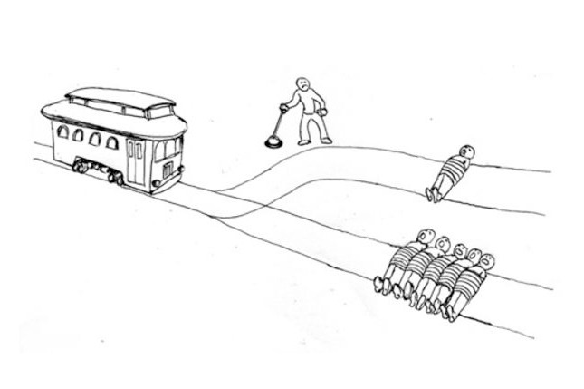
Maximization of natural good impartially
The Trolley Problem

Slide 64
Maximization of natural good impartially
The Trolley Problem

Slide 65
Maximization of natural good impartially
The Trolley Problem
“It sounds bad, but it is still the best thing to do.”

Slide 66
Maximization of natural good impartially
The Trolley Problem
“It sounds bad, but it is still the best thing to do.”
A terrorist tortured to save millions of innocent people?

Slide 67
Maximization of natural good impartially
The Trolley Problem
“It sounds bad, but it is still the best thing to do.”
A terrorist tortured to save millions of innocent people?
Allocating health care resources to many rather than a few?

Slide 68
Maximization of natural good impartially
The Trolley Problem
“It sounds bad, but it is still the best thing to do.”
A terrorist tortured to save millions of innocent people?
Allocating health care resources to many rather than a few?
Robot car (doing the opposite)?

Slide 69
Maximization of natural good impartially
The Trolley Problem
“It sounds bad, but it is still the best thing to do.”
A terrorist tortured to save millions of innocent people?
Allocating health care resources to many rather than a few?
Robot car (doing the opposite)?
“It sounds bad, it is bad, and it is the wrong thing to do.”

Slide 70
Maximization of natural good impartially
The Trolley Problem
“It sounds bad, but it is still the best thing to do.”
A terrorist tortured to save millions of innocent people?
Allocating health care resources to many rather than a few?
Robot car (doing the opposite)?
“It sounds bad, it is bad, and it is the wrong thing to do.”
Yes, well, it is, but all ethical theories have their problems.

Slide 71
Maximization of natural good impartially
The Trolley Problem
“It sounds bad, but it is still the best thing to do.”
A terrorist tortured to save millions of innocent people?
Allocating health care resources to many rather than a few?
Robot car (doing the opposite)?
“It sounds bad, it is bad, and it is the wrong thing to do.”
Yes, well, it is, but all ethical theories have their problems.
This is such a core failure that utilitarianism has to be rejected.

Slide 72
Maximization of natural good impartially
The Trolley Problem
“It sounds bad, but it is still the best thing to do.”
A terrorist tortured to save millions of innocent people?
Allocating health care resources to many rather than a few?
Robot car (doing the opposite)?
“It sounds bad, it is bad, and it is the wrong thing to do.”
Yes, well, it is, but all ethical theories have their problems.
This is such a core failure that utilitarianism has to be rejected.
This is an obvious failure, but utilitarianism can be modified.

Slide 74
Rule utilitarianism

Slide 75
Rule utilitarianism
Maximization of natural good impartially, yes

Slide 76
Rule utilitarianism
Maximization of natural good impartially, yes
This is the aim, but not for individual choices, because

Slide 77
Rule utilitarianism
Maximization of natural good impartially, yes
This is the aim, but not for individual choices, because
we do not know all the consequences of our choices

Slide 78
Rule utilitarianism
Maximization of natural good impartially, yes
This is the aim, but not for individual choices, because
we do not know all the consequences of our choices
and even if we did, the calculation would take too long.

Slide 79
Rule utilitarianism
Maximization of natural good impartially, yes
This is the aim, but not for individual choices, because
we do not know all the consequences of our choices
and even if we did, the calculation would take too long.
Rules are designed to maximize natural good impartially

Slide 80
Rule utilitarianism
Maximization of natural good impartially, yes
This is the aim, but not for individual choices, because
we do not know all the consequences of our choices
and even if we did, the calculation would take too long.
Rules are designed to maximize natural good impartially
Calculations are made neutrally, objectively, in the light of the best information, and taking all the time needed for the task.

Slide 81
Rule utilitarianism
Maximization of natural good impartially, yes
This is the aim, but not for individual choices, because
we do not know all the consequences of our choices
and even if we did, the calculation would take too long.
Rules are designed to maximize natural good impartially
Calculations are made neutrally, objectively, in the light of the best information, and taking all the time needed for the task.
The resulting rules, if observed satisfactorily, maximize good.

Slide 82
Rule utilitarianism
Maximization of natural good impartially, yes
This is the aim, but not for individual choices, because
we do not know all the consequences of our choices
and even if we did, the calculation would take too long.
Rules are designed to maximize natural good impartially
Calculations are made neutrally, objectively, in the light of the best information, and taking all the time needed for the task.
The resulting rules, if observed satisfactorily, maximize good.
Rule following

Slide 83
Rule utilitarianism
Maximization of natural good impartially, yes
This is the aim, but not for individual choices, because
we do not know all the consequences of our choices
and even if we did, the calculation would take too long.
Rules are designed to maximize natural good impartially
Calculations are made neutrally, objectively, in the light of the best information, and taking all the time needed for the task.
The resulting rules, if observed satisfactorily, maximize good.
Rule following
In all our individual choices, we ought to follow the rules.

Slide 84
Following rules maximizing good
The Trolley Problem

Slide 85
Following rules maximizing good
The Trolley Problem

Slide 86
Following rules maximizing good
The Trolley Problem

Slide 87
Following rules maximizing good
The Trolley Problem
“In an impartial analysis, it is better to save more lives.”

Slide 88
Following rules maximizing good
The Trolley Problem
“In an impartial analysis, it is better to save more lives.”
Rule utilitarianism yields the same result as act utilitarianism.

Slide 89
Following rules maximizing good
The Trolley Problem
“In an impartial analysis, it is better to save more lives.”
Rule utilitarianism yields the same result as act utilitarianism.
“Acts and omissions have different consequences.”

Slide 90
Following rules maximizing good
The Trolley Problem
“In an impartial analysis, it is better to save more lives.”
Rule utilitarianism yields the same result as act utilitarianism.
“Acts and omissions have different consequences.”
It is better, as a rule, to allow people to die than to kill them.

Slide 91
Following rules maximizing good
The Trolley Problem
“In an impartial analysis, it is better to save more lives.”
Rule utilitarianism yields the same result as act utilitarianism.
“Acts and omissions have different consequences.”
It is better, as a rule, to allow people to die than to kill them.
We tend to think that allowing someone to die is not a violation
of rights, whereas killing someone definitely is.

Slide 92
Following rules maximizing good
The Trolley Problem
“In an impartial analysis, it is better to save more lives.”
Rule utilitarianism yields the same result as act utilitarianism.
“Acts and omissions have different consequences.”
It is better, as a rule, to allow people to die than to kill them.
We tend to think that allowing someone to die is not a violation
of rights, whereas killing someone definitely is.
This conventional view is so strong that less good would come
out of ignoring it, at least under normal circumstances.

Slide 93
Following rules maximizing good
The Trolley Problem
“In an impartial analysis, it is better to save more lives.”
Rule utilitarianism yields the same result as act utilitarianism.
“Acts and omissions have different consequences.”
It is better, as a rule, to allow people to die than to kill them.
We tend to think that allowing someone to die is not a violation
of rights, whereas killing someone definitely is.
This conventional view is so strong that less good would come
out of ignoring it, at least under normal circumstances.
Exceptional rules can still be applied to exceptional cases.

Slide 95
General instructions for using utilitarianism

Slide 96
General instructions for using utilitarianism
The good to be maximized

Slide 97
General instructions for using utilitarianism
The good to be maximized
Use a common-sense understanding of “well-being”

Slide 98
General instructions for using utilitarianism
The good to be maximized
Use a common-sense understanding of “well-being”
Lives, freedom, health, and reasonable need satisfaction.

Slide 99
General instructions for using utilitarianism
The good to be maximized
Use a common-sense understanding of “well-being”
Lives, freedom, health, and reasonable need satisfaction.
The consequences taken into account

Slide 100
General instructions for using utilitarianism
The good to be maximized
Use a common-sense understanding of “well-being”
Lives, freedom, health, and reasonable need satisfaction.
The consequences taken into account
Use expected, not actual or possible consequences

Slide 101
General instructions for using utilitarianism
The good to be maximized
Use a common-sense understanding of “well-being”
Lives, freedom, health, and reasonable need satisfaction.
The consequences taken into account
Use expected, not actual or possible consequences
Actual consequences are only known when world ends.

Slide 102
General instructions for using utilitarianism
The good to be maximized
Use a common-sense understanding of “well-being”
Lives, freedom, health, and reasonable need satisfaction.
The consequences taken into account
Use expected, not actual or possible consequences
Actual consequences are only known when world ends.
Possible consequences tend to emphasize hopes and fears.

Slide 103
General instructions for using utilitarianism
The good to be maximized
Use a common-sense understanding of “well-being”
Lives, freedom, health, and reasonable need satisfaction.
The consequences taken into account
Use expected, not actual or possible consequences
Actual consequences are only known when world ends.
Possible consequences tend to emphasize hopes and fears.
The beings taken into account

Slide 104
General instructions for using utilitarianism
The good to be maximized
Use a common-sense understanding of “well-being”
Lives, freedom, health, and reasonable need satisfaction.
The consequences taken into account
Use expected, not actual or possible consequences
Actual consequences are only known when world ends.
Possible consequences tend to emphasize hopes and fears.
The beings taken into account
Take into account all and only sentient beings

Slide 105
General instructions for using utilitarianism
The good to be maximized
Use a common-sense understanding of “well-being”
Lives, freedom, health, and reasonable need satisfaction.
The consequences taken into account
Use expected, not actual or possible consequences
Actual consequences are only known when world ends.
Possible consequences tend to emphasize hopes and fears.
The beings taken into account
Take into account all and only sentient beings
Living people (not unborn or gone), sentient animals.

Slide 106
General instructions for using utilitarianism
The good to be maximized
Use a common-sense understanding of “well-being”
Lives, freedom, health, and reasonable need satisfaction.
The consequences taken into account
Use expected, not actual or possible consequences
Actual consequences are only known when world ends.
Possible consequences tend to emphasize hopes and fears.
The beings taken into account
Take into account all and only sentient beings
Living people (not unborn or gone), sentient animals.

Slide 108
Moral legalism

Slide 109
Moral legalism
It’s all there, in the law
A good citizen, to be moral / ethical, only needs to obey the law,
however much philosophers and activists try to say otherwise

Slide 110
Moral legalism
It’s all there, in the law
A good citizen, to be moral / ethical, only needs to obey the law,
however much philosophers and activists try to say otherwise
Compatible with legal positivism
The law, as it is, is the law, because it is the law, as it is
so it cannot be reasonably criticized for immorality

Slide 111
Moral legalism
It’s all there, in the law
A good citizen, to be moral / ethical, only needs to obey the law,
however much philosophers and activists try to say otherwise
Compatible with legal positivism
The law, as it is, is the law, because it is the law, as it is
so it cannot be reasonably criticized for immorality
Incompatible with natural law theory
According to this, good law has a moral foundation
so an immoral law is bad law – or not law at all

Slide 113
Doing only what is legal

Slide 114
Doing only what is legal
A decent minimum?

Slide 115
Doing only what is legal
A decent minimum?
The workers of Yue Yuen Industrial (Holdings) Limited would have benefited from a moral legalist management approach.

Slide 116
Doing only what is legal
A decent minimum?
The workers of Yue Yuen Industrial (Holdings) Limited would have benefited from a moral legalist management approach.
* See, however: http://www.yueyuen.com/index.php/en/csr/category/6-statement

Slide 117
Doing only what is legal
A decent minimum?
The workers of Yue Yuen Industrial (Holdings) Limited would have benefited from a moral legalist management approach.
Minimum wages
Written and signed work contracts
Rules for severance, retirement, and pensions – etc.

Slide 118
Doing only what is legal
A decent minimum?
The workers of Yue Yuen Industrial (Holdings) Limited would have benefited from a moral legalist management approach.
Minimum wages
Written and signed work contracts
Rules for severance, retirement, and pensions – etc.
But this would have required a more supportive legal system.
If this company obeys the laws alone, it will cease to function
Its place will then be taken by a company that does not
Unless, of course, there is international pressure

Slide 119
Doing only what is legal

Slide 120
Doing only what is legal
Indecent moral negligence?
It has (since these lectures were first prepared during the Obama era) again become legal for coal ashes to be released into rivers.
http://www.vox.com/2017/2/2/14488448/stream-protection-rule
So Duke Energy would not be fined for the 2014 case any more
So it is now OK for Duke Energy and others to do such things?

Slide 121
Doing only what is legal
Indecent moral negligence?
It has (since these lectures were first prepared during the Obama era) again become legal for coal ashes to be released into rivers.
http://www.vox.com/2017/2/2/14488448/stream-protection-rule
So Duke Energy would not be fined for the 2014 case any more
So it is now OK for Duke Energy and others to do such things?
Moral legalists are not necessarily concerned by the oscillation.
This is how democracy works
The people have been heard, and that’s the end of it
Not the people living downstream river Dan in Eden, NC, though

Slide 123
Kantian ethics

Slide 124
Kantian ethics
Immanuel Kant

Slide 125
Kantian ethics
Morality is about choices and actions that are free
We cannot be held morally responsible for behaviour that is
forced, coerced, or dictated by laws imposed on us by others

Slide 126
Kantian ethics
Morality is about choices and actions that are free
We cannot be held morally responsible for behaviour that is
forced, coerced, or dictated by laws imposed on us by others
Our only sphere of freedom is our reason (intellect)
As sentient beings we are forced to seek pleasure & avoid pain,
and as social beings we act under the influence of others

Slide 127
Kantian ethics
Morality is about choices and actions that are free
We cannot be held morally responsible for behaviour that is
forced, coerced, or dictated by laws imposed on us by others
Our only sphere of freedom is our reason (intellect)
As sentient beings we are forced to seek pleasure & avoid pain,
and as social beings we act under the influence of others
We have to find our reasons for moral action from reason
Since reason is the same in every person, morality is universal:
a choice can be right for me only if it is right for every person

Slide 128
Acting by rules dictated by reason

Slide 129
Acting by rules dictated by reason
How can I act morally?
“Always act by rules dictated by your own reason!”
Not by rules dictated by pleasure, pain, or social custom
(even when they converge: according to duty, not inclination)

Slide 130
Acting by rules dictated by reason
How can I act morally?
“Always act by rules dictated by your own reason!”
Not by rules dictated by pleasure, pain, or social custom
(even when they converge: according to duty, not inclination)
“By rules that you can think / wish everyone to follow!”
E.g., should I lie if this is a way out of an awkward situation?
No: If everyone did that, we would never know what is true

Slide 131
Acting by rules dictated by reason
How can I act morally?
“Always act by rules dictated by your own reason!”
Not by rules dictated by pleasure, pain, or social custom
(even when they converge: according to duty, not inclination)
“By rules that you can think / wish everyone to follow!”
E.g., should I lie if this is a way out of an awkward situation?
No: If everyone did that, we would never know what is true
“Always respect humanity, in yourself and in others!”
Our moral core as persons is reason – the source of our dignity
This must not be violated by ending it or by confusing it

Slide 132
Acting by rules dictated by reason

Slide 133
Acting by rules dictated by reason
Possible examples of acting morally or immorally (Kant)
Respecting the human body as the carrier of our reason
You may not kill yourself or others (even if you or they are in pain)!
You may not let yourself to be vaccinated (as it will poison / kill you)!
You may not intoxicate yourself with opium (wine does not hurt)!
You may not sell you living tooth (but you may sell your hair)!
You may not castrate yourself to earn a living as an opera singer!

Slide 134
Acting by rules dictated by reason
Possible examples of acting morally or immorally (Kant)
Respecting the human body as the carrier of our reason
You may not kill yourself or others (even if you or they are in pain)!
You may not let yourself to be vaccinated (as it will poison / kill you)!
You may not intoxicate yourself with opium (wine does not hurt)!
You may not sell you living tooth (but you may sell your hair)!
You may not castrate yourself to earn a living as an opera singer!
Respecting institutions on which our human life is based
You may not lie even if you could save someone’s life by doing so!
The social institution of truth telling is too valuable to be sacrificed.
Wrong will be done, but by the wrongdoer, not you.

Slide 136
General instructions for using deontology

Slide 137
General instructions for using deontology
Both moral legalism and Kantian ethics: Follow rules
Moral legalism: Follow the rules that are (the law)
Kantian ethics: Follow the rules that ought to be (reason)

Slide 138
General instructions for using deontology
Both moral legalism and Kantian ethics: Follow rules
Moral legalism: Follow the rules that are (the law)
Kantian ethics: Follow the rules that ought to be (reason)
An example: The concentration camp guard
Simple moral legalist: “I was just obeying the law.”
Kant: “You shouldn’t have, the law was not reasonable.”

Slide 139
General instructions for using deontology
Both moral legalism and Kantian ethics: Follow rules
Moral legalism: Follow the rules that are (the law)
Kantian ethics: Follow the rules that ought to be (reason)
An example: The concentration camp guard
Simple moral legalist: “I was just obeying the law.”
Kant: “You shouldn’t have, the law was not reasonable.”
More advanced moral legalism / legal positivism:
Legislation must have some decency (the rule of law must have some content), and you should have seen it.

Slide 140
General instructions for using deontology
Both moral legalism and Kantian ethics: Follow rules
Moral legalism: Follow the rules that are (the law)
Kantian ethics: Follow the rules that ought to be (reason)
An example: The concentration camp guard
Simple moral legalist: “I was just obeying the law.”
Kant: “You shouldn’t have, the law was not reasonable.”
More advanced moral legalism / legal positivism:
Legislation must have some decency (the rule of law must have some content), and you should have seen it.

Slide 141
General instructions for using deontology
Both moral legalism and Kantian ethics: Follow rules
Moral legalism: Follow the rules that are (the law)
Kantian ethics: Follow the rules that ought to be (reason)

Slide 143
Natural law theory

Slide 144
Natural law theory
All beings have a telos (end, destination, purpose, aim)
Heavy objects aim to go down, light objects aim to go up
Plants live, take and use nutrients, and propagate
Animals (also) move towards pleasure and away from pain

Slide 145
Natural law theory
Aristotle
All beings have a telos (end, destination, purpose, aim)
Heavy objects aim to go down, light objects aim to go up
Plants live, take and use nutrients, and propagate
Animals (also) move towards pleasure and away from pain

Slide 146
Natural law theory
Aristotle
All beings have a telos (end, destination, purpose, aim)
Heavy objects aim to go down, light objects aim to go up
Plants live, take and use nutrients, and propagate
Animals (also) move towards pleasure and away from pain
Human beings are living, moving beings (plant & animal soul)
As such they aim at survival, nourishment, having children, and bringing them up – or they ought to do (descriptive ≈ normative)

Slide 147
Natural law theory
Aristotle
Aquinas
All beings have a telos (end, destination, purpose, aim)
Heavy objects aim to go down, light objects aim to go up
Plants live, take and use nutrients, and propagate
Animals (also) move towards pleasure and away from pain
Human beings are living, moving beings (plant & animal soul)
As such they aim at survival, nourishment, having children, and bringing them up – or they ought to do (descriptive ≈ normative)

Slide 148
Natural law theory
Aristotle
Aquinas
All beings have a telos (end, destination, purpose, aim)
Heavy objects aim to go down, light objects aim to go up
Plants live, take and use nutrients, and propagate
Animals (also) move towards pleasure and away from pain
Human beings are living, moving beings (plant & animal soul)
As such they aim at survival, nourishment, having children, and bringing them up – or they ought to do (descriptive ≈ normative)
Human beings are also practically and theoretically rational
They (ought to) balance living and having a family (practical) with seeking knowledge of nature and of God (theoretical)

Slide 150
Acting according to the natural law (telos)

Slide 151
Acting according to the natural law (telos)
Practically reasonable experts know how to reach our telos
They know what the primary human goods are
And they know how they can best be reached

Slide 152
Acting according to the natural law (telos)
Practically reasonable experts know how to reach our telos
They know what the primary human goods are
And they know how they can best be reached
The primary human goods are:
Life
Knowledge
Play
Aesthetic experience
Sociability (friendship)
Practical reasonableness
Religion

Slide 153
Acting according to the natural law (telos)
Practically reasonable experts know how to reach our telos
They know what the primary human goods are
And they know how they can best be reached
The primary human goods are:
Life
Knowledge
Play
Aesthetic experience
Sociability (friendship)
Practical reasonableness
Religion
John Finnis

Slide 154
Acting according to the natural law (telos)
Practically reasonable experts know how to reach our telos
They know what the primary human goods are
And they know how they can best be reached
The primary human goods are:
Life
Knowledge
Play
Aesthetic experience
Sociability (friendship)
Practical reasonableness
Religion
John Finnis
Roman Catholicism

Slide 155
Acting according to the natural law (telos)
Practically reasonable experts know how to reach our telos
They know what the primary human goods are
And they know how they can best be reached
The primary human goods are:
Life
Knowledge
Play
Aesthetic experience
Sociability (friendship)
Practical reasonableness
Religion
John Finnis
Look familiar?
Roman Catholicism

Slide 157
Theories of justice
Individual rights
Communal tradition
Capability promotion
Fair contract
Relations Care
Preference satisfaction
Responsi-bility / Not

Slide 158
Theories of justice
Individual rights
Nussbaum and her list
of capabilities
Communal tradition
Capability promotion
Fair contract
Relations Care
Preference satisfaction
Responsi-bility / Not

Slide 159
Theories of justice
Individual rights
Nussbaum and her list
of capabilities
Communal tradition
Capability promotion
Aristotelean
Teleological
Fair contract
Relations Care
Preference satisfaction
Responsi-bility / Not

Slide 160
Theories of justice
Individual rights
Nussbaum and her list
of capabilities
Communal tradition
Capability promotion
Aristotelean
Teleological
Fair contract
Relations Care
Preference satisfaction
Responsi-bility / Not

Slide 161
Theories of justice
Individual rights
Nussbaum and her list
of capabilities
Communal tradition
Capability promotion
Aristotelean
Teleological
Fair contract
Relations Care
Preference satisfaction
Responsi-bility / Not

Slide 162
Theories of justice
Individual rights
Communal tradition
Capability promotion
Aristotelean
Teleological
Fair contract
Relations Care
Preference satisfaction
Responsi-bility / Not

Slide 163
Theories of justice
Individual rights
Communal tradition
Capability promotion
Aristotelean
Fair contract
Relations Care
Preference satisfaction
Responsi-bility / Not

Slide 164
Theories of justice
Individual rights
Communal tradition
Capability promotion
Aristotelean
Virtue ethics
Fair contract
Relations Care
Preference satisfaction
Responsi-bility / Not

Slide 166
Virtue ethics

Slide 167
Virtue ethics
Aristotle

Slide 168
Virtue ethics
Aristotle
Our aim is to live a good life in a good society
Happiness (pleasure over pain) is important, but
A truly good life is a virtuous life

Slide 169
Virtue ethics
Aristotle
Our aim is to live a good life in a good society
Happiness (pleasure over pain) is important, but
A truly good life is a virtuous life
Virtue means keeping a “golden mean” between extremes
In emotions, attitudes, and actions, too much is not good
And similarly, too little (or not enough) is not good, either

Slide 170
Virtue ethics
Aristotle
Our aim is to live a good life in a good society
Happiness (pleasure over pain) is important, but
A truly good life is a virtuous life
Virtue means keeping a “golden mean” between extremes
In emotions, attitudes, and actions, too much is not good
And similarly, too little (or not enough) is not good, either
Virtuousness is a result of successful education
Children first imitate virtuous action, then see why
If this fails, weakness of the will (inclinations take over) or viciousness (going perversely against the good life) follow

Slide 172
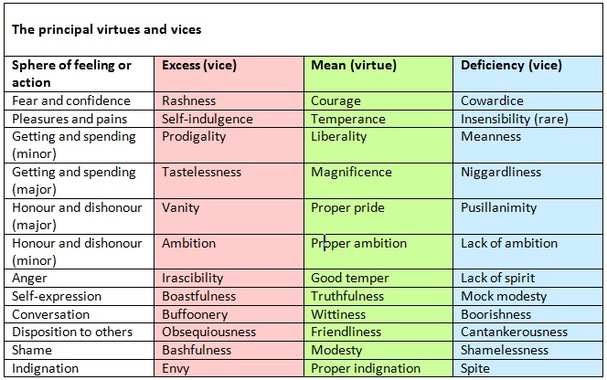
Keeping the golden mean between extremes
Aristotle, Nichomachean Ethics

Slide 173
Keeping the golden mean between extremes
Aristotle, Nichomachean Ethics

Slide 174
Keeping the golden mean between extremes
Aristotle, Nichomachean Ethics

Slide 175
Keeping the golden mean between extremes
Aristotle, Nichomachean Ethics

Slide 176
Keeping the golden mean between extremes
Aristotle, Nichomachean Ethics

Slide 177
Keeping the golden mean between extremes
Aristotle, Nichomachean Ethics

Slide 179
General instructions for using teleology

Slide 180
General instructions for using teleology
Both natural law and virtue ethics are context-sensitive
Our telos can be promoted differently in different circumstances
And what is brave in one context may be rash in another
So feel free to use your practical reasonableness

Slide 181
General instructions for using teleology
Both natural law and virtue ethics are context-sensitive
Our telos can be promoted differently in different circumstances
And what is brave in one context may be rash in another
So feel free to use your practical reasonableness
Natural law theorists cannot stray from the primary goods
That human life is sacred means that human life is sacred, and so on
How it can be best protected may be a matter of interpretation

Slide 182
General instructions for using teleology
Both natural law and virtue ethics are context-sensitive
Our telos can be promoted differently in different circumstances
And what is brave in one context may be rash in another
So feel free to use your practical reasonableness
Natural law theorists cannot stray from the primary goods
That human life is sacred means that human life is sacred, and so on
How it can be best protected may be a matter of interpretation
Virtue ethicists need to set, to an extent, their own premises
Some dimensions relevant to the case can be found in Aristotle
There may by others, though, and you must find them yourselves

Slide 183
General instructions for using teleology
Both natural law and virtue ethics are context-sensitive
Our telos can be promoted differently in different circumstances
And what is brave in one context may be rash in another
So feel free to use your practical reasonableness
Natural law theorists cannot stray from the primary goods
That human life is sacred means that human life is sacred, and so on
How it can be best protected may be a matter of interpretation
Virtue ethicists need to set, to an extent, their own premises
Some dimensions relevant to the case can be found in Aristotle
There may by others, though, and you must find them yourselves

Slide 184
Do not forget to send me your question at:
matti.hayry@aalto.fi

Slide 186
Intermission

Slide 188
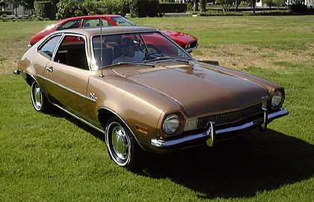
The Ford Pinto case

Slide 189
The Ford Pinto case

Slide 190
The Ford Pinto case
In 1968, Ford Motor Company decided to design their 1971 model by using a rule of 2000/2000: the car should weigh below 2000 lb and cost below $ 2000

Slide 191
The Ford Pinto case
In 1968, Ford Motor Company decided to design their 1971 model by using a rule of 2000/2000: the car should weigh below 2000 lb and cost below $ 2000
Engineering was seriously hampered by the weight, cost, and time limits, and this resulted in various construction flaws in the completed car – Ford Pinto

Slide 192
The Ford Pinto case
In 1968, Ford Motor Company decided to design their 1971 model by using a rule of 2000/2000: the car should weigh below 2000 lb and cost below $ 2000
Engineering was seriously hampered by the weight, cost, and time limits, and this resulted in various construction flaws in the completed car – Ford Pinto
One of them was that if the car was rear ended at 30 mph or more, its gas tank exploded and the doors jammed shut, leading people inside to burn alive

Slide 193
The Ford Pinto case
Ford knew, or should have known, about the defect – it was evident in their own pre-marketing safety tests
However, the business decision was made to present the car to the buying public in September 1970
In January 1971, US National Highway Traffic Safety Administration banned rear-bumper and gas-tank designs like the ones causing the trouble in the Pinto
Since the rule did not extend to models already in the market, Ford did nothing illegal

Slide 194
The Ford Pinto case
Ford knew, or should have known, about the defect – it was evident in their own pre-marketing safety tests
However, the business decision was made to present the car to the buying public in September 1970
In January 1971, US National Highway Traffic Safety Administration banned rear-bumper and gas-tank designs like the ones causing the trouble in the Pinto
Since the rule did not extend to models already in the market, Ford did nothing illegal

Slide 195
The Ford Pinto case
Ford knew, or should have known, about the defect – it was evident in their own pre-marketing safety tests
However, the business decision was made to present the car to the buying public in September 1970
In January 1971, US National Highway Traffic Safety Administration banned rear-bumper and gas-tank designs like the ones causing the trouble in the Pinto
Since the rule did not extend to models already in the market, Ford did nothing illegal

Slide 196
The Ford Pinto case
Ford knew, or should have known, about the defect – it was evident in their own pre-marketing safety tests
However, the business decision was made to present the car to the buying public in September 1970
In January 1971, US National Highway Traffic Safety Administration banned rear-bumper and gas-tank designs like the ones causing the trouble in the Pinto
Since the rule did not extend to models already in the market, Ford did nothing illegal

Slide 197
The Ford Pinto case
Ford knew, or should have known, about the defect – it was evident in their own pre-marketing safety tests
However, the business decision was made to present the car to the buying public in September 1970
In January 1971, US National Highway Traffic Safety Administration banned rear-bumper and gas-tank designs like the ones causing the trouble in the Pinto
Since the rule did not extend to models already in the market, Ford did nothing illegal

Slide 198
The Ford Pinto case
In 1977, the first law suit was brought against Ford, after a rear-end collision had left one dead and another badly burned (Ford lost the case in 1978)
By this time, the problem had been fixed, as the NHTSA had extended the rule to old models, as well
However, law suits continued to pile up, as the 1971–76 models claimed hundreds of casualties
Ford considered recalling those cars for repairs but decided against it based on a cost-benefit-analysis

Slide 199
The Ford Pinto case
In 1977, the first law suit was brought against Ford, after a rear-end collision had left one dead and another badly burned (Ford lost the case in 1978)
By this time, the problem had been fixed, as the NHTSA had extended the rule to old models, as well
However, law suits continued to pile up, as the 1971–76 models claimed hundreds of casualties
Ford considered recalling those cars for repairs but decided against it based on a cost-benefit-analysis

Slide 200
The Ford Pinto case
In 1977, the first law suit was brought against Ford, after a rear-end collision had left one dead and another badly burned (Ford lost the case in 1978)
By this time, the problem had been fixed, as the NHTSA had extended the rule to old models, as well
However, law suits continued to pile up, as the 1971–76 models claimed hundreds of casualties
Ford considered recalling those cars for repairs but decided against it based on a cost-benefit-analysis

Slide 201
The Ford Pinto case
In 1977, the first law suit was brought against Ford, after a rear-end collision had left one dead and another badly burned (Ford lost the case in 1978)
By this time, the problem had been fixed, as the NHTSA had extended the rule to old models, as well
However, law suits continued to pile up, as the 1971–76 models claimed hundreds of casualties
Ford considered recalling those cars for repairs but decided against it based on a cost-benefit-analysis

Slide 202
The Ford Pinto case
In 1977, the first law suit was brought against Ford, after a rear-end collision had left one dead and another badly burned (Ford lost the case in 1978)
By this time, the problem had been fixed, as the NHTSA had extended the rule to old models, as well
However, law suits continued to pile up, as the 1971–76 models claimed hundreds of casualties
Ford considered recalling those cars for repairs but decided against it based on a cost-benefit-analysis

Slide 203
The Ford Pinto case
The (social) benefits of the recall considered were:
180 burn deaths prevented, $200,000 per death
180 serious burn injuries prevented, $67,000 per injury
2,100 burned vehicles prevented, $700 per vehicle
= Total benefit to society $49.5 million
The (company) costs for the recall considered were:
11 million cars, $11 per car
1.5 million light trucks, $11 per truck
Total cost to company $137 million

Slide 204
The Ford Pinto case
The (social) benefits of the recall considered were:
180 burn deaths prevented, $200,000 per death
180 serious burn injuries prevented, $67,000 per injury
2,100 burned vehicles prevented, $700 per vehicle
= Total benefit to society $49.5 million
The (company) costs for the recall considered were:
11 million cars, $11 per car
1.5 million light trucks, $11 per truck
Total cost to company $137 million

Slide 205
The Ford Pinto case
The (social) benefits of the recall considered were:
180 burn deaths prevented, $200,000 per death
180 serious burn injuries prevented, $67,000 per injury
2,100 burned vehicles prevented, $700 per vehicle
= Total benefit to society $49.5 million
The (company) costs for the recall considered were:
11 million cars, $11 per car
1.5 million light trucks, $11 per truck
Total cost to company $137 million

Slide 206
The Ford Pinto case
The (social) benefits of the recall considered were:
180 burn deaths prevented, $200,000 per death
180 serious burn injuries prevented, $67,000 per injury
2,100 burned vehicles prevented, $700 per vehicle
= Total benefit to society $49.5 million
The (company) costs for the recall considered were:
11 million cars, $11 per car
1.5 million light trucks, $11 per truck
Total cost to company $137 million

Slide 207
The Ford Pinto case
The (social) benefits of the recall considered were:
180 burn deaths prevented, $200,000 per death
180 serious burn injuries prevented, $67,000 per injury
2,100 burned vehicles prevented, $700 per vehicle
= Total benefit to society $49.5 million
The (company) costs for the recall considered were:
11 million cars, $11 per car
1.5 million light trucks, $11 per truck
Total cost to company $137 million

Slide 208
The Ford Pinto case
The (social) benefits of the recall considered were:
180 burn deaths prevented, $200,000 per death
180 serious burn injuries prevented, $67,000 per injury
2,100 burned vehicles prevented, $700 per vehicle
= Total benefit to society $49.5 million
The (company) costs for the recall considered were:
11 million cars, $11 per car
1.5 million light trucks, $11 per truck
Total cost to company $137 million

Slide 209
The Ford Pinto case
The (social) benefits of the recall considered were:
180 burn deaths prevented, $200,000 per death
180 serious burn injuries prevented, $67,000 per injury
2,100 burned vehicles prevented, $700 per vehicle
= Total benefit to society $49.5 million
The (company) costs for the recall considered were:
11 million cars, $11 per car
1.5 million light trucks, $11 per truck
Total cost to company $137 million

Slide 210
The Ford Pinto case
The (social) benefits of the recall considered were:
180 burn deaths prevented, $200,000 per death
180 serious burn injuries prevented, $67,000 per injury
2,100 burned vehicles prevented, $700 per vehicle
= Total benefit to society $49.5 million
The (company) costs for the recall considered were:
11 million cars, $11 per car
1.5 million light trucks, $11 per truck
Total cost to company $137 million

Slide 211
The Ford Pinto case
The (social) benefits of the recall considered were:
180 burn deaths prevented, $200,000 per death
180 serious burn injuries prevented, $67,000 per injury
2,100 burned vehicles prevented, $700 per vehicle
= Total benefit to society $49.5 million
The (company) costs for the recall considered were:
11 million cars, $11 per car
1.5 million light trucks, $11 per truck
Total cost to company $137 million

Slide 212
The Ford Pinto case
The (social) benefits of the recall considered were:
180 burn deaths prevented, $200,000 per death
180 serious burn injuries prevented, $67,000 per injury
2,100 burned vehicles prevented, $700 per vehicle
= Total benefit to society $49.5 million
The (company) costs for the recall considered were:
11 million cars, $11 per car
1.5 million light trucks, $11 per truck
Total cost to company $137 million

Slide 213
The Ford Pinto case
Since the cost would have been considerably greater than the benefit (137 > 49.5), Ford decided not to recall
In 1977, the situation and Ford’s decisions were exposed, resulting in outrage and scandal
Ford recalled the 1971–76 models in 1978, and had them repaired
The company’s short-term reputation in the US suffered badly, but pretty soon Ford regained its position as one of the most esteemed car manufacturers globally

Slide 214
The Ford Pinto case
Since the cost would have been considerably greater than the benefit (137 > 49.5), Ford decided not to recall
In 1977, the situation and Ford’s decisions were exposed, resulting in outrage and scandal
Ford recalled the 1971–76 models in 1978, and had them repaired
The company’s short-term reputation in the US suffered badly, but pretty soon Ford regained its position as one of the most esteemed car manufacturers globally

Slide 215
The Ford Pinto case
Since the cost would have been considerably greater than the benefit (137 > 49.5), Ford decided not to recall
In 1977, the situation and Ford’s decisions were exposed, resulting in outrage and scandal
Ford recalled the 1971–76 models in 1978, and had them repaired
The company’s short-term reputation in the US suffered badly, but pretty soon Ford regained its position as one of the most esteemed car manufacturers globally

Slide 216
The Ford Pinto case
Since the cost would have been considerably greater than the benefit (137 > 49.5), Ford decided not to recall
In 1977, the situation and Ford’s decisions were exposed, resulting in outrage and scandal
Ford recalled the 1971–76 models in 1978, and had them repaired
The company’s short-term reputation in the US suffered badly, but pretty soon Ford regained its position as one of the most esteemed car manufacturers globally

Slide 217
The Ford Pinto case
Since the cost would have been considerably greater than the benefit (137 > 49.5), Ford decided not to recall
In 1977, the situation and Ford’s decisions were exposed, resulting in outrage and scandal
Ford recalled the 1971–76 models in 1978, and had them repaired
The company’s short-term reputation in the US suffered badly, but pretty soon Ford regained its position as one of the most esteemed car manufacturers globally

Slide 218
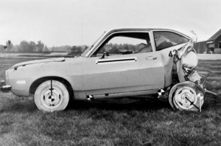
So what should we think about this?

Slide 220
Group Work 6
Groups

Slide 221
Find out and report
What are the reasons given by the CE in particular cases?
What other reasons could be given in particular cases?
Environmental ethics
Sustainability
CSR
Business ethics
Moral theories
Theories of justice
The background in the different approaches and theories will be provided by lectures, guest lectures, and reading material.
Everything is geared towards your investigation and reporting.

Slide 222
Group Work 6
Find out and report
State briefly the principle(s) of your ethical approach
What do you have to say, based on your approach and the Ford Pinto case, about the behaviour and/or character of
Ford Pinto engineers?
Ford managers between the Pinto engineers and Lee Iacocca?
Lee Iacocca?
Ford Motor Company?
Cases
Act utilitarianism
Rule utilitarianism
Moral legalism
Kantian ethics
Natural law theory
Virtue ethics

Slide 223
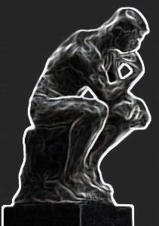
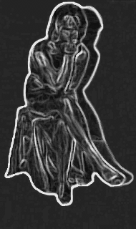
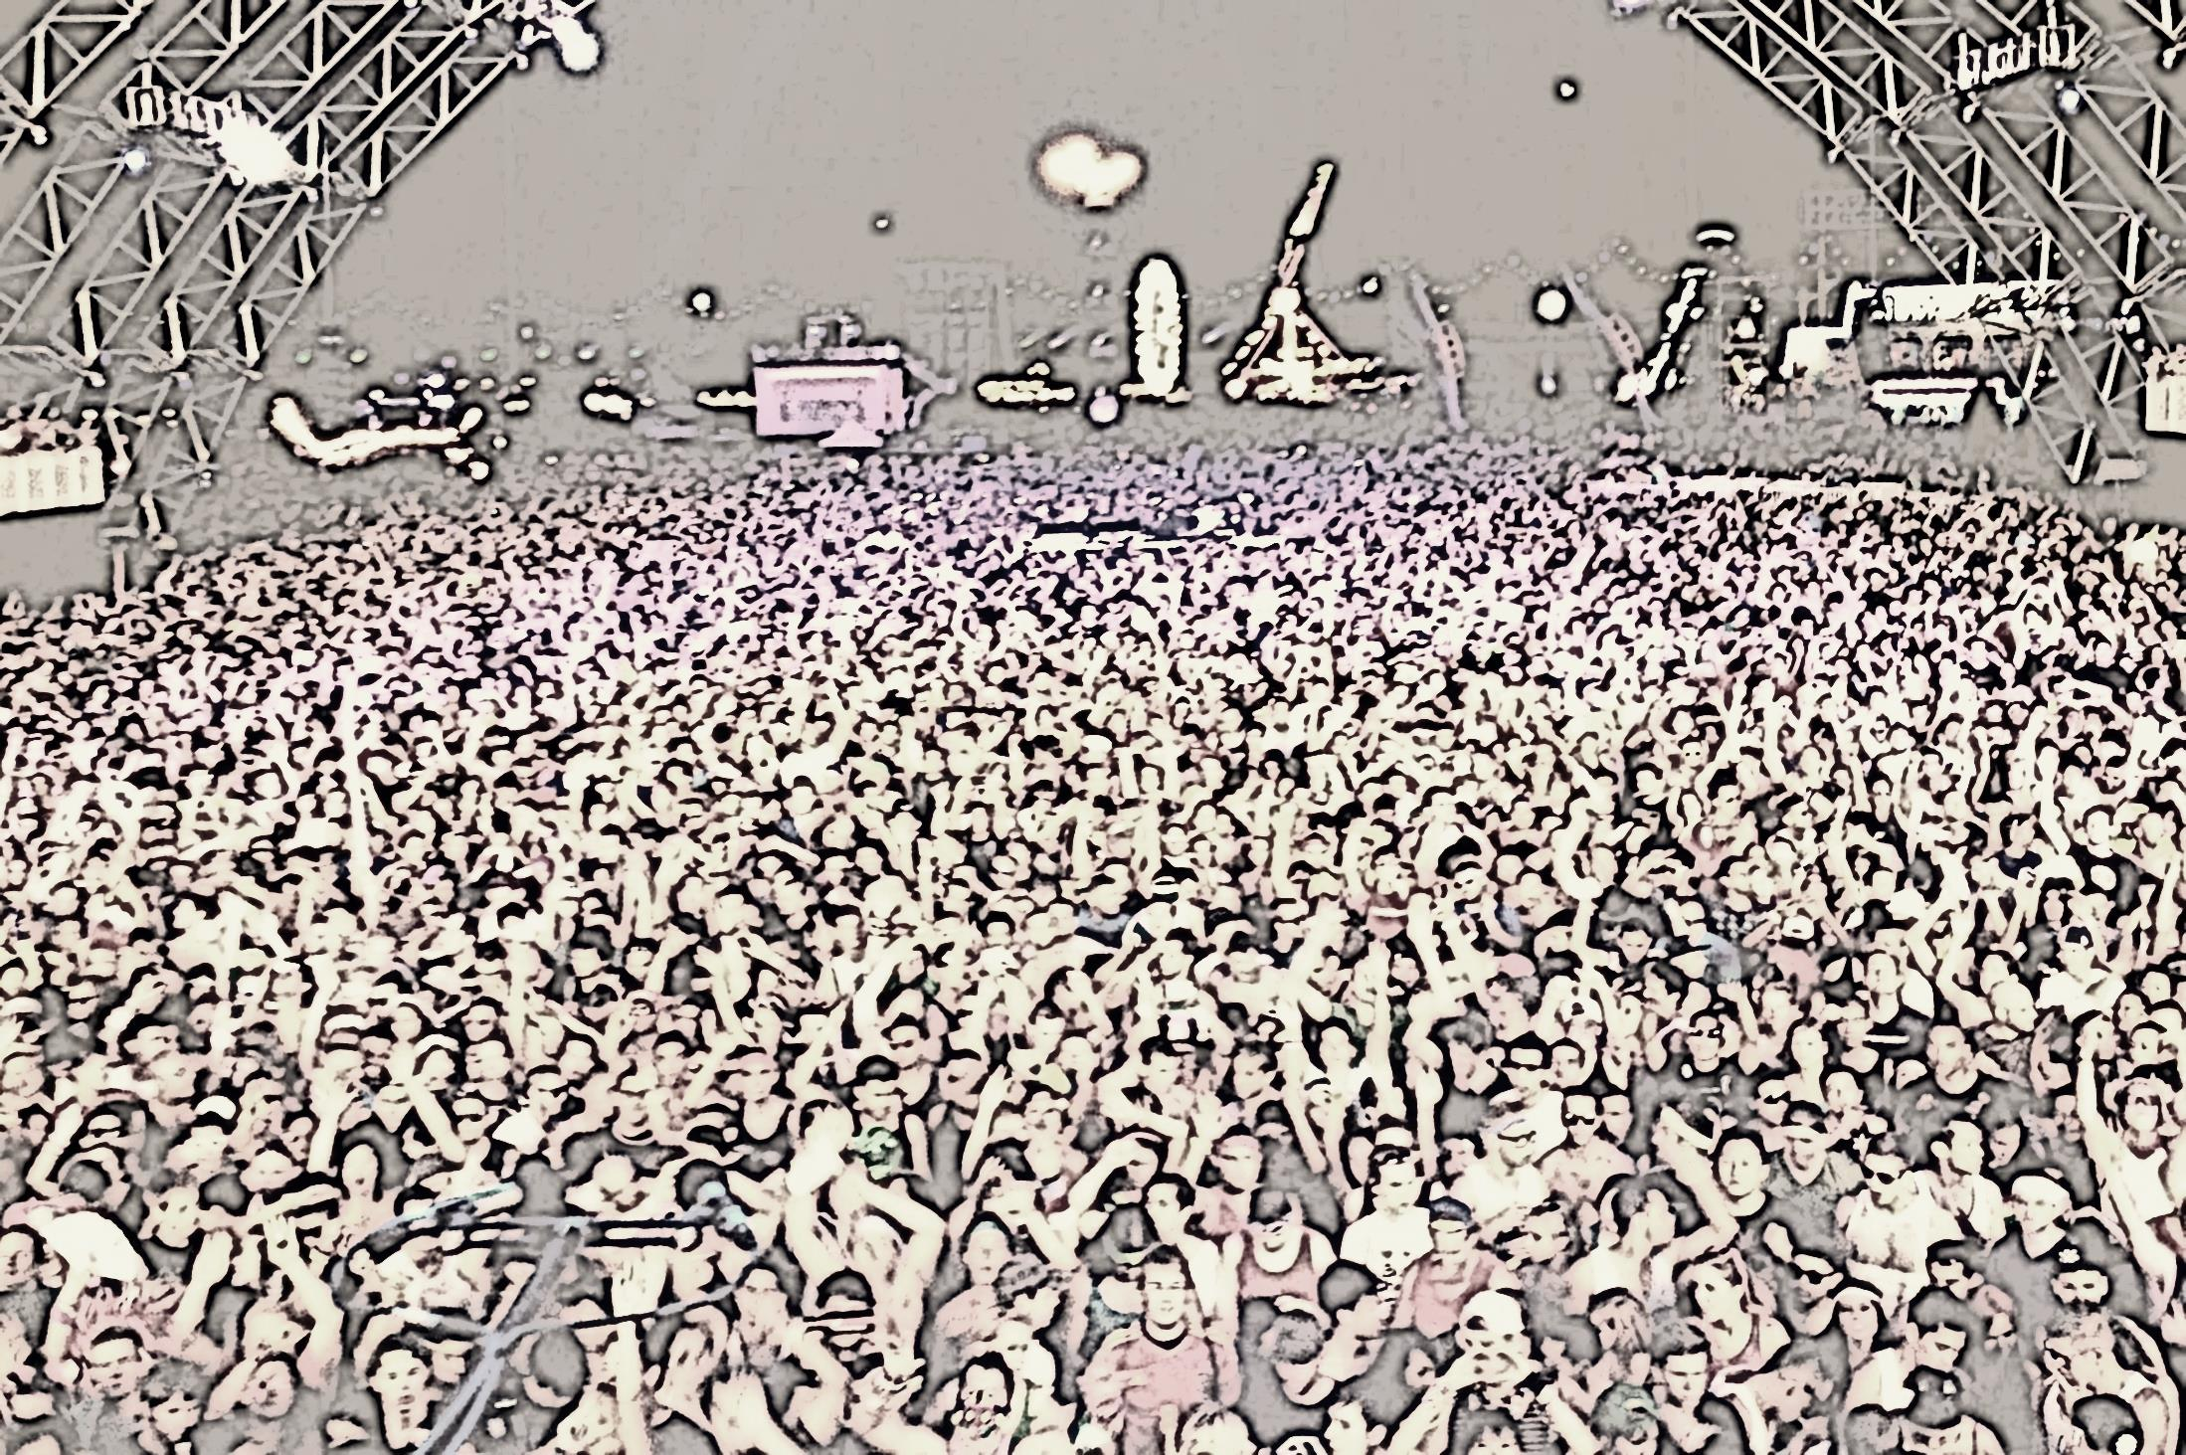
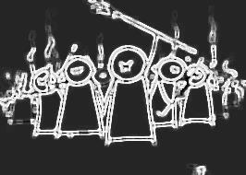

Slide 225
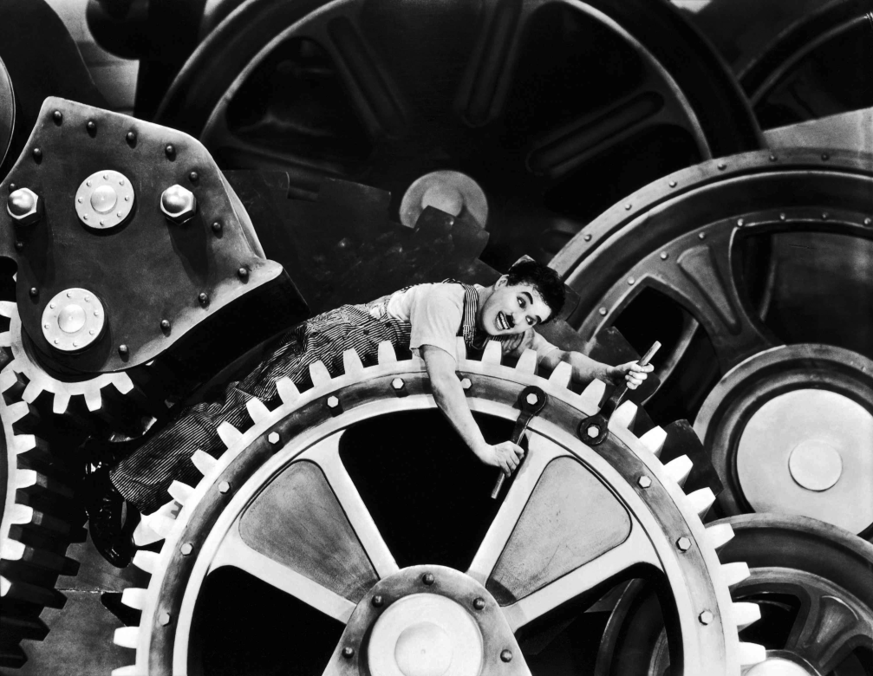
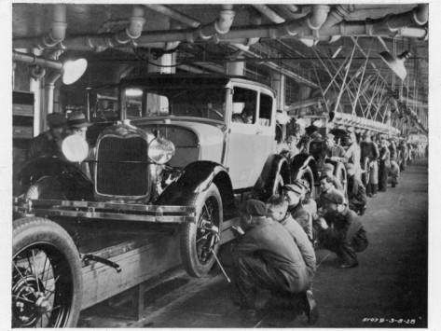
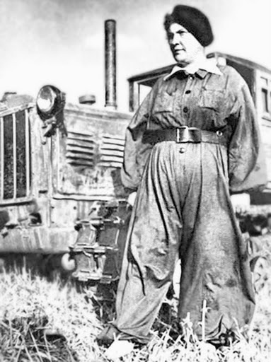
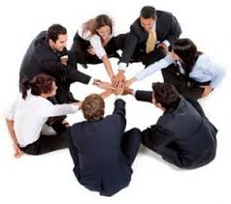
Business ethics in management approaches

