Slide 1
Corporate irresponsibility Principles of and antecedents to organizational wrongdoing
Jukka Rintamäki
Loughborough University London

Slide 2
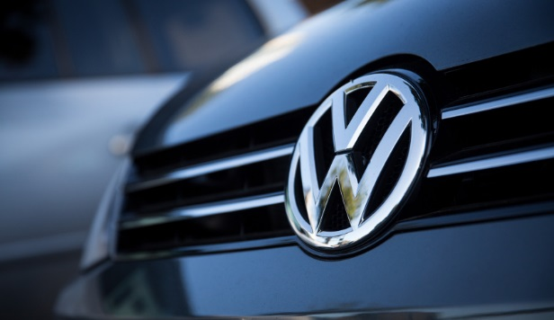

Slide 3
Agenda
Why corporate irresponsibility?
What is corporate irresponsibility?
How does corporate irresponsibility come about?
Normal and abnormal accounts of irresponsibility
Group assignment

Slide 4
Understanding corporate irresponsibility

Slide 5
Why corporate irresponsibility
Many experts agree that corporate irresponsibililty is more common than responsible business activity
Compliance, punishment, and social order are fundamental questions in any society
Organizations, large ones in particular, are capable of wrongdoing with ramifications far beyond anything an individual could achieve
Death, destruction (of natural habitats), hardship (loss of livelihoods), and pain (injuries)
Individual level issues are important too, as wrongdoing often begins with individuals or small groups

Slide 6
Why corporate irresponsibility and not CSR?
Many firms that conduct high profile irresponsibility are poster children for CSR
Enron, VW, RBS...
CSR is often somewhat symbolic, and generally deals with organization-wide routine processes and is a result of institutional pressures and employee agency
Irresponsbility, on the other hand, can be very local (within the organization), is often unpredictable, and difficult to observe, pin down, and discuss – publicly or internally
And often is a result of routine processes, or in other cases, driven by unethical individuals!
To deal with irresponsibility, we need to explicitly discuss irresponsibility

Slide 7
What is corporate irresponsibility?
Irresponsibility, wrongdoing, misconduct...
Harm
Attention
Attribution (of blame)
Undesirability of impacts
Culpability of the firm
Affected party noncomplicity

Slide 8
Definitions
Organizational misconduct
”Behavior in or by an organization that a social-control agent judges to transgress a line separating right from wrong; where such a line can separate legal, ethical, and socially responsible behavior from their antitheses.”
Greve et al., 2010.
Corporate irresponsibility
”Organizational actions that cause harm to stakeholders.”
Mena et al., 2016.

Slide 9
Famous examples of corporate irresponsibility
Ford Pinto
Bhopal disaster
Exxon Valdez
Shell Brent Spar
BP Deepwater Horizon oil spill
A pattern in oil industry?
VW
The most severe instance in a long continuum of similar cheats

Slide 10
Accounts of corporate wrongdoing

Slide 11
Is corporate wrongdoing normal or abnormal?
Abnormal wrongdoing
Irresponsible activity a result of deviant, unethical organizations or individuals
The “bad apple/barrel” explanation
Normal wrongdoing
Irresponsible activity a result of normal, “good” people in challenging, complex contexts ending up doing bad things, or things with bad consequences

Slide 12
Wrongdoing accounts: ab/normal
Wrongdoing as abnormal
Wrongdoing as normal
The rational choice account
The accidental behavior account
The power structure account
The administrative system account
The situational social influence account
The culture account
The ethical decision account

Slide 13
Wrongdoing accounts: ab/normal
Wrongdoing as abnormal
The rational choice account

Slide 14
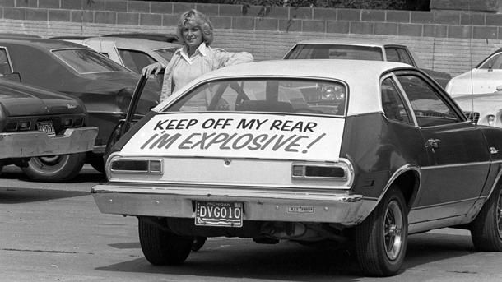
Irresponsibility as rational choice
Individuals and organizations are self-interested actors who need to be controlled so they will not choose actions that are harmful to others (while beneficial for themselves)
Corporate irresponsibility as cost-benefit analysis where sometimes harmful behavior is financially profitable
Employees within firms may commit acts of irresponsibility because they e.g. may potentially improve their career progression
(Management) groups may commit acts of irresponsibility, because it is thought that it will not be noticed, or that the penalties will be smaller than the benefits

Slide 15
Wrongdoing accounts: ab/normal
Wrongdoing as abnormal
The rational choice account
The culture account

Slide 16
Culture as a source of irresponsibility
Organizational cultures can can be conducive of irresponsibility or misconduct
Cultures can endorse irresponsibility e.g. by emphasizing high levels of personal or collective-level achievement without specifying any related ethical considerations
Cultures can permit irresponsibility in certain contexts, such as when there is no direct harm to humans involved, or that stupid customers deserve to be cheated, and so on
Cultures conducive for conducting irresponsibility may be influenced by leaders, or by environmental factors

Slide 17
Strain as a source of irresponsibility
When gaps in expected/potential and actual performance appear, the likelihood of acts of irresponsibility increases
Segway to organizational level irresponsibility:
Failing and marginal organizations are the likeliest offenders
Not a simple matter though: Some studies find that high-growth firms are likelier than others to exhibit irresponsible behavior
Baseline: Any firm can be susceptible for irresponsibility

Slide 18
Wrongdoing accounts: ab/normal
Wrongdoing as abnormal
The rational choice account
The culture account
The ethical decision account

Slide 19
Ethical decision-making account
Focus on the process of ethical decision-making
Early idea, four stages:
(Fail to) become aware of need for ethical consideration
Deliberate and (fail to) identify the ethical course of action
(Fail to) develop intention to act consistently with that course
(Fail to) act in accordance
Useful, but appears to assume a vacuum for decision-making
More recent work in this strand have emphasized the need for context, limits of rationality, the need to consider emotions, intuition, temporality, and so on
Perhaps useful for demonstrating how difficult it is to reach an ethically sound decision in a complex context

Slide 20
Wrongdoing accounts: ab/normal
Wrongdoing as abnormal
Wrongdoing as normal
The rational choice account
The culture account
The ethical decision account

Slide 21
Wrongdoing accounts: ab/normal
Wrongdoing as abnormal
Wrongdoing as normal
The rational choice account
The administrative system account
The culture account
The ethical decision account

Slide 22
The administrative system account
Administrative systems:
Obtrusive controls such as division of labor, rules, and standard operating procedures
Explicit guidelines that tell managers and employees what to do in specific situations
Sometimes, such explicit obtrusive controls prevent or hamper individual (moral/ethical) judgment
Unobtrusive controls such as (restrictive) communication channels, information processing technologies, and schemas
Less explicit guidelines, help navigating where obtrusive controls do not reach
Sometimes these un/obtrusive controls lead to wrongdoing!
Notes:
Obtrusive Ford Pinto – 2000 rule – max 2000 buck prod cost, max 2000 pound weight
Unobtrusive: Ford Pinto – aim attention at commonly occurring flaws only

Slide 23
Wrongdoing accounts: ab/normal
Wrongdoing as abnormal
Wrongdoing as normal
The rational choice account
The administrative system account
The situational social influence account
The culture account
The ethical decision account

Slide 24
The situational social influence account
Social relationships provide information about the attitudes and behaviors that are appropriate for the work environment
The idea is to support attitudes and behaviors that facilitate desired organizational outcomes
Peer influence has been shown to e.g. cause lower level employees work harder and better than they otherwise would
Sometimes, things go awry, however
Among professional cyclists, cyclists whose teammates use doping, are more likely to engage in use of doping than those whose teammates do not use doping
Also other types of related phenomena such as groupthink or commitment processes
Notes:
Groupthink = group-cohesion-induced censorship and self-censorship
Commitment processes = when your results are exposed to others, you may want to show good results and “tweak” the indicators in your favor…the real values stay the same however, and once this practice escalates, it is impossible to catch up to real figures anymore as the gap between real and reported (tweaked) grows too wide

Slide 25
Wrongdoing accounts: ab/normal
Wrongdoing as abnormal
Wrongdoing as normal
The rational choice account
The power structure account
The administrative system account
The situational social influence account
The culture account
The ethical decision account

Slide 26
The power structure account
Power structures establish a pecking order that provides direction for employees when confronted with tasks or problems
For instance, a chain of command
Gives employees the possibility to turn to their superiors, but also to managers to exert control over subordinates
But also more informal structures
Such as someone in an organization controlling access to a scarce resource
Power structures also hold potential dangers
Abuse of power in organizations
The Milgram study
Power corrupts!
Notes:
Chain of command: military cover-ups, difficult to uncover because of loyal hierarchy
Informal structures: finance whiz Andy Fastow at Enron, all top brass were dependent on his constructs in their dealings so he came out on top in all internal negotiations

Slide 27
Wrongdoing accounts: ab/normal
Wrongdoing as abnormal
Wrongdoing as normal
The rational choice account
The accidental behavior account
The power structure account
The administrative system account
The situational social influence account
The culture account
The ethical decision account

Slide 28
The accidental behavior account
Sometimes, a specific phenomenon-related explanation is difficult to find
Environments may change, we may misinterpret things or miscommunicate etc.
And as a result our actions may have unintended consequences
The (technological) systems we work in/with can become extremely complex and tightly coupled
One way to explain the financial crisis
The outcomes are still wrongful, and thus such activity can be considered misconduct

Slide 29
Wrongdoing accounts: ab/normal
Wrongdoing as abnormal
Wrongdoing as normal
The social control account
The rational choice account
The accidental behavior account
The power structure account
The administrative system account
The situational social influence account
The culture account
The ethical decision account

Slide 30
The social control account
Social control agents – most typically the state or a similar actor – have an influence on, or in fact generate organizational wrongdoing
What is demarcated as right or wrong is always decided by these agents, and they may change the bases for such evaluations over time and space
They may come up with rules and regulations that are difficult to follow or interpret
Organizations may inadvertently end up crossing the line from right to wrong
They may otherwise come up with rules and regulations, or otherwise incentivize actors or organizations to transgress

Slide 31
How to combat wrongdoing risks: Generally
Be aware of the ubiquity and normality of wrongdoing; how easily and the different ways it comes about
Be aware that preventing and dealing with organizational wrongdoing is very complex and difficult; across the board measures are difficult to come by, but context-specific measures are possible
Generate understanding across all levels of the organization, managers especially, on the different aspects (accounts) of organizational wrongdoing

Slide 32
How to combat wrongdoing risks: More specifically
Minimize incentive system (rational choice) related misconduct
Hire people with tempered preference structures, provide incentive systems that encourage rightdoing (discourage wrongdoing), monitor wrongdoing through governance
Minimize culture-related misconduct
Hire people with the right values, endorse cultural values that support rightdoing (discredit wrongdoing), have the right types of leaders
Minimize power-related misconduct
Good followership: it is ok to challenge superior as well as to obey them; spread power around instead of focusing it
Minimize administrative system facilitated wrongdoing
Be aware of unintended consequences of admin systems, encourage reflexivity

Slide 33
Recap
Corporate irresponsibility/wrongdoing is common, and in many cases more complex than simply ‘evil’
Can be seen as either a normal or an abnormal feature of organizational activity
Can be summarized to be a result of an interplay between personal traits of the decision-maker and characteristics of the situation
Decision-making hardly rational in the first place, and obstructed and distracted by a variety of factors and issues
Thus, the path following which decisions have been arrived at tend to be highly case-specific
This does not mean, however, that there are no safeguards against

Slide 34
Group assignment
Work in groups
Choose an instance of corporate irresponsibility
What happened?
To what extent is the case normal / abnormal wrongdoing?
Which different types of accounts are present? Any dominant ones?
Can you find anything on whether the wrongdoing could have been prevented? Or lessons learned?
Instances of corporate irresponsibility
Bhopal disaster
Ford Pinto scandal
Volkswagen emissions cheating scandal
Boeing 737 MAX scandal
Wells Fargo false accounts scandal
Toyota accelerator pedal scandal
Or if you have a better idea!
Nordea, Danske Bank…

Slide 35
References
Gioia, D. A. 1992. Pinto fires and personal ethics: A script analysis of missed opportunities. Journal of Business Ethics, 11(5–6): 379–389.
Greve, H. R., Palmer, D., & Pozner, J. 2010. Organizations Gone Wild: The Causes, Processes, and Consequences of Organizational Misconduct. The Academy of Management Annals, 4(1): 53–107.
Mena, S., Rintamaki, J., Fleming, P., & Spicer, A. 2016. On the forgetting of corporate irresponsibility. Academy of Management Review, 41(4): 720–738.
Palazzo, G., Krings, F., & Hoffrage, U. 2011. Ethical Blindness. Journal of Business Ethics, 109(3): 323–338.
Palmer, D. A. 2013. The New Perspective on Organizational Wrongdoing. California Management Review, 56(1): 5–24.
Palmer, D. 2013. Normal organizational wrongdoing: A critical analysis of theories of misconduct in and by organizations. Oxford University Press.
Perrow, C. 1984. Normal accidents: Living with high risk technologies. Princeton University Press.

