Slide 1
Cynefin Domains of Knowledge
A tool for thinking about five different knowledge context and possible actions relevant to use in each context

Slide 2
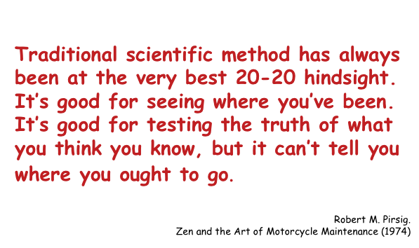

Slide 3
Learning to look ahead
While traditional scientific knowledge may have its limits, a problem inhibiting achievement is the habit of applying one approach to knowledge use and acquisition.
The Cynefin model identifies FIVE Domains in which we work with knowledge.
Each has its own features and all need different responses
Good managers ask
“Which Domain of Knowledge am in in?
What do I need to know about the relation between what is happening (Cause) and what impact it will have (Effect)?”

Slide 4
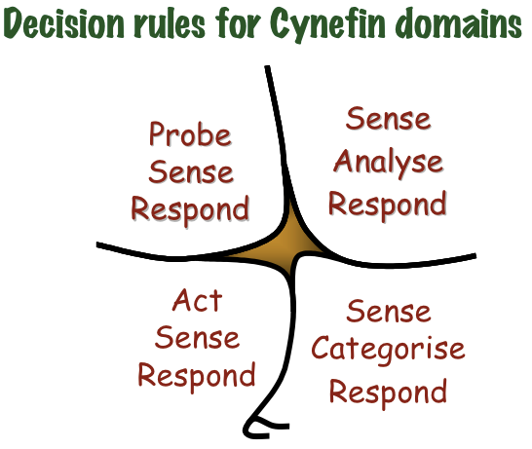
Cynefin Domains
Information
is
U
N
O
R
D
E
R
E
D
We do not know how it works until we work with it
Information
is
O
R
D
E
R
E
D
We know how it works
Complex Domain
Complicated Domain
Domain
Of DISORDER
Chaos Domain
Familiar Domain

Slide 5
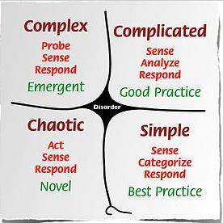
When we set up repeating processes we follow - ‘best practice’ or
‘good practice’
Both are designed for ‘ordered’ contexts
Notes:
Human beings really like order and familiar conditions. We try to keep our lives in an ordered situation - and sometimes we can become so dependent on being in an ‘ordered’ environment, that we do not know what to do if things are not completely familiar.
However

Slide 6
When we experience unique processes we need to establish new processes based on what is emerging - or create novel approaches
Notes:
Sometimes there is no known prior order we can rely on. When such situations arise we can either flee from them back into the ‘ordered’ domain or stand and face the new situation and explore it until we know all we can, and are able to work out the best possible solution for this occasion. And we know that at some times just doing something is what is needed.

Slide 7
Complicated Domain
Complex Domain
Domain
Of DISORDER
Familiar Domain
Chaos Domain
Notes:
For each of the four operational knowledge domains we operate in a specific way. In the Familiar/Simple domain we make sense quickly deciding what ‘category’ of knowledge we are working with and then respond to what we know.
In the Complicated Domain we make sense of what we know, and have time to analyse the data we are gathering and then respond to what we know. This is the domain of expertise. Knowledge is acquired and used. Others come other experts because they know they know!
In the Coplex Domain we face problems which have not happened before, and for which there is no prepared answer. We have to explore and seek out what might work, text and trial and when we have the best available answer we apply that and have to wait for the outcome.
In the Chaos Domain - there is no time for expertise or searching. We have to ‘Act’ and the make sense of what happens as a result. We may never ow what cased the problem, or may only know much later - and what we need to do is accept that taking action is all we could do in the moment of chaos

Slide 8
‘Complexity’
The Domain of ‘Disorder’
We often ‘fear’ because of there is an actual absence of any structure
Using these ‘frames’ we can explore the differences between ‘disorder’ and ‘un-order’.
Understanding the difference between ‘unorder’ and ‘disorder’, helps us to understand what may be happening in contexts where the pattern is larger than anything we can see or comprehend, while we accept the possibility of its existence.
‘Simplicity’
‘Un-order’
‘Order’
Notes:
This “Fifth Domain” is the one we are all most concerned about. We are afraid of not knowing and yet think of this as something to be avoided - so we try to return to the familiar and safe ordered domains when it may be that we are actually operating in the Complicated or Complex domain. And for both of those there are ways of operating to address the knowledge problems we are in.
Only for the ‘Disorder’ domain is there no operating process - except to work out which one we are actually n and then start working with the rules of that Domain.

Slide 9
Notes:
These rules are important for our understanding of how we - and others - are using our knowledge.
We will volunteer knowledge - we can not be forced to give others what we know. We will withhold our knowledge in the workplace if doing so give su power over others or the satiation; or if we are afford that telling what we know will cause others to persecute us; or if it takes too long to explain what we know we may not try to speak it.
Sometimes we know things when someone asks us and then we are surprised that we know what we say. This is what it means when we say ‘i only know what .kKnow when I need to know it.
And finally think about all the knowledge you are acquiring and filing away. Sometimes ti is formal, sometimes it is informal. We all - always - know more than we can say about what we know, and we can far more easily say it that we can write ti down.
Knowledge is in our body - think of the sports moves you practice until you do them ‘without thinking’. This is ‘embodied knowledge’ out muscles and sinews know ti, we don’t speak it.
We tell stories to help us understand what we know. And we share these stories so others understand what we know. All societies and cultures have stories ‘narratives’ that they sphere within themselves but not with others.
And then there is all the abstract knowledge that helps us work in specific contexts, which we Amy not even be aware of knowing - until/unless someone else notices us using it.

Slide 10
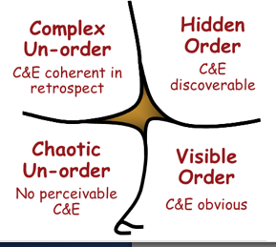
Relational Data Bases link and relate words in many different ways
Hidden Order (Knowable)
Cause and Effect
separated in time & space
can be repeated
Complex
Un-order
CAUSE AND EFFECT
ARE coherent in retrospect
DO NOT repeat
Thesaurus, and Taxonomy examine how words connect
Word soup - words have no clear meaning but action is needed
Unresolved Dissonance - there is no agreement on any meaning
Chaos
(Un-order)
Cause and Effect
no perceivable linkage
Visible Order (Known)
Cause and Effect
are evident
AND repeatable
A dictionary lists words and defines them
Notes:
This is a way of thinking about information as it works in knowledge domains.
A dictionary - is tightly ordered and does not vary very much from one to another. It helps us find words and use them correctly - but does not tell us much about how they are connected.
A thesaurus / taxonomy tells us how words connect and are link and can be use to replace others.
A ‘relational data base’ can be searched in any number of different ways ,and each search will show new/different connections among words and concepts - relationships among words are tied more closely to contextual realities
“Word soup’ - tells us that usual meanings are not working and we have to take action without a lot of / any guidance to help us make sense of what we are encountering.

Slide 11
Hidden Order (Knowable)
Data base documents built in/for this quadrant rely on the expertise of the person/s building them. Roget had specialist knowledge/understanding that had not been available in the same way to others before him.
Complex Un-order
In regard to information/knowledge management this quadrant requires access methods that can anticipate somewhat the needs of users the database is designed for, but allows for free searching such that unanticipated searches are still possible
Chaos
Un-order
Words may have some kind of order but there is no known way to explain or access them. For example those heard to be ‘speaking in tongues’ are using language-like verbal structures but close examination has shown that there is no meaning that can be ascribed to their utterances
Visible Order (Known)
Information is arranged according to logics that are known and shared (however illogical they may actually be (e.g. alphabetical order is totally arbitrary, but shared and known by all as ‘order’)
There is no need to learn to understand the document beyond some simple basics, order does not change across languages

