Slide 1
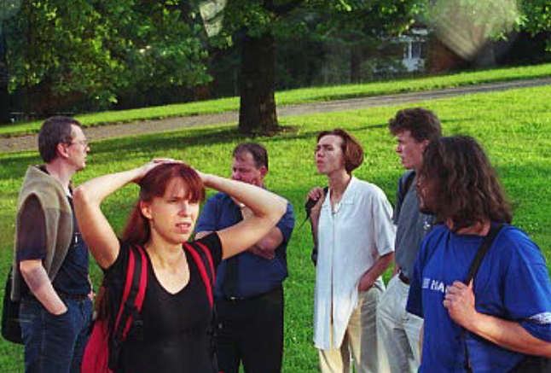
Appreciating Teams
Teams work with their hearts
And with their heads and hands
Effective Teams:
Appreciate difference
Value diversity
Begin with their ‘end in mind’
Plan then act
Notes:
In the context of the MPM the ‘value diversity issue’ is especially important which will become evident by the time teams are formed.
There is a diversity of professions and skills here; a diversity of prior education and work experiences; a diversity of language and cultures; and a diversity of abilities and interests.
And this aspect of your MPM studies is intended to help you focus on how to contribute effectively to the team you join, and do everything possibel to enable others to do the same for you.
But before we get there this time is provided to review what you need to know about some of the key elements of creating yourselves as highly effective teams.
The people in the photo are from 6 different countries and were studying together as a team in a seventh country! This moment in their program was one where they were feeling lost and distracted. Today they would say it was a most successful time – and it was. But at this moment they were having trouble remembering their purpose. We anticipate you will encounter similar moments and will also have similar strength of purpose to name and face your own problems effectively.
The theories and concepts that follow are introduced here to give you an advantage by telling you what to look for, how to address the issues and how to learn about yourself in the context of the team you create.

Slide 2
The BELBIN Team Roles
Teams require specific ‘functions’ to be undertaken to achieve goals.
Individuals prefer to focus on some of these functions, and have ‘allowable’ and ‘unallowable’ weakness associated with these preferences.
High performing teams undertake to learn how to identify and manage these preferences for the good of the Task, the whole Team and Individual members

Slide 4
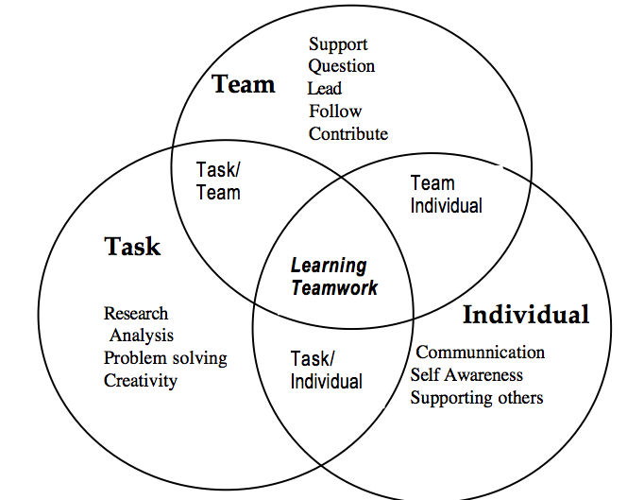
Three Points of Focus
Notes:
This is based on the work of John Adair an UK researcher. He was interested in ‘how to lead’ teams – but this model shows the factors that a team and the leader all have to manage for.
Highly effective teams pay attention to each one – not all at once, that’s impossible – but each in turn, and especially to the one that need attention when there is evidence of the need. The most neglected are the individual needs – in the mistaken belief that ‘doing the task’ well is all that is needed.
Yet when these are neglected everything can come down.
So pay attention to each one consciously and make it a routine to check in one each one at some point each day. At least once a day stop and ask -
Are we managing the task well?
Are we working as a team and doing it well?
Is there anything not right for any of us? We can handle things best when we know they exist.

Slide 5
Plant
The "ideas person" of the team, the prime source of ideas and innovation. Can play a strategic role such as forward planning. Advances new ideas and strategies, with special attention to major issues. Looks for ways around problems confronting the team.

Slide 6
Resource Investigator
Develops contacts with the outside world. A source of outside information and ideas. Explores and reports on ideas, developments and other resources from outside the group. Creates and maintains external contacts which may be useful to the team. Negotiates with outside contacts.

Slide 7
Co-ordinator
Provides leadership by co-ordinating the efforts and contributions of team members. Encourages contributions from others, and sums up the team verdict. Often uses a subtle form of leadership. Controls the way in which the team moves towards group objectives. Helps to make best use of the team's resources by recognising the team's strengths and weaknesses.

Slide 8
Shaper
Provides leadership (in the conventional sense of the term) by directing and controlling the team's members. Exerts a strong influence on the way in which the team operates and the objectives it pursues. Directs attention to such matters as setting goals and priorities. Imposes a predetermined shape on the team's operating style.

Slide 9
Monitor Evaluator
The "devils advocate", critiquing the ideas and suggestions offered by team members. Evaluates new plans (which should seldom be implemented against the ME's advice). Analyses problems. Evaluates ideas and suggestions so that the team is better placed to take balanced decisions.

Slide 10
Team worker
Maintains group harmony, member satisfaction, and team spirit to maintain team effectiveness. Usefully fills support positions within a team. There are often several in a team. Supports members in their strengths, for example by building on their suggestions. Underpins members in their shortcomings. Improves communication and fosters team spirit.

Slide 11
Implementer
The backbone of the team in accomplishing detailed and practical outcomes. Is best allowed a considerable amount of direct responsibility, and a principal action role in implementing group decisions. Turns concepts and plans into practical working procedures. Carries out agreed plans systematically and efficiently.

Slide 12
Completer Finisher
Attends to detail and follow-up, Maintains a sense of urgency. Most usefully given the role of checking completion of team tasks. Valuable in an emergency. Protects the team from mistakes and omissions. Searches for aspects which require special attention.

Slide 13
Specialist
Single-minded, self-starting, dedicated. Contributes knowledge and skills that are of special importance. May focus on a narrow set of details. Enjoys the technical nature of their work.

Slide 14
The Learning Cycle
Activist
Reflector
Pragmatist
Theorist
Learning is a cyclic activity. We do, observe, think and practice. Each phase helps to strengthen our understanding
Notes:
To KC – these are familiar to you I think, and I ad lib the specific message. Key themes
We all learn differently and this is reflected in our behaviour and attitudes to getting things done.
We can seldom alter own own default modes but can be conscious of how they operate and their impact on others so that we can reduce any negative impact.
Similarly we cannot alter others’ modes but can take conscious action to work with others in a collaborative way.
To do this means we need to understand that ‘they are different’ and a good way to manage this is to listen and then ask questions – while reducing our tendency to impose our behaviours and needs.
So the message is to be aware of our actions/behaviours and observe others to allow room for the differences to be productive.

Slide 15
Activist Preference
Needs lots of concrete experience
Talks a lot, uses their own experiences as a reference point, and wants to “include everything”!
Contribution - getting things done, energy and interest—even in slow times—having lots of ideas and different perspectives
Problems others may have with activists - impatience, “butterfly mind”, “slapdash”, talks a lot, can’t end things, critical of those who “take too long to know their own mind.”
Notes:
This and the next three slides focus on the “Learning Cycle’ model as this is more likely to be visibly evident to others.
The focus in on observable behaviour and taking time to stop and assess what we are seeing and then ask questions and check for mutual understanding and allow time for the differences to have their say.

Slide 16
Reflector Preference
Also likes concrete experience— needs lots of time to think about what has happened
Asks lots of questions - expects answers
Contribution - concern for quality and relevance of ideas, have lots of carefully acquired knowledge, able to critically assess progress and standards.
Problems others may have with reflectors-
‘slow’ to act, need lots of time to answer questions, critical of others who ‘rush through things’
Notes:
As for previous slide

Slide 17
Theorist Preference
Loves facts and theories—the more the better!! Is good at working with concepts and abstract ideas.
Contribution – confident dealing with complex ideas, creates new ideas and brings in information, focus on caution, carefulness and content.
Problems others may have with Theorist -
may ignore needs of others, criticise a focus on ‘practicalities’, dislike teamwork not happy to contribute, emphasise own intelligence (‘arrogant’)
Notes:
As for previous slide

Slide 18
Pragmatic Preference
Interested in using ideas and skills. Seeks first to know how things will help work/goals
Contribution - focus on usefulness, application. Keen to ‘test’ ideas, seek solutions to problems. Brings attention to clarity of expression etc
Problems others may have with pragmatists
With this preference there is an impatience with those needing time to think, resent being told the answers, want to “skip the theory bit”
Focused on “how will it help—NOW?”
Notes:
As for previous slide

Slide 19
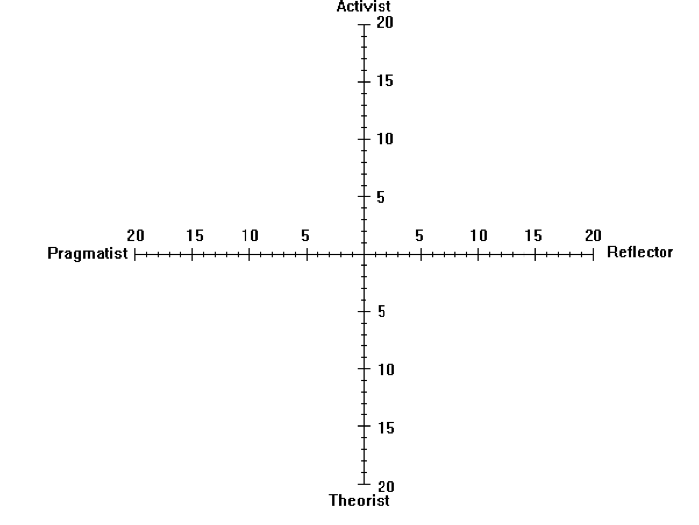
How we prefer to learn
Notes:
This is a map of Rod Gorrie’s preferences in Honey and Mumford and mine!
I’m the one in back. Rod’s red. I usually ask people to suggest the benefit sand problems of such a pairing. As they have the H&M Questionnaire – one way to explore their differences once they are in a team, is to prepare a similar map and identify some of the possible problems/gaps that sow up.

Slide 20
Dee Hock established the
“virtual organisation” known as “VISA”
and created the term
“Chaordic”
To describe the relationship
Between order and chaos
Notes:
“Chaordic’ = a mixture of chaos and order.
i.e. – CHA and ORD
Where we sometimes have control and at others have none but must work anyway. The term was created by Dee Hock – the man who led the creation of the VISA card and shaped all similar financial programs. He recognised that there were things they could shape and control tightly and others they could not – so had to devise means of being variously “in ‘ and “out’ of control and have plans to manage such contingencies.
The success of VISA is a testament to his understanding and a model for all teams to emulate.

Slide 21
Characteristics of Chaordic Teams
Sensitive to Initial Conditions
Members know that the team’s beginning shapes its outcomes
Order exists even in chaotic conditions
Members accept that effective learning can occur anywhere
Finding rather than Imposing structure
Members begin by paying attention to what they have and know, then they work what is to be done and achieved
Enough repetitions produce a pattern
Individual contributions remain unpredictable and members appreciate what each person contributes
Notes:
These elements invite the teams to pay attention to the impact of all that has gone before.
1 When they form teams – in a few minutes – they will be creating the ‘initial conditions’ so choose carefully and give full attention to team members.
Accept that things will not be neat and tidy every moment – that in fact nothing 2 really worthwhile gets done with out some chaos.
3 Allow things to evolve but also be attentive to what they are doing as a team.
4 They can create a good atmosphere from the beginning and then build it every meeting – or not pay attention and endure a less than high achieving team.

Slide 22
Effective Teams
Share concerns and ideas
Balance three key factors
Requirements to complete assigned tasks
Addressing individual members’ needs
Achieving team goals
Begin with the end in mind
‘we know what we intend to achieve’
Develop and use Team Rules
Value and reflect on all the learning available
“go beyond doing the task”
Have FUN - and - CELEBRATE
Notes:
Self explanatory and it leads into the Belbin roles overview.

Slide 23
Team “Life Cycle”
Teams go through a cycle of development
Repeated by each new team
When members first meet there is a sense of reservation about how to act (Forming)
As action is taken members begin to compete or demand things from others - conflict emerges (Storming)
As conflict is resolved - ways of working together are established (Norming)
Approaching deadlines draw members together to focus on achievement - or push them back into unproductive conflict (Performing)
Achievement brings success, celebration a sense of closure - even loss (of friendships etc) (Mourning)
Notes:
I end the presentation here. This also is more for reading and thinking about.
And the activities that follow are designed to move them out of ‘forming and even storming as a whole group into ‘norming’
They will of course begin again once they are in teams. See the separate session plan notes for who I devise the teams.

Slide 24
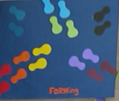
FORMING
entering the space / working out how to act
FORMING
Concerns and actions - reserved, needing to be led, wanting direction, expecting to be told

Slide 25
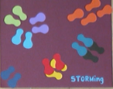
STORMING
Setting / challenging boundaries
STORMING
Concerns and actions - conflict, taking the lead or demanding others do so, setting direction/or resisting direction proposed

Slide 26
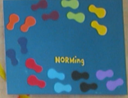
NORMING
Finding ways to define agreement,
Working together agreeably
NORMING
Concerns and actions - collaboration, everyone leading and following, sharing and asking

Slide 27
Group Task Roles
Initiating-contributing
Information seeking
Opinion seeking
Information giving
Opinion giving
Elaborating
Coordinate
Orient
Evaluate
Energize
Assist on procedures
Record

Slide 28
POSITIVE
Information seeking
Asking for clarification, for pertinent facts, etc.
Opinion seeking
inquiring about the values and relevance of facts, options,
Information giving
Offering pertinent facts to aid deliberations
Opinion giving
Stating beliefs / opinions pertinent to discussion
NEGATIVE
Information seeking
Demanding facts regardless of their relevance
Opinion seeking
Asking for others opinions not accepting/acknowledging them
Information giving
Telling ‘facts’ as we know them, expecting others to accept our ‘facts’ without question
Opinion giving
Giving our opinion as if it is what is requried

Slide 29
POSITIVE
Orient
Summarise progress, define position, maintain focus on direction
Evaluate
Check work against standards, question ‘logic’, ‘quality’ and ‘practicality’
Energize
arouse the group to ‘greater’ or ‘higher quality’ action
NEGATIVE
Orient
Try to keep action on the path we thinks is ‘right’
Evaluate
Set our standards and expect others to accept them without question
Energise
Maintain high energy for personal goals and avoid attending to group goals

Slide 30
POSITIVE
Assist on procedures
doing things for the group, expediting action, completing essential routine tasks
Record
keep records of decisions. Ensure group memory is accurate
Elaborate
spelling out the details, extending ideas to check applicability
NEGATIVE
Assist on procedures
Focus on personal tasks and ignore how they fit with the group task
Record
Keep records that accord with personal perceptions
Elaborate
Giving most attention to personal focus and keeping them on the agenda

Slide 31
Introducing Groupthink
“Groupthink” describes how groups behave when a need for being seen to be in agreement overrides realistic appraisal of alternatives to proposed actions
It occurs when members of decision-making groups are more concerned to avoid harsh judgments of a leader’s or colleagues’ ideas

Slide 32
Groupthink
There is an illusion of invulnerability, -members are optimistic and tend to take risks
Members rationalise away warnings or threats ‘that won’t affect us’
Members think group decisions have inherent morality - ignore ideas of unethical behaviour saying ‘We could not do such things!”’
Stereotypes - opponents are seen as ‘too evil, stupid or weak to be taken seriously’

Slide 33
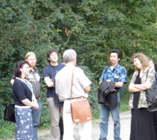
Groupthink
Direct pressure to conform, -applied to anyone who questions the status quo within the group
Self-censorship members who doubt the rightness of actions do not speak up creating appearance of consent
An illusion of unanimity - silence comes to be interpreted as consent

Slide 34
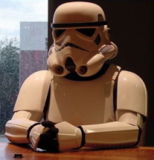
Groupthink
Mind-guards behave like bodyguards who protect us from physical harm
Such people set themselves up as censors or gatekeepers
They aim to stop challenging / threatening information from outside, getting to the group

Slide 35
To avoid Groupthink
Develop contingency plans
Ask: “what might go wrong? how will we manage ourselves if it does?”
Invite a visitor to act as “devil's advocate” to review the work and suggest improvements
Take turns to “find fault” with the team’s work
Do not ignore or minimise problems
Be realistic about listening carefully to criticisms of progress. Ask questions to seek agreement about what to do

Slide 36
To avoid Groupthink
Build good feelings about members, but not at the expense of non-members
Avoid use of terms such as “us” and “them”
Encourage criticism
Speak up - do no fear saying something unpopular or being ridiculed or ignored
Value, collect and consider the opinions of every member
There are no “silent partners” - agreement emerges from discussion and is based on input from everyone; no-one “self-censors” their ideas

Slide 37
The Abilene Paradox
The inability to manage agreement - not the inability to manage conflict - is the essential symptom that identifies organizations caught in the web of the Abilene Paradox
Groups that fail to effectively manage agreement, display characteristics of this paradox

Slide 38
The Abilene Paradox Begins
Members individually and privately
agree about the nature of the situation or problem facing them
agree about steps required to cope with the situation
THEN THEY
Collectively
fail to accurately communicate their desires and/or beliefs to one another
And do the opposite, leading each other into mis-perceiving the collective reality

Slide 39
As the Abilene Paradox proceeds
Invalid and inaccurate conditions allow members to make decisions that lead them to take (collective) actions contrary to what they (individually) want to do
In this state they create - and / or contribute to - results that are counter to their intent and purposes
Members experience frustration, anger, irritation, and dissatisfaction with their situation

Slide 40
Results are familiar
Members
form subgroups with trusted acquaintances
blame other subgroups for their dilemma
may also blame other authority figures
even blame one another
Finally
When members do not deal with the generic issue of their inability to manage agreement - the cycle repeats itself with greater intensity

Slide 41
Why we “go to Abilene”
The causes
Action anxiety: people take action in contradiction to their understanding of the problems before them because thinking about acting in accord with what we believe needs to be done, makes us intensely anxious
Negative fantasies: we feel caught "on the horns of a dilemma" and see all alternatives as equally 'bad'.
It seems that whatever we do will be harmful and we fail to seek out 'third options' that could help us achieve congruence with our beliefs

Slide 42
Sources of negative fantasises
Real risk - since we cannot 'know' what lies ahead we draw on past experience and imagined consequences
Real risk is easily confused with 'fantasised consequences’ and we fail to consider that:
"They may be possible - but are the likely?"
Fear of separation - we may fear the unknown less than we fear the 'known'. The fear of taking risks that may cause our separation from others, who are important to us, can lead us to self-destructive decisions.
Willingness to conform with what we think others are thinking - and thereby not risking separation and isolation - can ensure the separation and loneliness we fear

Slide 43
To avoid “going to Abilene”
Distinguish between
real conflict and ‘phony' conflict
Phony conflict is when we act (or decide to act) in ways that (silently) no one was fully committed to, but no one says so
group tyranny and personal choice
when we are in an "Abilene Paradox" we are not being pressured by the group at all - we are taking our own actions without external pressure
HOWEVER we are making disastrous assumptions about what we imagine is happening for the 'group'

Slide 44
To avoid “going to Abilene”
Be yourself
Be honest with yourself
Speak your OWN mind
Listen to others carefully (listen especially carefully for things that are not said!)
Check for shared meaning
Continue to revisit decisions that are not working
Trust your intuition - it may be the most accurate team/group assessment tool you have

Slide 45
PERFORMING
Working together, collaboration at a high level of commitment, quality is paramount
PERFORMING
Concerns and actions - are we doing the best we all can? No blame. How can we achieve our goal together?

Slide 46
MOURNING
Time to end this group, leaving friends/enemies. What did we gain/learn?
MOURNING
Concerns and actions - It’s time to part. What happens next? How did we do? I am leaving friends. I am sad. But new things lie ahead.

