Slide 1
Learning Occurs in Contexts (situations)
Insights from the field of Knowledge Management

Slide 2
Ikujiro Nonaka, Ryoko Toyama and Noboru Konno
Four aspect of the leadership tasks in Knowledge Management
SECI = Socialisation, Externalisation, Combination and Internalisation - a sequence for learning
Ba - a context for learning - where, how and who are all vital components of the learning context
Knowledge assets
Experiential
Conceptual
Systemic
Routine

Slide 3
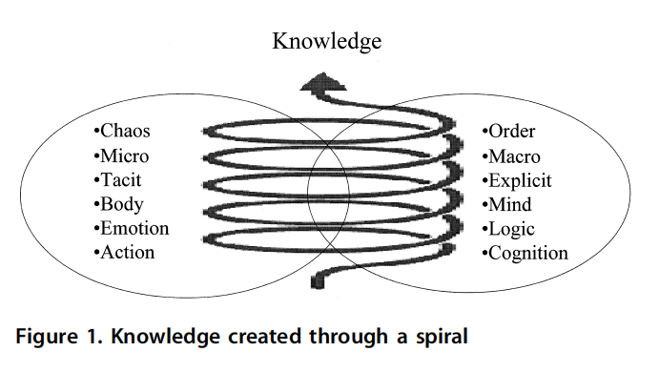
My feedback
I am not seeing a lot of chaos but anticipate that it is happening at times as you plan your work
I am seeing al too oc action - and what I am seeing is all modelling knowledge engagement

Slide 4
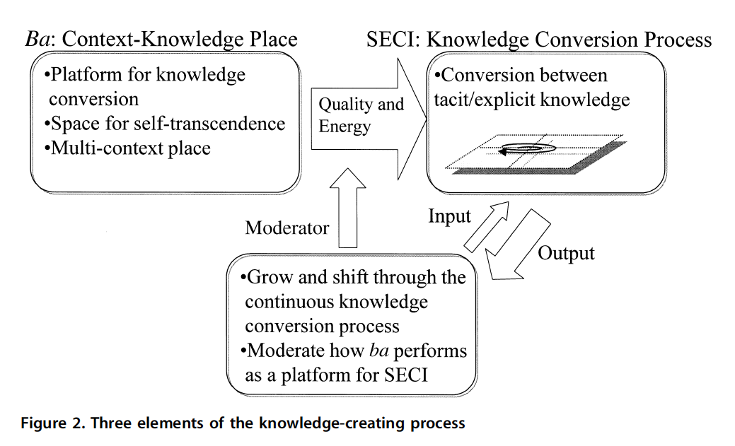

Slide 5
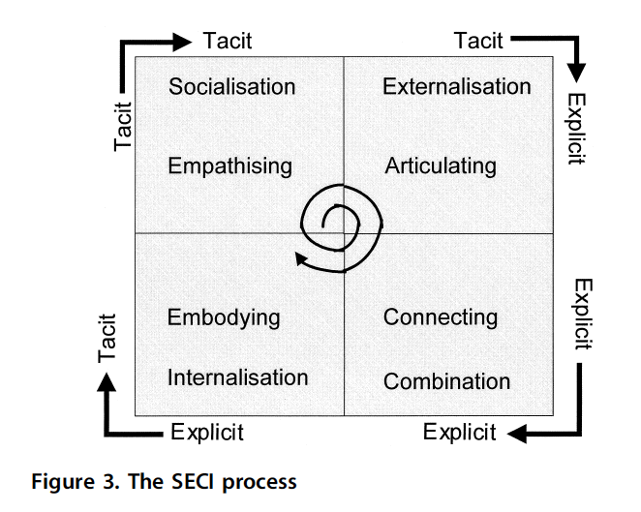

Slide 6
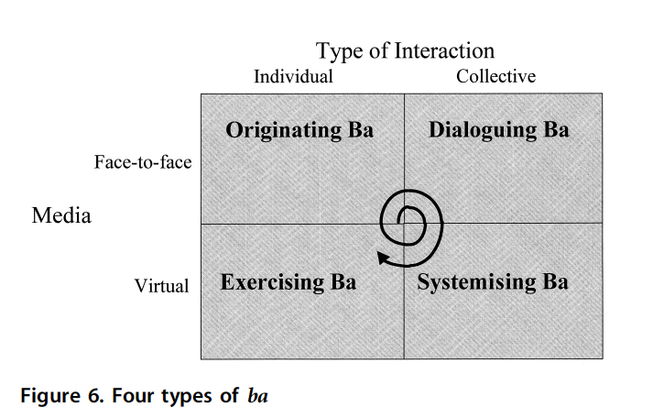

Slide 7
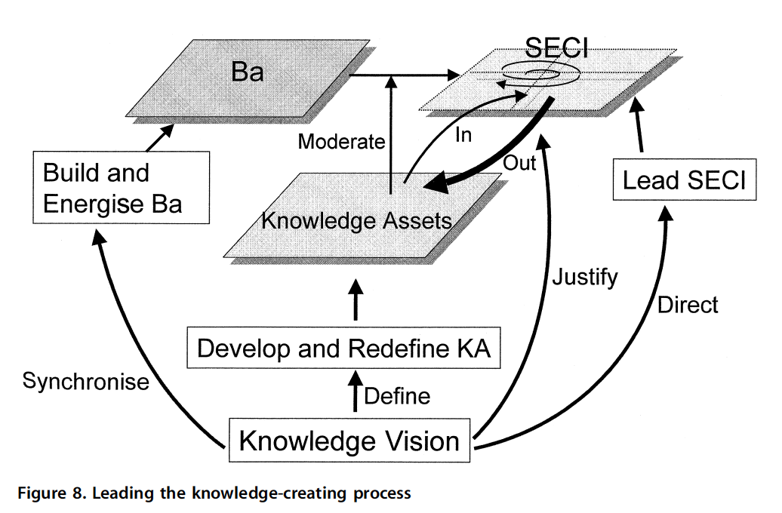

Slide 8
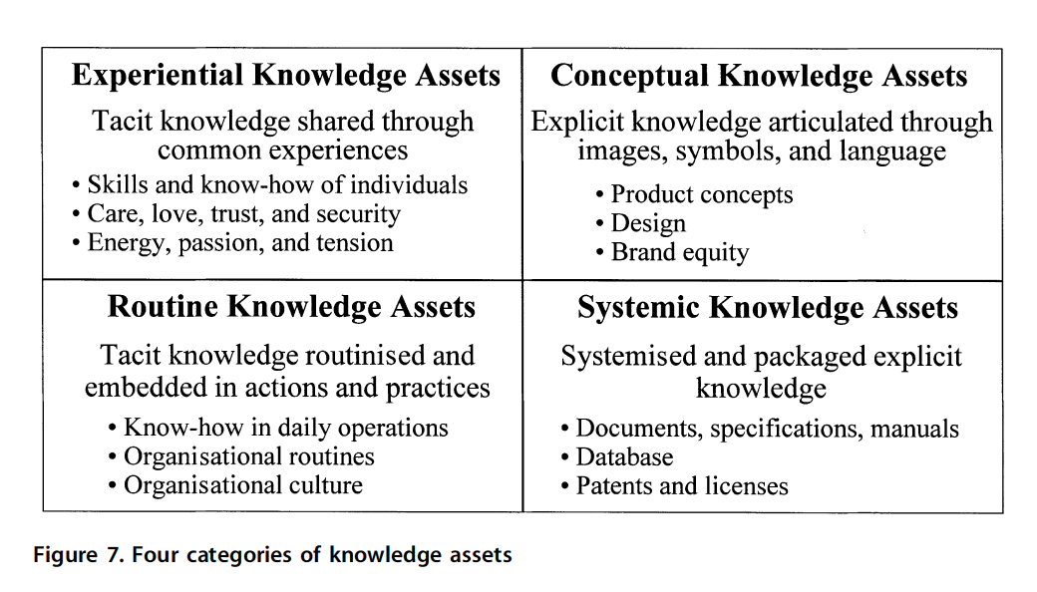

Slide 9
