Slide 1
Session 2: Writing problem-solution texts
LC-1114 Communicating Technology

Slide 2
Session 2:
The Problem-Solution (P-S) pattern
Task 2-1 Types of P-S patterns
Task 2-2 Analysis of examples
Writing assignment A2

Slide 3
Situation
Importance?
Relevance?
What is the current situation?
Why is the topic important for this reader?
Problem
Causes?
Consequences?
Past problem?
Criteria for solving?
What is wrong with the current situation?
What is needed / lacking?
Solution
What are its features?
How does it work?
What solutions past and current have been tried?
What is your solution?
Evaluation
How effective is it?
Meet criteria?
Is this a good solution?
Why?

Slide 4
Situation
major, important, popular, common, and many
Problem
contrast (However, despite, although, but),
negative (limited, few, little, no, not, none), synonyms (danger, drawback, disadvantage, weakness, need, shortcoming, obstacle).
Solution
Nouns (solution, answer, approach, strategy, improvement) verbs (solve, address a problem, work out and develop) causative connectors (therefore, as a result, thus).
Evaluation
Nouns (benefit or advantage) verbs (provide, offer, enable, allow) Adjectives (effective, efficient, reliable, safe, useful)

Slide 5
Task 2-1: E-reader recommendation
Read the three versions of an introduction to a recommendation report.
Indicate which sentences (e.g., sen. 1, sen. 2) discuss
Situation
Problem
Solution
Evaluation
Which language features indicate the purpose of the sentence?
Which version do you prefer? Why?

Slide 6
Task 2-1
Introduction A
¹The threat of global warming has forced consumers to find ‘green’ alternatives to many of the everyday objects that we use. ²One important object that is widely used for both entertainment and educational purposes is the book. ³However, to feed our need for information and knowledge, the book and newspaper industries require the harvest of 125 million trees each year and emit over 40 million metric tons of CO₂ annually, equivalent to the annual CO₂ emissions of 7.3 million cars. ⁴Moreover, considering the conversion into paper, printing and distribution of these printed media, one can easily understand why books have one of the highest per-unit carbon footprints. ⁵These adverse environmental effects can be avoided by replacing .
¹The threat of global warming has forced consumers to find ‘green’ alternatives to many of the everyday objects that we use. ²One important object that is widely used for both entertainment and educational purposes is the book. ³However, to feed our need for information and knowledge, the book and newspaper industries require the harvest of 125 million trees each year and emit over 40 million metric tons of CO₂ annually, equivalent to the annual CO₂ emissions of 7.3 million cars. ⁴Moreover, considering the conversion into paper, printing and distribution of these printed media, one can easily understand why books have one of the highest per-unit carbon footprints. ⁵These adverse environmental effects can be avoided by replacing .
¹The threat of global warming has forced consumers to find ‘green’ alternatives to many of the everyday objects that we use. ²One important object that is widely used for both entertainment and educational purposes is the book. ³However, to feed our need for information and knowledge, the book and newspaper industries require the harvest of 125 million trees each year and emit over 40 million metric tons of CO₂ annually, equivalent to the annual CO₂ emissions of 7.3 million cars. ⁴Moreover, considering the conversion into paper, printing and distribution of these printed media, one can easily understand why books have one of the highest per-unit carbon footprints. ⁵These adverse environmental effects can be avoided by replacing printed media with digital forms.
6
Notes:
6

Slide 7
Task 2-1
Introduction A
⁵These adverse environmental effects can be avoided by replacing printed media with digital forms. ⁶Electronic books can be downloaded from the Internet, and then read using special devices, known as e-readers. ⁷An e-reader allows readers to store many books at once, and is lighter and more portable than the traditional book. ⁸E-readers are not only being used by the general public but also by specific groups of people for their own special purposes, and the available banks of digital texts are constantly growing. ⁹These specific groups include college and high school students, mobile professionals, and people with vision problems. ¹⁰The aim of this report is to evaluate the feasibility of adopting an e-reader for use by students and staff at the South Tapiola High School.
⁵These adverse environmental effects can be avoided by replacing printed media with digital forms. ⁶Electronic books can be downloaded from the Internet, and then read using special devices, known as e-readers. ⁷An e-reader allows readers to store many books at once, and is lighter and more portable than the traditional book. ⁸E-readers are not only being used by the general public but also by specific groups of people for their own special purposes, and the available banks of digital texts are constantly growing. ⁹These specific groups include college and high school students, mobile professionals, and people with vision problems. ¹⁰The aim of this report is to evaluate the feasibility of adopting an e-reader for use by students and staff at the South Tapiola High School.
⁵These adverse environmental effects can be avoided by replacing printed media with digital forms. ⁶Electronic books can be downloaded from the Internet, and then read using special devices, known as e-readers. ⁷An e-reader allows readers to store many books at once, and is lighter and more portable than the traditional book. ⁸E-readers are not only being used by the general public but also by specific groups of people for their own special purposes, and the available banks of digital texts are constantly growing. ⁹These specific groups include college and high school students, mobile professionals, and people with vision problems. ¹⁰The aim of this report is to evaluate the feasibility of adopting an e-reader for use by students and staff at the South Tapiola High School.
7
Notes:
7

Slide 8
Task 2-1
Introduction B
¹Books and other written media, such newspapers and magazines, have become an important part of our social and intellectual life in modern society. ²Indeed, without written media, making informed choices and educating each successive generation would become difficult tasks. ³However, producing these media requires the harvest of 125 million trees each year and emits over 40 million metric tons of CO₂ annually, equivalent to the annual CO₂ emissions of 7.3 million cars. ⁴Moreover, it has been estimated that the special storage requirements for books can account for a further 5 million tons of CO₂ annually. ⁵One solution to this problem is to replace printed media with digital forms that can be stored and read in ‘e-readers’. ⁶E-readers allow the reader
¹Books and other written media, such newspapers and magazines, have become an important part of our social and intellectual life in modern society. ²Indeed, without written media, making informed choices and educating each successive generation would become difficult tasks. ³However, producing these media requires the harvest of 125 million trees each year and emits over 40 million metric tons of CO₂ annually, equivalent to the annual CO₂ emissions of 7.3 million cars. ⁴Moreover, it has been estimated that the special storage requirements for books can account for a further 5 million tons of CO₂ annually. ⁵One solution to this problem is to replace printed media with digital forms that can be stored and read in ‘e-readers’. ⁶E-readers allow the reader
¹Books and other written media, such newspapers and magazines, have become an important part of our social and intellectual life in modern society. ²Indeed, without written media, making informed choices and educating each successive generation would become difficult tasks. ³However, producing these media requires the harvest of 125 million trees each year and emits over 40 million metric tons of CO₂ annually, equivalent to the annual CO₂ emissions of 7.3 million cars. ⁴Moreover, it has been estimated that the special storage requirements for books can account for a further 5 million tons of CO₂ annually. ⁵One solution to this problem is to replace printed media with digital forms that can be stored and read in ‘e-readers’. ⁶E-readers allow the reader
8
Notes:
8

Slide 9
Task 2-1
Introduction B
to store many books at once, and are lighter and more portable than traditional books. ⁷E-readers can not only be used by the general public but also by other groups of people for their own specific purposes, including college and high school students, mobile professionals, and people with vision problems. ⁸South Tapiola High School has received funding from government and private sources to sponsor a pilot project studying the suitability of using e-readers as an integral component of its educational strategy. ⁹This report discusses the advantages and disadvantages of using e-readers in order to determine the feasibility of using these devices in an upper-secondary school context
to store many books at once, and are lighter and more portable than traditional books. ⁷E-readers can not only be used by the general public but also by other groups of people for their own specific purposes, including college and high school students, mobile professionals, and people with vision problems. ⁸South Tapiola High School has received funding from government and private sources to sponsor a pilot project studying the suitability of using e-readers as an integral component of its educational strategy. ⁹This report discusses the advantages and disadvantages of using e-readers in order to determine the feasibility of using these devices in an upper-secondary school context
to store many books at once, and are lighter and more portable than traditional books. ⁷E-readers can not only be used by the general public but also by other groups of people for their own specific purposes, including college and high school students, mobile professionals, and people with vision problems. ⁸South Tapiola High School has received funding from government and private sources to sponsor a pilot project studying the suitability of using e-readers as an integral component of its educational strategy. ⁹This report discusses the advantages and disadvantages of using e-readers in order to determine the feasibility of using these devices in an upper-secondary school context.
to store many books at once, and are lighter and more portable than traditional books. ⁷E-readers can not only be used by the general public but also by other groups of people for their own specific purposes, including college and high school students, mobile professionals, and people with vision problems. ⁸South Tapiola High School has received funding from government and private sources to sponsor a pilot project studying the suitability of using e-readers as an integral component of its educational strategy. ⁹This report discusses the advantages and disadvantages of using e-readers in order to determine the feasibility of using these devices in an upper-secondary school context.
9
Notes:
9

Slide 10
Task 2-1
Introduction C
¹Today, studying at the secondary level requires a growing number of books. ²This has not only increased the costs of education but requires other means for transporting and storage of these media on school premises, such as school lockers and knapsacks. ³E-readers could ease these problems by providing students with a single, portable, light-weight location for storing and reading their books, homework and assignments. ⁴Unlike conventional textbooks, e-readers allow students to search through textbooks quickly for specific information, and many allow the student to highlight important text, to mark their last location in the book, and more importantly to
¹Today, studying at the secondary level requires a growing number of books. ²This has not only increased the costs of education but requires other means for transporting and storage of these media on school premises, such as school lockers and knapsacks. ³E-readers could ease these problems by providing students with a single, portable, light-weight location for storing and reading their books, homework and assignments. ⁴Unlike conventional textbooks, e-readers allow students to search through textbooks quickly for specific information, and many allow the student to highlight important text, to mark their last location in the book, and more importantly to
¹Today, studying at the secondary level requires a growing number of books. ²This has not only increased the costs of education but requires other means for transporting and storage of these media on school premises, such as school lockers and knapsacks. ³E-readers could ease these problems by providing students with a single, portable, light-weight location for storing and reading their books, homework and assignments. ⁴Unlike conventional textbooks, e-readers allow students to search through textbooks quickly for specific information, and many allow the student to highlight important text, to mark their last location in the book, and more importantly to
10
Notes:
10

Slide 11
Task 2-1
Introduction C
determine the meaning of new vocabulary by right-clicking on a word for a definition or translation. ⁵E-readers would also provide a central location for storage of all the student’s textbooks and assignments. ⁶To determine the effectiveness of e-readers in educational settings, the South Tapiola High School has decided to conduct a feasibility study before making any decision to invest in e-readers. ⁷Therefore, this report compares the benefits and drawbacks of implementing this new technology in Finnish secondary schools.
determine the meaning of new vocabulary by right-clicking on a word for a definition or translation. ⁵E-readers would also provide a central location for storage of all the student’s textbooks and assignments. ⁶To determine the effectiveness of e-readers in educational settings, the South Tapiola High School has decided to conduct a feasibility study before making any decision to invest in e-readers. ⁷Therefore, this report compares the benefits and drawbacks of implementing this new technology in Finnish secondary schools.
determine the meaning of new vocabulary by right-clicking on a word for a definition or translation. ⁵E-readers would also provide a central location for storage of all the student’s textbooks and assignments. ⁶To determine the effectiveness of e-readers in educational settings, the South Tapiola High School has decided to conduct a feasibility study before making any decision to invest in e-readers. ⁷Therefore, this report compares the benefits and drawbacks of implementing this new technology in Finnish secondary schools.
11
Notes:
11

Slide 12
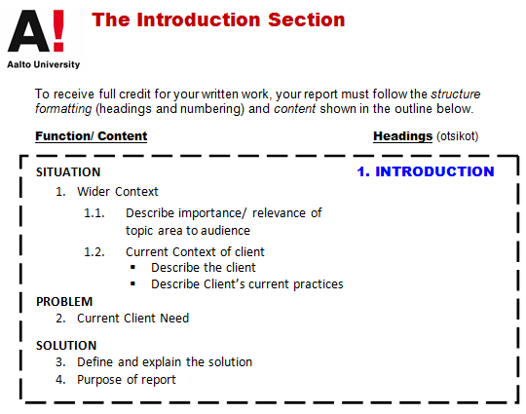

Slide 13
Task 2-2: Evaluating introductions
Read the six versions of an introduction to a feasibility report.
Indicate which sentences (e.g., sen. 1, sen. 2) discuss
Situation
Problem
Solution
Evaluation
Which language features indicate the purpose of the sentence?
Which version do you prefer? Why?

Slide 14
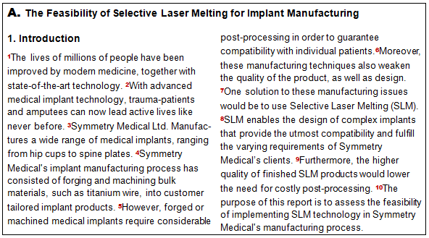
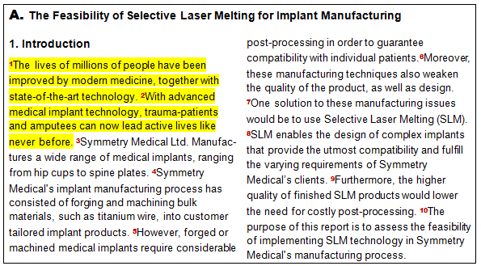
Task 2-2: Find the components of the problem-solution pattern in these introductions

Slide 15
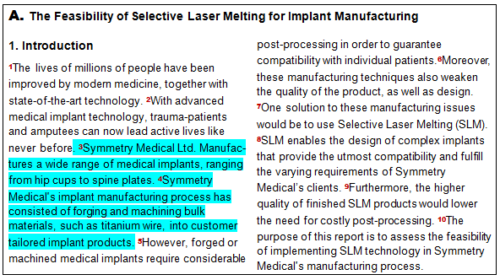
Task 2-2: What are the strengths and weaknesses of these introductions?

Slide 16
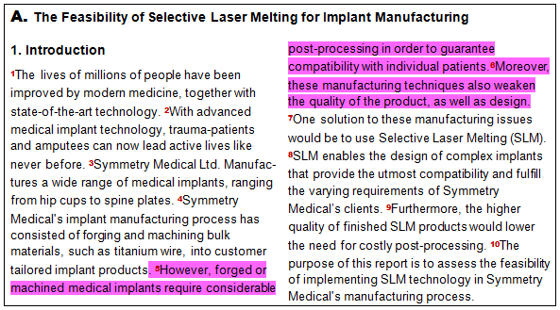
Task 2-2: What are the strengths and weaknesses of these introductions?

Slide 17
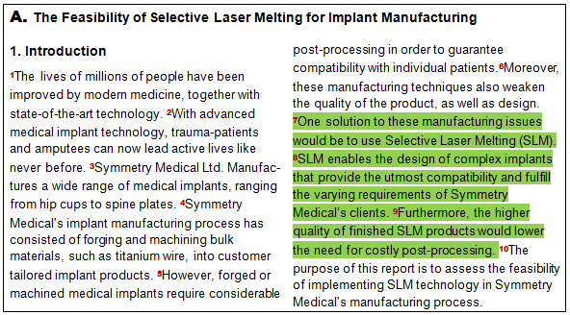
Task 2-2: What are the strengths and weaknesses of these introductions?

Slide 18
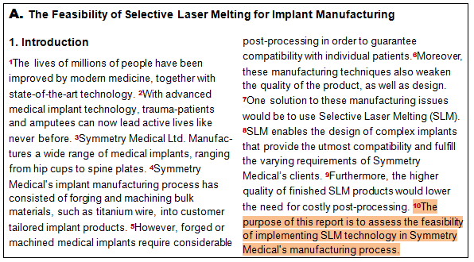
Task 2-2: What are the strengths and weaknesses of these introductions?

Slide 19
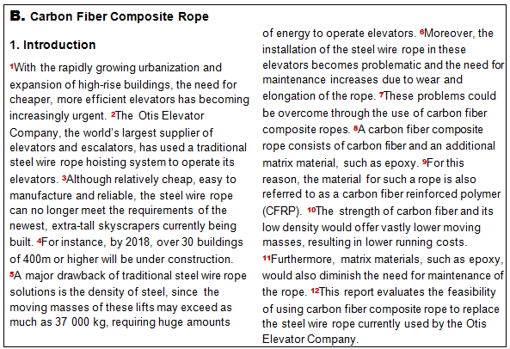

Slide 20
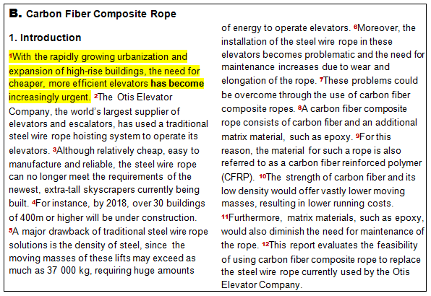

Slide 21
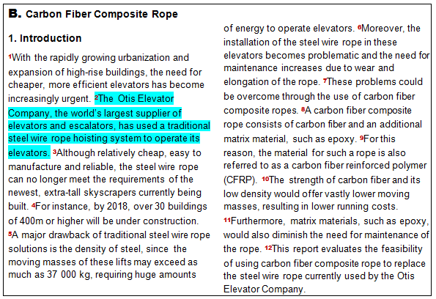

Slide 22
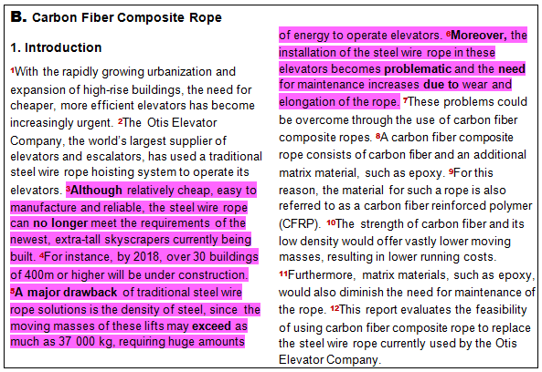

Slide 23
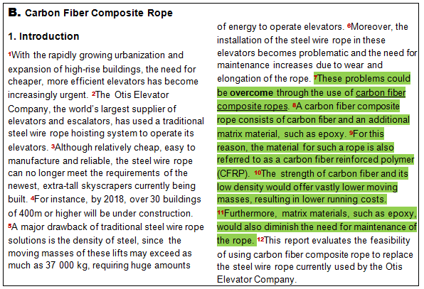

Slide 24
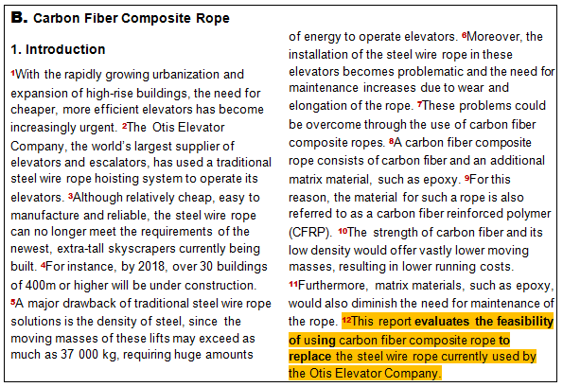

Slide 25
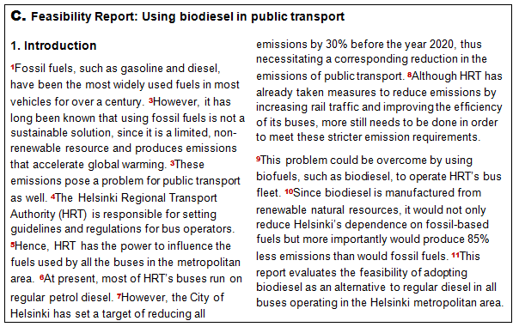

Slide 26
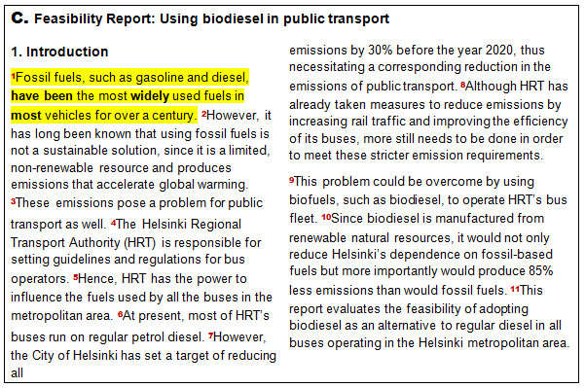

Slide 27
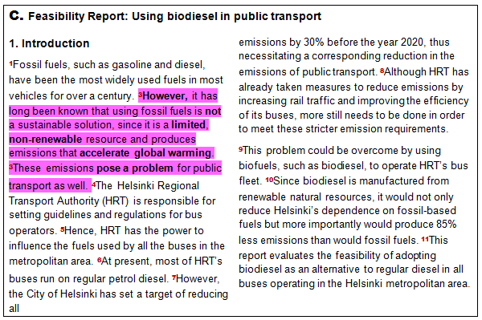

Slide 28
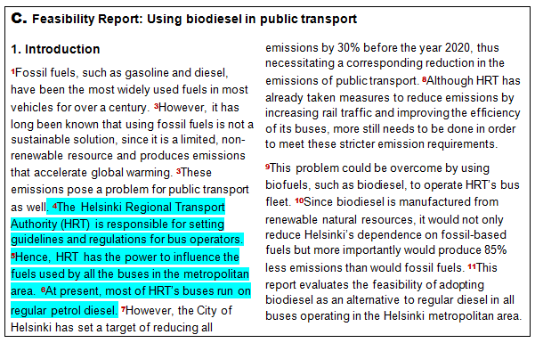

Slide 29
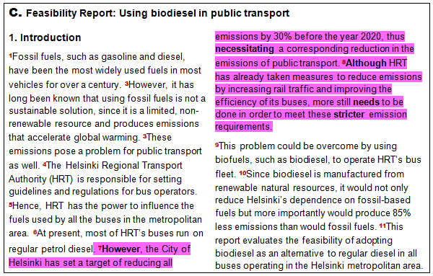

Slide 30
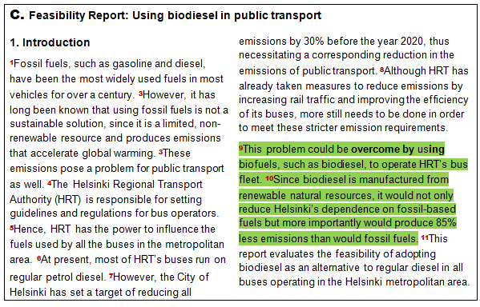

Slide 31
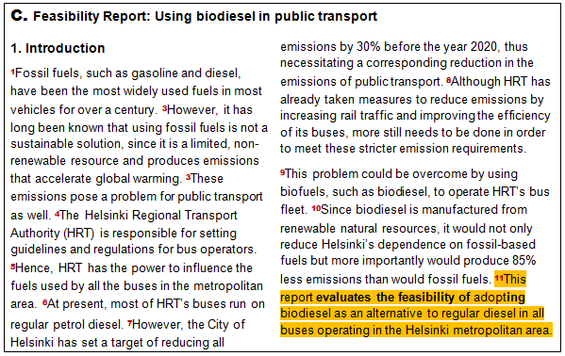

Slide 32
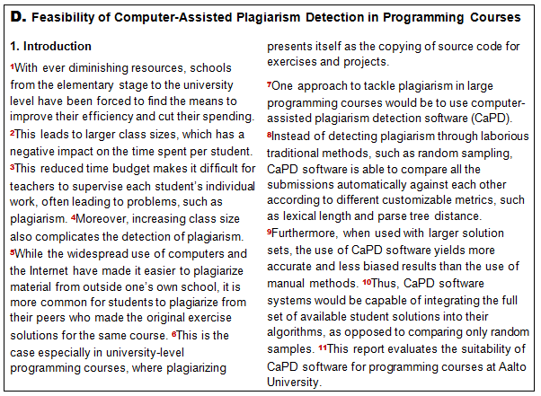

Slide 33
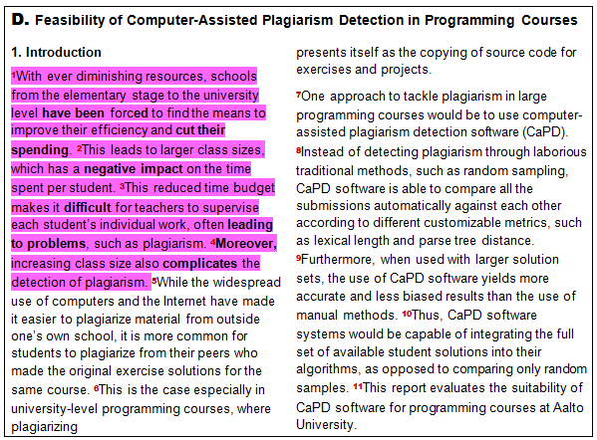
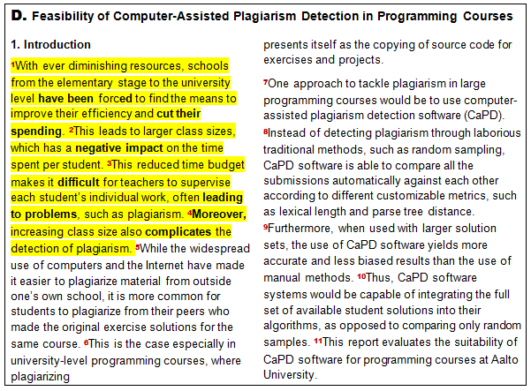

Slide 34
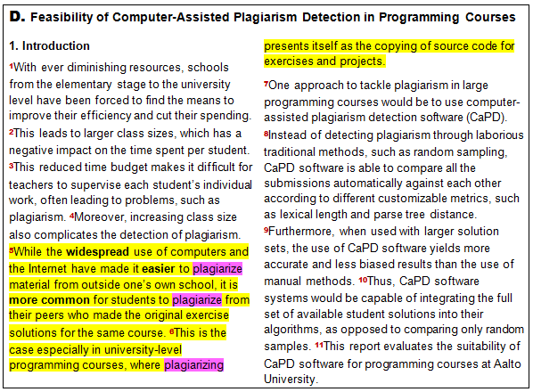
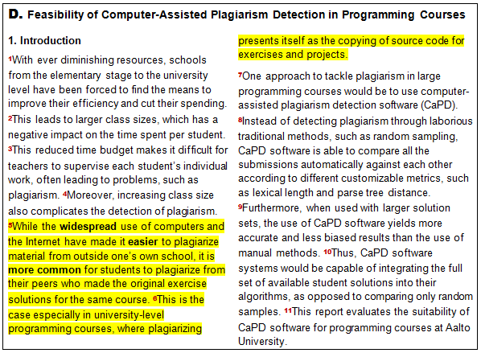

Slide 35
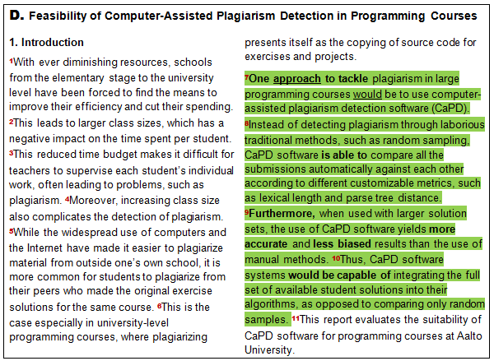

Slide 36
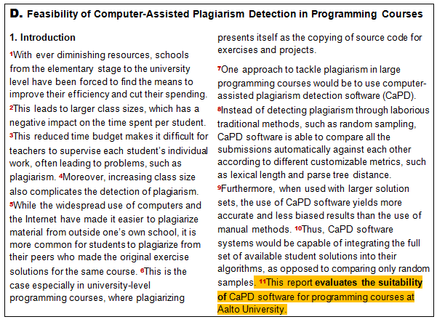

Slide 37
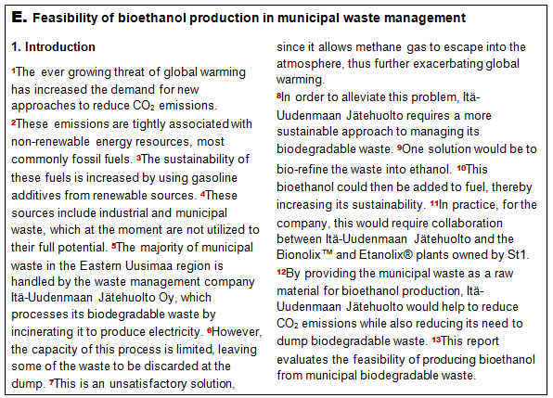

Slide 38
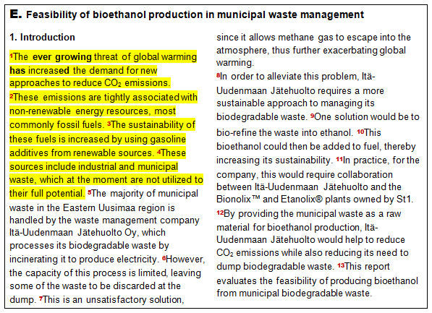
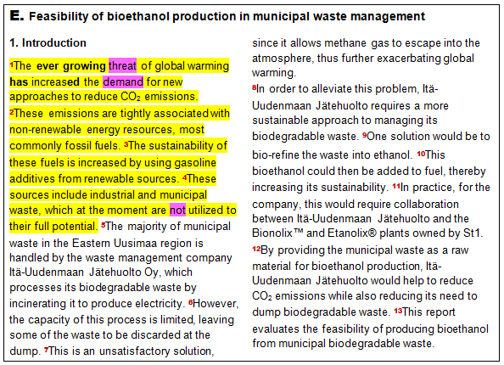

Slide 39
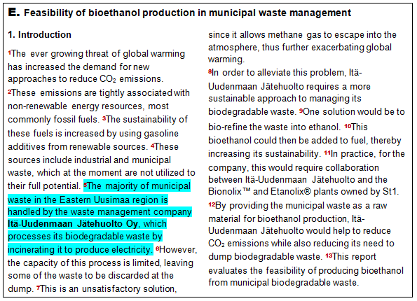

Slide 40
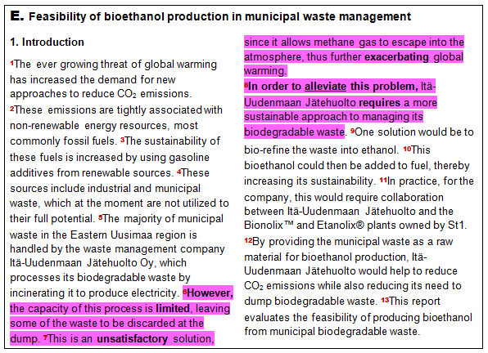

Slide 41
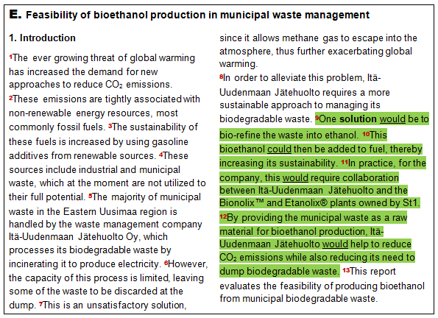

Slide 42
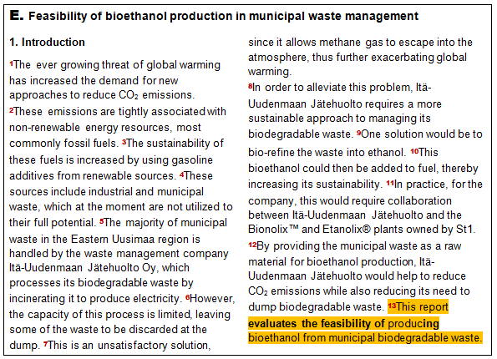

Slide 45
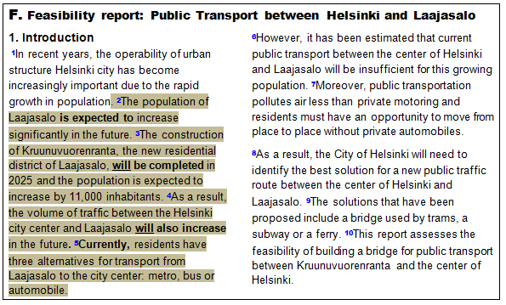
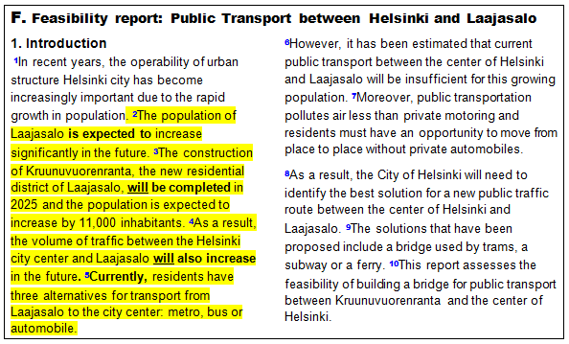

Slide 46
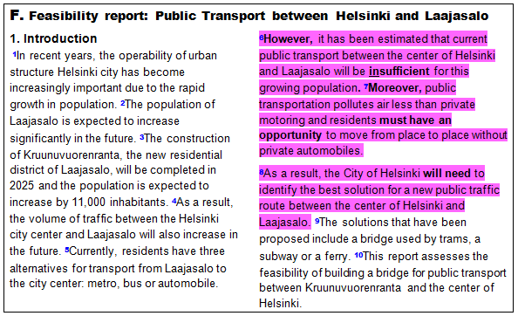

Slide 47
