Slide 1


Session 10:
Structuring your presentation

Slide 2
Before beginning a presentation, you need to ask yourself
five questions:
Why are you giving this presentation to this audience?
What are you claiming is true/false, good/bad?
What should the audience believe or do afterwards?
What do you hope to achieve?
What does your audience expect?
What is your audience’s attitude toward your claim?

Slide 3
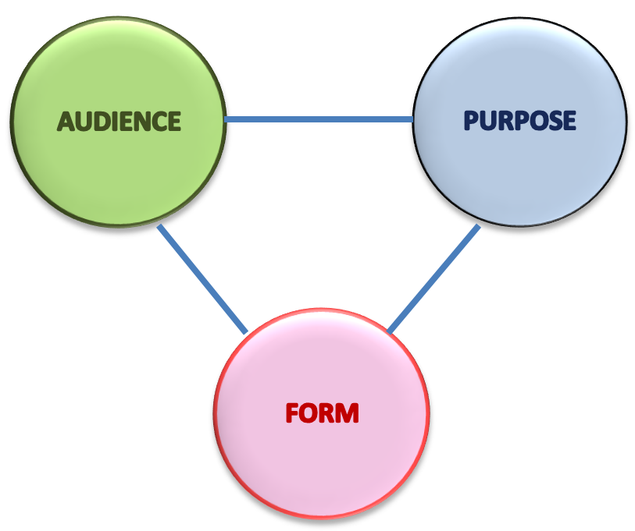
Successful communication
Product of three considerations:
Organization

Slide 4

What is your purpose or goal?

Slide 5
INFORMATIVE presentations
Teach or explain a new concept Explain how to perform a task Update audience's existing knowledge base Describe a technical concept or phenomenon
INFORM / PERSUADE
Teach or explain a new concept and suggest audience to take action. Explain how to perform a task and promote a particular viewpoint. Update audience's existing knowledge base & recommend a plan to take action. Describe a technical concept or phenomenon and suggest an approach to related problem.
PERSUASIVE presentations
Convince audience to take action Promote a particular viewpoint Recommend an action plan Suggest an approach to a problem

Slide 6
What is your purpose or goal?

Slide 7
AUDIENCE ATTITUDE
Hostile | Opposed | Mildly opposed | Neither in favor nor opposed | Mildly in favor | In favor | Highly in favor
Figure 13.1 Opinion continuum
What strategies should you use for each type of audience?

Slide 8
Adapting persuasive strategies to audience attitudes
In favor?
Hostile | Opposed | Mildly opposed | Neither in favor nor opposed | Mildly in favor | In favor | Highly in favor
Focus on motivating them to take action.
Suggest a specific course of action / solution

Slide 9
No Opinion
Hostile | Opposed | Mildly opposed | Neither in favor nor opposed | Mildly in favor | In favor | Highly in favor
Uninformed? Neutral? Apathetic?
Give enough info to help understand the subject before you develop persuasive appeals
Because able to accept reasoning, present your best arguments and support them with the best information you can find
Focus on moving them out of their apathy. Less info, emphasize instead motivation. Focus on listeners' personal needs, not logical argument.

Slide 10
Opposed?
Hostile | Opposed | Mildly opposed | Neither in favor nor opposed | Mildly in favor | In favor | Highly in favor
Totally Hostile Slightly Negative
Approach the topic indirectly.
Consider a less ambitious goal.
Because still open to reasoning, present good reasons and evidence supporting the proposal

Slide 11
What is your own position?
Choice of either deductive or inductive organizational structures.
CLAIM
E V I D E N C E
E V I D E N C E
EVIDENCE
EVIDENCE
E V I D E N C E
E V I D E N C E
CLAIM
DEDUCTIVE ORGANIZATION
INDUCTIVE ORGANIZATION

Slide 12
TIPS FOR CREATING EFFECTIVE PERSUASIVE PRESENTATIONS
CLAIM
Deductive means that you state your “bottom line” first, then provide evidence to support your claim.
EVIDENCE
E V I D E N C E
E V I D E N C E
DEDUCTIVE ORGANIZATION

Slide 13
TIPS FOR CREATING EFFECTIVE PERSUASIVE PRESENTATIONS
Inductive means that you state the individual facts first, building up to your argument on a point-by-point basis.
E V I D E N C E
E V I D E N C E
EVIDENCE
CLAIM
INDUCTIVE ORGANIZATION

Slide 14
Which audiences is would react better to these two patterns of organization?
For learners (“Dummies”), better if you know the main idea in advance.
If audience disagrees with you, an indirect approach might be better.
CLAIM
E V I D E N C E
E V I D E N C E
EVIDENCE
EVIDENCE
E V I D E N C E
E V I D E N C E
CLAIM
DEDUCTIVE ORGANIZATION
INDUCTIVE ORGANIZATION

Slide 15
Persuasive Organizational Patterns
Statement-of-Logical-Reasons Pattern
Problem/Solution Pattern
Comparative-Advantages Pattern
Requirements-Satisfaction Pattern
“Straw Man” Pattern

Slide 16
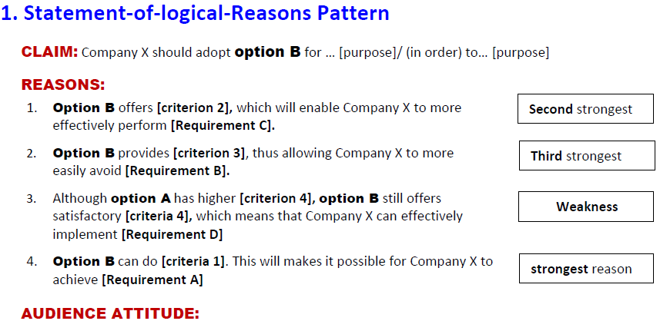
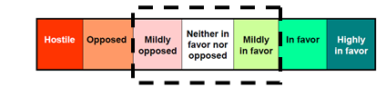
apathetic audience

Slide 17
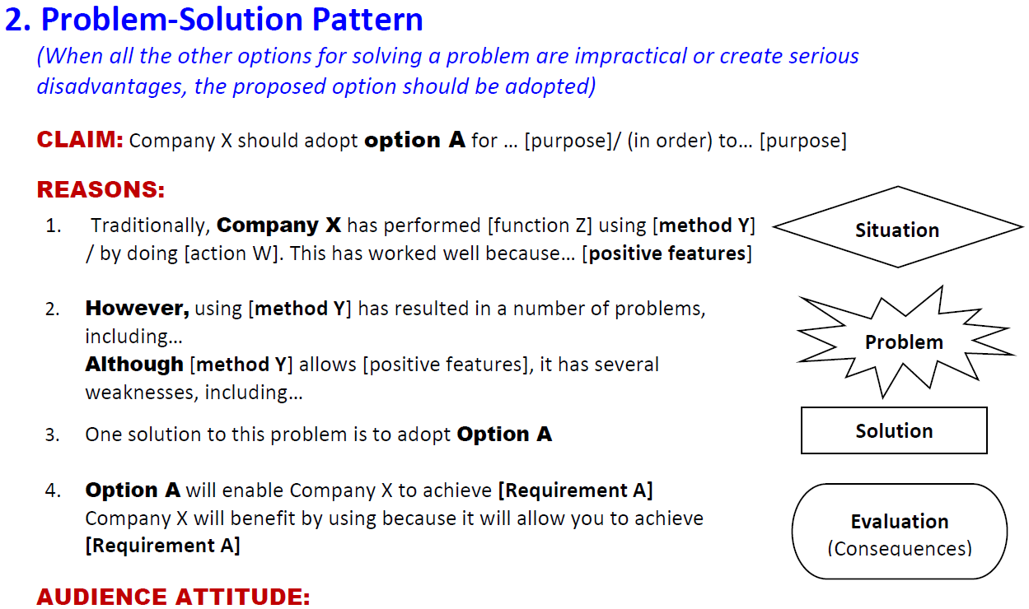
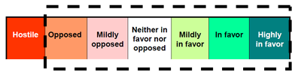
  Topic unfamiliar to audience
Unaware that a problem exists

Slide 18
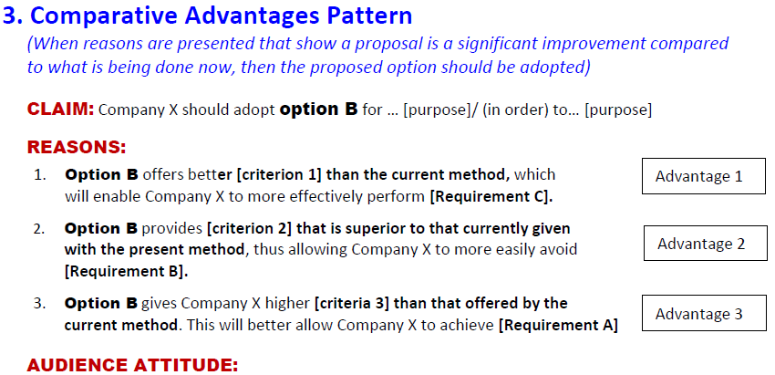
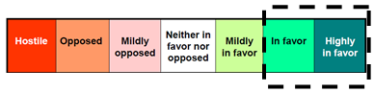
  Audience agrees that there is a problem that must be solved

Slide 19
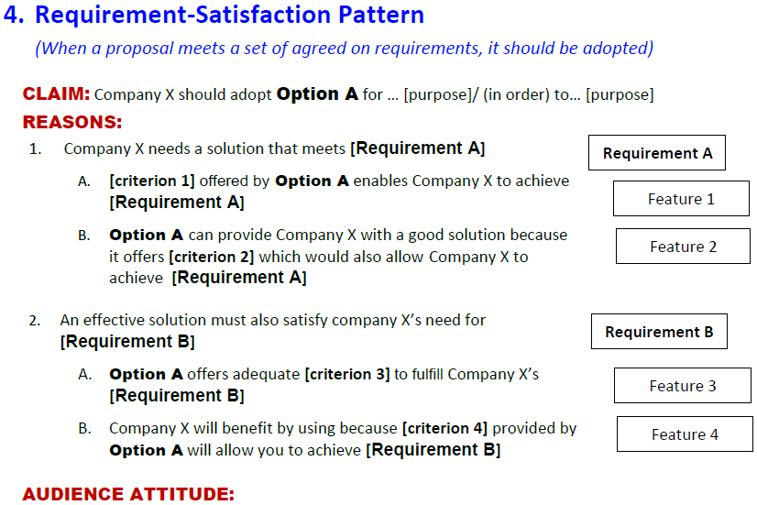
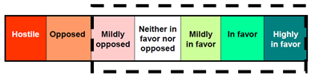
  Engineers’ favorite

Slide 20
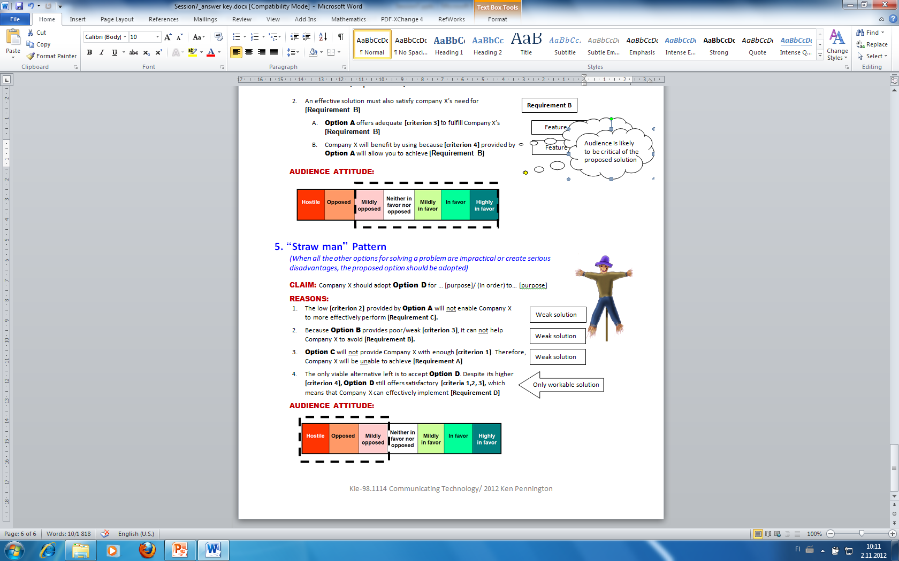
  Point out benefits of opponent before criticizing!!

Slide 21
ORGANIZATIONAL PATTERNS
Statement-of-Logical-Reasons Pattern
Problem/Solution Pattern
Comparative-Advantages Pattern
Requirements-Satisfaction Pattern
“Straw Man” Pattern

Slide 22
SKILL DEVELOPMENT EXERCISE
Selecting an Organizational Pattern
Select a pattern of organization for your talk.
Justify your selection on the basis of your audience analysis.

Slide 23

Session 10:
Beginnings and Endings

Slide 24
What is the function of introductions?
Showing the importance and relevance of your topic to the listeners

Slide 25
4 STEPS TO AN
EFFECTIVE INTRODUCTION
1. CAPTURE ATTENTION
2. ESTABLISH CREDIBILITY
3. STATE PURPOSE
4. PREVIEW TALK

Slide 26
4 STEPS TO AN
EFFECTIVE INTRODUCTION
1. CAPTURE ATTENTION
2. ESTABLISH CREDIBILITY
3. STATE PURPOSE
4. PREVIEW TALK

Slide 27
STEP 1: CAPTURE ATTENTION
Begin with a story (anecdote)
Refer to a recent event
Connect with something your audience knows or cares about
Ask rhetorical questions
Make a startling statement
Create suspense or dissonance
Use humor to put your audience at ease
Use a quotation or familiar phrase

Slide 28
STEP 1: CAPTURE ATTENTION
Begin with a story (anecdote)
That one time I really needed my mobile phone to work was the time that there wasn’t enough coverage…
Be careful: telling long stories in the introduction can be distracting (both for you and the audience).

Slide 29
STEP 1: CAPTURE ATTENTION
2. Refer to a recent event
Many of you are familiar with Lex Nokia, aren’t you? Do you think companies should have the right to…?

Slide 30

STEP 1: CAPTURE ATTENTION
3. Connect with something your audience knows or cares about
How many of you own a Nokia cellular? How many of you have had problems with your Nokia cellphone?

Slide 31
STEP 1: CAPTURE ATTENTION
Ask rhetorical questions
Create questions your audience would ask—questions about items they might not understand or that are controversial.
Did you ever wonder how planes are able to land when visibility is low?
Be careful not to ask too many questions!

Slide 32
STEP 1: CAPTURE ATTENTION
Make a startling statement
Did you know that 40% of all people that work for Nokia suffer from chronic migraines?

Slide 33
STEP 1: CAPTURE ATTENTION
Create suspense or dissonance
DISSONANCE:
A feeling that things are just a bit unsettled…
Leaves you wishing for a happy ending….
The fact that the globe is warming up cannot be refuted and its effects are in many ways disastrous for the human kind. Is there anything we can do?

Slide 34

STEP 1: CAPTURE ATTENTION
Put your audience at ease with humor

Slide 35
STEP 1: CAPTURE ATTENTION
Use a quotation or familiar phrase
Someone once said that “management is doing things right; leadership is doing the right things.” But what are the rights things a good leader should be doing?

Slide 36
STEP 1: CAPTURE ATTENTION
Begin with a story (anecdote)
Refer to a recent event
Connect with something your audience knows or cares about
Ask rhetorical questions
Make a startling statement
Create suspense or dissonance
Use humor to put your audience at ease
Use a quotation or familiar phrase

Slide 37
4 STEPS TO AN
EFFECTIVE INTRODUCTION
1. CAPTURE ATTENTION
2. ESTABLISH CREDIBILITY
3. STATE PURPOSE
4. PREVIEW TALK

Slide 38
STEP 2: ESTABLISH CREDIBILITY
Tell the audience who you are and why they should listen to you.
⁵My name is Juha Virtanen, and I'm a graduate student here at Aalto University, majoring in Energy Technology, and am currently writing my thesis on the topic of renewable energy sources."

Slide 39
4 STEPS TO AN
EFFECTIVE INTRODUCTION
1. CAPTURE ATTENTION
2. ESTABLISH CREDIBILITY
3. STATE PURPOSE
4. PREVIEW TALK

Slide 40
STEP 3: STATE YOUR PURPOSE
Declare what your speech is about (your topic) and what you hope to accomplish (your purpose).
⁷Today, I'd like to introduce you to an environmentally friendly solution
that will help you to not only produce electricity for your home but also reduce your electricity bills.
⁸This solution is the wind turbine.

Slide 41
4 STEPS TO AN
EFFECTIVE INTRODUCTION
1. CAPTURE ATTENTION
2. ESTABLISH CREDIBILITY
3. STATE PURPOSE
4. PREVIEW TALK

Slide 42
STEP 4: PREVIEW YOUR TALK
¹Did you know that the price of electricity has risen no less than 157 per cent in only ten years? ²For a citizen like yourself living in a house with electric heating, this means nearly 1000 € more to be paid each year. ³Moreover, electricity is often produced using fossil fuels, which is a major factor contributing to global warming. ⁴If you care about our planet, you will want to stop using fossil fuels and begin to utilize renewable natural resources. ⁵But how can we do this?
⁶My name is Juha Virtanen, and I'm a graduate student here at Aalto University, majoring in Energy Technology, and am currently writing my thesis on the topic of renewable energy sources. ⁷Today, I'd like to introduce you to an environmentally friendly solution that will help you to not only produce electricity for your home but also reduce your electricity bills. ⁸This solution is the wind turbine.
⁹I have divided my talk into three parts. ¹⁰First, we will look at current competing technologies. ¹¹Then, we will examine the installation setup to find out where and how to situate your own wind turbine. ¹²And finally, we will discuss the advantages and disadvantages of residential wind turbines to see whether a wind turbine can work for you.

Slide 43
THE INTRODUCTION
Attention-gaining Strategy
Establish your credibility
Preview the purpose of your presentation
"Today, I would like to introduce you to…”
"Today, I 'd like to tell you about..."
Give an overview of the structure (3-5 main points)
“I’ve divided my talk into 3 parts...
First, I’ll define…
Second,. I’d like to explain…
And finally, we’ll examine some examples of…"

Slide 44
WHY ARE CONCLUSIONS IMPORTANT?
People remember the last part best
Last chance to remind your audience why they’ve been listening to you.
Opportunity to reach your audience one last time.
Notes:
Conclusion is the last part of your presentation, so your audience is most likely going to remember it the best.
2. It’s your last chance to remind your audience why they’ve been listening to you in the first place.
3. It gives you a wonderful opportunity to touch your audiences hearts one more time. Don’t forget to provide logical and emotional closure.

Slide 45
Mirror images: Conclusion & Introduction
CAPTURE ATTENTION
ESTABLISH CREDIBILITY
STATE PURPOSE
PREVIEW MAIN POINTS
INTRODUCTION
Main point 1
Sub-point
Sub point
Main point 2
Sub point
Sub point
Main point 3
Sub point
Sub point
BODY
Signal
conclusion
RECOMMEND
one option
Summarize arguments: consequences and benefits
RETURN TO THE PROBLEM
and describe a brighter tomorrow.
CONCLUSION

Slide 46

FIVE STEPS TO AN
EFFECTIVE
CONCLUSION
Few things annoy listeners more than hearing a speaker say "in conclusion," and then having to sit through another ten minutes of the speech.
SIGNAL THE CLOSE
RECOMMEND A SOLUTION
Alert listeners that your talk is coming to an end!
  Transition statement
  (e.g., In summary, To sum up)
  Vary your voice
  (e.g., speed, tone, pitch, rhythm).
3. SUMMARIZE MAIN ARGUMENTS
4. RETURN TO PROBLEM IN INTRO
  Do not introduce
  new ideas!
INVITES QUESTIONS

Slide 47
FIVE STEPS TO AN
EFFECTIVE
CONCLUSION
SIGNAL THE CLOSE
NEED MORE THAN ONLY the recommendation!
RECOMMEND A SOLUTION
3. SUMMARIZE MAIN ARGUMENTS
This study recommends motes , since it offers more…Secondly, motes can be used in many applications, such as… Finally, your company can benefit from motes because it can be used to build your own smart systems.
4. RETURN TO PROBLEM IN INTRO
INVITES QUESTIONS

Slide 48
FIVE STEPS TO AN
EFFECTIVE
CONCLUSION
SIGNAL THE CLOSE
Re-visit each main topic
your audience can mentally check off what heard during the speech.
Not mechanical repetition of the main points: paraphrase!
RECOMMEND A SOLUTION
3. SUMMARIZE MAIN ARGUMENTS
4. RETURN TO PROBLEM IN INTRO
INVITES QUESTIONS

Slide 49
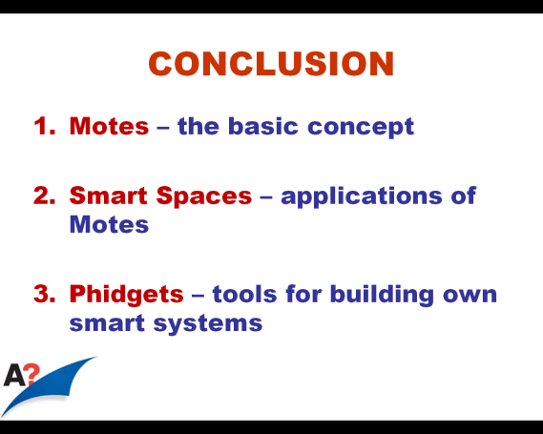
FIVE STEPS TO AN
EFFECTIVE
CONCLUSION
SIGNAL THE CLOSE
RECOMMEND A SOLUTION
3. SUMMARIZE MAIN ARGUMENTS
So, what we have learnt today is that motes, also called the sensor node, is the building block of sensor networks.
You have also learned that motes can be used in many applications, often referred to as ‘smart spaces’.
Finally, you have learned that Phidgets can be used to build your own smart systems.
4. RETURN TO PROBLEM IN INTRO
ENCOURAGE QUESTIONS

Slide 50
MAKE YOUR LAST WORDS MOST MEMORABLE
Refer to your introduction
(So, in the future, using X will ensure that no Chernobyls will occur, since…)
Quotations
(As X once said, ”…”)
Rhetorical questions
(So, the real question is do we really know what we are doing?)
Humour
Challenge your audience to take action (Sign this petition!)
Returning to the original problem is by far the best strategy for a recommendation

Slide 51
FIVE STEPS TO AN
EFFECTIVE
CONCLUSION
SIGNAL THE CLOSE
Right, so, returning now to that 32-km Donghai Bridge. In the future, we will be able to overcome the problem of monitoring the physical condition of bridges such as this one by using motes.
RECOMMEND A SOLUTION
3. SUMMARIZE MAIN ARGUMENTS
4. RETURN TO PROBLEM IN INTRO
ENCOURAGE QUESTIONS

Slide 52
FIVE STEPS TO AN
EFFECTIVE
CONCLUSION
SIGNAL THE CLOSE
Right, I’d now be glad to answer any questions that you might have.
RECOMMEND A SOLUTION
3. SUMMARIZE MAIN ARGUMENTS
4. RETURN TO PROBLEM IN INTRO
ENCOURAGE QUESTIONS

Slide 53
Exercise 10-1
Identify the following elements in this presentation:
Introduction
Gains audience attention:
Establishes credibility:
States purpose:
Overviews structure:
Previews first main point:
Conclusion
Signals the close:
Recommends a solution:
Summarizes main arguments :
Encourages audience to take action:
Returns to problem in introduction:
Encourages questions:
1 - 5
6
7 - 8
9 - 13
14
86
88
87
90
90
91

Slide 54
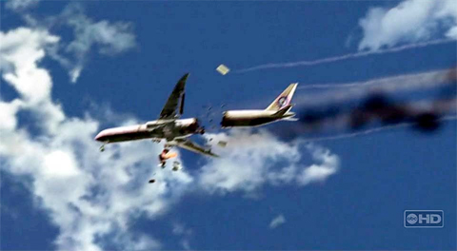
Exercise 10-2
Fill in the blanks (A-U) with suitable metalanguage.
¹Many of you may remember Air France flight 447 that crashed unexpectedly while on a routine flight from Brazil over the south Atlantic. ²It was a tragic waste of life and was a disaster of huge economic proportions for Air France. ³Unlike many similar accidents, this was not due to human error, but caused by faults in the welding process joining the aluminum sheeting on the aircraft. ⁴These faults could have been easily avoided had the manufacturer used a new welding method.
¹………[A]….… Air France flight 447 that crashed unexpectedly while on a routine flight from Brazil over the south Atlantic. ²It was a tragic waste of life and was a disaster of huge economic proportions for Air France. ³Unlike many similar accidents, this was not due to human error, but caused by faults in the welding process joining the aluminum sheeting on the aircraft. ⁴These faults could have been easily avoided had the manufacturer used a new welding method.

Slide 55
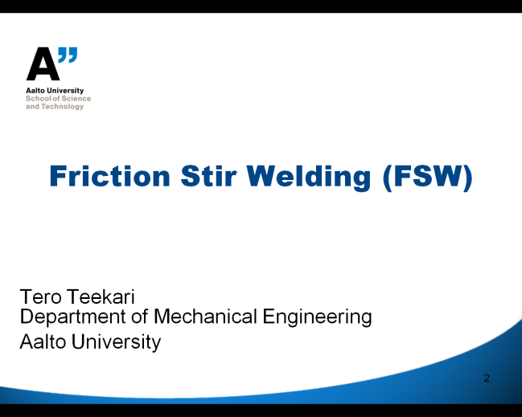
Exercise 10-2
Fill in the blanks (A-U) with metalanguage.
⁵My name is Tero Teekari, and I'm a graduate student at Aalto University, currently concluding my studies in Mechanical Engineering. ⁶………[B]….… a new method, called Friction Stir Welding, that not only overcomes these problems but also decreases costs while increasing the strength and reliability of the weld.
⁵My name is Tero Teekari, and I'm a graduate student at Aalto University, currently concluding my studies in Mechanical Engineering. ⁶Today, I would like to tell you about a new method, called Friction Stir Welding, that not only overcomes these problems but also decreases costs while increasing the strength and reliability of the weld.

Slide 56
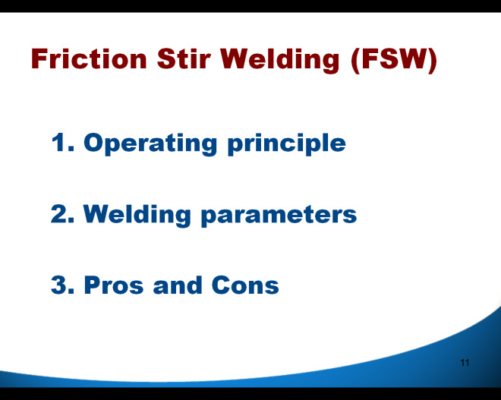
Exercise 10-2
Fill in the blanks (A-U) with metalanguage.
⁷………[C]….…. ⁸………[D]….… how this new methods actually works, some of its applications, as well as some examples. ⁹………[E]….… the parameters that must be met in order to use this technique. ¹⁰………[F]….… the advantages and disadvantages of using the FSW method. ¹¹………[G]….… what is FSW and how does it work?
⁷I have divided my talk into three parts. ⁸………[D]….… how this new methods actually works, some of its applications, as well as some examples. ⁹………[E]….… the parameters that must be met in order to use this technique. ¹⁰………[F]….… the advantages and disadvantages of using the FSW method. ¹¹………[G]….… what is FSW and how does it work?
⁷I have divided my talk into three parts. ⁸First, we’ll look at how this new methods actually works, some of its applications, as well as some examples. ⁹………[E]….… the parameters that must be met in order to use this technique. ¹⁰………[F]….… the advantages and disadvantages of using the FSW method. ¹¹………[G]….… what is FSW and how does it work?
⁷I have divided my talk into three parts. ⁸First, we’ll look at how this new methods actually works, some of its applications, as well as some examples. ⁹Next, I’ll describe the parameters that must be met in order to use this technique. ¹⁰………[F]….… the advantages and disadvantages of using the FSW method. ¹¹………[G]….… what is FSW and how does it work?
⁷I have divided my talk into three parts. ⁸First, we’ll look at how this new methods actually works, some of its applications, as well as some examples. ⁹Next, I’ll describe the parameters that must be met in order to use this technique. ¹⁰Finally, we’ll examine the advantages and disadvantages of using the FSW method. ¹¹………[G]….… what is FSW and how does it work?
⁷I have divided my talk into three parts. ⁸First, we’ll look at how this new methods actually works, some of its applications, as well as some examples. ⁹Next, I’ll describe the parameters that must be met in order to use this technique. ¹⁰Finally, we’ll examine the advantages and disadvantages of using the FSW method. ¹¹Right, let’s start by taking a look at what is FSW and how does it work?

Slide 57
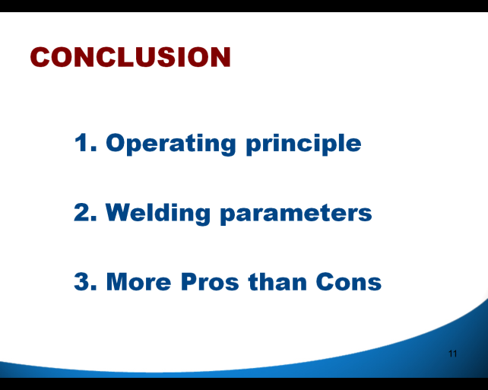
Exercise 10-2
Fill in the blanks (A-U) with metalanguage.
⁶³ So, ………[H]….… all this, ………[I]….… is that FSW is a process that does not melt the metal. ⁶⁴It can be used for applications where the original metal characteristics must remain unchanged as far as possible. ⁶⁵You ………[J]….… that the precision of this method is dependent on rotation speed, tilt, and plunge depth of the tool. ⁶⁶Therefore, tool design is also a very important consideration. ⁶⁷Finally, ………[K]….… although an exit hole is left when the tool is withdrawn, this is outweighed by the superior mechanical properties, improved safety, and the low environmental impact of FSW. …
⁶³ So, to summarize all this, ………[I]….… is that FSW is a process that does not melt the metal. ⁶⁴It can be used for applications where the original metal characteristics must remain unchanged as far as possible. ⁶⁵You ………[J]….… that the precision of this method is dependent on rotation speed, tilt, and plunge depth of the tool. ⁶⁶Therefore, tool design is also a very important consideration. ⁶⁷Finally, ………[K]….… although an exit hole is left when the tool is withdrawn, this is outweighed by the superior mechanical properties, improved safety, and the low environmental impact of FSW. …
⁶³ So, to summarize all this, what we have learned today is that FSW is a process that does not melt the metal. ⁶⁴It can be used for applications where the original metal characteristics must remain unchanged as far as possible. ⁶⁵You (have) also learned that the precision of this method is dependent on rotation speed, tilt, and plunge depth of the tool. ⁶⁶Therefore, tool design is also a very important consideration. ⁶⁷Finally, ………[K]….… that although an exit hole is left when the tool is withdrawn, this is outweighed by the superior mechanical properties, improved safety, and the low environmental impact of FSW. …
⁶³ So, to summarize all this, what we have learned today is that FSW is a process that does not melt the metal. ⁶⁴It can be used for applications where the original metal characteristics must remain unchanged as far as possible. ⁶⁵You (have) also learned that the precision of this method is dependent on rotation speed, tilt, and plunge depth of the tool. ⁶⁶Therefore, tool design is also a very important consideration. ⁶⁷Finally, we found out that although an exit hole is left when the tool is withdrawn, this is outweighed by the superior mechanical properties, improved safety, and the low environmental impact of FSW. …
⁶³ So, to summarize all this, what we have learned today is that FSW is a process that does not melt the metal. ⁶⁴It can be used for applications where the original metal characteristics must remain unchanged as far as possible. ⁶⁵You ………[J]….… that the precision of this method is dependent on rotation speed, tilt, and plunge depth of the tool. ⁶⁶Therefore, tool design is also a very important consideration. ⁶⁷Finally, ………[K]….… although an exit hole is left when the tool is withdrawn, this is outweighed by the superior mechanical properties, improved safety, and the low environmental impact of FSW. …

Slide 58
Exercise 10-2
Fill in the blanks (A-U) with metalanguage.
⁶⁸As we have seen today, FSW ………[L]….… a better ………[M]….… for welding aluminum alloys, since it ………[N]….… you / us to overcome many of the ………[O]….… of traditional Fusion welding techniques. ⁶⁹FSW requires significantly fewer process elements to control, FSW ensures higher joint strength and increased safety, and FSW requires no addition of filler or other consumables as do other fusion welding techniques. ⁷⁰Additionally, FSW also exhibits superior weld strength and fatigue life compared to traditional welding methods.
⁶⁸As we have seen today, FSW provides/offers a better solution for welding aluminum alloys, since it ………[N]….… you / us to overcome many of the ………[O]….… of traditional Fusion welding techniques. ⁶⁹FSW requires significantly fewer process elements to control, FSW ensures higher joint strength and increased safety, and FSW requires no addition of filler or other consumables as do other fusion welding techniques. ⁷⁰Additionally, FSW also exhibits superior weld strength and fatigue life compared to traditional welding methods.
⁶⁸As we have seen today, FSW provides/offers a better solution for welding aluminum alloys, since it enables/allows you / us to overcome many of the ………[O]….… of traditional Fusion welding techniques. ⁶⁹FSW requires significantly fewer process elements to control, FSW ensures higher joint strength and increased safety, and FSW requires no addition of filler or other consumables as do other fusion welding techniques. ⁷⁰Additionally, FSW also exhibits superior weld strength and fatigue life compared to traditional welding methods.
⁶⁸As we have seen today, FSW provides/offers a better solution for welding aluminum alloys, since it enables/allows you / us to overcome many of the drawbacks/problems of traditional Fusion welding techniques. ⁶⁹FSW requires significantly fewer process elements to control, FSW ensures higher joint strength and increased safety, and FSW requires no addition of filler or other consumables as do other fusion welding techniques. ⁷⁰Additionally, FSW also exhibits superior weld strength and fatigue life compared to traditional welding methods.
⁶⁸As we have seen today, FSW provides/offers a better ………[M]….… for welding aluminum alloys, since it ………[N]….… you / us to overcome many of the ………[O]….… of traditional Fusion welding techniques. ⁶⁹FSW requires significantly fewer process elements to control, FSW ensures higher joint strength and increased safety, and FSW requires no addition of filler or other consumables as do other fusion welding techniques. ⁷⁰Additionally, FSW also exhibits superior weld strength and fatigue life compared to traditional welding methods.

Slide 59
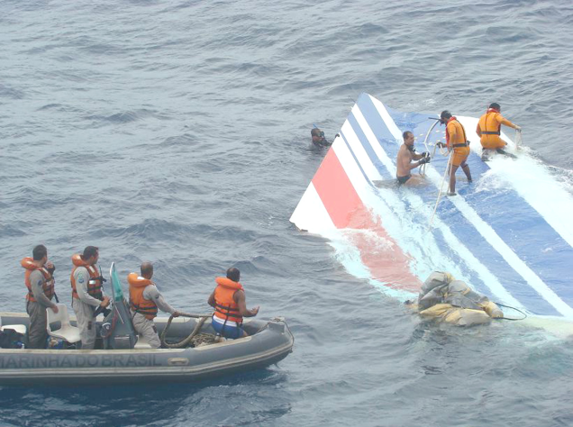
Exercise 10-2
Fill in the blanks (A-U) with metalanguage.
⁷¹ ………[P]….… that ill-fated Air France flight 447 that crashed over the Atlantic. ⁷²In ………[Q]….… , by using the FSW welding method, we can ………[R]….… that such tragic events will be far less likely to occur, and that future aircraft will not only be safer and more reliable, but that they will also be cheaper to manufacture.
⁷¹Returning now to that ill-fated Air France flight 447 that crashed over the Atlantic. ⁷²In ………[Q]….… , by using the FSW welding method, we can ………[R]….… that such tragic events will be far less likely to occur, and that future aircraft will not only be safer and more reliable, but that they will also be cheaper to manufacture.
⁷¹Returning now to that ill-fated Air France flight 447 that crashed over the Atlantic. ⁷²In the future, by using the FSW welding method, we can ………[R]….… that such tragic events will be far less likely to occur, and that future aircraft will not only be safer and more reliable, but that they will also be cheaper to manufacture.
⁷¹Returning now to that ill-fated Air France flight 447 that crashed over the Atlantic. ⁷²In the future, by using the FSW welding method, we can ensure that such tragic events will be far less likely to occur, and that future aircraft will not only be safer and more reliable, but that they will also be cheaper to manufacture.

Slide 60
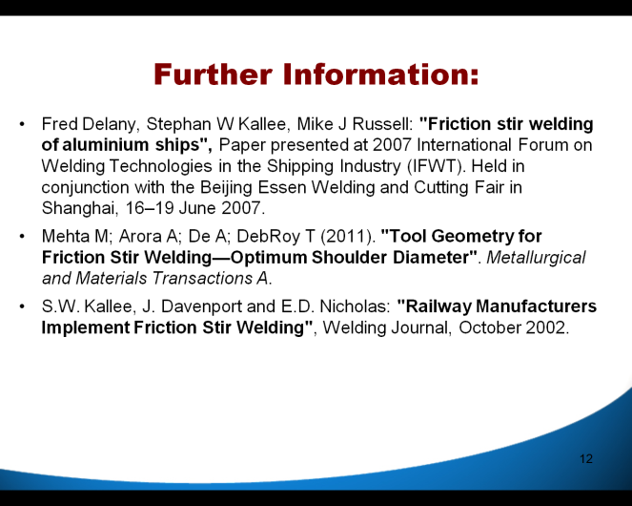
Exercise 10-2
Fill in the blanks (A-U) with metalanguage.
⁷³If any of you ………[S]….… deeper into this ………[T]….…, here are some links that could be helpful. ⁷⁴Right, ………[U]….… to answer any questions that you might have.
⁷³If any of you wish to dig deeper into this ………[T]….… , here are some links that could be helpful. ⁷⁴Right, ………[U]….… to answer any questions that you might have.
⁷³If any of you wish to dig deeper into this subject/topic, here are some links that could be helpful. ⁷⁴Right, ………[U]….… to answer any questions that you might have.
⁷³If any of you wish to dig deeper into this subject/topic, here are some links that could be helpful. ⁷⁴Right, I’d now be happy to answer any questions that you might have.

Slide 61
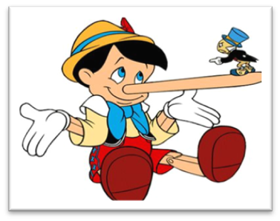
Exercise 10-3
¹A Gallup poll made in 2011 reported that 40% of American adults think it is very likely that scientists have falsified global warming research.
²Could this really be true?
³In fact, the earth’s average surface temperature has increased in the last three decades twice as much as it did in the previous seven decades.
⁴So, there must be a way to be less harmful to the environment.
⁵But how?

Slide 62

Exercise 10-3
⁶My name is Tero Teekkari, and I’m an engineering student at Aalto University, majoring in machine design.
⁷Today, I would like to tell you about a solution that will help you to decrease your carbon footprint.
⁸The solution is a new technology called the hybrid automobile.

Slide 63
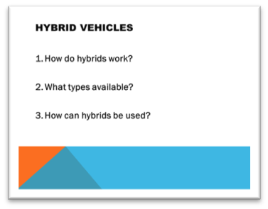
Exercise 10-3
⁹I have divided my talk into three areas.
¹⁰First, we will look at what a hybrid vehicle is and how it works.
¹¹Then, we will go through the common types of hybrid engines.
¹²And finally, we will take a closer look at some of the applications of these hybrid systems.

Slide 64

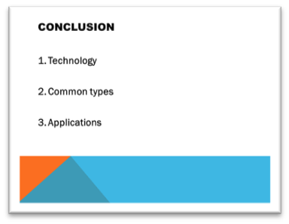

Exercise 10-3
⁸³So, today we looked at the technology.
⁸⁴We also found out about the most common types of hybrids.
⁸⁵And finally, we saw that there are many applications.
⁸⁶Now, if you have any questions, go ahead and ask.
⁸⁷Here are some links to more reading. ⁸⁸Thank you.
What is wrong with this conclusion?

Slide 65

Exercise 10-3
⁸³So, what we have learned today is that a hybrid is a vehicle that uses two engines for two reasons:
The first reason is to increase energy efficiency and the second reason is to re-capture the energy which is usually wasted in current internal combustion engines.
⁸⁴You also found out that two types of hybrid systems are currently available: the parallel hybrid system and the series hybrid system.
⁸⁵And finally, you saw that they can be used to power not only automobiles but also trains and commercial vehicles, such as lorries, buses and even cranes.

Slide 66
Exercise 10-3
⁸⁶So, don’t just be skeptical about the global warming studies, do something about it. ⁸⁷Be a part of the solution. ⁸⁸Trade in your old car for a hybrid. ⁸⁹Your children and grandchildren will thank you, because that way you’ll help to ensure that the future will be greener for all of us.
⁸⁶So, don’t just be skeptical about the global warming studies, do something about it. ⁸⁷Be a part of the solution. Trade in your old car for a hybrid. ⁸⁸Your children and grandchildren will thank you, because that way you’ll help to ensure that the future will be greener for all of us.

Slide 67
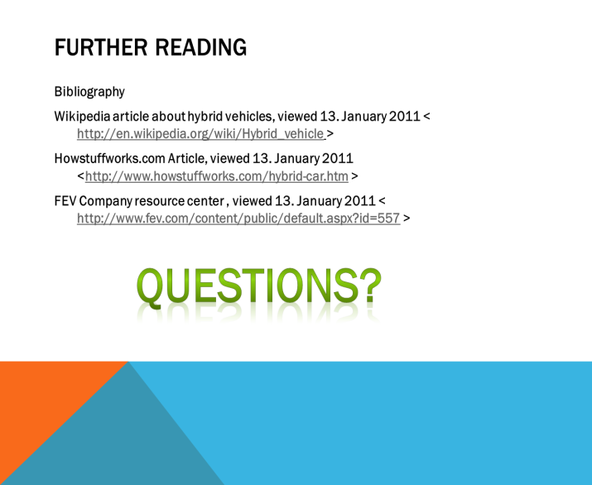
Exercise 10-3
⁹⁰For those of you who’d like to find out more about this subject, I’d suggest the following sources. ⁹¹And now, if you have any questions I’ll try my best to answer them.

