Slide 1
Sessions 11-12: Structuring your presentation -More feedback time on written assignments! -Metalanguage -Visuals

Slide 2
ROBOTIC SURGERY
What are your expectations as a listener?
What information would you include/ exclude in a presentation about “robotic surgery”?
Into what 3-4 areas would you divide up the content of this presentation?

Slide 3
Creating Connections
Full-sentence transitions
Transitions between main topics (slides)
Transitions between subtopics
Language Functions

Slide 4
TRANSITIONS What are they?
Transitions:
Words, phrases, or sentences that connect the speech ideas together
Act as “verbal bridges” between ideas
Alert the audience that a new point will be made
Examples:
Let’s now… In conclusion, … To sum up,…
However,… Another reason is… I’d now like to…

Slide 5
TRANSITIONS Transitions between main topics
When moving from one main point to another, full-sentence transitions are especially effective
Next, let's look at exactly what sales contests can do for us.

Slide 6
TRANSITIONS Transitions between main topics
Rhetorical questions
Topic sentences
Restate-forecast

Slide 7
TRANSITIONS Transitions between main topic areas
Rhetorical questions
Audience wants to see if you agree with their answer.
Will contests be too expensive? [pause…] Well, actually they won’t because...
How do the costs of contests stack up against the expense of training new people? [pause…] Well, if you take a look at the following graph…

Slide 8
TRANSITIONS Transitions between main topics
Topic sentences
Introduce the topic by summarizing the content/main message or making a claim.
There are three reasons for using contests. First, contests are... A second reason for using contests is that…
The costs of contests are significantly lower than the expense of training new people. This can be seen in the following graph…

Slide 9
TRANSITIONS Transitions between main topics
Restate-forecast
Restates the point just covered and previews the point to be covered next.
Now that we've established a need for sales contests (restatement),
Now that we've established a need for sales contests (restatement), let's now take a look at what sales contests can do for us (forecast).
Now that I've shown you that "junk" is the appropriate word to describe junk bonds, let’s turn to an analysis of three secure financial instruments: bank certificates of deposit, Treasury bonds, and high quality corporate paper.
Now that I've shown you that "junk" is the appropriate word to describe junk bonds,

Slide 10
TRANSITIONS Transitions between subpoints (A and B)
Adjectives, like ‘another’ and ‘other’
enumeration, such as The first…, The second, The third,
superordinate terms in guiding your audience between points.
A second way that sales competitions will benefit us is by their relative cost effectiveness.

Slide 11
Techniques for creating transitions Superordinate terms
'Umbrella' terms that can stand for an entire class or category of things.
VEHICLES
(superordinate)
lorries cars bicycles trams ships
Typical superordinate terms:
Option
Alternative
Example
Criterion
Feature
Aspect
Benefit
Advantage
Drawback
Problem
Issue
Technique
Method
Strategy
Approach
Solution
Reason
Rationale
Consequence
Effect
Motivation
Phase
Stage
Step
Effect
Procedure

Slide 12
Techniques for creating transitions Superordinate terms
NUMBER + [superordinate] + [list of items]
In front of the house were parked three vehicles: a lorry, a car and a large, red bicycle.
Today's computer-display manufacturers are limited by three factors. First, …. Second, … Finally, …
Today's computer-display manufacturers are limited by three factors. The first factor is… Another factor is…. And the third factor is…
[superordinate] + SUCH AS / INCLUDING + [examples]
The mobile lifestyle we know today would not be possible without vehicles such as automobiles, buses, trams, and aircraft.

Slide 13
TRANSITIONS Transitions between subpoints (1 and 2)
In addition to costing less than a loss in revenues, sales contests are less expensive than training new people.

Slide 14
TRANSITIONS Transitions between subpoints (1 and 2)
In addition to costing less than a loss in revenues, sales competitions are less expensive than training new people.
The conjunction ‘in addition to’ is particularly effective here, since it uses ‘old’ information already discussed to introduce ‘new’ information, the next point

Slide 15
Techniques for creating transitions Superordinate terms
So, let’s now take a look at the three advantages that our company can gain by sponsoring sales contests.
The first advantage is that competition will motivate…
The most important reason is that…
The second advantage of choosing a contest instead of … is that…
Another reason is that…
In addition to being cheaper than the other options, a third advantage of sales contests is that…

Slide 16
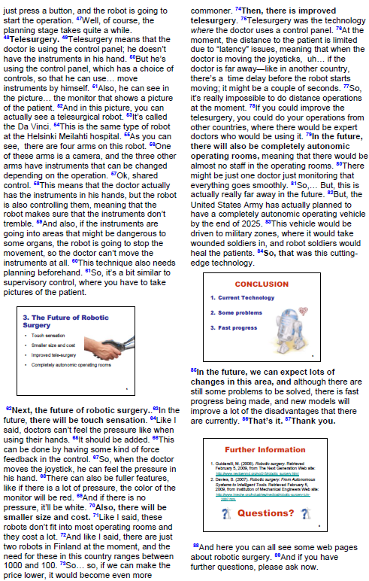
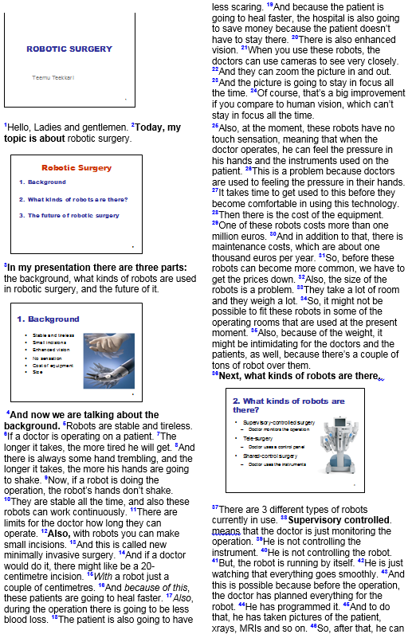
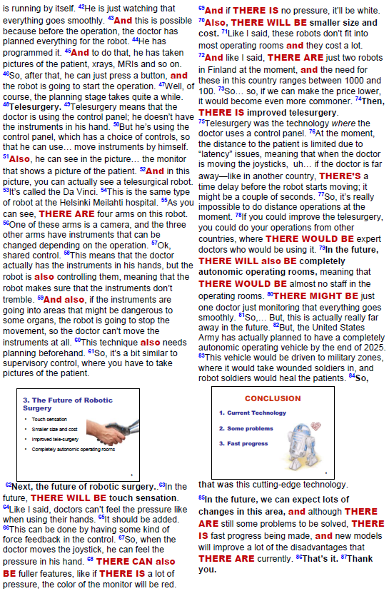

Slide 17
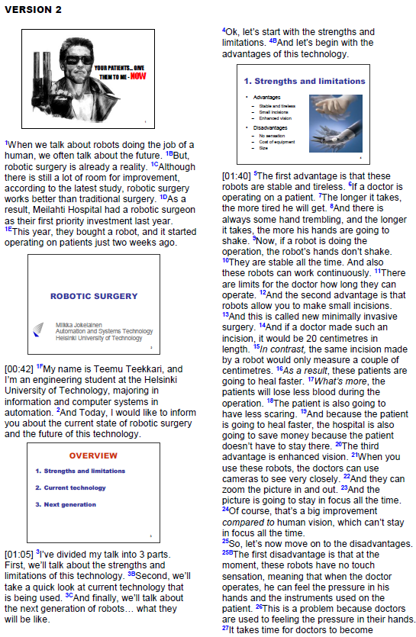
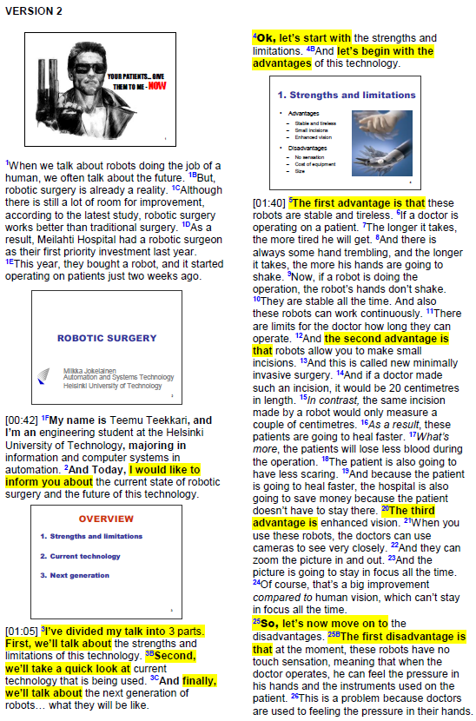
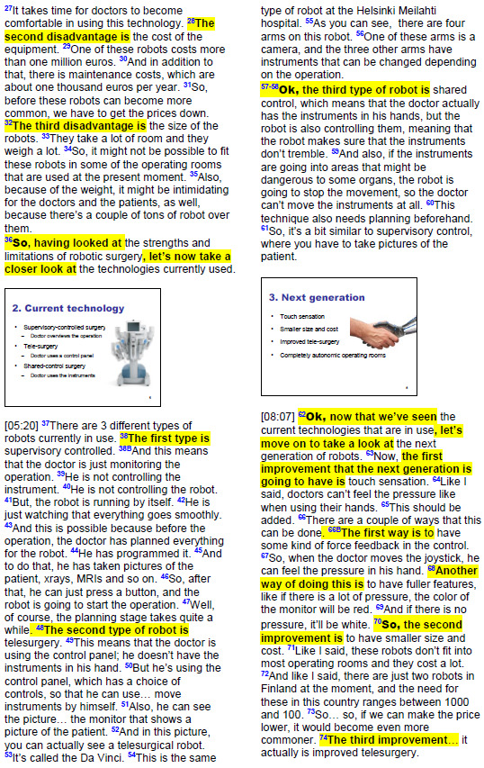
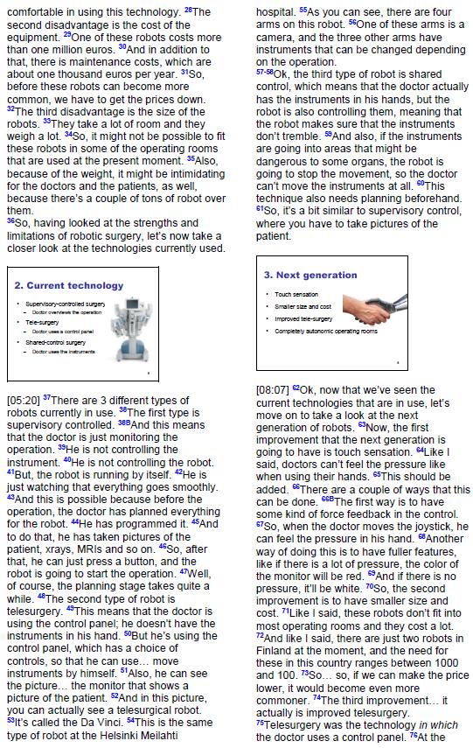

Slide 18
LANGUAGE FUNCTIONS
Click Language functions
Most important:
Presenting the purpose*
Previewing the organization*
Summarizing the main idea*
Introducing a new topic*
Summarizing the main points*

Slide 19
LANGUAGE FUNCTIONS

Slide 20
LANGUAGE FUNCTIONS

Slide 21
LANGUAGE FUNCTIONS

Slide 22
LANGUAGE FUNCTIONS

Slide 23
LANGUAGE FUNCTIONS

Slide 24
LANGUAGE FUNCTIONS

Slide 25
 | CHECKLIST: Using Transitions
Do you include enough transitions to adequately guide your listeners through your speech ?
Do you include full-sentence transitions that will alert listeners to shifts from one main point to the next ?
Do you make appropriate use of
Restate-forecast technique?
Rhetorical questions?
Topic sentences?
Do you use a “no niin”, such as so, right or okay, to alert listeners that you will move to a new topic?
Do you use superordinate terms to help your listeners see the connection between separate points in a bulleted list within a single slide ?

Slide 26
Session 12: Effective visuals

Slide 27
Why use visuals in presentations?
It has been said that people retain
20% of what they hear
30% of what they see
50-85% of what they see and hear

Slide 28
How to creat effective visuals?
Grammatical Form
Titles
Headings
subpoints
Formatting your text
True or False
Subordinating ideas

Slide 29
1. Grammatical Form: Headings
You can solve equations using modal transition systems.
What is most common form?
nouns (substantiivit)
noun phrases (substantiivilauseke)
Equations solving using modal transition systems.

Slide 30
1. Grammatical Form: Headings
Noun phrases take 3 forms:
Latin form: | The design of lasers The implementation of network protocols
Anglo-Saxon: | Ø Designing lasers Ø Implementing network protocols
Noun compound: | Lasers design Network-protocols implementation

Slide 31
1. Grammatical Form: Headings
Alternative forms:
Anglo-Saxon: | Ø Designing lasers Ø Implementing network protocols
Question: | How to design Lasers? Why to implement network protocols?
Command: | Design Lasers (!) Implement network protocols (!)

Slide 32
1. Grammatical Form: Headings
Stylistic features
Omit "the", "a" and "an" from beginning of noun phrases
The supervisory control of a rapid thermal multiprocessor.
Ø Supervisory control of Ø rapid thermal multiprocessors.
A C-Based Process-Oriented Simulation Language.
CSMI: Ø C-Based Process-Oriented Simulation Language. Ø C-Based Process-Oriented Simulation Language (CSMI)

Slide 33
2. Formatting your text
There are significant differences in the choice of type faces between printed information and a presentation. While a typeface like Arial might look presentable on paper, in a presentation it can be more difficult to read than Times New Roman.
Depending on the size of the presentation room, some font sizes might be more legible than others. Use a font size of at least size 12pt.
Although upper case letters might be good to emphasize a point, their use should be sparing or avoided. Upper case letters despite occupying more space on the slide, are also slow to read.
There are significant differences in the choice of type faces between printed information and a presentation. While a typeface like Arial might look presentable on paper, in a presentation it can be more difficult to read than Times New Roman.
Depending on the size of the presentation room, some font sizes might be more legible than others. Use a font size of at least size 12pt.
Although upper case letters might be good to emphasize a point, their use should be sparing or avoided. Upper case letters despite occupying more space on the slide, are also slow to read.
False
Serif
Sans serif

Slide 34
2. Formatting your text
There are significant differences in the choice of type faces between printed information and a presentation. While a typeface like Arial might look presentable on paper, in a presentation it can be more difficult to read than Times New Roman.
Depending on the size of the presentation room, some font sizes might be more legible than others. Use a font size of at least size 12pt.
Although upper case letters might be good to emphasize a point, their use should be sparing or avoided. Upper case letters despite occupying more space on the slide, are also slow to read.
There are significant differences in the choice of type faces between printed information and a presentation. While a typeface like Times New Roman might look presentable on paper, in a presentation it can be more difficult to read than Arial.
Depending on the size of the presentation room, some font sizes might be more legible than others. Use a font size of at least size 12pt.
Although upper case letters might be good to emphasize a point, their use should be sparing or avoided. Upper case letters despite occupying more space on the slide, are also slow to read.
There are significant differences in the choice of type faces between printed information and a presentation. While a typeface like Times New Roman might look presentable on paper, in a presentation it can be more difficult to read than Arial.
Depending on the size of the presentation room, some font sizes might be more legible than others. Use a font size of at least size 20-24 pt.
Although UPPER CASE LETTERS might be good to emphasize a point, their use should be sparing or avoided. Upper case letters despite occupying more space on the slide, are also slow to read.
False
False (12 pt)
False (20 pt)
False (24 pt)
False
True

Slide 35
2. Formatting your text
Use bold face to make letters more readable and clearer when projected on a screen. Italics are slow to read especially from a distance and should be avoided or used sparingly.
Colour blind people (i.e., those who have a problem differentiating red, green and brown) are estimated to be as high as 0.5% of the male population.
It is imperative that all important points or graphics are placed in the upper part of the screen and highlighted with a brighter colour.
Too much details on a slide is intimidating and incomprehensible to most viewers, leading to information overload.
Use bold face to emphasize and make key words stand out. Italics are slow to read especially from a distance and should be avoided or used sparingly.
Colour blind people (i.e., those who have a problem differentiating red, green and brown) are estimated to be as high as 0.5% of the male population.
It is imperative that all important points or graphics are placed in the upper part of the screen and highlighted with a brighter colour.
Too much details on a slide is intimidating and incomprehensible to most viewers, leading to information overload.
Use bold face to make letters more readable and clearer when projected on a screen. Italics are slow to read especially from a distance and should be avoided or used sparingly.
Colour blind people (i.e., those who have a problem differentiating red, green and brown) are estimated to be as high as 0.5% of the male population.
It is imperative that all important points or graphics are placed in the upper part of the screen and highlighted with a brighter colour.
Too much details on a slide is intimidating and incomprehensible to most viewers, leading to information overload.
False
False

Slide 36
2. Formatting your text
Use bold face to emphasize and make key words stand out. Italics are slow to read especially from a distance and should be avoided or used sparingly.
Colour blind people (i.e., those who have a problem differentiating red, green and brown) are estimated to be as high as 0.5% of the male population.
It is imperative that all important points or graphics are placed in the upper part of the screen and highlighted with a brighter colour.
Too much details on a slide is intimidating and incomprehensible to most viewers, leading to information overload.
Use bold face to emphasize and make key words stand out. Italics are slow to read especially from a distance and should be avoided or used sparingly.
Colour blind people (i.e., those who have a problem differentiating red, green and brown) are estimated to be as high as 8% of the male population.
It is imperative that all important points or graphics are placed in the upper part of the screen and highlighted with a brighter colour.
Too much details on a slide is intimidating and incomprehensible to most viewers, leading to information overload.
False
False
True
True

Slide 37
2. Formatting your text
Use fly-in or other entrance effects, such as ’blinds’, to avoid overloading your listener. Text competes with your spoken words, so give information only when it is needed, not before.
All headings and the subheadings on the same slide should have parallel grammatical form. Try to start most subheadings with the same part of speech, such as a verb or a noun. This will make them easier to scan.
Write key words. Split long sentences, lists, and complex ideas into numbered or bulleted vertical lists.
Do not fill slides with more than 6 words per line and no more than 6 lines per slide.
Use generous line spacing.
Use fly-in or other entrance effects, such as ’blinds’, to avoid overloading your listener. Text competes with your spoken words, so give information only when it is needed, not before.
All headings and the subheadings on the same slide should have parallel grammatical form. Try to start most subheadings with the same part of speech, such as a verb or a noun. This will make them easier to scan.
Write key words. Split long sentences, lists, and complex ideas into numbered or bulleted vertical lists.
Do not fill slides with more than 6 words per line and no more than 6 lines per slide.
Use generous line spacing.
Information should not fly in to your slides. Avoid using animation in your slides. Most listeners want to see all of the contents of a slide, and not be surprised by new information.
All headings and the subheadings on the same slide should have parallel grammatical form. Try to start most subheadings with the same part of speech, such as a verb or a noun. This will make them easier to scan.
Write complete thoughts—full sentences. That way, your listeners can study your handout when they have problems understanding your accent.
Do not fill slides more than 10 words per line and no more than 10 lines per slide.
Use generous line spacing.
Use fly-in or other entrance effects, such as ’blinds’, to avoid overloading your listener. Text competes with your spoken words, so give information only when it is needed, not before.
All headings and the subheadings on the same slide should have parallel grammatical form. Try to start most subheadings with the same part of speech, such as a verb or a noun. This will make them easier to scan.
Write complete thoughts—full sentences. That way, your listeners can study your handout when they have problems understanding your accent.
Do not fill slides more than 10 words per line and no more than 10 lines per slide.
Use generous line spacing.
Use fly-in or other entrance effects, such as ’blinds’, to avoid overloading your listener. Text competes with your spoken words, so give information only when it is needed, not before.
All headings and the subheadings on the same slide should have parallel grammatical form. Try to start most subheadings with the same part of speech, such as a verb or a noun. This will make them easier to scan.
Write key words. Split long sentences, lists, and complex ideas into numbered or bulleted vertical lists.
Do not fill slides more than 10 words per line and no more than 10 lines per slide.
Use generous line spacing.
Use fly-in or other entrance effects, such as ’blinds’, to avoid overloading your listener. Text competes with your spoken words, so give information only when it is needed, not before.
All headings and the subheadings on the same slide should have parallel grammatical form. Try to start most subheadings with the same part of speech, such as a verb or a noun. This will make them easier to scan.
Write key words. Split long sentences, lists, and complex ideas into numbered or bulleted vertical lists.
Do not fill slides with more than 6 words per line and no more than 6 lines per slide.
Use generous line spacing.
False
True
False
False
True

Slide 38
2. Formatting your text
How to deal with formula/equations/algorithms?

Slide 39
2. Formatting your text
How to show where you are in a bulleted list?

Slide 40
2. System Integration (1/4)
Requirements
Automation
Flexibility
Policies
Location Technologies
Security
Notes:
Having seen the importance of privacy policies and how they can be modeled into a system, let’s now integrate them into a system, starting with the system’s requirements.
1. Such as Automation…
2. Second, we have…
1. First one is…
2. And the second one is…
3. The last requirement is…
BETTER:
SO, having seen the importance of privacy policies and how they can be modeled into a system, let’s now integrate them into a system, starting with the system’s requirements.
1. THE FIRST REQUIREMENT IS Automation…
2. ANOTHER REQUIREMENT IS…
1. THE first TYPE OF FLEXIBILITY IS…
2. And the second TYPE OF FLEXIBILITY is…
3. The FINAL requirement is…

Slide 41
Which slide background color is better for your eyes:
white or black?

Slide 42
2. System Integration (1/4)
Requirements
Automation
Flexibility
Policies
Location Technologies
Security
Notes:
Having seen the importance of privacy policies and how they can be modeled into a system, let’s now integrate them into a system, starting with the system’s requirements.
1. Such as Automation…
2. Second, we have…
1. First one is…
2. And the second one is…
3. The last requirement is…
BETTER:
SO, having seen the importance of privacy policies and how they can be modeled into a system, let’s now integrate them into a system, starting with the system’s requirements.
1. THE FIRST REQUIREMENT IS Automation…
2. ANOTHER REQUIREMENT IS…
1. THE first TYPE OF FLEXIBILITY IS…
2. And the second TYPE OF FLEXIBILITY is…
3. The FINAL requirement is…

Slide 43
2. System Integration (1/4)
Requirements
Automation
Flexibility
Policies
Location Technologies
Security
Notes:
Having seen the importance of privacy policies and how they can be modeled into a system, let’s now integrate them into a system, starting with the system’s requirements.
1. Such as Automation…
2. Second, we have…
1. First one is…
2. And the second one is…
3. The last requirement is…
BETTER:
SO, having seen the importance of privacy policies and how they can be modeled into a system, let’s now integrate them into a system, starting with the system’s requirements.
1. THE FIRST REQUIREMENT IS Automation…
2. ANOTHER REQUIREMENT IS…
1. THE first TYPE OF FLEXIBILITY IS…
2. And the second TYPE OF FLEXIBILITY is…
3. The FINAL requirement is…

Slide 44
Which slide background color is better for your eyes:
white or black?
Studies indicate that dark backgrounds are more restful for your eyes than white ones.

Slide 45
2. System Integration (2/4)
LocServ
Privacy Boundary
Validator
You
Location Server
PP
Your
Boss
Validator
Location
Translation
Notes:
So, having seen this requirements now we can build an architecture based on those requirements.
1. The first one is…
2. The second is…
3. Then, there is…
4. And then there is…
BETTER:
So, having seen THESE requirements we can NOW TAKE A LOOK AT an architecture based on THEM.
1. FIRST,…
2. SECOND,…
3. THIRD,…
4. FINALLY,…

Slide 46
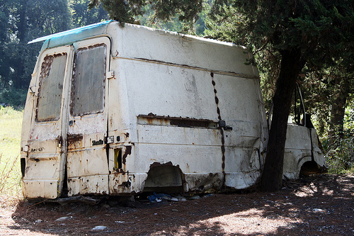
Electric vans for Sillink
Teemu Teekkari
Department of electrical engineering
Aalto University

Slide 47
Electric vans for Sillink
1. Requirements
2. Alternatives
3. Comparison
>>> Recommendation

Slide 48
1. Requirements
Operating range
Recharging time
Maintenance
Performance & size
Towing
Moving payloads
Minimum requirements
Price
Street legality

Slide 49
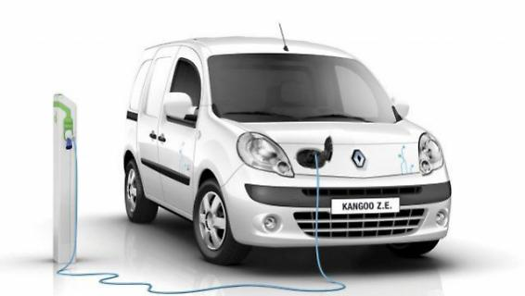
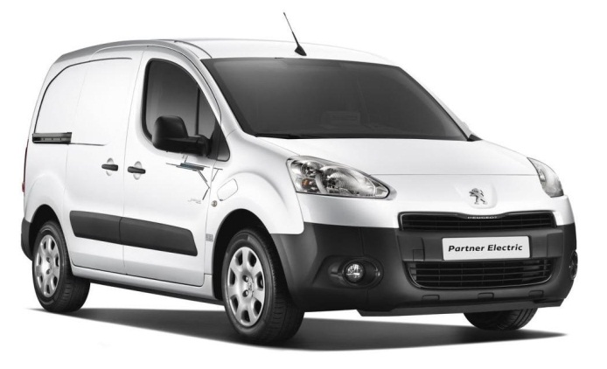
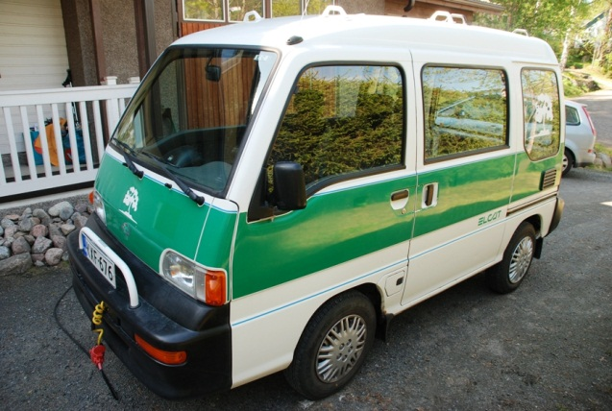
2. Alternatives
Mercedes Benz Vito
Renault Kangoo Z.E. Maxi
Peugeot Partner Electric van
Elcat Cityvan 202

Slide 50
3. Comparison
 | Mercedes Benz Vito E-CELL | Renault Kangoo Z.E. Maxi | Peugeot Partner electric van | Elcat Cityvan 202
Operating Range (km) | 170 | 160 | 160 | 120

Slide 51
3. Comparison
 | Mercedes Benz Vito E-CELL | Renault Kangoo Z.E. Maxi | Peugeot Partner electric van | Elcat Cityvan 202
Operating Range (km) | 170 | 160 | 160 | 120
Recharge time (h) | 6 | 8(0.5) | 7 | 9

Slide 52
3. Comparison
 | Mercedes Benz Vito E-CELL | Renault Kangoo Z.E. Maxi | Peugeot Partner electric van | Elcat Cityvan 202
Operating Range (km) | 170 | 160 | 160 | 120
Recharge time (h) | 6 | 8(0.5) | 7 | 9
Availability of service | Excellent | Good | Good | Poor

Slide 53
3. Comparison
 | Mercedes Benz Vito E-CELL | Renault Kangoo Z.E. Maxi | Peugeot Partner electric van | Elcat Cityvan 202
Operating Range (km) | 170 | 160 | 160 | 120
Recharge time (h) | 6 | 8(0.5) | 7 | 9
Availability of service | Excellent | Good | Good | Poor
Performance (kW/Nm) | 60/280 | 44/226 | 49/200 | 14/73

Slide 54
3. Comparison
 | Mercedes Benz Vito E-CELL | Renault Kangoo Z.E. Maxi | Peugeot Partner electric van | Elcat Cityvan 202
Operating Range (km) | 170 | 160 | 160 | 120
Recharge time (h) | 6 | 8(0.5) | 7 | 9
Availability of service | Excellent | Good | Good | Poor
Performance (kW/Nm) | 60/280 | 44/226 | 49/200 | 14/73
Cargo Space (m³) | 7.4 | 4.6 | 3.7 | 1.8

Slide 55
CONCLUSION
Mercedes Benz Vito E-CELL:
Longest range
Quickest normal recharging
Service readily available
Highest performance
Towing
Moving payloads

Slide 57
Questions?

Slide 58
3. Comparison
 | Mercedes Benz Vito E-CELL | Renault Kangoo Z.E. Maxi | Peugeot Partner electric van | Elcat Cityvan 202
Operating Range (km) | 170 | 160 | 160 | 120
Recharge time (h) | 6 | 8(0.5) | 7 | 9
Availability of service | Excellent | Good | Good | Poor
Performance (kW/Nm) | 60/280 | 44/226 | 49/200 | 14/73
Cargo Space (m³) | 7.4 | 4.6 | 3.7 | 1.8

Slide 59
3. Subordinating ideas
Slides 1:
How would you improve the readability of the following ’wordy’ slide?

Slide 60
Slide 1: What changes would you suggest?
Implementation and Analysis
In order to test the performance of the WSCTP, the developed protocol was plotted into 8-bit micro-controllers which were then incorporated into both the NA module and the NM module.
The wireless link was then established according to the procedure described above.
Each microcontroller consisted of a built-in UART and non-volatile memories.
The UART allowed the application layer to access the WSCTP while the non-volatile memories stored the protocol settings.
For home application, a data rate of 4.8kbps was sufficient.
In our implementation, a main controller was connected to the NA module and short commands were sent via the UART. Devices connected to NM modules will then react to the command sent by the main controller.

Slide 61
Slide 1: What changes would you suggest?
Implementation and Analysis
In order to test the performance of the WSCTP, the developed protocol was plotted into 8-bit micro-controllers which were then incorporated into both the NA module and the NM module.
The wireless link was then established according to the procedure described above.
Each microcontroller consisted of a built-in UART and non-volatile memories.
The UART allowed the application layer to access the WSCTP while the non-volatile memories stored the protocol settings.
For home application, a data rate of 4.8kbps was sufficient.
In our implementation, a main controller was connected to the NA module and short commands were sent via the UART. Devices connected to NM modules will then react to the command sent by the main controller.

Slide 62
Slide 1: What changes would you suggest?
Implementation and Analysis
To test performance of WSCTP:
The developed protocol was plotted into 8-bit micro-controllers which were then incorporated into both the NA module and the NM module.
The wireless link was then established according to the procedure described above.
Each microcontroller consisted of a built-in UART and non-volatile memories.
The UART allowed the application layer to access the WSCTP while the non-volatile memories stored the protocol settings.
For home application, a data rate of 4.8kbps was sufficient.
In our implementation, a main controller was connected to the NA module and short commands were sent via the UART. Devices connected to NM modules will then react to the command sent by the main controller.

Slide 63
Slide 1: What changes would you suggest?
Implementation and Analysis
To test performance of WSCTP:
the developed protocol was plotted into 8-bit micro-controllers which were then incorporated into both the NA module and the NM module.
The wireless link was then established according to the procedure described above.
Each microcontroller consisted of a built-in UART and non-volatile memories.
The UART allowed the application layer to access the WSCTP while the non-volatile memories stored the protocol settings.
For home application, a data rate of 4.8kbps was sufficient.
In our implementation, a main controller was connected to the NA module and short commands were sent via the UART. Devices connected to NM modules will then react to the command sent by the main controller.

Slide 64
Slide 1: What changes would you suggest?
Implementation and Analysis
To test performance of WSCTP:
Protocol was plotted into 8-bit micro-controllers which were then incorporated into both the NA module and the NM module.
The wireless link was then established according to the procedure described above.
Each microcontroller consisted of a built-in UART and non-volatile memories.
The UART allowed the application layer to access the WSCTP while the non-volatile memories stored the protocol settings.
For home application, a data rate of 4.8kbps was sufficient.
In our implementation, a main controller was connected to the NA module and short commands were sent via the UART. Devices connected to NM modules will then react to the command sent by the main controller.

Slide 65
Slide 1: What changes would you suggest?
Implementation and Analysis
To test performance of WSCTP:
Protocol was plotted into 8-bit micro-controllers which were then incorporated into both the NA module and the NM module.
The wireless link was then established according to the procedure described above.
Each microcontroller consisted of a built-in UART and non-volatile memories.
The UART allowed the application layer to access the WSCTP while the non-volatile memories stored the protocol settings.
For home application, a data rate of 4.8kbps was sufficient.
In our implementation, a main controller was connected to the NA module and short commands were sent via the UART. Devices connected to NM modules will then react to the command sent by the main controller.

Slide 66
Slide 1: What changes would you suggest?
Implementation and Analysis
To test performance of WSCTP:
(We) plotted protocol into 8-bit micro-controllers which were then incorporated into both the NA module and the NM module.
The wireless link was then established according to the procedure described above.
Each microcontroller consisted of a built-in UART and non-volatile memories.
The UART allowed the application layer to access the WSCTP while the non-volatile memories stored the protocol settings.
For home application, a data rate of 4.8kbps was sufficient.
In our implementation, a main controller was connected to the NA module and short commands were sent via the UART. Devices connected to NM modules will then react to the command sent by the main controller.

Slide 67
Slide 1: What changes would you suggest?
Implementation and Analysis
To test performance of WSCTP:
Plotted protocol into 8-bit micro-controllers which were then incorporated into both the NA module and the NM module.
The wireless link was then established according to the procedure described above.
Each microcontroller consisted of a built-in UART and non-volatile memories.
The UART allowed the application layer to access the WSCTP while the non-volatile memories stored the protocol settings.
For home application, a data rate of 4.8kbps was sufficient.
In our implementation, a main controller was connected to the NA module and short commands were sent via the UART. Devices connected to NM modules will then react to the command sent by the main controller.

Slide 68
Slide 1: What changes would you suggest?
Implementation and Analysis
To test performance of WSCTP:
Plotted protocol into 8-bit micro-controllers which were then incorporated into both the NA module and the NM module.
The wireless link was then established according to the procedure described above.
Each microcontroller consisted of a built-in UART and non-volatile memories.
The UART allowed the application layer to access the WSCTP while the non-volatile memories stored the protocol settings.
For home application, a data rate of 4.8kbps was sufficient.
In our implementation, a main controller was connected to the NA module and short commands were sent via the UART. Devices connected to NM modules will then react to the command sent by the main controller.

Slide 69
Slide 1: What changes would you suggest?
Implementation and Analysis
To test performance of WSCTP:
Plotted protocol into 8-bit micro-controllers
Incorporated controllers into both the NA module and the NM module.
The wireless link was then established according to the procedure described above.
Each microcontroller consisted of a built-in UART and non-volatile memories.
The UART allowed the application layer to access the WSCTP while the non-volatile memories stored the protocol settings.
For home application, a data rate of 4.8kbps was sufficient.
In our implementation, a main controller was connected to the NA module and short commands were sent via the UART. Devices connected to NM modules will then react to the command sent by the main controller.

Slide 70
Slide 1: What changes would you suggest?
Implementation and Analysis
To test performance of WSCTP:
Plotted protocol into 8-bit micro-controllers
Incorporated controllers into both the NA module and the NM module.
The wireless link was then established according to the procedure described above.
Each microcontroller consisted of a built-in UART and non-volatile memories.
The UART allowed the application layer to access the WSCTP while the non-volatile memories stored the protocol settings.
For home application, a data rate of 4.8kbps was sufficient.
In our implementation, a main controller was connected to the NA module and short commands were sent via the UART. Devices connected to NM modules will then react to the command sent by the main controller.

Slide 71
Slide 1: What changes would you suggest?
Implementation and Analysis
To test performance of WSCTP:
Plotted protocol into 8-bit micro-controllers
Incorporated controllers into NA module and NM module.
The wireless link was then established according to the procedure described above.
Each microcontroller consisted of a built-in UART and non-volatile memories.
The UART allowed the application layer to access the WSCTP while the non-volatile memories stored the protocol settings.
For home application, a data rate of 4.8kbps was sufficient.
In our implementation, a main controller was connected to the NA module and short commands were sent via the UART. Devices connected to NM modules will then react to the command sent by the main controller.

Slide 72
Slide 1: What changes would you suggest?
Implementation and Analysis
To test performance of WSCTP:
Plotted protocol into 8-bit micro-controllers
Incorporated controllers into NA and NM modules.
The wireless link was then established according to the procedure described above.
Each microcontroller consisted of a built-in UART and non-volatile memories.
The UART allowed the application layer to access the WSCTP while the non-volatile memories stored the protocol settings.
For home application, a data rate of 4.8kbps was sufficient.
In our implementation, a main controller was connected to the NA module and short commands were sent via the UART. Devices connected to NM modules will then react to the command sent by the main controller.

Slide 73
Slide 1: What changes would you suggest?
Implementation and Analysis
To test performance of WSCTP:
Plotted protocol into 8-bit micro-controllers
Incorporated controllers into NA and NM modules.
The wireless link was then established according to the procedure described above.
Each microcontroller consisted of a built-in UART and non-volatile memories.
The UART allowed the application layer to access the WSCTP while the non-volatile memories stored the protocol settings.
For home application, a data rate of 4.8kbps was sufficient.
In our implementation, a main controller was connected to the NA module and short commands were sent via the UART. Devices connected to NM modules will then react to the command sent by the main controller.

Slide 74
Slide 1: What changes would you suggest?
Implementation and Analysis
To test performance of WSCTP:
Plotted protocol into 8-bit micro-controllers
Incorporated controllers into NA and NM modules.
Established the wireless link according to the procedure described above.
Each microcontroller consisted of a built-in UART and non-volatile memories.
The UART allowed the application layer to access the WSCTP while the non-volatile memories stored the protocol settings.
For home application, a data rate of 4.8kbps was sufficient.
In our implementation, a main controller was connected to the NA module and short commands were sent via the UART. Devices connected to NM modules will then react to the command sent by the main controller.

Slide 75
Slide 1: What changes would you suggest?
Implementation and Analysis
To test performance of WSCTP:
Plotted protocol into 8-bit micro-controllers
Incorporated controllers into NA and NM modules.
Established the wireless link according to the procedure described above.
Each microcontroller consisted of a built-in UART and non-volatile memories.
The UART allowed the application layer to access the WSCTP while the non-volatile memories stored the protocol settings.
For home application, a data rate of 4.8kbps was sufficient.
In our implementation, a main controller was connected to the NA module and short commands were sent via the UART. Devices connected to NM modules will then react to the command sent by the main controller.
Implementation and Analysis
To test performance of WSCTP:
Plotted protocol into 8-bit micro-controllers
Incorporated controllers into NA and NM modules.
Established the wireless link according to the procedure described above.
Each microcontroller consisted of a built-in UART and non-volatile memories.
The UART allowed the application layer to access the WSCTP while the non-volatile memories stored the protocol settings.
For home application, a data rate of 4.8kbps was sufficient.
In our implementation, a main controller was connected to the NA module and short commands were sent via the UART. Devices connected to NM modules will then react to the command sent by the main controller.

Slide 76
Slide 1: What changes would you suggest?
Implementation and Analysis
To test performance of WSCTP:
Plotted protocol into 8-bit micro-controllers
Incorporated controllers into NA and NM modules.
Established the wireless link according to above procedure.
Each microcontroller consisted of a built-in UART and non-volatile memories.
The UART allowed the application layer to access the WSCTP while the non-volatile memories stored the protocol settings.
For home application, a data rate of 4.8kbps was sufficient.
In our implementation, a main controller was connected to the NA module and short commands were sent via the UART. Devices connected to NM modules will then react to the command sent by the main controller.

Slide 77
Slide 1: What changes would you suggest?
Implementation and Analysis
To test performance of WSCTP:
Plotted protocol into 8-bit micro-controllers
Incorporated controllers into NA and NM modules.
Established wireless link according to above procedure.
Each micro-controller consisted of a built-in UART and non-volatile memories.
The UART allowed the application layer to access the WSCTP while the non-volatile memories stored the protocol settings.
For home application, a data rate of 4.8kbps was sufficient.
In our implementation, a main controller was connected to the NA module and short commands were sent via the UART. Devices connected to NM modules will then react to the command sent by the main controller.

Slide 78
Slide 1: What changes would you suggest?
Implementation and Analysis
To test performance of WSCTP:
Plotted protocol into 8-bit micro-controllers
Incorporated controllers into NA and NM modules.
Established wireless link according to above procedure.
Micro-controller
A built-in UART
Non-volatile memories.
The UART allowed the application layer to access the WSCTP while the non-volatile memories stored the protocol settings.
For home application, a data rate of 4.8kbps was sufficient.
In our implementation, a main controller was connected to the NA module and short commands were sent via the UART. Devices connected to NM modules will then react to the command sent by the main controller.

Slide 79
Slide 1: What changes would you suggest?
Implementation and Analysis
To test performance of WSCTP:
Plotted protocol into 8-bit micro-controllers
Incorporated controllers into NA and NM modules.
Established wireless link according to above procedure.
Micro-controller
A built-in UART
Non-volatile memories.
The UART allowed the application layer to access the WSCTP while the non-volatile memories stored the protocol settings.
For home application, a data rate of 4.8kbps was sufficient.
In our implementation, a main controller was connected to the NA module and short commands were sent via the UART. Devices connected to NM modules will then react to the command sent by the main controller.

Slide 80
Slide 1: What changes would you suggest?
Implementation and Analysis
To test performance of WSCTP:
Plotted protocol into 8-bit micro-controllers
Incorporated controllers into NA and NM modules.
Established wireless link according to above procedure.
Micro-controller
Built-in UART
non-volatile memories.
The UART allowed the application layer to access the WSCTP while the non-volatile memories stored the protocol settings.
For home application, a data rate of 4.8kbps was sufficient.
In our implementation, a main controller was connected to the NA module and short commands were sent via the UART. Devices connected to NM modules will then react to the command sent by the main controller.

Slide 81
Slide 1: What changes would you suggest?
Implementation and Analysis
To test performance of WSCTP:
Plotted protocol into 8-bit micro-controllers
Incorporated controllers into NA and NM modules.
Established wireless link according to above procedure.
Micro-controller
built-in UART
allows the application layer to access the WSCTP
non-volatile memories.
The UART allowed the application layer to access the WSCTP, while the non-volatile memories stored the protocol settings.
For home application, a data rate of 4.8kbps was sufficient.
In our implementation, a main controller was connected to the NA module and short commands were sent via the UART. Devices connected to NM modules will then react to the command sent by the main controller.

Slide 82
Slide 1: What changes would you suggest?
Implementation and Analysis
To test performance of WSCTP:
Plotted protocol into 8-bit micro-controllers
Incorporated controllers into NA and NM modules.
Established wireless link according to above procedure.
Micro-controller
built-in UART
allows the application layer to access the WSCTP
non-volatile memories.
The UART allowed the application layer to access the WSCTP, while the non-volatile memories stored the protocol settings.
For home application, a data rate of 4.8kbps was sufficient.
In our implementation, a main controller was connected to the NA module and short commands were sent via the UART. Devices connected to NM modules will then react to the command sent by the main controller.

Slide 83
Slide 1: What changes would you suggest?
Implementation and Analysis
To test performance of WSCTP:
Plotted protocol into 8-bit micro-controllers
Incorporated controllers into NA and NM modules.
Established wireless link according to above procedure.
Micro-controller
Built-in UART
allows application layer to access WSCTP
Non-volatile memories.
The UART allowed the application layer to access the WSCTP while the non-volatile memories stored the protocol settings.
For home application, a data rate of 4.8kbps was sufficient.
In our implementation, a main controller was connected to the NA module and short commands were sent via the UART. Devices connected to NM modules will then react to the command sent by the main controller.

Slide 84
Slide 1: What changes would you suggest?
Implementation and Analysis
To test performance of WSCTP:
Plotted protocol into 8-bit micro-controllers
Incorporated controllers into NA and NM modules.
Established wireless link according to above procedure.
Micro-controller
built-in UART
allows application layer to access WSCTP
non-volatile memories
stores the protocol settings
For home application, a data rate of 4.8kbps was sufficient.
In our implementation, a main controller was connected to the NA module and short commands were sent via the UART. Devices connected to NM modules will then react to the command sent by the main controller.

Slide 85
Slide 1: What changes would you suggest?
Implementation and Analysis
To test performance of WSCTP:
Plotted protocol into 8-bit micro-controllers
Incorporated controllers into NA and NM modules.
Established wireless link according to above procedure.
Micro-controller
Built-in UART
allows application layer to access WSCTP
Non-volatile memories
stores the protocol settings
For home application, a data rate of 4.8kbps was sufficient.
In our implementation, a main controller was connected to the NA module and short commands were sent via the UART. Devices connected to NM modules will then react to the command sent by the main controller.

Slide 86
Slide 1: What changes would you suggest?
Implementation and Analysis
To test performance of WSCTP:
Plotted protocol into 8-bit micro-controllers
Incorporated controllers into NA and NM modules.
Established wireless link according to above procedure.
Micro-controller
Built-in UART
allows application layer to access WSCTP
Non-volatile memories
stores protocol settings
For home application, a data rate of 4.8kbps was sufficient.
In our implementation, a main controller was connected to the NA module and short commands were sent via the UART. Devices connected to NM modules will then react to the command sent by the main controller.

Slide 87
Slide 1: What changes would you suggest?
Implementation and Analysis
To test performance of WSCTP:
Plotted protocol into 8-bit micro-controllers
Incorporated controllers into NA and NM modules.
Established wireless link according to above procedure.
Micro-controller
Built-in UART
allows application layer to access WSCTP
Non-volatile memories
stores protocol settings
For home application:
data rate = 4.8kbps
In our implementation, a main controller was connected to the NA module and short commands were sent via the UART. Devices connected to NM modules will then react to the command sent by the main controller.

Slide 88
Slide 1: What changes would you suggest?
Implementation and Analysis
To test performance of WSCTP:
Plotted protocol into 8-bit micro-controllers
Incorporated controllers into NA and NM modules.
Established wireless link according to above procedure.
Micro-controller
built-in UART
allows application layer to access WSCTP
non-volatile memories
stores protocol settings
For home application:
data rate = 4.8kbps
In our implementation, a main controller was connected to the NA module and short commands were sent via the UART. Devices connected to NM modules will then react to the command sent by the main controller.

Slide 89
Slide 1: What changes would you suggest?
Implementation and Analysis
To test performance of WSCTP:
Plotted protocol into 8-bit micro-controllers
Incorporated controllers into NA and NM modules.
Established wireless link according to above procedure.
Micro-controller
Built-in UART
allows application layer to access WSCTP
Non-volatile memories
stores the protocol settings
For home application:
data rate = 4.8kbps
Implementation:
a main controller was connected to the NA module and short commands were sent via the UART. Devices connected to NM modules will then react to the command sent by the main controller.

Slide 90
Slide 1: What changes would you suggest?
Implementation and Analysis
To test performance of WSCTP:
Plotted protocol into 8-bit micro-controllers
Incorporated controllers into NA and NM modules.
Established wireless link according to above procedure.
Micro-controller
Built-in UART
allows application layer to access WSCTP
Non-volatile memories
stores the protocol settings
For home application:
data rate = 4.8kbps
Implementation:
a main controller was connected to the NA module and short commands were sent via the UART. Devices connected to NM modules will then react to the command sent by the main controller.

Slide 91
Slide 1: What changes would you suggest?
Implementation and Analysis
To test performance of WSCTP:
Plotted protocol into 8-bit micro-controllers
Incorporated controllers into NA and NM modules.
Established wireless link according to above procedure.
Micro-controller
BUILT-IN UART
allows application layer to access WSCTP
Non-volatile memories
stores the protocol settings
For home application:
Data rate = 4.8kbps
Implementation:
a main controller was connected to the NA module and short commands were sent via the UART. Devices connected to NM modules will then react to the command sent by the main controller.

Slide 92
Slide 1: What changes would you suggest?
Implementation and Analysis
To test performance of WSCTP:
Plotted protocol into 8-bit micro-controllers
Incorporated controllers into NA and NM modules.
Established wireless link according to above procedure.
Micro-controller
Built-in UART
allows application layer to access WSCTP
Non-volatile memories
stores the protocol settings
For home application:
Data rate = 4.8kbps
Implementation:
Connected a main controller to the NA module and short commands were sent via the UART. Devices connected to NM modules will then react to the command sent by the main controller.

Slide 93
Slide 1: What changes would you suggest?
Implementation and Analysis
To test performance of WSCTP:
Plotted protocol into 8-bit micro-controllers
Incorporated controllers into NA and NM modules.
Established wireless link according to above procedure.
Micro-controller
Built-in UART
allows application layer to access WSCTP
Non-volatile memories
stores the protocol settings
For home application:
Data rate = 4.8kbps
Implementation:
Connected main controller to NA module
Short commands were sent via the UART. Devices connected to NM modules will then react to the command sent by the main controller.

Slide 94
Slide 1: What changes would you suggest?
Implementation and Analysis
To test performance of WSCTP:
Plotted protocol into 8-bit micro-controllers
Incorporated controllers into NA and NM modules.
Established wireless link according to above procedure.
Micro-controller
Built-in UART
allows application layer to access WSCTP
Non-volatile memories
stores the protocol settings
For home application:
Data rate = 4.8kbps
Implementation:
Connected main controller to NA
Sent short commands via the UART. Devices connected to NM modules will then react to the command sent by the main controller.

Slide 95
Slide 1: What changes would you suggest?
Implementation and Analysis
To test performance of WSCTP:
Plotted protocol into 8-bit micro-controllers
Incorporated controllers into NA and NM modules.
Established wireless link according to above procedure.
Micro-controller
Built-in UART
allows application layer to access WSCTP
Non-volatile memories
stores the protocol settings
For home application:
Data rate = 4.8kbps
Implementation:
Connected main controller to NA
Sent short commands via UART
Devices connected to NM modules will then react to the command sent by the main controller.

Slide 96
Slide 1: What changes would you suggest?
Implementation and Analysis
To test performance of WSCTP:
Plotted protocol into 8-bit micro-controllers
Incorporated controllers into NA and NM modules.
Established wireless link according to above procedure.
Micro-controller
Built-in UART
allows application layer to access WSCTP
Non-volatile memories
stores the protocol settings
For home application:
Data rate = 4.8kbps
Implementation:
Connected main controller to NA
Sent short commands via UART
Devices connected to NM modules react to command sent by main controller.

Slide 97
Slide 1: What changes would you suggest?
Implementation and Analysis
To test performance of WSCTP:
Plotted protocol into 8-bit micro-controllers
Incorporated controllers into NA and NM modules.
Established wireless link according to above procedure.
Micro-controller
built-in UART
allows application layer to access WSCTP
non-volatile memories
stores the protocol settings
For home application:
data rate = 4.8kbps
Implementation:
Connected main controller to NA
Sent short commands via UART
→ Devices connected to NM modules react to command sent by main controller.

Slide 98
Slide 1: What changes would you suggest?
Implementation and Analysis
To test performance of WSCTP:
Plotted protocol into 8-bit micro-controllers
Incorporated controllers into NA and NM modules.
Established wireless link according to above procedure.
Micro-controller
built-in UART
allows application layer to access WSCTP
non-volatile memories
stores the protocol settings
For home application:
data rate = 4.8kbps
Implementation:
Connected main controller to NA
Sent short commands via UART → Devices connected to NM modules

Slide 99
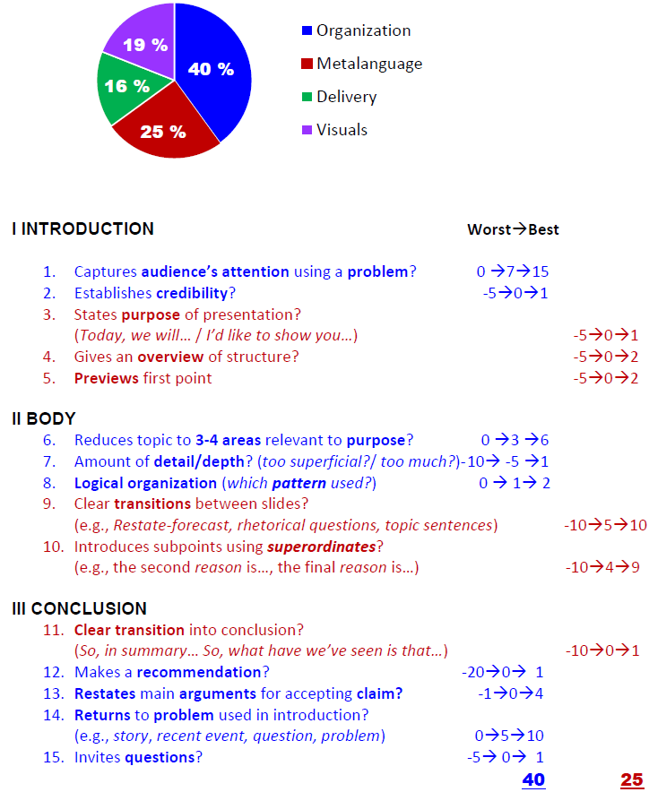
Presentation grade

Slide 100
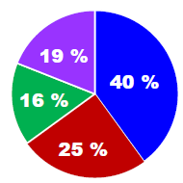
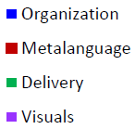

Slide 101
Notes:
Hello world

