Slide 1



Sessions 5&6
Definitions
Relative clauses
Topic sentences
Paragraph structure
Communicating Technology

Slide 2
Task 5-1:
Each of these sentences has an element of information which is vague for most readers. Identify and underline the terms that need explaining.
The Mars mission was originally funded to last 90 sols (One sol equals 24.65 hours) and to end last April.
The Mars Science Laboratory (MSL) is scheduled to be launched on September 15, 2009.
The rover can perform all planned operations (e.g., driving, communicating, imaging) under solar panel power alone.
The Mars rover will seek samples that have minerals deposited by water-related processes, such as precipitation, evaporation, or sedimentary cementation.
The space mission will carry more advanced scientific instruments than any other mission ever sent to Mars, including those for analysis of samples scooped up from the soil.
The Mars mission was originally funded to last 90 sols and to end last April.
The MSL is scheduled to be launched on September 15, 2009.
The rover can perform all planned operations under solar panel power alone.
The Mars rover will seek samples that have minerals deposited by water-related processes.
The space mission will carry more advanced scientific instruments than any other mission ever sent to Mars.
The Mars mission was originally funded to last 90 sols (One sol equals 24.65 hours) and to end last April.
MSL is scheduled to be launched on September 15, 2009.
The rover can perform all planned operations under solar panel power alone.
The Mars rover will seek samples that have minerals deposited by water-related processes.
The space mission will carry more advanced scientific instruments than any other mission ever sent to Mars.
The Mars mission was originally funded to last 90 sols (One sol equals 24.65 hours) and to end last April.
The Mars Science Laboratory (MSL) is scheduled to be launched on September 15, 2009.
The rover can perform all planned operations under solar panel power alone.
The Mars rover will seek samples that have minerals deposited by water-related processes.
The space mission will carry more advanced scientific instruments than any other mission ever sent to Mars.
The Mars mission was originally funded to last 90 sols (One sol equals 24.65 hours) and to end last April.
The Mars Science Laboratory (MSL) is scheduled to be launched on September 15, 2009.
The rover can perform all planned operations (e.g., driving, communicating, imaging) under solar panel power alone.
The Mars rover will seek samples that have minerals deposited by water-related processes.
The space mission will carry more advanced scientific instruments than any other mission ever sent to Mars.
The Mars mission was originally funded to last 90 sols (One sol equals 24.65 hours) and to end last April.
The Mars Science Laboratory (MSL) is scheduled to be launched on September 15, 2009.
The rover can perform all planned operations (e.g., driving, communicating, imaging) under solar panel power alone.
The Mars rover will seek samples that have minerals deposited by water-related processes, such as precipitation, evaporation, or sedimentary cementation.
The space mission will carry more advanced scientific instruments than any other mission ever sent to Mars.

Slide 3
Task 5-2 :
Which one of these definitions is the most effective?
What makes the others less effective?
An mp3 player is used when playing mp3 files.
A media player is a what? used to store, transfer, and play back digital media.
A media player is a device which can be used to store, transfer, and play back digital media, such as mp3 files and various video clips.
A media player is an electronic device. It can be used to store, transfer, and play back digital media. For example, it can be used to play mp3 files and various video clips.
The media player is the device that can be used in storing, transferring, and playing back digital media, such as mp3 files and various video clips.
An mp3 player is used when playing mp3 files.
A media player is used to store, transfer, and play back digital media.
A media player is a device which can be used to store, transfer, and play back digital media, such as mp3 files and various video clips.
A media player is an electronic device. It can be used to store, transfer, and play back digital media. For example, it can be used to play mp3 files and various video clips.
The media player is the device that can be used in storing, transferring, and playing back digital media, such as mp3 files and various video clips.
An mp3 player is used when playing mp3 files.
A media player is used to store, transfer, and play back digital media.
A media player is a device which can be used to store, transfer, and play back digital media, such as mp3 files and various video clips.
A media player is an electronic device. It can be used to store, transfer, and play back digital media. For example, it can be used to play mp3 files and various video clips.
The media player is the device that can be used in storing, transferring, and playing back digital media, such as mp3 files and various video clips.
An mp3 player is used when playing mp3 files.
A media player is a what? used to store, transfer, and play back digital media.
A media player is a device which can be used to store, transfer, and play back digital media, such as mp3 files and various video clips.
A media player is an electronic device. It can be used to store, transfer, and play back digital media. For example, it can be used to play mp3 files and various video clips.
The media player is the device that can be used in storing, transferring, and playing back digital media, such as mp3 files and various video clips.
An mp3 player is used when playing mp3 files.
A media player is a what? used to store, transfer, and play back digital media.
A media player is a device which can be used to store, transfer, and play back digital media, such as mp3 files and various video clips.
A media player is an electronic device. It can be used to store, transfer, and play back digital media. For example, it can be used to play mp3 files and various video clips.
The media player is the device that can be used in storing, transferring, and playing back digital media, such as mp3 files and various video clips.
An mp3 player is used when playing mp3 files.
A media player is a what? used to store, transfer, and play back digital media.
A media player is a device which can be used to store, transfer, and play back digital media, such as mp3 files and various video clips.
A media player is an electronic device. It can be used to store, transfer, and play back digital media. For example, it can be used to play mp3 files and various video clips.
The media player is the device that can be used in storing, transferring, and playing back digital media, such as mp3 files and various video clips.

Slide 4
What is a definition?
A definition answers the question
“what is it”?
A definition gives readers information about the meanings of terms and concepts.

Slide 5
How much information do readers need?
Always define new terms and concepts.
Define terms you use in a non-standard way
Define the terms you use if you are unsure readers will understand them.
The less readers know about the topic, the more you need to explain the terms using language they can understand.

Slide 6
Types of Definition
Parenthetical definition
Sentence definition
Extended definition
6

Slide 7

1. Parenthetical Definition
A parenthetical definition explains a term briefly in
parenthesis or between commas using synonyms or
examples.
Examples:
A term (definition)
The Mars mission was originally funded to last 90 sols (One sol
equals 24.65 hours) and to end last April.
A term, definition,
A parenthetical definition explains a term briefly in parenthesis or between commas using synonyms or examples.
Examples:
A term (definition)
A term, definition,
The Mars mission was originally funded to last
90 sols, the equivalent of 90 Mars days, and come to an end last April.

Slide 8

1. Parenthetical Definition
Common phrases used in parenthetical definitions
e.g.
such as
including
i.e.
The rover can perform driving, communicating, imaging, etc. using solar panel power alone.
The rover can perform all planned operations (e.g., driving, communicating, imaging) under solar panel power alone.
The rover can perform all planned operations, e.g., driving, communicating, imaging, under solar panel power alone.
The Mars rover will seek samples that have minerals deposited by precipitation, evaporation, sedimentary cementation, etc.
The Mars rover will seek samples that have minerals deposited by water-related processes, such as precipitation, evaporation, and sedimentary cementation.
The mars rover has been designed to perform imaging, driving, drilling, etc.
The Mars rover has been designed to perform VARIOUS tasks, including imaging, driving, and drilling.
On Mars, the average duration between two successive risings of Phobos is just over 11 hours, because Phobos rises and sets twice every Martian day.
On Mars, the average duration between two successive risings of Phobos is just over 11 hours (i.e., Phobos rises and sets twice every Martian day).
On Mars, the average duration between two successive risings of Phobos is just over 11 hours, i.e., Phobos rises and sets twice every Martian day.

Slide 9
2. Sentence Definitions
Good sentence definitions consists of three elements:
Term
Class
CharacteristicS
= object / concept to be defined
= group to which the thing belongs
= specific details that separate it
from others in the same class

Slide 10
2. Sentence Definition
TERM | = | CLASS | + | CHARACTERISTICS
A car | is | a motor vehicle | that | is used for transporting passengers.
A media player | is | an eletronic device | which | can be used to store, transfer, and play back digital media, such as mp3 files and various video clips.
A house mouse | is | a small rodent | that | lives in a tiny hole and eats cheese.
An optical mouse | is | a pointing device | that | functions by detecting two-dimensional motion relative to its supporting surface.
A CEO | is | a person | who | is in charge of a corporation.
A university | is | an organization | where / in which | research and teaching is performed by scientists

Slide 11

Techniques for creating transitions
Superordinate terms
'Umbrella' terms that can stand for an entire class or category of things.
VEHICLES
(superordinate)
lorries cars bicycles trams ships
Typical superordinate terms:
Option
Alternative
Example
Criterion
Feature
Aspect
Benefit
Advantage
Drawback
Problem
Issue
Technique
Method
Strategy
Approach
Solution
Reason
Rationale
Consequence
Effect
Motivation
Phase
Stage
Step
Effect
Procedure

Slide 12

Task 5-3:
The terms and the characteristics are given in the following sentence definitions. Add the missing superordinates to describe the class of things these objects/concepts belong to.
A machine is any device that uses energy to perform some activity.
Water distillation is a process in which volatile gases are removed in a degasification chamber.
Body mass index (BMI) is a measure of body fat based on height and weight that applies to both adult men and women.
Methane is a chemical compound with the molecular formula CH4.
An algorithm is a procedure or formula for solving a problem.
A lamp is a replaceable component, such as an incandescent light bulb, which is designed to produce light from electricity.
A machine is any _________ that uses energy to perform some activity.
Water distillation is _________ in which volatile gases are removed in a degasification chamber.
Body mass index (BMI) is _________ of body fat based on height and weight that applies to both adult men and women.
Methane is a chemical _________ with the molecular formula CH4.
An algorithm is _________ or formula for solving a problem.
A lamp is a replaceable _________ , such as an incandescent light bulb, which is designed to produce light from electricity.
A machine is any device that uses energy to perform some activity.
Water distillation is _________ in which volatile gases are removed in a degasification chamber.
Body mass index (BMI) is _________ of body fat based on height and weight that applies to both adult men and women.
Methane is a chemical _________ with the molecular formula CH4.
An algorithm is _________ or formula for solving a problem.
A lamp is a replaceable _________ , such as an incandescent light bulb, which is designed to produce light from electricity.
A machine is any device that uses energy to perform some activity.
Water distillation is a process in which volatile gases are removed in a degasification chamber.
Body mass index (BMI) is _________ of body fat based on height and weight that applies to both adult men and women.
Methane is a chemical _________ with the molecular formula CH4.
An algorithm is _________ or formula for solving a problem.
A lamp is a replaceable _________ , such as an incandescent light bulb, which is designed to produce light from electricity.
A machine is any device that uses energy to perform some activity.
Water distillation is a process in which volatile gases are removed in a degasification chamber.
Body mass index (BMI) is a measure of body fat based on height and weight that applies to both adult men and women.
Methane is a chemical _________ with the molecular formula CH4.
An algorithm is _________ or formula for solving a problem.
A lamp is a replaceable _________ , such as an incandescent light bulb, which is designed to produce light from electricity.
A machine is any device that uses energy to perform some activity.
Water distillation is a process in which volatile gases are removed in a degasification chamber.
Body mass index (BMI) is a measure of body fat based on height and weight that applies to both adult men and women.
Methane is a chemical compound with the molecular formula CH4.
An algorithm is _________ or formula for solving a problem.
A lamp is a replaceable _________ , such as an incandescent light bulb, which is designed to produce light from electricity.
A machine is any device that uses energy to perform some activity.
Water distillation is a process in which volatile gases are removed in a degasification chamber.
Body mass index (BMI) is a measure of body fat based on height and weight that applies to both adult men and women.
Methane is a chemical compound with the molecular formula CH4.
An algorithm is a procedure or formula for solving a problem.
A lamp is a replaceable _________ , such as an incandescent light bulb, which is designed to produce light from electricity.

Slide 13
Task 5-3:
The terms and the characteristics are given in the following sentence definitions. Add the missing superordinates to describe the class of things these objects/concepts belong to.
Radiometry is ________ that studies the measurement of electromagnetic radiation, including visible light.
Bluetooth is ________ that allows devices to communicate with each other without cables or wires.
Radiometry is a field that studies the measurement of electromagnetic radiation, including visible light.
Bluetooth is ________ that allows devices to communicate with each other without cables or wires.
Radiometry is a field that studies the measurement of electromagnetic radiation, including visible light.
Bluetooth is a technology that allows devices to communicate with each other without cables or wires.
Radiometry is a field that studies the measurement of electromagnetic radiation, including visible light.
Bluetooth is a technology that allows devices to communicate with each other without cables or wires.
Radiometry is a field that studies the measurement of electromagnetic radiation, including visible light.
Bluetooth is a technology that allows devices to communicate with each other without cables or wires.
Radiometry is a field that studies the measurement of electromagnetic radiation, including visible light.
Bluetooth is a technology that allows devices to communicate with each other without cables or wires.

Slide 14
3. Extended Definition
Extended Definitions usually begin with a sentence definition.
What other information can be added to amplify your definition?

Slide 15
3. Extended Definitions
Eight methods for amplifying an extended definition:
Analysis of parts (What are its parts? classes? types?)
Operating principles (How does it work?)
Applications / Examples (How is it used or applied?)
Analogy/ Comparison (Is it similar to something familiar?)
History (What is its origin? Who developed it?)
Advantages/ problems
Requirements (What is needed to make it work?)
Physical appearance/ features (What does it look like? What are its characteristic features? )

Slide 16
Task 5-4 Extended definitions
Take a look at the excerpts taken from extended definitions.
Which method of amplification (1-8) has been used in each?
The term RADAR was coined in 1941 as an acronym for Radio Detection and Ranging. The term has since entered the English language as a standard word, radar, losing the capitalization. Radar was originally called RDF (Radio Direction Finder) in the United Kingdom.
The technique of holography can also be used to optically store, retrieve, and process information. While holography is commonly used to display static 5-D pictures, it is not yet possible to generate arbitrary scenes by a holographic volumetric display.
A fuel cell is an electrochemical conversion device. It produces electricity from fuel (on the anode side) and an oxidant (on the cathode side), which react in the presence of an electrolyte. The reactants flow into the cell, and the reaction products flow out of it, while the electrolyte remains within it. Fuel cells can operate virtually continuously as long as the necessary flows are maintained.
5. History → Etymology.
6. Problems/Disadvantages
2. Operating principle → process

Slide 17
Task 5-4 Extended definitions
Take a look at the excerpts taken from extended definitions.
Which method of amplification (1-8) has been used in each?
Fuel cells differ from electrochemical cell batteries in that they consume reactant, which must be replenished, whereas batteries store electrical energy chemically in a closed system. Additionally, while the electrodes within a battery react and change as a battery is charged or discharged, a fuel cell's electrodes are catalytic and relatively stable.
A lighter is a portable device used to create a flame. It consists of a metal or plastic container filled with lighter fluid (usually naphtha or liquid butane under pressure), as well as a means of ignition and some provision for extinguishing the flame, by depriving it of either air or fuel.
LEDs are widely used as indicator lights on electronic devices and increasingly in higher power applications such as flashlights and area lighting. In addition to lighting, interesting applications include using UV-LEDs for sterilization of water and disinfection of devices,[4] and as a grow light to enhance photosynthesis in plants.[5]
4. Comparison
1. Analysis of parts
3. Applications

Slide 18

Extended definition: en example
Take a look at the example of a full extended definition of optical fibers.
Label the method of amplification that corresponds to each sentence.
¹An optical fiber is a glass or plastic fiber that carries light along its length. ²Optical fibers are widely used in fiber-optic communications, which permits transmission over longer distances and at higher data rates (i.e., bandwidth) than other forms of communications. ³Fibers are used instead of metal wires because signals travel along them with less loss, and they are also immune to electromagnetic interference. ⁴Optical fibers are also used for illumination and, when wrapped in bundles, can be used to carry images, thus allowing viewing in tight spaces. ⁵Specially designed fibers are used for a variety of other applications, including sensors and fiber lasers.
18
Notes:
18

Slide 19
Extended definition: an example
¹An optical fiber is a glass or plastic fiber that carries light along its length. ²Optical fibers are widely used in fiber-optic communications, which permits transmission over longer distances and at higher data rates (i.e., bandwidth) than other forms of communications. ³Fibers are used instead of metal wires because signals travel along them with less loss, and they are also immune to electromagnetic interference. ⁴Optical fibers are also used for illumination and, when wrapped in bundles, can be used to carry images, thus allowing viewing in tight spaces. ⁵Specially designed fibers are used for a variety of other applications, including sensors and fiber lasers.
¹An optical fiber is a glass or plastic fiber that carries light along its length. ²Optical fibers are widely used in fiber-optic communications, which permits transmission over longer distances and at higher data rates (i.e., bandwidth) than other forms of communications. ³Fibers are used instead of metal wires because signals travel along them with less loss, and they are also immune to electromagnetic interference. ⁴Optical fibers are also used for illumination and, when wrapped in bundles, can be used to carry images, thus allowing viewing in tight spaces. ⁵Specially designed fibers are used for a variety of other applications, including sensors and fiber lasers.
¹An optical fiber is a glass or plastic fiber that carries light along its length. ²Optical fibers are widely used in fiber-optic communications, which permits transmission over longer distances and at higher data rates (i.e., bandwidth) than other forms of communications. ³Fibers are used instead of metal wires because signals travel along them with less loss, and they are also immune to electromagnetic interference. ⁴Optical fibers are also used for illumination and, when wrapped in bundles, can be used to carry images, thus allowing viewing in tight spaces. ⁵Specially designed fibers are used for a variety of other applications, including sensors and fiber lasers.
¹An optical fiber is a glass or plastic fiber that carries light along its length. ²Optical fibers are widely used in fiber-optic communications, which permits transmission over longer distances and at higher data rates (i.e., bandwidth) than other forms of communications. ³Fibers are used instead of metal wires because signals travel along them with less loss, and they are also immune to electromagnetic interference. ⁴Optical fibers are also used for illumination and, when wrapped in bundles, can be used to carry images, thus allowing viewing in tight spaces. ⁵Specially designed fibers are used for a variety of other applications, including sensors and fiber lasers.
1) Full-sentence definition
¹An optical fiber is a glass or plastic fiber that carries light along its length. ²Optical fibers are widely used in fiber-optic communications, which permits transmission over longer distances and at higher data rates (i.e., bandwidth) than other forms of communications. ³Fibers are used instead of metal wires because signals travel along them with less loss, and they are also immune to electromagnetic interference. ⁴Optical fibers are also used for illumination and, when wrapped in bundles, can be used to carry images, thus allowing viewing in tight spaces. ⁵Specially designed fibers are used for a variety of other applications, including sensors and fiber lasers.
2) Applications + Advantages
3) Advantages
4) Applications + Advantages
5) Applications
19
Notes:
19

Slide 20
Extended definition: an example
⁶Optical fibers are used by many telecommunications companies to transmit telephone signals, Internet communication, and cable television signals. ⁷Due to much lower attenuation and interference, optical fiber has several advantages over existing copper wire in long-distance and high-demand applications. ⁸However, due to the difficulties and expense of installing and operating fiber-optic systems in cities, fiber-optic communication systems have primarily been installed in long-distance applications, where they can be used to their full transmission capacity, thus compensating for the higher cost. ⁹Nevertheless, since the year 2000, the prices for fiber-optic communications have dropped considerably. ¹⁰The price for rolling out fiber to the home has currently become more cost-effective than that of rolling out a copper based network. 11Prices have dropped to $850 per subscriber in the US and lower in countries like The Netherlands, where digging costs are low.
⁶Optical fibers are used by many telecommunications companies to transmit telephone signals, Internet communication, and cable television signals. ⁷Due to much lower attenuation and interference, optical fiber has large advantages over existing copper wire in long-distance and high-demand applications. ⁸However, due to the difficulties and expense of installing and operating fiber-optic systems in cities, fiber-optic communication systems have primarily been installed in long-distance applications, where they can be used to their full transmission capacity, thus compensating for the higher cost. ⁹Since the year 2000, the prices for fiber-optic communications have dropped considerably. ¹⁰The price for rolling out fiber to the home has currently become more cost-effective than that of rolling out a copper based network. ¹¹Prices have dropped to $850 per subscriber in the US and lower in countries like The Netherlands, where digging costs are low.
⁶Optical fibers are used by many telecommunications companies to transmit telephone signals, Internet communication, and cable television signals. ⁷Due to much lower attenuation and interference, optical fiber has several advantages over existing copper wire in long-distance and high-demand applications. ⁸However, due to the difficulties and expense of installing and operating fiber-optic systems in cities, fiber-optic communication systems have primarily been installed in long-distance applications, where they can be used to their full transmission capacity, thus compensating for the higher cost. ⁹Since the year 2000, the prices for fiber-optic communications have dropped considerably. ¹⁰The price for rolling out fiber to the home has currently become more cost-effective than that of rolling out a copper based network. ¹¹Prices have dropped to $850 per subscriber in the US and lower in countries like The Netherlands, where digging costs are low.
⁶Optical fibers are used by many telecommunications companies to transmit telephone signals, Internet communication, and cable television signals. ⁷Due to much lower attenuation and interference, optical fiber has several advantages over existing copper wire in long-distance and high-demand applications.
⁸However, due to the difficulties and expense of installing and operating fiber-optic systems in cities, fiber-optic communication systems have primarily been installed in long-distance applications, where they can be used to their full transmission capacity, thus compensating for the higher cost. ⁹Nevertheless, since the year 2000, the prices for fiber-optic communications have dropped considerably. ¹⁰The price for rolling out fiber to the home has currently become more cost-effective than that of rolling out a copper based network. ¹¹Prices have dropped to $850 per subscriber in the US and lower in countries like The Netherlands, where digging costs are low.
⁶Optical fibers are used by many telecommunications companies to transmit telephone signals, Internet communication, and cable television signals. ⁷Due to much lower attenuation and interference, optical fiber has several advantages over existing copper wire in long-distance and high-demand applications.
⁸However, due to the difficulties and expense of installing and operating fiber-optic systems in cities, fiber-optic communication systems have primarily been installed in long-distance applications, where they can be used to their full transmission capacity, thus compensating for the higher cost. ⁹Nevertheless, since the year 2000, the prices for fiber-optic communications have dropped considerably. ¹⁰The price for rolling out fiber to the home has currently become more cost-effective than that of rolling out a copper based network. ¹¹Prices have dropped to $850 per subscriber in the US and lower in countries like The Netherlands, where digging costs are low.
6) Applications
⁶Optical fibers are used by many telecommunications companies to transmit telephone signals, Internet communication, and cable television signals. ⁷Due to much lower attenuation and interference, optical fiber has several advantages over existing copper wire in long-distance and high-demand applications.
⁸However, due to the difficulties and expense of installing and operating fiber-optic systems in cities, fiber-optic communication systems have primarily been installed in long-distance applications, where they can be used to their full transmission capacity, thus compensating for the higher cost. ⁹Nevertheless, since the year 2000, the prices for fiber-optic communications have dropped considerably. ¹⁰The price for rolling out fiber to the home has currently become more cost-effective than that of rolling out a copper based network. ¹¹Prices have dropped to $850 per subscriber in the US and lower in countries like The Netherlands, where digging costs are low.
⁶Optical fibers are used by many telecommunications companies to transmit telephone signals, Internet communication, and cable television signals. ⁷Due to much lower attenuation and interference, optical fiber has large advantages over existing copper wire in long-distance and high-demand applications. ⁸However, due to the difficulties and expense of installing and operating fiber-optic systems in cities, fiber-optic communication systems have primarily been installed in long-distance applications, where they can be used to their full transmission capacity, thus compensating for the higher cost. ⁹Since the year 2000, the prices for fiber-optic communications have dropped considerably. ¹⁰The price for rolling out fiber to the home has currently become more cost-effective than that of rolling out a copper based network. ¹¹Prices have dropped to $850 per subscriber in the US and lower in countries like The Netherlands, where digging costs are low.
7) Advantages
8) Disdvantages
9) Advantages
10) Advantages
11) Advantages
20
Notes:
20

Slide 21
Extended definition: an example
12) Analysis of parts
¹²An optical fiber consists of a core, cladding, and a buffer (a protective outer coating), in which the cladding guides the light along the core by using the method of total internal reflection. ¹³The core and the cladding (which has a lower-refractive-index) are usually made of high-quality silica glass, although they can both be made of plastic as well. ¹⁴Two optical fibers can be connected by fusion or mechanical splicing, requiring special skills and interconnection technology due to the microscopic precision required to align the fiber cores.
¹²An optical fiber consists of a core, cladding, and a buffer (a protective outer coating), in which the cladding guides the light along the core by using the method of total internal reflection. ¹³The core and the cladding (which has a lower-refractive-index) are usually made of high-quality silica glass, although they can both be made of plastic as well. ¹⁴Two optical fibers can be connected by fusion or mechanical splicing, requiring special skills and interconnection technology due to the microscopic precision required to align the fiber cores.
¹²An optical fiber consists of a core, cladding, and a buffer (a protective outer coating), in which the cladding guides the light along the core by using the method of total internal reflection. ¹³The core and the cladding (which has a lower-refractive-index) are usually made of high-quality silica glass, although they can both be made of plastic as well. ¹⁴Two optical fibers can be connected by fusion or mechanical splicing, requiring special skills and interconnection technology due to the microscopic precision required to align the fiber cores.
¹²An optical fiber consists of a core, cladding, and a buffer (a protective outer coating), in which the cladding guides the light along the core by using the method of total internal reflection. ¹³The core and the cladding (which has a lower-refractive-index) are usually made of high-quality silica glass, although they can both be made of plastic as well. ¹⁴Two optical fibers can be connected by fusion or mechanical splicing, requiring special skills and interconnection technology due to the microscopic precision required to align the fiber cores.
13) Physical description
14) Physical description
21
Notes:
21

Slide 22
Extended definition: an example
15) Analysis of types
¹⁵Two types of optical fiber are used in fiber optic communications: multi-mode and single-mode optical fibers. ¹⁶A multi-mode optical fiber has a larger core (≥ 50 micrometres), allowing less precise, cheaper transmitters and receivers to connect to it, as well as cheaper connectors. ¹⁷However, multi-mode fiber introduces multimode distortion, which often limits the bandwidth and length of the link. ¹⁸Moreover, because of its higher dopant content, multimode fibers are usually expensive and exhibit higher attenuation. ¹⁹In contrast, the core of a single-mode fiber is smaller (<10 micrometres) and requires more expensive components and interconnection methods but allows much longer, higher-performance links.
¹⁵Two types of optical fiber are used in fiber optic communications: multi-mode and single-mode optical fibers. ¹⁶A multi-mode optical fiber has a larger core (≥ 50 micrometres), allowing less precise, cheaper transmitters and receivers to connect to it, as well as cheaper connectors. ¹⁷However, multi-mode fiber introduces multimode distortion, which often limits the bandwidth and length of the link. ¹⁸Moreover, because of its higher dopant content, multimode fibers are usually expensive and exhibit higher attenuation. ¹⁹In contrast, the core of a single-mode fiber is smaller (<10 micrometres) and requires more expensive components and interconnection methods but allows much longer, higher-performance links.
¹⁵Two types of optical fiber are used in fiber optic communications: multi-mode and single-mode optical fibers. ¹⁶A multi-mode optical fiber has a larger core (≥ 50 micrometres), allowing less precise, cheaper transmitters and receivers to connect to it, as well as cheaper connectors. ¹⁷However, multi-mode fiber introduces multimode distortion, which often limits the bandwidth and length of the link. ¹⁸Moreover, because of its higher dopant content, multimode fibers are usually expensive and exhibit higher attenuation. ¹⁹In contrast, the core of a single-mode fiber is smaller (<10 micrometres) and requires more expensive components and interconnection methods but allows much longer, higher-performance links.
¹⁵Two types of optical fiber are used in fiber optic communications: multi-mode and single-mode optical fibers. ¹⁶A multi-mode optical fiber has a larger core (≥ 50 micrometres), allowing less precise, cheaper transmitters and receivers to connect to it, as well as cheaper connectors. ¹⁷However, multi-mode fiber introduces multimode distortion, which often limits the bandwidth and length of the link. ¹⁸Moreover, because of its higher dopant content, multimode fibers are usually expensive and exhibit higher attenuation. ¹⁹In contrast, the core of a single-mode fiber is smaller (<10 micrometres) and requires more expensive components and interconnection methods but allows much longer, higher-performance links.
¹⁵Two types of optical fiber are used in fiber optic communications: multi-mode and single-mode optical fibers. ¹⁶A multi-mode optical fiber has a larger core (≥ 50 micrometres), allowing less precise, cheaper transmitters and receivers to connect to it, as well as cheaper connectors. ¹⁷However, multi-mode fiber introduces multimode distortion, which often limits the bandwidth and length of the link. ¹⁸Moreover, because of its higher dopant content, multimode fibers are usually expensive and exhibit higher attenuation. ¹⁹In contrast, the core of a single-mode fiber is smaller (<10 micrometres) and requires more expensive components and interconnection methods but allows much longer, higher-performance links.
¹⁵Two types of optical fiber are used in fiber optic communications: multi-mode and single-mode optical fibers. ¹⁶A multi-mode optical fiber has a larger core (≥ 50 micrometres), allowing less precise, cheaper transmitters and receivers to connect to it, as well as cheaper connectors. ¹⁷However, multi-mode fiber introduces multimode distortion, which often limits the bandwidth and length of the link. ¹⁸Moreover, because of its higher dopant content, multimode fibers are usually expensive and exhibit higher attenuation. ¹⁹In contrast, the core of a single-mode fiber is smaller (<10 micrometres) and requires more expensive components and interconnection methods but allows much longer, higher-performance links.
16) Physical description
17) Problems
18) Problems
19) Physical description
strengths/weaknesses
22
Notes:
22

Slide 23
Sessions 5&6
Definitions
Relative clauses
Topic sentences
Paragraph structure
Communicating Technology

Slide 24
Pre- and Post-modification using relative rlauses
Aalto University Language Centre

Slide 25
4
3
2
1
Visually identified precipitation type
1
2
3
4
Type of precipitation that will be identified visually

Slide 26

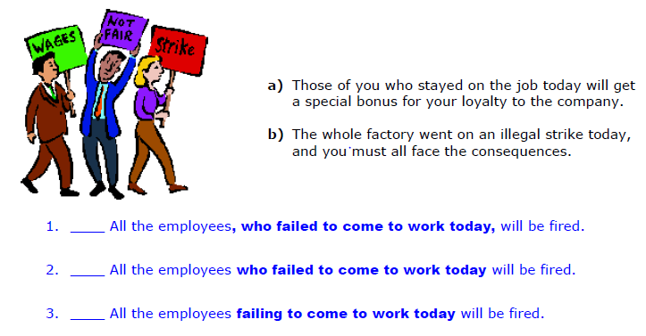
Exercise 6-1:

Slide 27
Exercise 5-5:
Those of you who stayed on the job today will get a special bonus for your loyalty to the company.
The whole factory went on an illegal strike today, and you must all face the consequences.
b.
____ All the employees, who failed to come to work today,
will be fired.
____ All the employees who failed to come to work today
will be fired.
____ All the employees failing to come to work today will
be fired.
(who failed to come to work today)
a.
a.

Slide 28

Exercise 5-5:
All of the servers crashed, so we will need to replace all of them.
Only a couple of servers actually went down, so we will not need to replace too many.
d.
____ The university servers which crashed on Saturday
evening will be replaced with newer models.
____ The university servers, which crashed on Saturday
evening, will be replaced with newer models.
____ The university servers that crashed on Saturday
evening will be replaced with newer models.
____ The university servers, that crashed on Saturday
evening, will be replaced with newer models.
____ The university servers crashing on Saturday evening
will be replaced with newer models
c.
(which crashed on Saturday
evening)
d.
d.

Slide 29

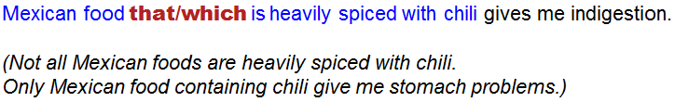

Slide 30
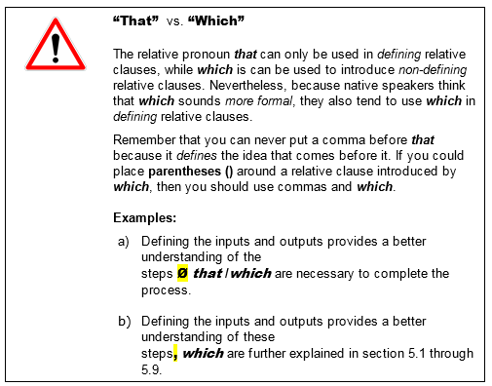

Slide 31
Exercise 5-6:
Engineers who design, develop, and test aircraft, spacecraft and missiles, as well as supervise the manufacture of these products are known as aerospace engineers.
Computer software engineers who are also referred to as software developers or software programmers are the individuals responsible for designing and programming large-scale computer systems and applications.
One important emerging area in Mechanical engineering is nanotechnology which integrates atoms and molecules to create high-performance materials and components.
Electronics is a branch of electrical engineering which deals with devices which use electricity for control of processes.
Gravitational forces are simply an attraction that occurs between any two physical objects.
Engineers who design, develop, and test aircraft, spacecraft and missiles, as well as supervise the manufacture of these products are known as aerospace engineers.
Computer software engineers, who are also referred to as software developers or software programmers, are the individuals responsible for designing and programming large-scale computer systems and applications.
One important emerging area in Mechanical engineering is nanotechnology which integrates atoms and molecules to create high-performance materials and components.
Electronics is a branch of electrical engineering which deals with devices which use electricity for control of processes.
Gravitational forces are simply an attraction that occurs between any two physical objects.
Engineers who design, develop, and test aircraft, spacecraft and missiles, as well as supervise the manufacture of these products are known as aerospace engineers.
Computer software engineers, who are also referred to as software developers or software programmers, are the individuals responsible for designing and programming large-scale computer systems and applications.
One important emerging area in Mechanical engineering is nanotechnology, which integrates atoms and molecules to create high-performance materials and components.
Electronics is a branch of electrical engineering which deals with devices that use electricity for control of processes.
Gravitational forces are simply an attraction that occurs between any two physical objects.
Engineers who design, develop, and test aircraft, spacecraft and missiles, as well as supervise the manufacture of these products are known as aerospace engineers.
Computer software engineers, who are also referred to as software developers or software programmers, are the individuals responsible for designing and programming large-scale computer systems and applications.
One important emerging area in Mechanical engineering is nanotechnology, which integrates atoms and molecules to create high-performance materials and components.
Electronics is a branch of electrical engineering which deals with devices that use electricity for control of processes.
Gravitational forces are simply an attraction that occurs between any two physical objects.
Engineers who design, develop, and test aircraft, spacecraft and missiles, as well as supervise the manufacture of these products are known as aerospace engineers.
Computer software engineers who are also referred to as software developers or software programmers are the individuals responsible for designing and programming large-scale computer systems and applications.
One important emerging area in Mechanical engineering is nanotechnology which integrates atoms and molecules to create high-performance materials and components.
Electronics is a branch of electrical engineering which deals with devices which use electricity for control of processes.
Gravitational forces are simply an attraction that occurs between any two physical objects.
Engineers who design, develop, and test aircraft, spacecraft and missiles, as well as supervise the manufacture of these products are known as aerospace engineers.
Computer software engineers, who are also referred to as software developers or software programmers, are the individuals responsible for designing and programming large-scale computer systems and applications.
One important emerging area in Mechanical engineering is nanotechnology, which integrates atoms and molecules to create high-performance materials and components.
Electronics is a branch of electrical engineering which deals with devices using electricity for control of processes.
Gravitational forces are simply an attraction that occurs between any two physical objects.
Engineers who design, develop, and test aircraft, spacecraft and missiles, as well as supervise the manufacture of these products are known as aerospace engineers.
Computer software engineers, who are also referred to as software developers or software programmers, are the individuals responsible for designing and programming large-scale computer systems and applications.
One important emerging area in Mechanical engineering is nanotechnology, which integrates atoms and molecules to create high-performance materials and components.
Electronics is a branch of electrical engineering which deals with devices using electricity for control of processes.
Gravitational forces are simply an attraction that occurs between any two physical objects.

Slide 32
Exercise 5-6:
Comet Shoemaker-Levy which struck the planet Jupiter in 1994 had a mass of roughly 4×10¹³ kg and was moving at a speed of 60 km/s.
Virtually every person who has driven an automobile or pushed a power lawnmower has used a reciprocating internal combustion (IC) engine. By far, the most widely used IC engine is the spark-ignition gasoline engine which takes us to school and work and on pleasure jaunts.
Wind power can provide an attractive product to customers who are seeking “green” power.
The hazards which have been associated with using hydrogen gas should not be minimized; however, to put this into perspective, we should remember that society has enthusiastically adopted an automobile that commonly carries ten to twenty gallons of gasoline, a very hazardous fuel.
An antielectron which is also known as a positron is subatomic particle which has the same mass and magnitude of charge as an electron but exhibits a positive charge.
Comet Shoemaker-Levy, which struck the planet Jupiter in 1994, had a mass of roughly 4×10¹³ kg and was moving at a speed of 60 km/s.
Virtually every person who has driven an automobile or pushed a power lawnmower has used a reciprocating internal combustion (IC) engine. By far, the most widely used IC engine is the spark-ignition gasoline engine which takes us to school and work and on pleasure jaunts.
Wind power can provide an attractive product to customers who are seeking “green” power.
The hazards which have been associated with using hydrogen gas should not be minimized; however, to put this into perspective, we should remember that society has enthusiastically adopted an automobile that commonly carries ten to twenty gallons of gasoline, a very hazardous fuel.
An antielectron which is also known as a positron is subatomic particle which has the same mass and magnitude of charge as an electron but exhibits a positive charge.
Comet Shoemaker-Levy, which struck the planet Jupiter in 1994, had a mass of roughly 4×10¹³ kg and was moving at a speed of 60 km/s.
Virtually every person who has driven an automobile or pushed a power lawnmower has used a reciprocating internal combustion (IC) engine. By far, the most widely used IC engine is the spark-ignition gasoline engine, which takes us to school and work and on pleasure jaunts.
Wind power can provide an attractive product to customers who are seeking “green” power.
The hazards which have been associated with using hydrogen gas should not be minimized; however, to put this into perspective, we should remember that society has enthusiastically adopted an automobile that commonly carries ten to twenty gallons of gasoline, a very hazardous fuel.
An antielectron, which is also known as a positron, is a subatomic particle which has the same mass and magnitude of charge as an electron but exhibits a positive charge.
Comet Shoemaker-Levy, which struck the planet Jupiter in 1994, had a mass of roughly 4×10¹³ kg and was moving at a speed of 60 km/s.
Virtually every person who has driven an automobile or pushed a power lawnmower has used a reciprocating internal combustion (IC) engine. By far, the most widely used IC engine is the spark-ignition gasoline engine, which takes us to school and work and on pleasure jaunts.
Wind power can provide an attractive product to customers who are seeking “green” power.
The hazards which have been associated with using hydrogen gas should not be minimized; however, to put this into perspective, we should remember that society has enthusiastically adopted an automobile that commonly carries ten to twenty gallons of gasoline, a very hazardous fuel.
An antielectron which is also known as a positron is subatomic particle which has the same mass and magnitude of charge as an electron but exhibits a positive charge.
Comet Shoemaker-Levy, which struck the planet Jupiter in 1994, had a mass of roughly 4×10¹³ kg and was moving at a speed of 60 km/s.
Virtually every person who has driven an automobile or pushed a power lawnmower has used a reciprocating internal combustion (IC) engine. By far, the most widely used IC engine is the spark-ignition gasoline engine, which takes us to school and work and on pleasure jaunts.
Wind power can provide an attractive product to customers who are seeking “green” power.
The hazards which have been associated with using hydrogen gas should not be minimized; however, to put this into perspective, we should remember that society has enthusiastically adopted an automobile that commonly carries ten to twenty gallons of gasoline, a very hazardous fuel.
An antielectron which is also known as a positron is subatomic particle which has the same mass and magnitude of charge as an electron but exhibits a positive charge.
Comet Shoemaker-Levy, which struck the planet Jupiter in 1994, had a mass of roughly 4×10¹³ kg and was moving at a speed of 60 km/s.
Virtually every person who has driven an automobile or pushed a power lawnmower has used a reciprocating internal combustion (IC) engine. By far, the most widely used IC engine is the spark-ignition gasoline engine, which takes us to school and work and on pleasure jaunts.
Wind power can provide an attractive product to customers who are seeking “green” power.
The hazards which have been associated with using hydrogen gas should not be minimized; however, to put this into perspective, we should remember that society has enthusiastically adopted an automobile that commonly carries ten to twenty gallons of gasoline, a very hazardous fuel.
An antielectron which is also known as a positron is subatomic particle which has the same mass and magnitude of charge as an electron but exhibits a positive charge.
Comet Shoemaker-Levy, which struck the planet Jupiter in 1994, had a mass of roughly 4×10¹³ kg and was moving at a speed of 60 km/s.
Virtually every person who has driven an automobile or pushed a power lawnmower has used a reciprocating internal combustion (IC) engine. By far, the most widely used IC engine is the spark-ignition gasoline engine which takes us to school and work and on pleasure jaunts.
Wind power can provide an attractive product to customers who are seeking “green” power.
The hazards which have been associated with using hydrogen gas should not be minimized; however, to put this into perspective, we should remember that society has enthusiastically adopted an automobile that commonly carries ten to twenty gallons of gasoline, a very hazardous fuel.
An antielectron which is also known as a positron is subatomic particle which has the same mass and magnitude of charge as an electron but exhibits a positive charge.
Comet Shoemaker-Levy, which struck the planet Jupiter in 1994, had a mass of roughly 4×10¹³ kg and was moving at a speed of 60 km/s.
Virtually every person who has driven an automobile or pushed a power lawnmower has used a reciprocating internal combustion (IC) engine. By far, the most widely used IC engine is the spark-ignition gasoline engine, which takes us to school and work and on pleasure jaunts.
Wind power can provide an attractive product to customers who are seeking “green” power.
The hazards which have been associated with using hydrogen gas should not be minimized; however, to put this into perspective, we should remember that society has enthusiastically adopted an automobile that commonly carries ten to twenty gallons of gasoline, a very hazardous fuel.
An antielectron which is also known as a positron is subatomic particle which has the same mass and magnitude of charge as an electron but exhibits a positive charge.

Slide 33
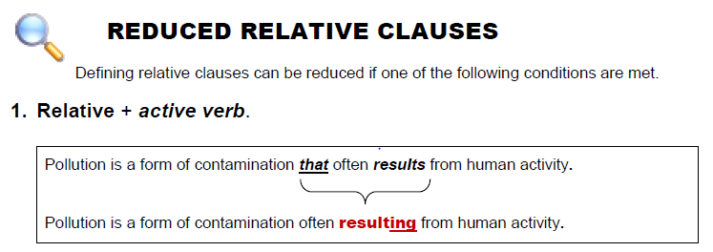
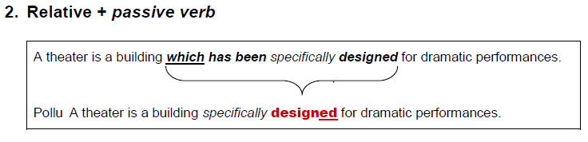
Language Centre

Slide 34
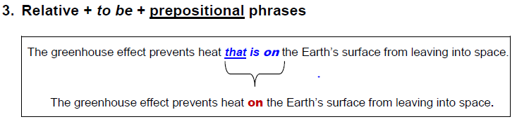
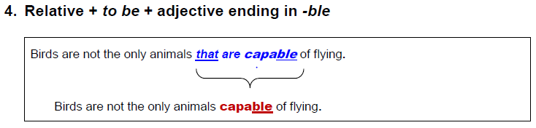
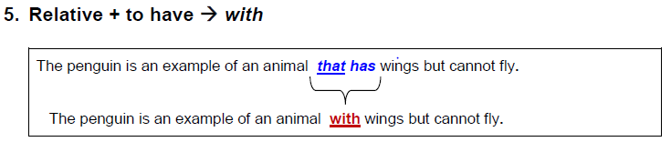

Slide 35


Slide 36
Exercise 5-7:
Power plants using natural bodies of water for cooling must be designed to prevent the intake of organisms into the cooling system.
Sigma is the Greek letter used in mathematics to denote standard deviation, or the amount a process varies from the mean.
The amount of available uranium depends on the price users are willing to pay for its recovery.
The amount of uranium available to support the world's nuclear power programs depends on the price users are prepared to pay for its recovery.
The energy required to break the bonds between atoms in molecules is called the dissociation energy.
A turboprop engine with a gearbox efficiency of 0.95 will transmit only 95% of its power output to its propeller.

Slide 37
Exercise 5-7:
Power plants using natural bodies of water for cooling must be designed to prevent the intake of organisms into the cooling system.
Sigma is the Greek letter used in mathematics to denote standard deviation, or the amount a process varies from the mean.
The amount of available uranium depends on the price users are willing to pay for its recovery.
The amount of uranium available to support the world's nuclear power programs depends on the price users are prepared to pay for its recovery
The energy required to break the bonds between atoms in molecules is called the dissociation energy.
A turboprop engine with a gearbox efficiency of 0.95 will transmit only 95% of its power output to its propeller.
Reduced form of active form
”that use”

Slide 38
Exercise 5-7:
Power plants using natural bodies of water for cooling must be designed to prevent the intake of organisms into the cooling system.
Sigma is the Greek letter used in mathematics to denote standard deviation, or the amount (that) a process varies from the mean.
The amount of available uranium depends on the price users are willing to pay for its recovery.
The amount of uranium available to support the world's nuclear power programs depends on the price users are prepared to pay for its recovery
The energy required to break the bonds between atoms in molecules is called the dissociation energy.
A turboprop engine with a gearbox efficiency of 0.95 will transmit only 95% of its power output to its propeller.
Power plants using natural bodies of water for cooling must be designed to prevent the intake of organisms into the cooling system.
Sigma is the Greek letter used in mathematics to denote standard deviation, or the amount a process varies from the mean.
The amount of available uranium depends on the price users are willing to pay for its recovery.
The amount of uranium available to support the world's nuclear power programs depends on the price users are prepared to pay for its recovery
The energy required to break the bonds between atoms in molecules is called the dissociation energy.
A turboprop engine with a gearbox efficiency of 0.95 will transmit only 95% of its power output to its propeller.
Informal/ spoken deletion of ”that”
Reduced form of passive form
”that is used”

Slide 39
Exercise 5-7:
Power plants using natural bodies of water for cooling must be designed to prevent the intake of organisms into the cooling system.
Sigma is the Greek letter used in mathematics to denote standard deviation, or the amount a process varies from the mean.
The amount of available uranium depends on the price users are willing to pay for its recovery.
The amount of uranium available to support the world's nuclear power programs depends on the price users are prepared to pay for its recovery
The energy required to break the bonds between atoms in molecules is called the dissociation energy.
A turboprop engine with a gearbox efficiency of 0.95 will transmit only 95% of its power output to its propeller.
Reduced form of
”that is available”

Slide 40
Exercise 5-7:
Power plants using natural bodies of water for cooling must be designed to prevent the intake of organisms into the cooling system.
Sigma is the Greek letter used in mathematics to denote standard deviation, or the amount a process varies from the mean.
The amount of available uranium depends on the price users are willing to pay for its recovery.
The amount of uranium available to support the world's nuclear power programs depends on the price users are prepared to pay for its recovery.
The energy required to break the bonds between atoms in molecules is called the dissociation energy.
A turboprop engine with a gearbox efficiency of 0.95 will transmit only 95% of its power output to its propeller.
Reduced form of
”that is available to support…”

Slide 41
Exercise 5-7:
Power plants using natural bodies of water for cooling must be designed to prevent the intake of organisms into the cooling system.
Sigma is the Greek letter used in mathematics to denote standard deviation, or the amount a process varies from the mean.
The amount of available uranium depends on the price users are willing to pay for its recovery.
The amount of uranium available to support the world's nuclear power programs depends on the price (that) users are prepared to pay for its recovery.
The energy required to break the bonds between atoms in molecules is called the dissociation energy.
A turboprop engine with a gearbox efficiency of 0.95 will transmit only 95% of its power output to its propeller.
Informal/ spoken deletion of ”that”

Slide 42
Exercise 5-7:
Power plants using natural bodies of water for cooling must be designed to prevent the intake of organisms into the cooling system.
Sigma is the Greek letter used in mathematics to denote standard deviation, or the amount a process varies from the mean.
The amount of available uranium depends on the price users are willing to pay for its recovery.
The amount of uranium available to support the world's nuclear power programs depends on the price users are prepared to pay for its recovery.
The energy required to break the bonds between atoms in molecules is called the dissociation energy.
A turboprop engine with a gearbox efficiency of 0.95 will transmit only 95% of its power output to its propeller.
Reduced form of passive form
”that is required”
Reduced form of
”that are in”

Slide 43
Exercise 5-7:
Power plants using natural bodies of water for cooling must be designed to prevent the intake of organisms into the cooling system.
Sigma is the Greek letter used in mathematics to denote standard deviation, or the amount a process varies from the mean.
The amount of available uranium depends on the price users are willing to pay for its recovery.
The amount of uranium available to support the world's nuclear power programs depends on the price users are prepared to pay for its recovery.
The energy required to break the bonds between atoms in molecules is called the dissociation energy.
A turboprop engine with a gearbox efficiency of 0.95 will transmit only 95% of its power output to its propeller.
Reduced form of
”which has”

Slide 44
Exercise 5-8:
Today, the IC engine that is most widely used is the spark-ignition gasoline engine.
The Otto cycle is the theoretical cycle that is commonly used to represent the processes which are in the spark ignition (SI) internal combustion engine.
While the performance of the two machines is found to be essentially the same, the single-shaft machine is sometimes preferred in applications that have fixed operating conditions where good part-load performance that happens over a range of speeds is not important.

Slide 45
Exercise 5-8:
Today, the IC engine that is most widely used is the spark-ignition gasoline engine.
Today, the most widely used IC engine is the spark-ignition gasoline engine. (pre-modification)
Today, the IC engine most widely used is the spark-ignition gasoline engine. (post-modification)
The Otto cycle is the theoretical cycle commonly used to represent the processes which are in the spark ignition (SI) internal combustion engine.
The Otto cycle is the theoretical cycle that is commonly used to represent the processes which are in the spark ignition (SI) internal combustion engine.
The Otto cycle is the theoretical cycle that is commonly used to represent the processes which are in the spark ignition (SI) internal combustion engine.
The Otto cycle is the theoretical cycle commonly used to represent the processes Ø in the spark ignition (SI) internal combustion engine.
The Otto cycle is the theoretical cycle commonly used to represent the processes which are in the spark ignition (SI) internal combustion engine.
While the performance of the two machines is found to be essentially the same, the single-shaft machine is sometimes preferred in applications with fixed operating conditions where good part-load performance that happens over a range of speeds is not important.
While the performance of the two machines is found to be essentially the same, the single-shaft machine is sometimes preferred in applications with fixed operating conditions where good part-load performance that happens over a range of speeds is not important.
While the performance of the two machines is found to be essentially the same, the single-shaft machine is sometimes preferred in applications that have fixed operating conditions where good part-load performance that happens over a range of speeds is not important.
While the performance of the two machines is found to be essentially the same, the single-shaft machine is sometimes preferred in applications that have fixed operating conditions where good part-load performance that happens over a range of speeds is not important.
While the performance of the two machines is found to be essentially the same, the single-shaft machine is sometimes preferred in applications with fixed operating conditions where good part-load performance happening over a range of speeds is not important.

Slide 46
Exercise 5-8:
(pre-modification)
(post-modification)
We are living in a world that is rapidly changing and that requires continuous adaptation of old technologies and the development of new ones.
We are living in a world that is rapidly changing and that requires continuous adaptation of old technologies and the development of new ones.
We are living in a rapidly changing world that requires continuous adaptation of old technologies and the development of new ones.
We are living in a world rapidly changing and requiring continuous adaptation of old technologies and the development of new ones.
All human activities involve conversion of energy from one form to another. The human body, through complex processes, transforms the chemical energy stored in food into external motion and work that will be produced by muscles as well as electrical impulses that control and activate internal functions.
All human activities involve conversion of energy from one form to another. The human body, through complex processes, transforms the chemical energy which has been stored in food into external motion and work that will be produced by muscles as well as electrical impulses that control and activate internal functions.
All human activities involve conversion of energy from one form to another. The human body, through complex processes, transforms the chemical energy which has been stored in food into external motion and work that will be produced by muscles as well as electrical impulses that control and activate internal functions.
All human activities involve conversion of energy from one form to another. The human body, through complex processes, transforms the chemical energy stored in food into external motion and work produced by muscles as well as electrical impulses that control and activate internal functions.
All human activities involve conversion of energy from one form to another. The human body, through complex processes, transforms the chemical energy stored in food into external motion and work that will be produced by muscles as well as electrical impulses that control and activate internal functions.
All human activities involve conversion of energy from one form to another. The human body, through complex processes, transforms the chemical energy stored in food into external motion and work produced by muscles as well as electrical impulses controlling and activating internal functions.
It is well known that the two planets Ø closest to the sun have average temperatures higher than those of the Earth and that the outer planets are colder because of the inverse square law of radiative transfer of the sun's radiation field.
It is well known that the two planets that are closest to the sun have average temperatures higher than those of the Earth and that the outer planets are colder because of the inverse square law of radiative transfer of the sun's radiation field.
It is well known that the two planets that are closest to the sun have average temperatures higher than those of the Earth and that the outer planets are colder because of the inverse square law of radiative transfer of the sun's radiation field.

Slide 47
Exercise 5-10: Advanced use of relatives
The list will be pre-populated with the address the client provided.
The list will be pre-populated with the address (that) the client provided.
… with the address which was provided by the client.
The list will be pre-populated with the address provided by the client.

Slide 48
Exercise 5-10:
The list will be pre-populated with the address (that) the client provided.
I found the report. Jukka wrote it.
A number of suggestions were made at the meeting. Most of them were not very practical.
He acted in a famous movie. I don't remember the name of it now.
Choose the e-mail address that the welcome message will be sent to.
The list will be pre-populated with the address provided by the client.
I found the report written by Jukka.
A number of suggestions were made at the meeting, most of which
were not very practical.
He acted in a famous movie, the name of which I don't remember now.
Choose the e-mail address to which the welcome message will be sent.

Slide 49
Exercise 5-11:
Vehicles that fuel cells power combine the attractive advantages of battery-powered cars and the convenience of an internal combustion engine.
Vehicles powered by fuel cells combine the attractive advantages of battery-powered cars and the convenience of an internal combustion engine.
The options and advantages computers provide are endless.
The options and advantages provided by computers are endless..
In order to function well, the virtual communities which the Internet supports depend upon rules of conduct, the same as any society.
In order to function well, the virtual communities supported by the Internet depend upon rules of conduct, the same as any society.

Slide 50
Exercise 5-11:
The 75-kW power unit converts fuel into electric power with an efficiency of approximately 40%. Nearly 2,837 kcal of fuel energy is consumed for each kilowatt-hour the system delivers.
The 75-kW power unit converts fuel into electric power with an efficiency of approximately 40%. Nearly 2,837 kcal of fuel energy is consumed for each kilowatt-hour delivered by the system.
There is an important difference between the CO₂ which nature produces and that which human activities emit.
There is an important difference between the CO₂ produced by nature and that emitted by human activities.
This program builds a log of the queries a user has given, the results Google has returned, the result the user has clicked on, and the summaries, titles and ranks of the results Google has presented.
This program builds a log of the queries given by a user, the results returned by Google, the result clicked by the user, and the summaries, titles and ranks of the results presented by Google.

Slide 51
Options for modifying a noun
Noun phrase
Premodifiers | Head | Postmodification
Portable (adj.) | devices | that detect bombs.
Prototype (noun) | evaluation | by end users.
Testing (pres. part) | equipment | for wireless networks.
Encryption (noun) | algorithms | providing higher security. (pres. part)
Downloaded (past part) | files | from the Internet.
Video (noun) | files | downloaded to the hard disk. (past part.)
Noun phrase
Premodifiers | Head | Postmodification
Portable (adj.) | devices | that detect bombs.
Noun phrase
Premodifiers | Head | Postmodification
Portable (adj.) | devices | that detect bombs.
Prototype (noun) | evaluation | by end users.
Noun phrase
Premodifiers | Head | Postmodification
Portable (adj.) | devices | that detect bombs.
Prototype (noun) | evaluation | by end users.
Testing (pres. part) | equipment | for wireless networks.
Noun phrase
Premodifiers | Head | Postmodification
Portable (adj.) | devices | that detect bombs.
Prototype (noun) | evaluation | by end users.
Testing (pres. part) | equipment | for wireless networks.
Encryption (noun) | algorithms | providing (pres. part) higher security.
Noun phrase
Premodifiers | Head | Postmodification
Portable (adj.) | devices | that detect bombs.
Prototype (noun) | evaluation | by end users.
Testing (pres. part) | equipment | for wireless networks.
Encryption (noun) | algorithms | providing (pres. part) higher security.
Downloaded (past part) | files | from the Internet.

Slide 52
Options for modifying a noun
Noun phrase
Premodifiers | Head | Postmodification
Portable (adj.) | devices | that detect bombs.
Prototype (noun) | evaluation | by end users.
Testing (pres. part) | equipment | for wireless networks.
Encryption (noun) | algorithms | providing (pres. part) higher security.
Downloaded (past part) | files | from the Internet.
Video (noun) | files | downloaded (past part.) to the hard disk.
Personal (adj.) | data | entered by the user.

Slide 53
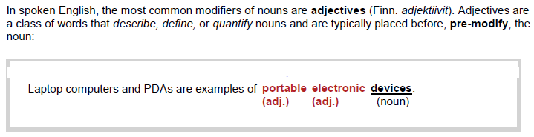
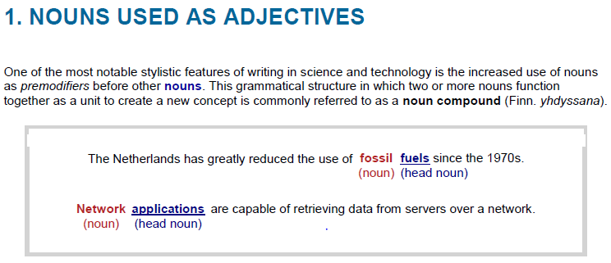

Slide 54
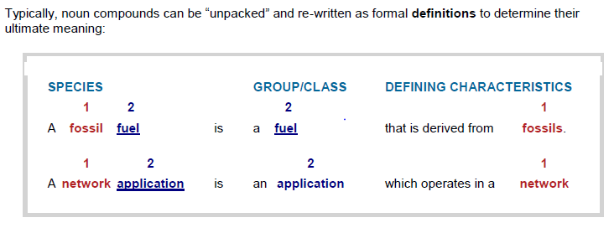

Slide 55
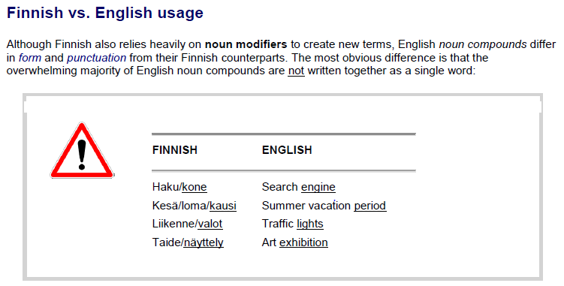

Slide 56
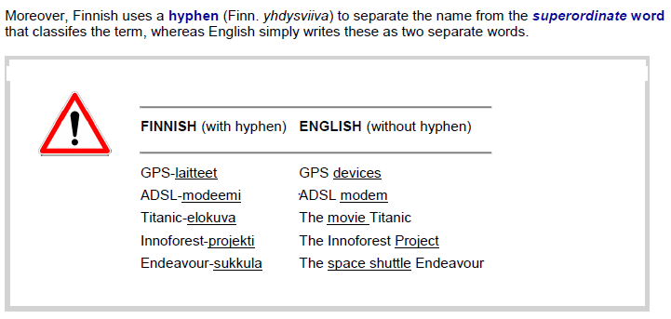

Slide 57
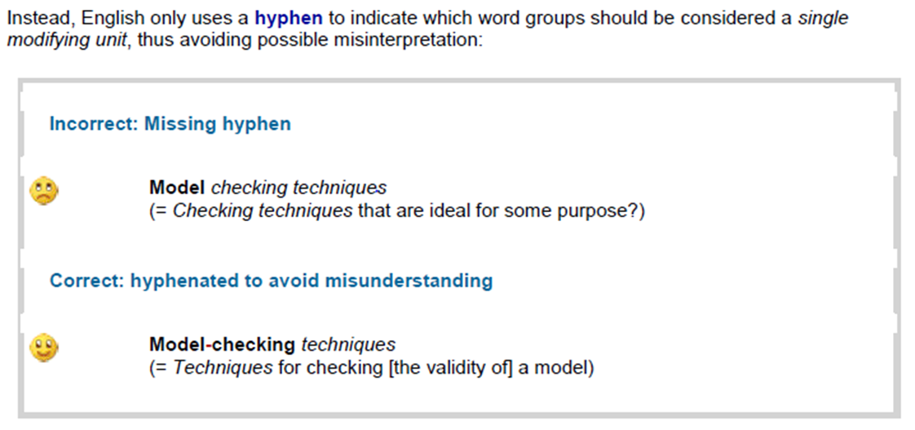

Slide 58
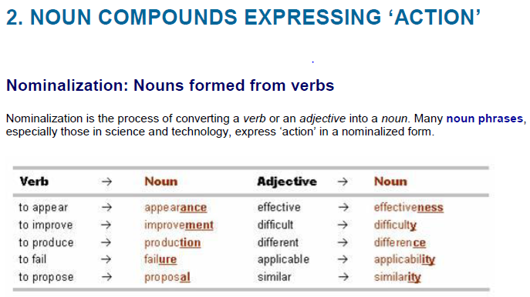

Slide 59
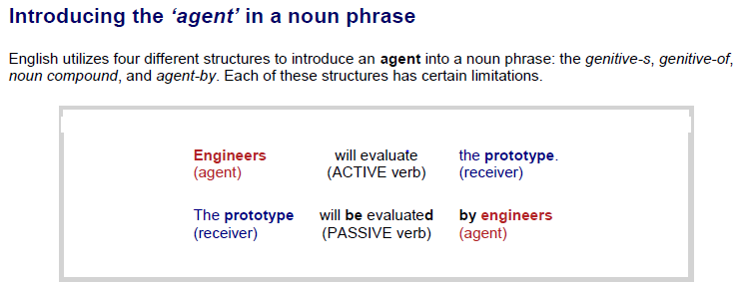

Slide 60
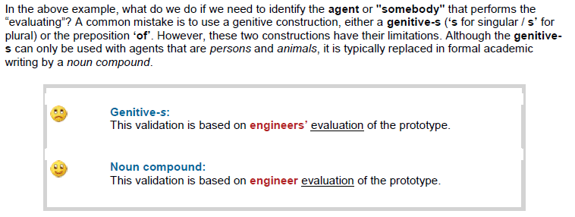
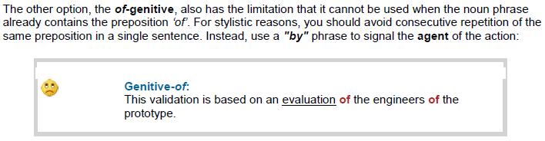


Slide 61
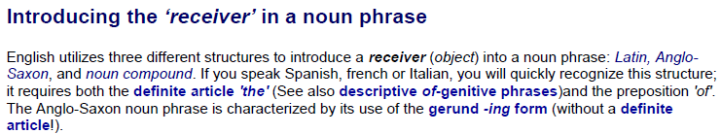
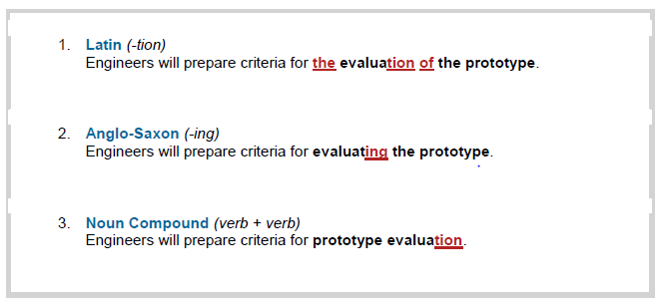

Slide 62
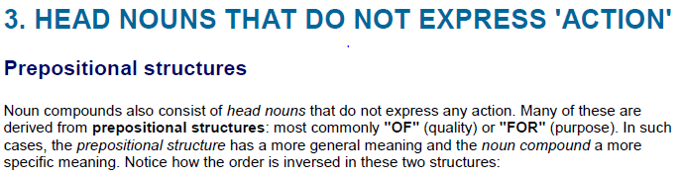
NOUN COMPOUND PREPOSITIONAL STRUCTURE
  1 2 3 3 2 1
A motion detection algorithm = An algorithm for the detection of motion
An algorithm for detecting motion
  1 2 3 3 2 1
Consumer product safety = The safety of products for consumers
1 2 3 3 2 1
Graphics software packages = Packages of software for graphics

Slide 63
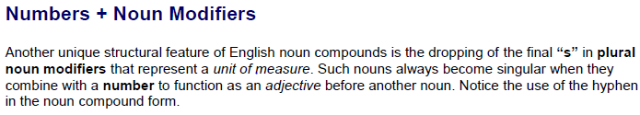
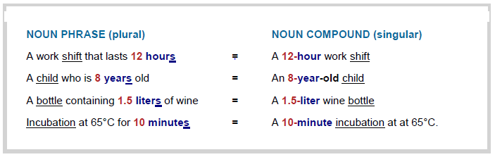

Slide 64



Slide 65


Hyphenation of compound premodifiers
HYPHENATED [-]
NOT HYPHENATED [Ø]
A man-eating shark
A man eating shark
(a carnivorous fish)
(A man who eats shark, i.e.,
a carnivorous male human)

Slide 66
Hyphenation of compound premodifiers
1. [ NOUN + NOUN ]
Pre-modifier
+
HEAD NOUN
A video-game industry
An industry that produces video games
A silver-gold alloy
An alloy that consist of silver and gold

Slide 67
Hyphenation of compound premodifiers
2. [ ADJECTIVE + NOUN ]
Pre-modifier
+
HEAD NOUN
A high-performance internet server
(An internet server that performs at a high speed)
Low-power electronics
(Electronics that have a low consumption of electrical power)

Slide 68
Hyphenation of compound premodifiers
3. [ NOUN + PAST PARTICIPLE ]
Pre-modifier
+
HEAD NOUN
computer-related terms
(Terms that are related to computers)
A helium-filled balloon
(A balloon that is filled with helium)

Slide 69
Hyphenation of compound premodifiers
+
4. [ NOUN + PRESENT PARTICIPLE ]
Pre-modifier
HEAD NOUN
A light-emitting diode
(A diode that emits light)
A water-cooling system
(A system that is used for cooling water)

Slide 70
Hyphenating compound adjectives
5. [ ADVERB + PAST PARTICIPLE ]
Premodifier
+
HEAD NOUN
A well-established transportation system
(A transportation system that is well established)

Slide 71
Hyphenation of compound premodifiers
6. [ NUMBER + UNIT ]
Pre-modifier
+
HEAD NOUN
A 2-inch gap
An 8-millisecond delay
(A gap that is two inches wide)
(A delay lasting 8 milliseconds)
A 500-gigabyte hard drive
(A hard drive with the capacity of 500 gigabytes)
Three-dimensional objects
(Objects that have three dimensions)

Slide 72
Exercise 5-12
1. A picture of two different 9 volt batteries is shown in figure 1.2.
1. A picture of two different 9-volt batteries is shown in figure 1.2.
2. A simplified drawing of a practical, high precision experiment is shown in figure 1.1.
2. A simplified drawing of a practical, high-precision experiment is shown in figure 1.1.
3. If you perform a gas releasing reaction in a sealed chamber with no room for expansion, you get an explosion.
3. If you perform a gas-releasing reaction in a sealed chamber with no room for expansion, you get an explosion.
4. Certain types of calculations can be approached with the divide and conquer technique.
4. Certain types of calculations can be approached with the divide-and-conquer technique.
5. The solution was found by measuring the mass to charge ratios of highly ionized atoms.
5. The solution was found by measuring the mass-to-charge ratios of highly ionized atoms.
6. A working 30 meter diameter solar sail, Cosmos 1, was built by an American company. Earlier solar sails exceeding 30 m in diameter were launched into orbit but failed to open.
6. A working 30-meter-diameter solar sail, Cosmos 1, was built by an American company. Earlier solar sails exceeding 30 m in diameter were launched into orbit but failed to open.

Slide 73
Exercise 5-13
data which have not been published
unpublished data
2. a phenomenon that has been well documented
a well-documented phenomenon
3. techniques that are used in solving problems
problem-solving techniques
4. metals that have been treated with heat
heat-treated metals
5. an earthquake that has a magnitude of 7.6
a 7.6-magnitude earthquake

Slide 74
Exercise 5-14
air-saturated water
water that has been saturated with air
2. a data-storage device
a device that is used for storing data
3. an easy-to-use application
an application that is easy to use
4. current-conducting materials
materials that conduct electrical current
5. a data-management system
a system that is used to manage data

Slide 75
Sessions 5&6
Definitions
Relative clauses
Topic sentences
Paragraph structure
Communicating Technology

Slide 76
How do I know when to start a new paragraph?
Start a new paragraph…
when you begin a new idea, point, or claim.
to contrast information or ideas.
when you are ending your introduction or
starting your conclusion
when your readers need a pause

Slide 77
What is a paragraph?
A sentence or a group of sentences dealing with one single topic.
A paragraph focuses only on one main idea/topic
Each paragraph should have its own topic sentence
New idea / point / claim = new paragraph + topic sentence

Slide 78
Task 6-1:
This paragraph is far too long. How many paragraphs would you divide this text into? Where are the natural places to make the breaks?
¹Wind energy technology has become a mature renewable electricity generating technology. ²Today, more than 74,000 MW of wind capacity was/were installed worldwide by the end of 2007. ³A substantial portion of this capacity has been in commercial operation for more than a decade. ⁴During this time, manufacturers have gained considerable experience in wind turbine maintenance and are now designing a new generation of wind turbines with a clear focus on maintenance. ⁵Low maintenance costs help make wind energy economically competitive with other energy sources. ⁶Wind turbine maintenance costs are typically less than maintenance costs for conventional forms of electricity generation. ⁷Scheduled wind turbine maintenance is usually completed twice a year, resulting in about 12 to 18 hours of downtime for each maintenance event. ⁸Generally, only a few turbines in a facility are down at any one time for maintenance activities. ⁹The only time the entire facility is brought off-line is for substation maintenance, which usually lasts for only about 12 hours and occurs twice a year during low production periods.
¹Wind energy technology has become a mature renewable electricity generating technology. ²By the end of 2007, more than 74,000 MW of wind capacity was installed worldwide. ³A substantial portion of this capacity has been in commercial operation for more than a decade. ⁴During this time, manufacturers have gained considerable experience in wind turbine maintenance and are now designing a new generation of wind turbines with a clear focus on maintenance. ⁵Low maintenance costs help make wind energy economically competitive with other energy sources. ⁶Wind turbine maintenance costs are typically less than maintenance costs for conventional forms of electricity generation. ⁷Scheduled wind turbine maintenance is usually completed twice a year, resulting in about 12 to 18 hours of downtime for each maintenance event. ⁸Generally, only a few turbines in a facility are down at any one time for maintenance activities. ⁹The only time the entire facility is brought off-line is for substation maintenance, which usually lasts for only about 12 hours and occurs twice a year during low production periods.

Slide 79
Task 6-1:
⁹The only time the entire facility is brought off-line is for substation maintenance, which usually lasts for only about 12 hours and occurs twice a year during low production periods. ¹⁰Generator and gearbox rebuilds are wind facilities’ two most costly maintenance items. ¹¹Not only are the replacement components expensive but major expense is also associated with obtaining and mobilizing the large crane needed to repair these components. ¹²Moreover, the actual crane costs and in/out costs, a long lead time to get the crane to the site and set up is common, resulting in longer than planned down time and additional lost revenue. ¹³To improve generator performance, manufacturers are improving wind turbines’ electrical architecture. ¹⁴Larger turbines (greater than 1 MW) have typically used variable speed constant frequency (VSCF) technology to produce 60 Hz output from the wind turbine’s variable input speed. ¹⁵This technology was developed in the 1990s and is limited by the solid state switches used at that time. ¹⁶However, one unintended consequence of this technology is the production of a stray current in the generator rotor. ¹⁷This stray current follows the path to ground and, in doing so, arcs across the generator bearings, causing the generator to fail.
⁹The only time the entire facility is brought off-line is for substation maintenance, which usually lasts for only about 12 hours and occurs twice a year during low production periods. ¹⁰Generator and gearbox rebuilds are wind facilities’ two most costly maintenance items. ¹¹Not only are the replacement components expensive but major expense is also associated with obtaining and mobilizing the large crane needed to repair these components. ¹²Moreover, the actual crane costs and in/out costs, a long lead time to get the crane to the site and set up is common, resulting in longer than planned down time and additional lost revenue. ¹³To improve generator performance, manufacturers are improving wind turbines’ electrical architecture. ¹⁴Larger turbines (greater than 1 MW) have typically used variable speed constant frequency (VSCF) technology to produce 60 Hz output from the wind turbine’s variable input speed. ¹⁵This technology was developed in the 1990s and is limited by the solid state switches used at that time. ¹⁶However, one unintended consequence of this technology is the production of a stray current in the generator rotor. ¹⁷This stray current follows the path to ground and, in doing so, arcs across the generator bearings, causing the generator to fail.
⁹The only time the entire facility is brought off-line is for substation maintenance, which usually lasts for only about 12 hours and occurs twice a year during low production periods. ¹⁰Generator and gearbox rebuilds are wind facilities’ two most costly maintenance items. ¹¹Not only are the replacement components expensive but major expense is also associated with obtaining and mobilizing the large crane needed to repair these components. ¹²Moreover, the actual crane costs and in/out costs, a long lead time to get the crane to the site and set up is common, resulting in longer than planned down time and additional lost revenue. ¹³To improve generator performance, manufacturers are improving wind turbines’ electrical architecture. ¹⁴Larger turbines (greater than 1 MW) have typically used variable speed constant frequency (VSCF) technology to produce 60 Hz output from the wind turbine’s variable input speed. ¹⁵This technology was developed in the 1990s and is limited by the solid state switches used at that time. ¹⁶However, one unintended consequence of this technology is the production of a stray current in the generator rotor. ¹⁷This stray current follows the path to ground and, in doing so, arcs across the generator bearings, causing the generator to fail.

Slide 80
Task 6-1:
¹⁸To address this problem, turbine manufacturers are currently working to develop less complex VSCF systems. ¹⁹Some manufacturers of new turbines are using permanent magnet generators that eliminate current in the rotor, thus eliminating arcing damage. ²⁰These new simpler controller/converter designs use today’s solid state technology, which is much improved over the solid state technology of the 1990s. ²¹In addition, these controllers/converters contain fewer parts to maintain and/or fail, making the design simpler and more reliable. ²²As wind turbines have increased in size, gearbox reliability has suffered more than any other maintenance area. ²³Wind turbines are one of the most demanding applications for gearboxes due to variable loads that are extremely difficult to predict. ²⁴The larger blades common on larger machines result in massive torque through the three-stage gearbox typically used in these large turbines. ²⁵In an attempt to meet the increased torque requirement, manufacturers have developed huge, costly ring gears and bearings. ²⁶When these components fail (often due to torque-related stress), replacement components are expensive, as well as difficult and time consuming to replace. ²⁷Because these components are heavy, replacement almost always requires a crane, resulting in not only lead time delay but lost production revenue as well.
¹⁸To address this problem, turbine manufacturers are currently working to develop less complex VSCF systems. ¹⁹Some manufacturers of new turbines are using permanent magnet generators that eliminate current in the rotor, thus eliminating arcing damage. ²⁰These new simpler controller/converter designs use today’s solid state technology, which is much improved over the solid state technology of the 1990s. ²¹In addition, these controllers/converters contain fewer parts to maintain and/or fail, making the design simpler and more reliable. ²²As wind turbines have increased in size, gearbox reliability has suffered more than any other maintenance area. ²³Wind turbines are one of the most demanding applications for gearboxes due to variable loads that are extremely difficult to predict. ²⁴The larger blades common on larger machines result in massive torque through the three-stage gearbox typically used in these large turbines. ²⁵In an attempt to meet the increased torque requirement, manufacturers have developed huge, costly ring gears and bearings. ²⁶When these components fail (often due to torque-related stress), replacement components are expensive, as well as difficult and time consuming to replace. ²⁷Because these components are heavy, replacement almost always requires a crane, resulting in not only lead time delay but lost production revenue as well.
¹⁸To address this problem, turbine manufacturers are currently working to develop less complex VSCF systems. ¹⁹Some manufacturers of new turbines are using permanent magnet generators that eliminate current in the rotor, thus eliminating arcing damage. ²⁰These new simpler controller/converter designs use today’s solid state technology, which is much improved over the solid state technology of the 1990s. ²¹In addition, these controllers/converters contain fewer parts to maintain and/or fail, making the design simpler and more reliable. ²²As wind turbines have increased in size, gearbox reliability has suffered more than any other maintenance area. ²³Wind turbines are one of the most demanding applications for gearboxes due to variable loads that are extremely difficult to predict. ²⁴The larger blades common on larger machines result in massive torque through the three-stage gearbox typically used in these large turbines. ²⁵In an attempt to meet the increased torque requirement, manufacturers have developed huge, costly ring gears and bearings. ²⁶When these components fail (often due to torque-related stress), replacement components are expensive, as well as difficult and time consuming to replace. ²⁷Because these components are heavy, replacement almost always requires a crane, resulting in not only lead time delay but lost production revenue as well.

Slide 81
Task 6-1:
²⁵In an attempt to meet the increased torque requirement, manufacturers have developed huge, costly ring gears and bearings. ²⁶When these components fail (often due to torque-related stress), replacement components are expensive, as well as difficult and time consuming to replace. ²⁷Because these components are heavy, replacement almost always requires a crane, resulting in not only lead time delay but lost production revenue as well. ²⁸To mitigate the problems associated with large turbine gearboxes, manufacturers are working on various gearbox improvements. ²⁹A distributed load path gearbox has recently been introduced that uses multiple generators and a multiple path, distributed gearbox to split the load. ³⁰This split load path reduces strain on gears and simplifies the design. ³¹Because the design uses multiple smaller generators, it potentially allows generator replacement without the lead time delay and cost of the external crane.
²⁵In an attempt to meet the increased torque requirement, manufacturers have developed huge, costly ring gears and bearings. ²⁶When these components fail (often due to torque-related stress), replacement components are expensive, as well as difficult and time consuming to replace. ²⁷Because these components are heavy, replacement almost always requires a crane, resulting in not only lead time delay but lost production revenue as well. ²⁸To mitigate the problems associated with large turbine gearboxes, manufacturers are working on various gearbox improvements. ²⁹A distributed load path gearbox has recently been introduced that uses multiple generators and a multiple path, distributed gearbox to split the load. ³⁰This split load path reduces strain on gears and simplifies the design. ³¹Because the design uses multiple smaller generators, it potentially allows generator replacement without the lead time delay and cost of the external crane.

Slide 82
Task 6-1:
What is so special about sentences 5, 10, 13, 18, 22, 25, 28 ?
⁵Low maintenance costs help make wind energy economically competitive with other energy sources.
¹⁰Generator and gearbox rebuilds are wind facilities’ two most costly maintenance items.
¹³To improve generator performance, manufacturers are improving wind turbines’ electrical architecture.
¹⁸To address this problem, turbine manufacturers are currently working to develop less complex VSCF systems.
²²As wind turbines have increased in size, gearbox reliability has suffered more than any other maintenance area.
²⁵In an attempt to meet the increased torque requirement, manufacturers have developed huge, costly ring gears and bearings.
²⁸To mitigate the problems associated with large turbine gearboxes, manufacturers are working on various gearbox improvements.
Topic sentences
(pp. 39-42)

Slide 83
TOPIC SENTENCES (pp. 39-42)
Topic sentences = paragraph unity
Each paragraph
should have its own topic sentence
focus only on one main idea/topic
(i.e. new idea = new paragraph + topic sentence)

Slide 84
TOPIC SENTENCES (pp. 39-42)
What is a topic sentence?
A general statement that conveys the content and organisation of a paragraph.
Wider in its scope than the rest of the sentences
Supported by specific details in later sentences

Slide 85
TOPIC SENTENCES (pp. 39-42)
Why use topic sentences?
Topic sentences improve readability by
unifying the contents of a paragraph
presenting the reader with the topic to be discussed and how it will be treated
allowing readers to quickly scan the main ideas in a text

Slide 86
TOPIC SENTENCES (pp. 39-42)
How to form a topic sentence?
Topic sentences consist of two parts:
topic (i.e. what the paragraph is about)
controlling idea(s)
(i.e. what you want to say about the topic)

Slide 87
TOPIC SENTENCES (pp. 39-42)
New topic
¹The Finnish higher education system consists of universities and polytechnics. ²The universities stress the connection between research and teaching. ³The basic purpose of the universities is to carry out scientific research and to provide teaching in related subjects. ⁴Students at universities may take a lower (Bachelor’s) or higher (Master’s) academic degree, as well as academic further education, consisting of licentiate and doctoral degrees. ⁵Universities also arrange further education and open university teaching. ⁶In contrast, polytechnics emphasize a connection with working life, and the degrees offered are higher education degrees with a professional emphasis. ⁷Located throughout Finland, universities and polytechnics aim to ensure that all prospective students have equal opportunities for study, regardless of where they live.

Slide 88
TOPIC SENTENCES (pp. 39-42)
New topic
¹The Finnish higher education system consists of universities and polytechnics. ²The universities stress the connection between research and teaching. ³The basic purpose of the universities is to carry out scientific research and to provide teaching in related subjects. ⁴Students at universities may take a lower (Bachelor’s) or higher (Master’s) academic degree, as well as academic further education, consisting of licentiate and doctoral degrees. ⁵Universities also arrange further education and open university teaching. ⁶In contrast, polytechnics emphasize a connection with working life, and the degrees offered are higher education degrees with a professional emphasis. ⁷Located throughout Finland, universities and polytechnics aim to ensure that all prospective students have equal opportunities for study, regardless of where they live.

Slide 89
TOPIC SENTENCES (pp. 39-42)
New topic
¹The Finnish higher education system consists of universities and polytechnics. ²The universities stress the connection between research and teaching. ³The basic purpose of the universities is to carry out scientific research and to provide teaching in related subjects. ⁴Students at universities may take a lower (Bachelor’s) or higher (Master’s) academic degree, as well as academic further education, consisting of licentiate and doctoral degrees. ⁵Universities also arrange further education and open university teaching. ⁶In contrast, polytechnics emphasize a connection with working life, and the degrees offered are higher education degrees with a professional emphasis. ⁷Located throughout Finland, universities and polytechnics aim to ensure that all prospective students have equal opportunities for study, regardless of where they live.

Slide 90
TOPIC SENTENCES (pp. 39-42)
New topic
¹The Finnish higher education system consists of universities and polytechnics. ²The universities stress the connection between research and teaching. ³The basic purpose of the universities is to carry out scientific research and to provide teaching in related subjects. ⁴Students at universities may take a lower (Bachelor’s) or higher (Master’s) academic degree, as well as academic further education, consisting of licentiate and doctoral degrees. ⁵Universities also arrange further education and open university teaching. ⁶In contrast, polytechnics emphasize a connection with working life, and the degrees offered are higher education degrees with a professional emphasis. ⁷Located throughout Finland, universities and polytechnics aim to ensure that all prospective students have equal opportunities for study, regardless of where they live.

Slide 91
TOPIC SENTENCES (pp. 39-42)
What would the outline for this text look like?
Finnish higher education system
A. University
  1.
  2.
  3.
B. Polytechnic
  1.
  2.
Purpose
Types of degrees
Other activities
Purpose
Types of Degrees

Slide 92
TOPIC SENTENCES (pp. 39-42)
What would the outline for this text look like?
Finnish higher education system
A. University
  1. Purpose
  2. Types of degrees
  3. Other activities
B. Polytechnic
  1. Purpose
  2. Types of degrees
2.1. BSc
2.2. MSc
2.3. PhD
2.1. ??
3. ??

Slide 93
Task 6-2
Select the topic sentence that best controls the body of each paragraph below.
The causes of workplace injuries have dramatically increased..
Workplace injuries can frequently be attributed to a number of causes.
A major cause of workplace injury is lifting or carrying heavy objects.
The workplace can be a dangerous place.
Studies have found things influencing injuries in the workplace.
The causes of workplace injuries have dramatically increased..
Workplace injuries can frequently be attributed to a number of causes.
A major cause of workplace injury is lifting or carrying heavy objects.
The workplace can be a dangerous place.
Studies have found things influencing injuries in the workplace
¹ Lifting or carrying heavy and awkward objects has been shown to account for one-third of all injuries requiring sick leave of three days or more. ² The second most common cause of injuries results from being struck by falling objects or hit by moving vehicles. ³Another cause typically involves slipping or tripping due to either poor housekeeping or failure to promptly clear up spillages. ⁴ Most studies show that the greatest number of fatalities over the last decade have been due to contact with a harmful substance. ⁵ Finally, falls from a height, such as from a ladder or elevated walkways has been shown to be the cause of serious injuries, especially in construction engineering.
¹ Lifting or carrying heavy and awkward objects has been shown to account for one-third of all injuries requiring sick leave of three days or more. ² The second most common cause of injuries results from being struck by falling objects or hit by moving vehicles. ³Another cause typically involves slipping or tripping due to either poor housekeeping or failure to promptly clear up spillages. ⁴ Most studies show that the greatest number of fatalities over the last decade have been due to contact with a harmful substance. ⁵ Finally, falls from a height, such as from a ladder or elevated walkways has been shown to be the cause of serious injuries, especially in construction engineering.
¹ Lifting or carrying heavy and awkward objects has been shown to account for one-third of all injuries requiring sick leave of three days or more. ² The second most common cause of injuries results from being struck by falling objects or hit by moving vehicles. ³Another cause typically involves slipping or tripping due to either poor housekeeping or failure to promptly clear up spillages. ⁴ Most studies show that the greatest number of fatalities over the last decade have been due to contact with a harmful substance. ⁵ Finally, falls from a height, such as from a ladder or elevated walkways has been shown to be the cause of serious injuries, especially in construction engineering.
¹ Lifting or carrying heavy and awkward objects has been shown to account for one-third of all injuries requiring sick leave of three days or more. ² The second most common cause of injuries results from being struck by falling objects or hit by moving vehicles. ³Another cause typically involves slipping or tripping due to either poor housekeeping or failure to promptly clear up spillages. ⁴ Most studies show that the greatest number of fatalities over the last decade have been due to contact with a harmful substance. ⁵ Finally, falls from a height, such as from a ladder or elevated walkways has been shown to be the cause of serious injuries, especially in construction engineering.
¹ Lifting or carrying heavy and awkward objects has been shown to account for one-third of all injuries requiring sick leave of three days or more. ² The second most common cause of injuries results from being struck by falling objects or hit by moving vehicles. ³Another cause typically involves slipping or tripping due to either poor housekeeping or failure to promptly clear up spillages. ⁴ Most studies show that the greatest number of fatalities over the last decade have been due to contact with a harmful substance. ⁵ Finally, falls from a height, such as from a ladder or elevated walkways has been shown to be the cause of serious injuries, especially in construction engineering.
¹ Lifting or carrying heavy and awkward objects has been shown to account for one-third of all injuries requiring sick leave of three days or more. ² The second most common cause of injuries results from being struck by falling objects or hit by moving vehicles. ³Another cause typically involves slipping or tripping due to either poor housekeeping or failure to promptly clear up spillages. ⁴ Most studies show that the greatest number of fatalities over the last decade have been due to contact with a harmful substance. ⁵ Finally, falls from a height, such as from a ladder or elevated walkways has been shown to be the cause of serious injuries, especially in construction engineering.
¹ Lifting or carrying heavy and awkward objects has been shown to account for one-third of all injuries requiring sick leave of three days or more. ² The second most common cause of injuries results from being struck by falling objects or hit by moving vehicles. ³Another cause typically involves slipping or tripping due to either poor housekeeping or failure to promptly clear up spillages. ⁴ Most studies show that the greatest number of fatalities over the last decade have been due to contact with a harmful substance. ⁵ Finally, falls from a height, such as from a ladder or elevated walkways has been shown to be the cause of serious injuries, especially in construction engineering.

Slide 94
Task 6-3
Which of the following (A-D) do you prefer?
Why?
How do the four versions differ?

Slide 95
Task 6-3
A
¹Nuclear power is an environmentally clean solution, as it produces no greenhouse gases (e.g, CO₂, NO) that contribute to global warming. ²Nuclear energy is cheap, too. ³Even when oil and gas prices are low, nuclear electric energy is competitive with fossil fuel. ⁴Nuclear fuel is also more compact and can be easily stored until needed. ⁵In addition, because uranium reserves are plentiful, there is enough to last most of the century if we use just the U-235 (0.7%). ⁶Furthermore, despite the importance of wind power as a form of renewable energy, the efficiency of a wind turbine is much less than that offered by a nuclear power. ⁷The power of one single nuclear reactor (1,000 MW) is equivalent to the energy generated by 1000 wind turbines. ⁸In the future, today's fission reactors will be replaced by fusion reactors that will produce energy even more efficiently and significantly less nuclear waste. For these reasons, nuclear power is the solution to our energy needs.
Notes:
95

Slide 96
Task 6-3
A
¹Nuclear power is an environmentally clean solution, as it produces no greenhouse gases (e.g, CO₂, NO) that contribute to global warming. ²Nuclear energy is cheap, too. ³Even when oil and gas prices are low, nuclear electric energy is competitive with fossil fuel. ⁴Nuclear fuel is also more compact and can be easily stored until needed. ⁵In addition, because uranium reserves are plentiful, there is enough to last most of the century if we use just the U-235 (0.7%). ⁶Furthermore, despite the importance of wind power as a form of renewable energy, the efficiency of a wind turbine is much less than that offered by a nuclear power. ⁷The power of one single nuclear reactor (1,000 MW) is equivalent to the energy generated by 1000 wind turbines. ⁸In the future, today's fission reactors will be replaced by fusion reactors that will produce energy even more efficiently and significantly less nuclear waste. For these reasons, nuclear power is the solution to our energy needs.
Notes:
96

Slide 97
Task 6-3
¹Nuclear power is an environmentally clean solution, as it produces no greenhouse gases (e.g, CO2, NO) that contribute to global warming. ²Nuclear energy is cheap, too. ³Even when oil and gas prices are low, nuclear electric energy is competitive with fossil fuel. ⁴Nuclear fuel is also more compact and can be easily stored until needed. ⁵In addition, because uranium reserves are plentiful, there is enough to last most of the century if we use just the U-235 (0.7%). ⁶Furthermore, despite the importance of wind power as a form of renewable energy, the efficiency of a wind turbine is much less than that offered by a nuclear power. ⁷Thus, the power of one single nuclear reactor (1,000 MW) is equivalent to the energy generated by 1000 wind turbines. ⁸In the future, today's fission reactors will be replaced by fusion reactors that will produce energy even more efficiently and significantly less nuclear waste. For these reasons, nuclear power is the solution to our energy needs.
A
¹Nuclear power is an environmentally clean solution, as it produces no greenhouse gases (e.g, CO₂, NO) that contribute to global warming. ²Nuclear energy is cheap, too. ³Even when oil and gas prices are low, nuclear electric energy is competitive with fossil fuel. ⁴Nuclear fuel is also more compact and can be easily stored until needed. ⁵In addition, because uranium reserves are plentiful, there is enough to last most of the century if we use just the U-235 (0.7%). ⁶Furthermore, despite the importance of wind power as a form of renewable energy, the efficiency of a wind turbine is much less than that offered by a nuclear power. ⁷The power of one single nuclear reactor (1,000 MW) is equivalent to the energy generated by 1000 wind turbines. ⁸In the future, today's fission reactors will be replaced by fusion reactors that will produce energy even more efficiently and significantly less nuclear waste. For these reasons, nuclear power is the solution to our energy needs.
Topic sentence at the end
Uses additive connectors
No enumeration

Slide 98
Task 6-3
B
There are a number of reasons to support nuclear power. ¹Nuclear power is an environmentally clean solution, as it produces no greenhouse gases (e.g, CO2, NO) that contribute to global warming. ²Nuclear energy is cheap. ³Even when oil and gas prices are low, nuclear electric energy is competitive with fossil fuel. ⁴Nuclear fuel is more compact and can be easily stored until needed. ⁵Because uranium reserves are plentiful, there is enough to last most of the century if we use just the U-235 (0.7%). ⁶Despite the importance of wind power as a form of renewable energy, the efficiency of a wind turbine is much less than that offered by a nuclear power. ⁷Thus, the power of one single nuclear reactor (1,000 MW) is equivalent to the energy generated by 1000 wind turbines. ⁸In the future, today's fission reactors will be replaced by fusion reactors that will produce energy even more efficiently and significantly less nuclear waste.
There are a number of reasons to support nuclear power. ¹Nuclear power is an environmentally clean solution, as it produces no greenhouse gases (e.g, CO₂, NO) that contribute to global warming. ²Nuclear energy is cheap. ³Even when oil and gas prices are low, nuclear electric energy is competitive with fossil fuel. ⁴Nuclear fuel is more compact and can be easily stored until needed. ⁵Because uranium reserves are plentiful, there is enough to last most of the century if we use just the U-235 (0.7%). ⁶Despite the importance of wind power as a form of renewable energy, the efficiency of a wind turbine is much less than that offered by a nuclear power. ⁷ The power of one single nuclear reactor (1,000 MW) is equivalent to the energy generated by 1000 wind turbines. ⁸In the future, today's fission reactors will be replaced by fusion reactors that will produce energy even more efficiently and significantly less nuclear waste.
¹There are three important THINGS that must be considered in the design of a nuclear power plant that are not THINGS in conventional power plant design and operation. First, the entire amount of fuel needed to operate a nuclear power plant for up to two years is loaded into the plant at one time. Second, because the products of fission are highly radioactive and their rate of decay cannot be controlled, the heat from radioactive decay of fission products after shutdown amounts to as much as 7% of full power output. Third, if radioactive materials from the reactor core find their way to the environment, they can be hazardous to nearby life.
Notes:
98

Slide 99
Task 6-3
B
There are a number of reasons to support nuclear power. ¹Nuclear power is an environmentally clean solution, as it produces no greenhouse gases (e.g, CO2, NO) that contribute to global warming. ²Nuclear energy is cheap. ³Even when oil and gas prices are low, nuclear electric energy is competitive with fossil fuel. ⁴Nuclear fuel is more compact and can be easily stored until needed. ⁵Because uranium reserves are plentiful, there is enough to last most of the century if we use just the U-235 (0.7%). ⁶Despite the importance of wind power as a form of renewable energy, the efficiency of a wind turbine is much less than that offered by a nuclear power. ⁷Thus, the power of one single nuclear reactor (1,000 MW) is equivalent to the energy generated by 1000 wind turbines. ⁸In the future, today's fission reactors will be replaced by fusion reactors that will produce energy even more efficiently and significantly less nuclear waste.
There are a number of reasons to support nuclear power. ¹Nuclear power is an environmentally clean solution, as it produces no greenhouse gases (e.g, CO₂, NO) that contribute to global warming. ²Nuclear energy is cheap. ³Even when oil and gas prices are low, nuclear electric energy is competitive with fossil fuel. ⁴Nuclear fuel is more compact and can be easily stored until needed. ⁵Because uranium reserves are plentiful, there is enough to last most of the century if we use just the U-235 (0.7%). ⁶Despite the importance of wind power as a form of renewable energy, the efficiency of a wind turbine is much less than that offered by a nuclear power. ⁷The power of one single nuclear reactor (1,000 MW) is equivalent to the energy generated by 1000 wind turbines. ⁸In the future, today's fission reactors will be replaced by fusion reactors that will produce energy even more efficiently and significantly less nuclear waste.
¹There are three important THINGS that must be considered in the design of a nuclear power plant that are not THINGS in conventional power plant design and operation. First, the entire amount of fuel needed to operate a nuclear power plant for up to two years is loaded into the plant at one time. Second, because the products of fission are highly radioactive and their rate of decay cannot be controlled, the heat from radioactive decay of fission products after shutdown amounts to as much as 7% of full power output. Third, if radioactive materials from the reactor core find their way to the environment, they can be hazardous to nearby life.
Begins with a topic sentence
No connectors
No enumeration

Slide 100
Task 6-3
C
There are five reasons to support nuclear power. ¹First, Nuclear power is an environmentally clean solution, as it produces no greenhouse gases (e.g, CO₂, NO) that contribute to global warming. ²Second, nuclear energy is cheap. ³Even when oil and gas prices are low, nuclear electric energy is competitive with fossil fuel. ⁴Third, nuclear fuel is more compact and can be easily stored until needed. ⁵Fourth, because uranium reserves are plentiful, there is enough to last most of the century if we use just the U-235 (0.7%). ⁶Fifth, despite the importance of wind power as a form of renewable energy, the efficiency of a wind turbine is much less than that offered by a nuclear power. ⁷The power of one single nuclear reactor (1,000 MW) is equivalent to the energy generated by 1000 wind turbines. ⁸In the future, today's fission reactors will be replaced by fusion reactors that will produce energy even more efficiently and significantly less nuclear waste.
Notes:
100

Slide 101
Task 6-3
C
There are five reasons to support nuclear power. ¹First, Nuclear power is an environmentally clean solution, as it produces no greenhouse gases (e.g, CO₂, NO) that contribute to global warming. ²Second, nuclear energy is cheap. ³Even when oil and gas prices are low, nuclear electric energy is competitive with fossil fuel. ⁴Third, nuclear fuel is more compact and can be easily stored until needed. ⁵Fourth, because uranium reserves are plentiful, there is enough to last most of the century if we use just the U-235 (0.7%). ⁶Fifth, despite the importance of wind power as a form of renewable energy, the efficiency of a wind turbine is much less than that offered by a nuclear power. ⁷The power of one single nuclear reactor (1,000 MW) is equivalent to the energy generated by 1000 wind turbines. ⁸In the future, today's fission reactors will be replaced by fusion reactors that will produce energy even more efficiently and significantly less nuclear waste.

Slide 102
Task 6-3
C
There are five reasons to support nuclear power. ¹First, Nuclear power is an environmentally clean solution, as it produces no greenhouse gases (e.g, CO₂, NO) that contribute to global warming. ²Second, nuclear energy is cheap. ³Even when oil and gas prices are low, nuclear electric energy is competitive with fossil fuel. ⁴Third, nuclear fuel is more compact and can be easily stored until needed. ⁵Fourth, because uranium reserves are plentiful, there is enough to last most of the century if we use just the U-235 (0.7%). ⁶Fifth, despite the importance of wind power as a form of renewable energy, the efficiency of a wind turbine is much less than that offered by a nuclear power. ⁷The power of one single nuclear reactor (1,000 MW) is equivalent to the energy generated by 1000 wind turbines. ⁸In the future, today's fission reactors will be replaced by fusion reactors that will produce energy even more efficiently and significantly less nuclear waste.
There are five reasons to support nuclear power. ¹First, Nuclear power is an environmentally clean solution, as it produces no greenhouse gases (e.g, CO2, NO) that contribute to global warming. ²Second, nuclear energy is cheap. ³Even when oil and gas prices are low, nuclear electric energy is competitive with fossil fuel. ⁴Third, nuclear fuel is more compact and can be easily stored until needed. ⁵Fourth, because uranium reserves are plentiful, there is enough to last most of the century if we use just the U-235 (0.7%). ⁶Fifth, despite the importance of wind power as a form of renewable energy the efficiency of a wind turbine is much less than that offered by anuclear power. ⁷Thus, the power of one single nuclear reactor (1,000 MW) is equivalent to the energy generated by 1000 wind turbines. ⁸In the future, today's fission reactors will be replaced by fusion reactors that will produce energy even more efficiently and significantly less nuclear waste.
¹There are three important THINGS that must be considered in the design of a nuclear power plant that are not THINGS in conventional power plant design and operation. First, the entire amount of fuel needed to operate a nuclear power plant for up to two years is loaded into the plant at one time. Second, because the products of fission are highly radioactive and their rate of decay cannot be controlled, the heat from radioactive decay of fission products after shutdown amounts to as much as 7% of full power output. Third, if radioactive materials from the reactor core find their way to the environment, they can be hazardous to nearby life.
Notes:
102

Slide 103
Task 6-3
C
There are five reasons to support nuclear power. ¹First, Nuclear power is an environmentally clean solution, as it produces no greenhouse gases (e.g, CO₂, NO) that contribute to global warming. ²Second, nuclear energy is cheap. ³Even when oil and gas prices are low, nuclear electric energy is competitive with fossil fuel. ⁴Third, nuclear fuel is more compact and can be easily stored until needed. ⁵Fourth, because uranium reserves are plentiful, there is enough to last most of the century if we use just the U-235 (0.7%). ⁶Fifth, despite the importance of wind power as a form of renewable energy, the efficiency of a wind turbine is much less than that offered by a nuclear power. ⁷The power of one single nuclear reactor (1,000 MW) is equivalent to the energy generated by 1000 wind turbines. ⁸In the future, today's fission reactors will be replaced by fusion reactors that will produce energy even more efficiently and significantly less nuclear waste.
There are five reasons to support nuclear power. ¹First, Nuclear power is an environmentally clean solution, as it produces no greenhouse gases (e.g, CO2, NO) that contribute to global warming. ²Second, nuclear energy is cheap. ³Even when oil and gas prices are low, nuclear electric energy is competitive with fossil fuel. ⁴Third, nuclear fuel is more compact and can be easily stored until needed. ⁵Fourth, because uranium reserves are plentiful, there is enough to last most of the century if we use just the U-235 (0.7%). ⁶Fifth, despite the importance of wind power as a form of renewable energy the efficiency of a wind turbine is much less than that offered by anuclear power. ⁷Thus, the power of one single nuclear reactor (1,000 MW) is equivalent to the energy generated by 1000 wind turbines. ⁸In the future, today's fission reactors will be replaced by fusion reactors that will produce energy even more efficiently and significantly less nuclear waste.
¹There are three important THINGS that must be considered in the design of a nuclear power plant that are not THINGS in conventional power plant design and operation. First, the entire amount of fuel needed to operate a nuclear power plant for up to two years is loaded into the plant at one time. Second, because the products of fission are highly radioactive and their rate of decay cannot be controlled, the heat from radioactive decay of fission products after shutdown amounts to as much as 7% of full power output. Third, if radioactive materials from the reactor core find their way to the environment, they can be hazardous to nearby life.
Notes:
103

Slide 104
Task 6-3
C
There are five reasons to support nuclear power. ¹First, Nuclear power is an environmentally clean solution, as it produces no greenhouse gases (e.g, CO₂, NO) that contribute to global warming. ²Second, nuclear energy is cheap. ³Even when oil and gas prices are low, nuclear electric energy is competitive with fossil fuel. ⁴Third, nuclear fuel is more compact and can be easily stored until needed. ⁵Fourth, because uranium reserves are plentiful, there is enough to last most of the century if we use just the U-235 (0.7%). ⁶Fifth, despite the importance of wind power as a form of renewable energy, the efficiency of a wind turbine is much less than that offered by a nuclear power. ⁷The power of one single nuclear reactor (1,000 MW) is equivalent to the energy generated by 1000 wind turbines. ⁸In the future, today's fission reactors will be replaced by fusion reactors that will produce energy even more efficiently and significantly less nuclear waste.
There are five reasons to support nuclear power. ¹First, Nuclear power is an environmentally clean solution, as it produces no greenhouse gases (e.g, CO2, NO) that contribute to global warming. ²Second, nuclear energy is cheap. ³Even when oil and gas prices are low, nuclear electric energy is competitive with fossil fuel. ⁴Third, nuclear fuel is more compact and can be easily stored until needed. ⁵Fourth, because uranium reserves are plentiful, there is enough to last most of the century if we use just the U-235 (0.7%). ⁶Fifth, despite the importance of wind power as a form of renewable energy the efficiency of a wind turbine is much less than that offered by anuclear power. ⁷Thus, the power of one single nuclear reactor (1,000 MW) is equivalent to the energy generated by 1000 wind turbines. ⁸In the future, today's fission reactors will be replaced by fusion reactors that will produce energy even more efficiently and significantly less nuclear waste.
¹There are three important THINGS that must be considered in the design of a nuclear power plant that are not THINGS in conventional power plant design and operation. First, the entire amount of fuel needed to operate a nuclear power plant for up to two years is loaded into the plant at one time. Second, because the products of fission are highly radioactive and their rate of decay cannot be controlled, the heat from radioactive decay of fission products after shutdown amounts to as much as 7% of full power output. Third, if radioactive materials from the reactor core find their way to the environment, they can be hazardous to nearby life.
Begins with a topic sentence
Uses enumeration
Notes:
104

Slide 105
Task 6-3
D
There are many reasons to support nuclear power. ¹First, Nuclear power is an environmentally clean solution, as it produces no greenhouse gases (e.g, CO₂, NO) that contribute to global warming. ²The second reason is that nuclear energy is cheap. ³Even when oil and gas prices are low, nuclear electric energy is competitive with fossil fuel. ⁴A third reason is that nuclear fuel is more compact and can be easily stored until needed. ⁵Fourth, because uranium reserves are plentiful, there is enough to last most of the century if we use just the U-235 (0.7%). ⁶Finally, despite the importance of wind power as a form of renewable energy, the efficiency of a wind turbine is much less than that offered by a nuclear power. ⁷The power of one single nuclear reactor (1,000 MW) is equivalent to the energy generated by 1000 wind turbines. ⁸In the future, today's fission reactors will be replaced by fusion reactors that will produce energy even more efficiently and significantly less nuclear waste.
Notes:
105

Slide 106
Task 6-3
D
There are many reasons to support nuclear power. ¹First, Nuclear power is an environmentally clean solution, as it produces no greenhouse gases (e.g, CO₂, NO) that contribute to global warming. ²The second reason is that nuclear energy is cheap. ³Even when oil and gas prices are low, nuclear electric energy is competitive with fossil fuel. ⁴A third reason is that nuclear fuel is more compact and can be easily stored until needed. ⁵Fourth, because uranium reserves are plentiful, there is enough to last most of the century if we use just the U-235 (0.7%). ⁶Finally, despite the importance of wind power as a form of renewable energy, the efficiency of a wind turbine is much less than that offered by a nuclear power. ⁷The power of one single nuclear reactor (1,000 MW) is equivalent to the energy generated by 1000 wind turbines. ⁸In the future, today's fission reactors will be replaced by fusion reactors that will produce energy even more efficiently and significantly less nuclear waste.

Slide 107
Task 6-3
D
There are many reasons to support nuclear power. ¹First, Nuclear power is an environmentally clean solution, as it produces no greenhouse gases (e.g, CO₂, NO) that contribute to global warming. ²The second reason is that nuclear energy is cheap. ³Even when oil and gas prices are low, nuclear electric energy is competitive with fossil fuel. ⁴A third reason is that nuclear fuel is more compact and can be easily stored until needed. ⁵Fourth, because uranium reserves are plentiful, there is enough to last most of the century if we use just the U-235 (0.7%). ⁶Finally, despite the importance of wind power as a form of renewable energy, the efficiency of a wind turbine is much less than that offered by a nuclear power. ⁷The power of one single nuclear reactor (1,000 MW) is equivalent to the energy generated by 1000 wind turbines. ⁸In the future, today's fission reactors will be replaced by fusion reactors that will produce energy even more efficiently and significantly less nuclear waste.
five
Notes:
107

Slide 108
Task 6-3
D
There are five reasons to support nuclear power. ¹First, Nuclear power is an environmentally clean solution, as it produces no greenhouse gases (e.g, CO₂, NO) that contribute to global warming. ²The second reason is that nuclear energy is cheap. ³Even when oil and gas prices are low, nuclear electric energy is competitive with fossil fuel. ⁴A third reason is that nuclear fuel is more compact and can be easily stored until needed. ⁵Fourth, because uranium reserves are plentiful, there is enough to last most of the century if we use just the U-235 (0.7%). ⁶Finally, despite the importance of wind power as a form of renewable energy, the efficiency of a wind turbine is much less than that offered by a nuclear power. ⁷The power of one single nuclear reactor (1,000 MW) is equivalent to the energy generated by 1000 wind turbines. ⁸In the future, today's fission reactors will be replaced by fusion reactors that will produce energy even more efficiently and significantly less nuclear waste.
Notes:
108

Slide 109
Task 6-3
D
There are five reasons to support nuclear power. ¹First, Nuclear power is an environmentally clean solution, as it produces no greenhouse gases (e.g, CO₂, NO) that contribute to global warming. ²The second reason is that nuclear energy is cheap. ³Even when oil and gas prices are low, nuclear electric energy is competitive with fossil fuel. ⁴A third reason is that nuclear fuel is more compact and can be easily stored until needed. ⁵Fourth, because uranium reserves are plentiful, there is enough to last most of the century if we use just the U-235 (0.7%). ⁶Finally, despite the importance of wind power as a form of renewable energy, the efficiency of a wind turbine is much less than that offered by a nuclear power. ⁷The power of one single nuclear reactor (1,000 MW) is equivalent to the energy generated by 1000 wind turbines. ⁸In the future, today's fission reactors will be replaced by fusion reactors that will produce energy even more efficiently and significantly less nuclear waste.
Notes:
109

Slide 110
Task 6-3
D
There are five reasons to support nuclear power. ¹First, Nuclear power is an environmentally clean solution, as it produces no greenhouse gases (e.g, CO₂, NO) that contribute to global warming. ²The second reason is that nuclear energy is cheap. ³Even when oil and gas prices are low, nuclear electric energy is competitive with fossil fuel. ⁴A third reason is that nuclear fuel is more compact and can be easily stored until needed. ⁵Fourth, because uranium reserves are plentiful, there is enough to last most of the century if we use just the U-235 (0.7%). ⁶Finally, despite the importance of wind power as a form of renewable energy, the efficiency of a wind turbine is much less than that offered by a nuclear power. ⁷The power of one single nuclear reactor (1,000 MW) is equivalent to the energy generated by 1000 wind turbines. ⁸In the future, today's fission reactors will be replaced by fusion reactors that will produce energy even more efficiently and significantly less nuclear waste.
Notes:
110

Slide 111
Task 6-3
D
There are five reasons to support nuclear power. ¹First, Nuclear power is an environmentally clean solution, as it produces no greenhouse gases (e.g, CO₂, NO) that contribute to global warming. ²The second reason is that nuclear energy is cheap. ³Even when oil and gas prices are low, nuclear electric energy is competitive with fossil fuel. ⁴A third reason is that nuclear fuel is more compact and can be easily stored until needed. ⁵Fourth, because uranium reserves are plentiful, there is enough to last most of the century if we use just the U-235 (0.7%). ⁶Finally, despite the importance of wind power as a form of renewable energy, the efficiency of a wind turbine is much less than that offered by a nuclear power. ⁷Thus, the power of one single nuclear reactor (1,000 MW) is equivalent to the energy generated by 1000 wind turbines. ⁸In the future, today's fission reactors will be replaced by fusion reactors that will produce energy even more efficiently and significantly less nuclear waste.
Begins with a topic sentence
Uses enumeration
Occasionally repeats the superordinate
Notes:
111

Slide 112
Techniques for Enumeration
Superordinate terms
'Umbrella' terms that can stand for an entire class or category of things.
VEHICLES
(superordinate)
lorries cars bicycles trams ships
Typical superordinate terms:
Option
Alternative
Example
Criterion
Feature
Aspect
Benefit
Advantage
Drawback
Problem
Issue
Technique
Method
Strategy
Approach
Solution
Reason
Rationale
Consequence
Effect
Motivation
Phase
Stage
Step
Effect
Procedure

Slide 113
Task 6-4:
Select suitable superordinate terms to replace THINGS in the topic sentences of each paragraph below.
A
¹Beyond high efficiency, there are several additional major THINGS of fuel cells that make them particularly attractive as energy conversion systems. ²First, fuel cell operation has been shown to occur with very low levels of environmental pollution [1-4,5]. ³It has been projected that commercial fuel cells may attain pollution levels that are factors of ten below those of new conventional coal-burning power plants using the best available pollution control equipment [6,7]. ⁴A second important thing is that, because most fuel cells operate with a hydrogen-rich fuel or pure hydrogen, the fuel can be obtained from a number of sources, such as petroleum, natural gas, naptha, methanol, and syngas made from coal.
¹Beyond high efficiency, there are several additional major characteristics of fuel cells that make them particularly attractive as energy conversion systems. ²First, fuel cell operation has been shown to occur with very low levels of environmental pollution [1-4,5]. ³It has been projected that commercial fuel cells may attain pollution levels that are factors of ten below those of new conventional coal-burning power plants using the best available pollution control equipment [6,7]. ⁴A second important characteristic is that, because most fuel cells operate with a hydrogen-rich fuel or pure hydrogen, the fuel can be obtained from a number of sources, such as petroleum, natural gas, naptha, methanol, and syngas made from coal.
Other options: advantages, properties, features, benefits
Notes:
Other options:
advantages, properties, features, benefits

Slide 114
Task 6-4:
B
¹There are three important THINGS that must be considered in the design of a nuclear power plant that are not THINGS in conventional power plant design and operation. First, the entire amount of fuel needed to operate a nuclear power plant for up to two years is loaded into the plant at one time. Second, because the products of fission are highly radioactive and their rate of decay cannot be controlled, the heat from radioactive decay of fission products after shutdown amounts to as much as 7% of full power output. Third, if radioactive materials from the reactor core find their way to the environment, they can be hazardous to nearby life.
¹There are three important factors that must be considered in the design of a nuclear power plant that are not factors in conventional power plant design and operation. First, the entire amount of fuel needed to operate a nuclear power plant for up to two years is loaded into the plant at one time. Second, because the products of fission are highly radioactive and their rate of decay cannot be controlled, the heat from radioactive decay of fission products after shutdown amounts to as much as 7% of full power output. Third, if radioactive materials from the reactor core find their way to the environment, they can be hazardous to nearby life.
Other options: problems, issues, concerns, aspects
Notes:
Problems, issues, concerns, aspects

Slide 115
Task 6-4:
C
¹There Metal hydrides, such as magnesium-based alloys, have been used as media to store hydrogen. Although this method does not require high pressure and is operable at room temperature, there are numerous things. Metal hydrides are heavy, generally heavier than the hydrogen gas by a factor of about 50. Metal hydrides also undesirably contaminate the hydrogen as it is released. Further, metal hydride storage is not energy-efficient in this context; the energy required to extract the hydrogen from the metal hydride is equivalent to nearly half the amount stored within it. Finally, the rate of heat transfer within metal hydrides is limited by the fact that they are solids and are thus unable to benefit from the higher rate of heat transfer afforded by gas that exists in porous materials.
¹There Metal hydrides, such as magnesium-based alloys, have been used as media to store hydrogen. Although this method does not require high pressure and is operable at room temperature, there are numerous drawbacks. Metal hydrides are heavy, generally heavier than the hydrogen gas by a factor of about 50. Metal hydrides also undesirably contaminate the hydrogen as it is released. Further, metal hydride storage is not energy-efficient in this context; the energy required to extract the hydrogen from the metal hydride is equivalent to nearly half the amount stored within it. Finally, the rate of heat transfer within metal hydrides is limited by the fact that they are solids and are thus unable to benefit from the higher rate of heat transfer afforded by gas that exists in porous materials.
Other options: problems, issues

Slide 116
Task 6-4:
D
¹Scientists are researching and refining designs in an effort to raise fuel cell efficiency. ²One approach is to combine fuel cell and battery-powered vehicles. ³Ford Motors and Airstream are developing a concept vehicle powered by a hybrid fuel cell drivetrain named the HySeries Drive. ³Ford claims the vehicle has a fuel economy comparable to 41 miles per gallon. ⁴The vehicle uses a lithium battery to power the car, while the fuel cell recharges the battery.
¹Scientists are researching and refining designs in an effort to raise fuel cell efficiency. ²One thing is to combine fuel cell and battery-powered vehicles. ³Ford Motors and Airstream are developing a concept vehicle powered by a hybrid fuel cell drivetrain named the HySeries Drive. ³Ford claims the vehicle has a fuel economy comparable to 41 miles per gallon. ⁴The vehicle uses a lithium battery to power the car, while the fuel cell recharges the battery.
Other options: solution, method, option, strategy, way

Slide 117
Task 6-4:
E
¹There have been many things of highly efficient use of the energy generated from fossil fuels to minimize emissions. Recovery of waste heat from industrial processes is widespread. In Japan, there are serious attempts to recover waste heat from air and water that is close to ambient temperatures. Combined cycle gas turbines are increasing as a source of commercial electric power. Such installations achieve energy efficiencies of better than 50%. It is fairly common for large industrial installations, such as steel plants, to generate their own energy on-site and make the excess available to a nearby power grid, as Corus Holland does. Eco-industrial parks such as Kalundborg in Denmark have provided a model for future industrial parks.
¹There have been many examples of highly efficient use of the energy generated from fossil fuels to minimize emissions. ²Recovery of waste heat from industrial processes is widespread. ³In Japan, there are serious attempts to recover waste heat from air and water that is close to ambient temperatures. 4Combined cycle gas turbines are increasing as a source of commercial electric power. ⁵Such installations achieve energy efficiencies of better than 50%. ⁶It is fairly common for large industrial installations, such as steel plants, to generate their own energy on-site and make the excess available to a nearby power grid, as Corus Holland does. ⁷Eco-industrial parks such as Kalundborg in Denmark have provided a model for future industrial parks.
Other options: cases

Slide 118
Task 6-5:
Provide a topic statement for paragraphs A, B and C.
A
Many common foods and products contain hidden caffeine.
²Everyone knows about the presence of caffeine in coffee and tea, but it may not be generally known that caffeine is present in cola drinks. ³Products made with cocoa, like hot chocolate and chocolate bars, include this stimulant too, although its presence is not readily evident to us. ⁴Prescription and nonprescription drugs used for headaches and migraines are another hidden source of caffeine. ⁵Since consuming caffeine in excess is harmful, it is important to be aware of the products that contain it.

Slide 119
Task 6-5:
B
Economics integrates knowledge from many other fields.
²For example, geography is needed for an understanding of economics because natural resources and transportation affect production and distribution of goods. ³Changes in engineering affect economics. ⁴Psychology is also related because it can help the economist understand why some people want some products and not others. ⁵Because it is necessary to calculate averages and trends, mathematics is important to economics. ⁶Finally, the language and the writing method used may help or hinder trade. ⁷Excelling in economics requires knowledge of numerous other disciplines.

Slide 120
Task 6-5:
C
The efficiency of a gasoline-powered car is surprisingly low.
²All of the heat that comes out as exhaust or goes into the radiator is wasted energy. ³The engine also uses a lot of energy turning the various pumps, fans and generators that keep it going. ⁴Thus, the overall efficiency of an automotive gas engine is about 20 percent. ⁵That is, only about 20 percent of the thermal-energy content of the gasoline is converted into mechanical work.

Slide 121
Task 6-6:
Avoiding Data dumping
¹ ……………………………………………………………………………………………………………………………………………………………….
²In Finland, everyone speaks English (though they’re not very talkative). ³Moreover, Finland has a superior, free health system (if you don’t mind the long lines), and all education is free (and you get what you pay for). ⁴In addition, most public transport in Helsinki is free (except if you get caught). ⁵Finns are also a friendly, outgoing people (when they’re intoxicated). ⁶Furthermore, the Finn also values equality between the sexes (so, no opening of doors for the fairer sex). ⁷Also, where else except in Finland can you swim outside during the winter (through a hole in the ice)?
.

Slide 122
Task 6-6:
Enumeration
¹There are a number of good reasons for immigrating to Finland. ²First, everyone speaks English (though they’re not very talkative). ³Second, Finland has a superior, free health system (if you don’t mind the long lines) and all education is free (and you get what you pay for). ⁴In addition, most public transport is free (except if you get caught). ⁵A fourth reason is that Finns are friendly, outgoing people (when they’re intoxicated). ⁶Finns also value equality between the sexes (so, no opening of doors for the fairer sex). ⁷Finally, where else except in Finland can you swim outside during the winter (through a hole in the ice)?
.

Slide 123
Task 6-6
Avoiding Data Dumping
¹ ………………………………………………………………………………………………………………………………………………………………
²Finnish is written the way that it is pronounced. ³The Finnish also has no articles (i.e., a, an, the), nor does it distinguish between masculine and feminine forms, as do other European languages, such as Spanish, French and German. ⁴Thus, Finnish makes no distinction between she and he; one word hän serves for both sexes. ⁵In addition, words are formed from common ‘roots’. ⁶Therefore, learning the the word kirja (book) quickly opens the way to learning many other related words, including kirjasto (library), kirje (letter ), and kirjoittaa (to write). ⁷Furthermore, Finnish has no separate preposition words (e.g., to, from, on, in). ⁸Instead, they are all simply added to the end of words.words.

Slide 124
Task 6-6
Claims
¹Finnish has a number of features that make it easy to learn. ²It is written the way that it is pronounced. ³Finnish has no articles (i.e., a, an, the), nor does it distinguish between masculine and feminine forms, as do other European languages, such as Spanish, French and German. ⁴Thus, Finnish makes no distinction between she and he; one word hän serves for both sexes. ⁵Another feature that makes Finnish easy to learn is that words are formed from common ‘roots’, thus learning the the word kirja (book) quickly opens the way to learning other related words, including kirjasto (library), kirje (letter ), and kirjoittaa (to write). ⁶Furthermore, Finnish has no separate preposition words (e.g., to, from, on, in). Instead, they are all simply added to the end of words.
TOPIC SENTENCES (pp. 39-42)

Slide 125
Task 6-6
Claims
¹Finnish has a number of features that make it easy to learn. ²First, it is written the way that it is pronounced. ³Second, Finnish has no articles (i.e., a, an, the), nor does it distinguish between masculine and feminine forms, as do other European languages, such as Spanish, French and German. ⁴Thus, Finnish makes no distinction between she and he; one word hän serves for both sexes. ⁵The third feature that makes Finnish easy to learn is that words are formed from common ‘roots’, thus learning the the word kirja (book) quickly opens the way to learning other related words, including kirjasto (library), kirje (letter ), and kirjoittaa (to write). ⁶Finally, Finnish has no separate preposition words (e.g., to, from, on, in). Instead, they are all simply added to the end of words.
.
TOPIC SENTENCES (pp. 39-42)

