Slide 1
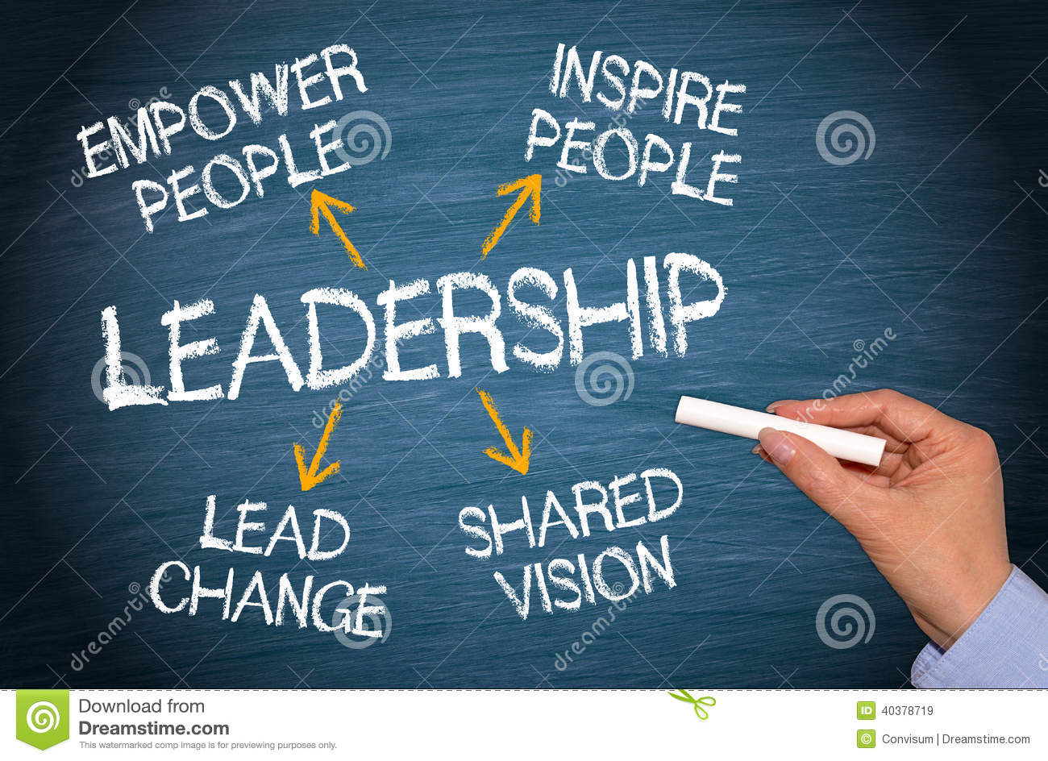
LEADERSHIP Aalto University Mikkeli
Dr Elyssebeth Leigh
18/02/2019 - 8/03/2018

Slide 2
In this course every moment is a learning opportunity
Every action may help you learn to be a better leader, and help others see good leadership in action (or not)
We are
collectively responsible for the quality of this learning environment
individually responsible for our contributions to it
What are your plans for being a leader and learning about how to do so?
Learning in the
LEADERSHIP ROOM

Slide 3
Agenda for Day 1
Syllabus - what it does and does not say
Assessment tasks and processes
We are all leaders at some time
in this course everyone is a leader
Force Field Analysis
What forces present in this room help and hinder knowledge and skill acquisition?
Leadership and Knowledge
How is knowledge acquired - learning about learning
Building Trust
Planning ahead

Slide 4
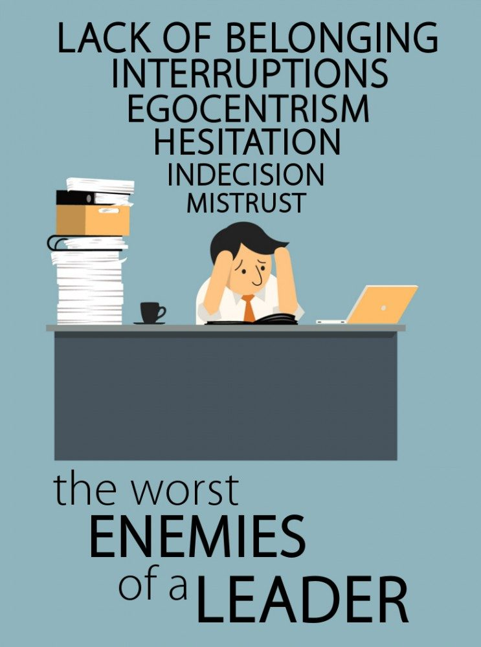
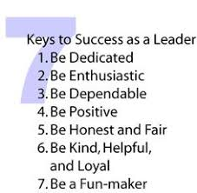
LEADERSHIP
7 Friends
6 Enemies

Slide 5
Welcome to
goal-oriented conversations
Today’s focus is on what will help us all to be better leaders

Slide 6
Force Field Analysis (FFA)
What forces, already present in this room, will help and hinder knowledge and skill acquisition?

Slide 7
Two Key Questions
What is our present situation
This is a collaborative statement about your present understanding of ‘Leadership’
It can include prior experiences and assumptions
It must be no more than two sentences
Write this in the centre of the sheet of paper
Where do we want to be at the end of 3 weeks?
This is a first attempt at setting goals for learning about leadership
You must briefly describe what you hope to know about / be able to do as a leader
Write this at the TOP of the sheet of paper

Slide 8
Planning our work together
What is needed to move ourselves from where we are today to where we want to be?
We will only know the answer to this question at the end of our time together.
However we can establish ground rules and initiate a plan of action by identifying two factors that operate every day.
RESTRAINING FORCES
These hold us back, impede progress - like car brakes
DRIVING FORCES
These enable movement forward - like a car’s accelerator

Slide 9
We want to be here in 3 weeks
R
E
S
T
R
A
I
N
T
R
E
S
T
R
A
I
N
T
Restraining Forces
R
E
S
T
R
A
I
N
T
R
E
S
T
R
A
I
N
T
R
E
S
T
R
A
I
N
T
R
E
S
T
R
A
I
N
T
R
E
S
T
R
A
I
N
T
R
E
S
T
R
A
I
N
T
Our present situation
Drivers
Drivers
Drivers
Drivers
Drivers
Drivers
Drivers
Drivers
Driving Forces

Slide 10
Restraining Forces
Factors in the present situation
List everything that will/could slow down the learning process
Driving forces
List everything that can assist achieving desired learning outcomes

Slide 11
Analysing your Data
Working together asses your Data in terms of relative importance and impact
Which items will be most/least important?
* Number them from 1 = highest to n = lowest
Which will have most/least impact on delaying/achieving the goal?
* Number them from A = highest to n = lowest
This identifies items by
level of urgency
how much attention do they need?
degree of importance
what happens if they are ignored?

Slide 12
Making Use of the Data
Individually - write yourself a statement indicating how you aim to avoid being a restraint to your own and others’ learning while contributing to being a driving force for learning.
This is the 1st step in your Individual Reading Plan
The goal for everyone is to
Reduce Restraints – these must be your focus for action
Support/sustain Drivers´- they only need regular maintenance
To achieve movement in a vehicle it is more effective to take the foot off the brake, than to press harder on the accelerator!

Slide 13
Planning the Next Steps
Decisions
Allowing for the Career Day hours?
Which of the four Leadership elements to be responsible for?
Assessment tasks (Day 2)

Slide 14
Theories touched on today
Theory X / Theory Y – underlying belief systems that influence how and whether, as a leader, we can trust people
Parataxic distortion – the tendency to congregate with/near people who are like us or like people we like
Theory of group development - (Tuckman) a theory that says human groups progress through a sequence of emotions/responses/ questions. These are predictable and influence our actions and interactions
Situational awareness – the skill of knowing how to learn from what we obsreve around us

