Slide 1
Masters course in circular economy for Materials Processing (7.5 credits)
[Theme 1 – Business landscape and policy landscape for circular economy]
This course has been created by the following Universities and Institutes:
Aalto University, Lappeenranta University of Technology – LUT, KTH royal institute of technology, Mineral and Energy Economy Research Institute of the PAS, Tallinn University of Technology TTU, Technical University of Košice – Tuke, University of Trento.

Slide 2
Theme 1 - Agenda
Sustainable development
What is circular economy?
Industrial symbiosis and circular economy
Towards a circular economy in the world and EU
Business perspectives on circular economy
Business models
Eco design
Critical raw materials
Renewable energy
Think in systems and cascades

Slide 3
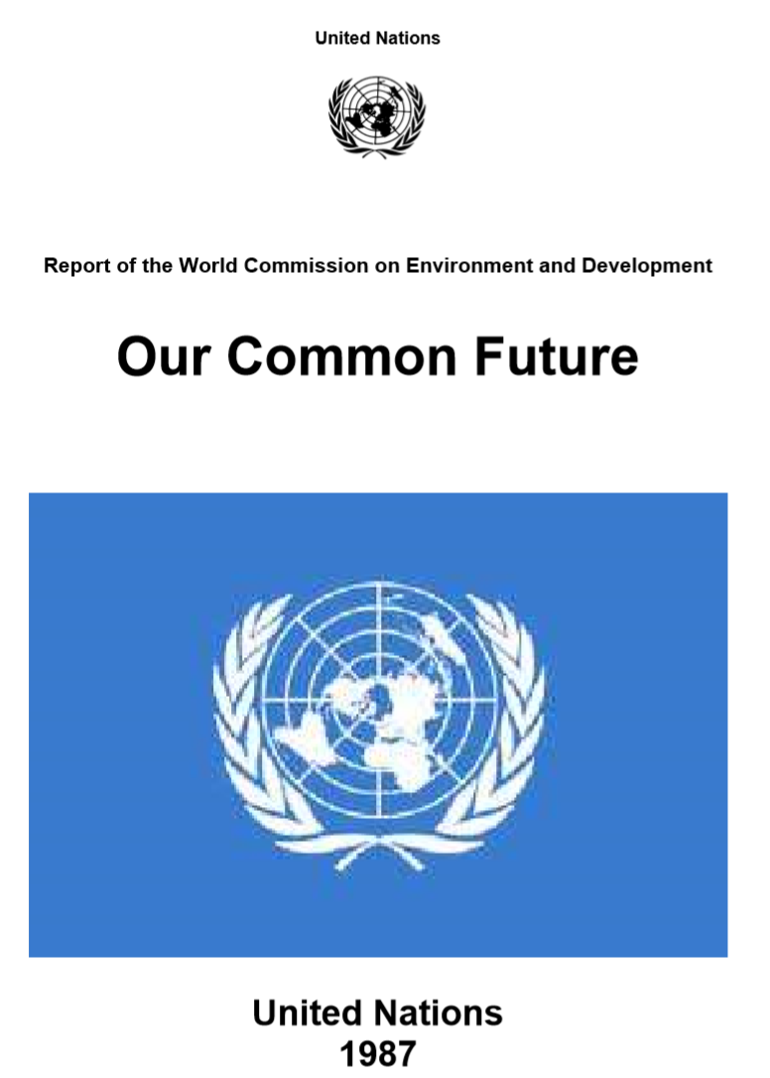
Sustainable development (SD)
In 1987, the World Commission on Environment and Development (WCED) published a report entitled „Our common future” also know as „Brundtland Report”. It called for a strategy that united development and the environment – described by the now-common term „sustainable development”.
SD Definition
"Sustainable development is development that meets the needs of the present without compromising the ability of future generations to meet their own needs"
Source: Our Common Future, Brundtland Report, 1987 (PDF, 1 MB, 14.03.2013)
Notes:
1987: Brundtland Report
In 1987, the World Commission on Environment and Development (WCED), which had been set up in 1983, published a report entitled «Our common future». The document came to be known as the «Brundtland Report» after the Commission's chairwoman, Gro Harlem Brundtland. It developed guiding principles for sustainable development as it is generally understood today.
The Brundtland Report stated that critical global environmental problems were primarily the result of the enormous poverty of the South and the non-sustainable patterns of consumption and production in the North. It called for a strategy that united development and the environment – described by the now-common term «sustainable development». Sustainable development is defined as follows:«Sustainable development is development that meets the needs of the present without compromising the ability of future generations to meet their own needs.»In 1989, the report was debated in the UN General Assembly, which decided to organize a UN Conference on Environment and Development.
Source: https://www.are.admin.ch/are/en/home/sustainable-development/international-cooperation/2030agenda/un-_-milestones-in-sustainable-development/1987--brundtland-report.html

Slide 4
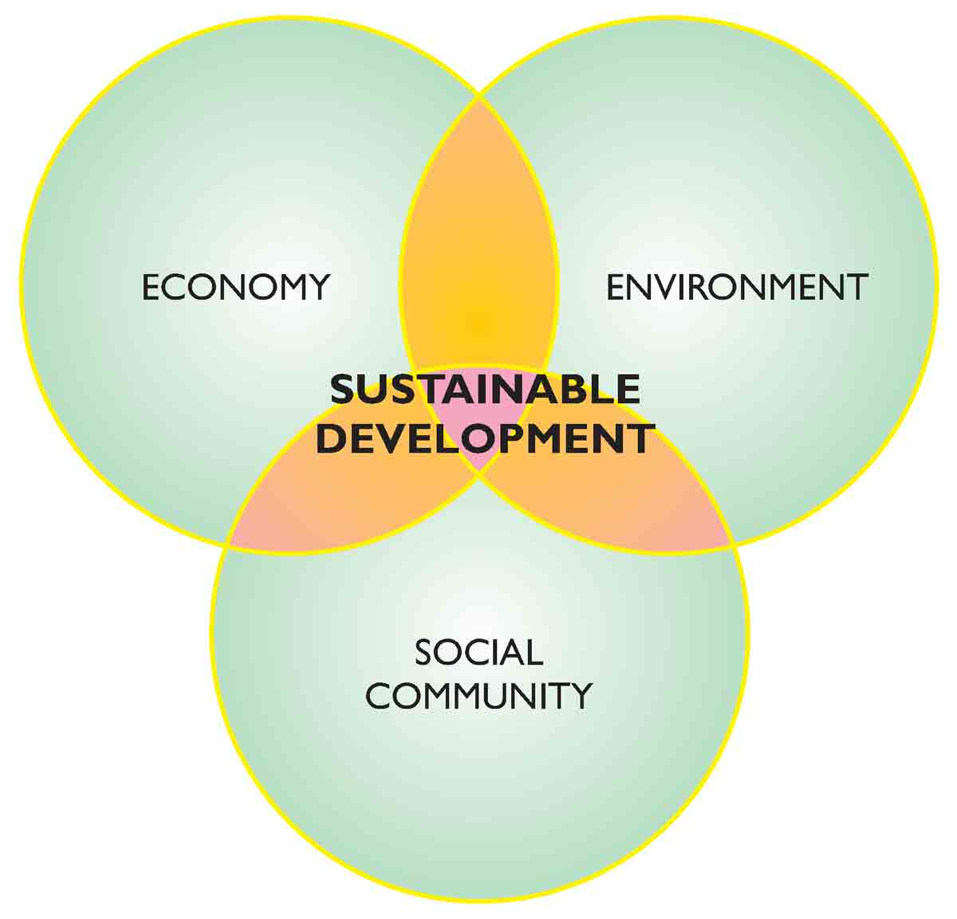
SD – integration of 3 aspects
Sustainable development is also defined by Hansen et al.(2009) as development that combines environmental, social, and economic dimensions in an integrated fashion to engage in truly sustainability-oriented innovation.
Source: http://www.yourarticlelibrary.com/environment/what-is-the-importance-of-sustainable-development/9910
Notes:
ENVIRONMENTAL SUSTAINABILITY
At the environmental level, sustainability prevents nature from being used as an inexhaustible source of resources and ensures its protection and rational use.
Aspects such as environmental conservation, investment in renewable energies, saving water, supporting sustainable mobility, and innovation in sustainable construction and architecture, contribute to achieving this environmental sustainability on several fronts.
SOCIAL SUSTAINABILITY
At the social level, sustainability can foster the development of people, communities and cultures to help achieve reasonable and fairly-distributed quality of life, healthcare and education across the globe.
The fight for gender equality, especially in developing countries, is another aspect which in coming years will form the basis of social sustainability.
ECONOMIC SUSTAINABILITY
Sustainability focusses on equal economic growth, that generates wealth for all, without harming the environment.
Investment and an equal distribution of the economic resources will strengthen the other pillars of sustainability for a complete development.
Source; https://www.acciona.com/sustainable-development/

Slide 5

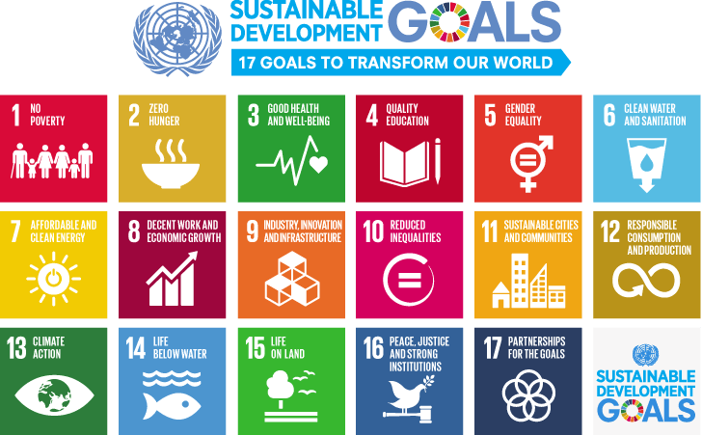
17 Sustainable Development Goals (SDGs)
Source: rockefellerfoundation.org
Notes:
Sustainability is the foundation for today’s leading global framework for international cooperation – the 2030 Agenda for Sustainable Development and its Sustainable Development Goals (SDGs).
Each of the 17 SDGs has specific targets to be achieved by 2030. The goals and targets are universal, meaning they apply to all countries around the world, not just poor countries. Reaching the goals requires action on all fronts – governments, businesses, civil society and people everywhere all have a role to play.
Source: https://www.iisd.org/topic/sustainable-development

Slide 6
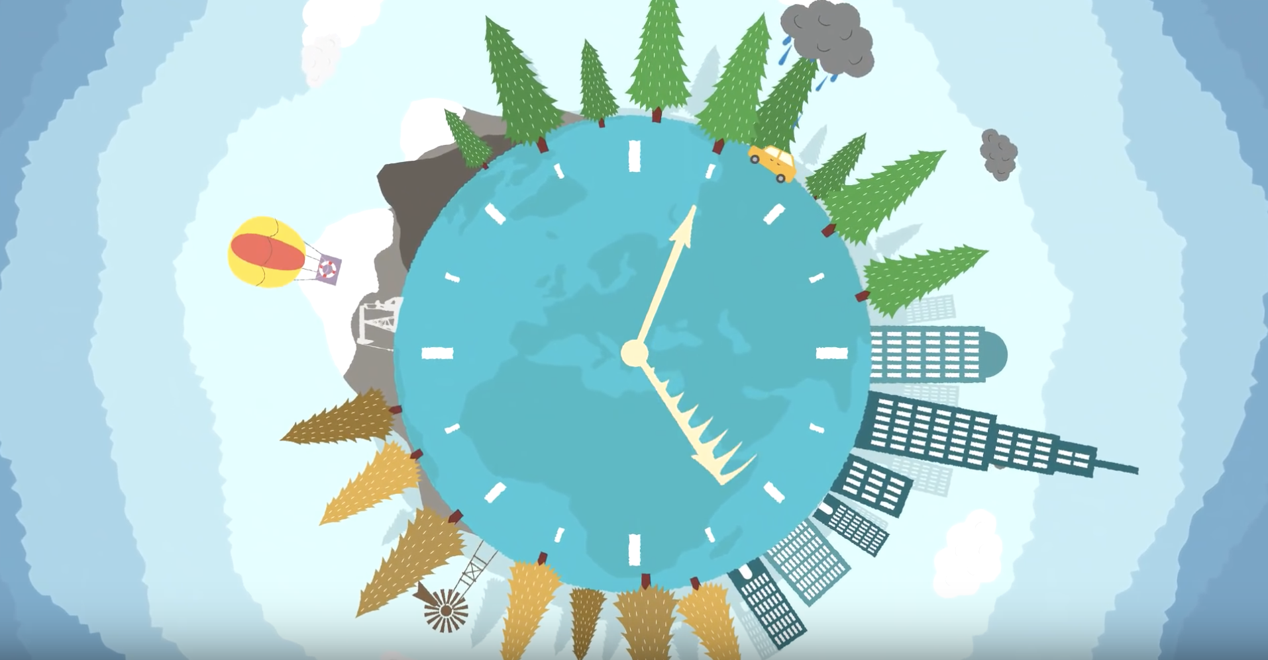
What is circular economy?

Slide 7

Why Circular Economy?
…because it is
the current EU strategy
Strategy that:
boost economic growth without increasing consumption of resources,
deeply transforms production chains and consumption habits,
re-designs industrial systems at the system level.
2014 (COM no 398, 2014)
Towards a circular economy: A zero waste programme for Europe,
2015 (COM no 614, 2015)
Closing the loop - An EU action plan for the Circular Economy,
2018 (COM nr 29, 2018)
Monitoring framework for the circular economy,
Link: https://eur-lex.europa.eu/legal-content/EN/TXT/?uri=celex%3A52014DC0398
Link: https://eur-lex.europa.eu/legal-content/EN/TXT/?uri=CELEX%3A52015DC0614
Link: https://eur-lex.europa.eu/legal-content/EN/TXT/?qid=1545129369991&uri=CELEX:52018DC0029
Source: Komunikat Komisji Europejskiej. 2014. Ku gospodarce o obiegu zamkniętym: program „zero odpadów dla Europy”. (COM nr 398, 2014), Komunikat Komisji Europejskiej. 2015. Zamknięcie obiegu -plan działania UE dotyczący gospodarki o obiegu zamkniętym. (COM nr 614, 2015). Komunikat w sprawie monitorowania gospodarki o obiegu zamkniętym (SWD nr 29, 2018),
Notes:
The CE has adopted 3 communications on CE.
European Commission – in selected Communications:
Towards a circular economy: A zero waste programme for Europe (2014) - Commission of European Communities. Communication. Towards a circular economy: A zero waste programme for Europe (COM 398, 2014).
European Parliament in December 2014 adopted the communication from the European Commission, “Towards a Circular Economy: a Zero Waste Programme for Europe”. This document emphasised the necessity of involving innovation in order to, inter alia: boost recycling and prevent the loss of valuable materials; create jobs and economic growth; show how new business models can emerge; move Europe towards zero-waste through eco-design and industrial symbiosis; and reduce greenhouse emissions and environmental impacts
Closing the loop - An EU action plan for the Circular Economy (2015) - Commission of European Communities. Communication No. 614, 2015. Closing the loop - An EU action plan for the Circular Economy. (COM 614, 2015).
On 2 December 2015, the European Commission put forward a package to support the EU's transition to a circular economy. The package is composed of a set of both general and material-specific actions.
Monitoring framework for the circular economy (2018) - Commission of European Communities. Communication No. 29, 2018. Monitoring framework for the circular economy. (COM 29, 2018).
The EU’s Circular Economy Package (CEP) has taken another step closer to fruition after the European Commission finalised its proposal for a Circular Economy Monitoring Framework to track the EU’s progress against the ambitions and objectives stated in the CEP.

Slide 8
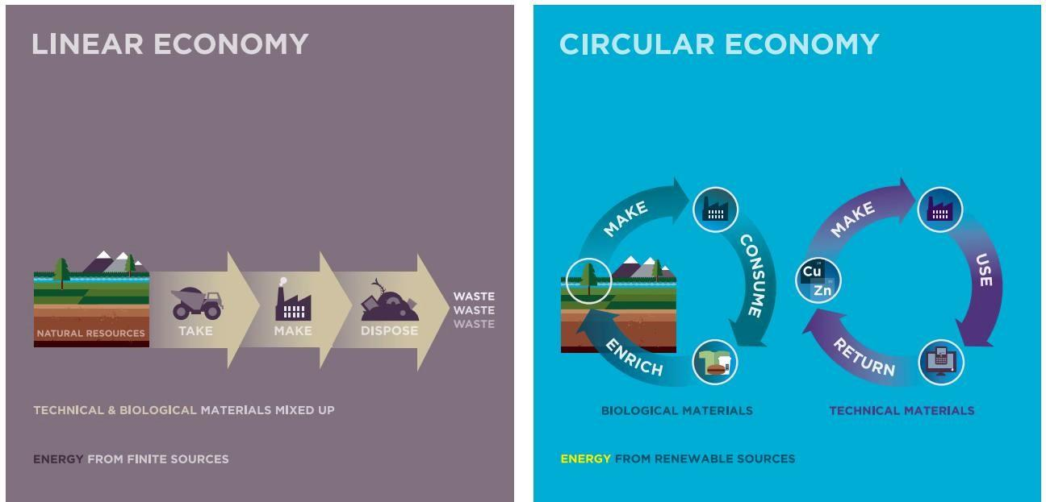
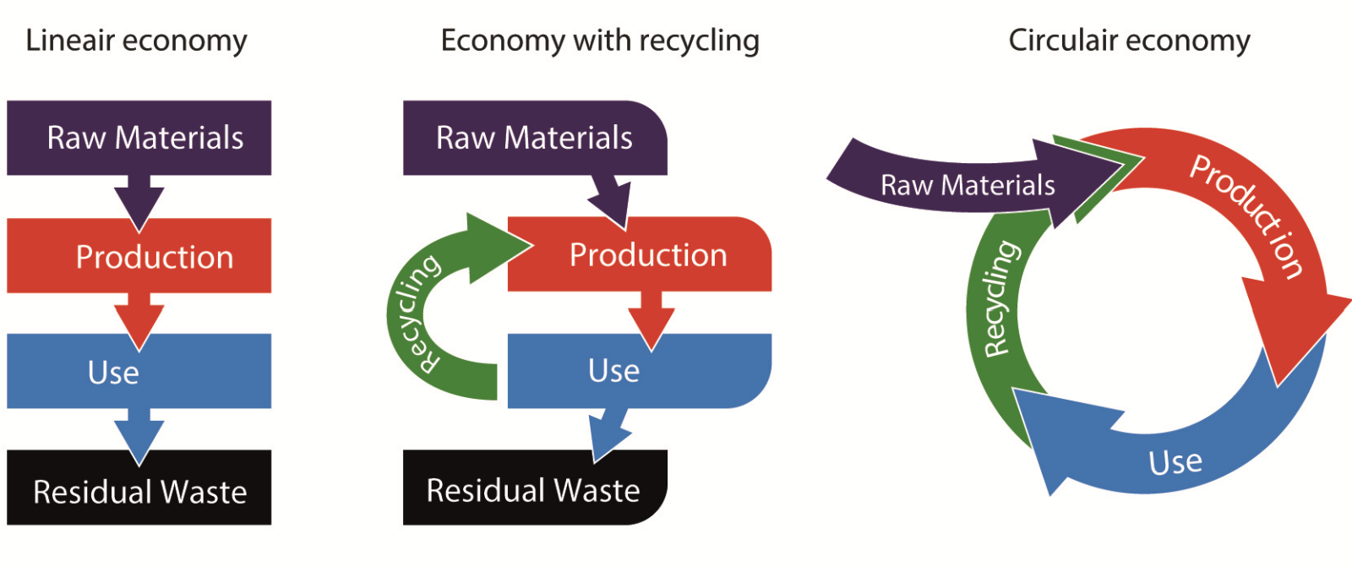
LINEAR MODEL ≠ CIRCULAR MODEL
≠
Source: Image developed by the Ellen MacArthur Foundation’s graphic designer Graham Pritchard; Guusje Korthals Altes, Economic Section at the Netherlands Embassy in Poland - Introduction of the strategy of the Netherlands: Circular in 2050, International Conference on Raw Materials and Energy in a Circular and Low-Carbon Economy , Cracow, 14-15 September 2017
Notes:
We are a consumer society
For a long time, our economy has been ‘linear’. This means that raw materials are used to make a product, and after its use any waste (e.g. packaging) is thrown away.
While this economic model has generated an unprecedented level of growth, the rising demand on resources has become unsustainable
In an economy based on recycling, materials are reused. For example, waste glass is used to make new glass and waste paper is used to make new paper. To ensure that in the future there are enough raw materials for food, shelter, heating and other necessities, our economy must become circular. That means preventing waste by making products and materials more efficiently and reusing them. If new raw materials are needed, they must be obtained sustainably so that the natural and human environment is not damaged.

Slide 9
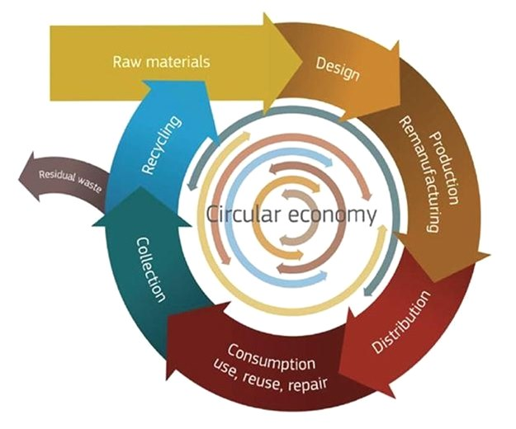

CIRCULAR ECONOMY (CE) – basic definitions
Definition proposed by the European Commission:
2014: ‚CE systems keep the added value in products for as long as possible and eliminates waste’ Source: Towards a circular economy: A zero waste programme for Europe (COM no. 398, 2014);
2015: CE is economy ‘where the value of products, materials and resources is maintained in the economy for as long as possible, and the generation of waste is minimised’ Source: Closing the loop - An EU action plan for the Circular Economy (COM no. 614, 2015)
Source: Towards a circular economy: A zero waste programme for Europe (COM no. 398, 2014);

Slide 10
Circular economy – a part of sustainable development
Circular economy is a sustainable development initiative with the objective of reducing the societal production-consumption systems’ linear material and energy throughput flows by applying materials cycles, renewable and cascade-type energy flows to the system.
Korhonen, Nuur, Feldmann and Birkie (2018)
Notes:
Circular economy is not an alternative to sustainable development, but rather a part of it. E.g. Circular economy does not solve all the SDGs. Other changes are required too.
This is one definition of circular economy. There are many

Slide 11
Circular value
As a result of circular thinking circular value can be created in four areas:
Raw materials are permanently re-used, and are not just more efficient, but infinite (eg renewable energy).
Liquid markets emerged, in which products are used optimally by the exchange between users (for example: the sharing economy).
Products are designed to have a long life cycle (eg the shift from product to performance or services).
Value chains are linked, so no waste is produced in manufacturing processes (eg recycling, new material flows).
Source: kenniskaarten.hetgroenebrein.nl/en/knowledge-map-circular-economy/value-creation-circular-economy/, OPAi, & MVO Nederland, 2004, p.31-33; Accenture, 2014, p.6
Notes:
In order to capture circular value, it is important to consider the entire value chain. This includes the value proposition (the product), the management of the value chain, the interaction with the user and the business model. Opportunities for circular business lie in the threat of a linear economy (supply of raw materials, increasing government regulations) and social trends (circular tender, multiple value-creation, co-creation of value propositions).
Source: https://kenniskaarten.hetgroenebrein.nl/en/knowledge-map-circular-economy/value-creation-circular-economy/

Slide 12
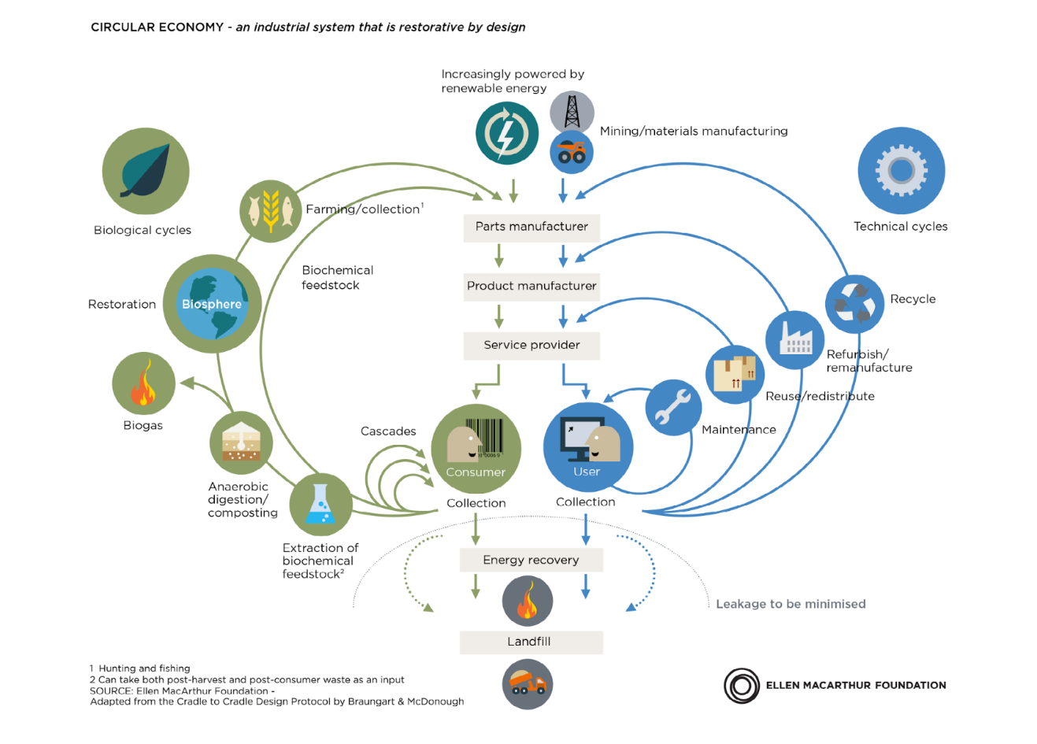
Cycles of CE
Within the cycles of a circular economy there are four ways to add value to a product:
The strength of the inner circle. Due to maintenance, repair and adaptation of existing products and services, products can be kept in use longer, before they should be taken back for recycling.
The strength of the long cycle. Extending the use and life time of existing products and processes.
The power of cascades. Creating new combinations of raw materials and product components and sale and purchase of upgraded waste streams;
The power of pure circles. 100% use of pure materials.
Source: kenniskaarten.hetgroenebrein.nl/en/knowledge-map-circular-economy/value-creation-circular-economy/, Ellen Macarthur Foundation, 2013a p.33-36
Notes:
Within the cycles of a circular economy there are four ways to add value to a product. By focusing on the following four points value that can be extracted from a product or material can be maximized:

Slide 13
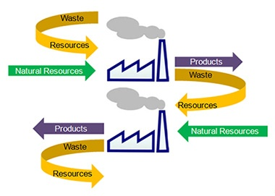
Industrial symbiosis (IS) – CE value chain
EC Communication "Closing the Loop - EU Action Plan on Circular Economy" (2015)
”industrial symbiosis means that waste or by-products from one industry sector become a raw material for another”
„Commission proposes measures to facilitate this practice and will work with Member States to ensure a uniform interpretation of the by-product rules”
IS - voluntary cooperation of various organizations (enterprises) focused on a certain area, whose main purpose is better use of raw materials and better management of waste
Source:: COM no. 614, 2015, eur-lex.europa.eu

Slide 14

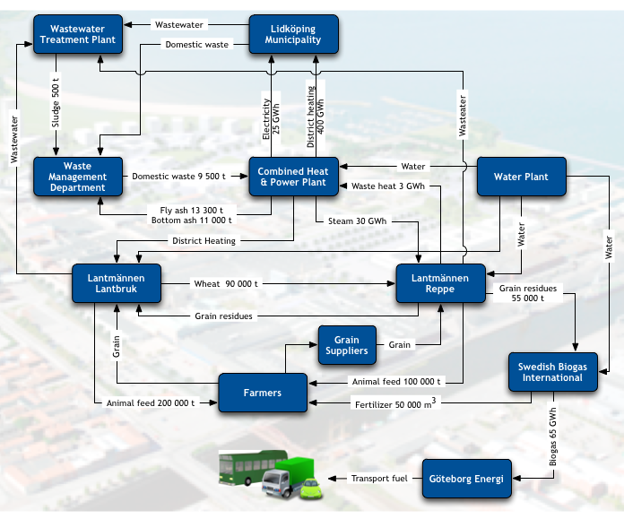
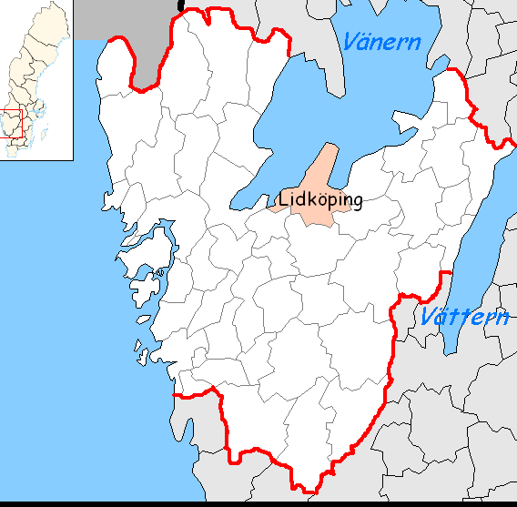
IS – example -Lidköping
Industrial Symbiosis:
Waste Management Department
Lantmännen Reppe - biorefinery
Swedish Biogas International - biogas plant
Power Plant
Surface | 703,19 km
Notes:
Lidköping Municipality (Lidköpings kommun) is a municipality in Västra Götaland County in western Sweden. Its seat is located in the city of Lidköping.
Lidköping sometimes refers to itself as "Lidköping by Vänern", possibly to distinguish itself from the namewise (and historically) similar city of Linköping in eastern Sweden.
In terms of population, Lidköping is the 59th municipality in Sweden (at 290).
37,241 people, of which 50.48% are women (18,798) and 49.52% are men (18,443).
The department of waste management – Oddział Gospodarki Odpadami
Collection of municipal waste from residents and selected industrial waste
Storage of sewage sludge
Collection of septic tanks from premises not connected to the sewage system
Management of a landfill, recycling and manual sorting center
Operation of waste storage infrastructure
Lantmännen ReppeLantmännen Reppe – local biorefinery
Uses wheat as the main raw material in the production of glucose syrup, gluten, ethanol, flour from wet and dry feed and raw material for biogas production
The steam needed for production processes is provided by a nearby combined heat and power plant - symbiosis
The residual heat from the installation still maintains a high temperature and is sent back to the heat and power plant and is then used for central heating
Relatively high amounts of water required by the plant comes from the municipal sewage treatment plant
Organic waste, sent to local plants as a substrate for biogas production and to local farmers as fodder
Swedish Biogas International
Biogas production - used as transport fuel, ecologically labeled (Nordic Ecolabel)
Most are sent to one of the world's first biogas liquefaction plants (Lidköping Biogas - owned by Göteborg Energi and the municipality of Lidköping). Here it is liquefied and distributed in the region as fuel for trucks
Waste residues rich in nutrients are used by local farmers as fertilizers
Power Plant
Burning of industrial waste collected by the Waste Management Department
Collection of waste heat from company - Lantmännen Reppe.
Ashes are transferred to a waste management facility
The cooperation between Lantmännen Reppe and the combined heat and power plant is mainly beneficial due to the high use of water vapor.
The heat and power plant is the only producer of heat for the city, and therefore focuses on maintaining a constant and safe supply of heat to the city Lidköping.

Slide 15
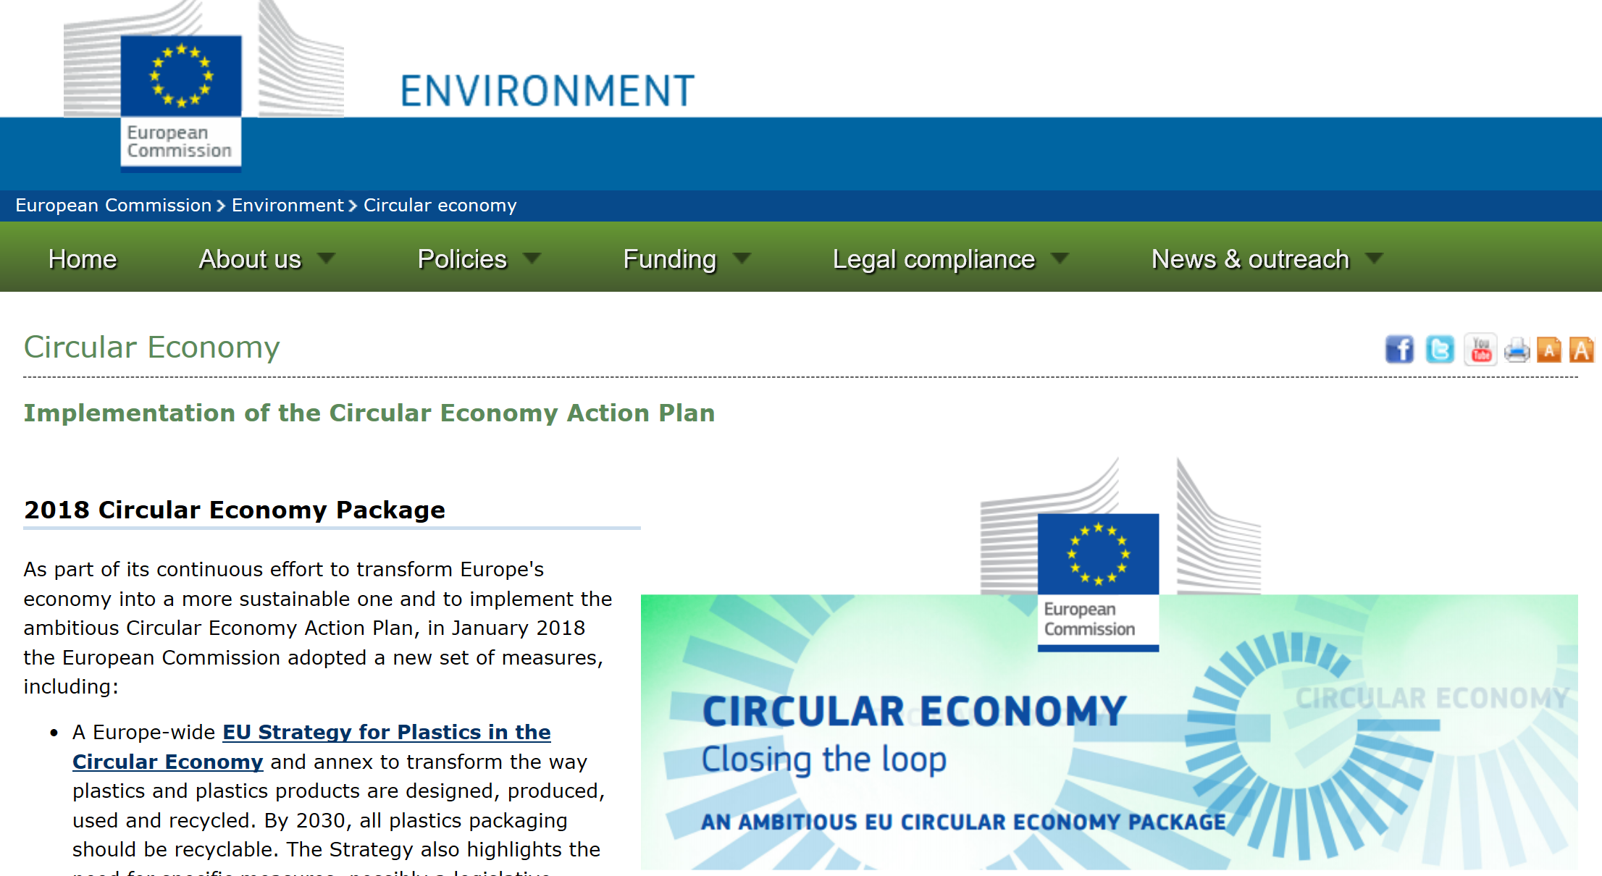
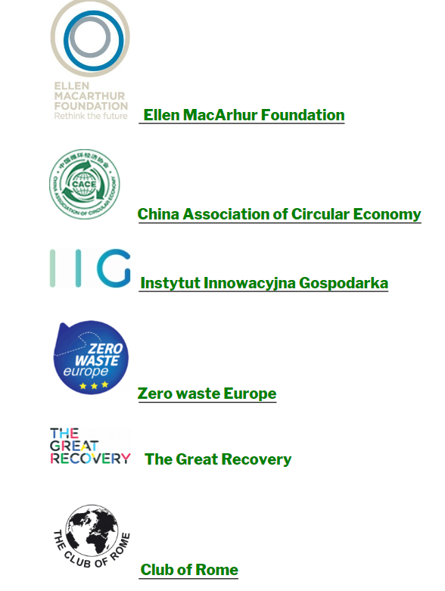
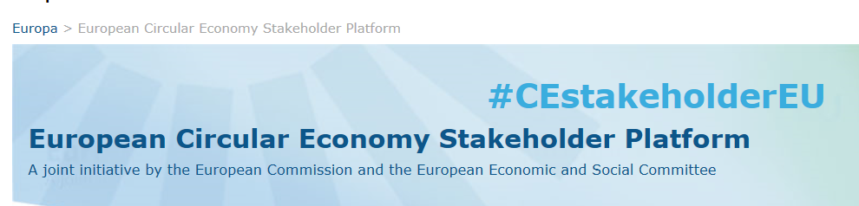
Info about CE
ec.europa.eu/environment/circular-economy
www.circulareconomy.com
circulareconomy.europa.eu/platform
eitrawmaterials.eu
Notes:
In an economy based on recycling, materials are reused. For example, waste glass is used to make new glass and waste paper is used to make new paper. To ensure that in the future there are enough raw materials for food, shelter, heating and other necessities, our economy must become circular. That means preventing waste by making products and materials more efficiently and reusing them. If new raw materials are needed, they must be obtained sustainably so that the natural and human environment is not damaged.

Slide 16
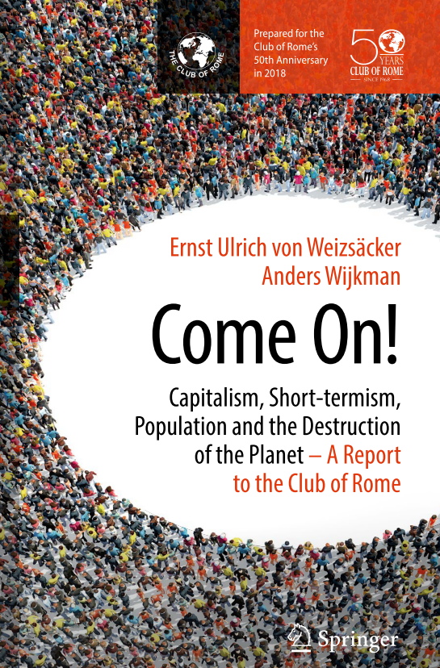
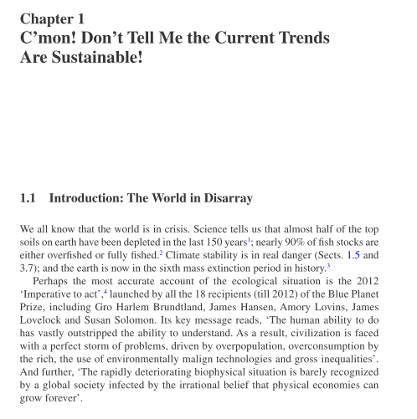
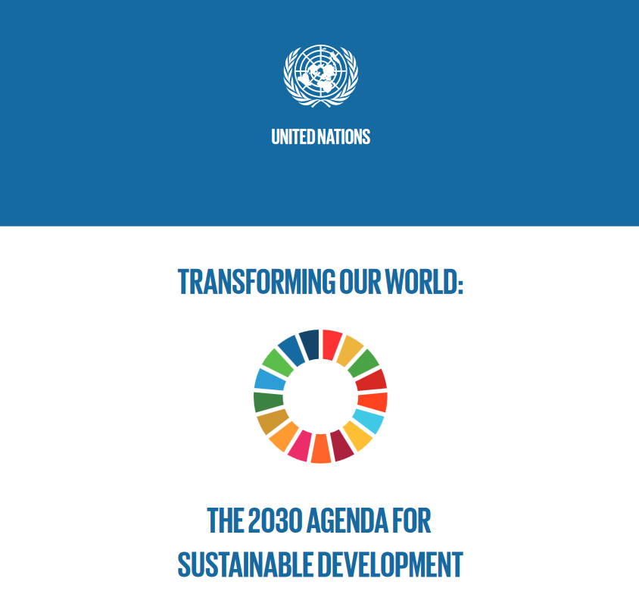
Towards CE in the world
2030 Agenda for Sustainable Development (2015) – a plan of action for people, planet and prosperity. It seeks to strengthen universal peace in larger freedom.
A Report to the Club of Rome (2018)
!!!
Conclusion:
Life cycle thinking!
Source: sustainabledevelopment.un.org
Notes:
1. This Agenda is a plan of action for people, planet and prosperity. It also seeks to strengthen universal peace in larger freedom, We recognize that eradicating poverty in all its forms and dimensions, including extreme poverty, is the greatest global challenge and an indispensable requirement for sustainable development.
2. In the years since its founding in 1968, there have been more than 40 reports to the Club of Rome. The first report, The Limits to Growth, catapulted the Club of Rome, and the authors of Limits, into the global limelight. The book served as a shock to a world as yet largely unaware of the long-term effects of continued growth in what we now call the human ecological footprint. Aurelio Peccei, founder and then president of the Club of Rome, saw the responsibility of addressing the suite of problems facing the world, what he called the predicament of mankind, but was astonished to learn from the Limits report that these problems could all be tied to the consequences of humankind’s desire for endless growth on a finite planet. The message from the bold young team at the Massachusetts Institute of Technology was that if growth continued unabated at the present pace, shrinking resources and heavy pollution would lead to an ultimate collapse of world systems.

Slide 17
Towards CE in the European Union
Directive 2008/98/EC on waste (2008)
Europe 2020 Strategy for smart, sustainable and inclusive growth for 2014-2020 (2010)
Towards a circular economy: A zero waste programme for Europe (2014)
Closing the loop - An EU action plan for the Circular Economy (2015)
Renewed EU Industrial Policy Strategy (2017)
Monitoring framework for the circular economy (2018).
This documents emphasised the necessity of involving innovation in order to, inter alia: boost recycling and prevent the loss of valuable materials; create jobs and economic growth; show how new business models can emerge; move Europe towards zero-waste through eco-design and industrial symbiosis; and reduce greenhouse emissions and environmental impacts
Source: eur-lex.europa.eu
Notes:
Europe faces a moment of transformation. The crisis has wiped out years of economic and social progress and exposed structural weaknesses in Europe's economy. In the meantime, the world is moving fast and long-term challenges
– globalisation, pressure on resources, ageing – intensify. The EU must now
take charge of its future.
Europe can succeed if it acts collectively, as a Union. We need a strategy to help us come out stronger from the crisis and turn the EU into a smart, sustainable and inclusive economy delivering high levels of employment, productivity and social cohesion. Europe 2020 sets out a vision of Europe's social market economy for the 21st century. Europe 2020 puts forward three mutu ally reinforcing priorities:
–Smart growth: developing an economy based on knowledge and innovation.
–Sustainable growth: promoting a more resource efficient, greener and more competitive economy.
–Inclusive growth: fostering a high-employment economy delivering social and territorial cohesion.
The EU needs to define where it wants to be by 2020. To this end, the Commission proposes the following EU headline targets:
–75 % of the population aged 20-64 should be employed.
–3% of the EU's GDP should be invested in R&D.
–The "20/20/20" climate/energy targets should be met (including an increase to 30% of emissions reduction if the conditions are right).
–The share of early school leavers should be under 10% and at least 40% of the younger generation should have a tertiary degree.
–20 million less people should be at risk of poverty.
These targets are interrelated and critical to our overall success. To ensure that each Member State tailors the Europe 2020 strategy to its particular situation, the Commission proposes that EU goals are translated into national targets and trajectories.

Slide 18
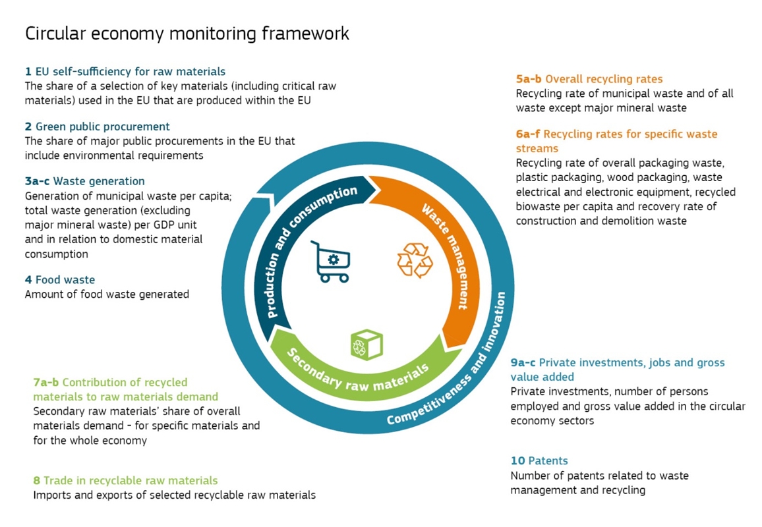
CE indicators: Monitoring framework for CE (2018)
(1) production and consumption
(2) waste management
(3) secondary raw materials
(4) competitiveness and innovation
Source: Monitoring framework for the circular economy (COM no. 29, 2018),
Notes:
There is no indicator that can be a single measurement for the Circular Economy. However a number of existing indicators can help to measure performance in several areas that directly or indirectly contribute to the Circular Economy development. They can be grouped into 4 presented groups.

Slide 19
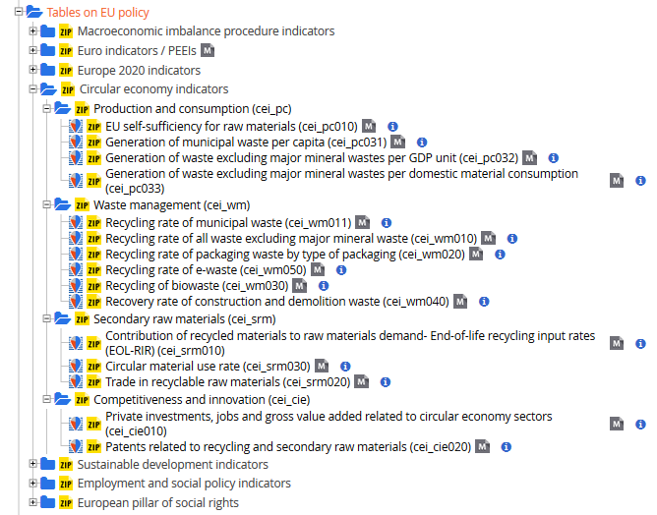

Official CE indicators (2018)
Source: ec.europa.eu/eurostat/data/database
Notes:
CE indicators – we can find them in official statistic of the EC - EUROSTAT

Slide 20
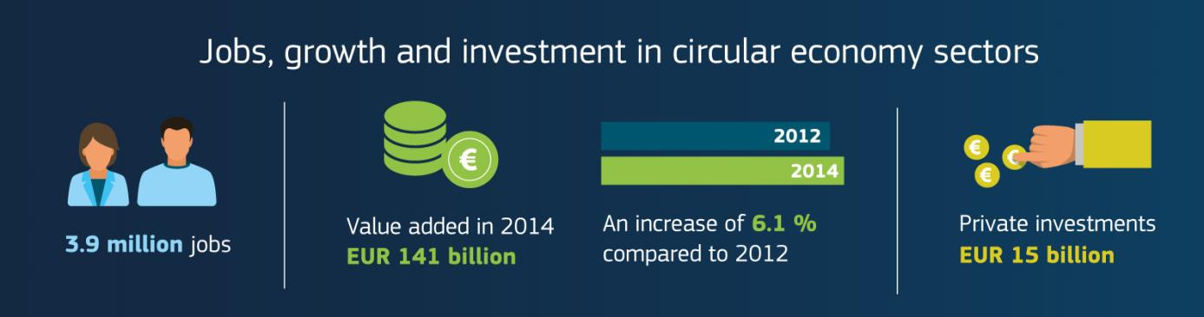
Benefits in the transition to CE
The EC:
The transition to a circular economy increases investments, value added and jobs, and stimulates innovation.
Ellen Macarthur Fundation (Report Toolkit for Policymakers):
Substantial net material savings and reduced exposure to price volatility
Increased innovation and job creation potential
Increased resilience in living systems and in the economy
Source: Monitoring framework for the circular economy (COM no. 29, 2018),
Notes:
The transition towards the circular economy can bring about the lasting benefits of a more innovative, resilient and productive economy. The principal benefits to moving to the circular economy are as follows:
• Substantial net material savings and reduced exposure to price volatility: based on detailed product-level modelling, the Ellen MacArthur Foundation has estimated that, in the medium-lived complex products industries, the circular economy represents net material cost savings at an EU level for an ‘advanced’ scenario of up to USD 630 billion annually; in fast-moving consumer goods (FCMG) at the global level net materials savings could reach USD 700 billion annually – see Figure 3.
• Increased innovation and job creation potential: circularity as a ‘rethinking device’ has proved to be a powerful new frame, capable of sparking creative solutions and stimulating innovation. The effects of a more circular industrial model on the structure and vitality of labour markets still need to be further explored, but initial evidence suggests that the impact will be positive (see below).
• Increased resilience in living systems and in the economy: land degradation costs an estimated USD 40 billion annually worldwide, without taking into account the hidden costs of increased fertiliser use, loss of biodiversity and loss of unique landscapes. Higher land productivity, less waste in the food value chain and the return of nutrients to the soil will enhance the value of land and soil as assets. The circular economy, by moving much more biological material through the anaerobic digestion or composting process and back into the soil, will reduce the need for replenishment with additional nutrients. This is the principle of regeneration at work.
Source: Ellen Macarthur Fundation (Report Toolkit for Policymakers): https://www.ellenmacarthurfoundation.org/assets/downloads/government/EllenMacArthurFoundation_Policymakers-Toolkit.pdf

Slide 21
Different stakeholders put different pressures with respect to sustainability and circular economy
Notes:
A list of stakeholders in a company. They put different pressures on the company with respect to sustainability and circular economy.
Don’t just expect the customers to pay for it!

Slide 22
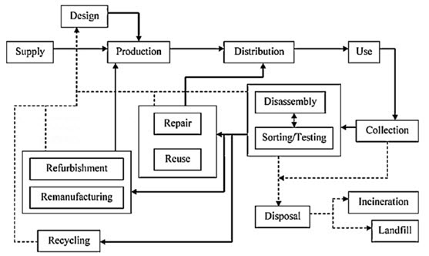
Value creation is a key component in closing the loop – not just for the main product
Adapted from
(Sasikumar and Kannan, 2008)

Slide 23
Large monetary values in a transition towards a circular economy
The European commission and the Ellen MacArthur Foundation estimate the total value for the manufacturing sector in a transition into a circular economy to be over 600 billion Euro
  Improved materials and energy efficiency
    Direct losses in material cycles in Sweden are estimated at 4.3 billion Euro per year (Just including plastics, aluminum and steel)
  Reduced costs from waste management
  In addition there are market and innovation related opportunities.

Slide 24
Established positive correlations between sustainability and performance
Authors | Independent var. | Dependent var.
Golic and Smith (2013) | Environment | Financial, market, operative
Montabon et al (2007) | Environment | Financial, operative
Lopez-Gamero et al. (2009) | Environment | Financial, operative
Pujari (2008) | Eco-design | Market
Chen, Feldmann and Tang (2015) | Social | Financial
Eklund (1995) | Ergonomics | Operative, quality
Donate et al. (2016) | HRM | Innovation
Notes:
Golicic, S. L. and Smith, C. D. (2013), A Meta‐Analysis of Environmentally Sustainable Supply Chain Management Practices and Firm Performance. J Supply Chain Manag, 49: 78-95
Montabon, Sroufe, Narasimhan (2007) An examination of corporate reporting, environmental management practices and firm performance, Journal of Operations Management, Vol 25, Issue 5
Lopez-Gamero, Molina-Azoring and Claver-Cortés (2009) The whole relationship between environmental variables and firm performance: Competitive advantage and firm resources mediator variables, Journal of Environmental Management, Vol 90 (10)
Pujari, (2008), Eco-innovation and new product development: understanding the influences on market performance, Technovation, Volume 26, Issue 1,
Chen, Feldmann, Tang, (2015) The relationship between disclosures of corporate social performance and financial performance: Evidences from GRI reports in manufacturing industry, International Journal of Production Economics, Volume 170, Part B,
Mario J. Donate, Isidro Peña & Jesús D. Sánchez de Pablo (2016) HRM practices for human and social capital development: effects on innovation capabilities, The International Journal of Human Resource Management,
Eklund (1995), Relationships between ergonomics and quality in assembly work, Applied Ergonomics, Volume 26, Issue 1,

Slide 25
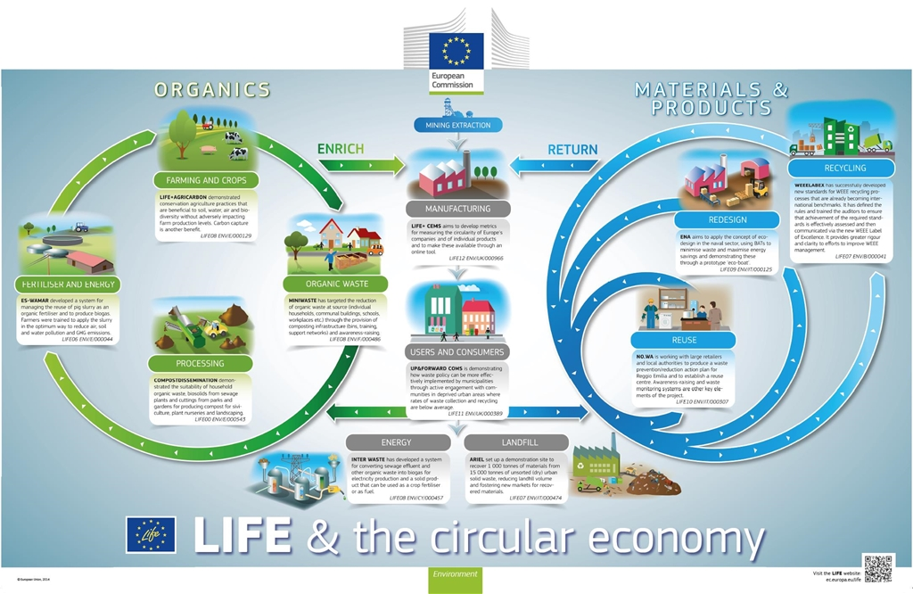
Different contexts, different problems and different solutions
Notes:
The organic side has different pre-conditions compared to the materials side since it is renewable with a constant inflow of energy. The material side is finite.

Slide 26
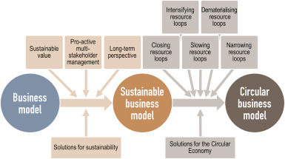
New Business models - Circular business models
Comparison of traditional, sustainable, and circular business models
Source: Geissdoerfer, M., Morioka, S. N., de Carvalho, M. M., & Evans, S. (2018). Business models and supply chains for the circular economy. Journal of Cleaner Production, 190, 712-721.
Notes:
Circular business models (CBMs) can be defined as Sustainable business models (SBMs) - which are business models that aim at solutions for sustainable development by creating additional monetary and non-monetary value by the pro-active management of a multiple stakeholders and incorporate a long-term perspective - that are specifically aiming at solutions for the Circular Economy through a circular value chain and stakeholder incentive alignment.
The arguably biggest difference between conventional business models and those designed for the Circular Economy lies in their value creation and delivery element, and here particularly in the supply chain. We use the term circular supply chain management (CSCM), which comprises the configuration and coordination of the supply chain to close, narrow, slow, intensify and dematerialise resource loops.
Source: Geissdoerfer, M., Morioka, S. N., de Carvalho, M. M., & Evans, S. (2018). Business models and supply chains for the circular economy. Journal of Cleaner Production, 190, 712-721.

Slide 27
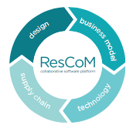
What is different from a business model perspective?
Value Delivery
Value Recovery
Value Capture
Value Offer

Slide 28
Selling service instead of products
Not unique to circular economy
Rolls Royce has used ”Power by the hour” since 1962
By keeping ownership of the physical product….
  It is easier to get products back (Important for volume)
  Responsibility stays with the organization developing the product
  But, the user may be equally careful with the product!

Slide 29
Opportunities in treating waste as a resource
Waste has a cost associated with it
Numerous laws and regulations connected to waste and waste management
However, the materials can still have value. Especially in a circular economy.
  Some argue for using the word secondary product or byproduct to emphasize the value potential
  The legislation, however, does not support this vocabulary.

Slide 30
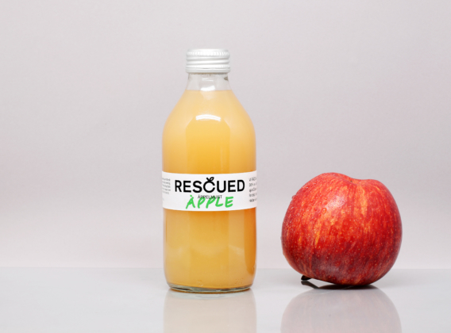
Rescued
Jucie made from discarded fruit at the grocery terminal
Sold to cafés and in grocery stores

Slide 31
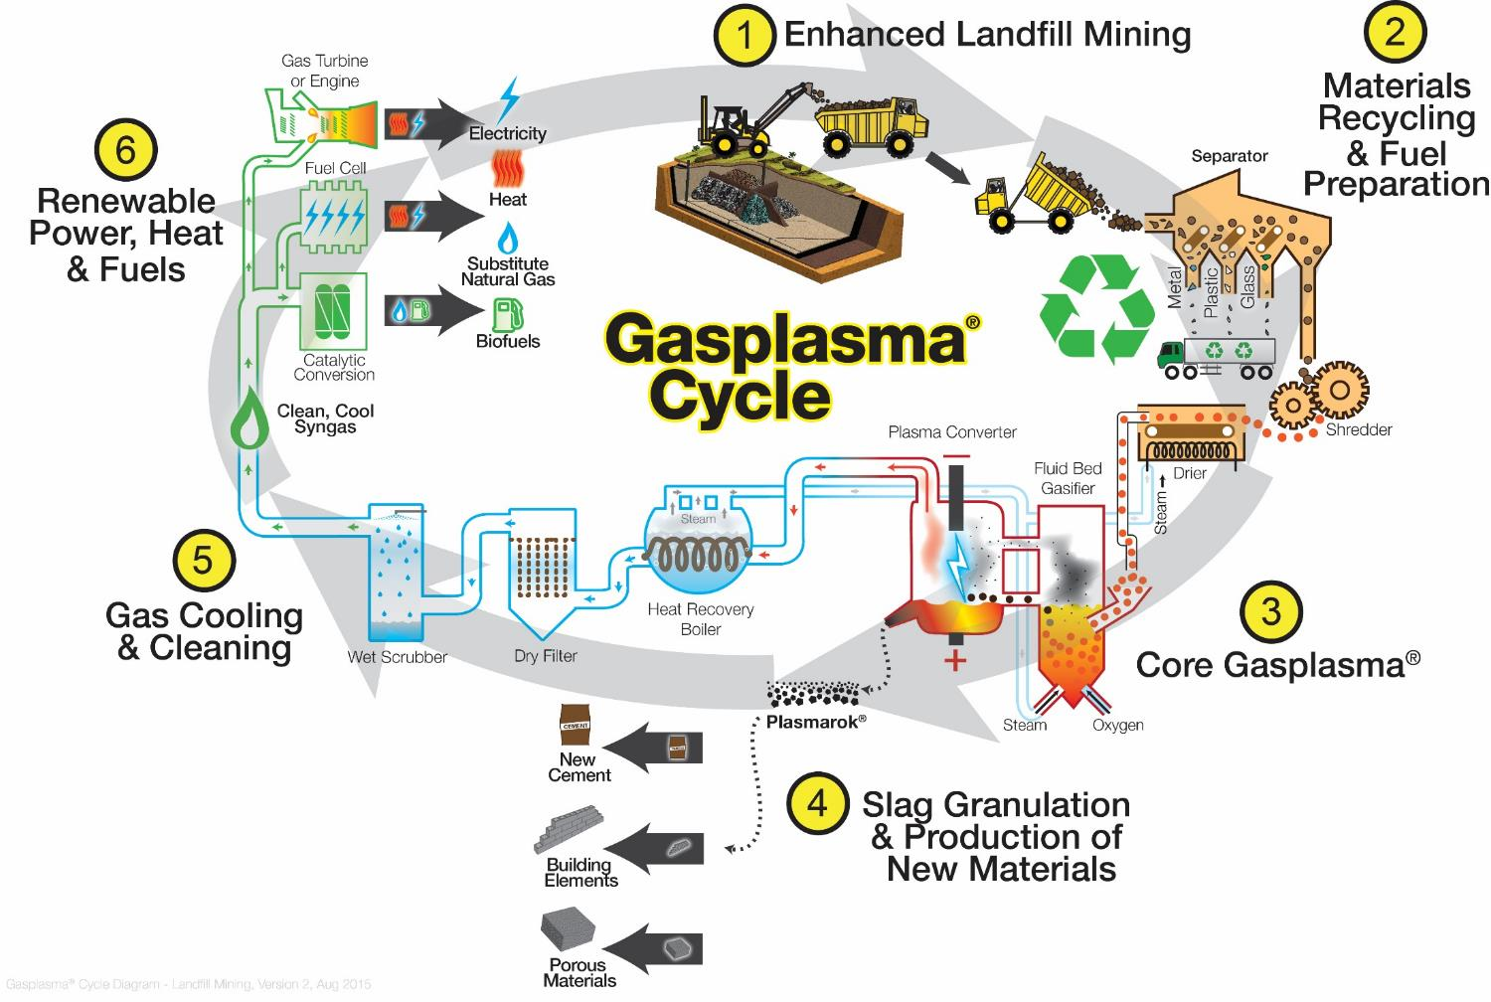
Project on landfill mining
The materials in landfills can be of significant value
Rest product tested as raw material for high value floor tile

Slide 32
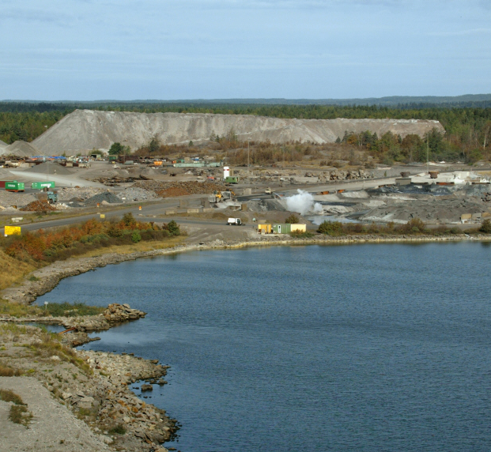
But it is not quite as straight forward as it sounds…
Slag from steel production can be used to neutralize acid
However, this results in larger amounts of waste classified as hazardous.
Discuss with the person sitting next to you in the classroom
Notes:
This is a current research project. By using slag, the company can reduce it’s use of pure calcium. On the other hand, the new bi-product is classified as hazardous.
Financially it is more costly per tonne to handle hazardous waste. BUT, the situation in this particular company is that the permits for slag piles is a more immediate problem. They are approaching the top limit and sealing the old pile and starting the new is a huge investment with significant uncertainty.

Slide 33
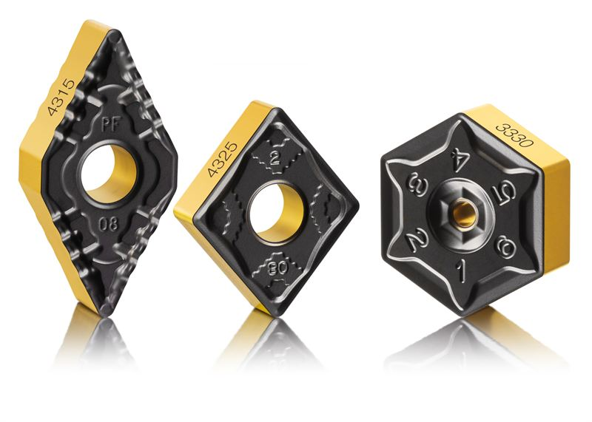
Preparation for future regulations
Example: project COFREE
Funded by EIT Raw Materials
Given concerns about the possible
reclassification of cobalt as a carcinogen,
this project aims to find a substitute to
cobalt that is feasible to use in cemented
carbide tools. Instead of cobalt and iron-
nickel alloy will be used as binder. Cemented
carbide tools are widely used in mining and
manufacturing industries.

Slide 34
Eco design
Eco design consists in designing a product -or service- so as to minimize its impacts on the environment.
World Business Council for Sustainable Development (WBCSD)
Rio de Janeiro Earth Summit, 3-14 June 1992
www.wbcsd.ch
Eco-design applies at every stage in a product’s life: raw material extraction, production, packaging, distribution, use, recovery, recycling, incineration, etc.
> 560 kg
of solid waste are produced per capita each year in the industrialized countries: 3 times more than in 1984
www.unep.fr/shared/publications/other/.../ecodesign.pdf
Notes:
www.wbcsd.ch
www.ecodesign.at/information/einfuehrung/index.en.html
http://europa.eu.int/comm/enterprise/eco_design
www.uneptie.org/pc/sustain/design/design.htm

Slide 35
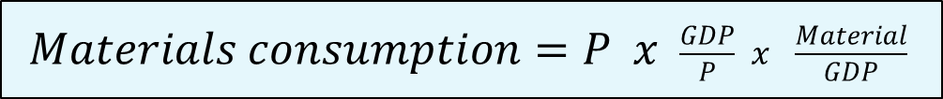
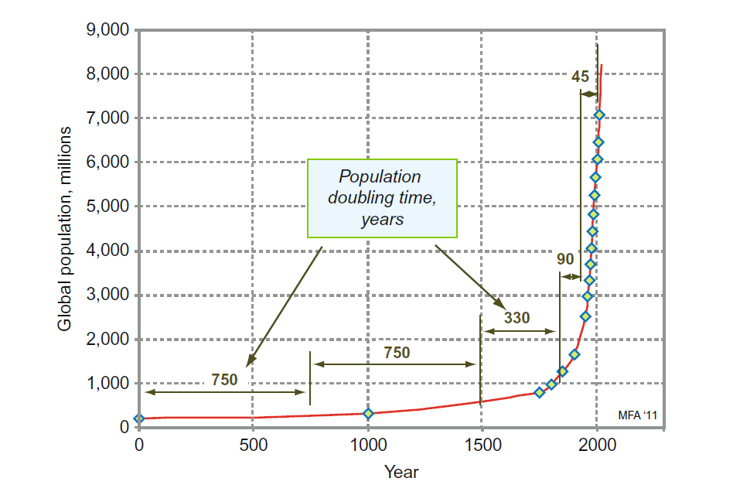
Eco design
Carbon, Energy and Gross Domestic Product (GDP)
The material consumption growth
Global Population
Material intensity of GDP = the amount of material consumed
per unit of GDP.
Gross domestic product per capita
Materials and the Environment. © 2013 Elsevier Inc. All rights reserved.
Notes:
www.wbcsd.ch
www.ecodesign.at/information/einfuehrung/index.en.html
http://europa.eu.int/comm/enterprise/eco_design
www.uneptie.org/pc/sustain/design/design.htm

Slide 36
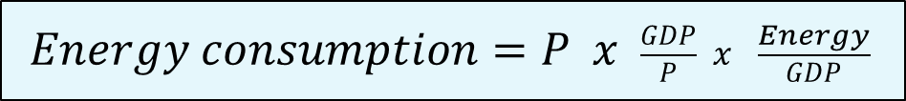
Eco design
Carbon, Energy and Gross Domestic Product (GDP)
Then energy consumption growth
Energy intensity of GDP = the amount of energy consumed
per unit of GDP.
Global
Population
Gross domestic product per capita
Materials and the Environment. © 2013 Elsevier Inc. All rights reserved.
Notes:
www.wbcsd.ch
www.ecodesign.at/information/einfuehrung/index.en.html
http://europa.eu.int/comm/enterprise/eco_design
www.uneptie.org/pc/sustain/design/design.htm

Slide 37
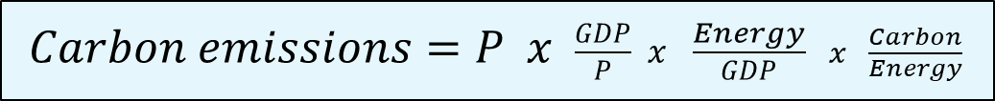
Eco design
Carbon, Energy and Gross Domestic Product (GDP)
Then Carbon emissions growth
Global
Population
Gross domestic product per capita
Carbon intensity of energy
Energy intensity of GDP = the amount of energy consumed
per unit of GDP.
Materials and the Environment. © 2013 Elsevier Inc. All rights reserved.
Notes:
www.wbcsd.ch
www.ecodesign.at/information/einfuehrung/index.en.html
http://europa.eu.int/comm/enterprise/eco_design
www.uneptie.org/pc/sustain/design/design.htm

Slide 38
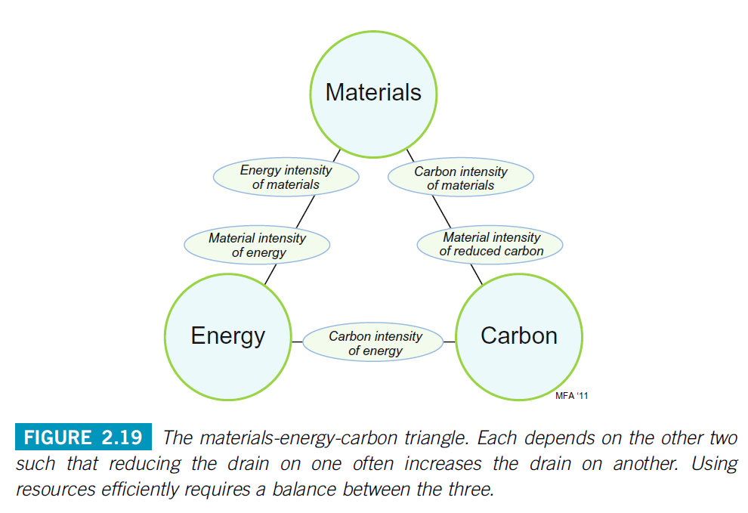
Eco design
Carbon, Energy and Gross Domestic Product (GDP)
Materials and the Environment. © 2013 Elsevier Inc. All rights reserved.

Slide 39
Eco design
Some of the ways eco-design can minimize environmental impact
1st stage
Raw materials. Manufacturing a product means first exploiting raw materials. Extracting and processing these constituent parts consumes natural resources, uses energy and is a source of pollution.
Solutions: reduce quantities, choose the most appropriate materials, transform waste into raw materials, prefer renewable materials and products that use only one type.
www.unep.fr/shared/publications/other/.../ecodesign.pdf
Notes:
www.wbcsd.ch
www.ecodesign.at/information/einfuehrung/index.en.html
http://europa.eu.int/comm/enterprise/eco_design
www.uneptie.org/pc/sustain/design/design.htm

Slide 40
Eco design
Some of the ways eco-design can minimize environmental impact
2nd stage
Production. Manufacturing tends to consume large amounts of energy because of the complex processes it involves.
Solutions: optimize production processes, use of renewable energies, assemble products so they are easy to separate into their different components for repair or recycling (design for disassembly).
www.unep.fr/shared/publications/other/.../ecodesign.pdf
Notes:
www.wbcsd.ch
www.ecodesign.at/information/einfuehrung/index.en.html
http://europa.eu.int/comm/enterprise/eco_design
www.uneptie.org/pc/sustain/design/design.htm

Slide 41
Eco design
Some of the ways eco-design can minimize impacts
3rd stage
Packaging. Bottles, boxes, cans and other packaging currently account for over half the volume of household waste in developed countries.
Solutions: concentrate products, reduce the amount and volume of packaging to make savings along the chain, from manufacturing to waste disposal.
www.unep.fr/shared/publications/other/.../ecodesign.pdf
Notes:
www.wbcsd.ch
www.ecodesign.at/information/einfuehrung/index.en.html
http://europa.eu.int/comm/enterprise/eco_design
www.uneptie.org/pc/sustain/design/design.htm

Slide 42
Eco design
Some of the ways eco-design can minimize impacts
4th stage
Transportation. Delocated production, cost-cutting and liberalized markets all add up to one thing: products travel thousands of kilometres before being used.
Solutions: choose manufacturing sites according to the products’ final destination, use combined transport and alternative fuels, optimize loads.
www.unep.fr/shared/publications/other/.../ecodesign.pdf
Notes:
www.wbcsd.ch
www.ecodesign.at/information/einfuehrung/index.en.html
http://europa.eu.int/comm/enterprise/eco_design
www.uneptie.org/pc/sustain/design/design.htm

Slide 43
Eco design
Some of the ways eco-design can minimize impacts
5th stage:
Use. Using products, operating appliances and maintaining them in working order requires more or less energy, water, etc. Usually designed to be frequently replaced, goods today are increasingly fragile and hard to repair, which encourages wastefulness and generates waste.
Solutions: design functional, energy-saving or autonomous products that are lasting, use of renewable energy, safe and easy to maintain or repair.
www.unep.fr/shared/publications/other/.../ecodesign.pdf
Notes:
www.wbcsd.ch
www.ecodesign.at/information/einfuehrung/index.en.html
http://europa.eu.int/comm/enterprise/eco_design
www.uneptie.org/pc/sustain/design/design.htm

Slide 44
Eco design
Some of the ways eco-design can minimize impacts
6th stage:
Disposal and recycling. Worn-out or damaged products are more or less easy to recycle. The multiple components, alloys and other combinations of materials from which they are made render disassembling and processing a complex and costly procedure.
Solutions: develop reusable or recyclable products and components, select feedstock materials based on circularity potential
.
www.unep.fr/shared/publications/other/.../ecodesign.pdf
Notes:
www.wbcsd.ch
www.ecodesign.at/information/einfuehrung/index.en.html
http://europa.eu.int/comm/enterprise/eco_design
www.uneptie.org/pc/sustain/design/design.htm

Slide 45
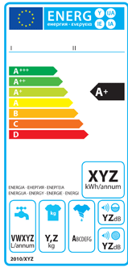
Eco design
& Energy Labelling Directive
Ecodesign Directive (2009/125/EC) aims at setting requirements on the significant environmental aspects of energy-using and energy-related products.
Energy Labelling Directive (2010/30/EU) informs consumers about the consumption of energy and other resources by energy-related products. It aims at helping consumers choose products which save energy and provides incentives for the industry to develop and invest in energy efficient product design.

Slide 46
Eco design - opportunities
Environmental Aspects, some Dilemma's
 | Emissions | Resources | Potential Toxicity
Use of natural gas instead of coal to generate energy | + (less CO2) | - (high entropy) | + (no ash)
Plastics vs. Metals | + (less energy needed) | - (recycling is a problem) | - (additives)
Leadfree solder | - (more energy needed) | - (uses more scarce resources) | + (presence of lead)
Use of flame retardants | ? | + (less material needed) | - (production, end of life issues)

Slide 47

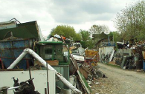

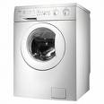



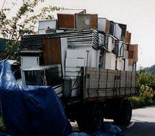
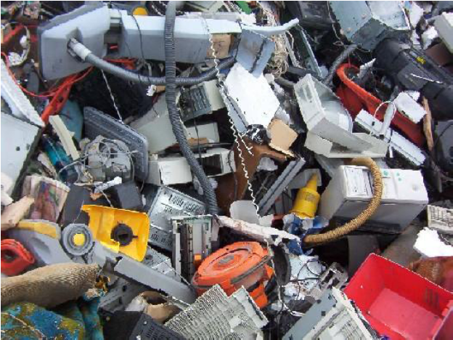

Eco design – opportunities
From “Less Bad” to “Doing Good” (2/2)
1990
Production
Use
Waste Collection
+ +
New
Σ all
- -
Focus on weight reduction
Prof.Dr.Ir. Ab Stevels Applied EcoDesign, Design for sustainability Lab Delft University of Technology

Slide 48

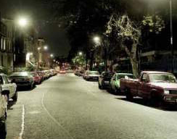
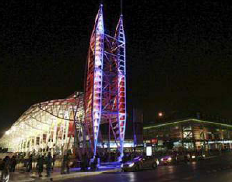

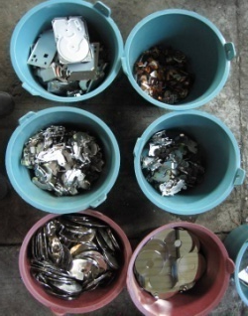
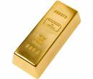

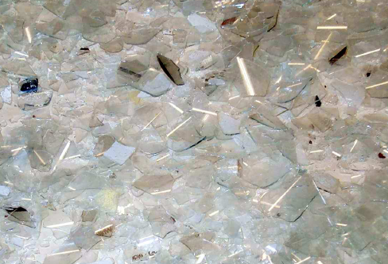


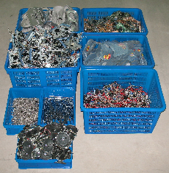
Eco design – opportunities
From “Less Bad” to “Doing Good” (2/2)
2015
Use
Collection
Recycling
Production
+ +
+ +
New
+ +
+ +
- -
+ +
Focus: Materials not only weight!
Prof.Dr.Ir. Ab Stevels Applied EcoDesign, Design for sustainability Lab Delft University of Technology

Slide 49
Critical raw materials (CRMs)
First list of CRMs – in 2011, a list of 14 CRMs was published in the communication on raw materials. The list of CRMs was established as a priority action of the EU ‘raw materials initiative’ of 2008. The Commission is committed to updating the list at least every 3 years to reflect production, market and technological developments.
Second list of CRMs – in 2014, a first revised list of 20 CRMs was published in the communication on the list of critical raw materials 2014.
Third list of CRMs – in 2017, a third list of 27 CRMs was published, based on a refined methodology.
http://ec.europa.eu/growth/sectors/raw-materials/specific-interest/critical_it

Slide 50
Critical raw materials (CRMs)
Methodology on CRMs – in July 2017, the Commission published a revised methodology for establishing the EU list of critical raw materials. They also integrate the methodological improvements identified by the Commission in the project ‘Assessment of the methodology on the list of critical raw materials’, in areas such as manufacturing applications, trade, substitution, recycling.
  Report on CRMs and the circular economy – in January 2018, the Commission published a report highlighting the potential for a more circular usage of CRMs in our economy. Reviewing important sectors for CRMs, it describes relevant EU policies, refers to key initiatives, presents and gives sources of data, identifies good practices and indicates possible further actions.
http://ec.europa.eu/growth/sectors/raw-materials/specific-interest/critical_it

Slide 51
The list of CRMs for EU 2017
The main parameters used to determine the criticality of the material for the EU are:
Economic importance - aims at providing insight into the importance of a material for the EU economy in terms of end-use applications and the value added (VA) of corresponding EU manufacturing sectors at the NACE Rev.2 (2-digit level). The economic importance is corrected by the substitution index (SIEI) related to technical and cost performance of the substitutes for individual applications.
Supply risk - reflects the risk of a disruption in the EU supply of the material. It is based on the concentration of primary supply from raw materials producing countries, considering their governance performance and trade aspects. Depending on the EU import reliance (IR), proportionally the 2 sets of the producing countries are taken into account — the global suppliers and the countries from which the EU is sourcing the raw materials. SR is measured at the ‘bottleneck’ stage of the material (extraction or processing), which presents the highest supply risk for the EU. Substitution and recycling are considered risk-reducing measures.
http://ec.europa.eu/growth/sectors/raw-materials/specific-interest/critical_it

Slide 52
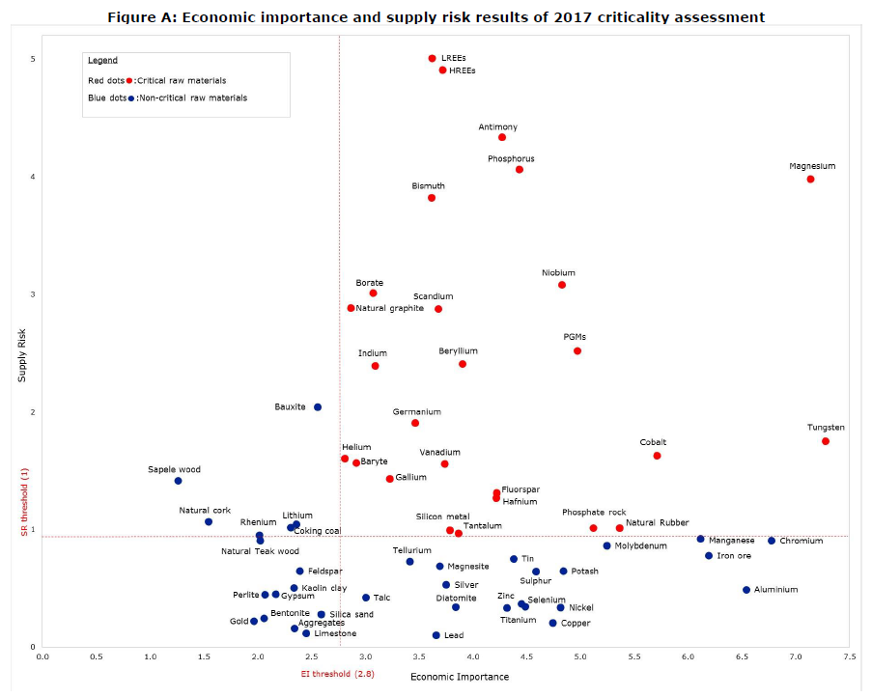

Slide 53
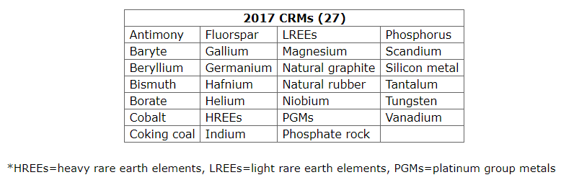
The list of CRMs for EU 2017
http://ec.europa.eu/growth/sectors/raw-materials/specific-interest/critical_it

Slide 54
Embodied energy
The embodied energy (Hm) of a material is the energy per unit mass (MJ/kg) that must be committed to
produce
1kg of material

Slide 55
Carbon (CO₂) footprint
The CO₂ footprint is the sum of all the contributions to CO₂ release (kgCO₂) per unit mass (kg) of usable material exiting the plant.
Possible contributes to CO₂ release:
Generation of electric power used by the plants;
Transportation
Shaping process

Slide 56
Embodied energy and Carbon (CO₂) footprint of materials

Slide 57


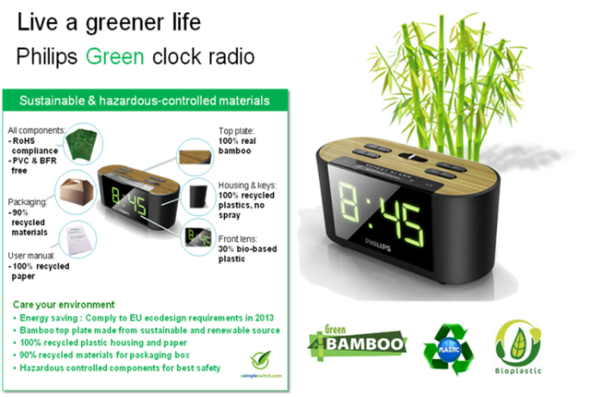

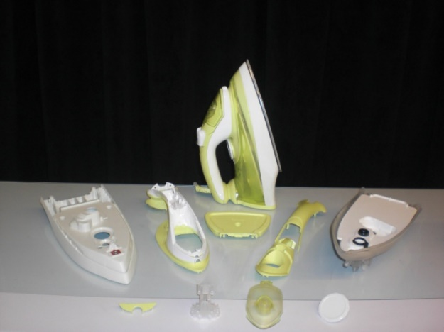
Philips products with recycled plastics running
4 vacuum cleaners:
25% to 47% recycled plastics
BDP9600 :
50% recycled plastics
Launched
In development – launch in 2011
Iron E3700:
30% recycled plastics
Senseo
Special edition:
50% recycled
plastics
AJ3570:
>30% recycled plastics
Prof.Dr.Ir. Ab Stevels Applied EcoDesign, Design for sustainability Lab Delft University of Technology
Notes:
We took the first steps with recycled plastics 2010.
In 2011 we expect to apply recycled plastics in products at floorcare, at Audio and Video, at Beverages and at Garment Care.
Some of the products are already on the market and some will be launched in 2011. Typically the percentage of plastic coming from a recycled source is between 25 and 50 %.

Slide 58

Philips products with recycled plastics running
Challenges in
Availability
Quality
Price
Post Industrial recycled
Plastics (PIR)
(from industrial waste)
Offers choice, but availability is limited
Post Consumer recycled plastics (PCR)
(from used products)
In principle high availability, but difficult to get high quality
Philips chemical requirements (RSL)
too strict for recycled materials
Conflict in legislation:
WEEE requires
recycling and reuse
REACH requires full transparency of materials
High quality recycled
plastics are scarce.
Suppliers tend to
ask price premium
Prof.Dr.Ir. Ab Stevels Applied EcoDesign, Design for sustainability Lab Delft University of Technology
Notes:
It seems simple, but it isn’t.
We face challenges on availability, quality and price.
On availability recycled plastics coming from industrial waste come from a known source (this ensures quality) and have color options. However the availability is limited.
For plastics coming from recycled old products (called post-consumer recycled), the availability is in principle high, but only offered in black and it is difficult to ensure the quality
The issue with quality is that the source for recycled plastics often is not homogeneous. As we have to comply with the strict chemical requirements from Philips, this is a difficult task. On top of that, the legislation is conflicting, as on the one hand legislation asked for more use of recycled materials, on the other hand a full transparency is required.
As the availability of high quality is limited the suppliers tend to ask a price premium.

Slide 59
Future sustainable technologies
No official definition for ‘sustainable technologies’.
Assumption - Technologies, whose use implicates positive environmental effects:
FST replace an obsolete technology and hereby reduce environmental impacts
FST lead to emission reductions (e.g. automotive catalysts)
FST provide power efficiency during the production or consumption phase (e.g. energy efficient LED lamps)
FST can be used to monitor political or social behaviour causing negative environmental effects (e.g. electronic devices in satellites for environmental surveillance)

Slide 60
Embodied energy and Carbon (CO₂) footprint of processes

Slide 61
Embodied energy and Carbon (CO₂) footprint of processes

Slide 62
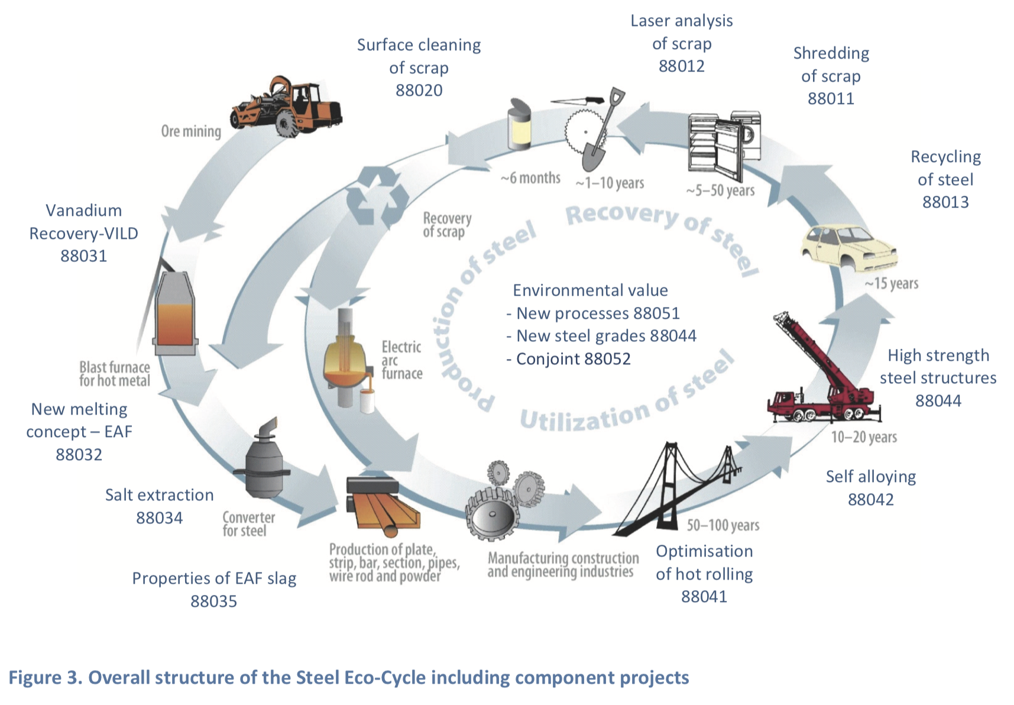
Think in systems and cascades
www.stalkretsloppet.se

Slide 63
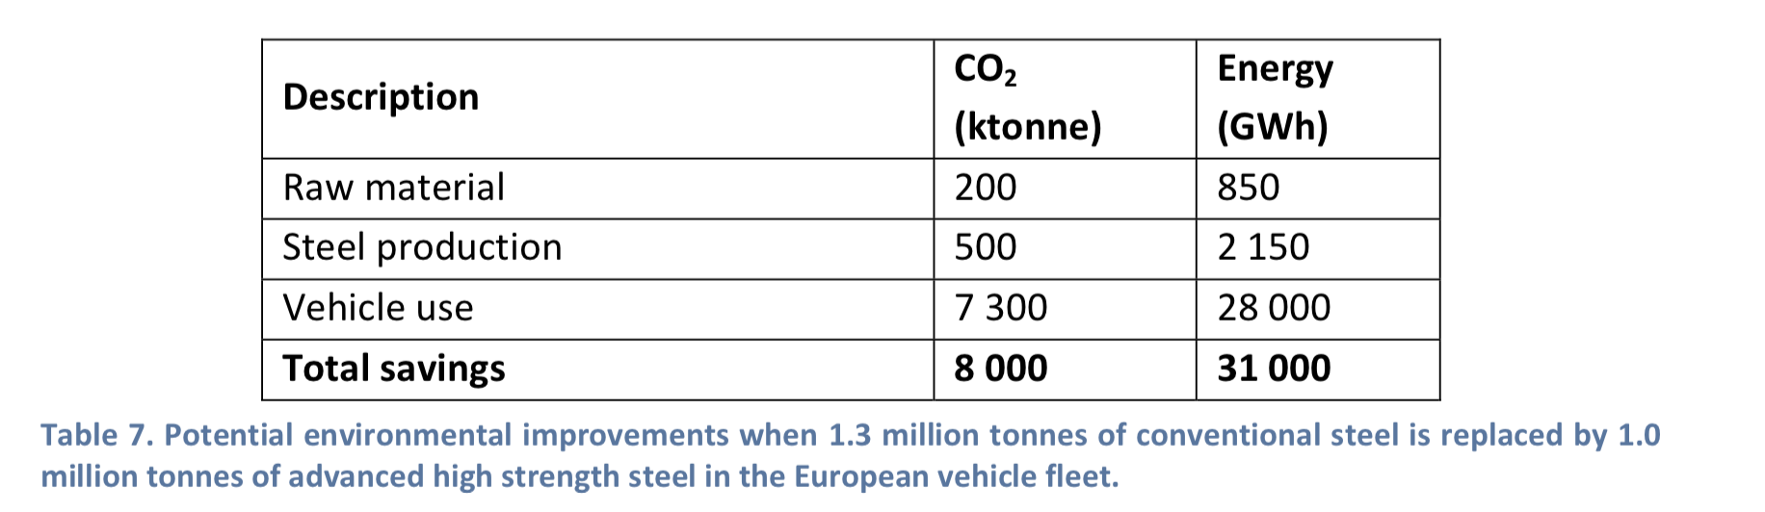

Slide 64
Barriers to system thinking
Actors don’t share a common goal
(Agency theory)
System thinking requires spending resources on coordination etc. Who takes these costs?
  This is a problem even within organisations, budgets etc.
  Complexity increseas exponentially with more actors

Slide 65

Geothermal cascades – Example from GE
Notes:
Example of energy cascades. The same principle can be applied to materials.

Slide 66



Changes with higher level of system integration are more challenging
Notes:
Slag from blast furnace steel production can be used as base in riding arenas is a simple case. The slag is an existing by product, no changes to the process were made. The steel maker just found a way to sell it on. Same with the consmer side. There are no lock in effects. If slag is not available, other materials are.
The second two are examples where two systems need to be integrated and adapted for the change to work.
The last two (one to the right) are examples of larger system changes….

Slide 67
References

Slide 68








Contact information: [name + organisation+ mail address]
Acknowledgements
Thank you to EIT-RM for its financial support to create this course.

