Slide 1
MEC-E5003
FLUID POWER BASICS – PNEUMATICS
Study Year 2018 - 2019

Slide 2
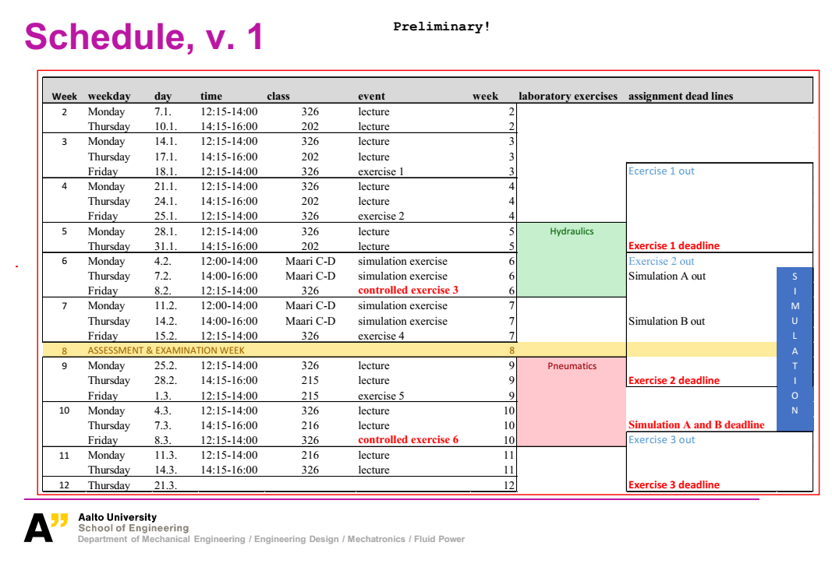

Slide 3
Content:
Introduction to Pneumatics
Advantages & Drawbacks
Applications
Pressure Units and Conversion
System components and Process
Compressor, Storage, Air Treatment, Distribution
Pressure Regulation, FRL, Actuators
Pneumatic system design considerations
Pneumatic components selection (Quiz)
Pneumatic circuits and control
Instrumentation in Pneumatics system
Safety and Maintenance
Study material resource
- - Lecture Quiz 1
- - Lecture Quiz 2
- - Lecture Quiz 3
- - Lecture Quiz 4
- - Lecture Quiz 5

Slide 4
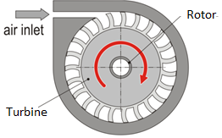
Introduction to Pneumatics
Fluid medium in pneumatics : Air
Working: The volume is reduced by compression and thus, increasing pressure. Compressed air is mainly used to do work by acting on a linear pistor or rotor – producing some useful motion.
Background: Compressed air is used widely in industry in different applications like automation, pneumatic tools, material handling, process industry applications and vacuum technology.
Why Air and not other gases? It is abundantly available in contrast to, for example, Nitrogen and Argon which are expensive to produce and process, although inert gas may be useful in fire hazard places

Slide 5
Introduction to Pneumatics
Factual Information:
According to various references in western European countries, 7-11 % of electric energy used in in industry is used for making compressed air. Compressed air is also the most expensive energy form used by industry.
“The cost to produce compressed air varies from 12 to 40 EUR per 1000 m_{n}^{3,} which depends on the geographical location.”
Ref: Price Reduction on Compressed Air by Dubravka Siminiati – Eng.Rev 31-1 (2011) 63-67

Slide 6
Advantages
Drawbacks
1. Unlimited source 2. Easy to store 3. easy to transfer pneumatic energy even long ways 4. For contamination free environment 5. Longer energy storage in reservoir
6. Safe to use in fire hazard places 7. natural overloading protection 8. easy and simple ways to control speed and force 9. simple and inexpensive components 10. high speeds (cylinder piston speed max 10-20 m/s, motor rotating speed varies between 10 - 500.000 rpm)
11. Low maintenance
12. Lower cost of installation than Hydraulics
1.slow and even motion is difficult to achieve (compressibility, friction)
2. small forces compared to hydraulics (cylinder force max about 10 kN)
3. noise level is sometimes high, especially from exhaust air
4. energy consumption of especially pneumatic motors is bad
5. low overall efficiency
6. Difficult to achieve precision movement

Slide 7
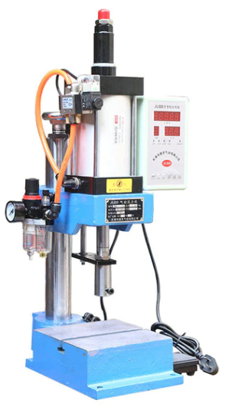
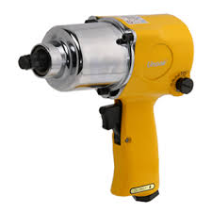
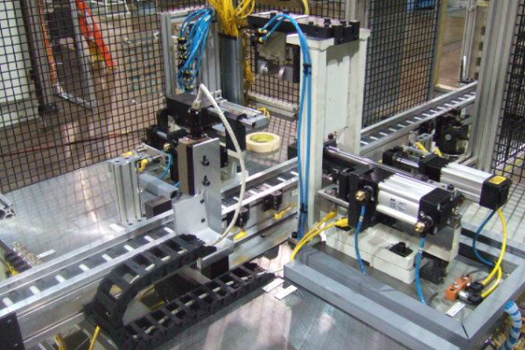
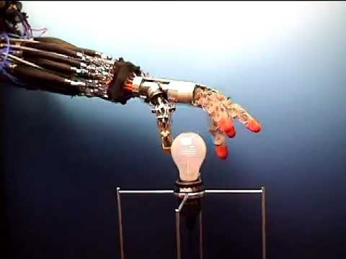
Applications
Pneumatic Toolings
Press machine/Sheet Metal/Assembly
Production Line automation
Other areas:
Light weight pieces are handled
Fast linear movements are required
Clean room/contamination free operations requirement.
Operation is located in a fire or explosion sensitive place
Soft griping, Robotics pneumatic muscles

Slide 8
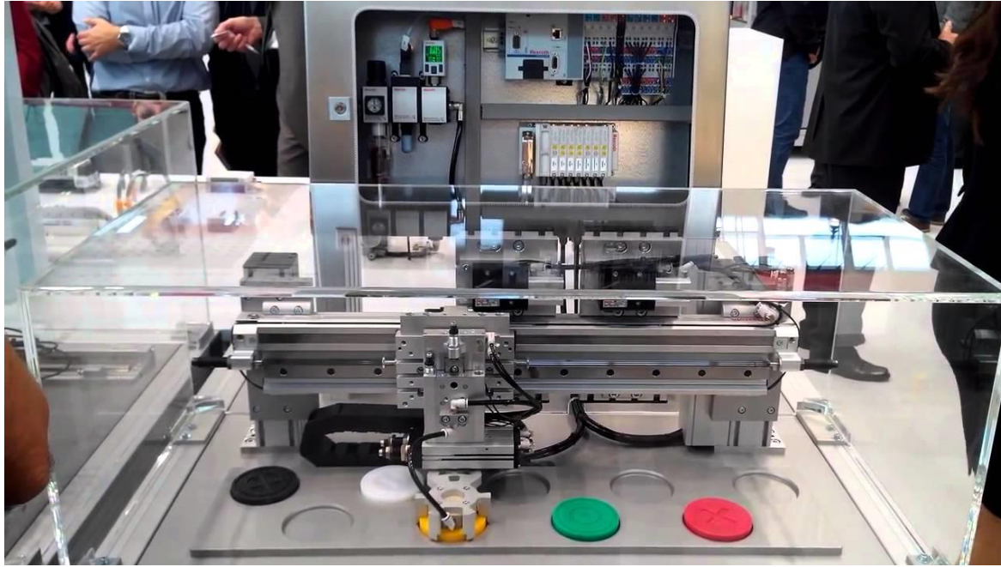
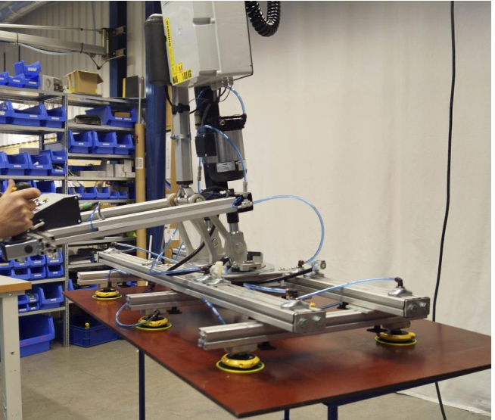
Other Applications
Positioning through pneumatic control
Vacuum handling
Pneumatics based automation video:
https://www.youtube.com/watch?v=LARXsENEFuU

Slide 9
Units and Conversion
Pressures
Pressure formula: p = F/A [N/m^2]
SI Unite for Pressure: N/m2 = Pascal = Pa
In pneumatic systems, pressures are typically between:
300 – 1000 kPa (= 3 – 10 bar)
In hydraulics, pressures are typically between:
5 – 45 MPa (= 50 – 450 bar)
In USA, the unit for pressure still used is:
1 psi = 1 lbf/in2 = 6894,8 Pa
Absolute pressure = air pressure + over pressure (”working pressure”)
In Vacuum = Pressure below atmospheric is called Under pressure / Negative pressure

Slide 10
Lecture Quiz 1:
List three advantages of Pneumatics over Hydraulics
List three applications of pneumatic in industry
Numerical 1: A clamping force of 500 N is required to hold a tool in an assembly factory, using pneumatic cylinder. What is the inlet pressure required (in bar), when the cap side diameter is 32 mm and stroke length is 100 mm and extends fully.
If the pressure source is cutoff, and counter force of 1000 N acts on the clamp in negative direction, what would be the new volume in the cylinder? Considering constant temperature (ideal gas law) and no leakages.

Slide 11
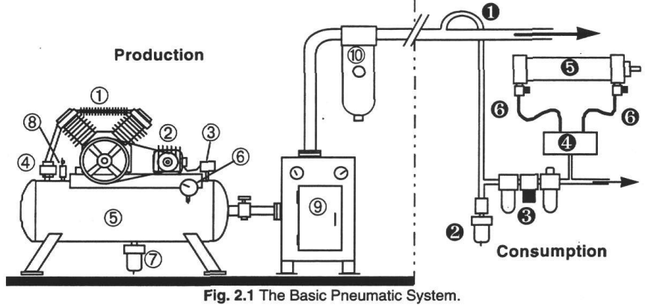
Pneumatic System and Process
Compression & Storage
Air Conditioning
Distrubtion/ Filtration
Actuator
Images Ref: SMC Basic Pneumatics

Slide 12
System in detail:
Compressor and drive
Pressure Switch and Valve
Storage
Conditioning
Distribution
FRL – Filter Regulator Lubricator
Directional Valve
Actuator

Slide 13
Electric Drive and Types of Compressor:
Electric motor
The air compressors are driven by the electric motor, connected via shaft to transmit mechanical power
Compressor
The air at atmospheric pressure is compressed to increase to higher pressure to the pneumatic system. The pressure is usually higher at the compression station than the actuator to account for pressure losses during distribution.
Positive Displacement Compressors
Reciprocating
Rotary
Piston
Diaphragm
Vane
Screw
Positive Displacement Pumps are covered due to requirement of high pressure in fluid power systems

Slide 14
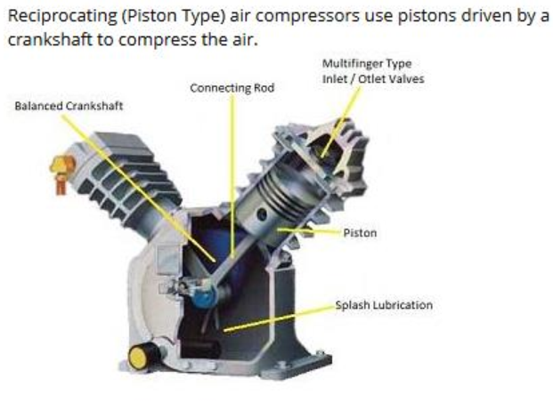
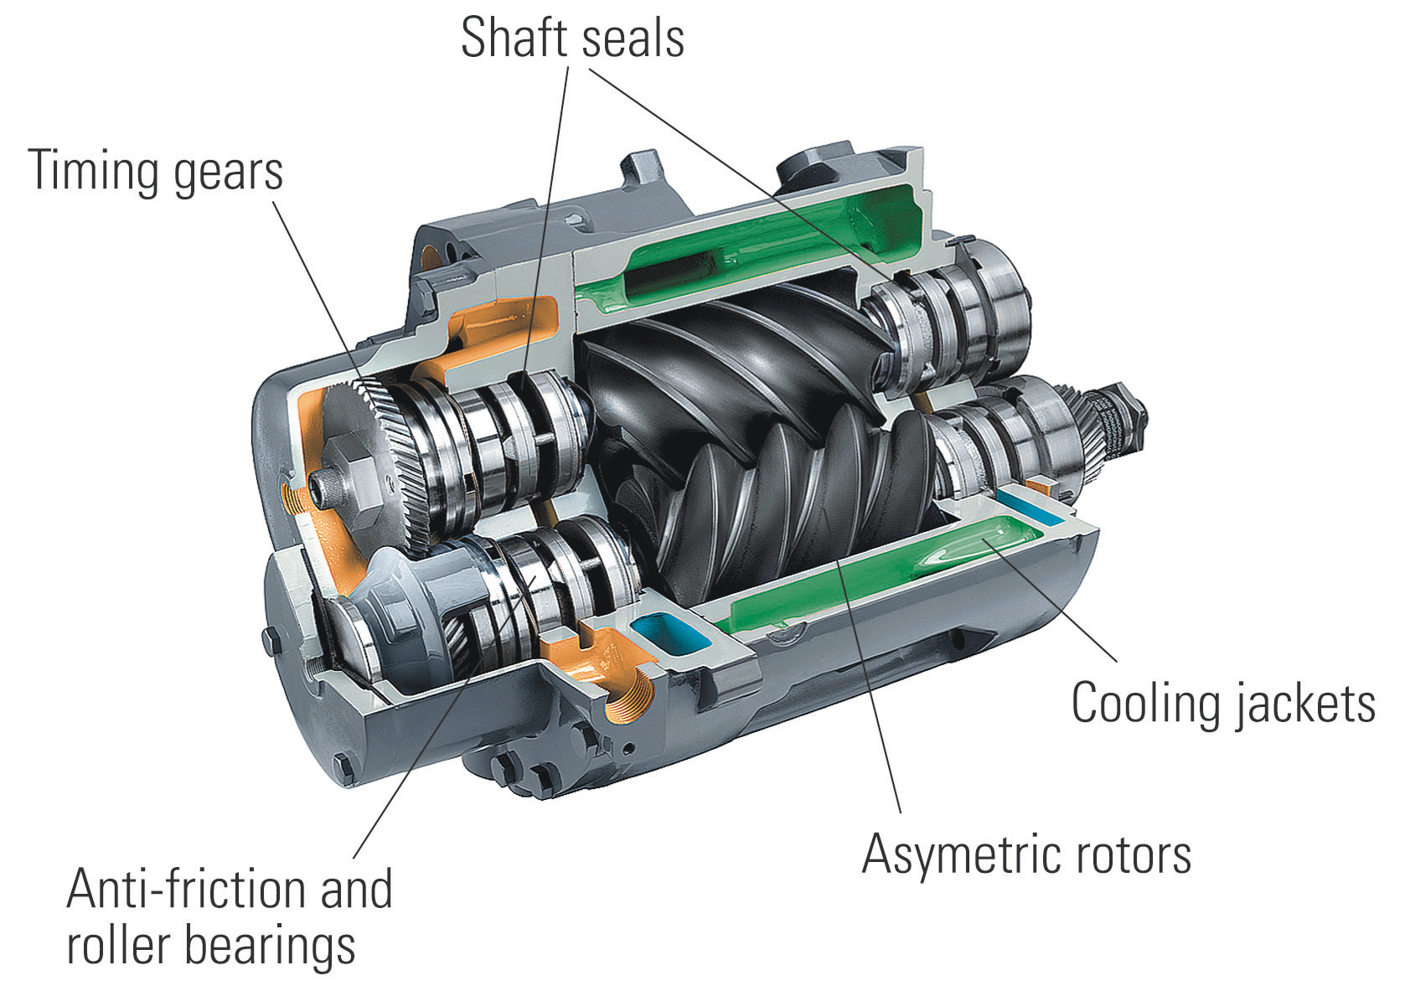
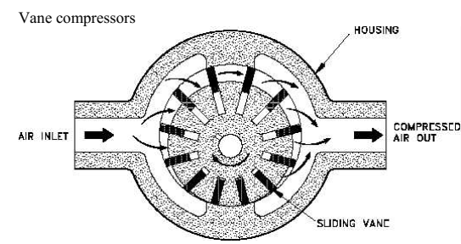
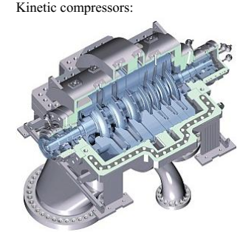
Types of Compressor:
Type : | Piston | Screw | Vane | Turbo
Figure
Flow (N m^3/h*) ** | 150 - 25000 | 800 - 60000 | 250 - 15000 | 60000-500000
Pressure Range (bar)** | 1 - 1000 | 0.8 - 25 | 0.15 – 8.5 | 0.7 – 4 (10-12 phase kinetics can go upto 20 bar)
Other Details | -Single stage/Multi-Stage compression - Pulse type flow | Gear Pump Continuous flow | Continuous flow Can vary displacement | Also called Centrifugal comp. - not exactly for closed circuit (FPS)
*Normal meter cube per hour
** Values may differ in different resources

Slide 15
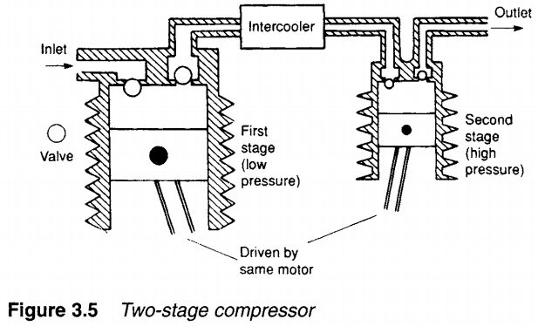
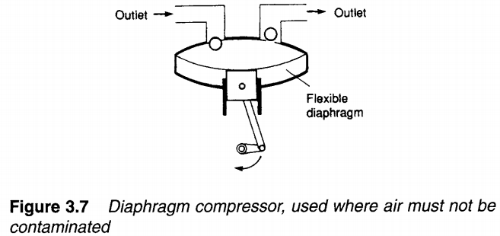
Compressors in detail:
Piston Pump
Compresses direct from atm pressure to desired range
Two stage compression usually for 10-15 bar
Possible contamination due to oil film contact with air, a diaphragm is installed, which is undesirable in food and chemical industry
Images Ref: Hydraulics and Pneumatics by Andrew A Parr

Slide 16
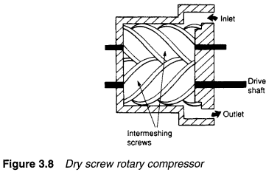
Compressors in detail:
Screw Pump
Suitable for medium range flows 10.000 m^3/hr and industrial pressure range of <10 bar or around.
Less moving parts, means lesser maintenance
Steady delivery than the pulse type in piston compressor
Dry type and Wet type rotary pump
Images Ref: Hydraulics and Pneumatics by Andrew A Parr

Slide 17
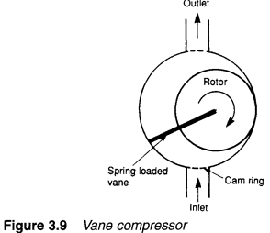
Compressors in detail:
Vane Pump
Only low pressure requirement areas - ~3 bar – 5 bar and high delivery volume
Can also be setup in two stage for higher compression pressure – 10 bar
Highly efficient than screw compressor in terms of energy use
Higher lifespan with reduced maintenance
Usually used in continuous pressured air delivery operation areas
Images Ref: Hydraulics and Pneumatics by Andrew A Parr

Slide 18
Compressors in detail:
For in-depth technical study of each construct, refer to:
Fluid Power with Applications Fourth Edition – Anthony Esposito - Chapter 10.4 (Aalto Library – K3)
Basic Pneumatics by SMC – Chapter 4 – (Link in the Reference Section
Open Source- Hydraulics and Pneumatics
https://www.hydraulicspneumatics.com/other-technologies/chapter-8-air-and-hydraulic-pumps-part-1
https://www.hydraulicspneumatics.com/other-technologies/chapter-8-air-and-hydraulic-pumps-part-2

Slide 19
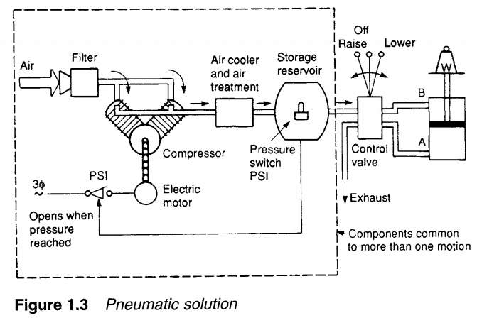
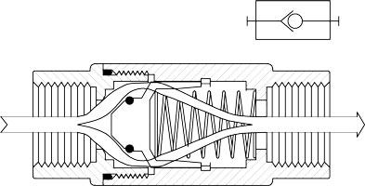
Safety switch and Pressure valve:
Pressure Switch
Several types of pressure control valves are found in the fluid power circuit. At the compression stage, the function of this switch is to turn off/on the electric motor when the preset maximum or minimum is reached, respectively, in the storage tank.
Check Valve
Allows compressed air to flow in one direction only to the storage tank, and prevents leaking back into the compressor.
Images Ref: Hydraulics and Pneumatics by Andrew A Parr

Slide 20
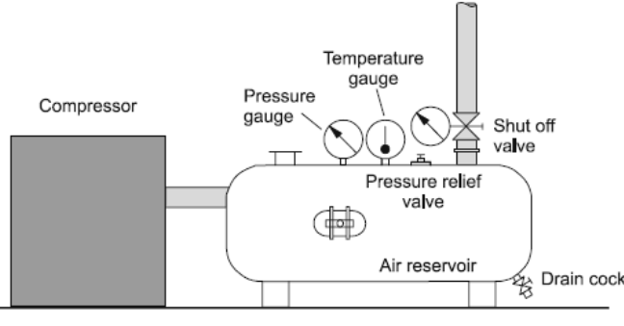
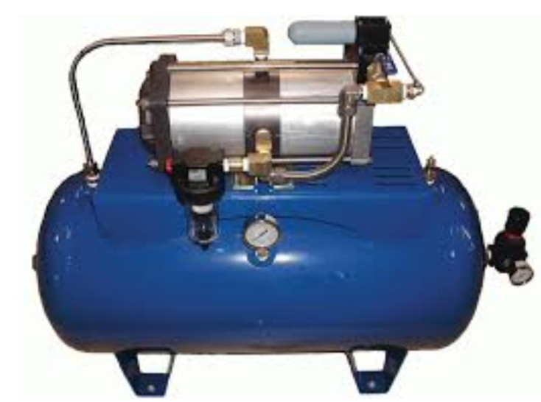
Storage/Reservoir:
Functions of compressed air reservoir
1) Dampens out pressure peaks - that is pressure pulsation of the compressor
2) Even out consumption peaks (act as an accumulator)
3) To remove condensed water
4) Act as reserve energy store during electric breakage
5) Monitor temperature, pressure and switches to control flow
To select the size of a reservoir you must take into account: compressor flow, air usage maximum and control method of the compressor.

Slide 21
Air treament and conditioning :
> After the compression of Air to be supplied to the network, the compressed air is classified according the to ISO 8573-1 standard based on impurities: Solid Particles, Water and Oil.
The impurities needs to be removed, according to the final load actuator/equipment requirement, to keep it clean and dry to reduce wear and have extended life and maintenance time.
The amount of impurities is controlled by different after treatment method in three stages that are:
STAGE 1 - Filtration: depending on the application filtration accuracy can be between 0,1 – 40 µm. This stage is usually before compression and can be also after compression stage depending on the required. Primary Filter is usually dry filter, while secondary could be the same or wet filters removed dirt attached with oil particles.
Images Ref: Hydraulics and Pneumatics by Andrew A Parr

Slide 22
Air treament and conditioning :
STAGE 2- Cooling and Drying: The amount of water in compressed air is determined as a pressurized condensation point (dew point). Air has to be dried to reduce humidity. Applications require very different condensation points depending on their use and environment.
Drying methods:
> Intercooler / Water separator unit (for bulk air drying) > pressurization to higher pressure level -> c. point +10 °C > absorption dryer -> condensation point +0 °C (a chemical method) > adsorption dryer -> condensation point up to -40 °C (-60) (a physical method)
STAGE 3 - Separation of oil: oil comes from the compressor and it is removed with an active carbon filter.
Sometimes, there is also need to do lubrication, introduction of oil in air where pneumatic tools are used in the operation (exception in areas to prevent contamination such as process industry) and keeping the air cooled.
It is usually a secondary process just before the distribution
Controlled amount is introduced in the system

Slide 23
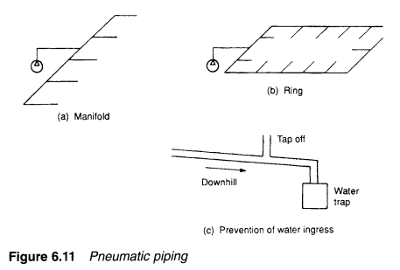
Distribution:
Dividing by connected equipment.
- Dry network including an air dryer has a free layout. − Wet network that has no dryer has limitations on the layout. The network must have angle of deflection about 2-3 degrees. It must have water separation equipment and all connections must be taken from upside of the pipe.
b) Dividing by shape of network.
− Straight network. Biggest disadvantage is that during reparations the network is out of use. − Circle shape network. Pressure distribution is better. Part of the network can be separated for repairing and the other part can still be used normally

Slide 24
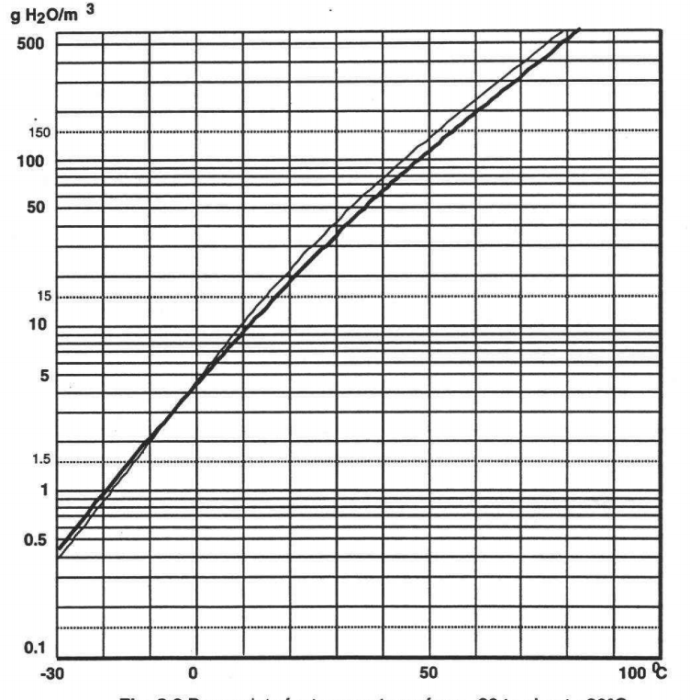
Lecture Quiz 2:
List two superiority of piston compressor over screw type
Name 4 types of compressor based on structure
Numerical 2: A 20 m^3 of air at atmospheric pressure at 30 C and 65% relative humidity (r.h) is compressed to 6 bar gauge pressure (usually the industrial line pressure). The temperature rises to 40 C. How much water condenses out?
r.h = $\frac{actual water content ∗100\%}{saturation quantity (dew point)}$

Slide 25
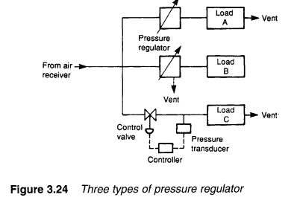
Pressure Regulation and Service unit FRL:
Pressure Regulation (before supply to load)
Flow velocities in pneumatic systems can be quite high, which can lead to significant flow-dependent pressure drops between the air receiver and the load.
Generally, air pressure in the receiver is set higher than the required load pressure and pressure regulation is performed local to loads to keep pressure constant regardless of flow.
Three methods of local pressure control can be used using pressure regulators as shown in the figure.
Three types of pressure regulators are used:
Relief Valve (for simply maintaining pressure or safety valve)
Non-relieving pressure regulators (A spring loaded diaphragm senses the outlet pressure and opens/closes the poppet accordingly to control air flow and pressure
Relieving pressure regulators
Source : Intro to Hydraulics and Pneumatics for detail, pg: 79

Slide 26
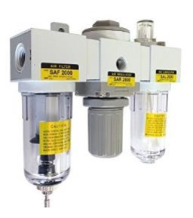
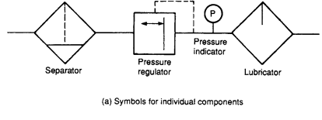
Pressure Regulation and Service unit FRL:
The unit consists of a filter, water separator, pressure controller, pressure gauge and oil mist lubrication system (used with special components only).
A filter separates solid particles and condensed water from air. Accuracy of filter elements with standard automation pneumatics is 20 - 40 µm. In low pressure pneumatics accuracy is about 5 µm and in special applications like food industry it is even 0,1 µm. Water draining can be automatic or hand operated.
Pressure controller is actually a pressure reducing valve which sets the pressure level to certain level and keeps it constant.
Oil mist lubrication systems uses low viscosity mineral oil. Most components today have permanent lubrication and need no oil mist. Pneumatic motors and pneumatic power tools usually need oil lubrication to work properly.

Slide 27
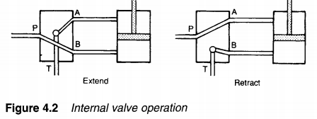
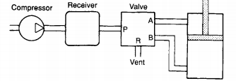
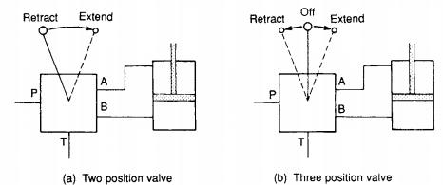
Pneumatic Directional Valves
All fluid power systems (Hydraulics/Pneumatics) requires control valves to regulate and control the flow line to the load. The actuation method of valve is also mostly similar as well as the construction. The stark difference comes with the operating pressure, body construction and seal material (seals material vary to handle oil medium and air medium).
Instead of Reservoir/Tank line, in directional valve it is the vent releasing back into the atmosphere.
Images Ref: Hydraulics and Pneumatics by Andrew A Parr

Slide 28
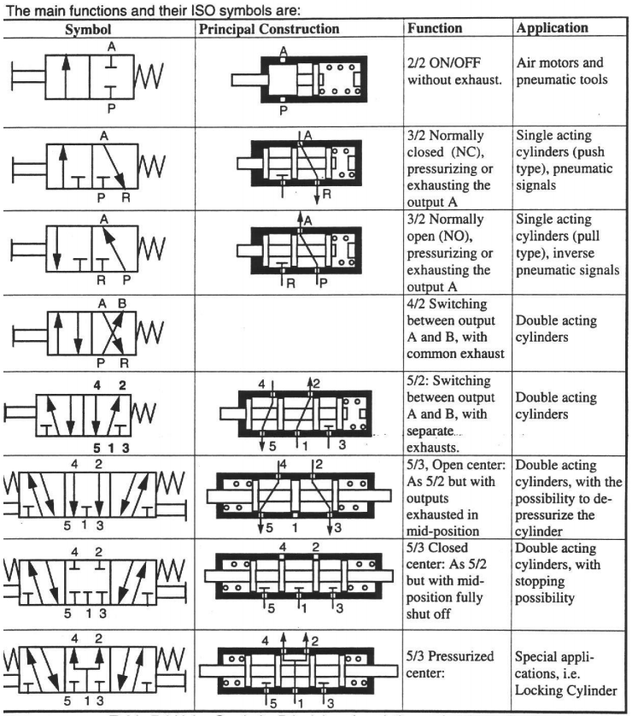
Chart Ref: SMC Pneumatics

Slide 29
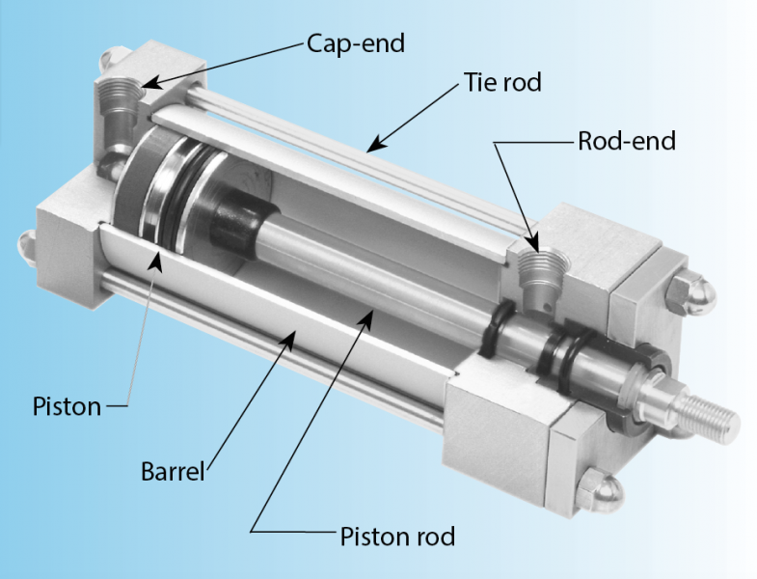
Actuators
Similar to hydraulics, the pneumatic actuators are divided basically into two categories:
Linear
Rotary
As the fluid medium is air, and the pressures are lower than required, the construction is of lighter material in air actuators such as aluminum and other alloys to keep the weight minium, non corrosive and heat transfer characteristics.
Most commonly used actuator in pneumatic applications is Linear Cylinder with various type of construction and functionalities.
Image Ref: Hydraulics and Pneumatics.com

Slide 30
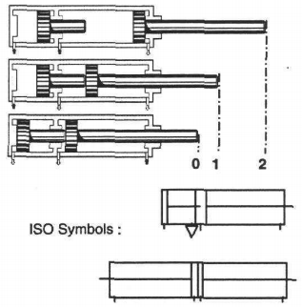
Actuators
Further different kind of linear cylinders used are:
Double Acting
Tandem Cylinder
Twin Rod
Double Rod
Image Ref: SMC Pneumatics
Three and Four position Cylinder

Slide 31
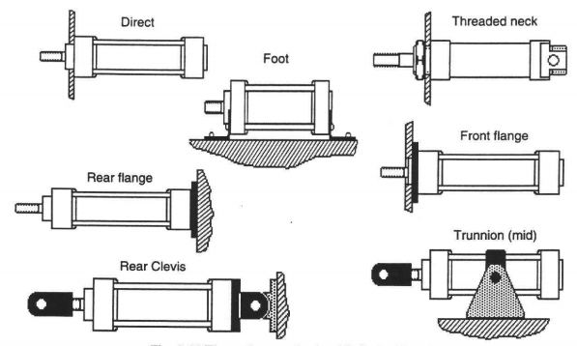
Actuators
Besides internal construction and operation, the external body type is of paramount importance in the use of different areas:
Image Ref: SMC Pneumatics

Slide 32
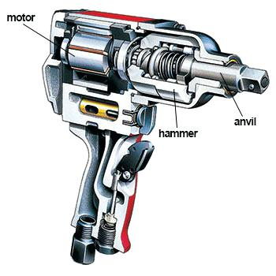
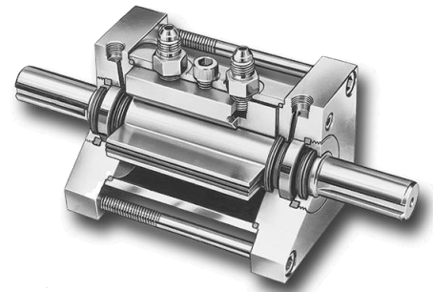
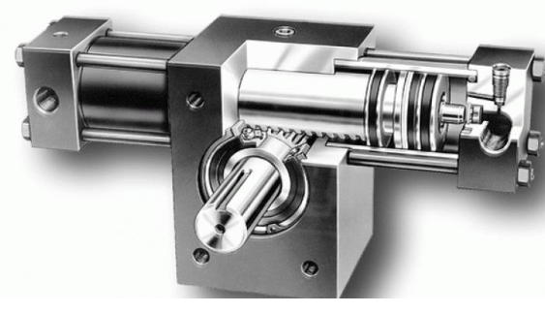
Actuators
Rotary actuator has similar construction like a Vane motor with a limited turning angle, rotating angle between 45 and 270 degrees.
An example of Pneumatic torque wrench with air motor
Other type of linear based actuation into rotary motion in steps, comes under special type called torque cylinder.

Slide 33
Lecture Quiz 3:
List three types of directional valve actuation (example: Lever type)
Name three pneumatic systems in a bus
What is cushioning in linear pneumatic cylinder (short answer) ?
What does the symbols below represent?

Slide 34
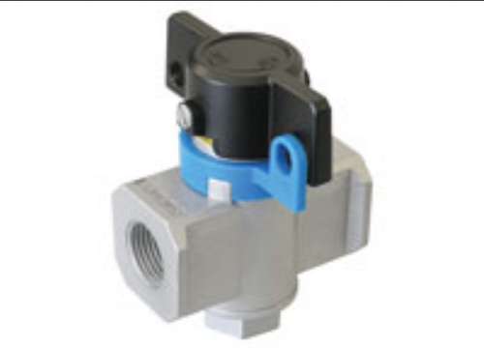
Pneumatics System design consideration
Pneumatic Systems design can generally be divided into two areas depending on the application and operation of the whole circuit.
1. System Design consideration
2. Individual components selection
In system design, following should be accounted for:
Safety of Operations: Built in kill switch/emergency cuttoff valves and safety locks are imperative to prevent any untoward incident, as compressed air usuall start with a jerk movement or sudden leakages. Shut off or Ball valves are usually used with pneumatic lines.

Slide 35
Pneumatics System design consideration
Performance and Reliability: The pneumatics actuators are usually used for gripping, production opeartion, lifting, for that, the maintenance and repeatibility of each should be checked and maintained that the operation works smoothly and seals are replaced on predicitve maintenance.
Efficiency and Cost: The use of compressor and distribution network should be carefully considered to keep the system operating cost in check. Such as:
Bigger continous running compressor
Air pressure loss in lines while in distrubtion (Energy loss in turn pressure due to pipe friction)
Improper sizing of actuator and valves
Leakages

Slide 36
Pneumatics System design consideration
Second Part of Pneumatic System Design is the selection of proper components considering the application (Guide for Quiz 4)
Cylinder materials 1) cylinder body pipe: - aluminum; different profiles - steel - stainless steel - plastic or composites (still not common although lower weight and friction) 2) cylinder ends: - aluminum - steel - stainless steel 3) piston rod: - compressed axle with hard crome plating - stainless steel - carbon fibre 4) piston: - aluminum (especially with small cylinders) - steel disc (with bigger cylinders)
5) seals: - nitrile rubber -20…+80 °C - polyurethane -20…+80 °C - viton -20…+200 °C - teflon -80…+250 °C

Slide 37
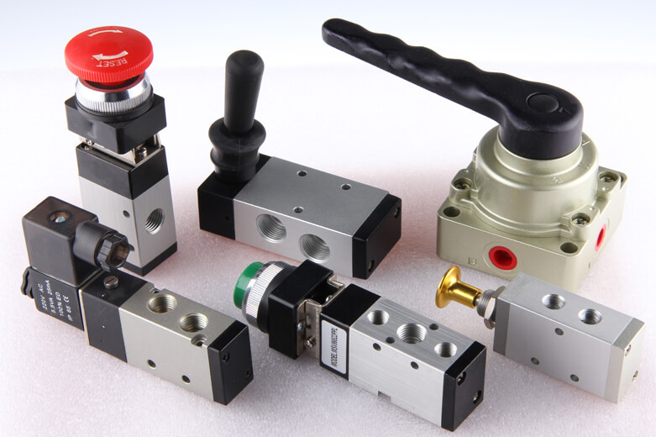
Pneumatics System design consideration
How to order a pneumatic valve What properties must be known: - number of connections and operating positions: 2/2, 3/2, 4/2, 5/2 valve etc. - operating principle: hand, mechanic, pressure, electric operation - spool or poppet return principle: spring, pressure, electric - size of the connection - pressure range (most pneumatics between 200…800 kPa) - normal position, centre position - exhaust connection type: without or with threads - connection type: ISO subplate, pipe assembly etc.
Pneumatic valve structures 1) Seat valves, ball and plate seat: - short movement of valve stem - fast operation - full flow with even a small opening - only few particles to wear - long working life without any service needed - quite a big operating force needed - mainly small nominal sizes M5 – R1/4 2) Spool valves: - smaller operating force - long spool movements - slower operation - working life shorter - big nominal sizes are usually spool type valves

Slide 38
Lecture Quiz 4:
Selection of Catalogue Pneumatic elements according to statement (Select catalogue parts from the given link, and write the type and model)
A compressor is required for continuous flow at 7.5 bar pressure in the network, low maintenance cost, 500 m3/hr.
https://www.atlascopco.com/content/dam/atlas-copco/compressor-technique/industrial-air/documents/brochures/air-compressors/oil-lubricated/GA30-90_antwerp_leaflet_EN_2935089249.pdf
A FRL unit which can regulate pressure from 7.5 bar to 7 bar, ¾’’ pneumatic connection, grade filter 5μm, condensate volume of 43 cm3, 2800 l/min flow volume
https://www.festo.com/cat/en-gb_gb/data/doc_ENUS/PDF/US/FRC-D-NPT_ENUS.PDF
In industry, the pneumatic tooling is routinely disconnected from the main line and the flexible hose is used with an easy to plug connector. Name?

Slide 39
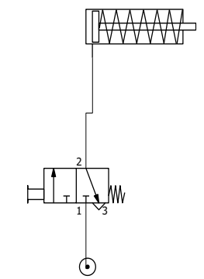
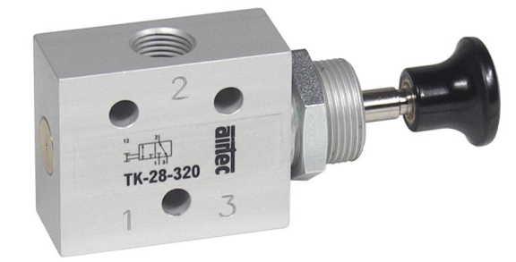
Pneumatics Circuit Control
1. Controlling of a single acting cylinder - with a hand operated valve - return stroke with a spring - distance from cylinder to valve must be small (to avoid compressibility and slack operation)

Slide 40
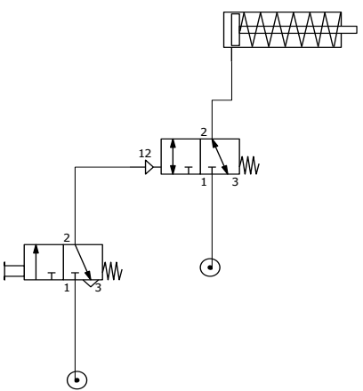
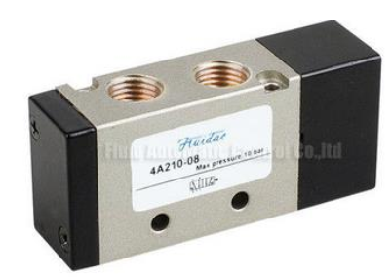
Pneumatics Circuit Control
2. Remote operation of a single acting cylinder - hand operated; distance between valves can be big e.g. 100 m - signal time for 100 m is about 8 seconds -> so long pneumatic signal paths are not recommended - electric operation between valves is used instead - distance between cylinder and upper valve must be small (less than 2 meters)

Slide 41
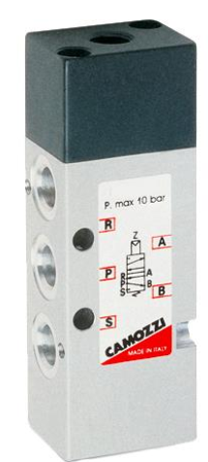
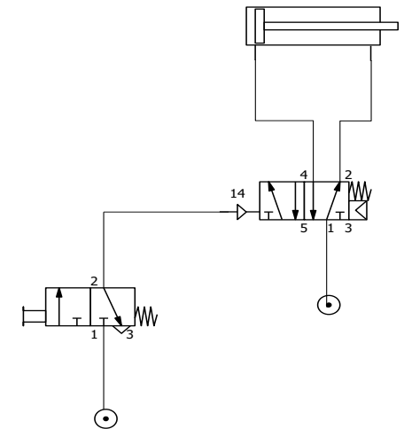
Pneumatics Circuit Control
3. Operation of a double acting cylinder with a monostable control valve - forward motion of cylinder happens when 3/2-valve is actuated by hand
- backward motion occurs when the signal valve is released and the control valve’s (5/2-valve) position is returned to it’s right position

Slide 42
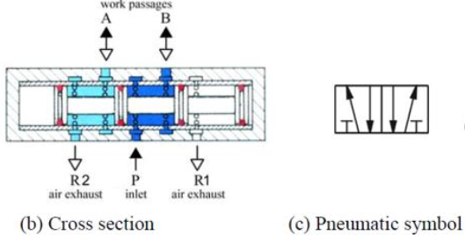
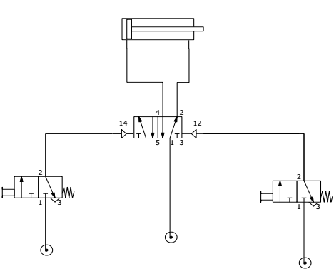
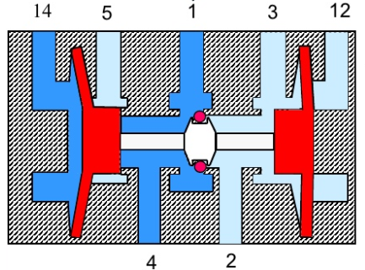
Pneumatics Circuit Control
4. Operation of a double acting cylinder with a bistable control valve - A bistable directional valve has two stable positions. - When left signal valve is actuated (even shortly) left position of control valve comes on and cylinder makes its’ forward motion. - Cylinder stays in its’ extended position until right signal valve is actuated and return stroke occurs.

Slide 43
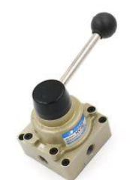
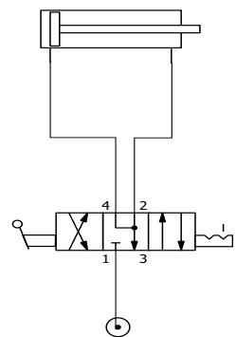
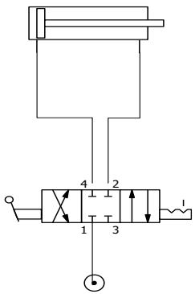
Pneumatics Circuit Control
5. Control of a cylinder with a 3-position valve 5/3-valve - Used usually in applications that need an emergency stop system or need a release of actuator for possibility to do service work. - Upper figure to release the cylinder force. Lower figure to put the cylinder between two air cushions.

Slide 44
Pneumatics Circuit Control
6. Automatic return stroke of cylinder - Right signal valve is physically located at the end of forward stroke. - Forward stroke of the cylinder is controlled by actuation of the left signal valve. - Cylinder piston rod mechanically actuates this right signal valve which moves the control valve to its’ right position and return stroke happens.

Slide 45
Pneumatics Circuit Control
7. Controlling cylinder force - Pressure reducing valve limit the pressure and thus the force achieved with the cylinder. - Check valve must be there to enable return stroke.

Slide 46
Pneumatics Circuit Control
8. OR-coupling e.g. alternative signal valves - Shuttle valve (=OR gate or logic OR function) is used to control signal flow from two or more alternative signal valves. - There are two alternative signal valves to start the forward stroke - Automatic return stroke.

Slide 47
Pneumatics Circuit Control
9. AND-coupling control of cylinder - AND-valve (=AND gate or logic AND function)) is needed for this circuit. - When both signal valves are actuated the AND gate gets pressures to both ends and signal goes through the gate. The signal then actuates the control valve and its’ position changes to left box and cylinder does forward stroke. - Return stroke is automatic

Slide 48
Pneumatics Circuit Control
10. Quick exhaust valve to speed up stroke - Quick exhaust valve is used between control valve and cylinder to make the stroke faster (= save time of total working cycle). - Exhaust air is released through the quick exhaust valve with much less resistance. Back up pressure does not rise so much and does not counteract the movement so much as in normal case. The speed of the piston rises substantially.

Slide 49
Pneumatics Circuit Control
11. Cylinder speed control with a throttle check valve - In a pneumatic circuit a throttle-check-valve is used to control the speed of the piston. - The check valve is assembled in a way that the throttle valve adjusts the outgoing flow from cylinder. So the throttle is always in the return line. - This throttle-check-valve is normally located in the cylinder port.

Slide 50
Pneumatics Circuit Control
12. To secure a desired force with a cylinder - A pressure switch is used in the circuit to start return stroke right after when the desired force (=pressure) has been achieved. - Pressure switch gives electric signal to the control relay of the valve. Electric operation of valve.

Slide 51
Pneumatics Circuit Control
13.Time delay valve in a circuit - Time delay valve is circled with dash line. - Signal from right signal valve is delayed with time delay valve. After delay the signal goes to control valve and cylinder return stroke occurs.
- The length of time delay is adjusted with throttle valve. - Controllable delay is between 1s…2min.

Slide 52
Instrumentation in Pneumatics system
Sensors:
All pneumatic sensors are based on pneumatic principle of pascal law. Following are the examples of some pneumatic principle based sensors.
1.Back Pressure Switch
In a backpressure switch, when the spring force exceeds the pressure of the process fluid, movement of the piston causes the switch to ON or OFF depending upon required operation on given pressure.

Slide 53
Instrumentation in Pneumatics system
2.Proximity Switch
They are actuated by a magnetic field; they have been designed typically for use in detecting pneumatic cylinder intermediate or end stroke positions; additionally, pneumatic proximity sensors are used for the contactless sensing of iron (Fe) parts within similar applications
Applications:
These sensors are majorly used in industries of manufacturing and oil and chemical refineries. But their used are not limited to them., where the actuators are used in operation of any kind.

Slide 54
Safety and Maintenance
Guidelines before use of Pneumatic machines and Instruments:
Never disconnect pressurized lines and components while working. Isolate and Lock-off relevant legs and then depressurize system.
Make prior preparation for any leakage of oil or fluid.
All Electrical and mechanical connections must be tight and isolated. This is to avoid any possibility of electrical shock and fire at workplace. Also leakage of pressure of fluid.
After the work is complete leave the area tidy and clean. Check all instruments. Disconnect all electrical and mechanical connections. Ensure no one can get hurt as no force electrical or mechanical is present in system.

Slide 55
Safety and Maintenance
Guidelines of Maintenance and Cleanliness:
Monitoring system pressure is the first part of inspection.
Most pneumatic and Hydraulic faults are caused by dirt. Cleanliness and washing (also flushing) is an important initial step before assembling
Ideally components must not be dismantled with dirt. They must be returned to clean shop for cleaning
Seals of component must be checked. In pneumatic systems connection with seals will not perform satisfactory if their seals are damaged or broken, causing loss of pressure and force during operation
Air filter or FRL must be checked and maintained on regular basis.
Draining Moisture

Slide 56
Lecture Quiz 5:
General Pneumatics MCQ quiz:
Go to the below website, and complete the MCQ quiz and share your own result on MyCourses discussion
https://www.proprofs.com/quiz-school/story.php?title=pneumatic-quiz

Slide 57
Study Material Resource
1- Basic Pneumatics theory and Components
http://www.smcpneumatics.com/pdfs/smc/basic_pneumatics.pdf
2- Fluid Power Basics - ebook
https://www.scribd.com/document/224513178/Fluid-Power-eBook-Fluid-Power-Basics
3- Fluid Power with applications – Book in Aalto Library
https://aalto.finna.fi/Record/alli.375462

