Slide 1
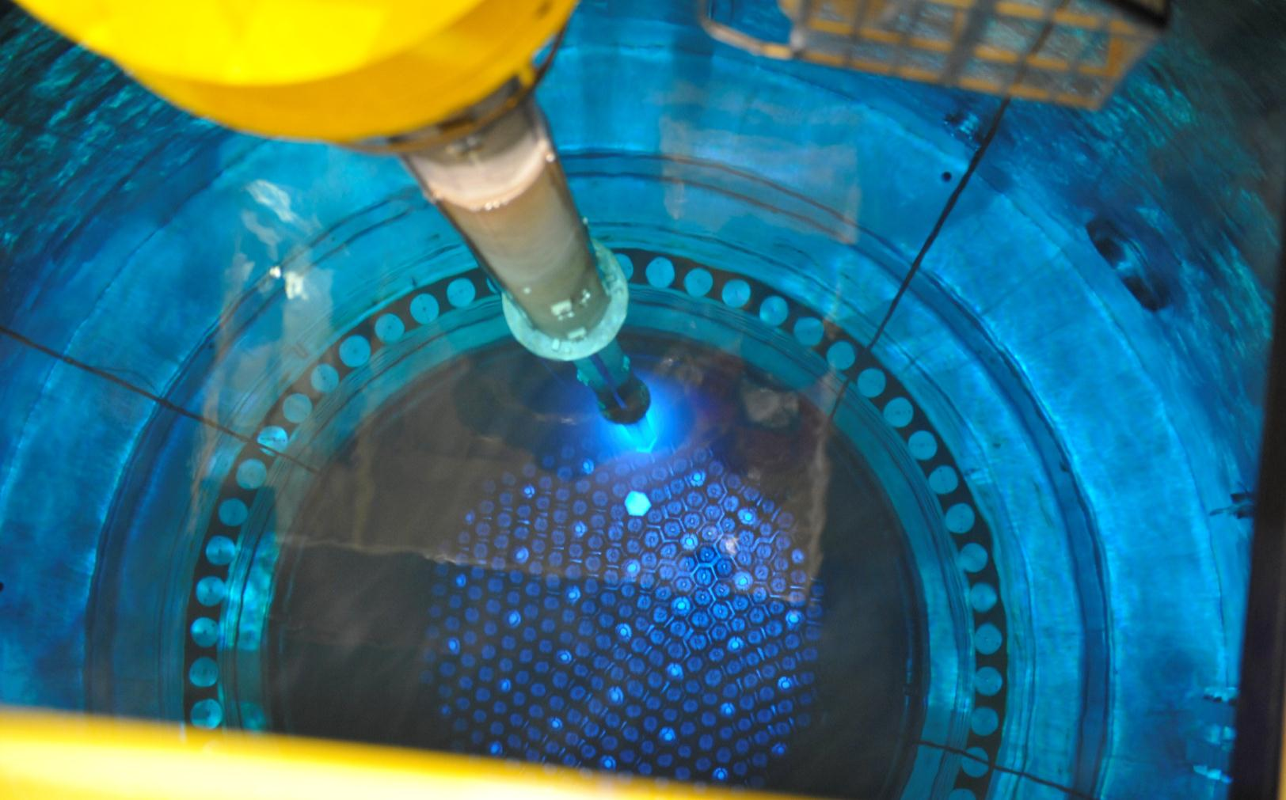
Design and simulation of reactor operating cycle
Jaakko Kuopanportti, jaakko.kuopanportti@fortum.com
Design Engineer, Fortum Power and Heat Oy
20.4.2018, Aalto University, PHYS-E0562 Nuclear Engineering, advanced course

Slide 2
Content
Introduction
Basic information about operating cycles of Loviisa NPPs
Basic information about fuel assemblies of Loviisa NPPs
Safety criteria and other boundary conditions for reactor operation
Core loading, loading pattern optimization and fuel economy
Reactor simulation tools
Reactor instrumentation and monitoring
Physical start-up tests
Reactor start-up
Feel free to ask during the lecture!

Slide 3
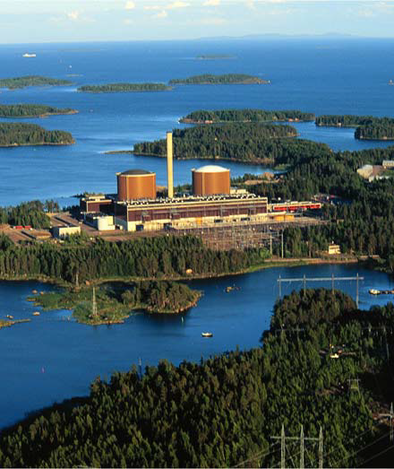
1. Introduction
Loviisa Nuclear Power Plants (NPPs):
2 x VVER-440
  6 primary loops and horizontal steam generators.
  Large water reserve compared to the reactor power.
First power:
  Loviisa 1 1977
  Loviisa 2 1980
Reduced core, P = 1500 MW_{th}, ~507 MW_{e} to grid (original power 1375 MW_{th}, 440 MW_{e})
Permission for uprated power 1998.
Present operating licenses until 2027 (LO1) and 2030 (LO2).

Slide 4
2. Basic information about operating cycles of Loviisa NPPs
An outage once per year.
About ¼ of the fuel assemblies is replaced every year with fresh assemblies.
The average energy production per cycle is about 336 Full Power Days (FPDs, 1 FPD = 1500 MW_{th}d = 36 000 MW_{th}h ≈ 12150 MW_{e}h).
Utilization factor of 98.8 % is used in the loading pattern designing.
Stretch-out/coast-down is utilized in order to save fuel.
  The reactor power and the inlet temperature of the coolant at the end of the cycle are designed to be below nominal.
  As the temperature and the power decrease, the reactivity increases due to the negative feedback coefficients. Thus, more energy can be produced and fuel can be saved.
  Nowadays, the optimal end of cycle power is about 93 % (depends on electricity price and fuel costs).

Slide 5
2. Basic information about operating cycles of Loviisa NPPs

Slide 6
2.1 Reactivity control during cycles
Slow reactivity changes are controlled by boron (¹⁰B) acid (H₃BO₃) in the coolant.
  At the beginning of the cycle, the critical boron concentration is about 1000 ppm (parts per million, ~5,71 g/kg of boron acid) at full power. The concentration decreases as the average burnup of the core increases during the cycle.
  At the end of the cycle, the boron concentration should be zero.
In VVER-440 reactors, all of the boron steel control rods are usually totally withdrawn from the core.
  The controlling group can be used to compensate reactivity changes if necessary. For example, there can be some unexpected coolant temperature changes that can be compensated with control rods.
In PWRs (and VVER-1000), the reactivity control with the controlling group is more common compared to VVER-440 reactors.
In BWRs, the reactivity is controlled by cruciform control rods and by adjusting the mass flow of the coolant, which effects the void fraction.
  In normal operation, there is no boron acid in the coolant.

Slide 7
3. Basic information about fuel assemblies of Loviisa NPPs
Fuel vendors: TVEL (Russian), BNFL (British, 1998-2008).
TVEL:
  First loading: 1.6 %, 2.4 % and 3.6 % enrichment fuels without profiling.
  For a long time: 3.6 % enrichment without profiling.
  4.0 % enrichment 1st generation fuel without profiling.
  4.0 % enrichment 2nd generation fuel without profiling (fuel followers).
  4.37 % average enrichment 2nd generation fuel with gadolinium as burnable absorber (used from 2009, mixing vanes added to spacers in 2012, more improvements in the future (link))
BNFL:
  3.7 % enrichment without profiling
  3.8 % enrichment without profiling

Slide 8
3. Basic information about fuel assemblies of Loviisa NPPs

Slide 9
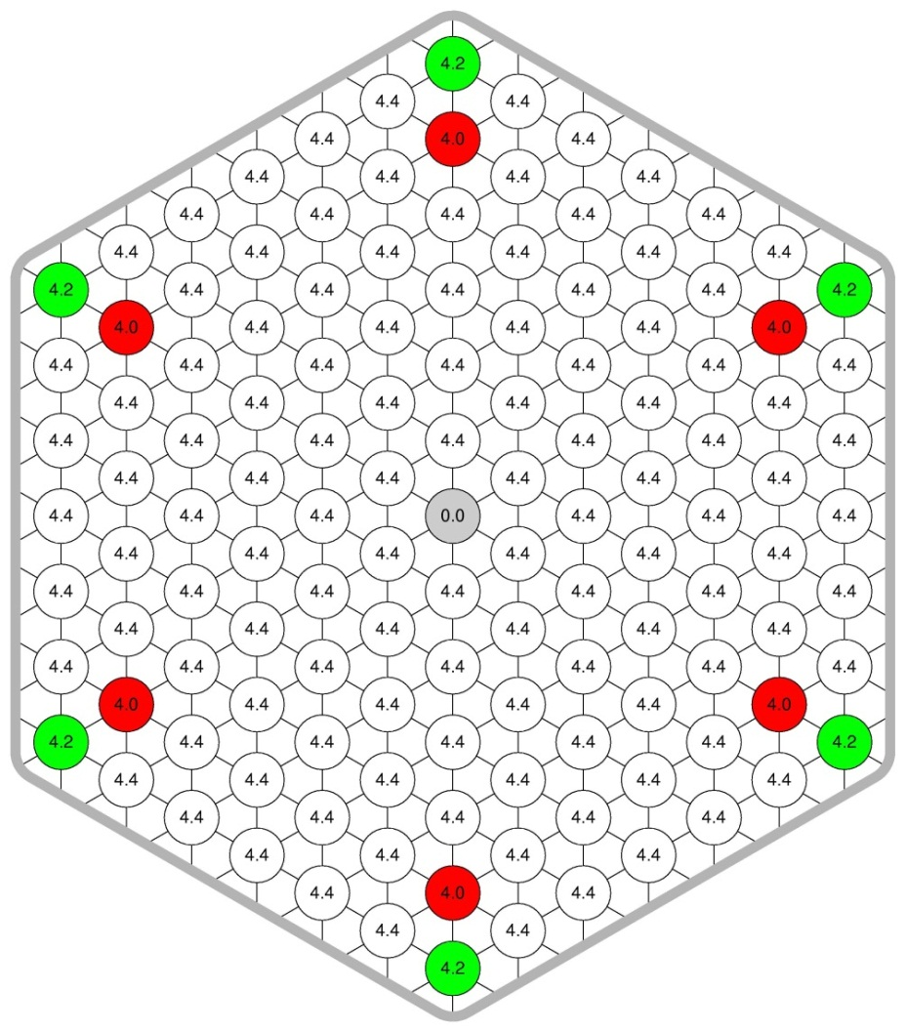
3. Basic information about fuel assemblies of Loviisa NPPs
The core contains 276 fixed fuel assemblies, 37 fuel followers of the control rods and 36 dummy assemblies in the outer periphery (reduced core).
Each year about 72 fixed fuel assemblies and 12 fuel followers are replaced.
126 fuel rods in each assembly.
4.37 % average enrichment with Gd:
  Mixing vanes at spacers at seven
  different heights.
  Fuel rod pitch 12.3 mm.
  Pellet stack height 248 cm.
  Rod outside diameter 9.1 mm.
  Pellet outside diameter 7.6 mm.
  Pellet central hole diameter 1.2 mm.
    Reduces peak fuel temperatures and
    provides additional volume for fission gases
  Uranium mass per assembly 126.3 kg.
    For comparison OL1&2 / EPR: 170 – 180 kg/530 kg
4.0 % U-235, 3.35 % Gd₂O₃
Subchannel (flow area between rods)
Central tube, no fuel
Shroud

Slide 10
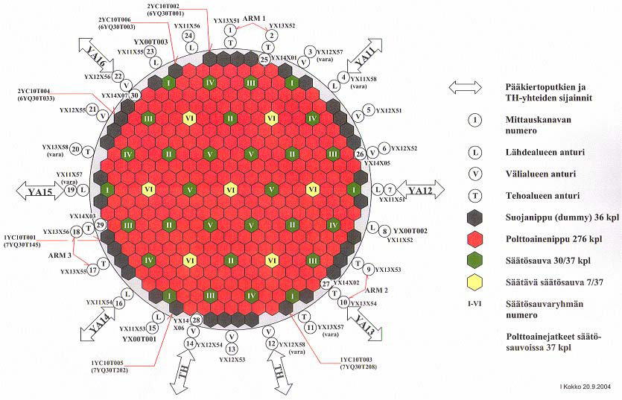
3. Basic information about fuel assemblies of Loviisa NPPs

Slide 11
3.1 Dummy assemblies of Loviisa
History of dummy assemblies of Loviisa:
  The pressure vessel has welds at the height of the active core region and the diameter of the pressure vessel is comparatively small.
  The neutron radiation dose to the pressure vessel was too high in the beginning of operation.
  Therefore, 36 fixed fuel assemblies at the outer periphery of the core were replaced with dummy assemblies, where the fuel rods are replaced with steel.
  This reduced the neutron flux at the pressure vessel to a less than 1/3 from the original value.
  As the thermal power of reactor was increased in 1998, the neutron flux somewhat increased.
  The neutron flux at the pressure vessel is kept low by placing as many of the most burned assemblies as possible at the outer periphery of the core. This is also economically profitable as the neutron leakage is minimized.
Notes:
Lämpökäsittely tehty Loviisa-1:lle 1996 vuosihuollossa, jolloin hitsin sitkeys on palautunut miltei alkuperäiselle tasolle. Hitsisaumojen kuntoa ja annosta seurataan.

Slide 12
3.2 Control rods
  Control rods in VVER-440:
    In VVER-440 reactors, each control rod has a fuel follower.
    When the boron steel absorber part of the control rod is withdrawn from the reactor, the fuel follower is in the active core region.
    6 different control rod groups. 5 x 6 + 7 control rods. The controlling group has 7 control rods.
    The active height of the fuel followers is 236 cm, thus they are 12 cm shorter than the fixed fuel assemblies.
In PWRs, control rods are usually finger type rods.
  There are several cylindrical control rods inside the assemblies. Each group of rods is called a cluster control rod.
In BWRs, control rods are usually cruciform rods.
  Two crossed blades that are between the fuel assemblies inside the core.

Slide 13
4. Safety criteria and other boundary conditions for reactor operation
The idea of the safety criteria for reactor operation is to prevent fuel failures in normal operation and to assure safe operation also during accidents.
  The limits come from accident analyses, fuel vendor and safety authority.
  YVL regulations by STUK.
Most of the limits are actively monitored during operation by measurements.
  Criteria that cannot be directly measured are shown to be met analytically before the operation cycle starts.
An operation cycle report must be delivered to STUK for approval no later than one week prior to the planned closing of the reactor pressure vessel head.
  Requirements for a such report are given in the YVL regulations A.6 (requirement 608).

Slide 14
4. Safety criteria and other boundary conditions for reactor operation
Boundary conditions for operation in Loviisa (random order):
  Fuel assemblies can stay in the reactor for four cycles at maximum.
  60° symmetry of the loading patterns is preserved whenever possible.
  Maximum assembly burnup cannot exceed 57 MWd/kgU (for 2nd generation fuel). The limit for 1st generation fuel is 45 MWd/kgU.
  Maximum linear heat rate of a fuel rod must stay below an average rod burnup dependent limit. The limit is at the maximum 325 W/cm when the burnup is zero and the limit goes to zero when the burnup exceeds 65 MWd/kgU (an indirect rod burnup limit). An engineering factor of 1.115 is used when the maximum linear heat rate is determined.
  The maximum coolant temperature of the hottest subchannel cannot exceed 325 °C. An engineering factor of 1.100 is used when the enthalpy rise margin is determined.
Notes:
Suunnitteluaineisto.
Käytännön tavoite.
STUK hyväksymä raja. Haettu, kun ollaan siirrytty 4-erälataukseen. Vaikuttaa turvallisuusanalyyseihin isotooppi-inventaarin kautta.
Raja perustuu polttoaineen käyttäytymiskokeisiin LOCA-tilanteessa. Pyritään estämään polttoainevauriot (PCI-vauriot ja rajoittamaan fissiokaasujen painetta). Raja vaikuttaa turvallisuusanalyysien tuloksiin (esim. LOCA, reaktiivisuustransientit).
Tällä rajalla on pyritty estämään kokonaiskiehunta reaktorissa. Rajoittaa suunnittelua kaikkein eniten. 325 °C on saturaatiopaine sallitulla minimipaineella 121 bar. Kokonaiskiehunnan estäminen vähentää myös crudin kertymistä polttoainesauvojen suojakuoren pinnoille. Crud voi vaikuttaa lämmönsiirtoon ja siten aiheuttaa aksiaalista tehovääristymää, joka puolestaan vaikuttaa aksiaaliseen palamajakaumaan.

Slide 15
4. Safety criteria and other boundary conditions for reactor operation
(the list continues):
  The maximum assembly power must stay below 6.8 MW (relatively 1.419).
  The shutdown margin with a boron concentration of 13 g/kg (2275 ppm) and without any control rods must be at least 1 % in all possible coolant temperatures.
  The reactor must stay subcritical in any state without the most reactive control rod and without extra boronization at least down to 175 °C.
  The reactivity feedback coefficient of coolant temperature must be negative in all possible critical states.
  The shutdown margin must be at least 5 % during refueling.
  Fresh fuel followers shall not be placed in the controlling group.
  The position of the controlling group cannot be below 235 cm at full power (only 15 cm from fully withdrawn). The minimum position of the control group depends on the reactor power.
Notes:
Tulee suunnitteluaineistosta ja vaikuttaa myös turvallisuusanalyyseihin (LOCA, jälkilämpötehon maksimi)
Varmistutaan, että reaktori pysyy seisokkitilanteissa alikriittisenä (YVL).
Varmistutaan, että reaktori saadaan pysymään alikriittisenä jäähtymistransienteissa.
STUK vaatima raja. Teoriassa rajoittaa maksimibooripitoisuutta, mutta ei ole enää ongelma Gd-polttoaineella, koska kriittiset booripitoisuudet ovat niin matalia.
Vaikuttaa oleellisesti säätösauvan sinkoutumisanalyysin tuloksiin.
Vaikuttaa sammutusmarginaaliin ja säätösauvojen ulosvedon turvallisuusanalyysien tuloksiin.

Slide 16
4. Safety criteria and other boundary conditions for reactor operation
Some other operation limits related to reactor safety:
  The boron concentration of the water used in boron dilution is limited. Nowadays, the limit depends on the critical boron concentration at the beginning of the cycle. Generally, boron concentrations of all important boron acid tanks are monitored.
  There must be sufficient amount of operational reactor instrumentation (neutron flux or assembly outlet temperature measurements).
  All of the six primary pumps must work at full power. The reactor power is automatically limited if any of the pumps shut down.
Safety criteria and other boundary conditions are defined in TTKE for each plant (turvallisuustekniset käyttöehdot, operational limits and conditions in UK, technical specifications in USA).
  About 700 pages for Loviisa-1 for example.

Slide 17
5. Core loading, loading pattern optimization and fuel economy
Operational limits and conditions define the boundary conditions for loading pattern designing.
When designing a loading pattern, the estimation accuracy must be taken into account. Otherwise, there could be unwanted reactor power limitations.
  Operating Loviisa-1 at 95 % power level for one week would cause about 4250 MWh_{e} loss of electricity production to the grid. Roughly, the loss in euros would be over 120 k€.
The goal is to produce the required amount of energy with the minimum amount of fuel while fulfilling all of the boundary conditions.
  Optimization between fuel economy and nuclear safety.
  Larger safety margins usually means worse fuel economy.
    However, unwanted reactor power limitations should always be avoided.
Notes:
Turvallisuusvaatimukset täytetään aina.
Koska turvallisuusvaatimukset pitää aina täyttää, niin optimoidaan käytännössä sitä, että ei jouduta jakson aikana suunnittelemattomasti rajoittamaan tehoa, koska tällöin kustannukset ovat isommat kuin varaamalla marginaalia etukäteissuunnittelulla. Toisaalta myös ylimääräinen marginaali etukäteissuunnittelussa maksaa. Kuitenkin se, että on vähän liikaa marginaalia tulee halvemmaksi kuin, että sitä oli vähän liian vähän. Pitää siis päästä (taloudellisen optimin kannalta) mahdollisimman lähelle toteutunutta 0 marginaalia menemättä kuitenkaan yli.

Slide 18
5. Core loading, loading pattern optimization and fuel economy
Some good designing principles:
  Minimization of the neutron leakage from the core improves fuel economy but it increases the power peaking factor (a.k.a maximum assembly power).
  Minimization of the power peaking factor usually increases safety margins. However, the rod power distribution and subchannel flow distribution of the assemblies must be taken into account.
  Loading pattern optimization should be done over few cycles at the same time.
  Prepare for quick changes caused by leaking fuels, changes in energy need of coming cycles, delays during outages etc.
  Each cycle is unique but past experiences can be utilized when starting the designing process.
  Use independent cross-check for the final loading pattern.

Slide 19
5. Core loading, loading pattern optimization and fuel economy
Basic ways to adapt to cycle length variations:
  Decrease the inlet coolant temperature and the end of cycle power. (stretch-out)
  Remove some fuel assembly group temporarily from the reactor into the fuel pool.
  Modify the amount of the fresh fuel assemblies.
  Vary the enrichment of the fresh assemblies.

Slide 20
5.1 Equilibrium loading pattern
Equilibrium loading pattern is formed when the same assembly moves are repeated after each cycle. Moreover, each cycle has the same length.
  An even-odd equilibrium patterns are formed when two different set of assembly moves are repeated in turn. The length of the cycles and the amount of fresh fuel assemblies of the two cycles can also be different.
The equilibrium pattern is an essential tool in optimizing the long term fuel economy.
  Guides the designing work of individual fuel cycles.
  Large deviation from the equilibrium cycle length hinders the fuel economy in the long run.
  It is utilized in accident analyses, analyses of assembly design improvements, effects of code changes, etc.

Slide 21
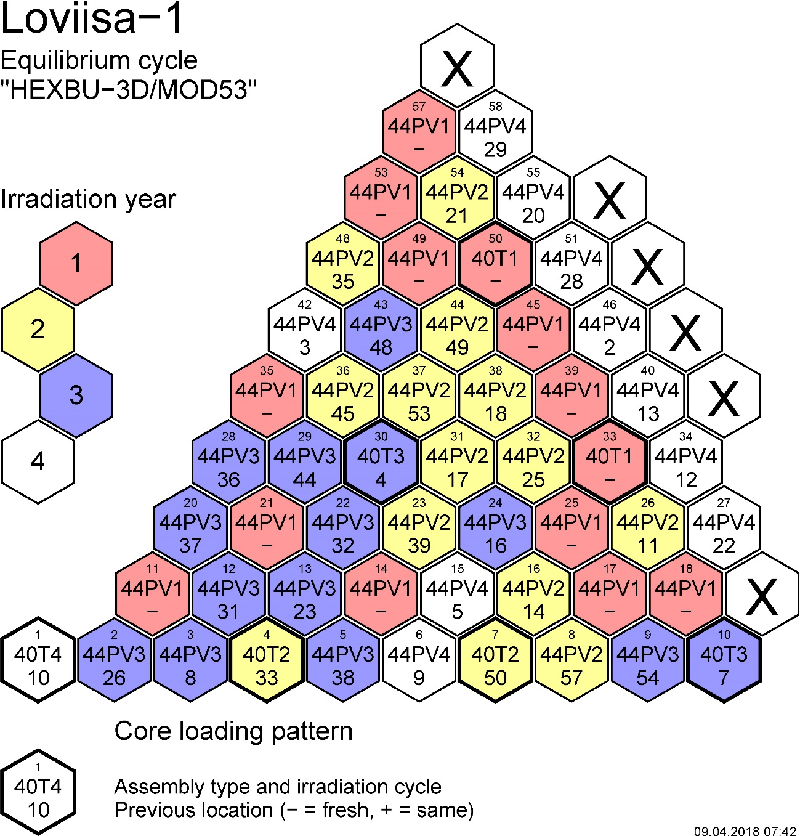
5.1 Equilibrium loading pattern
The current 4-batch scheme equilibrium pattern for Loviisa-1.
  72 fresh fixed 4.37 % Gd-fuel assemblies + 12 fresh 4.0 % fuel followers are loaded each year.
  337 fpd with 91.0 % end of cycle power.
  A low leakage pattern as the outer periphery contains the highest burnup assemblies (excluding symmetry locations 18 and 57).

Slide 22
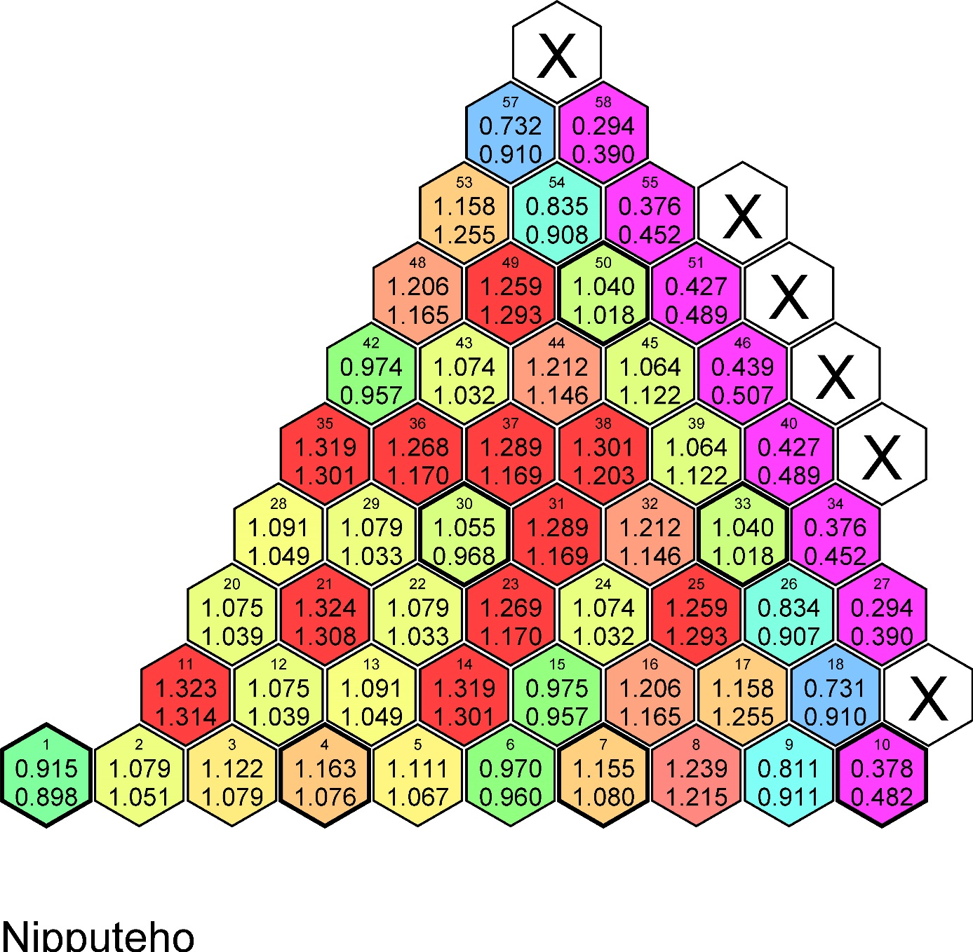
5.1 Equilibrium loading pattern
Relative assembly power distribution at the beginning and the end of the cycle:

Slide 23
5.1 Equilibrium loading pattern
Reactivity coefficients (BOC = Beginning Of Cycle, EOC = End Of Cycle)
 |  | BOC | EOC
Coolant density coefficient | pcm/(kg/m³) | 15.32 | 28.87
Coolant temperature coefficient | pcm/°C | -27.45 | -53.20
Fuel temperature coefficient | pcm/°C | -3.16 | -3.04
Power coefficient (T_{in} constant) | pcm/% | -16.26 | -22.76
Boron coefficient | pcm/ppm | -6.33 | -7.46
Fraction of delayed neutrons | % | 0.59 | 0.53
Lifetime of prompt neutrons | μs | 16.8 | 19.0

Slide 24
5.1 Equilibrium loading pattern
4.37 % Gd-fuel vs 4.0 % fuel from loading pattern designing’s point of view:
  Critical boron concentration in the beginning of the cycle is lower
  Negative reactivity feedback coefficient of coolant temperature is stronger.
  Linear heat rate margin is larger.
  Scram worth is smaller.
  Re-criticality temperature is higher.
  Higher assembly burnups.
  Loading pattern designing is harder because the enthalpy rise margin can be at minimum also in the middle of the cycle when the burnable Gd-absorber has burned away.
Notes:
Critical boron concentration in the beginning of the cycle is lower
Improved safety in many situations and less boron dilution needed during operation.
Negative reactivity feedback coefficient of coolant temperature is stronger.
Improved safety, enables longer cycle lengths
Linear heat rate margin is larger.
Improved safety, linear heat rate margin does not limit loading pattern designing so heavily.
Scram worth is smaller.
Less shutdown margin
Re-criticality temperature is higher.
Decreases safety during cooling transient.
Higher assembly burnups
Higher long-term decay heat power. More energy produced from a single assembly.

Slide 25
5.2 Loading pattern optimization
Designing the best possible loading pattern is a non-linear discrete optimization problem with several constraints.
  A general solution has not been found.
  Early optimization methods were deterministic and utilized simplified model of the core neutronic process.
  Nowadays, various stochastic methods with some “artificial intelligence” for guidance.
  Rather popular topic in scientific literature.

Slide 26
5.2 Loading pattern optimization
The amount of possible combinations is massive if there are many assemblies in the core. Loviisa as an example:
  When utilizing 60° symmetry and fuel followers are omitted, the amount of possible combinations is 46! (5.5 x 10⁵⁷).
  If the amount and pattern of the fresh fuel assemblies is locked, the number of possible combinations reduces to 34! (12x6 fixed fresh fuel assemblies).
  30° mirror symmetry is usually preserved, which decreases the amount of possible combinations to 19! (1.21 x 10¹⁷).
  If the calculation of a single combination takes about 3 seconds, it would take about 1.15 x 10¹⁰ years to calculate all of the possible combinations.
    For comparison, the age of the universe is about 13.8 x 10⁹ years according to Wikipedia.

Slide 27
5.2 Loading pattern optimization
Loviisa has its own automatic loading pattern optimization tool called ALPOT.
It has been utilized since 2012 effectively.
It includes three different stochastic optimization methods.
  Imitation of the equilibrium pattern
  Guided binary search that is a modified version of the standard binary search.
  Burnup kernel method that utilizes burnup kernel functions to estimate burnup variations that are required to achieve desired changes. (This method is usually not in use).
Also contains other helpful tools:
  Rotation of fuel assemblies during search, optimization of fuel loading moves and automatic leaking assembly replacement tool.

Slide 28
5.2 Loading pattern optimization
Challenges for loading pattern optimization:
  Cycle lengths can vary significantly from the length of the equilibrium cycle.
  Leaking fuel assemblies that have to be replaced. The leaking assembly can be found just before the loading of a new core should start.
  Unexpected outages and changing of outage dates.
  Optimal end of cycle power changes depending on the price of electricity and fuel.
  New fuel types always cause mixed core loadings, which may not be an ideal situation.
  New improved fuel designs may require more accurate simulation tools in order to maintain the calculation accuracy.
  How to define which loading pattern is the best?

Slide 29
5.3 Ways to improve fuel economy
Improved fuel designs.
  Better heat transfer qualities, higher durability, better neutron economy etc.
More accurate calculation tools and methods.
  Allows smaller engineering factors in the safety margins, which enables more fuel efficient loading patterns.
Improved loading pattern designing and searching methods.
  Automatic search tools tend to find solutions that an experienced engineer would not have tried to find.
Optimized cycle length and outage planning.
  Fuel economy is only one part.

Slide 30
6. Reactor simulation tools
There are a lot of different kind of reactor simulation tools in various countries.
Plant suppliers have their own codes.
STUK does not approve any specific codes to be used in analyses.
  Any code can be used if it has been verified and validated for the purpose.
In Finland, we have a lot of our own codes developed mainly in VTT.
  STUK has developed independent codes.
  Studsvik Scandpower’s programs (CASMO, SIMULATE, SNF etc) are widely utilized in Finland.

Slide 31
6.1 Reactor simulation tools used at Fortum
CASMO-4E (previous version CASMO-HEX)
  Developed by Studsvik Scandpower
  Generation of 2-group cross section data
  Recently, hexagonal support has been coded for CASMO-5 but it has not been tested in Fortum.
HEXBU-3D (developed by VTT)
  3D nodal reactor simulation program.
    MOD5: current version in production
    MOD6: enhanced version with wide-range feedback model (used in accident analyses)
ELSI-1440 (developed by Fortum/IVO)
  Rod power reconstruction program that calculated assemblies’ internal power distribution from HEXBU-3D results. The integrated version is called HEXBU-ELSI.
  Also calculates thermal hydraulic properties of the coolant in the subchannels.
RESU-98 (developed by Fortum/IVO)
  Core on-line monitoring program. It combines integrated HEXBU-ELSI program with reactor measurements.

Slide 32
6.1 Reactor simulation tools used at Fortum
Serpent (VTT) and MCNP (Los Alamos National Laboratory)
  Monte Carlo –codes
HEXTRAN (developed by VTT and analyses made in VTT)
  Dynamic version of HEXBU-3D
APROS (developed by VTT/Fortum, used in over 20 countries)
  Large scale process simulation software.
  Contains 3D nodal reactor core model with wide-range cross sections.
  Reactor physicists use mainly for accident analyses.
  Under constant development.
Other codes related to reactor behavior:
  Studsvik Scanpower’s SNF (decay heat, nuclide inventory analyses)
  SCALE/ORIGEN (isotopic depletion and decay analysis system)
  PREVIEW (neutron dosimetry)
  FLUENT (computational fluid dynamics)
  TRANSURANUS, ENIGMA and SCANAIR (fuel behavior codes)
  etc etc…

Slide 33
7. Reactor instrumentation and monitoring
Reactor power, neutron flux, temperatures, pressures, mass flows, different water levels and so on are constantly monitored during operation.
In VVER-440, there are 210 temperature measurements at assembly outlets and 36 detector strings that measure neutron flux with rhodium detectors at four different heights.
  The amount of measurements is very large compared to larger PWRs.
Some of the neutron flux detectors are replaced annually because their sensitivity weakens as burnup increases.
6 out-of-core neutron flux measurements at three different reactor power levels.
  Reactivity controls utilize the out-of-core measurements.

Slide 34
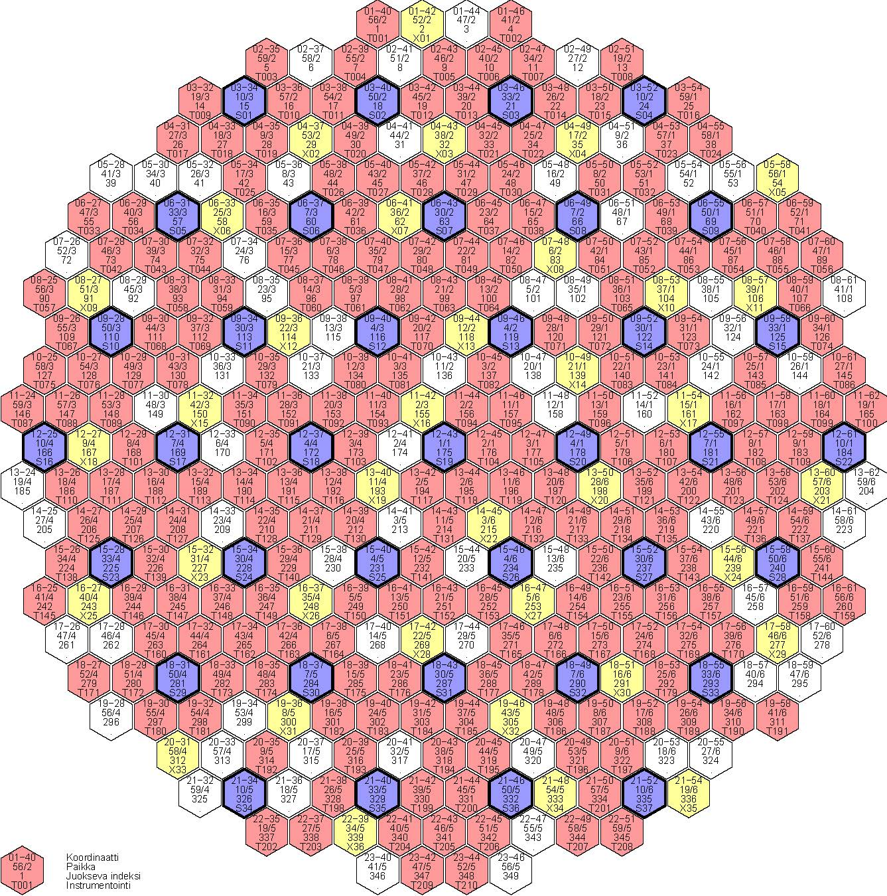
Red: Temperature
Yellow: Neutron flux
Blue: Control rod

Slide 35
7.1 RESU-98: core on-line monitoring program
Monitors core limitations.
  Purpose is the assure that the core is operated within the limitations and assumptions made in the accident analyses.
Calculations are performed automatically once per hour.
  Manual activation is possible.
  Averages of measurements from different time intervals or the instantaneous measurement values can be used.
Calculation can be divided into three main blocks:
  Collecting measurements and interpreting them.
  Performing characteristics calculation
  Burnup calculations

Slide 36
7.1 RESU-98: core on-line monitoring program
Measurements include:
  Reactor power
  Neutron flux (in-core and out-of-core measurements)
  Coolant temperatures at inlet and outlet of the assemblies
  Control rod positions
  Cold and hot leg coolant temperatures
  Mass flows of the primary loops
  Reactor pressure
  Boron concentration of the primary loop. (Does not effect the solution.)

Slide 37
7.1 RESU-98: core on-line monitoring program
Adjusts the calculated assembly power distribution according to the in-core neutron flux and temperature measurements.
  Only possible if the number of measurements is large enough.
  As a result, the accuracy of the power distribution increases.
The most limiting parameters are the subchannel outlet temperature of coolant, the maximum assembly power and the linear heat rate.
  Burnups, rod powers, DNB (Departure from Nucleate Boiling) ratio and so on are also being monitored.
Notes:
DNB = lämmönsiirtokriisi
Höyrykalvon peittämän pinta-alan kasvaessa (osittainen kalvokiehunta, partial film boiling) lämpövuo sauvasta jäähdytteeseen pienenee kunnes höyrykalvo peittää koko sauvan pinnan. Tästä eteenpäintäydellisessä kalvokiehunnassa lämpövuo alkaa taas nousta sauvan ja jäähdytteen lämpötilaeron kasvaessa (lämmön johtuminen höyrykalvon läpi kasvaa samaan tahtiin).

Slide 38
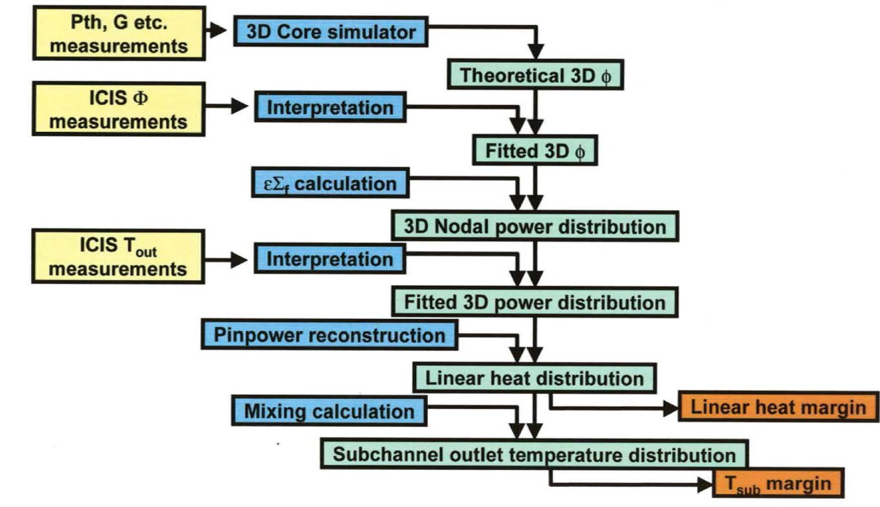
7.1 RESU-98: core on-line monitoring program

Slide 39
7.2 Reactor monitoring
The behavior of the core is automatically and constantly monitored.
The power distribution of the core is checked weekly.
  Thermal margins are OK also in the future?
  Calculated critical boron concentration is compared to the laboratory measurements.
  Power tilts?
  Expected behavior as a function of burnup?
  Any anomalies in the measurements?
  Have any new thermocouples or neutron flux detectors gone invalid?
  Difference between theoretically calculated power distribution and measurement adjusted distribution is OK?
If something suspicious is found, the reason is investigated.
Nowadays, the trend and map figures are plotted automatically when on-line reports are printed weekly.

Slide 40
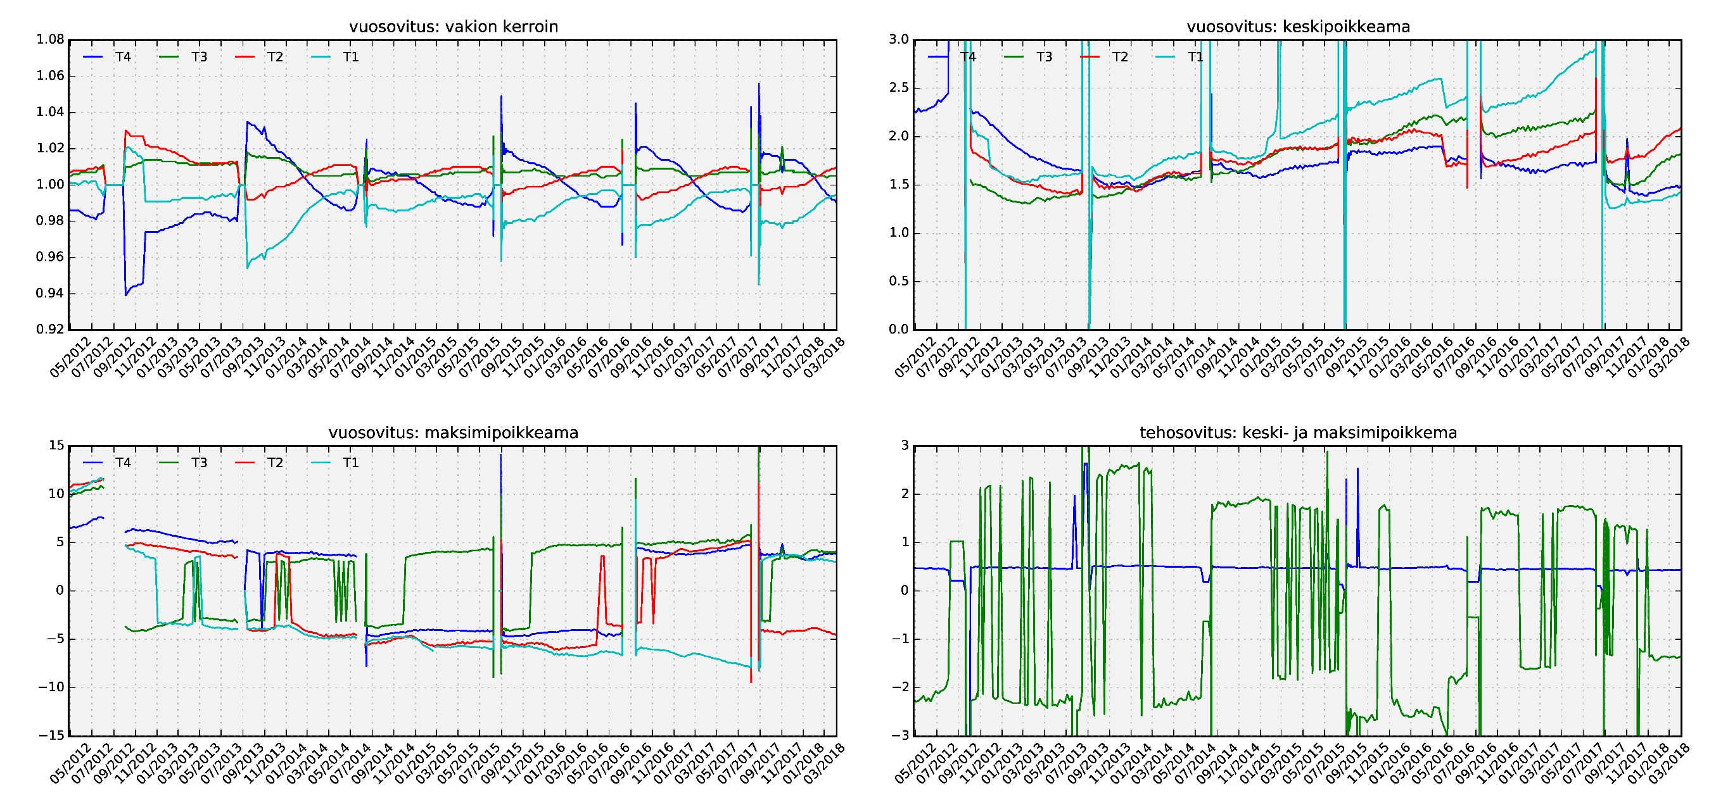
7.2 Reactor monitoring (Loviisa-1 data for few years)

Slide 41
8. Physical start-up tests
Purpose of the tests is to make sure the reactor operates as designed.
Initial state of the tests: Thermal power < 2 %, coolant temperature 260 °C and controlling group position 200 cm (50 cm below maximum).
Performed tests (estimated durations):
  Achieving criticality by withdrawing control rods and boron dilution (6 h)
    Critical boron measurement (confirmation at the end of the tests)
  Checking control rod fastenings (1.5 h)
  Control rod worth measurements (1.5 h)
    Controlling group
    Scram
  Measurement of reactivity coefficient of coolant temperature (1.5 h)
There are acceptance criteria for every measurement.

Slide 42
8. Physical start-up tests
In practice, reactor is deemed to be critical, when the reactor period is 100 – 200 s and stable.
Fastenings of the control rods are tested so that each control rod is driven to a position 175 cm and then the rod is returned to the original position.
  Negative reactivity effect tells the control rod works physically correctly. The precise magnitude of the reactivity change is not important because the measurement is not very accurate.
Controlling group worth and scram worth are calculated and compared to the calculated minimum acceptance criteria.
Reactivity coefficient of coolant temperature is checked to be negative.

Slide 43
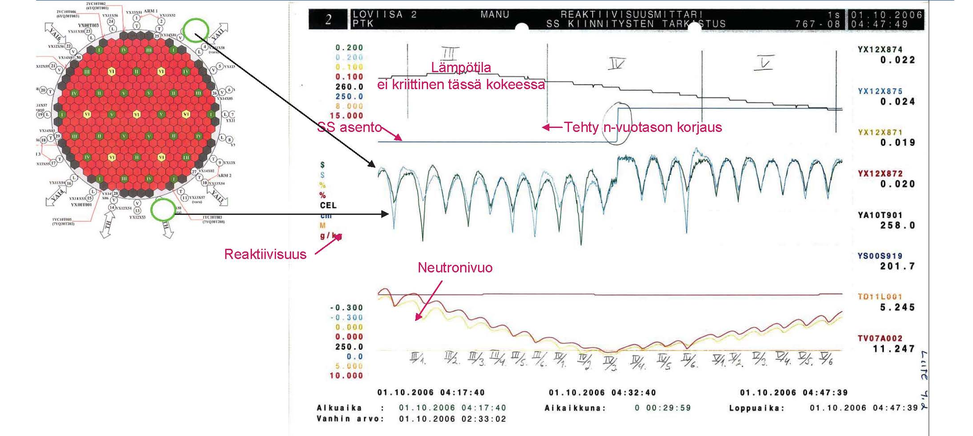
8. Physical start-up tests (Checking control rod fastenings)

Slide 44
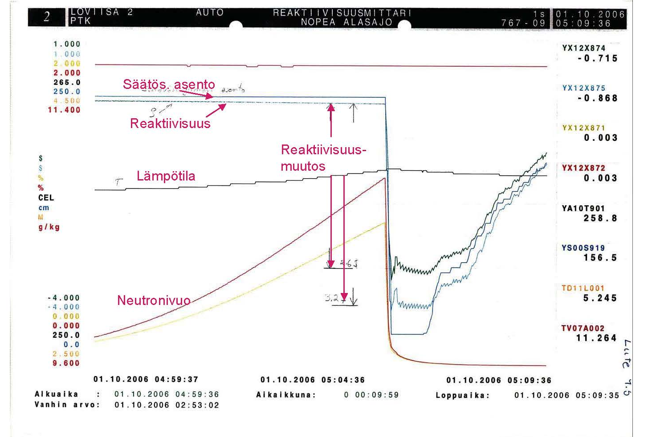
8. Physical start-up tests (Controlling group worth)

Slide 45
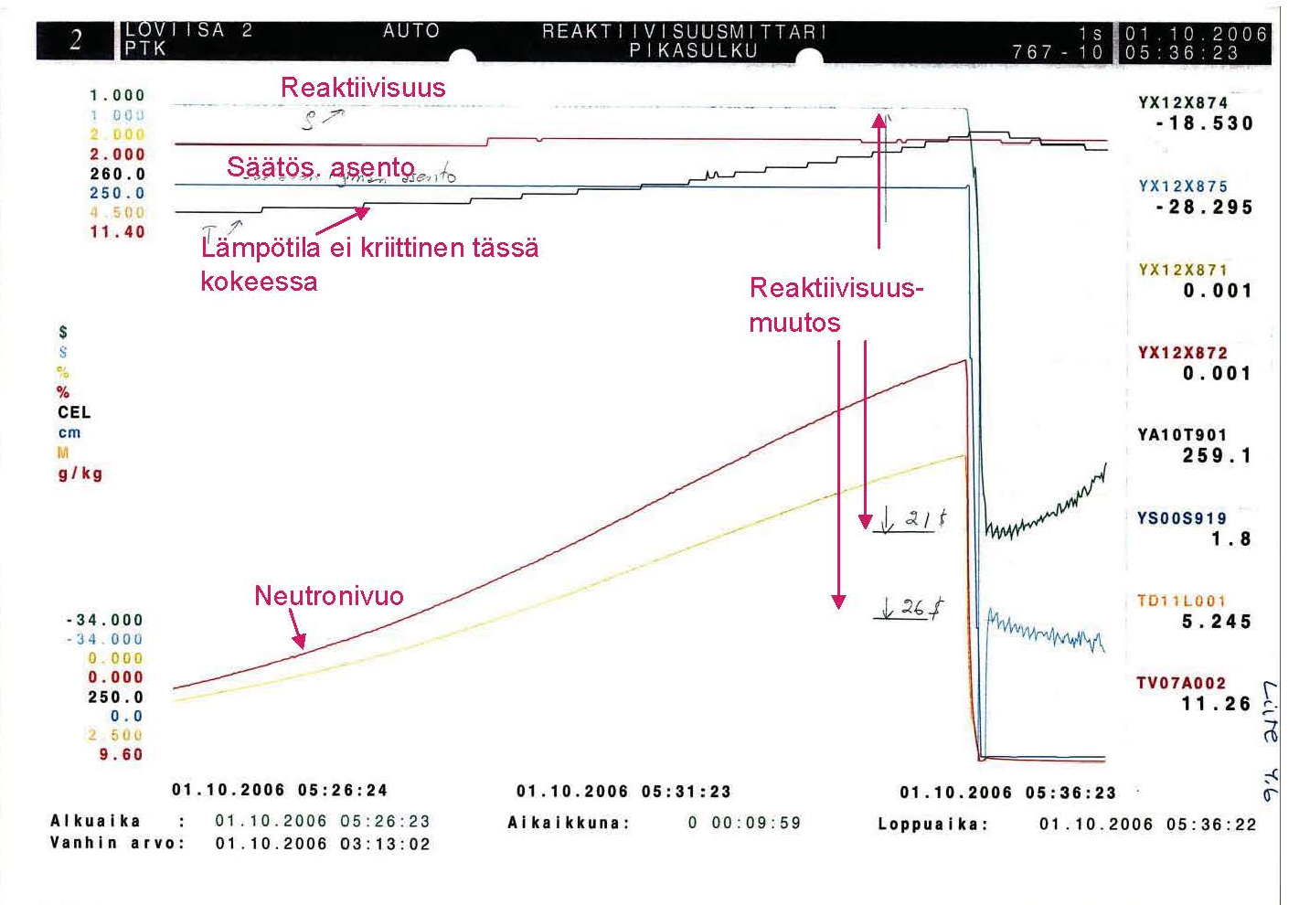
8. Physical start-up tests (Scram worth)

Slide 46
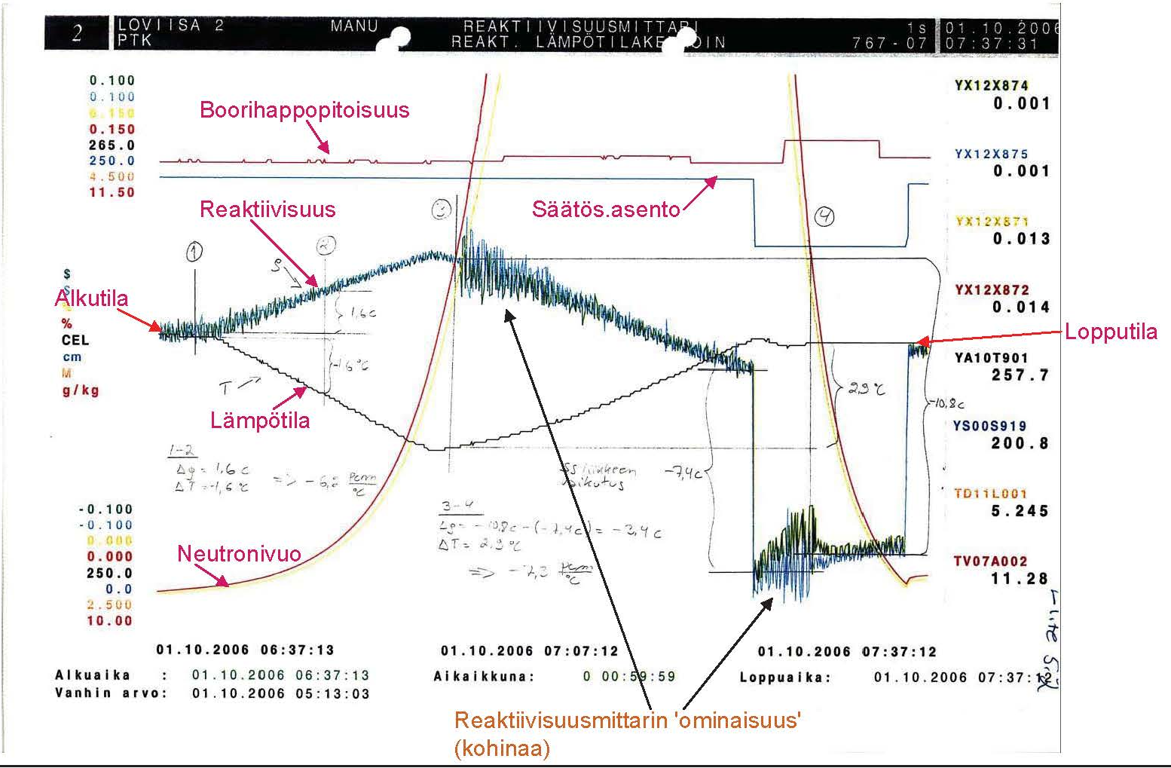
8. Physical start-up tests (Coolant temperature coefficient)

Slide 47
9. Reactor start-up
Reactor power can be increased above 2 % only after the physical tests have been performed and the results are acceptable.
Checks at 25 – 30 % thermal reactor power:
  RESU-98 on-line monitoring works.
  Power distribution seems legit (for example no significant asymmetries).
  In-core instrumentation is OK.
  Checking list of reports for anomalies.
  Possible problem situations have to be resolved before continuing the power increment.
The reactor power distribution is checked again at power levels 50 %, 75 % and 90…100 %.
  Checking list of reports for anomalies.

Slide 48

Thank you for your attention!

