Slide 1
Finding and defining fruitful problems
Notes:
IDEAS DO NOT COME TO US – ”EUREKA, I GOT AN IDEA!” LIKE WE ARE SOMEHOW GRACED FROM ABOVE – NO, WE WORK OUR WAY THROUGH TO THEM (THE PROCESS IS NOT ALWAYS LINEAR, BUT I PREFER NOT TO WAIT AND EXPECT THEM TO STRIKE)
POTENTIAL LEVERAGE POINTS IN THE SYSTEM – TYPES OF INTERVENTIONS: TOOL (CONCRETE-ABSTRACT) – PROCESS/SERVICE – ORGANIZATIONAL/CULTURAL/STRATEGY CHANGE

Slide 2
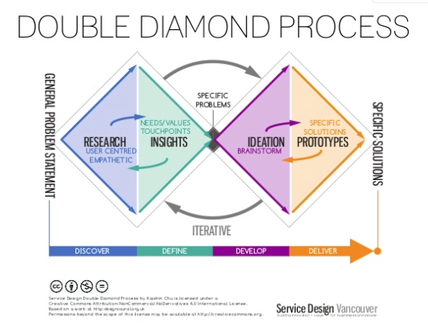
Notes:
THIS IS WHERE YOU ARE MOVING TOWARDS AND THINGS NEED TO REMAIN ITERATIVE

Slide 3
Insights are crystallized forms of understanding that support the creative work or decision-making
Words typically used to describe customer / consumer / human insights
Typical explanations of the insights
Deep understanding
Insights are NOT just data
Insights are NOT just findings of market research
Insights give perspective that inspires good decisions
They don’t just answer WHAT, but also WHY and HOW
Truth is not final
Truth
Discovery
Unconscious needs
Inspiration
Consumer aspirations
Perspective
Notes:
REMINDER ON INSIGHTS – SOMETHING NEW AND SOMETHING RELEVANT
1. Good insights explain the world of the consumer by interpreting research data.
They don't just answer the question of what is happening, but why it is happening in a given context and how it is unfolding
Abductive reasoning as a kind of educated guess - search of near truths. A fruitful interpretation. It’s ok to be in a state of doubt.

Slide 4
In order to consider something as insights we need to…
Form an understanding of how something works from someone’s (group of people, role) perspective or how something is meaningful for them…
Be able to use this understanding to define and solve a problem.
And solving of the problem needs to create positive change.
Notes:
THIS IS VERY BASIC AND IT’S MUCH TO ASK, BUT STILL HAVE THIS IN MIND

Slide 5
Finding a more fruitful well-defined problem – what could be solved or improved?
FROM
TO
How to boost consumer act among sme’s?
How to…. support/teach/etc. – intervene?
In which context?
For whom and by whom?
What kind of value?
By reasoning the choice of this challenge through interpreting research data.
Notes:
FROM A GENERAL PROBLEM TO A CHOICE OF a MORE SPECIFIC PROBLEM – HOW TO QUESTIONS ARE ONE WAY OF TRYING TO FRAME AND RE-FRAME THE PROBLEM
WHERE DO YOU SEE GAPS TO BRIDGE OR LEVERAGE POINTS FOR POSITIVE CHANGE?

Slide 6
Group discussion – What problems could we solve?
Take 5 minutes to individually write down problems that could be worth solving (who has these problems, what are they like, what could be better, how?)
Take 10 minutes to gather and discuss these problems
Write down and adjust the list of potential problems to solve
Notes:
20 min

Slide 7
Today afternoon: Iterate your affinity diagram based on your findings and interpretations
Use affinity diagram as a tool of discussion and discovery within your team
Add new data and discuss new learnings
Go back to your original research questions – are you able to answer them?
Arrange, map, re-arrange the data according to patterns you see emerging
Give names and labels to these patterns. Try out different frameworks – what are your key findings and interpretations of those findings?
Have you come up with ideas along the way? How can you define these ideas?
Notes:
Let’s take this as an exercise in the afternoon + keep your ideas on the other track and analysis on the other track + this re-visit of affinity diagram proved to be a useful exercise for teams in past years

Slide 8
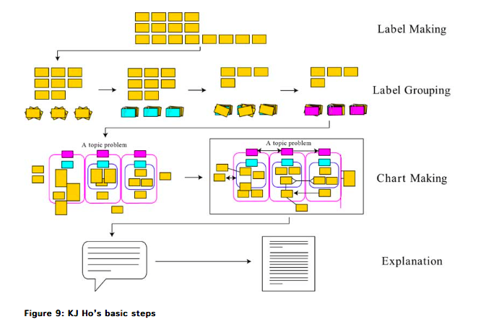
Analysis
Affinity diagram as a method for pattern recognition and analysis
Notes:
The affinity diagram is actually developed by a Japanese anthropologist Jiro Kawakita, sometimes referred to as KJ method. Nowadays often conducted by post-it’s, but you can use other means too. You can also do this digitally if you prefer.
Steps:
Label making: Record each idea on cards or notes. Only one fact, thought or concept related to the problem of concern should be written on each label. Don’t be too general, with a label like ”social connections matter in decision-making” -> specify and break into smaller pieces ”which connection” ”how they matter?” ”in what kind of decision-making”
Label grouping: Physically spread the labels. Look for ideas that seem to be related. You can build groups and subgroups and build and re-build, combine and separate. You can also add new ones at this stage if needed. If you have lone wolves that don’t seem to fit any group, don’t throw them away. Take time and get immersed in the data before making any strong judgments.
Chart making: Name different groups and see for connections between them.
Cause and effect: One is a predecessor or a cause of another --------->
Contradiction: Objects are conflicting with each other >---------<
Interdependence: Objects are dependent on each other <-------→
Correlation: Both objects relate to one another in some way ---------
Then you proceed to explanations and start thinking about how to crystallize your analysis, and to formulate it in a way that will help you in the creative task at hand.
https://www.creativityjournal.net/index.php/contents/articles/item/201-kj-ho_japanese_problem_solving#.V8WDvmW0nww

Slide 9
Pattern recognition workshop – asking questions from the data and making sense with the help of data wall
Spend time with data and make your own comments and notes (alone)
Take 10 mins for one person to present one part of data (interview they made or report they read)
Others write relevant findings and thoughts on post-its – connecting to quotes or observations on other parts of research they are familiar with (you may also ask questions)
Present your post-its and start grouping them – remember that you can change your groups (keep empirical data on the wall in a traceable form)
Look for patterns and charts of related groups of findings
Try crafting insights, opportunities and most fruitful problems to solve
Notes:
HOW WE USUALLY DO THIS? When somebody explains – listen and write down thoughst and start discussing, comparing, challenging etc.
Going to more defined problems –
Don’t jump into conclusions
Inspirational -> analytical
Take the research questions – if you come up with ideas, move them aside and consider them later
Try to be specific!
METAPHORS + CONCEPTS + FRAMEWORKS

Slide 10
Language matters – seeing something from a new perspective through new definitions and metaphors
Notes:
Giving names and labels IS the first part also in cultural change – HOW DO WE CREATE CHANGE AND ALSO EXPLANATION AND ARGUMENT FOR THE VALUE OF CHANGE
METAPHOR AND NEW CONCEPT
GUIDING DEFINITION THAT TURNSS INTO A TAGLINE
STORY THAT EMPOWERS A SPECIFIC DIRECTION FOR CHANGE

Slide 11
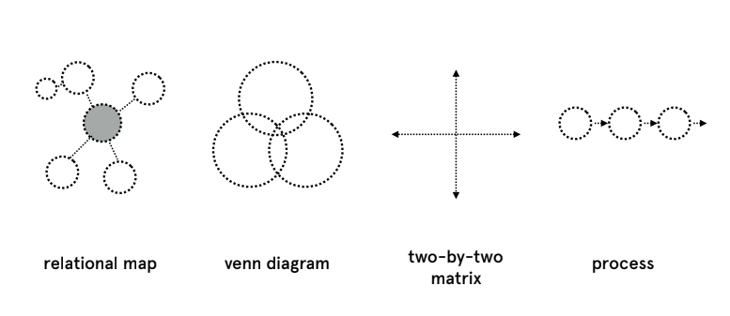
Visualizing and relating your findings through frameworks
Notes:
SPATIAL WAY OF ARRANGING THINGS - HOW DIFFERENT PHENOMENON RELATE + OVERLAPS + MATRIX: TIME – POWER EG + UNFOLDS OVER TIME AS A PROCESS
FEW VERY BASIC WAYS OF LAYING THINGS OUT

Slide 12
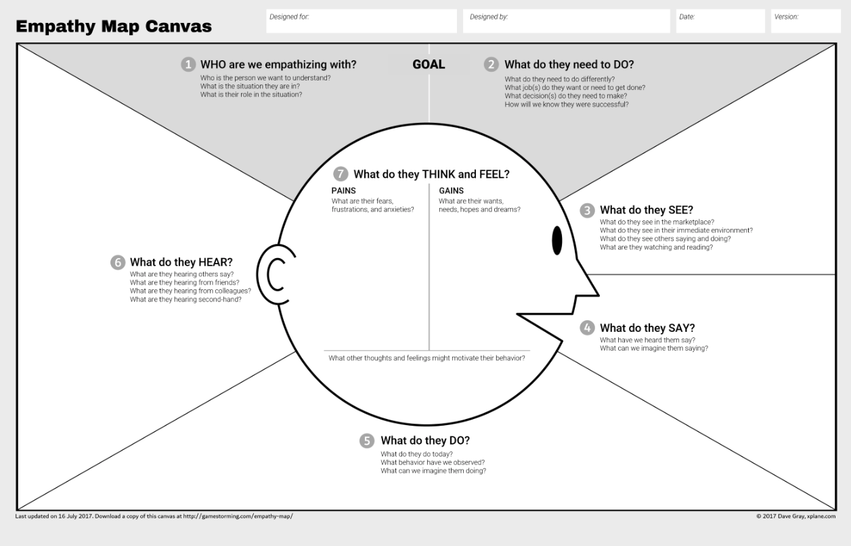
Empathy map as a tool for mapping different types of people in the system
SEE: https://medium.com/the-xplane-collection/updated-empathy-map-canvas-46df22df3c8a
Notes:
ESPECIALLY IN SERVICE DESIGN, DIFFERENT TYPES OF CANVASES ARE VERY POPULAR – THEY PROVIDE A VISUAL WAY TO GATHER THOUGHTS AND ALSO TO SHARE THEM
DAVE GRAY AND ALEX OSTERWALDER (CONNECTING TO BUSINESS MODEL CANVAS)

Slide 13
What needs to be taken into account? Design drivers as a way to guide oneself from insights to ideation
Principles and directions for ideation
Checklist for making sure you have common goals and aims - based on your insights
Different parts of the solution may have different design drivers
Notes:
Can you come up with principles or directions – have a discussion of 20 minutes and share a few of them.

Slide 14
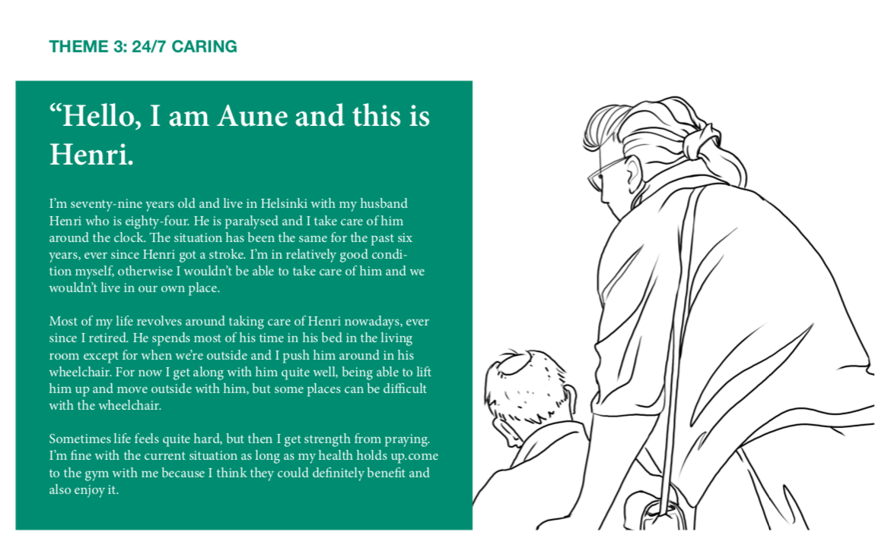
Example: Connecting design drivers to user profiles
Source: realchallenge.info
Notes:
YOU HAVE ACTORS – THESE DON’T NEED TO BE INDIVIDUALS THOUGH THAT IS HOW WE OFTEN PROFILE AND PLACE PEOPLE IN BOXES

Slide 15
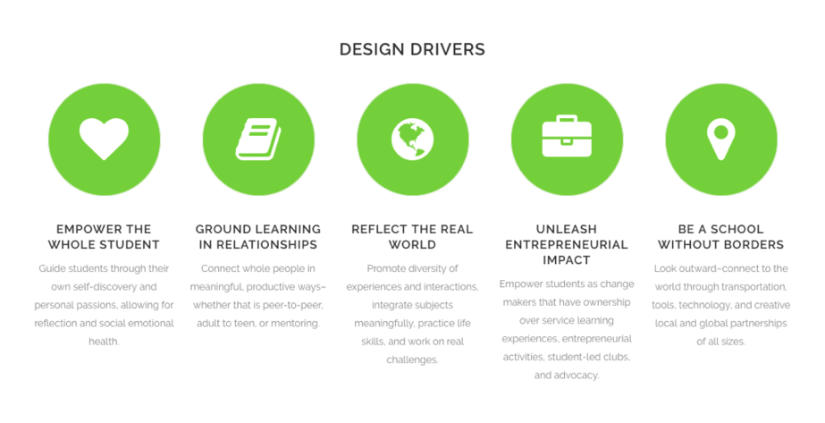
Source: http://www.melaniekahl.com/beacon
Notes:
Luotu fokuryhmien, co-creation työpajojen sekä kyselyn avulla luodun käyttäjäymmärryksen kautta – Montessori High Schoolin kehittämiseksi (osoittamaan erilaisten kehityskohteiden laajaa kirjoa)

Slide 16
Group discussion – What kind of principles or guidelines should we follow?
Take 5 minutes to individually write potential design drivers
Take 10 minutes to gather and discuss these (why these? What do they mean in practice?)
Write down and adjust the list of design drivers to follow
Notes:
YOU DON’T YET HAVE THE EXACT PROBLEM NECESSARILY BUT WHAT ARE THO CORE PRINCIPLES

Slide 17
How to test assumptions and value propositions of potential solutions?
Notes:
IF YOU CONTINUE DOING RESEARCH, MAKE SURE YOU MOVE IT TOWARDS SOLUTIONS – THERE ARE DIFFERENT TYPES OF INTERVIEWS FOR EXAMPLE – YOU ZOOM INTO DIFFERENT ASPECTS WITH DIFFERENT GRANULARITY – A VERY EXPLORATIVE ETHNO INTERVIEW -> A SHORT PROTOTYPING INTERVIEW TO TEST ASSUMPTIONS

Slide 18
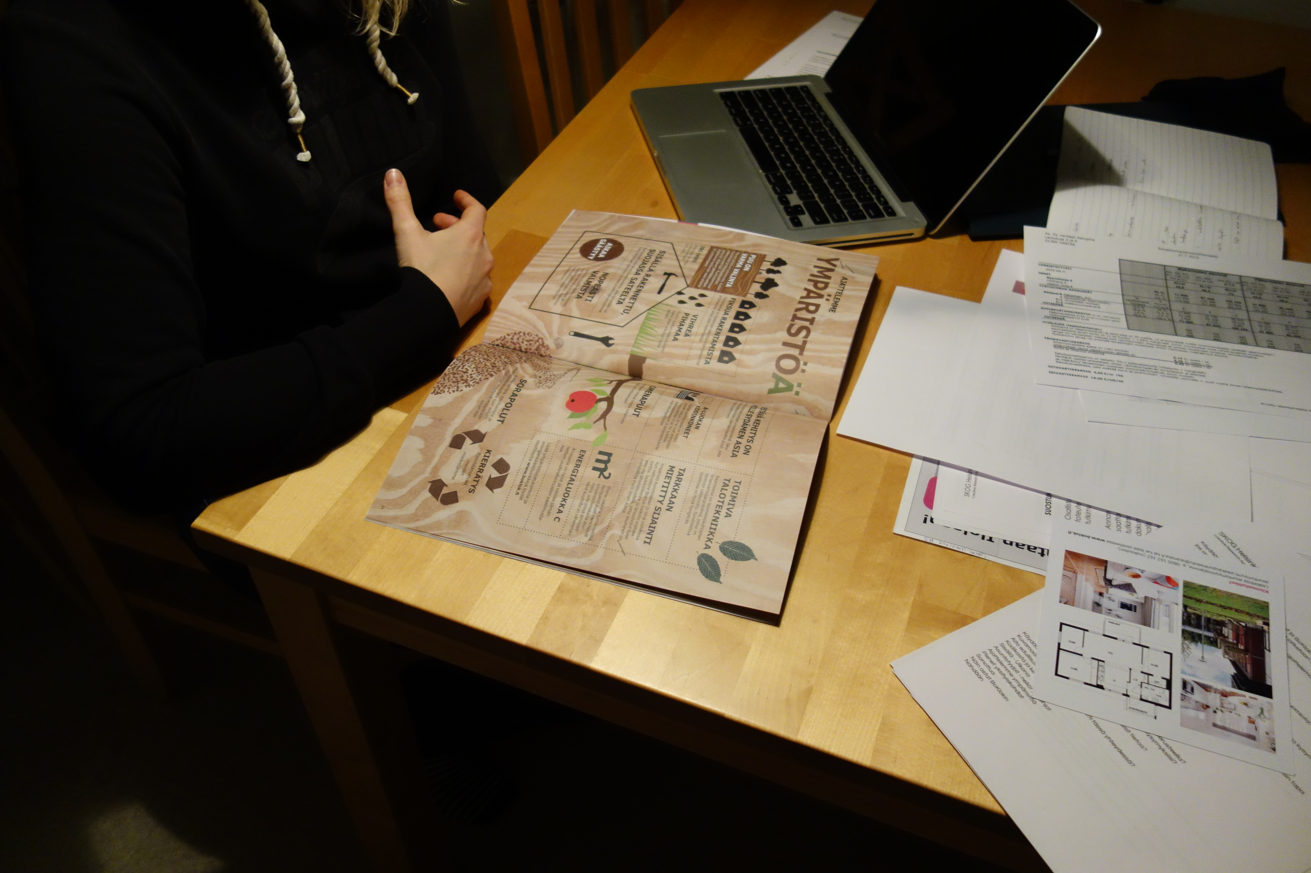
Think about the purpose of your prototype
To explain and convince
To develop ideas
To test assumptions
To learn with users
Don’t try to do all of these at once.
(Hylerstedt 2015)
At early stage – does this idea have any value
Later stage – which parts don’t work the way we wish

Slide 19
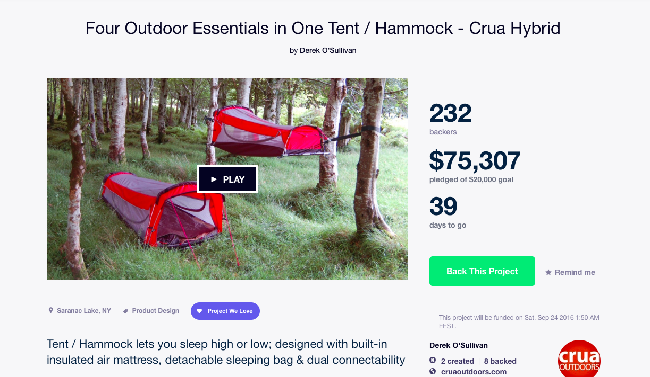
Testing beyond paper
Video
Package prototype

Slide 20
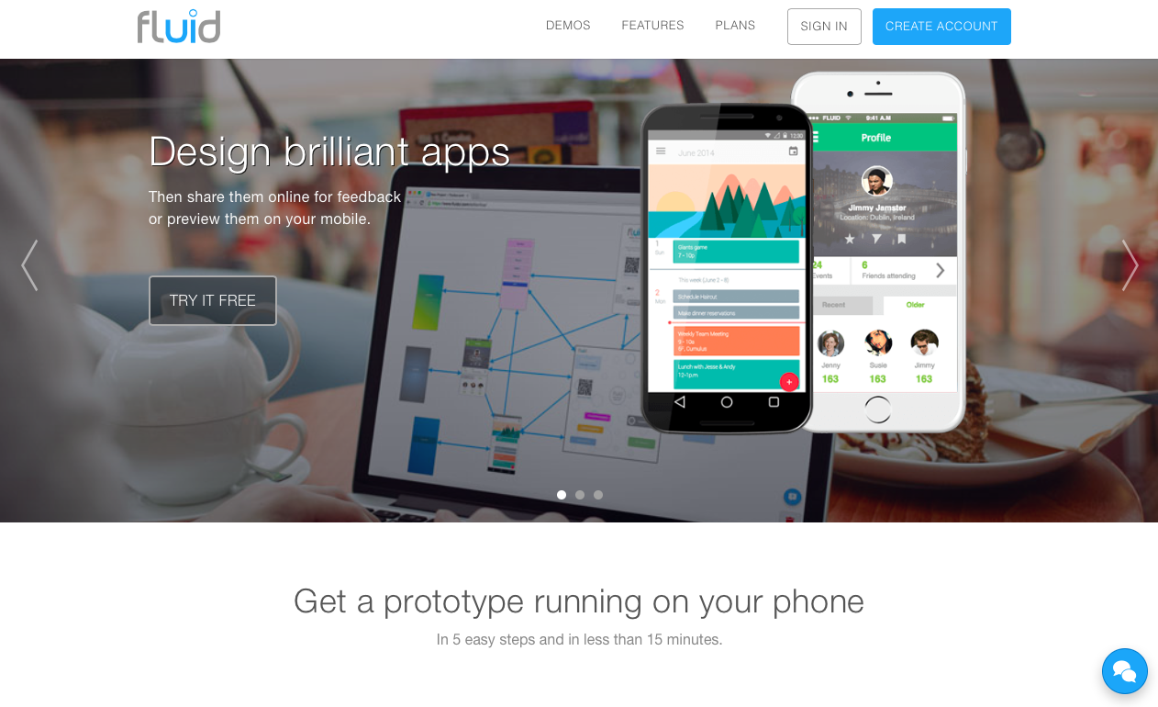
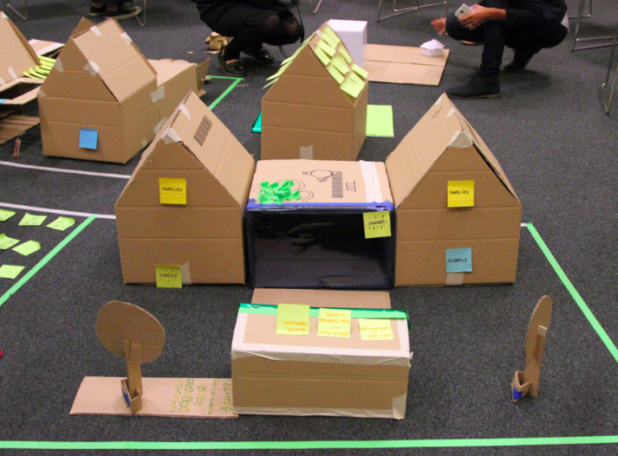
Testing beyond paper
Application / website prototype
Cardboard prototype

Slide 21
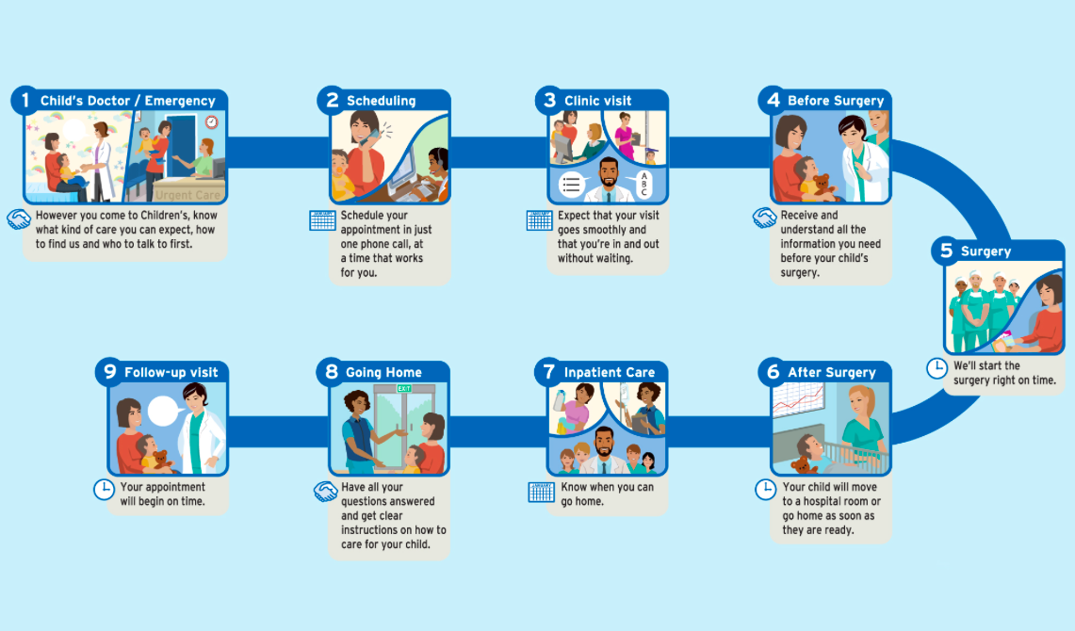
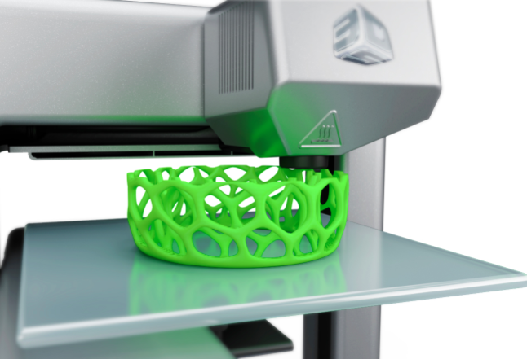
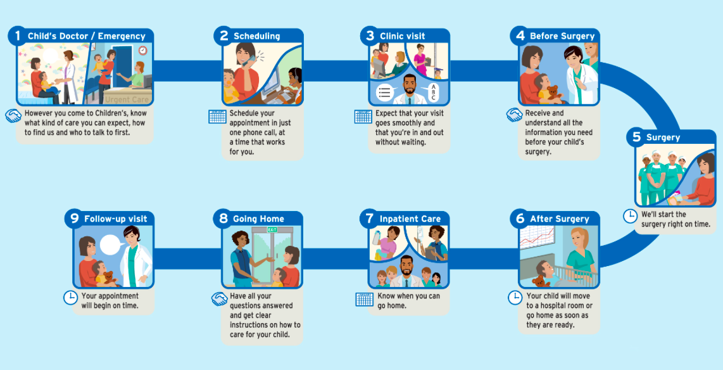
Testing beyond paper
Servicedesigntools.org
Scenarios and scripts
3D-printing
Notes:
Test and study the assumptions you have about the customers or potential customers – IF IT DOESN’T DO A RELEVANT JOB it won’t succeed
Fail quick, fail cheap etc. Always try to quickly move to value propositions and then prototypes.
Main reason why new products / services fail is not that they wouldn’t work properly IT rather that they don’t meet the needs in a way that enough people would hire them for the job.
Servicedesigntools.org

Slide 22
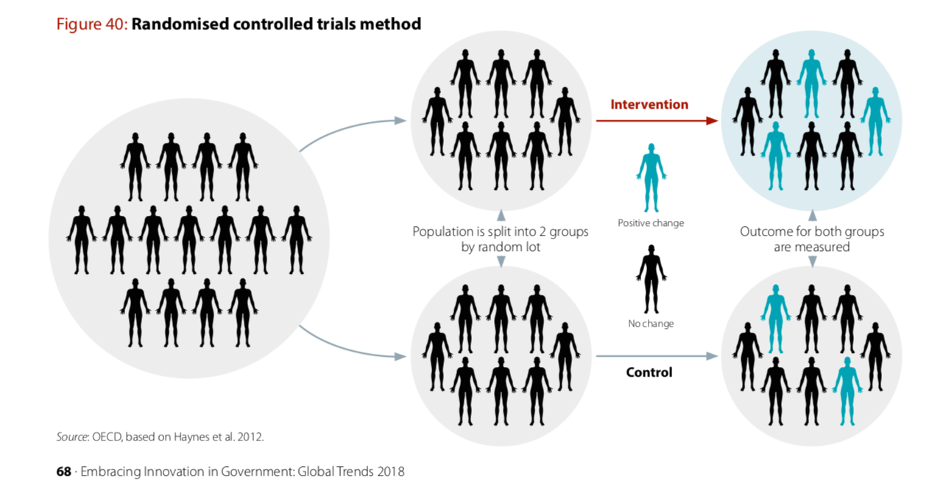
Randomized controlled trials in public policy
Notes:
How to get people to pay their tax in time, enroll for retirement plans, see how basic income supports them etc.
Behavioral Insights Team and the Cabinet Office UK

