Slide 1
Student services
Current situation
Saara Maalismaa, Learning services
25.2.2019

Slide 2
Services for students
”Infrastructure”
Learning services
Academic services
Student services, other providers than University
Under construction or lacking
Hopes
Facts

Slide 3
1. Infrastructure
Spaces to study
Aalto Space App/booking
Special Fasilities
Workshops, Fab Lab etc
IT-services
Software
Devices
Wifi
Start-up scene (resources)
Learning environments: for example MyCourses
Electrical exams
Information sharing: Into.aalto.fi

Slide 4
2. Learning services
Study advice & guidance
Service points: Schools, Starting point, the Starting point of wellbeing
All Well-questionnaire and personal feedback
Study register (Oodi)
Statutory insurance for students
Individual study arrangements
Study- and career planning psychologists: courses, groups and online services as well as a personal counselling appointments
Library – books, access to scientific articles, databases and eBooks, information service and information skills training, visual archives, open access publishing
Career services – CV-clinics, happenings, internships, Career web

Slide 5
3. Academic service
Studies, curriculum planning etc., academic guidance
Language & communication studies
Services: writing clinic, language certificates etc.
Cross-school and cross-university studies
University wide studies
Personal Impact
Studies in other Finnish universities
Exchange studies
Etc.

Slide 6
4. Student services
other providers than University
Student Restaurants
Student financial aid, Meal subsidy (discounted meals at participating student restaurants, €1.94 per meal) (Kela=Social Insurance Institution)
Services of student union AYY
Unisport; AYY Sport services
University chaplains
Housing: AYY, HOAS
Health care: FSHS (YTHS in Finnish)
Nyyti (a national Finnish non-profit organisation, promotes students’ mental health by providing versatile information and activities)
Notes:
From Espoo congregation
the Foundation for Student Housing in the Helsinki Region
The Finnish Student Health Service (FSHS)
City, nation, organization

Slide 7
5. Under construction or lacking
-One interface to all services for student
Aalto University App for students?
Student dashboard?
-Study analytics as a service
-Into.aalto.fi to Aalto.fi
-Student guidance alignment – for example minimum criteria
-Specific services for international student
-Lifelong learning
Notes:
Ministry of Education and Culture - funding

Slide 8
6. Hopes:
-open viewpoint
-customer-oriented
-out of the box
-Aalto level: different schools, fields, degrees and places in student journey
Notes:
Variety!

Slide 9
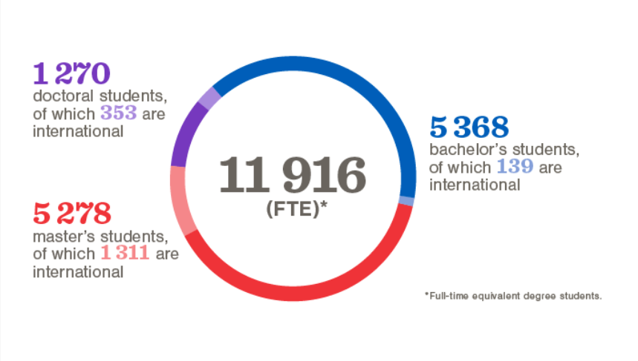
7. Facts (2017)
5 new bachelor programmes in English starting 2019
+
https://www.aalto.fi/aalto-university/key-figures-and-reports
Notes:
Number of service personel have gone down

Slide 10
Thank you!
Saara Maalismaa, Manager, Student services
saara.maalismaa@aalto.fi

