Slide 1
Introduction for EDFI/Interact

Slide 2
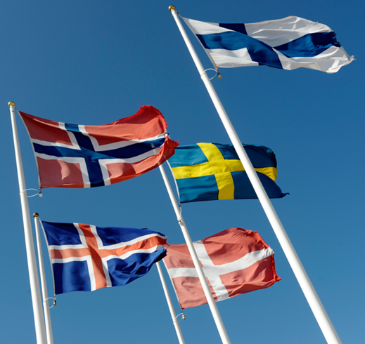
NDF in brief
Established in 1989 and owned by Denmark,
Finland, Iceland, Norway and Sweden
Operations mirror the Nordic countries’
priorities in the areas of climate change and
development
The only joint Nordic finance institution
focused exclusively on climate change and
development in low and lower-middle income
countries
Originally funded by the Nordic countries' development assistance budgets
Total assets ~EUR 820 million
Headquarters in Helsinki, Finland, in connection to Nordic Investment Bank (NIB)
Staff of 20 persons (a variety of support services is bought from NIB)

Slide 3
Institutional Framework
Established through an international treaty ratified by Nordic countries
NDF has the legal status of an international legal person, with full legal capacity and is vested with some privileges and immunities typical for an intergovernmental organisation
e.g. immunity from jurisdiction of national authorities
25 Framework Agreements with sovereign countries where NDF has (had) activities in
Members of Board of Directors represent ministries of foreign affairs in each Nordic country
Members of supervisory body Control Committee are parliamentarians from each Nordic country
Mandate of Managing Director up to 5 years

Slide 4
Governance
MEMBER COUNTRIES
NORDIC COUNCIL OF MINISTERS
CONTROL COMMITTEE
BOARD OF DIRECTORS
MANAGING DIRECTOR

Slide 5
NDF Mission and policy context
Mission
Provide concessional financing and knowledge for climate change and development activities primarily in low-income countries
adaptation and/or mitigation activities
Policy context for NDF operations
Global sustainable development agenda / contribution to the UN Sustainable Development Goals
Development policies of the Nordic countries

Slide 6
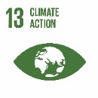
Translating NDF's Strategic Mission into Results
Provide financing and knowledge for climate change and development activities primarily in low-income countries
Strong focus on
Poverty reduction
Development effectiveness
Inclusive development
Gender responsiveness
NDF’s key comparative advantages
Nordic know-how
Innovative frontrunner
Agile and flexible
Reaching over regions
Core principles
Strategic focus
areas
Programmes & Projects
Climate change
Development
Nordic identity
Catalytic role and leverage
Project preparation
Innovation
Private sector development & blended finance
High risk interventions
Emerging climate issues
Co-financed projects
Nordic Climate Facility
EEP Africa Trust Fund
Policy context
Global sustainable development agenda | Development policies of the Nordic countries
Notes:
.

Slide 7
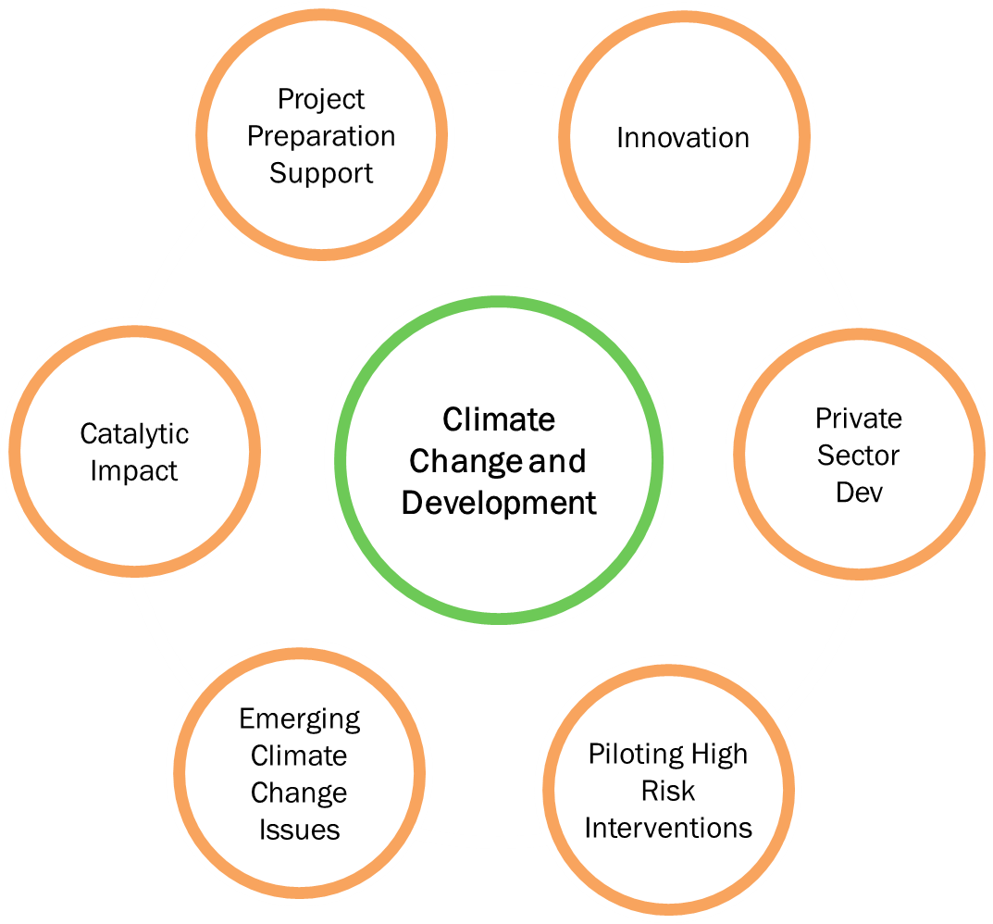
Strategic Focal Areas
steering selection of projects to be financed

Slide 8
Where we operate
Latin America (3)
Bolivia
Honduras
Nicaragua
Africa (14)
Benin
Burkina Faso
Cape Verde
Ethiopia
Ghana Senegal
Kenya Tanzania
Malawi Uganda
Mozambique Zambia
Rwanda Zimbabwe
Asia (10)
Bangladesh
Cambodia
Kyrgyz Republic
Lao PDR
Maldives
Mongolia
Nepal
Pakistan
Sri Lanka
Vietnam

Slide 9
NDF's modes of financing
NDF finances projects usually in cooperation with bilateral, multilateral and other development institutions
NDF flexibly uses loans, equity, traditional grants, reimbursable grants and any combination of these as financing instruments
NDF concessional financing typically in the range of EUR 0.5-10 million
Two NDF-managed challenge funds
Nordic Climate Facility (NCF): a challenge fund providing seed funding for Nordic applicants
the Energy and Environment Partnership Trust fund (EEP Africa): a multi-donor fund providing early stage and catalytic financing primarily for private-sector-led projects

Slide 10
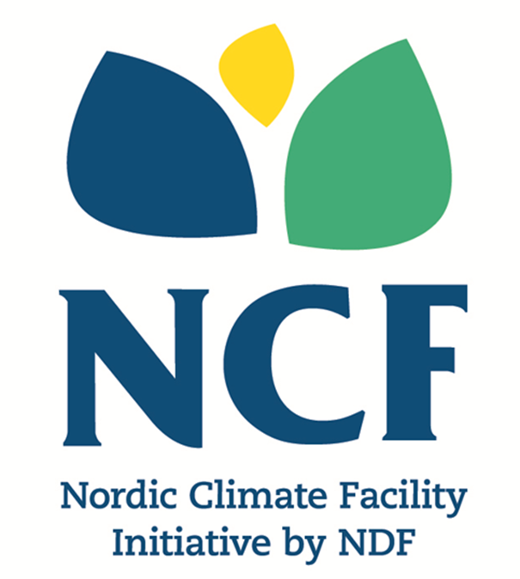
Nordic Climate Facility (NCF)
Support (grant) up to 500,000 euro to innovative projects that have the potential to combat climate change (mitigation and/or adaptation) and alleviate poverty in low-income countries.
8 Calls for Proposals targeting Nordic applicants, with a requirement of partner institution in an NDF partner country, launched since 2009.
82 projects financed

Slide 11
WHAT IS EEP AFRICA
Multi-donor fund providing early stage grant and catalytic financing to innovative clean energy projects, technologies and business models
Hosted and managed by NDF
15 countries in Southern and East Africa of which 8 NDF focal countries
EUR 14 m committed to 28 projects since NDF took over management
ABOUT EEP AFRICA

Slide 12
Typical characteristics of NDF projects
Catalytic role and leverage targeting projects with significant scale-up potential
Project preparatory funding targeting opportunities early in the project cycle
Support for innovation targeting new climate solutions, new financing tools and new partners
Support for private sector development harnessing immense private sector potential for climate solutions
Piloting of high risk interventions with targeted grant and blended finance
Emerging climate change issues allowing for dynamic and evolving climate threats and solutions

Slide 13
Our Added Value
We are the only joint Nordic finance institution combining development and climate and focusing on low-income countries
As a fast and agile cooperation partner we are attractive to partner countries, large MDBs and other financiers
We have a palette of financing instruments enabling i.a. blended financing
We can respond to demand in niches where larger financiers cannot ,e.g. SME financing with MDBs, upstream activities involving high risk
We have a solid experience of climate financing mechanisms

Slide 14
Portfolio as of 31 December 2018
600+ projects financed altogether by NDF since 1989
223 projects under current climate change and development mandate since 2009
142 on-going projects at various stages in 16 countries
51 new projects in 2018
Predominant themes in 2018
Blended financing, increased use of equity/loans vs. traditional grants
Private sector adaptation
Catalytic financing for coastal resilience

Slide 15
2018 Operations

Slide 16
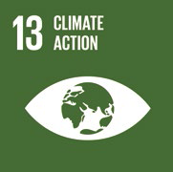
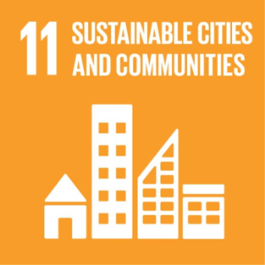
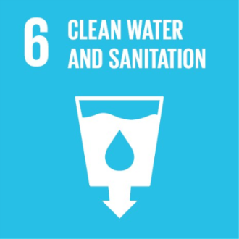
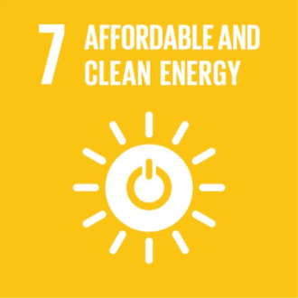
Project Performance and Results 2018
NDF financed projects work towards the sustainable development goals (SDGs) defined by the United Nations, especially the following:

