Slide 1
Fundamentals of Sprays
AAE-E3030 Numerical Modeling of Multiphase Flows
25.2.2019
D.Sc. (Tech) Ossi Kaario

Slide 2

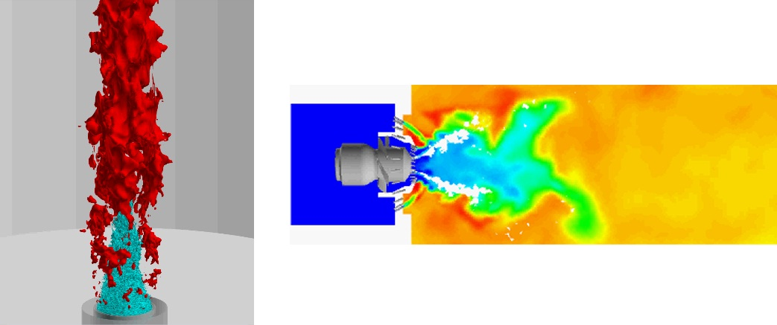

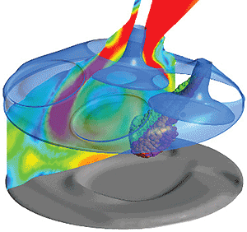
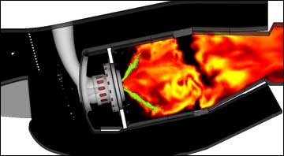

Motivation
Why learn about sprays ?
Sprays are used in many industrial applications: engines (diesel & gasoline), furnaces, gas turbines, rockets and in many other applications: aerosols, water taps…
Therefore, understanding concepts related to sprays might be beneficial
This lesson is about sprays: general topics of sprays in order to better understand what sprays are and how they form and interact with their surroundings

Slide 3
Course related phenomena
Wehrfritz et al., Comb. Flame 2016.

Slide 4
Optical Spray Investigations
What does a fuel spray look like ?
Pictures by Harri Hillamo, 2010
Fuel injection pressure is 1400bar
Gas density is 35 kg/m3
Nozzle diameter d=0.34mm

Slide 5
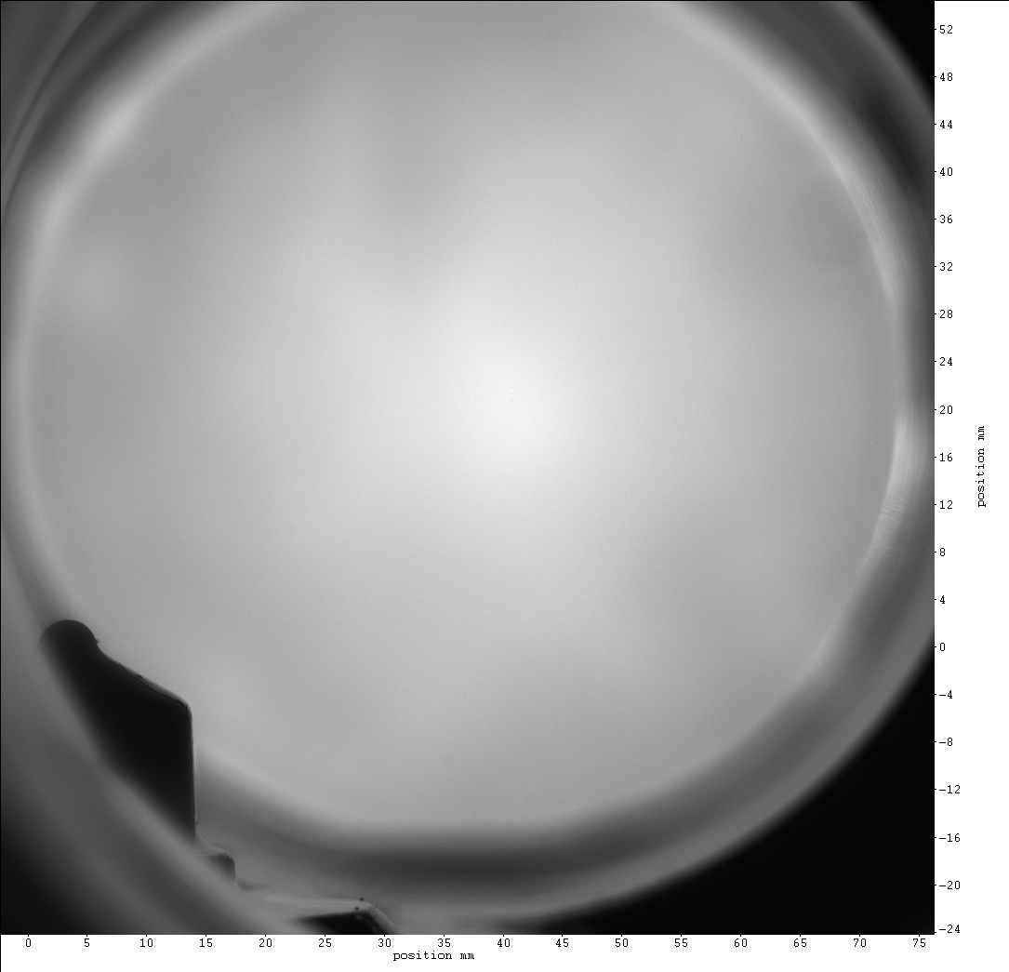
Field of optical view (~10 cm)
Nozzle tip
Nozzle hole (0.34 mm)

Slide 6
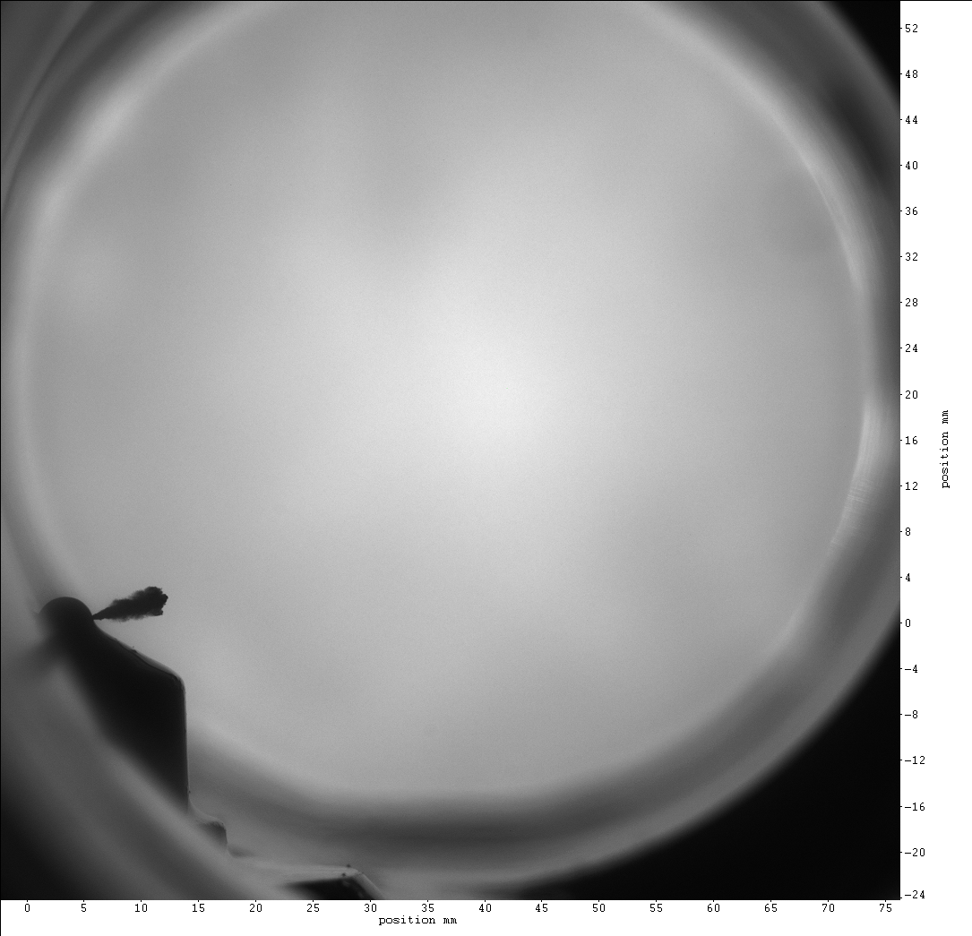

Slide 7
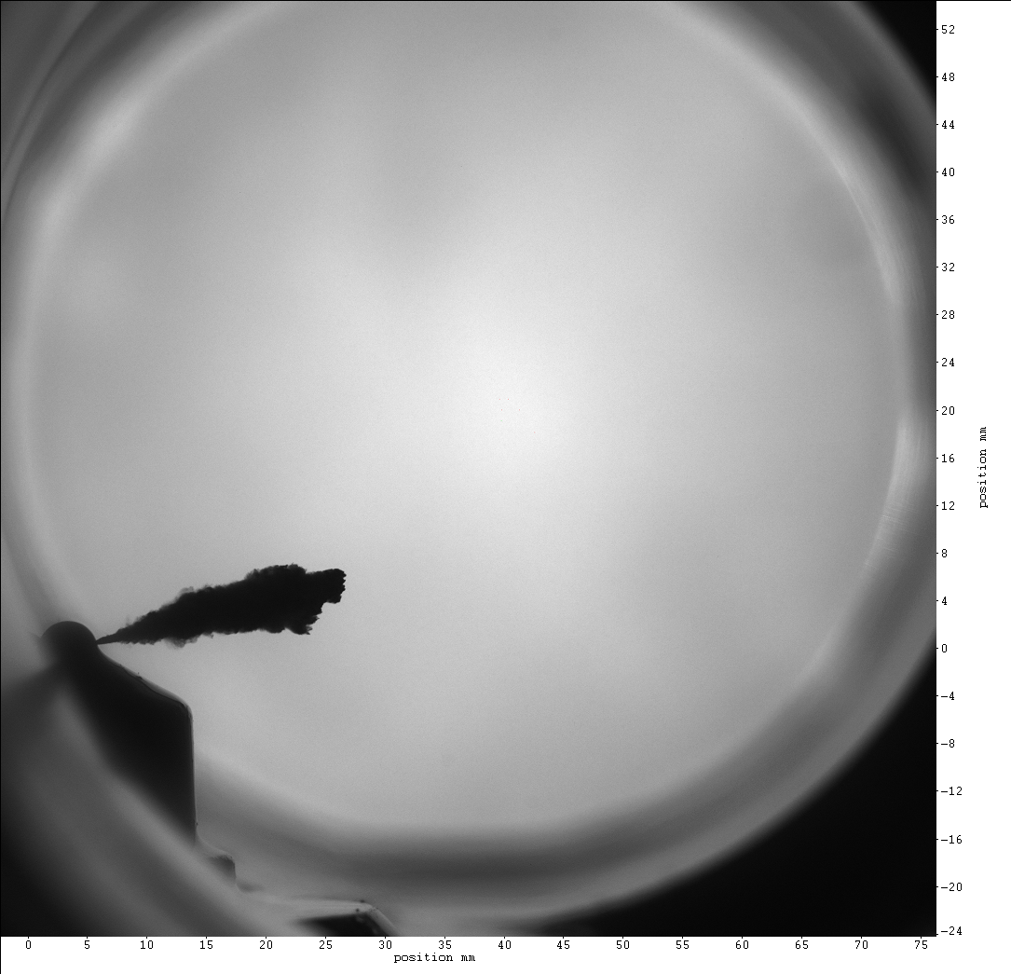

Slide 8
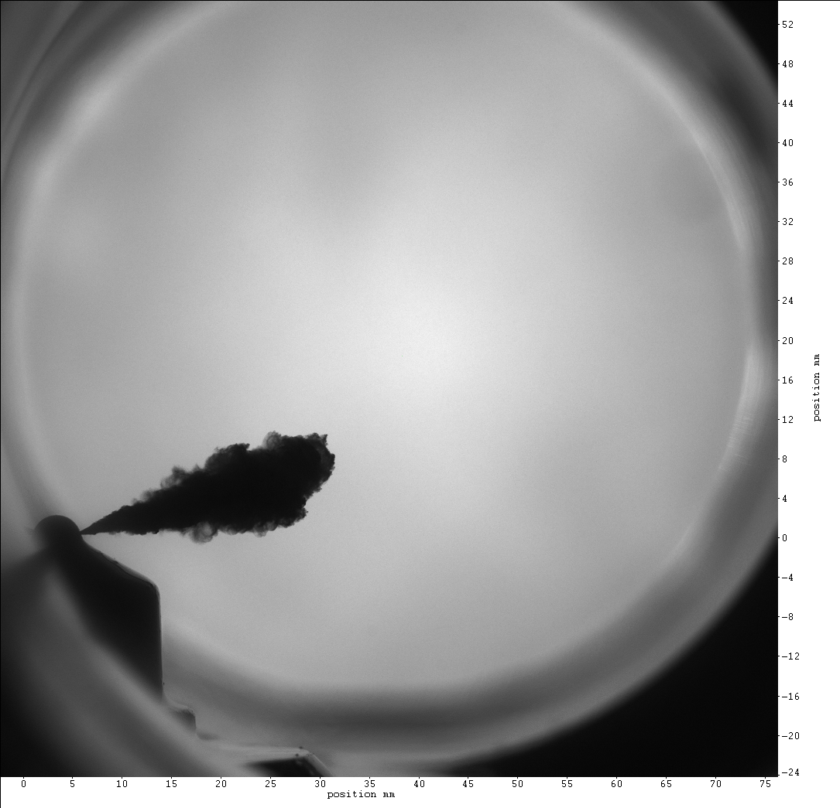

Slide 9
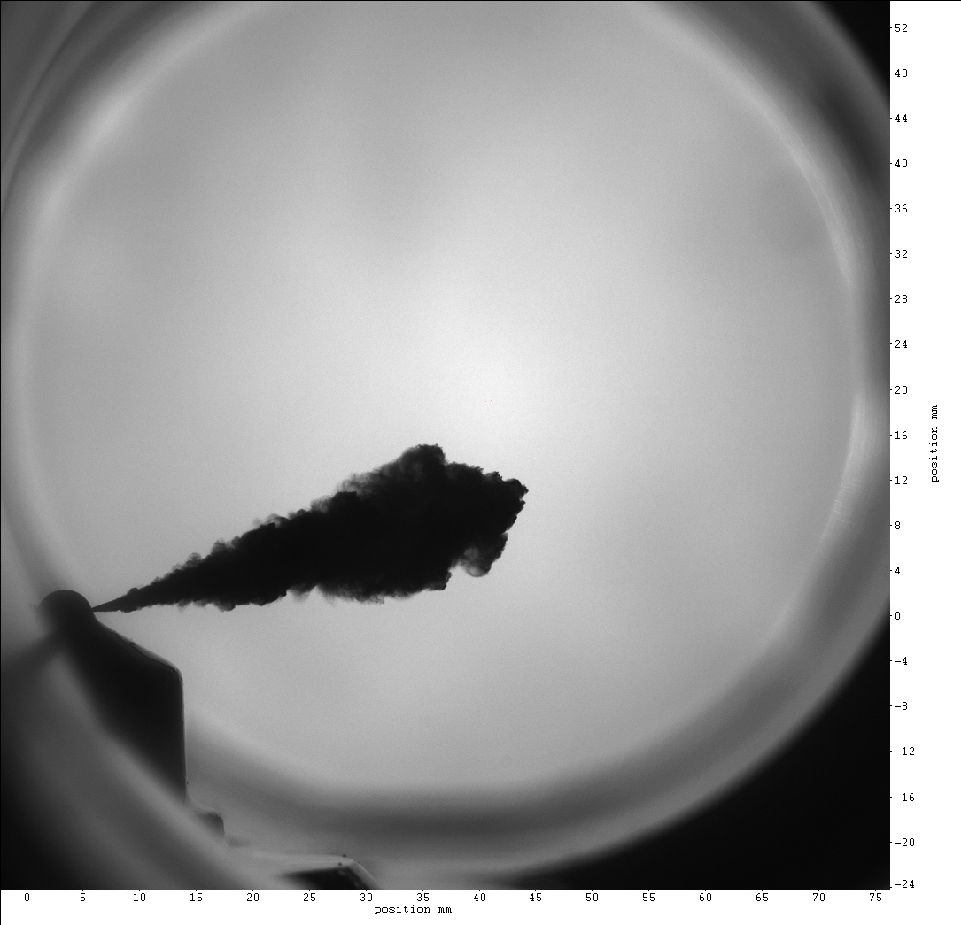

Slide 10
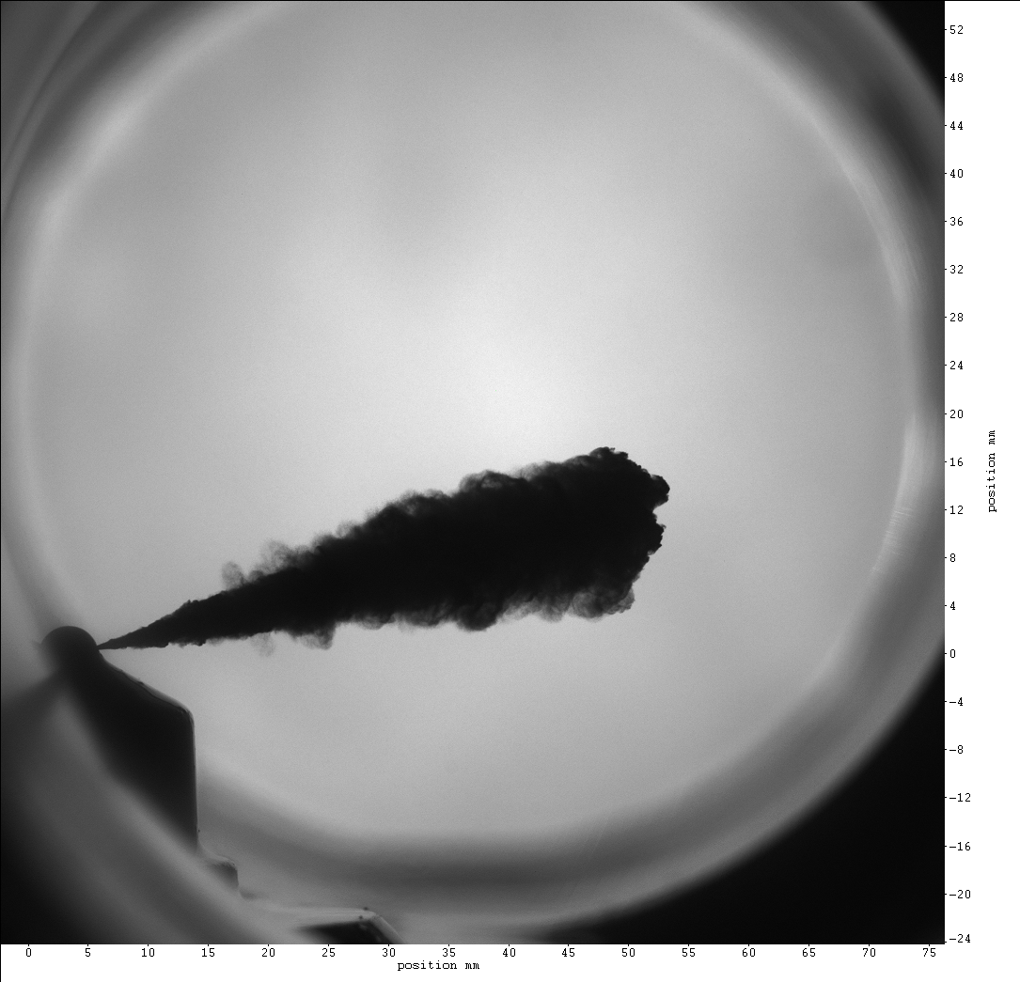

Slide 11
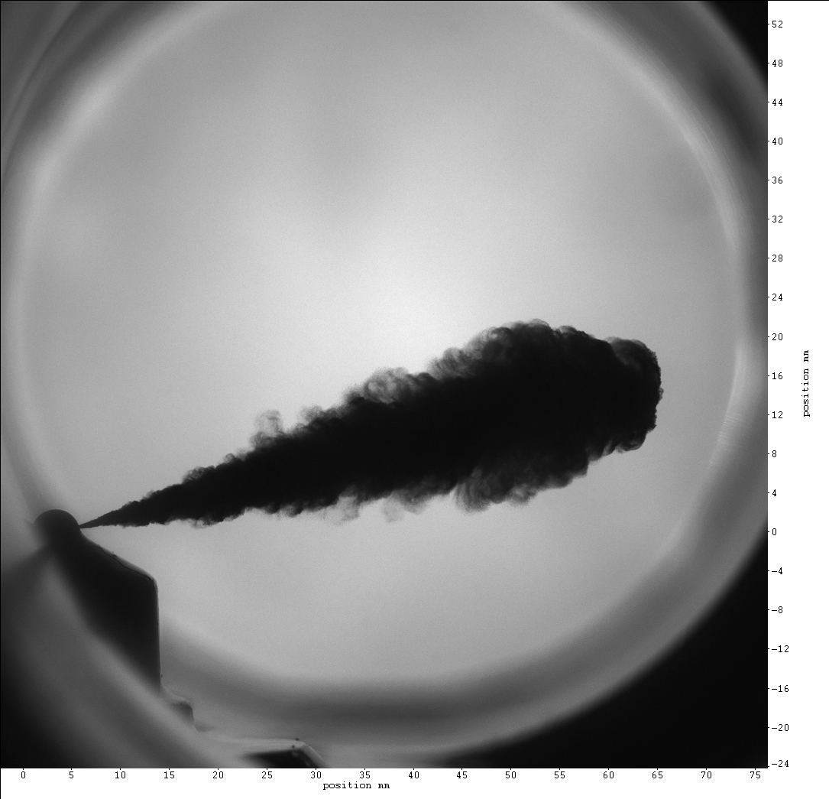

Slide 12
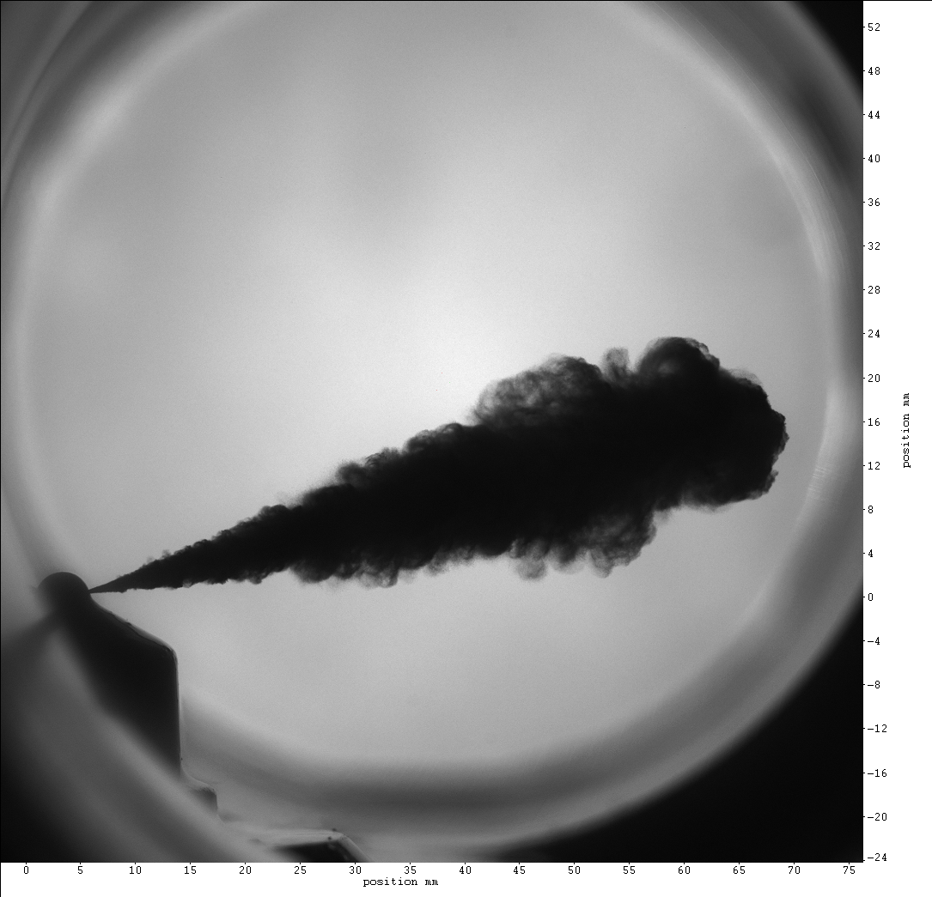

Slide 13
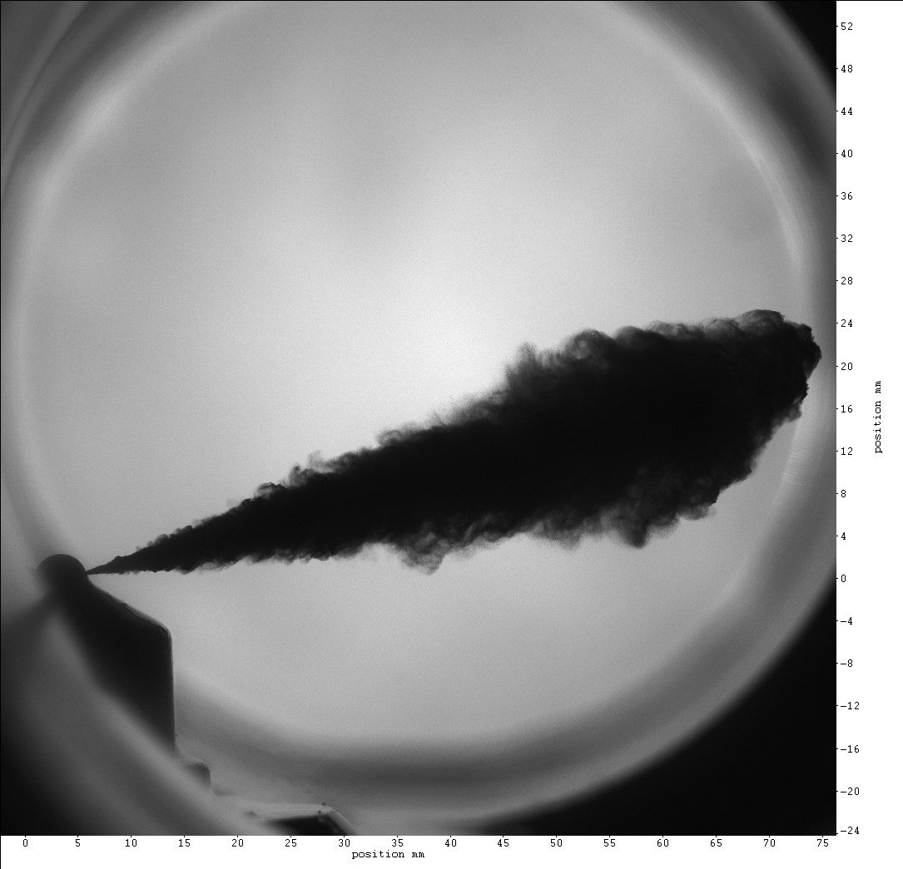

Slide 14
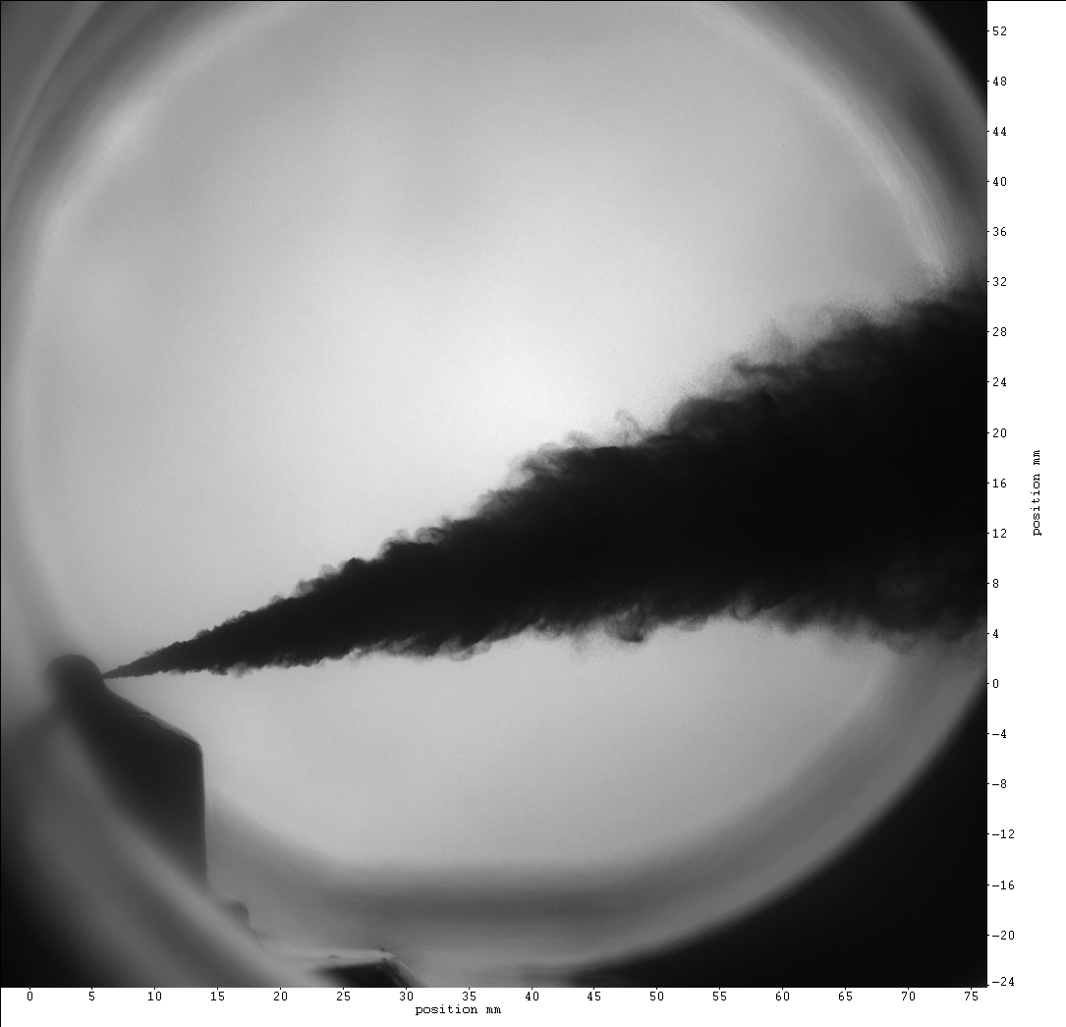

Slide 15
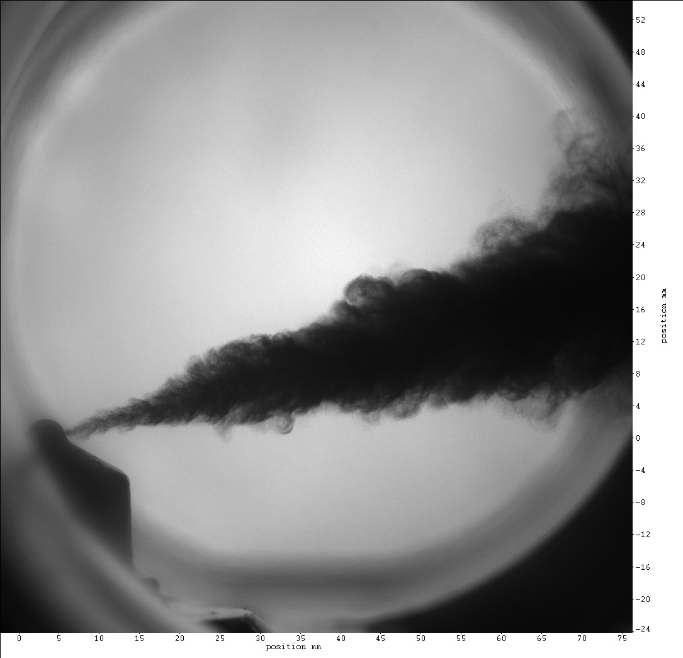

Slide 16
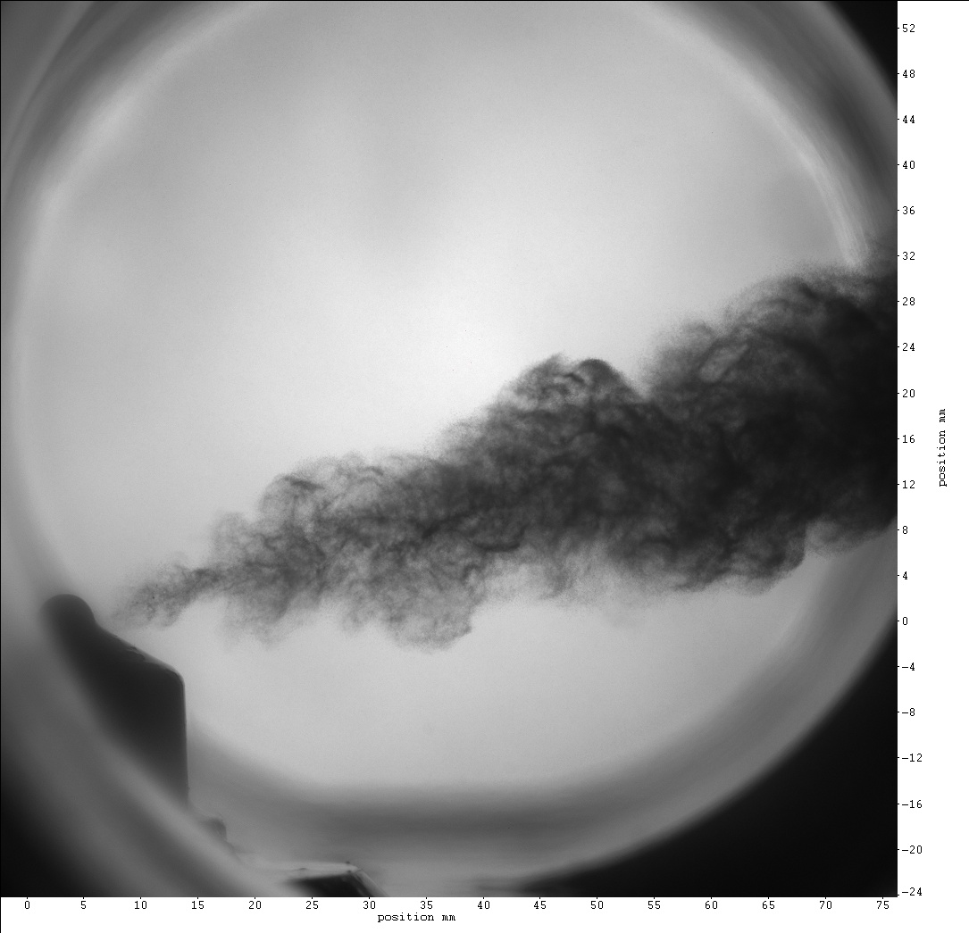

Slide 17
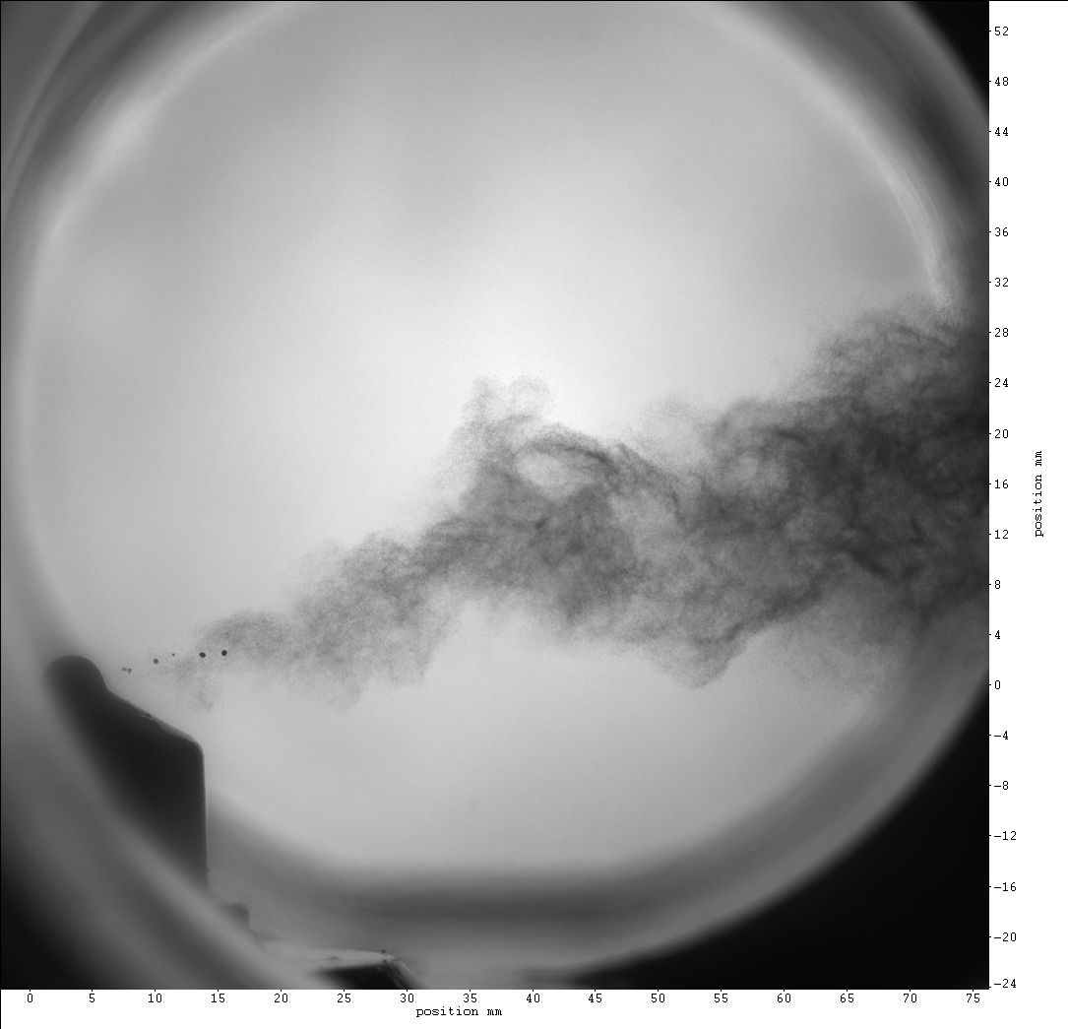

Slide 18
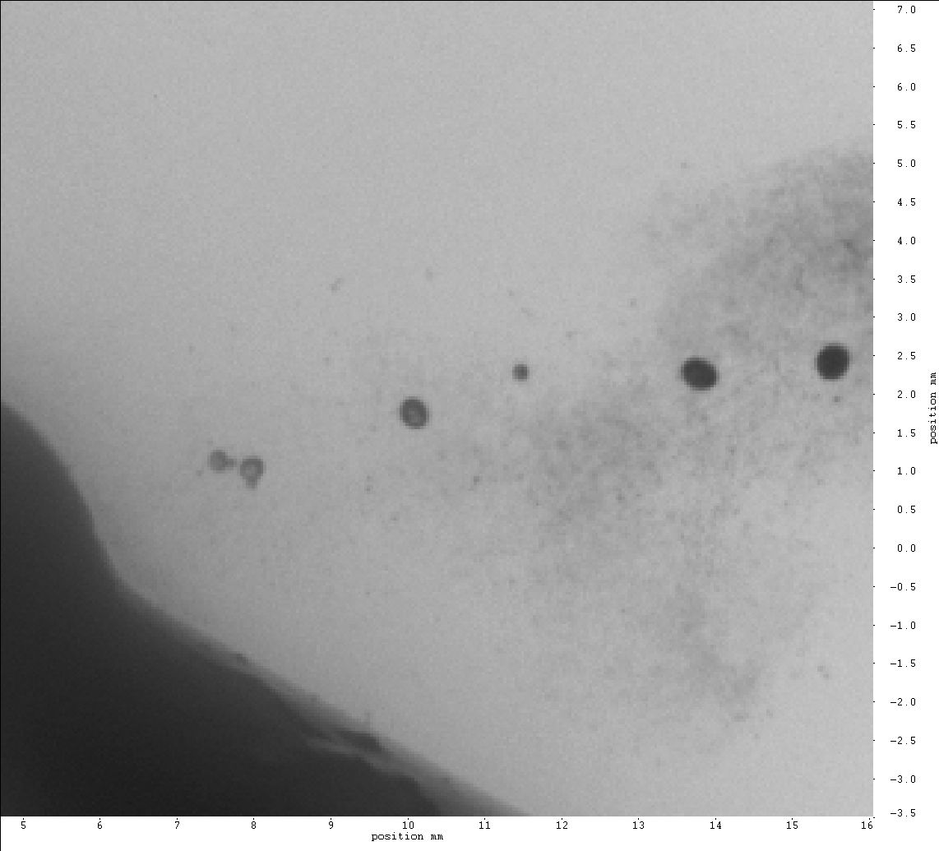

Slide 19

Spray Angle

Slide 20
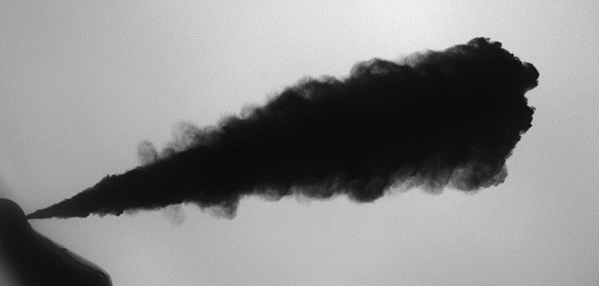
Spray penetration & opening angle
nozzle
opening
angle
spray tip penetration
Hillamo et al., 2010.

Slide 21

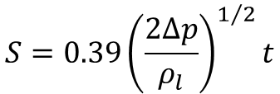


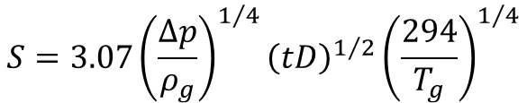


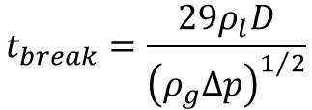

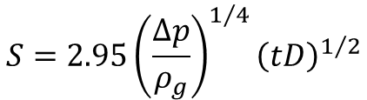

Spray penetration correlations
$$S=3.07{\left(\frac{∆p}{ρ_{g}}\right)}^{1/4}{\left(tD\right)}^{1/2}{\left(\frac{294}{T_{g}}\right)}^{1/4}$$
Dent (1971)
$$S=0.39{\left(\frac{2∆p}{ρ_{l}}\right)}^{1/2}t$$
$t<t_{break}$ :
Hiroyasu & Kadota (1980)
$$S=2.95{\left(\frac{∆p}{ρ_{g}}\right)}^{1/4}{\left(tD\right)}^{1/2}$$
$t>t_{break}$ :
$$t_{break}=\frac{29ρ_{l}D}{{\left(ρ_{g}∆p\right)}^{1/2}}$$
$$ρ_{g}$$
Gas density (kg/m3)
Liquid density (kg/m3)
Pressure difference (Pa)
Time (s)
Nozzle diameter (m)
$$ρ_{l}$$
OK/Aalto 2015
$$∆p$$
$$t$$
$$D$$

Slide 22
Spray penetration &
opening angle
Opening angle
Heywood, 1988
Hillamo et al., SAE 2008

Slide 23
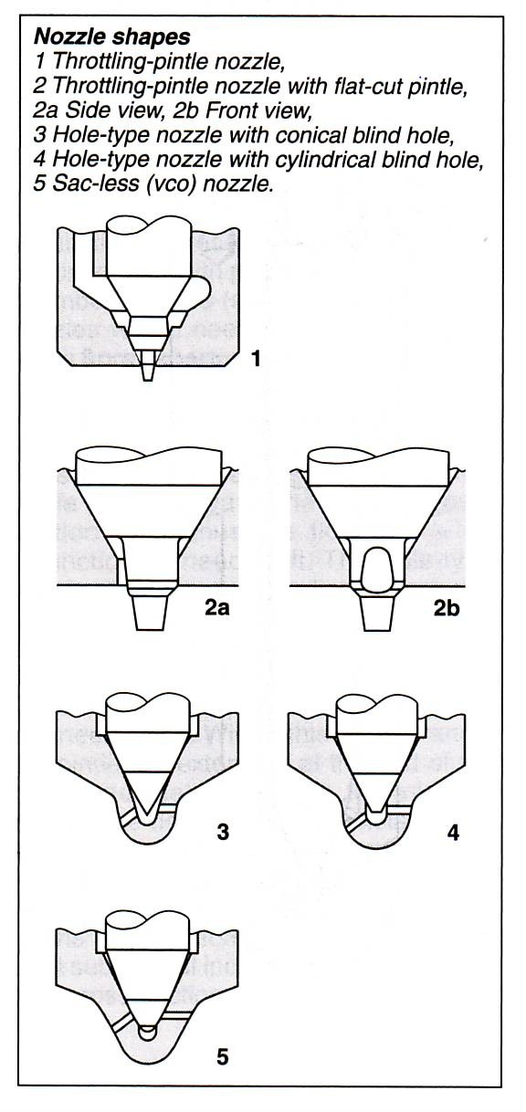
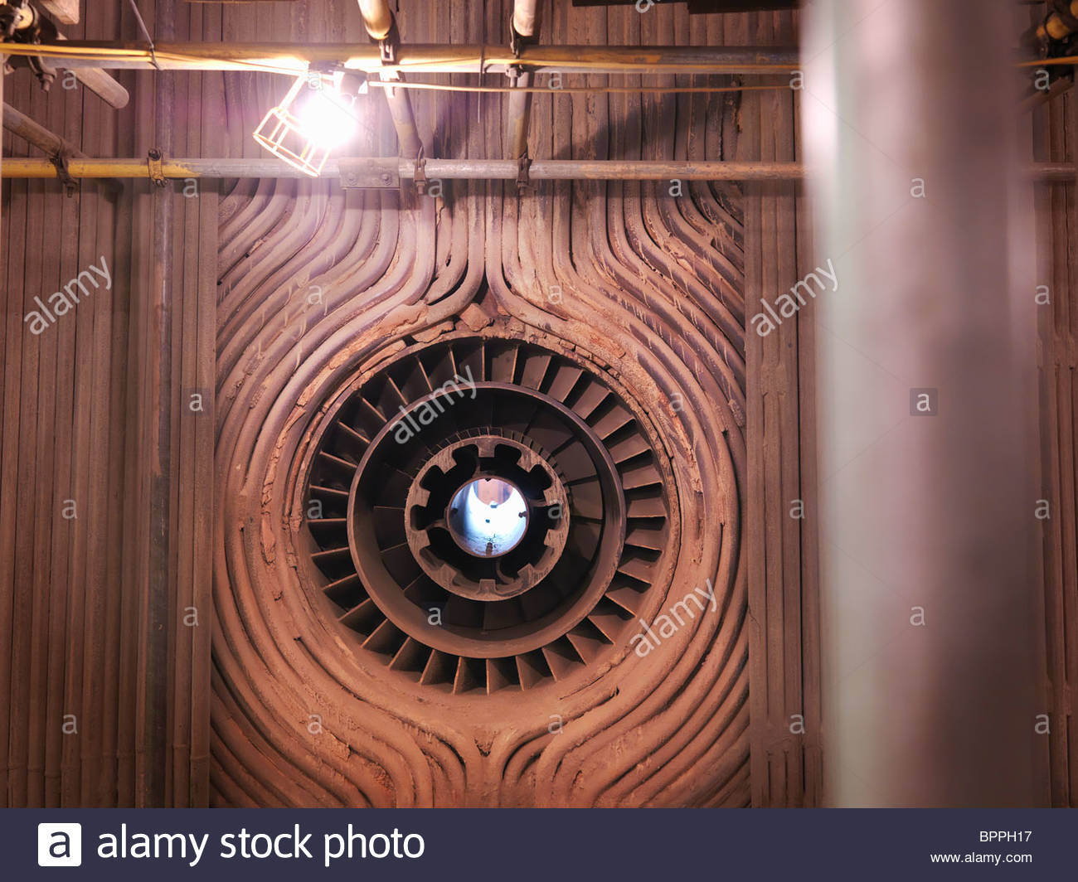
Nozzle types
Furnaces:
diameter ~ 1m
Engines:
hole diameter D ~ 0.1-0.5mm

Slide 24
Some liquid fuel properties
Fuel | HVO | Fischer-Tropsch diesel | FAME (RME) | EN 590
Density at +15C° (kg/m3) | 775-785 | 770-785 | 885 | 835
Viscosity at +40C° (mm2/s) | 3.0-3.5 | 3.2-4.5 | 4.5 | 3.5
Cetane number | 80-99 | 73-81 | 51 | 53
Distillation range (C°) | 180-320 | 180-360 | 350-370 | 180-360
Heating value (MJ/kg) | 44 | 43 | 37.5 | 43

Slide 25
Some liquid fuel properties
Fuel | Methanol | DME
Density at +15C° (kg/m3) | 722.1 | 612
Viscosity at +40C° (mm2/s) | 0.45 | 0.22
Cetane number | ~ 5 | 55
Heating value (MJ/kg) | 22.7 | 29

Slide 26
Some liquid fuel properties
HEP = Heptane (C₇ H₁₆)
DF2= U.S. Diesel fuel
EN590=Standard Diesel in EU
HVO=Hydrotreated vegetable oil
Y. Gong et al., SAE 2010.

Slide 27
Topics on Spray Velocity

Slide 28
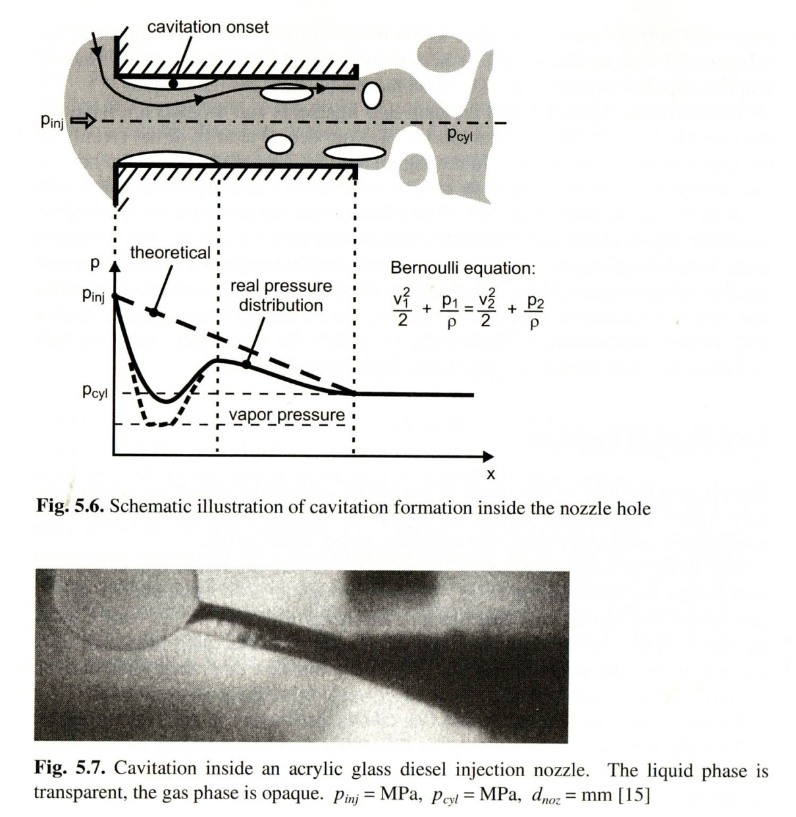
Sprays are pressure driven
Cavitation
Liquid

Slide 29
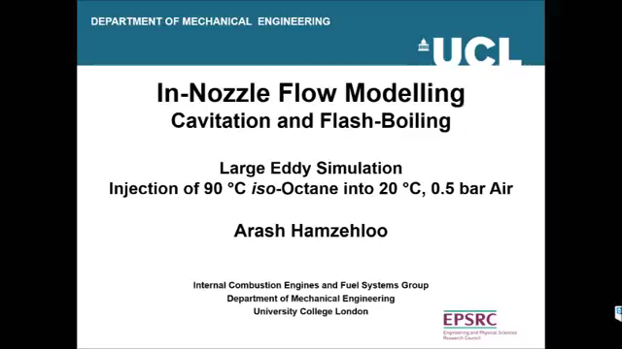
Cavitation

Slide 30
Sprays are pressure driven
Calculating the theoretical fuel exit velocity
Theoretical fuel exit velocity from nozzle
Velocity in practice

Slide 31
Discharge coefficient Cd
Discharge coefficient
used when calculating mass flow
‘velocity coefficient’, used when calculating real injection velocity
‘area contraction coefficient’, used when calculating effective nozzle hole diameter

Slide 32
Additional material
Intact Liquid Core

Slide 33
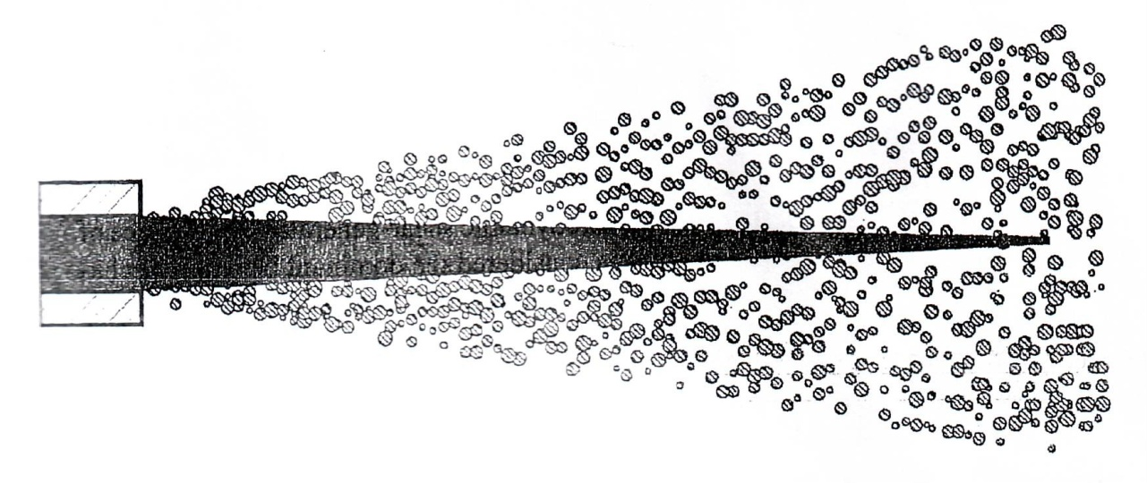
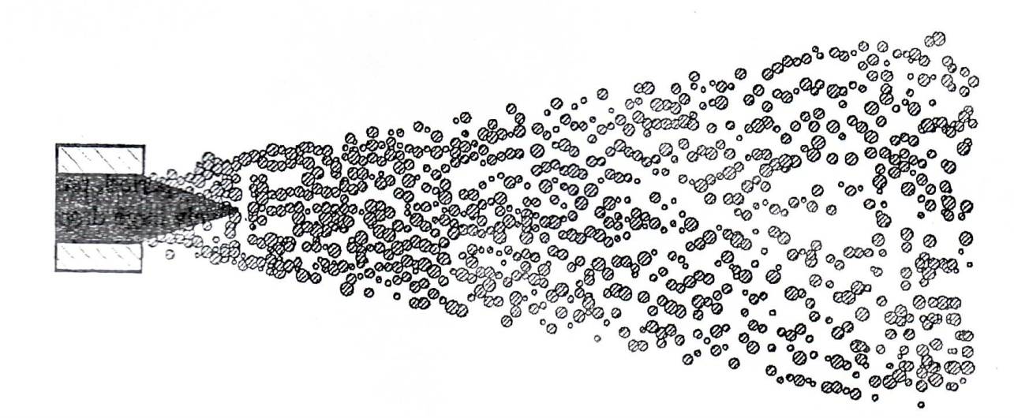
Intact liquid core ?
Additional material
Smallwood, G., and Gulder, O., Atom & sprays, 2000.

Slide 34
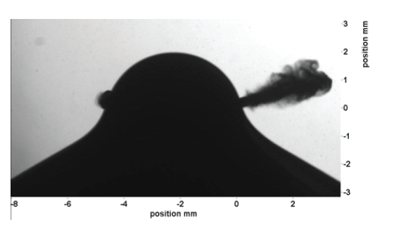
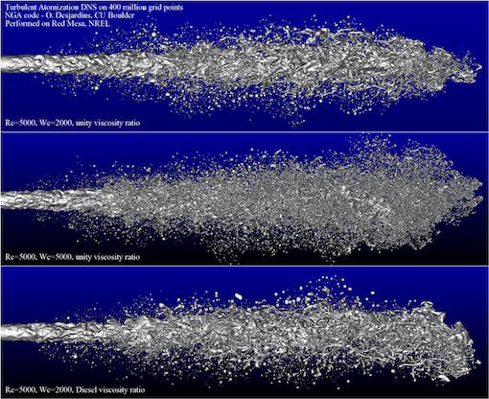
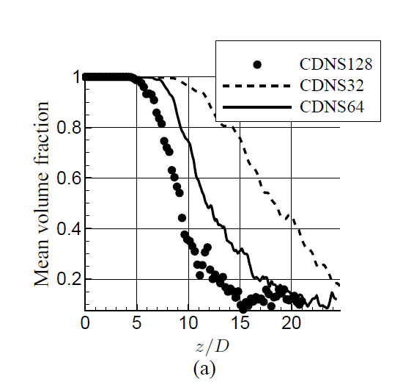
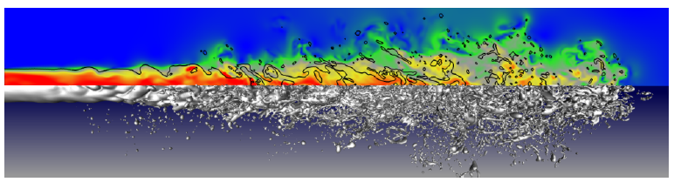
Intact liquid core ?
Additional material
Hillamo et al. 2010, Atom. Sprays
6d_{n}
or 2mm
Desjardins et al, 2010
Reynolds number compared to real high-pressure sprays.
DNS done with U_{exit}~100m/s
Chesnel et al. 2011

Slide 35
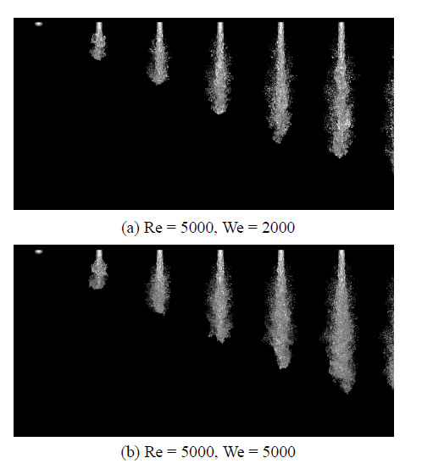
Intact liquid core ?
Additional material
Turbulence inside the nozzle has bigger effect than previously thought of.
Taken the experimental and numerical evidence, it seems very likely that in modern high-pressure injection systems, the intact liquid core is either very short or even non-existent.
Desjardins et al, 2013, Atom. Sprays

Slide 36
Spray Equations

Slide 37



Lagrangian spray modeling
Discrete computational points are tracked
Spray equations (Ordinary differential equation (ODE)):
  Parcel position
  Eq. (1) can be used to calculate the particle position at each time instant.
$$dt$$
Droplet position, $x_{p}$
→
$$x_{p,2}=x_{p,1}+u_{p} dt$$
(1)

Slide 38
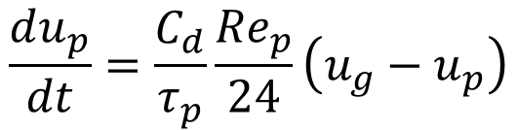
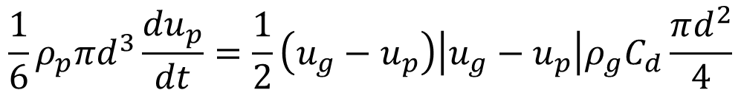
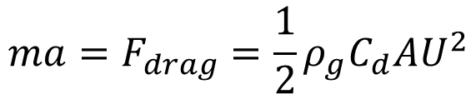
Lagrangian spray modeling
  Parcel equation of motion
$$ma=F_{drag}=\frac{1}{2}ρ_{g}C_{d}AU^{2}$$
$$\frac{1}{6}ρ_{p}πd^{3}\frac{{du}_{p}}{dt}=\frac{1}{2}\left(u_{g}−u_{p}\right)\left|u_{g}−u_{p}\right|ρ_{g}C_{d}\frac{πd^{2}}{4}$$
$$\frac{du_{p}}{dt}=\frac{C_{d}}{τ_{p}}\frac{{Re}_{p}}{24}\left(u_{g}−u_{p}\right)$$
→

Slide 39

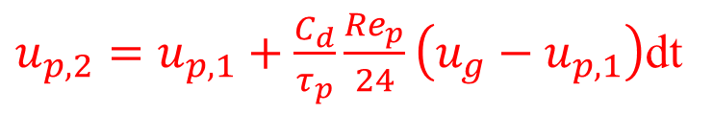


Lagrangian spray modeling
  or
  Eq. (2) can be used to update the particle velocity for
  each time instant, and then use Eq. (1) to update the
  position.
$u_{p,2}=u_{p,1}+\frac{C_{d}}{τ_{p}}\frac{{Re}_{p}}{24}\left(u_{g}−u_{p,1}\right)$dt
(2)
$$dt$$
Droplet velocity, $u_{p}$
Droplet position, $x_{p}$

Slide 40
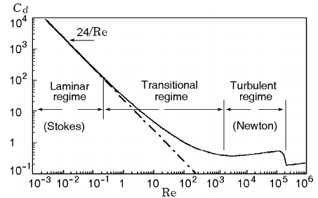
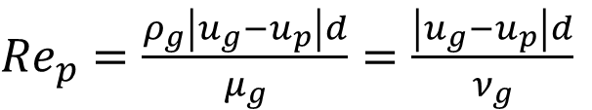
Droplet Drag
The resistance a droplet/particle encounters, is due to shear and form drag
Droplet drag coefficient Cd is calculated from
Droplet Reynolds number is
${Re}_{p}=\frac{ρ_{g}\left|u_{g}−u_{p}\right|d}{μ_{g}}=\frac{\left|u_{g}−u_{p}\right|d}{ν_{g}}$
Boiko et al., 2013

Slide 41
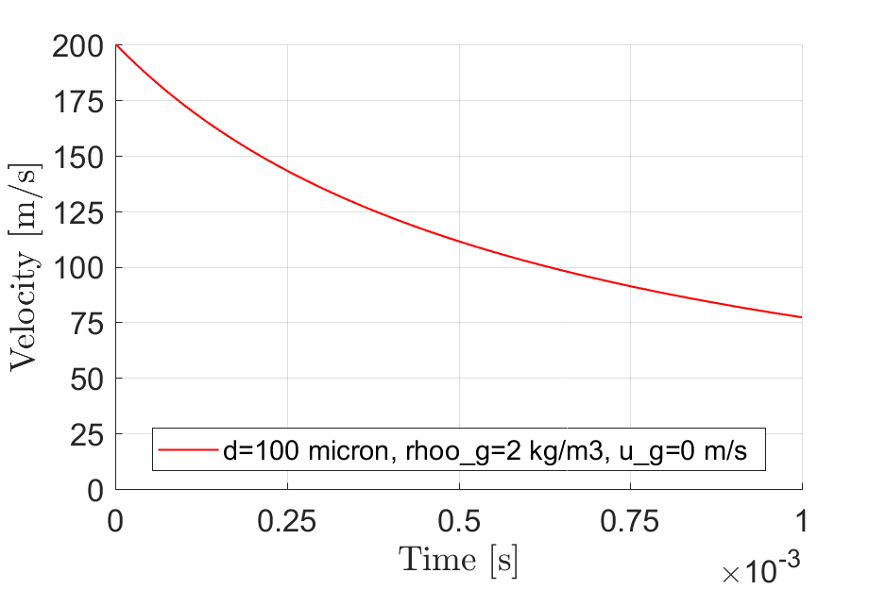
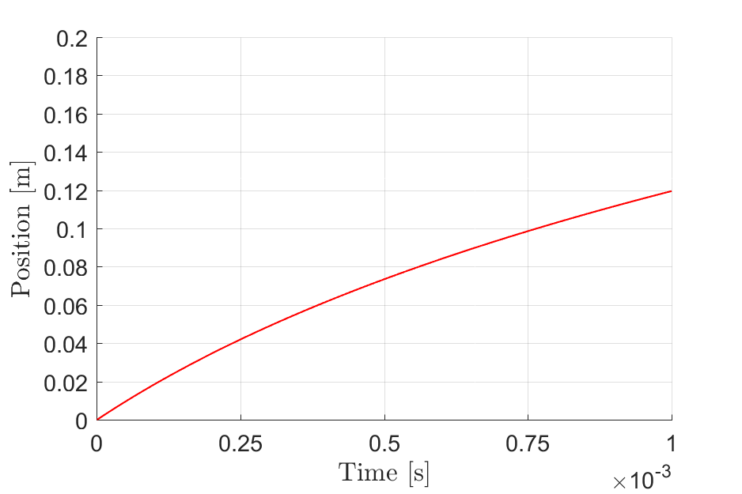
Lagrangian spray modeling (Matlab)
Constant Cd=0.424 and constant gas phase velocity (0 m/s)
Droplet size is constant d=100micro-m
Gas density is 2 kg/m3 and liquid density is 800kg/m3.
Constant gas phase velocity may be a strong assumption.

Slide 42
Dispersed and continuous phase coupling

Slide 43

Stokes number
    Stokes number
    Ratio of the characteristic particle time scale (or
    the momentum relaxation time scale)
    To the characteristic flow time scale
droplet diameter
D nozzle diameter
U₀ flow velocity
$$d$$

Slide 44
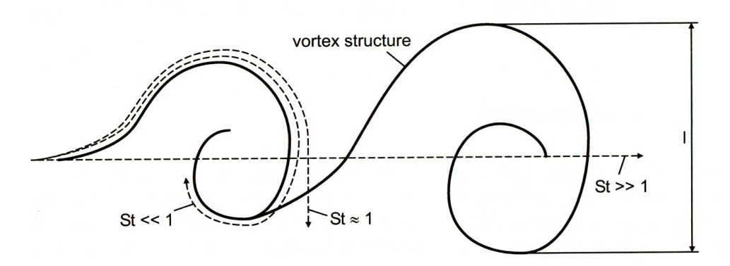
Stokes number & Turbulent dispersion
Figure by G. Stiesch

Slide 45
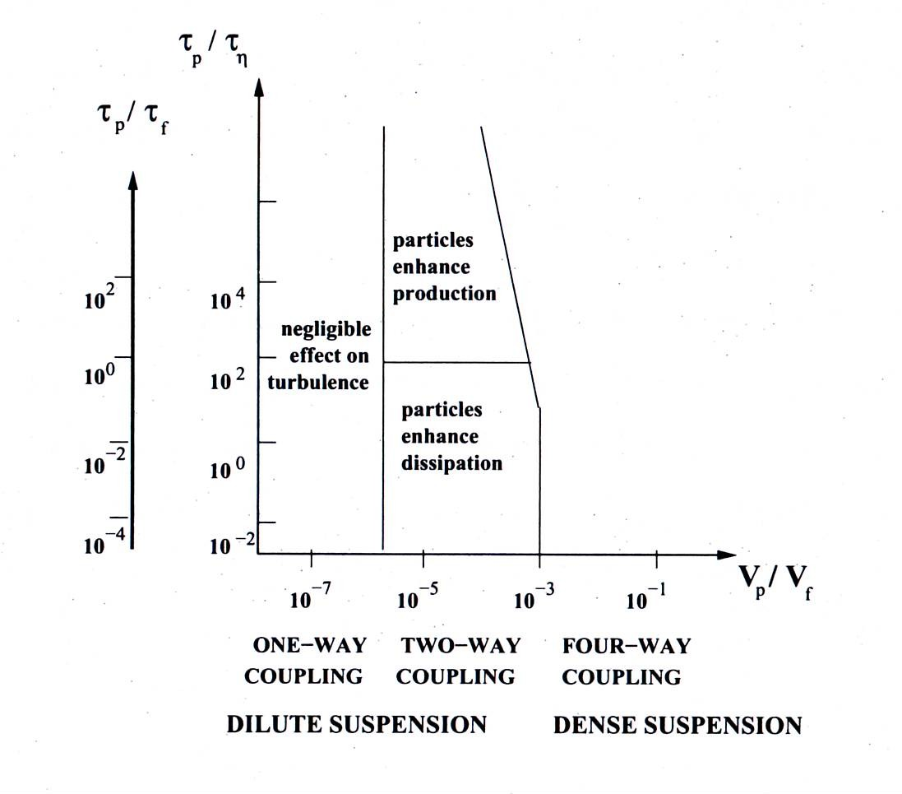
Coupling regimes
One-way coupling → Gas phase only interacts with particles
Two-way coupling → Gas phase and particles both interact with each other
Four-way coupling → Additionally, particles interact with each other
Figure by Elghobashi, 1994.

Slide 46

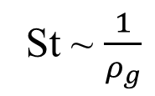
Stokes number
If $St≪1$ Particles will have plenty of time to adjust to changes in flow field velocity. Particle and fluid velocities nearly equal.
If $St≫1$ Particle velocity will be little affected by flow velocity.
St number
effect
St ~ $\frac{1}{ρ_{g}}$
Kaario, 2012

Slide 47
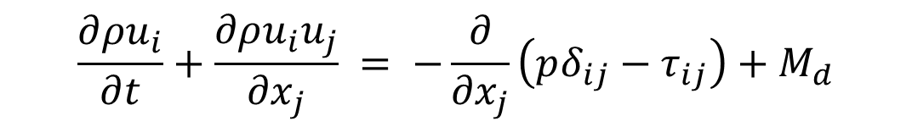
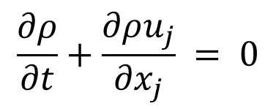
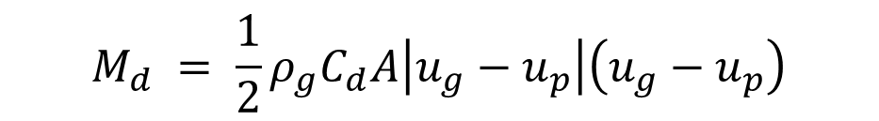
Source term in N-S Eqs.
The flow field ’sees’ the droplets via source terms in the N-S eqs. In the 2-way coupling regime, the source term M_{d} accounts for the coupling. Droplets ’see’ the flow field effect from the velocity difference.
$$\frac{∂ρ}{∂t}+\frac{∂ρu_{j}}{∂x_{j}} = 0$$
$$\frac{∂ρu_{i}}{∂t}+\frac{∂ρu_{i}u_{j}}{∂x_{j}} = −\frac{∂}{∂x_{j}}\left(pδ_{ij}−τ_{ij}\right)+M_{d}$$
$$M_{d} = \frac{1}{2}ρ_{g}C_{d}A\left|u_{g}−u_{p}\right|\left(u_{g}−u_{p}\right)$$

Slide 48
Group Work
Discuss in pairs for about 10 min:
What information is needed to calculate droplet/particle Stokes number ?
What information is not needed ?
What does a particle St number mean ?
If you would be given a task to design a spray configuration that would give a homogeneous mixture (of droplets and air / vapor and air), what kind of a St number would you aim for and why ?

Slide 49
What is dense ?

Slide 50
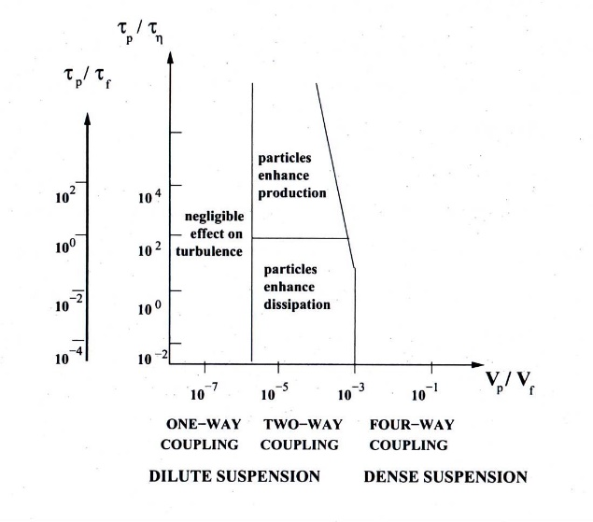
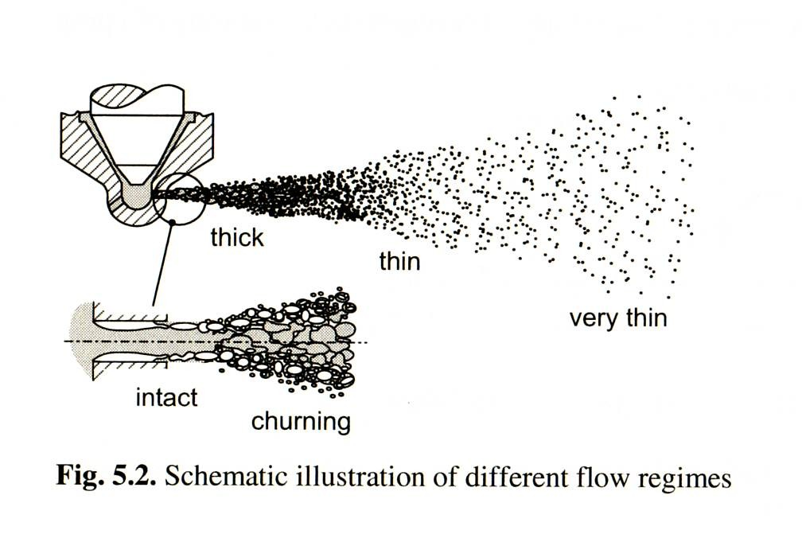
What is dense ?
d
~ 8%
~ 52%
b=d
b

Slide 51





What is dense ?
Typically assumed dense if V_{p}/V_{f} > 10⁻³
Assuming spray mass is divided homogenously in a cone –like volume
From the schematic spray opening angle picture, the
area ratio:
r
$$tan\frac{α}{2}=\frac{r}{S}$$
D
S
α
r$=tan\frac{α}{2}S$
assuming
$$D$$
nozzle diameter
spray penetration
spray opening angle
If D=90µm, S<8.1mm
$$S$$
$$α$$

Slide 52
Nozzle Hole Size vs Average Fuel Concentration
Additional material
Average concentration
Assumed constant injection rate
The spray volume evolves as a cone
Bottom area of the cone
Spray penetration assumes well known correlation
We obtain
Vuorinen, V., thesis 2010

Slide 53
Nozzle Hole Size vs Average Fuel Concentration
Additional material
Calculated result from the previous slide final result
D=0.12mm, α=15º or 20º
D=0.12mm or 0.36mm, α=20º

Slide 54


Turbulence in flow
Turbulent flow consists of vortices (eddies) of different size
The biggest vortices are of the size of the flow geometry
The eddies are breaking up into smaller eddies. At the same time kinetic energy is transported from the bigger eddies to smaller ones
At the smallest turbulent scale (Kolmogorov scale) kinetic energy is dissipated into heat
Fluctuations
Convection

Slide 55

Turbulence in flow
Turbulence ←→ Shear
Turbulence is characterized by the following:
  Three dimensional
  Unsteady
  Random
  Strong vorticity
  Dissipative
  Strongly diffusive
Turbulence = increased mixing !

Slide 56
Jet development
Mixing area
Developing flow
Self-preserving flow
D
Potential core
Nozzle
Potential core
~ 4-6D
Developing flow
~15-20D
Self-preserving flow

Slide 57


Jet development:
Kelvin Helmholtz Instability and Spray Mixing
Spray and jet turbulence is initiated by a Kelvin Helmholtz instability at the near nozzle region
Growth rate of KH instability is related to the velocity difference of the fluids and to the wavelength.

Slide 58

KH Instability

Slide 59

KH Instability and Mixing
Figure V. Vuorinen

Slide 60
Additional Reading
Crowe, C.T., Schwarzkof, J.D., Sommerfeld, M., and Tsuji, Y., Multiphase Flows with Droplets and Particles, 2nd edition, CRC Press, ISBN 978-1-4398-4050-4, 2012.
Wehrfritz Armin, Kaario Ossi, Vuorinen Ville, and Bart Somers, Large Eddy Simulation of n-dodecane spray flames using flamelet generated manifolds, Combustion and Flame, Vol. 167, pp. 113-131, 2016.
Vuorinen, V., Hillamo, H., Kaario, O., Larmi, M., and Fuchs, L., Large Eddy Simulation of droplet stokes number effects on turbulent spray shape, Atomization and Sprays, vol. 20, no. 2, pp. 93–114, 2010.
Kaario Ossi, Vuorinen Ville, Hulkkonen Tuomo, Keskinen Karri, Nuutinen Mika, Larmi Martti, and Tanner Franz, Large Eddy Simulation of High Gas Density Effects in Fuel Sprays, Atomization and Sprays, Vol. 23, Issue 4, pp. 297-325, 2013.
Eaton, J. and Fessler, J., Preferential concentration of particles by turbulence, Int. J. Multiphase Flow, vol. 20, pp. 169–209, 1994.
Elghobashi, S., Particle-laden turbulent flows: Direct simulation and closure models, Appl. Sci. Res., vol. 52, pp. 309–329, 1994.
G. J. Smallwood and Ö. L. Gulder, Views on the structure of transient diesel sprays, Atomization and sprays, Vol. 10, pp.-355-386, 2000.
J. Naber and D. L. Siebers, Effects of gas density and vaporization on penetration and dispersion of diesel sprays, SAE paper 960034, 1996.
D.L. Siebers, Scaling liquid-phase fuel penetration in diesel sprays based on mixing-limited vaporization, SAE paper 1999-01-0528, 1999.
Harri Hillamo, Teemu Sarjovaara, Ossi Kaario, Ville Vuorinen, and Martti Larmi, Diesel spray visualization and shockwaves, Atomization and Sprays, Vol. 20, Issue 3, pp. 177-189, 2010.

