Slide 1
CES Edupack and Material Connexion

Slide 2
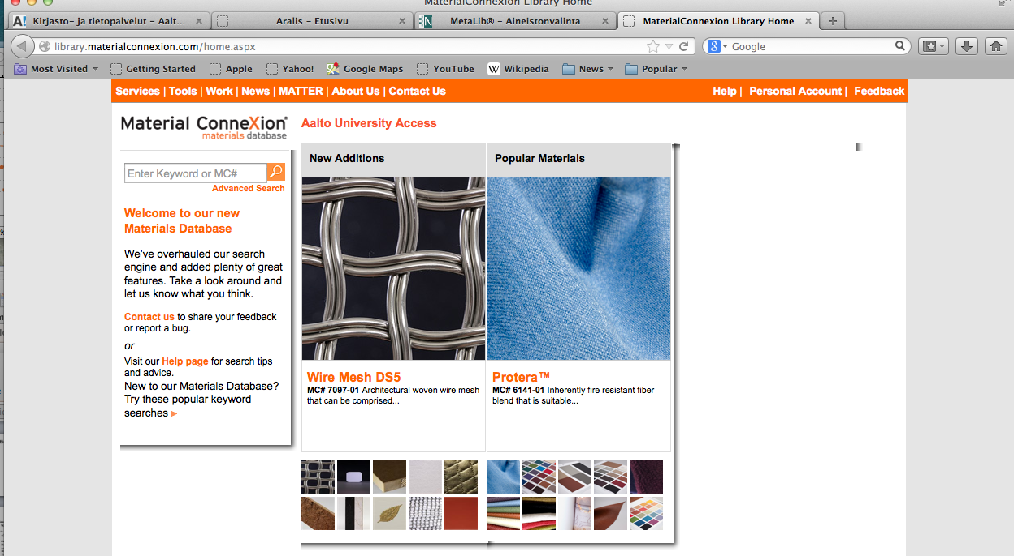
Työkaluja: Tietokannat, esim. Material ConneXion (kirjaston kautta)

Slide 3
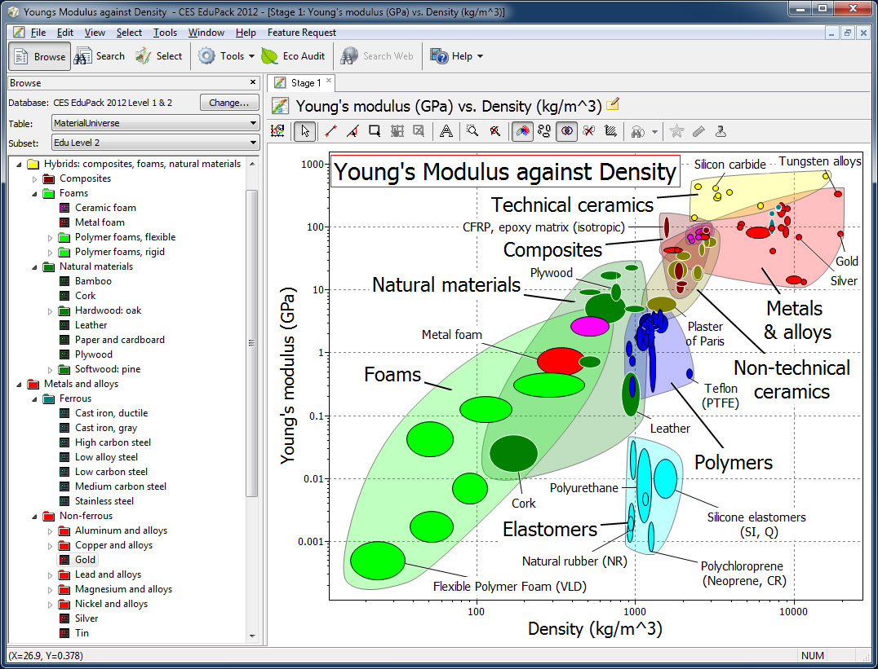
CES Edupack, in Aalto computers

Slide 4
Material Universe
Two main approaches in teaching material sciences: Science-driven & design-driven.
Design-driven begins with specification of design requirements and translation into material choices.
In sustainable design it is also important to assess impacts of existing material choices in product design.
Source: Edupack 2009 Manual

Slide 5
Material Universe
Materials selection:
Impacts assessment:

Slide 6
Material Universe
In the CES Edupack database there are several datasheets, regarding:
Material Universe
Process Universe
Legislation & regulations
Nations of The World
Producers

Slide 7
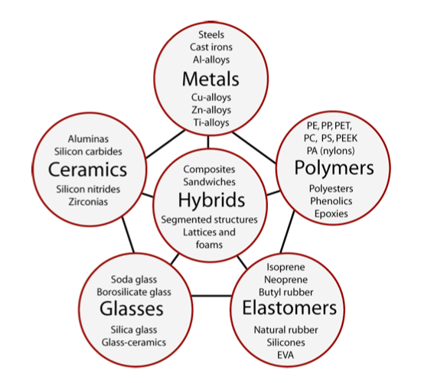
Material Universe
The menu of engineering materials. The basic families of metals, ceramics, glasses, polymers and elastomers can be combined in various geometries to create hybrids.
Source: Ashby & Cebon (2007) Teaching Engineering Materials

Slide 8
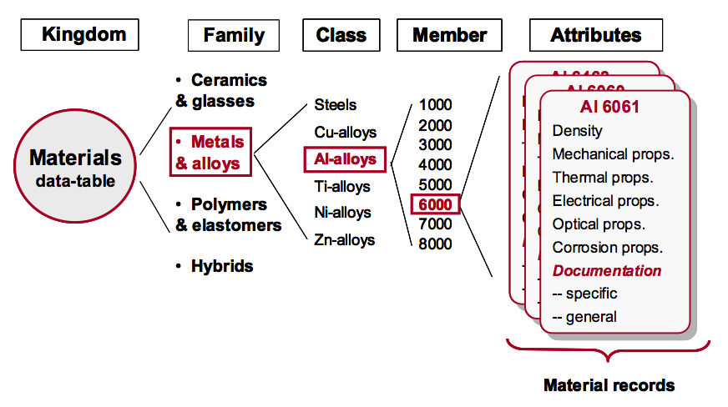
Taxonomies in Material Universe data-tables:
A hierarchical structure for process classification, ending with a schematic of a record.
Source: Edupack 2009 Manual

Slide 9
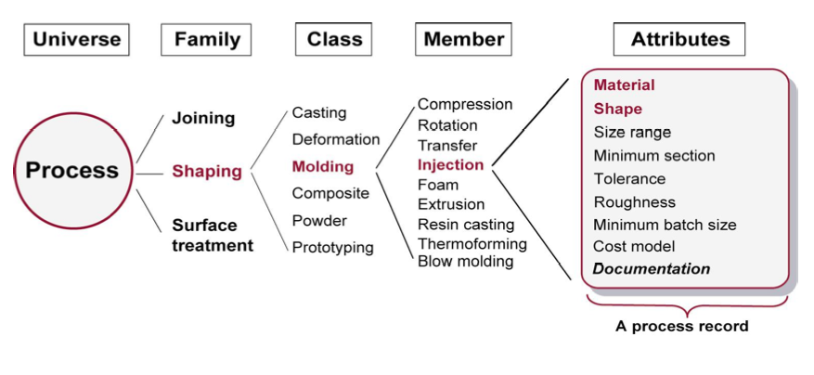
Taxonomies in Process Universe data-tables:
A hierarchical structure for process classification, ending with a schematic of a record.
Source: Ashby & Cebon (2007) Teaching Engineering Materials

Slide 10
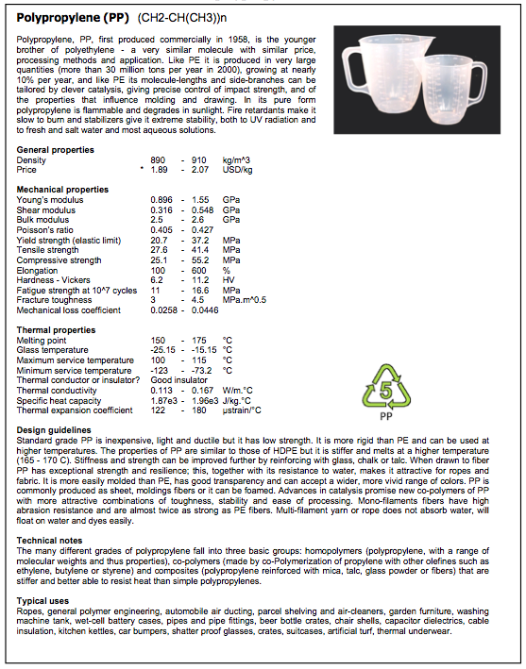
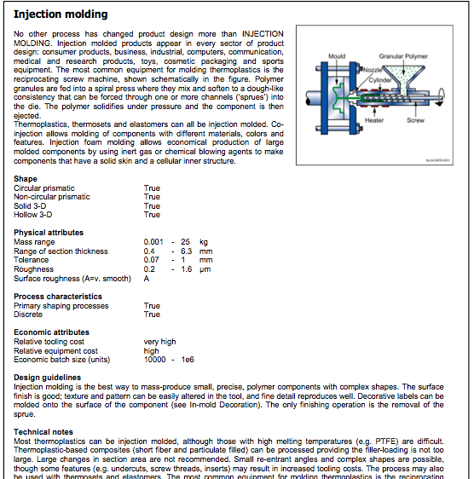
Data table record sheets
Source: Ashby (2013) CES Edupack tutorial

Slide 11
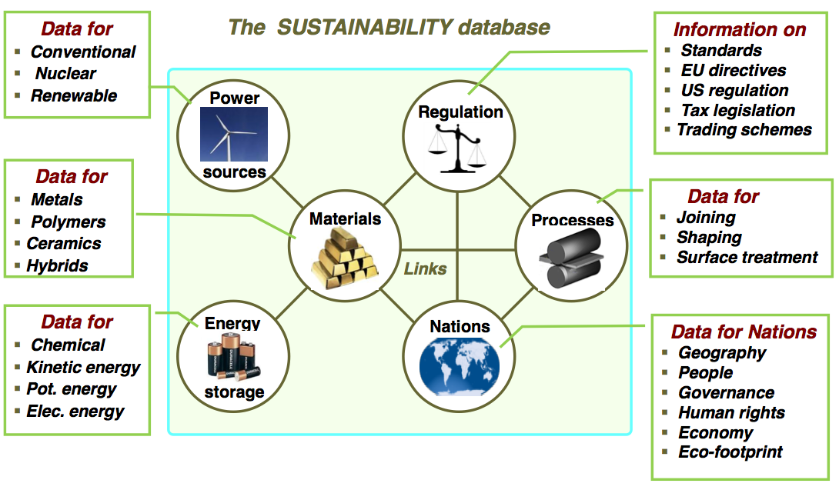
Data-tables to assist sustainable design process:
Source: Ashby et al. (2012) Materials & SD

Slide 13
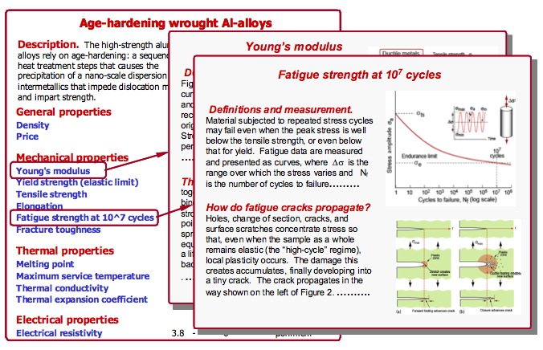
Science notes:

Slide 14
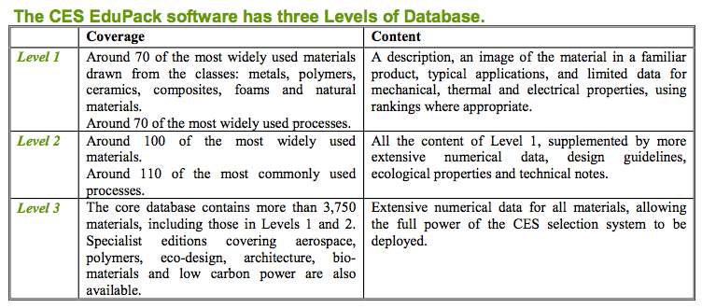
Data-tables to assist sustainable design process:
Source: Ashby (2013) CES Edupack tutorial

Slide 15
Each of the three levels can be interrogated by
BROWSING
Exploring the database and retrieving records via a hierarchical index.
SEARCHING
Finding information via a full-text search of records.
SELECTION
Using the powerful selection engine to find records that meet an array of design criteria.
And several interrogations can be combined into a single project…
Source: Ashby et al. (2012) Materials & SD

Slide 16
CES Edupack interface:

Slide 17
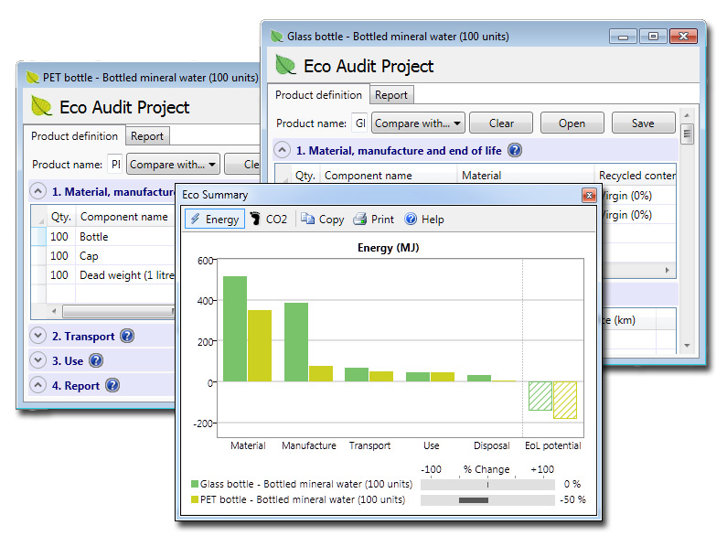
CES Edupack interface:

Slide 18
CES Edupack: Material Selection

Slide 19
Material selection strategies
Assemble data for the characteristics of the thing you want to select; make a database, mental or physical.
Formulate the characteristics that the thing must have to satisfy your requirement; list the constraints.
Decide on the ranking criterion you will use to decide which, of the candidate things that meet all the constraints, is the best; choose and apply the objective.
Research the top-ranked candidates more fully to satisfy yourself that nothing has been overlooked; seek documentation.
SOURCE: Ashby, M. (2009) Materials and the Environment: Eco-Informed Material Choice. Oxford: Elsevier.

Slide 20
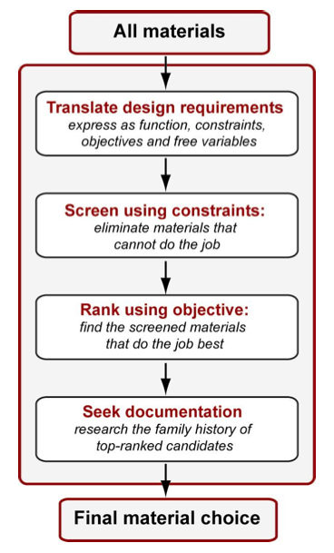
Material selection process in CES Edupack:
Four steps:
Translation,
Screening,
Ranking, and
Documentation
Source: Ashby & Cebon (2007) Teaching Engineering Materials

Slide 21
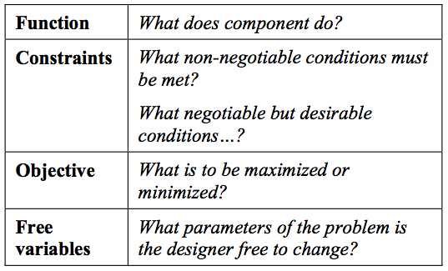
Material selection strategies
Step one: translation - converting the design requirements into a prescription for selecting a material and a process to shape it.
Source: Ashby & Cebon (2007) Teaching Engineering Materials

Slide 22
Selection strategies
Step two: screening - eliminating the candidates that cannot do the job because one or more of their attributes lies outsides the limits set by the constraints
Common constraints, e.g.:
Must be: Must meet a target value of:
Electrically conducting Stiffness
Optically transparent Strength
Corrosion resistant Fracture toughness
Nontoxic Thermal conductivity
Nonrestricted substance Service temperature
Able to be recycled
SOURCE: Ashby, M. (2009) Materials and the Environment: Eco-Informed Material Choice. Oxford: Elsevier.

Slide 23
Selection strategies
Step three: ranking - ordering the survivors by their ability to meet a criterion of excellence, such as minimizing cost, embodied energy, or carbon footprint
- the property or property-group that maximizes performance for a given design is called its material index
Common objectives:
Minimize:
Cost Energy consumption
Mass Carbon emissions
Volume Waste
Thermal losses Environmental impact
Electrical losses Resource depletion
SOURCE: Ashby, M. (2009) Materials and the Environment: Eco-Informed Material Choice. Oxford: Elsevier.

Slide 24
Selection strategies
Step four: documentation - exploring the most promising candidates in depth, examining how they are used at present, case histories of failures and how best to design with them
- any hidden weaknesses?
- what is its reputation?
- has it got a good track record?
SOURCE: Ashby, M. (2009) Materials and the Environment: Eco-Informed Material Choice. Oxford: Elsevier.

Slide 25
Using CES Edupack: Material selection

Slide 26
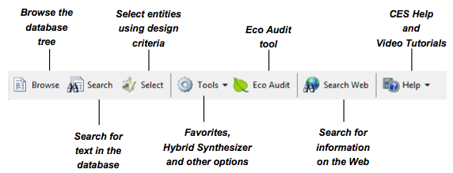
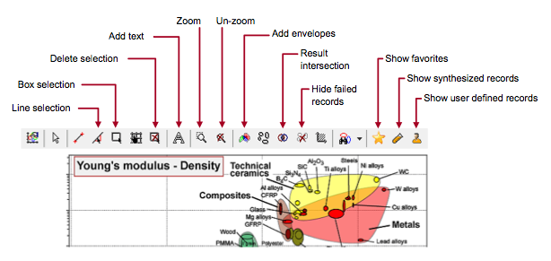
Standard and graph stage toolbars:

Slide 27
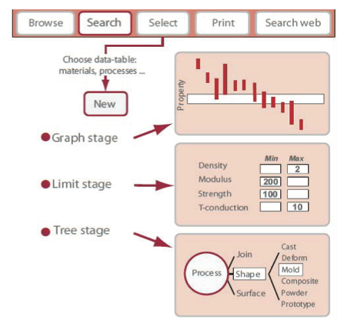
BROWSE, SEARCH and SELECT materials:
GRAPH, LIMIT and TREE stages:

Slide 28
Exercises #1 BROWSING and SEARCHING Using CES EduPack Levels 1 & 2

Slide 29
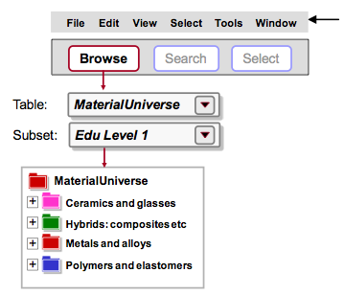
Exercise 1: BROWSE Materials
• Find record for STAINLESS STEEL (LEVEL 1)
• Find record for CONCRETE
• Find record for POLYPROPYLENE
• Find PROCESSES that can shape POLYPROPYLENE using the LINK at the bottom of the record
• Explore POLYPROPYLENE record at LEVEL 2
What else can be found?

Slide 30
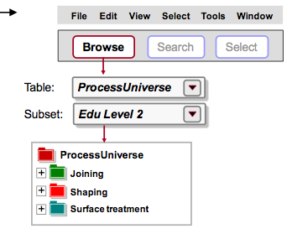
Exercise 2: BROWSE processes
Select LEVEL 2, ALL PROCESSES
• Find record for INJECTION MOLDING
• Find record for LASER SURFACE HARDENING
• Find record for FRICTION WELDING (METALS)
• Find MATERIALS that can be DIE CAST, using the LINK at the bottom of the record for DIE CASTING

Slide 31
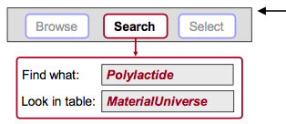
Exercise 3: Applying SEARCH
• Find the material POLYLACTIDE
• Find materials for CUTTING TOOLS
• Find the process RTM

Slide 32
Exercises #2 PROPERTY CHARTS Using CES EduPack Levels 1 & 2

Slide 33
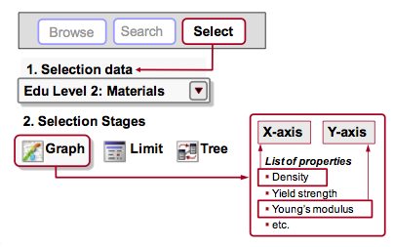
Exercise 4: Making PROPERTY CHARTS
• SELECT MaterialUniverse: LEVEL 2, MATERIALS
• Make a BAR CHART of YOUNG’S MODULUS (E)
– Set only y-axis
Make a BUBBLE CHART of YOUNG’S MODULUS (E) VS. DENSITY (ρ)
– Set both x-axis and y-axis
– Materials can be labeled – click and drag to move the labels; use DEL to delete a label
Finally, DELETE THE STAGE (Right click on stage in Selection Stages and select “Delete”)

Slide 34
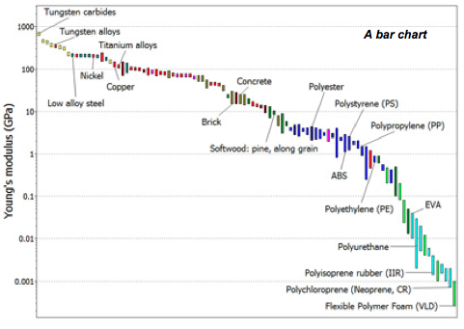
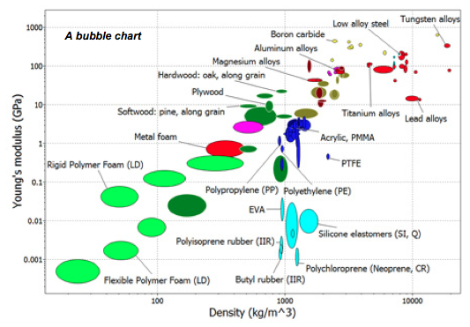
Charts with one – two axes & logarithmic scales:

Slide 35
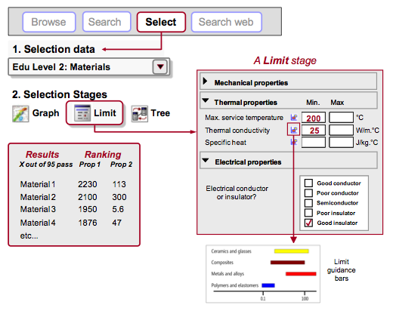
Exercise 5: Selection using a LIMIT stage
• Find materials with:
MAX. SERVICE TEMPERATURE > 200 °C
THERMAL CONDUCTIVITY > 25 W/m.°C
ELECTRICAL CONDUCTOR OR INSULATOR? = GOOD INSULATOR
– Enter the limits – minimum or maximum as appropriate – and click “Apply”
DELETE THE STAGE
Notes:
(Results at Level 1 or 2: aluminum nitride, alumina, silicon nitride)

Slide 36
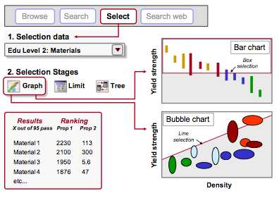
Exercise 6: Selection with a GRAPH stage, 1/2
• Make a BAR CHART of YIELD STRENGTH ( σy ) (plotted on the y-axis)
• Use a BOX SELECTION to find materials with high values of elastic limit (or strength) – Click the box icon, then click-drag-release to define it
• Add, on the other axis, DENSITY ( ρ ):
Either highlight Stage 1 in Selection Stages, right-click and choose Edit Stage from the menu; or double-click the graph axis to edit
Notes:
(Results at Level 1 or 2: CFRP (isotropic), Titanium alloys, Magnesium alloys, ...)

Slide 37
Exercise 6: Selection with a GRAPH stage, 2/2
• Use a BOX SELECTION to find materials with high strength and low density
Replace the BOX with a LINE SELECTION to find materials with high values of the “specific strength” (σy /ρ):
Click the gradient line icon, then enter slope: “1” in this case.
Click on the graph to position the line through a particular point.
Click above or below the line to select an area: above the line for high values of σy /ρ in this case.
Now click on the line and drag upwards, to refine the selection to fewer materials
DELETE THE STAGE
Notes:
(Results at Level 1 or 2: CFRP (isotropic), Titanium alloys, Magnesium alloys, ...)

Slide 38
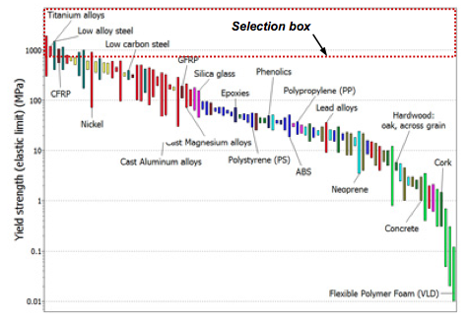
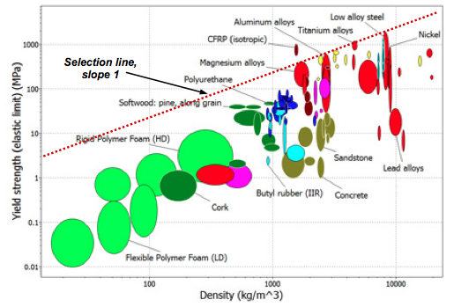

Slide 39
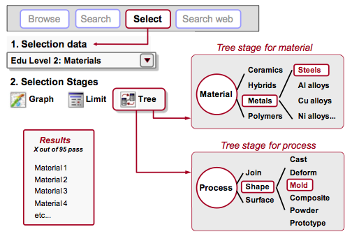
Exercise 7: Selection with a TREE Stage, 1/2
• Find MATERIALS that can be MOLDED
In Tree Stage window, select ProcessUniverse, expand “Shaping” in the tree, select Molding, and click “Insert”, then OK
DELETE THE STAGE

Slide 40
Exercise 7: Selection with a TREE Stage, 2/2
• Find PROCESSES to join STEELS
First change Selection Data to select Processes: LEVEL 2, JOINING PROCESSES
Then, in Tree Stage window, select MaterialUniverse, expand “Metals and alloys” in the tree, select Ferrous, and click “Insert”, then OK
DELETE THE STAGE

Slide 41
Tauko…

Slide 42
Using CES Edupack: Sustainability Assessment

Slide 43
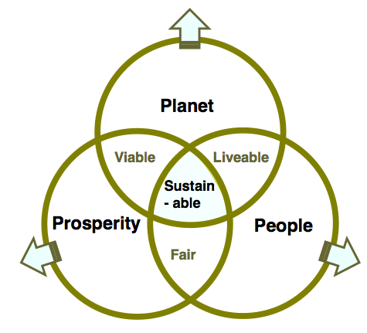
Sustainability – complex to assess…
Prioritization: “Sustainability” vs. “Sustainable development”?
Reporting:
Financial bottom line
Social / ethical performance
Environmental performance
Decouple the circles – unpack their meaning…
Source: Ashby et al. (2012) Materials & SD

Slide 44
Assessment process for sustainability in design
Steps to assess sustainability of designs:
Identify prime objective for design action
Define system boundaries for the assessment
Review stakeholders and both production system and product components
Perform fact-finding on stakeholders and components (Materials & Manufacturing; Environment; Society; Economics; Regulation; Design)
Integration back into communicative message (Natural capital; Manufactured capital; Human capital)

Slide 45
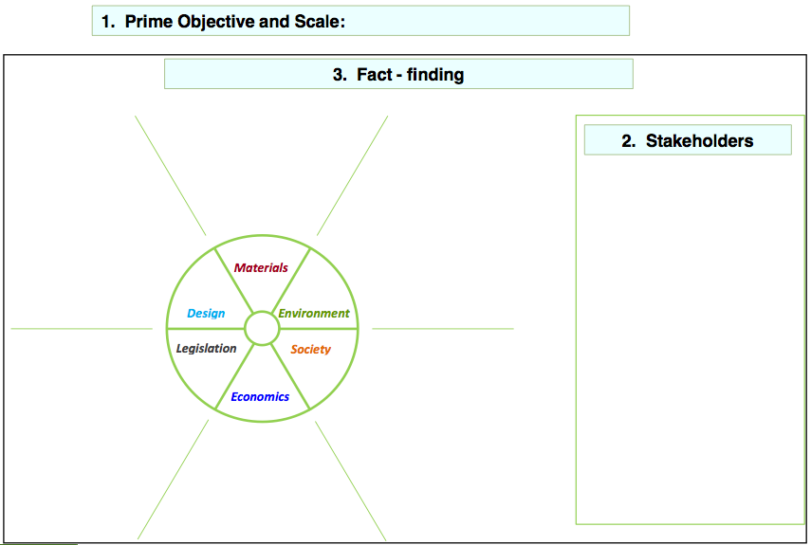

Slide 46
Exercises #4 SUSTAINABILITY Using CES EduPack Level 3

Slide 47
Exercise 10: Expanding material inquiries
Explore MATERIALS on LEVEL 3, SUSTAINABILITY
Question 1:
Platinum. From which nations is Platinum sourced? What is its Material Criticality status? Why does it have this status?
Question 2:
Sourcing cobalt. You are consulted by a steel-maker who wishes to make a special steel with 5% Cobalt content. What can you tell them about the risk to supply of Cobalt? Trace the Material Criticality status of Cobalt to the nation from which the most of it is sourced. What can you discover about the stability and governance of this nation?
Notes:
The table, copied from the Platinum record in the Materials data-table, lists the main producing countries. Over 72% derives from a single nation, South Africa. This is an example of supply-chain concentration, a cause for concern for users of Platinum. The Critical Material status of Platinum is very high. This is partly because of supply-chain concentration and partly because of the abundance risk. Each of the Nations in this list is linked to its record in the Nations data-table, providing economic, political, and social background.
The table, copied from the Cobalt record in the Materials and Processes database, lists the main producing nations. More than half the world’s Cobalt is sourced from the Democratic Republic of the Congo, meaning that the supply-chain is heavily dependent on a single source. Following the link to D R Congo record in the Nations data-table reveals that this nation has disturbingly poor ratings for Rule of Law and Control of Corruption. There are on-going conflicts that may be funded by mineral sales.

Slide 48
Exercise 11: Legislation and Regulations data-table
Explore LEGISLATION AND REGULATIONS on LEVEL 3, SUSTAINABILITY
Question 1:
European Directives. What does the WEEE Directive of the European Commission say? Use the Browse or the Search facility of the Sustainability database to query the Regulations data-table to find a summary. Then follow the link to the web site.
Question 2:
Landfill tax. What is a land-fill tax? Approximately how much does it cost to send building waste to landfill in Europe? Use either the Browse facility or the Search facility (search on Landfill) to find out.
Notes:
The WEEE Directive (EC 2002/96 and 2003/108) sets collection, recycling, and recovery targets for electrical goods. It is part of a legislative initiative to solve the problem of toxic contamination arising from waste electronic products (www.environment- agency.gov.uk/business/topics/waste/32084.aspx).
Landfill Tax is a tax on the disposal of waste. It aims to encourage waste producers to recover more value from waste, for example through recycling or composting, and to use more environmentally friendly methods of waste disposal. The UK landfill tax in 2012 stands at £64 per tonne.

Slide 49
Exercise 12: Nations data-table
Explore NATIONS on LEVEL 3, SUSTAINABILITY
Question:
Wealth and happiness. Does money buy happiness? Plot the Satisfaction with Life Scale against GDP per capita, using a linear scale for Satisfaction, to find out.

Slide 50
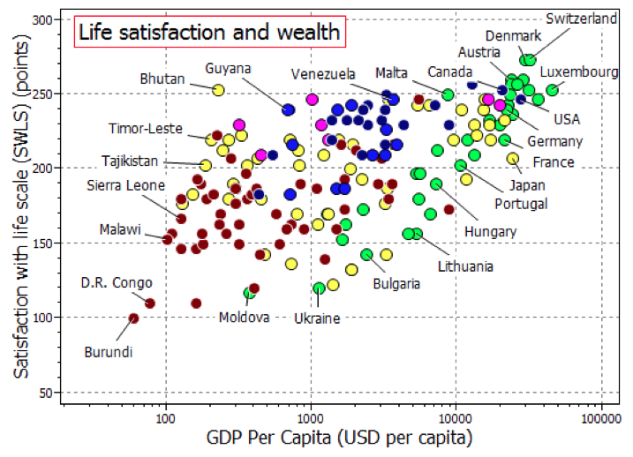
Notes:
Figure 13 shows the plot. Globally, the correlation is poor. But if the data for Europe, the green dots, is examined, a clear correlation emerges. It is interesting to ask why Austria is so happy and France and Japan so miserable on almost the same per capita GDP. Also to ask why the Satisfaction with Life in Butan, Malta and the Bahamas

Slide 51
Using CES Edupack: Eco Audit tool & process

Slide 52
Eco-Auditing with CES Edupack
The Eco Audit tool calculates the energy used and CO2 produced during five key life phases of a product (material, manufacture, transport, use and end of life) and identifies which is the dominant phase.
This is the starting point for eco-aware product design, as it identifies which parameters need to be targeted to reduce the eco-footprint of the product.
In 'material selection' terminology, the result of the eco audit forms the objective for the product design. This objective is dependent on both the dominant phase and the product application. For example, when the use phase is dominant, the objective for a car would be to minimize mass, whereas for a boiler, it would be to minimize thermal loss

Slide 53
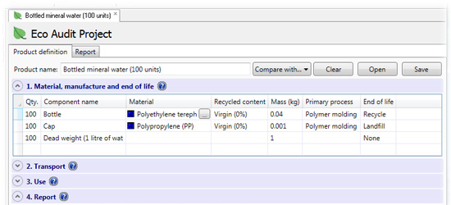
Eco-Auditing with CES: Material, manufacture and end of life
The first part of eco audit is a product definition with a list of components and their mass & materials, involved processes and end of life.

Slide 54
Eco-Auditing with CES: Bill of Materials
The first section of the product definition allows entry of the 'bill of materials' for the product, with each line representing an individual component. There is no limit on the number of components that can be added.
Quantity
Component name
Material
Recycled content
Mass
Primary process
End-of-life

Slide 55
Eco-Auditing with CES: Primary Processing Techniques
The primary process options display the processes that are applicable to the material selected.
This information, and associated data, is extracted from the material's datasheet.
Depends on the level of database used. On some levels also more options (secondary processing; finishing options).

Slide 56
Eco-Auditing with CES: End-of-life
This option displays all viable end of life options for the selected material.
Of the seven options the validity of the first four, 'Landfill', 'Combust for energy recovery', 'Recycle' and 'Downcycle' is determined by the associated status flag on the material's datasheet.
The remaining 'Re- manufacture', 'Reused' and 'None' options, which are not specified on the datasheet, are added as viable options for all materials.
'None' applies to components that have no end of life costs (for example, building foundations that are left in the ground).

Slide 57
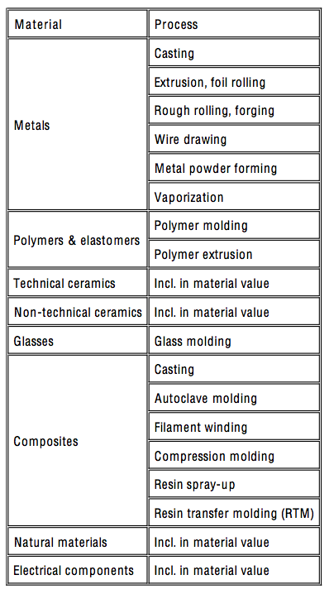
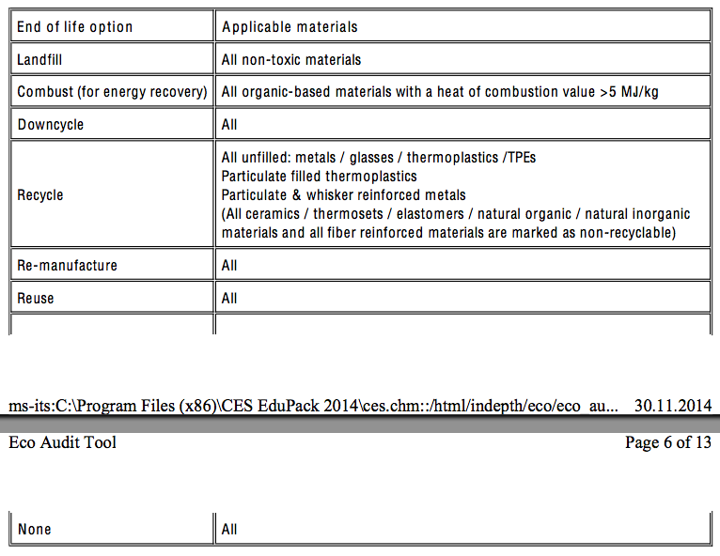
End of life options and primary processes:
Notes:
Figure 13 shows the plot. Globally, the correlation is poor. But if the data for Europe, the green dots, is examined, a clear correlation emerges. It is interesting to ask why Austria is so happy and France and Japan so miserable on almost the same per capita GDP. Also to ask why the Satisfaction with Life in Butan, Malta and the Bahamas

Slide 58
Eco-Auditing with CES: Transport
The second part of the product definition is the transportation phase. This relates to the transport of the finished product from the source of manufacture to the customer.
Each line in the table relates to one stage of the journey. There is no limit on the number of stages that can be added. For each stage, three parameters are defined: stage name, transport efficiency, and distance.
The transport efficiency is specified through the 'transport type' dropdown menu, which lists the main methods for transporting freight

Slide 59
Eco-Auditing with CES: Use phase
The third stage of the product definition is the use phase.
Product life:
Numeric field for specifying the product life, in years. The default value is 1 year.
Country electricity mix:
The 'Country electricity mix' drop-down menu enables the particular mix of fossil and non-fossil fuel of the country of use to be specified. This is split into three main groups: global regions, individual countries, and fossil fuel percentage. The default option is 'World'.

Slide 60
Eco-Auditing with CES: Report
The final section of the product definition incorporates two main features. The first is the 'Summary chart’, and the second feature is the capability to have a 'Detailed Report’.
This is divided into three sections:
Summary page
– provides an overview of the eco audit, with headline values for each life phase. This enables rapid identification of the dominant life phase
Detailed breakdown of energy usage (accessed via 'Energy Details...' link on summary page)
– provides a component-by-component breakdown of each life phase, enabling the main contributors to the dominant phase to be identified
Detailed breakdown of CO2 footprint (accessed via 'CO2 Details...' link on summary page)
– similar to above, except for CO2 footprint.

Slide 61
Exercises #5: ECO AUDIT Using CES EduPack Level 2 with eco and durability properties

Slide 62
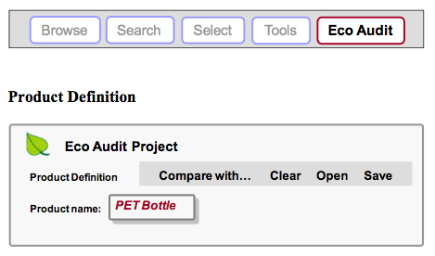
Exercise 13: Eco Audit Project, 1/7
Bottled mineral water is sold in 1 liter PET bottles with polypropylene caps. A bottle weighs 40 grams; the cap 1 gram.
Bottles and caps are molded, filled, and transported 550 km from the French Alps to England by 14 tonne truck, refrigerated for 2 days and then sold.
The overall life of the bottle is one year.

Slide 63
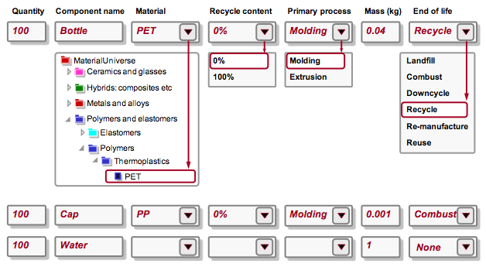
Exercise 13: Eco Audit Project, 2/7
1. Bill of materials, primary processing techniques and end of life:

Slide 64
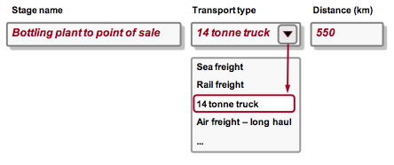
Exercise 13: Eco Audit Project, 3/7
2. Transportation from site of manufacture to point of sale:

Slide 65
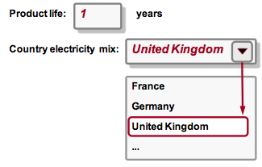
Exercise 13: Eco Audit Project, 4/7
3. Use – product life and location of use:

Slide 66
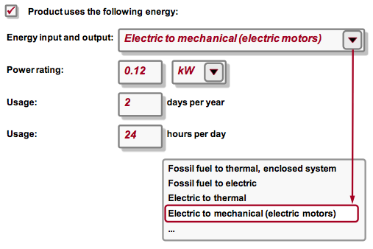
Exercise 13: Eco Audit Project, 5/7
Energy used to refrigerate product at point of sale (average energy required to refrigerate 100 bottles at 4°C = 0.12 kW)
3. Use – static consumption:

Slide 67
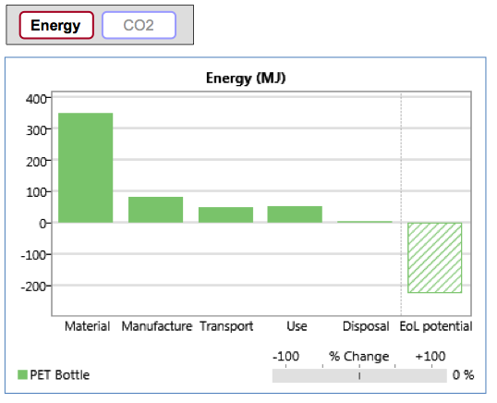
Exercise 13: Eco Audit Project, 6/7
4. Report:
Summary chart enables rapid identification of the dominant life phase. View energy usage or CO2 footprint.
(Click on the Material life phase bar in the summary chart for guidance on strategies to reduce its impact.)

Slide 68
Exercise 13: Eco Audit Project, 7/7
4. Report:
Detailed report provides a component by component breakdown of each life phase, enabling the main contributors to the dominant phase to be identified…
5. Reflection:
What remained outside assessment?

Slide 69
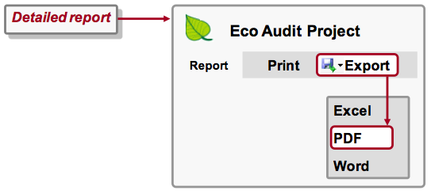
Exercise 14: Saving & exporting
Saving Eco Audit Product Definition:
Eco audit projects are not part of a selection project, and need to be saved separately
SAVE the product definition (give it a filename and directory location; Eco Audit product files have the extension “.prd”)
Saving/Exporting Eco Audit Report:
GENERATE the eco audit report
EXPORT the eco audit report as a PDF (Note: You will require Microsoft Excel or a PDF reader such as Adobe Reader to view the exported eco audit report)

Slide 70
Strategies for reducing environmental impact
Having identified the dominant life phase and component/s that contribute most to a product's environmental impact (using the Eco Audit tool), the next step is to identify the correct strategy for reducing that impact.
The appropriate strategies are highly dependent on both the type of product and the dominant life phase.
Guidance on what impact reduction strategies, and material indices, to consider is accessed by clicking on the dominant life phase bars in the Summary chart.
Competing scenarios can be created for comparison…

Slide 71
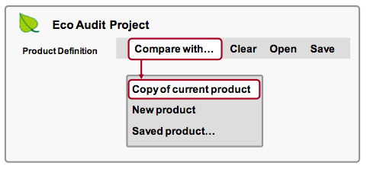
Exercise 15: Comparing Eco Audits, 1/2
Compare eco audits:
In Product Definition page, click “Compare with”, then select Copy of current product.
In the copy, change product name to ‘PET Bottle (Recycled)’

Slide 72
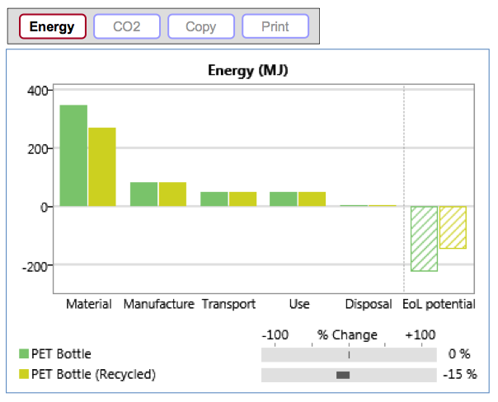
Exercise 15: Comparing Eco Audits, 2/2
Recycled PET:
Change the RECYCLED CONTENT to 35% Note the first life energy (not including the ‘EoL potential’) is reduced by 12%
Copying graphs:
Click COPY to copy the chart and PASTE it into a document

Slide 73
Further tips & reading…
See CES Edupack materials for more support and exercises. Can be found in program folder.
See also: Mike Ashby (2013) Materials and the Environment. Amsterdam, NL: Butterworth-Heinemann. In our library as E-material…

Slide 74
Kiitos!
Presentaatioslidet jaetaan meilitse…
Lisäinfoa ja –kysymykset: Tatu Marttila (tatu.marttila@aalto.fi)

Slide 75
Brainwriting
Write your ideas to a paper
Pass paper to the next
Read and write ideas or comments

Slide 76
Where could it be used?
Kitchen
Vehicle
Healthcare
Outdoors
As mold for something else
Construction
Something else

