Slide 1
Thesis-kick off seminar Information retrieval
Marika Sarvilahti
Information Specialist, Aalto University Learning Centre

Slide 2
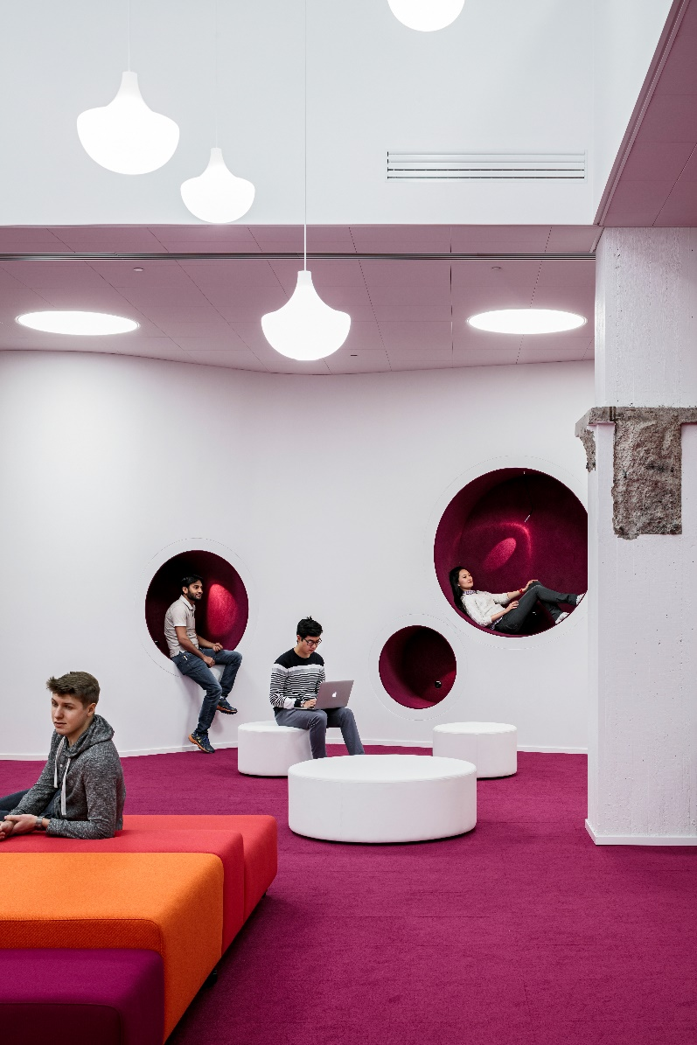
learningcentre.aalto.fi
Harald Herlin Learning Centre for Aalto University’s information collections
Books, e-books, journals, e-journals, visual resources, help on information searching etc. for all subjects
Information searching process as part of research
Key tools: Aalto-Finna and Research Guides, RefWorks
Notes:
Use the same color for you inside covers that you chose for your middle cover

Slide 3
Information searching process
Define research topic
Select information resources
Assess search results and locate information
Use and analyse information
Select search terms
Search again for…
Make searches

Slide 4
Selecting information sources
Always based on a need (academic vs. informal, slow vs. quick)
Type of information need determines the method and sources to be used
Different information sources are suitable for different situations (you are likely to mix & match):
- journal articles
- books
- fact finding from dictionaries, standards, statistics
- official documents (records, proceedings, reports)
- audio-visual information (images & sound)
- informal information (colleagues, social media)
- other organisations: museums, archives, others?

Slide 5
Your tools at Aalto
Make use of different resources, use more than one database and technique:
Learning Centre website is a good starting point
Resource Guides for browsing information
Design subject guide, Visual Resources, Citation guide
Aalto-Finna portal for searching printed and electronic resources.
All library services are usable also remotely with Aalto-Finna.
Includes references to dissertations and theses made at Aalto
Make good use of electronic resources available with Aalto-Finna!

Slide 7
Log in to Aalto-Finna and connect your library card with Finna

Slide 8
Resource Guides
Information sources are listed in the Design Guide
You should begin by identifying the central information sources in your research area
Shop around! Use multiple resources to gather enough information for your work
Articles often contain the most recent research, so learn to use electronic journal databases.

Slide 9
Combining concepts in a search
Impact of ecological ideology and globalisation on ecommerce
 | Concept 1 | Concept 2 | Concept 3
Keywords | Ecological ideology | Globalisation | Ecommerce
Synonyms | Environmentalism Eco-friendly Green | Multinational Globalization Global market Multicultural | E-commerce Online shopping Spending
Search combinations | (green OR eco-friendly) AND ecommerce | (Globali*ation OR multinational) AND ”online shopping” | (Ecommerce AND globalisation AND environment*) NOT transport

Slide 10
Keywords in a concept map

Slide 11
Why use concept mapping
Generate a comprehensive and imaginative map of search terms
Aid thinking and brainstorming at the beginning of the research process
Help keep track of evolving ideas during the research process
Create a visual overview of a topic
Develop questions on a topic
Reveal patterns, themes, and associations between ideas

Slide 12
Dissertations and research at Aalto
Aaltodoc https://aaltodoc.aalto.fi/
Publication archive for all levels of theses and dissertations, abstracts and full text pdfs, from 2010 onwards.
Older dissertations are held in the learning centre collection in print format.

Slide 13
Visual Resources Centre (VRC)
VRC resource guide with over 100 digital image databases and visualisation tools
libguides.aalto.fi/vrc
Free training and help on using visual resources
DVD-collection
Edit and produce your media material
Exhibition space

Slide 14
Information management
https://refworks.proquest.com Keep references organised in a reference management system such as RefWorks
RefWorks allows you to:
organize and create a personal database online
format bibliographies and manuscripts according to different output styles
import references from a variety of databases
create references for web pages
attach files and notes to references

Slide 15
Other information services
Finnish information services are open to all
Melinda: all Finnish University libraries http://melinda.kansalliskirjasto.fi
Helsinki University Library: http://www.helsinki.fi/kirjasto/
Art University Library: https://lib.uniarts.fi
Helsinki Public Library: www.helmet.fi/
National Gallery Library: https://www.kansallisgalleria.fi/en/kokoelmatietopalvelu/kirjaston-palvelut/
National Archives: www.arkisto.fi
National Audiovisual Archive: https://kavi.fi/

Slide 16
Thank you! Questions? oppimiskeskus@aalto.fi

